Slide 1
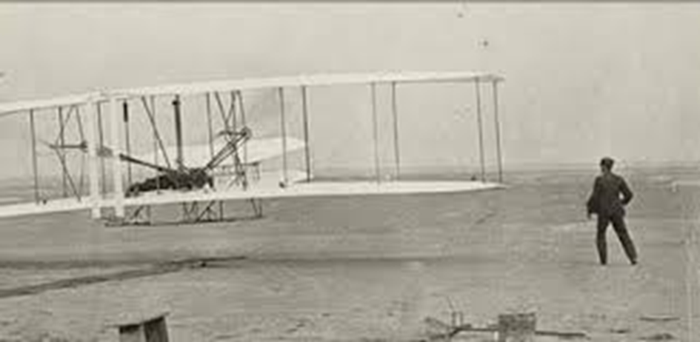
The 1st Revolution in Aviation

Slide 2
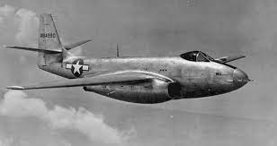
The 2nd Revolution in Aviation

Slide 3
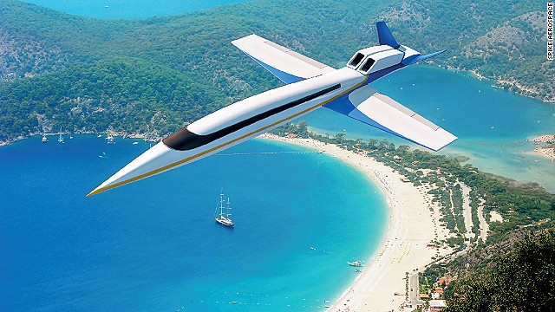
The 3rd Revolution in Aviation
COMPUTERS
Autonomy
Big data analytics
Artificial intelligence / machine learning
Cybersecurity
Electronically-enabled aircraft

Slide 4
The 3rd Revolution in Aviation
COMPUTERS
Autonomy
Big data analytics
Artificial intelligence / machine learning
Cybersecurity
Electronically-enabled aircraft
AIRCRAFT
Advanced propulsion
Advanced power systems
Composite materials
Swept wing and supersonic aircraft

Slide 5
The 3rd Revolution in Aviation
COMPUTERS
Autonomy
Big data analytics
Artificial intelligence / machine learning
Cybersecurity
Electronically-enabled aircraft
AIRCRAFT
Advanced propulsion
Advanced power systems
Composite materials
Swept wing and supersonic aircraft
CHANGING SOCIETY
Additive manufacturing
New entrants: drones, commercial space, high altitude
Robotics
Sustainable and Carbon-Neutral

Slide 6
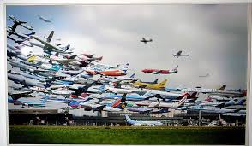
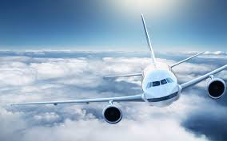
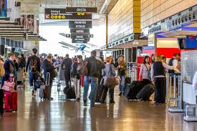
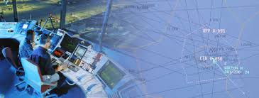
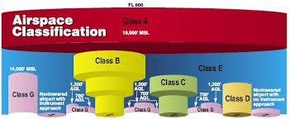
The Aviation Ecosystem
Airlines
Aircraft
Airports
Air Traffic Management
Airspace

Slide 9
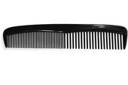
Unbreakable Comb – Money Back Guarantee

Slide 10
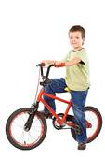
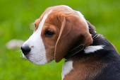
Unbreakable Comb – Money Back Guarantee

Slide 11
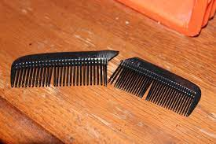
Unbreakable Comb – Money Back Guarantee

