Slide 1
Convergence in the NAS Enterprise Architecture
September 28, 2023
Presented At: 18th Annual Verification and Validation Summit
Presented By: Carleen Adams, NAS Chief Architect (ANG-B2)

Slide 2
NAS Enterprise Architecture (EA) Overview
The NAS Enterprise Architecture is a set of models and views that documents the NAS in the current state, the desired future state, and the transition strategy between the two
NAS EA: Service, Business and Technology (B&T), and Infrastructure roadmaps and the NAS Segment Implementation Plan (NSIP)
The NAS EA communicates strategic improvements to the NAS over time, and the supporting research, operational concept development, and capital investment activities that enable them

Slide 3
NAS Enterprise Planning Products
Shows the transition strategy for the desired future state of the NAS
Structured in a hierarchy consisting of four layers
Service
Strategy
Implementation
Investment
NAS Systems Engineering Portal (SEP), on FAA intranet
Research to Reality page, on FAA public website

Slide 4
Examples of Convergence in the NAS EA

Slide 5
Convergence of Systems in NAS EA Domains
Automation
Terminal Flight Data Manager (TFDM)
Offshore Automation
Enterprise Information Display System (E-IDS)
Enterprise Airspace Tool (EAST)
Communication
FAA Enterprise Network Services (FENS)
Voice Communication Systems
Navigation
NAS Monitoring Equipment
Surveillance
Mode-S Beacon Replacement System (MSBRS)
Weather
Common Support Services Weather (CSS-Wx)
NextGen Weather Processor (NWP)
ATCBI-5
ATCBI-6/6M
Mode-S
IDS4
NIDS
ACE-IDS
ERIDS
OFDPS
FDPS
SMA
AEFS
ARMT
FTI
TDM-to-IP
RTIR
ASTI
ETVS
RDVS
VSCS/VTABS
ICMS
UIC
WARP WINS & FBWTG
CIWS CDDS
CREWS
CIWS Prototype
WARP RAMP
CARF
DSP
TFR Builder
SDAT*
SAACE
AGMG
LDRCL
BWM
DMN
EFSTS
* To be removed; does not belong in EAST
Acronyms in backup slides

Slide 6
Convergence of Systems in NAS EA Domains – Roadmap View
The Infrastructure Roadmaps use red arrows to indicate the drawdown, decommission, and convergence of NAS systems
Example:
Surveillance
Mode-S Beacon Replacement System (MSBRS)
ATCBI-5
ATCBI-6/6M
Mode-S

Slide 7
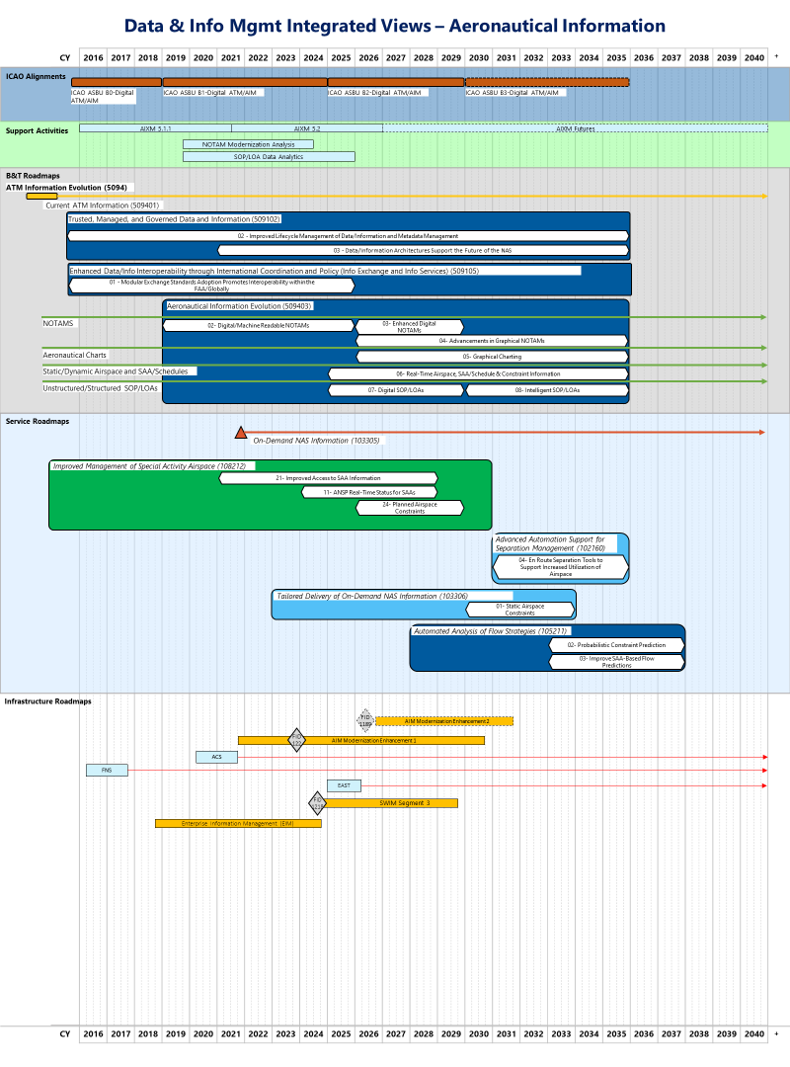
New Products – Integrated Views
Integrated Views present an Executive View that depicts the evolution of the National Airspace System (NAS) for a focused area of interest and incorporates applicable inter-related content from the NAS EA such as Roadmaps, Improvements, Increments, Support Activities (pre-implementation research, demonstrations, analyses), as well as relevant external references (e.g. ICAO, DoD, NASA).
The views contribute towards our holistic and integrated understanding of the complex inter-relationships necessary for effective planning, analysis, and decision-making, across the enterprise, portfolio, and specific investments.

Slide 8
Convergence of Info-Centric NAS (ICN) Vision into the NAS EA

Slide 9
ICN Vision Summary
An Info-Centric (ICN) NAS is FAA’s vision for the future
It describes how the FAA will build on the Next Generation Air Transportation System (NextGen) and trajectory-based operations foundations
The ICN seeks to address anticipated changes in aviation and aerospace while taking advantage of opportunities presenting themselves in business practices and technology.
The ICN builds on three foundational pillars:
Operations
Infrastructure
Safety Assurance
Initial elements of the ICN vision and steps to achieve it are already included in the NAS EA to better tell the ICN story in the EA
ICN EA Video – on YouTube

Slide 10
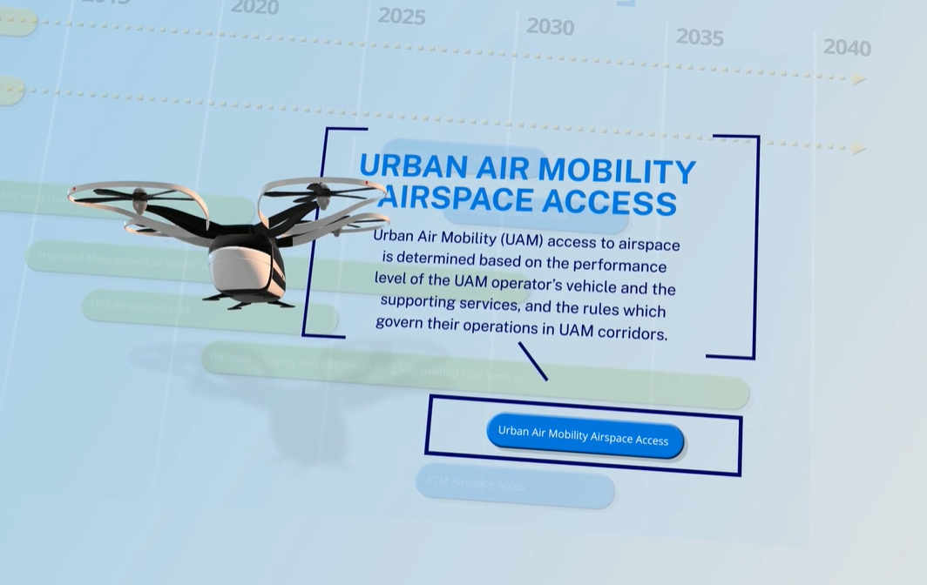
Operations
Operations in the 2035 NAS are characterized by collaboration among and within diverse traffic management services enabling the increased variety and number of new vehicles, missions, and operations. This collaboration is made possible through a fully integrated information regime with interoperable sharing of information. This can be leveraged to accurately estimate the current state and confidently predict the future state of the NAS. Increased agility in systems and services allows the NAS to adapt as needs evolve in unanticipated ways.
NAS EA Example
Operational Improvement 108216: Urban Air Mobility Airspace Access

Slide 11
Infrastructure
Infrastructure increasingly leverages commercial assets, services, and new technologies in support of operations across diverse traffic management services. This public and private infrastructure delivers traffic management services that are ubiquitous (available everywhere and always), resilient to unanticipated changes, and agile to respond to future user needs. Where necessary, public/private partnerships are established to help ensure any unique government requirements can be met through commercial services and technologies.
NAS EA Example
Business & Technology Improvement 508123: Establish Enterprise Services by Transforming and Converging Automation Platform Services into a Service Based Architecture

Slide 12
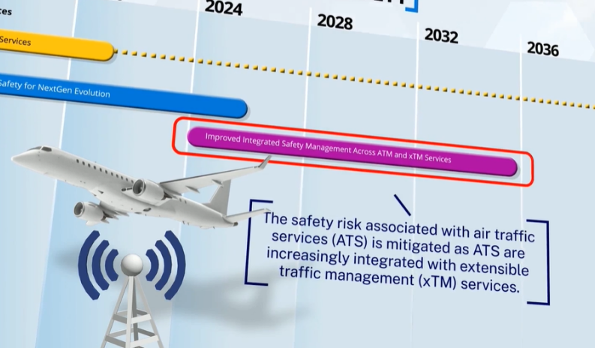
Safety Assurance
Safety Assurance for traffic management establishes tailored safety assurance to achieve acceptable safety based on operational characteristics. With big data, the NAS assures real-time safety through continuous monitoring, modeling, and verification to detect anomalies and correct for real-time spikes in risk. The compliance philosophy, including the use of the Safety Management System, assures each organization accounts for interoperability across a variety of new interactions, all supporting increased diversity of operations.
NAS EA Example
Business & Technology Improvement 401303: Improved Integrated Safety Management Across ATM and xTM Services

Slide 13
ICN EA Video

Slide 14
Info-Centric NAS (ICN) in the NAS EA
Currently in the NAS EA
Strategic elements – Operational Improvements (OIs), Business & Technology Improvements (BTIs), and Support Activities (SAs) – were added/updated on the Service and B&T Roadmaps with release of initial ICN vision
Implementation details – OI and BTI increments – have been added/updated in subsequent years and are tracked on the SEP
Investment information – initial CIP projects related to ICN – are depicted on the Infrastructure Roadmaps
Ongoing Initiatives to Support Future Updates
Automation Evolution Strategy (AES) – identifying Platform, Mission, and Common Services to obtain efficiencies and reduce time to develop/deploy new capabilities
Infrastructure Domain Strategies – developing strategies for the evolution of NAS domains (e.g., Automation, Surveillance) required to achieve the ICN vision

Slide 15
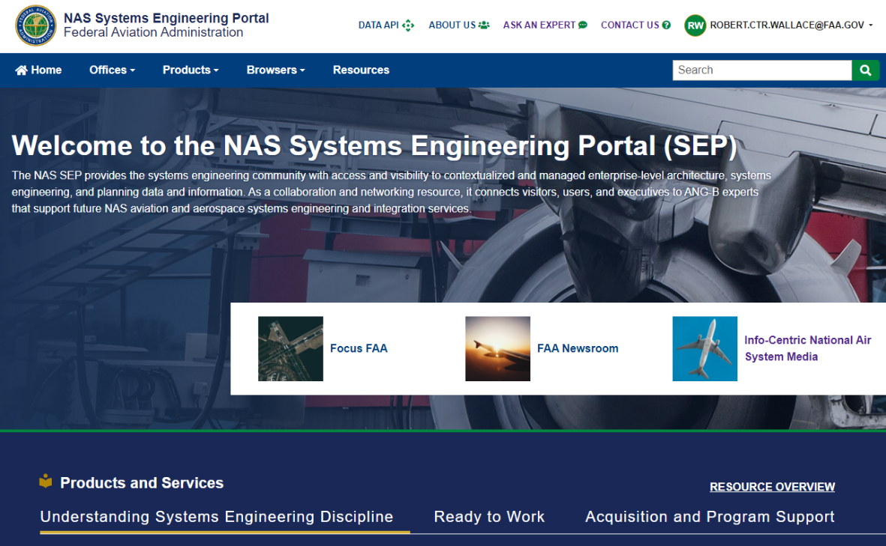
ICN EA Links & References
NAS Systems Engineering Portal (SEP), on FAA intranet
Research to Reality page, on FAA public website
ICN EA Video – on YouTube

Slide 16
Questions/Discussion

Slide 17
Backup

Slide 18
Automation Acronyms
ACE-IDS – AUTOMATED SURFACE OBSERVING SYSTEM CONTROLLER EQUIPMENT INFORMATION DISPLAY SYSTEM
AEFS – ADVANCED ELECTRONIC FLIGHT STRIP
ARMT – AIRPORT RESOURCE MANAGEMENT TOOL
CARF – CENTRAL ALTITUDE RESERVATION FUNCTION
DSP – DEPARTURE SPACING PROGRAM
EFSTS – ELECTRONIC FLIGHT STRIP TRANSFER SYSTEM
ERIDS – EN ROUTE INFORMATION DISPLAY SYSTEM
FDPS – FLIGHT DATA PROCESSING SYSTEM
IDS4 – INFORMATION DISPLAY SYSTEM 4
NIDS – NAS INFORMATION DISPLAY SYSTEM
OFDPS – OCEANIC FLIGHT DATA PROCESSING SYSTEM
SAACE – SPECIAL ACTIVITY AIRSPACE CREATOR EDITOR
SDAT – SECTOR DESIGN ANALYSIS TOOL
SMA – SURFACE MOVEMENT ADVISOR
TFR – TEMPORARY FLIGHT RESTRICTION
Back to slide # 5

Slide 19
Communication Acronyms
AGMG – AIR TO GROUND MEDIA GATEWAY
ASTI – ALASKA SATELLITE TELECOMMUNICATIONS INFRASTRUCTURE
BWM – BANDWIDTH MANAGER
DMN – DATA MULTIPLEXING NETWORK
ETVS – ENHANCED TERMINAL VOICE SWITCH
FTI – FAA TELECOMMUNICATIONS INFRASTRUCTURE
LDRCL – LOW-DENSITY RADIO TELECOMMUICATIONS LINK
RDVS – RAPID DEPLOYMENT VOICE SWITCH
RTIR – REMOTE TELECOMMUNICATIONS INFRASTRUCTURE REPLACEMENT
TDM-to-IP – TIME DIVISION MULTIPLEXING TO INTERNET PROTOCOL
VSCS – VOICE SWITCHING AND CONTROL SYSTEM
VTABS – VOICE SWITCHING AND CONTROL SYSTEM TRAINING AND BACKUP SYSTEM

Slide 20
Navigation Acronyms
ICMS – INTEGRATED CONTROL AND MONITORING SYSTEM
UIC – UNIVERSAL INTERLOCK CONTROLLER

Slide 21
Surveillance Acronyms
ATCBI-5 – AIR TRAFFIC CONTROL BEACON INTERROGATOR MODEL 5
ATCBI-6 – AIR TRAFFIC CONTROL BEACON INTERROGATOR MODEL 6
ATCBI-6M- AIR TRAFFIC CONTROL BEACON INTERROGATOR MODEL 6M
Mode-S – MODE SELECT

Slide 22
Weather Acronyms
CDDS – COMBINED DATA DISTRIBUTION SERVER
CIWS – CORRIDOR INTEGRATED WEATHER SYSTEM
CIWS Prototype – CORRIDOR INTEGRATED WEATHER SYSTEM PROTOTYPE
CREWS – CTAS [CENTER TRACON AUTOMATION SYSTEM] REMOTE WEATHER SYSTEM
FBWTG – FAA BULK WEATHER TELECOMMUNICATIONS GATEWAY
RAMP – RADAR ACQUISITION AND MOSAIC PROCESSOR
WARP – WEATHER AND RADAR PROCESSOR
WINS - WEATHER INFORMATION NETWORK SERVER

