Slide 1


431 (AD) SQN 2021 Flat Show
The following is a pictorial description of the proposed 2021 Flat Show
Manoeuvres have been classified as follows:
  Permitted Manoeuvres as per BGA 100 Ch 11
  Permitted Manoeuvres requiring Comd approval as per BGA 100 Ch 11
  Prohibited Manoeuvres as per BGA 100 Ch 11 waiver required

Slide 3
The weather limits for each of the Snowbirds performances are:
High Show 5000 feet ceiling and 5 statute miles visibility
Low show 1500 feet ceiling and 5 statute miles visibility
Flat Show 1000 feet and 5 statute miles visibility
The BGA-100 requires a minimum visibility of three statute miles for any air displays. The Snowbirds have raised the minimum visibility of the high and low show displays as an added safety measure due to the complexity of the rejoins post splits.

Slide 4


Slide 5
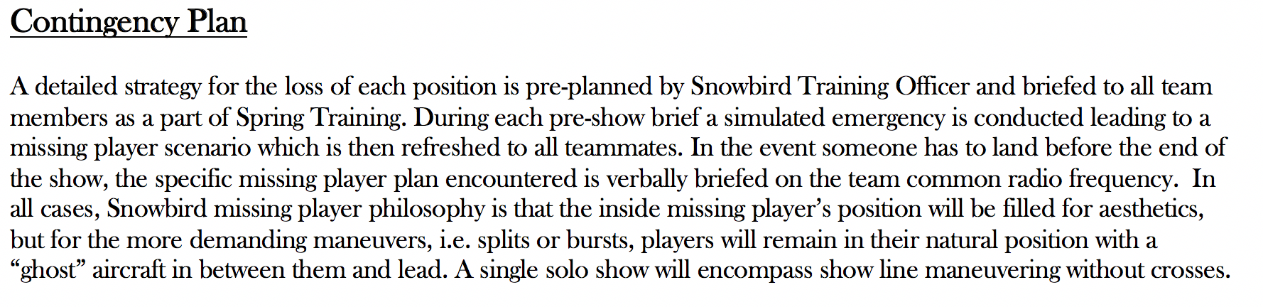
All Players
Missing Right Inner
Missing Line A Stern

Slide 6
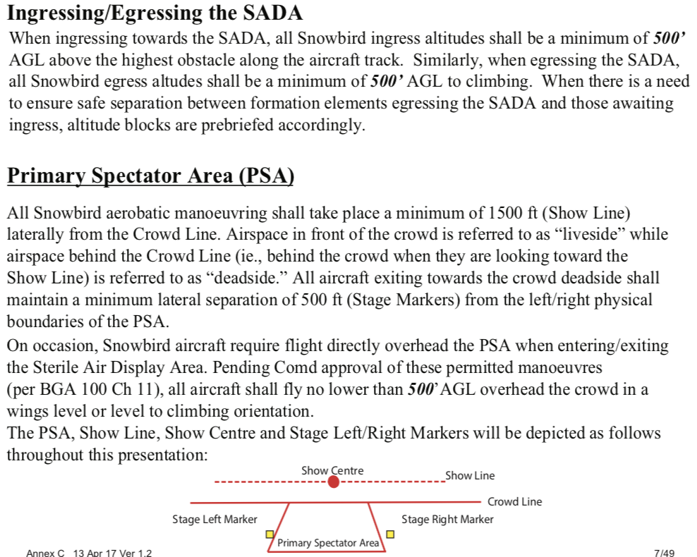

Slide 7
Air Display Flight
Snowbird 1 – Major Jean-Francois Dupont, Team Lead
Snowbird 2 – Capt Arpit Mahajan, Inner Right Wing
Snowbird 3 – Capt Ave Pyne, Inner Left Wing
Snowbird 4 – Capt Patrice Powis-Clement, First Line Astern
Snowbird 5 – Major Bassam Mnaymneh, Second Line Astern
Snowbird 6 – Capt Steven Sparks, Outer Right Wing
Snowbird 7 – Major Brett Parker, Outer Left Wing
Snowbird 8 – Capt Logan Reid, Lead Solo
Snowbird 9 – Major Taylor Evans, Opposing Solo
Snowbird 10 – Capt Eric Temple, Coordinator
Snowbird 11 – Capt Steven MacDonald, Coordinator

Slide 8
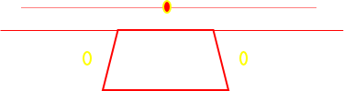
431 (AD) SQN 2021 Flat Show
Overhead pictorial with top-side and underside depictions.

Slide 9
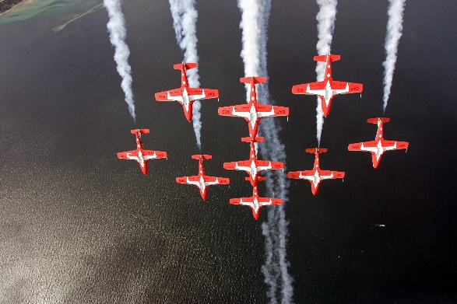
INK
BA
This is a permitted manoeuvre with the approval of 1 Cdn Air Div Comd for non aerobatic manoeuvre by multiple aircraft in formation with an energy vector toward the primary spectator area. BGA 100 Ch 11 Para 44.c(1)(c)
Liveside Stage Right Vulcan Run-in into Wrap  Big Arrow  INUK

Slide 10
This is a permitted manoeuvre with the approval of 1 Cdn Air Div Comd for non aerobatic manoeuvre by multiple aircraft in formation with an energy vector toward the primary spectator area. BGA 100 Ch 11 Para 44.c(1)(c)
UDR  Canuck, Canuck BS

Slide 11
UDR  Big Wedge T/S  Big Diamond

Slide 12
This is a permitted manoeuvre with the approval of 1 Cdn Air Div Comd for over-flight of the primary spectator area at 500 feet. BGA 100 Ch 11 Para 44.b(3)(e)
Overhead Big Diamond Pass  Vader

Slide 13
This is a permitted manoeuvre with the approval of 1 Cdn Air Div Comd for non aerobatic manoeuvre by multiple aircraft in formation with an energy vector toward the primary spectator area. BGA 100 Ch 11 Para 44.c(1)(c)
Vader Wrap ∆ Arrow Head Wrap ∆ Big Vic

Slide 14
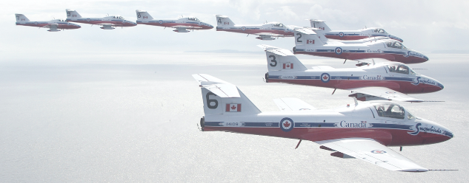
7, 9, 4, 3, 1, 2, 5, 8, 6
Big Vic ∆ To 9-Plane Line Abreast

Slide 15
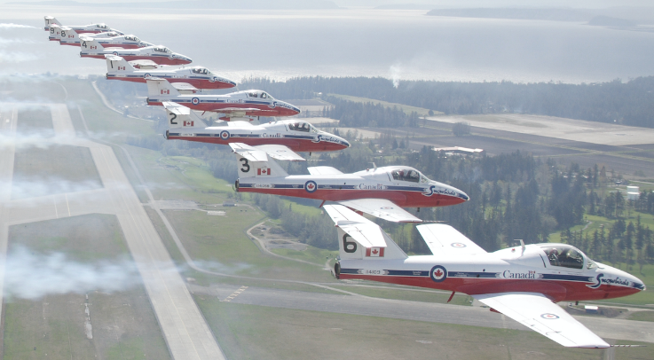
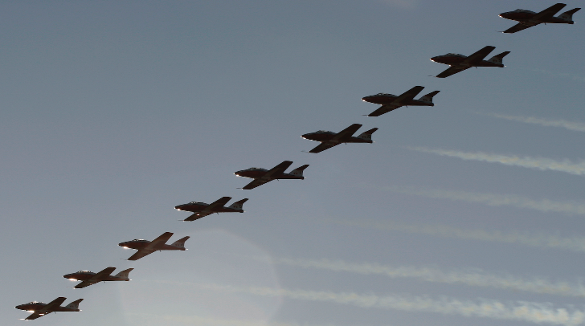
7, 9, 4, 3, 1, 2, 5, 8, 6
This is a permitted manoeuvre with the approval of 1 Cdn Air Div Comd for over-flight of the primary spectator area at 500 feet. BGA 100 Ch 11 Para 44.b(3)(e)
∆ To Big Diamond WTR -> Pitch to Land

