Slide 1


431 (AD) SQN 2021 High Show
The following is a pictorial description of the proposed 2021 High Show
Manoeuvres have been classified as follows:
  Permitted Manoeuvres as per BGA 100 Ch 11
  Permitted Manoeuvres requiring Comd approval as per BGA 100 Ch 11
  Prohibited Manoeuvres as per BGA 100 Ch 11 waiver required

Slide 3
The weather limits for each of the Snowbirds performances are:
High Show 5000 feet ceiling and 5 statute miles visibility
Low show 1500 feet ceiling and 5 statute miles visibility
Flat Show 1000 feet and 5 statute miles visibility
The BGA-100 requires a minimum visibility of three statute miles for any air displays. The Snowbirds have raised the minimum visibility of the high and low show displays as an added safety measure due to the complexity of the rejoins post splits.

Slide 4


Slide 5
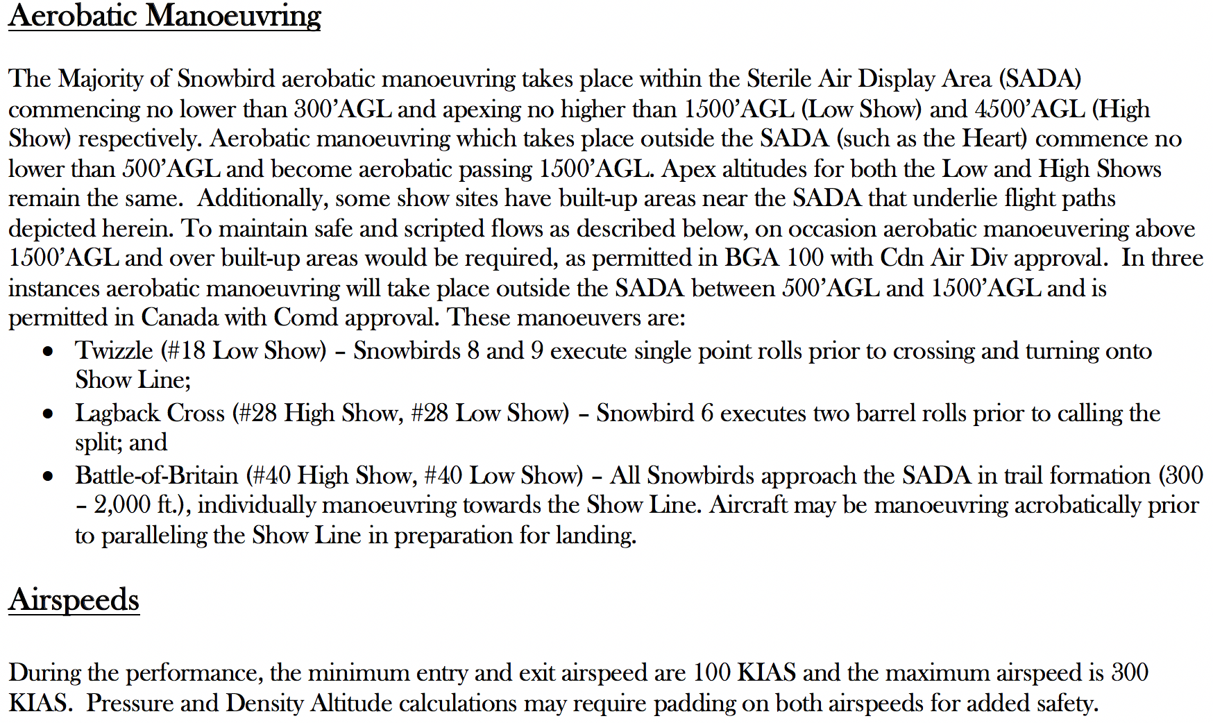
two
Vortex/Twizzle - Snowbird 8 and 9 execute single point rolls prior to crossing and turning onto show line;
Lagback Cross - Snowbird 7 executes two barrel rolls prior to calling the split.

Slide 7


Slide 8
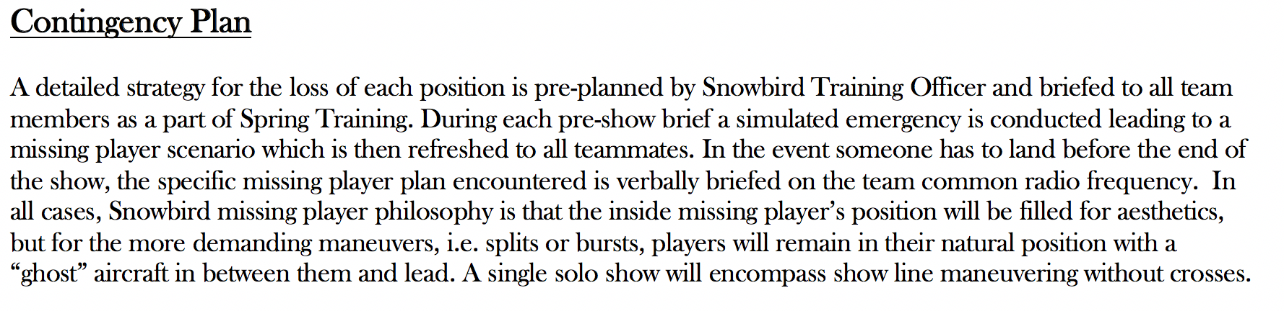
All Players
Missing Right Inner
Missing Line A Stern

Slide 9
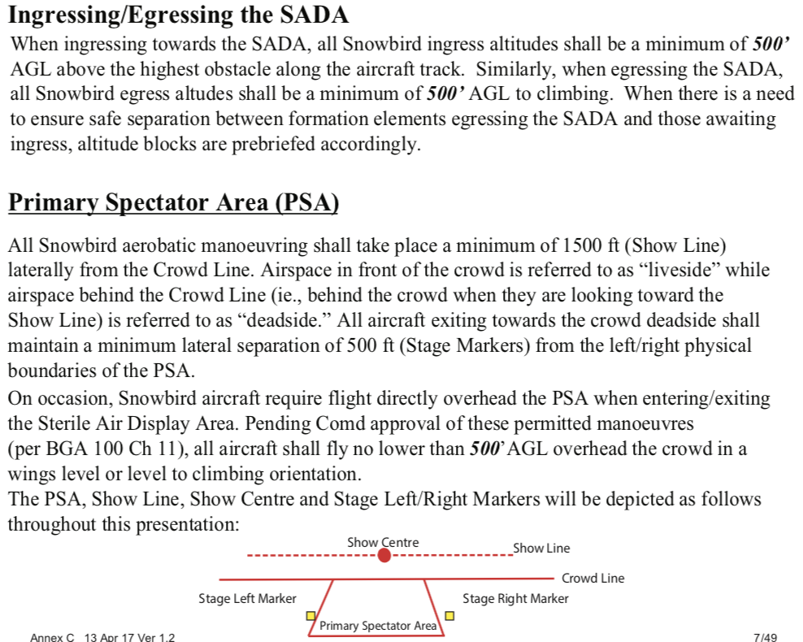

Slide 10
Air Display Flight
Snowbird 1 – Major Jean-Francois Dupont, Team Lead
Snowbird 2 – Capt Arpit Mahajan, Inner Right Wing
Snowbird 3 – Capt Ave Pyne, Inner Left Wing
Snowbird 4 – Capt Patrice Powis-Clement, First Line Astern
Snowbird 5 – Major Bassam Mnaymneh, Second Line Astern
Snowbird 6 – Capt Steven Sparks, Outer Right Wing
Snowbird 7 – Major Brett Parker, Outer Left Wing
Snowbird 8 – Capt Logan Reid, Lead Solo
Snowbird 9 – Major Taylor Evans, Opposing Solo
Snowbird 10 – Capt Eric Temple, Coordinator
Snowbird 11 – Capt Steven MacDonald, Coordinator

Slide 11
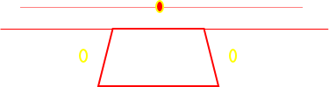
431 (AD) SQN 2021 High Show
Overhead pictorial with top-side and underside depictions.

Slide 12
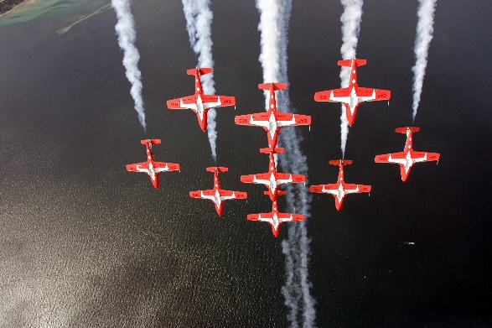
This is a permitted manoeuvre with the approval of 1 Cdn Air Div Comd for non aerobatic manoeuvre by multiple aircraft in formation with an energy vector toward the primary spectator area. BGA 100 Ch 11 Para 44.c(1)(c)
Snowbirds 1-9, in Canada Goose formation fly towards crowd from liveside and pull up into a loop beyond the 1500’ show line. A change to Big Arrow is completed on the frontside prior to the top of the loop.
1
4
5
3
2
9
8
7
6
Canada Goose  Big Arrow Loop

Slide 13
This is a permitted manoeuvre with the approval of 1 Cdn Air Div Comd for non aerobatic manoeuvre by multiple aircraft in formation with an energy vector toward the primary spectator area. BGA 100 Ch 11 Para 44.c(1)(c)
From Big Arrow, the Snowbirds change to Inuksuk formation and perform a Clover Leaf to the left, exiting stage left to set up for the next bottom side pass.
Inuksuk Clover Leaf (Left)

Slide 14
This is a permitted manoeuvre with the approval of 1 Cdn Air Div Comd for non aerobatic manoeuvre by multiple aircraft in formation with an energy vector toward the primary spectator area. BGA 100 Ch 11 Para 44.c(1)(c)
From Stage left the Snowbirds change to Canuck and run in for the
Canuck bottom side pass. The rollout and pullup into the loop happens
stage right beyond the 1500’ show line. A change to Arrow Head
is completed on the frontside. After the maneuver, the team changes to
Concorde.
Canuck bottom side to Loop ∆ Arrow Head ∆ Concorde

Slide 15
This is a permitted manoeuvre with the approval of 1 Cdn Air Div Comd for non aerobatic manoeuvre by multiple aircraft in formation with an energy vector toward the primary spectator area. BGA 100 Ch 11 Para 44.c(1)(c)
From Stage right the Snowbirds perform the Concorde
Combo. The maneuver starts with a roll and ends with a loop.
Concorde Combo (Roll & Loop)

Slide 16
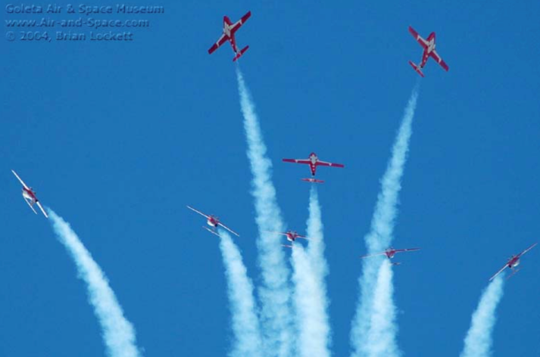
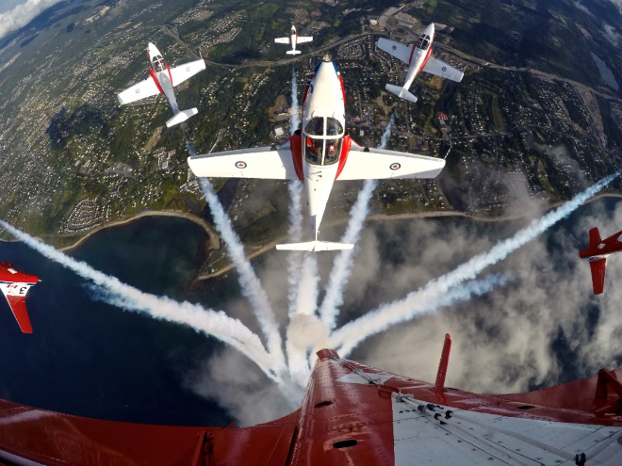
Head-On View
”Snowbirds Split Now”
Split – 5, 8, 9
Now – 6, 7
Pause – 2, 3, 4
”Smoke off Now”
5
7
6
9
4
8
1 Cdn Air Div Comd approval required for flight over the crowd (Snbd 5) at an altitude no lower than 500 feet AGL IAW BGA 100 Ch 11 Para 44.b(3)(e)
3
2
1
Running in from liveside, the Snowbirds pull up like a loop
and burst at the vertical. Lines are as depicted.
9-Ship Canada Burst

Slide 17
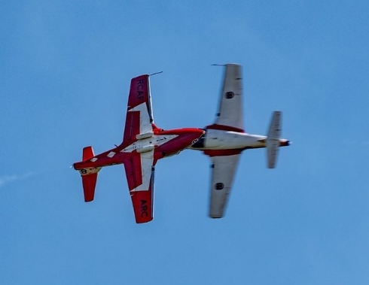
SOLO SERIES 1
= Reversal
= Roll
= Loop
9
8
Snowbird Solos 8 & 9 reposition via a slice to the 1500’ Showline
in opposing directions for the Level Roll.
Level Roll
S1. Slice, Level Roll
Notes:
SS1: SLICE from Canada Burst
LVL ROLL -> CUBAN REVERSAL
½ ROLL INV -> PRETZEL REVERSAL
HOOK LIVESIDE (& Roll?) ( Hook is like cobra exit but rolls and pulls, not rolls and pushes - gives us a vertical exit off stage without using negative G early in show)
EXIT LIVESIDE

Slide 18
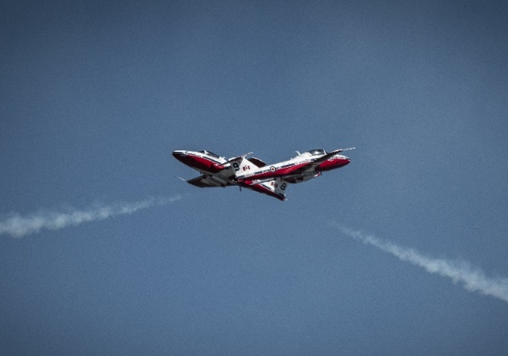
Cobra Cross
= Reversal
= Roll
= Loop
9
8
8
9
The Solos reposition via a Cuban Reversal and run in along the
1500’ Showline in opposing directions for the Cobra Exit. Both Solos
pull vertical to effect a cross, then roll 90 degrees and push negative G
until level facing away from the crowd.
S1. Cuban Reversal, Cobra Exit
Notes:
SS1: SLICE from Canada Burst
LVL ROLL -> CUBAN REVERSAL
½ ROLL INV -> PRETZEL REVERSAL
HOOK LIVESIDE (& Roll?) ( Hook is like cobra exit but rolls and pulls, not rolls and pushes - gives us a vertical exit off stage without using negative G early in show)
EXIT LIVESIDE

Slide 19
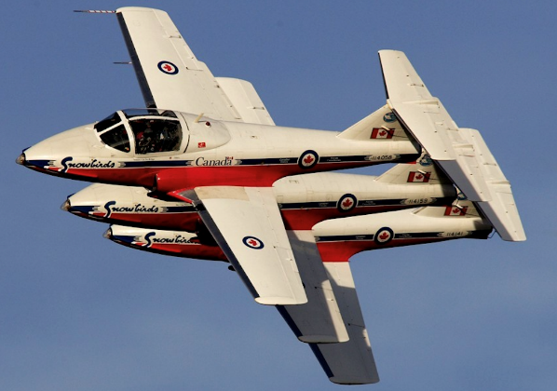
7
7
6
6
5
7
Snowbirds 7,6,5 run in from stage right, for a top side
pass, no closer than the 500’ show line .
6
5
7,6,5 Echelon In Review

Slide 20
6
7
*7, 6 Rejoin
1
2
1
2
4
4
3
3
Snowbirds 1-4 run in from stage left for the 431 & 2 Roll. Lead
will roll inverted and complete a half barrel roll to upright. Snowbirds
2-4, will start upright and finish in the inverted position.
431 Roll

Slide 21
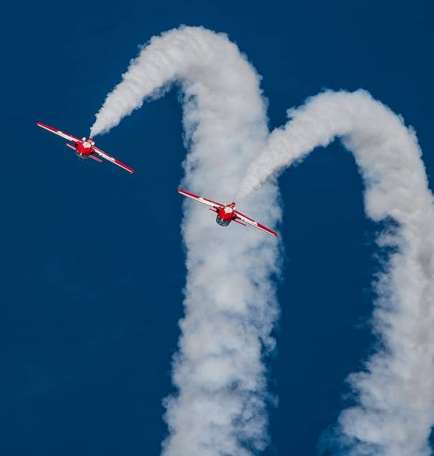
SOLO SERIES 2
= Reversal
= Roll
= Loop
9
8
8/9
Noose
Running in from Liveside the Solos conduct a 5G pull to the vertical before
splitting downwards onto the 1500’ show line via the Noose.
They reposition via a Vertical Reversal for the Upside Down cross then exit
Liveside via the Pigtail.
S2. Noose, Vertical, Upside Down, Pigtail exit
Notes:
SS2 ENTER LIVESIDE WITH A VORTEX ENTRY (B/U TWIZZLE)
VERTICAL REV – FLIP FLOP
CUBAN - KNIFE EDGE – ( SNAP – PUSH – PULL? ) (Mclovin batman exit)
EXIT DEADSIDE

Slide 22
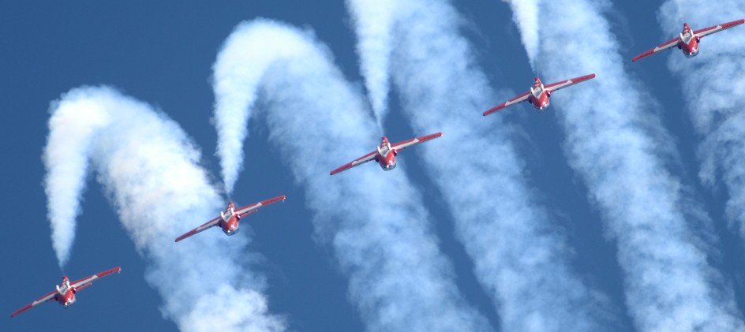
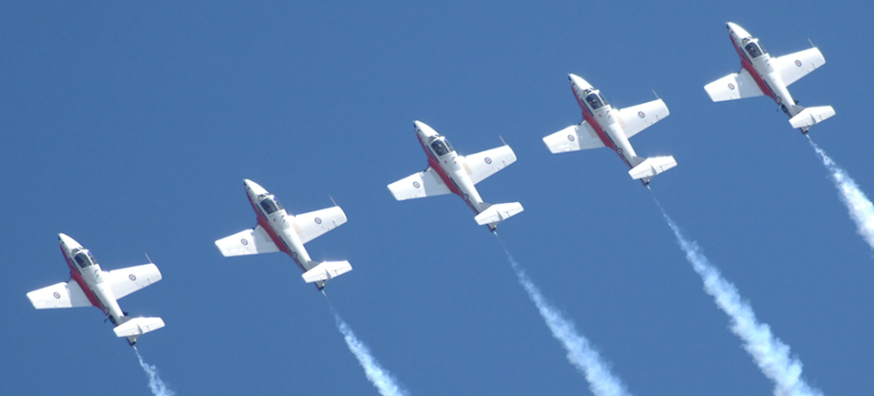
This is a permitted manoeuvre with the approval 1 Cdn Air Div Comd for aerobatic manoeuvre outside the sterile air display area below 1500 feet. BGA 100 Ch 11 Para 44.c(1)(a)
7,3,1,2,6
From Stage right the Snowbirds 1-4,6,7 perform the iconic
Line Abreast Combo. The maneuver starts with a roll and
ends with a loop while each jet are side by side.
8,5
9,4
Line Abreast Roll and Loop

Slide 23
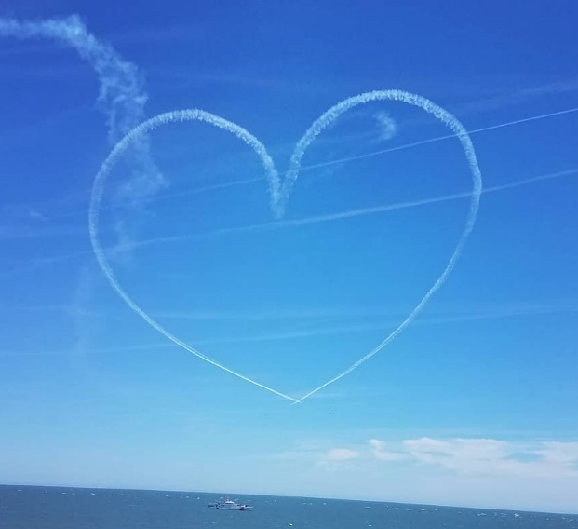
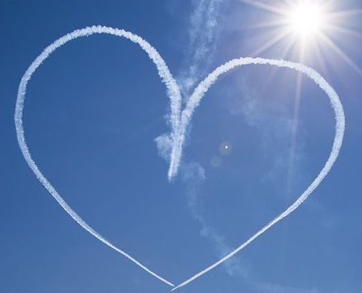
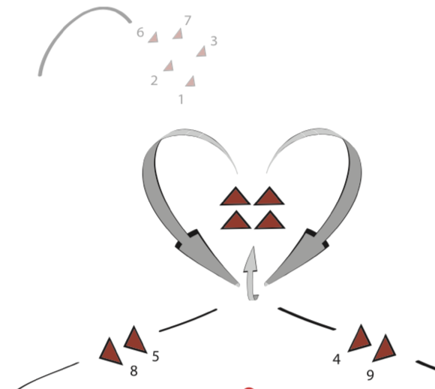
Snowbirds 8 with 5 and 9 with 4, run in from liveside and
complete separate clover leafs to illustrate a heart with the
smoke lines .
Solo Series 3: Heart
1,2,3,6,7 setup for the Lagback Cross

Slide 24
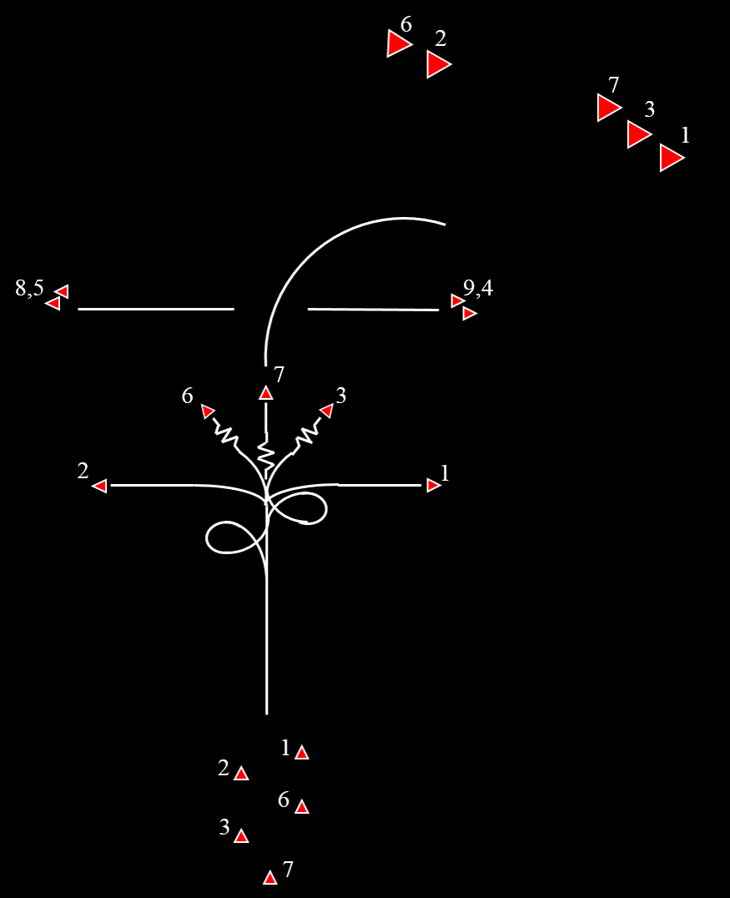
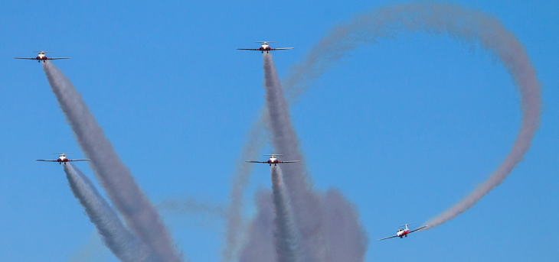

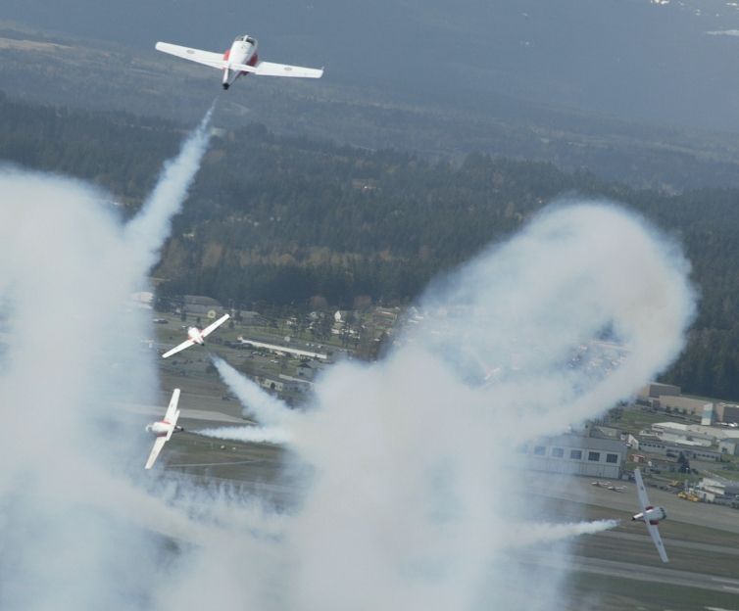
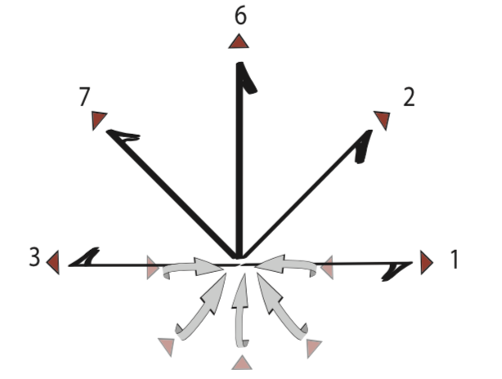
2
1
Snowbirds 1,2,3,6,7 run-in from liveside. Prior
to entering the show box, Snowbird 7 executes 2 barrel
rolls around the formation’s flight path. An inward
Burst is subsequently executed prior to the 1500’ show line.
6
3
7
This is a permitted manoeuvre with the approval 1 Cdn Air Div Comd for aerobatic manoeuvre outside the sterile air display area below 1500 feet. BGA 100 Ch 11 Para 44.c(1)(a)
In the United States, Snowbird 7
will not be executing 2 barrel rolls
7
Chase View
Head-On View
7
3
6
1
6
2
3
3
6
2
7
1
2
1
Lagback Cross

Slide 25
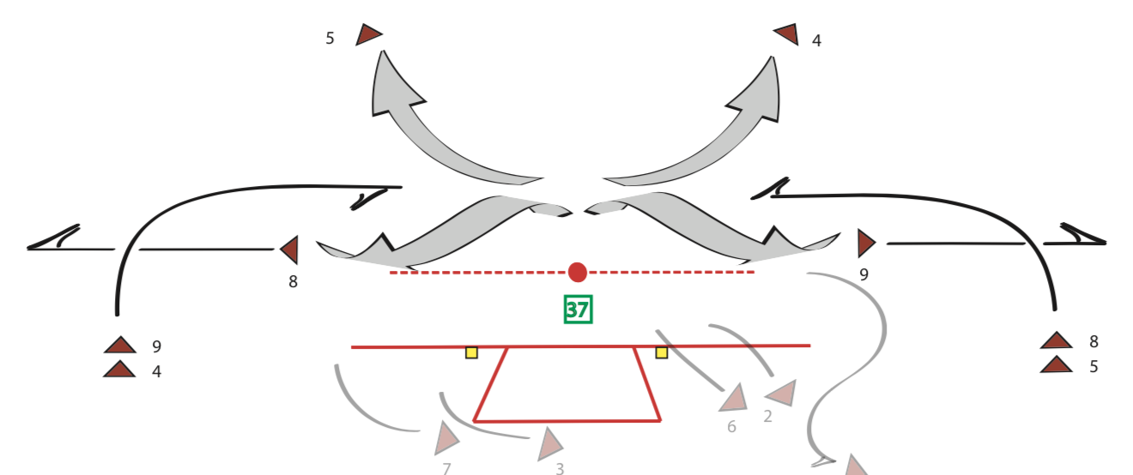
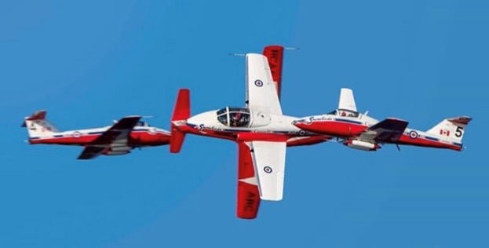
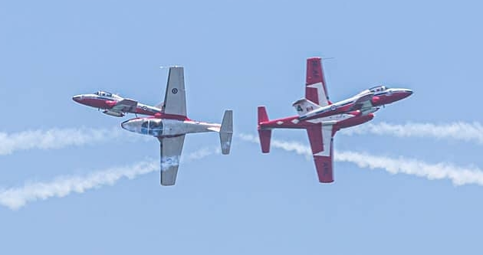
SOLO SERIES 3
Snowbirds 9,4 and 8,5 enter from stage left and right respectively and run-in along
the show line to execute the 4 way cross whereupon Snowbird 4,5 exit deadside to
rejoin with Snowbirds 1,2,3,6,7.
S3. 4 Way Cross

Slide 26
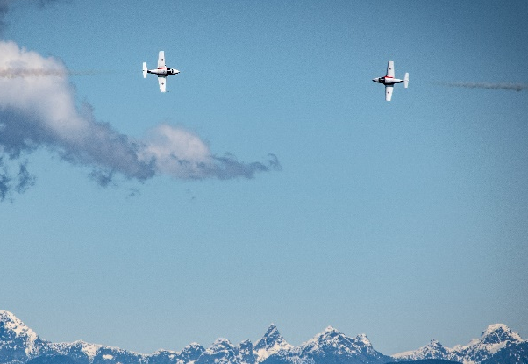
9
8
This is a permitted manoeuvre with the approval 1 Cdn Air Div Comd for aerobatic manoeuvre outside the sterile air display area below 1500 feet. BGA 100 Ch 11 Para 44.c(1)(a)
Solos reposition via a Pretzel Reversal to the 1500’ crowd line
to conduct an opposing 5G level turn before exiting Liveside.
S3. Pretzel Reversal / CO-360

Slide 27
1-7
This is a permitted manoeuvre with the approval of 1 Cdn Air Div Comd for over-flight of the primary spectator area at 500 feet. BGA 100 Ch 11 Para 44.b(3)(e)
1-7
The main formation enters from deadside overhead
and pulls up into a loop in Speed Bird beyond the 1500’ show
line. A change to Big Wedge is completed on top. A
change to Arrow is made on the backside.
Speed Bird ∆ Wedge ∆ Arrow loop

Slide 28
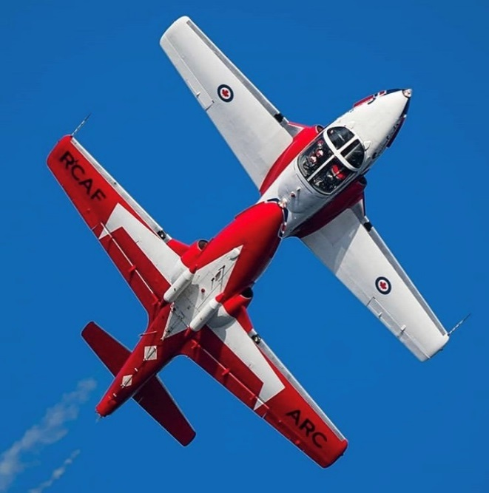
SOLO SERIES 4
9/8
Snowbird 8 conducts a slow negative barrel roll with Snowbird 9
maintaining a stacked canopy reference throughout.
S4. Mirror Roll

Slide 29
8
9
1-7
1-7 run in from stage right and complete the
Double Diamond Roll.
Double Diamond Roll

Slide 30
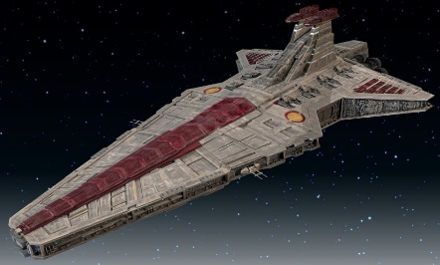
Venator
This is a permitted manoeuvre with the approval of 1 Cdn Air Div Comd for over-flight of the primary spectator area at 500 feet. BGA 100 Ch 11 Para 44.b(3)(e)
9
8
Solo Sneak Pass Rejoin to Venator

Slide 31
This is a permitted manoeuvre with the approval of 1 Cdn Air Div Comd for non aerobatic manoeuvre by multiple aircraft in formation with an energy vector toward the primary spectator area. BGA 100 Ch 11 Para 44.c(1)(c)
Snowbirds runs in from stage left and complete the
Venator Bottom side pass to Vader loop. Snowbirds then
changes to Maple Formation in preparation for the
Maple Split or Big Vic Loop.
Venator Bottom Side to Vader Loop

Slide 32
POST VADER LOOP
Pending show site, transit fuel and WX considerations,
Snowbird 1 will finish the show with either the Maple
Split or Big Vic loop. The Palm Clover Downward will
follow either the Maple Split or Big Vic loop.

Slide 33
POST VADER LOOP
MAPLE SPLIT

Slide 34
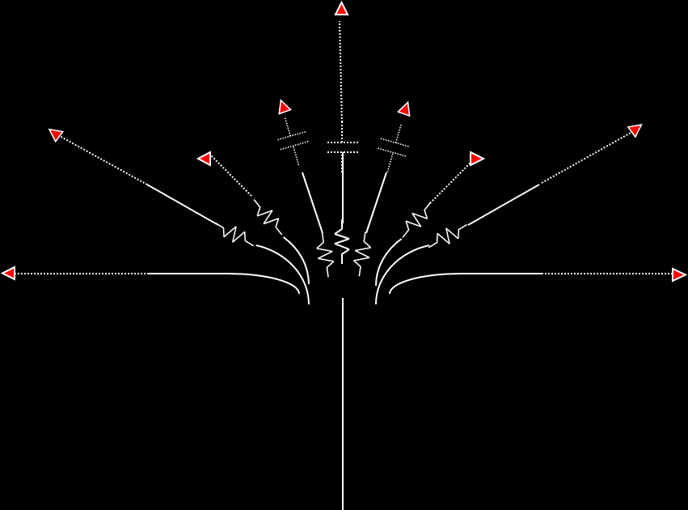

Running in from liveside, the Snowbirds ease up
and split. Lines are as depicted.
1
3
2
5
4
9
8
7
6
This is a permitted manoeuvre with the approval of 1 Cdn Air Div Comd for over-flight of the primary spectator area at 500 feet. BGA 100 Ch 11 Para 44.b(3)(e)
1
2
3
5
8
9
4
6
7
9 Plane Maple split

Slide 35
Rejoin order: 3-2-9-4-7-8-5-6
1
3
2
5
4
9
8
7
6
This is a permitted manoeuvre with the approval of 1 Cdn Air Div Comd for over-flight of the primary spectator area at 500 feet. BGA 100 Ch 11 Para 44.b(3)(e)
9 Plane Maple split rejoin to PALM WTR

Slide 36
6
7
This is a permitted manoeuvre with the approval of 1 Cdn Air Div Comd for non aerobatic manoeuvre by multiple aircraft in formation with an energy vector toward the primary spectator area. BGA 100 Ch 11 Para 44.c(1)(c)
8
9
5
4
2
3
1
Palm Clover Downward to Landing

Slide 37
POST VADER LOOP
BIG VIC LOOP

Slide 38
This is a permitted manoeuvre with the approval of 1 Cdn Air Div Comd for non aerobatic manoeuvre by multiple aircraft in formation with an energy vector toward the primary spectator area. BGA 100 Ch 11 Para 44.c(1)(c)
Snowbirds runs in from stage left and complete the
Venator Bottom side pass to Vader loop. Snowbirds then
changes to Maple Formation in preparation for the
Maple Split.
Venator Bottom Side to Vader Loop ∆ Maple

Slide 39
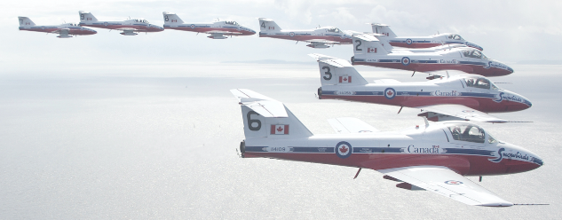
This is a permitted manoeuvre with the approval of 1 Cdn Air Div Comd for non aerobatic manoeuvre by multiple aircraft in formation with an energy vector toward the primary spectator area. BGA 100 Ch 11 Para 44.c(1)(c)
Maple ∆ Big Vic for Big Vic Loop

Slide 40
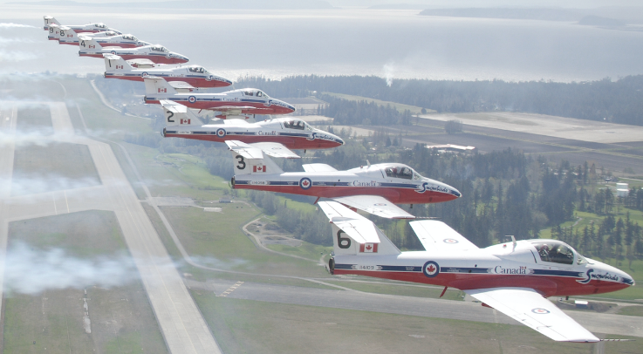
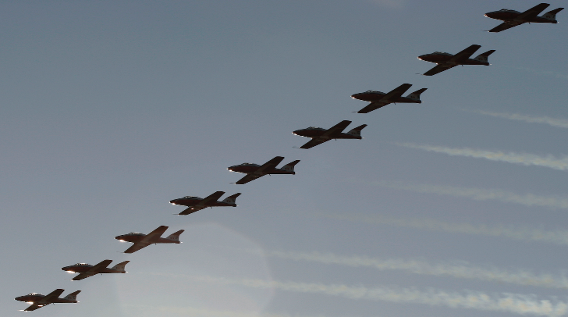
This is a permitted manoeuvre with the approval of 1 Cdn Air Div Comd for over-flight of the primary spectator area at 500 feet. BGA 100 Ch 11 Para 44.b(3)(e)
∆ To Palm WTR post Loop

Slide 41
6
7
This is a permitted manoeuvre with the approval of 1 Cdn Air Div Comd for non aerobatic manoeuvre by multiple aircraft in formation with an energy vector toward the primary spectator area. BGA 100 Ch 11 Para 44.c(1)(c)
8
9
5
4
2
3
1
Palm Clover Downward to Landing

