Slide 1


431 (AD) SQN 2021 Low Show
The following is a pictorial description of the proposed 2021 Low Show
Manoeuvres have been classified as follows:
  Permitted Manoeuvres as per BGA 100 Ch 11
  Permitted Manoeuvres requiring Comd approval as per BGA 100 Ch 11
  Prohibited Manoeuvres as per BGA 100 Ch 11 waiver required

Slide 3
The weather limits for each of the Snowbirds performances are:
High Show 5000 feet ceiling and 5 statute miles visibility
Low show 1500 feet ceiling and 5 statute miles visibility
Flat Show 1000 feet and 5 statute miles visibility
The BGA-100 requires a minimum visibility of three statute miles for any air displays. The Snowbirds have raised the minimum visibility of the high and low show displays as an added safety measure due to the complexity of the rejoins post splits.

Slide 4


Slide 5
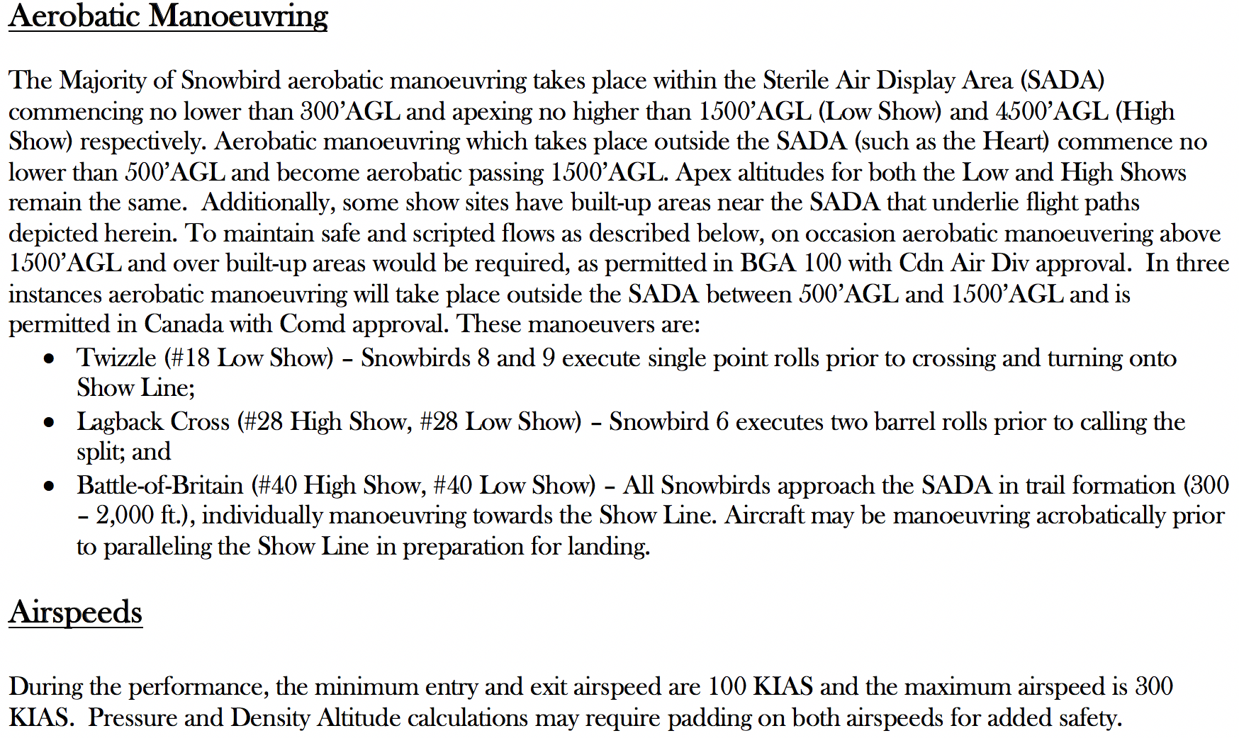
Vortex/Twizzle– Snowbird 8 and 9 execute single point rolls prior to crossing and turning onto show line;
Lagback Cross – Snowbird 7 executes two barrel rolls prior to calling the split; and
Battle-of-Britain – All Snowbirds approach the SADA in trail formation (300 – 2,000ft.), individually manoeuvring towards the show line. Aircraft may be manoeuvring acrobatically prior to paralleling the show line in preparation for landing.

Slide 7


Slide 8
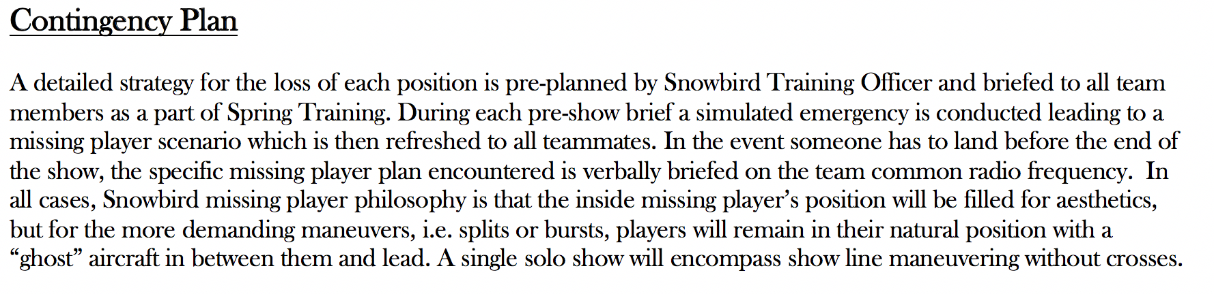
All Players
Missing Right Inner
Missing Line A Stern

Slide 9
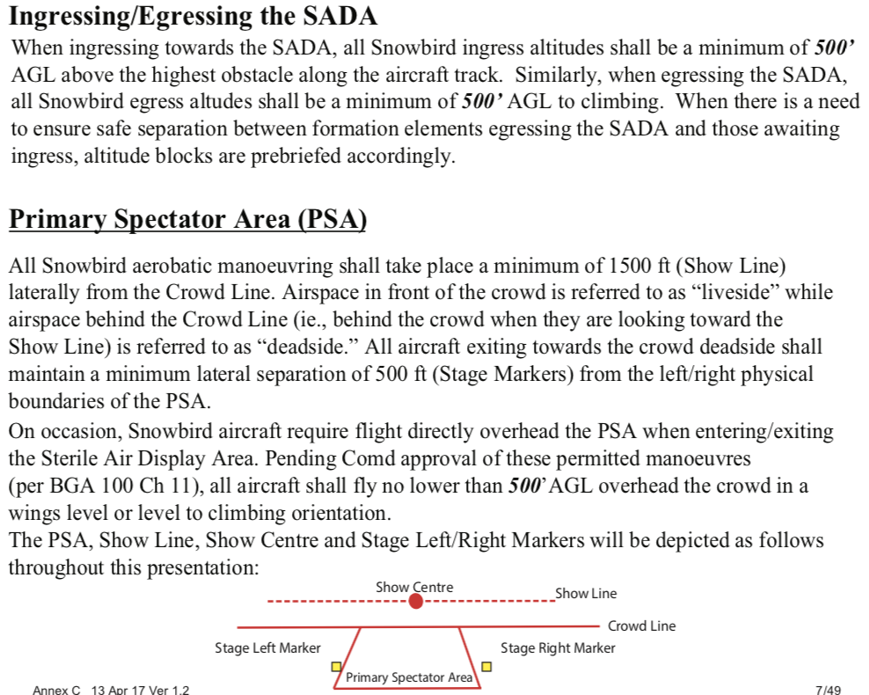

Slide 10
Air Display Flight
Snowbird 1 – Major Jean-Francois Dupont, Team Lead
Snowbird 2 – Capt Arpit Mahajan, Inner Right Wing
Snowbird 3 – Capt Ave Pyne, Inner Left Wing
Snowbird 4 – Capt Patrice Powis-Clement, First Line Astern
Snowbird 5 – Major Bassam Mnaymneh, Second Line Astern
Snowbird 6 – Capt Steven Sparks, Outer Right Wing
Snowbird 7 – Major Brett Parker, Outer Left Wing
Snowbird 8 – Capt Logan Reid, Lead Solo
Snowbird 9 – Major Taylor Evans, Opposing Solo
Snowbird 10 – Capt Eric Temple, Coordinator
Snowbird 11 – Capt Steven MacDonald, Coordinator

Slide 11
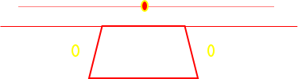
431 (AD) SQN 2021 Low Show
Overhead pictorial with top-side and underside depictions.

Slide 12
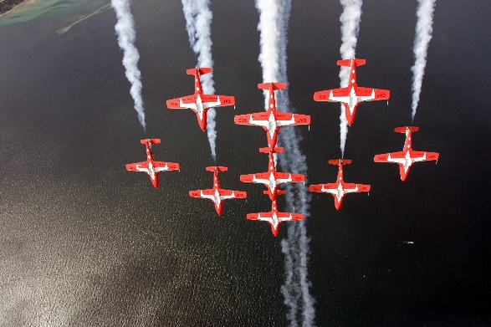
INK
BA
This is a permitted manoeuvre with the approval of 1 Cdn Air Div Comd for non aerobatic manoeuvre by multiple aircraft in formation with an energy vector toward the primary spectator area. BGA 100 Ch 11 Para 44.c(1)(c)
Liveside Stage Right Vulcan Run-in into Wrap  Big Arrow  INUK

Slide 13
This is a permitted manoeuvre with the approval of 1 Cdn Air Div Comd for non aerobatic manoeuvre by multiple aircraft in formation with an energy vector toward the primary spectator area. BGA 100 Ch 11 Para 44.c(1)(c)
UDR  Canuck, Canuck BS

Slide 14
UDR  Big Wedge T/S  Big Diamond

Slide 15
This is a permitted manoeuvre with the approval of 1 Cdn Air Div Comd for over-flight of the primary spectator area at 500 feet. BGA 100 Ch 11 Para 44.b(3)(e)
Overhead Big Diamond Pass

Slide 16
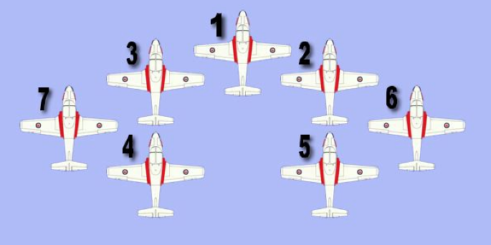

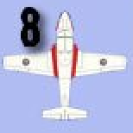
* After the split, the solos perform Solo Series One while
1-4 rejoin > 1500’AGL deadside stage left for the Corkscrew
. 7,5,6 rejoin at 1,000’AGL for the Echelon in Review.
Rejoins for 1-7 are done in a similar fashion as the High
Show rejoin post Canada Burst.
3
1
2
4
5
7
6
This is a permitted manoeuvre with the approval of 1 Cdn Air Div Comd for non aerobatic manoeuvre by multiple aircraft in formation with an energy vector toward the primary spectator area. BGA 100 Ch 11 Para 44.c(1)(c)
8
9
1 Cdn Air Div Comd approval required for flight over the crowd at an altitude no lower than 500 feet AGL IAW BGA 100 Ch 11 Para 44.b(3)(e)
9
8
Big Diamond  50th Split

Slide 17
SOLO SERIES 1
= Reversal
= Roll
= Loop
8
9
Snowbird Solos 8 & 9 reposition via a 90/270 reversal to the 1500’ Showline
in opposing directions for the level roll.
S1. 90/270, Lvl Roll

Slide 18
= Reversal
= Roll
= Loop
9
8
Snowbird Solos 8 & 9 reposition via a 270/90 reversal to the 1500’ Showline
in opposing directions for low Cobra exit.
S1. 90/270, Low Cobra LS

Slide 19
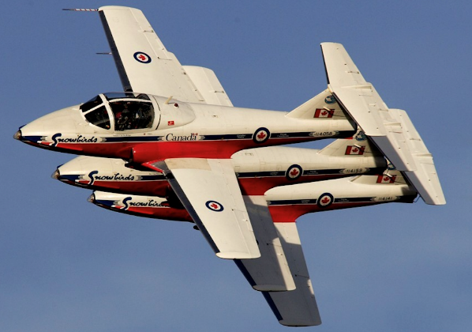
7
6
5
Echelon in Review (7,6 and 5 execute a tight banana top side pass)

Slide 20
6
7
This is a permitted manoeuvre with the approval of 1 Cdn Air Div Comd for non aerobatic manoeuvre by multiple aircraft in formation with an energy vector toward the primary spectator area. BGA 100 Ch 11 Para 44.c(1)(c)
*7,6 Rejoin with 1-4 for LA – Vic Wrap
5
1
2
3
4
*5 Holding LS Stage Left for 4, 8,9
Corkscrew

Slide 21
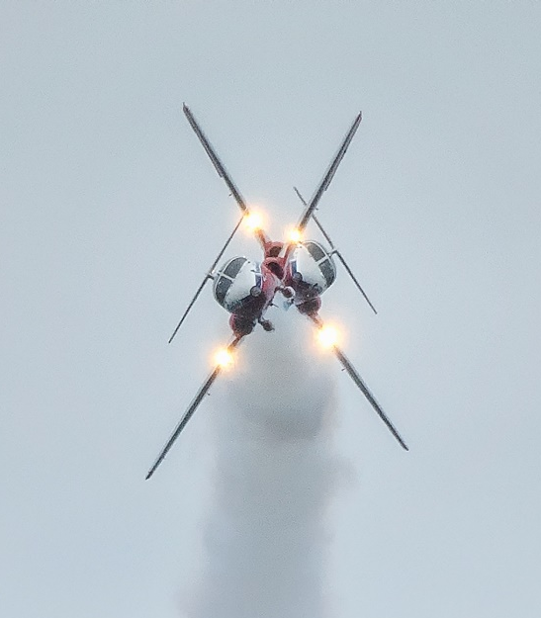
SOLO SERIES 2
= Reversal
= Roll
= Loop
9
8
9
8
8/9
Split from Vortex
Running in from Liveside the Solos conduct a counter-directional
point roll exiting outbound onto the 1500’ show line.
They reposition via a 270/90 reversal and run in along the
1500’ show line in opposing directions for the Upside Down Cross before
exiting liveside
S2. Vortex, 270/90, Upside Down, Pigtail LS
Notes:
SS2 ENTER LIVESIDE WITH A VORTEX ENTRY (B/U TWIZZLE)
VERTICAL REV – FLIP FLOP
CUBAN - KNIFE EDGE – ( SNAP – PUSH – PULL? ) (Mclovin batman exit)
EXIT DEADSIDE

Slide 22
#1, 2, 3, 6, 7 Set up Stage Right for LA/VIC Wrap
5
4
7, 3, 1, 2, 6
#4, 5 Hold Liveside stage Left until rejoin with #8, 9 for Kaleidoscope

Slide 23
1,2,3,6,7
Run-In Line Abreast to VIC Wrap

Slide 24
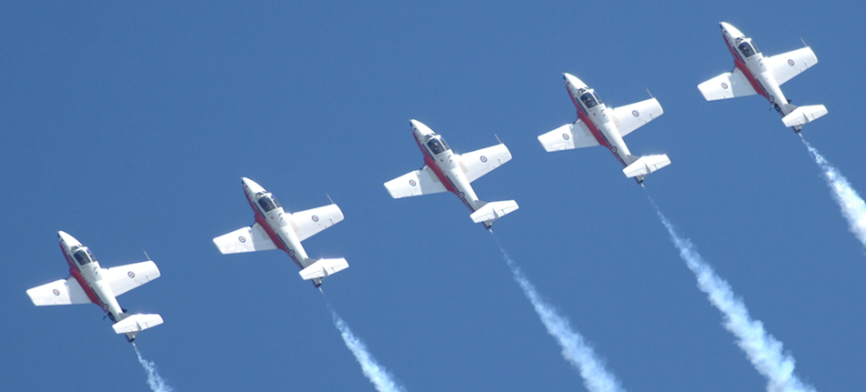
5 4
8 9
7,3,1,2,6
This is a permitted manoeuvre with the approval 1 Cdn Air Div Comd for aerobatic manoeuvre outside the sterile air display area below 1500 feet. BGA 100 Ch 11 Para 44.c(1)(a)
Line Abreast  VIC Wrap

Slide 25
SOLO SERIES 3
8
9
4
5
= Reversal
= Roll
= Loop
5 4
9 8
9 8
5 4
Snowbird 5 leads a pass down the 1500’ showline with Snowbird 4 flying inverted off the tail.
Solos conduct barrel rolls in sequence around the smokelines
S3. Kaleidoscope
1,2,3,6,7 setup for the Lagback Cross

Slide 26
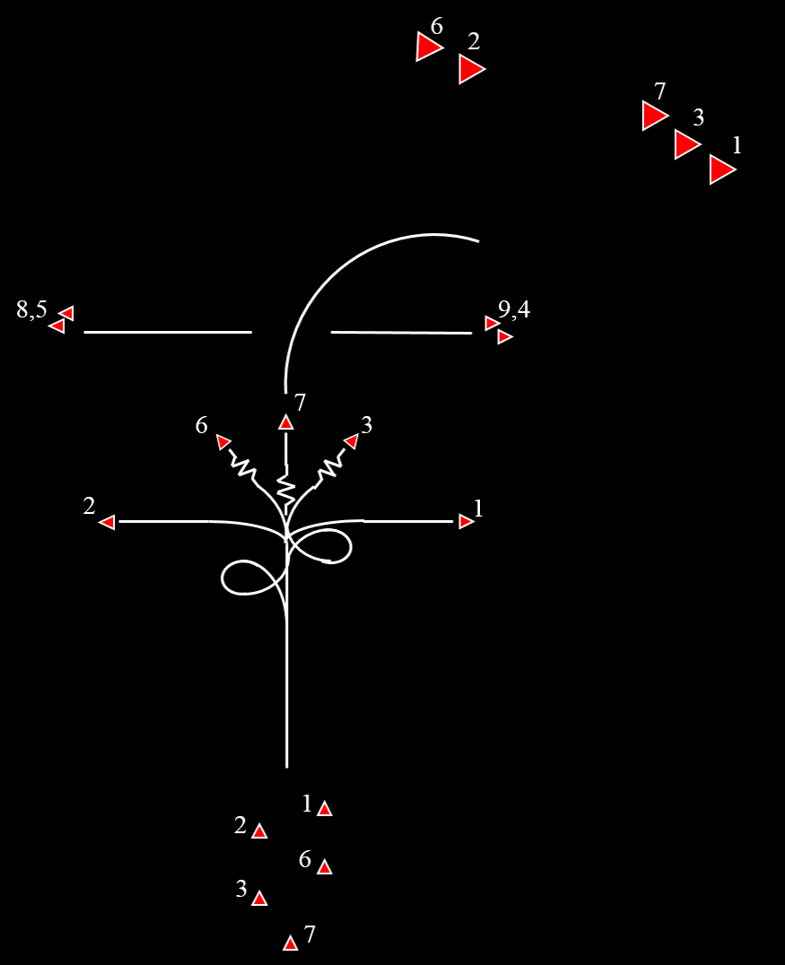
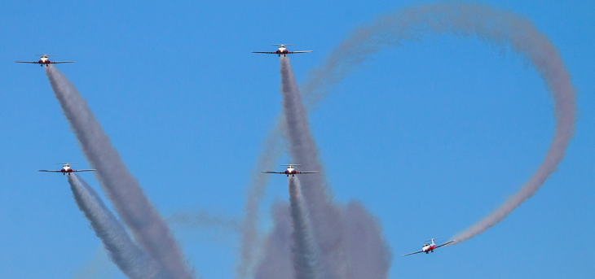

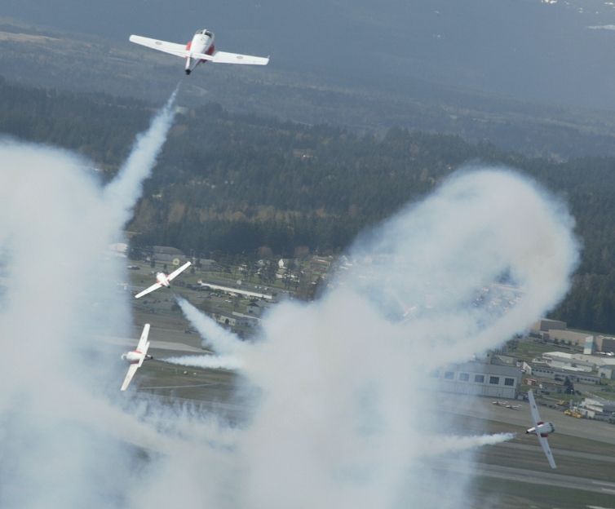
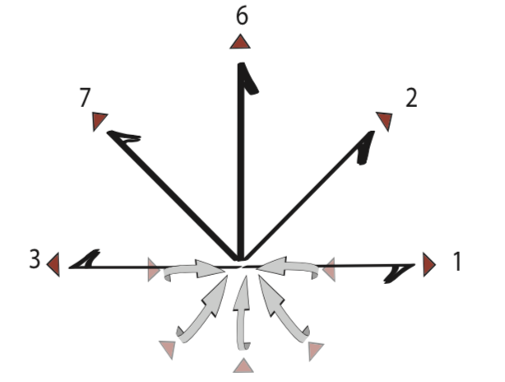
2
1
Snowbirds 1,2,3,6,7 run-in from liveside. Prior
to entering the show box, Snowbird 7 executes 2 barrel
rolls around the formation’s flight path. An inward
Burst is subsequently executed prior to the 1500’ show line.
6
3
7
This is a permitted manoeuvre with the approval 1 Cdn Air Div Comd for aerobatic manoeuvre outside the sterile air display area below 1500 feet. BGA 100 Ch 11 Para 44.c(1)(a)
In the United States, Snowbird 7
will not be executing 2 barrel rolls
7
Chase View
Head-On View
7
3
6
1
6
2
3
3
6
2
7
1
2
1
Lagback Cross

Slide 27
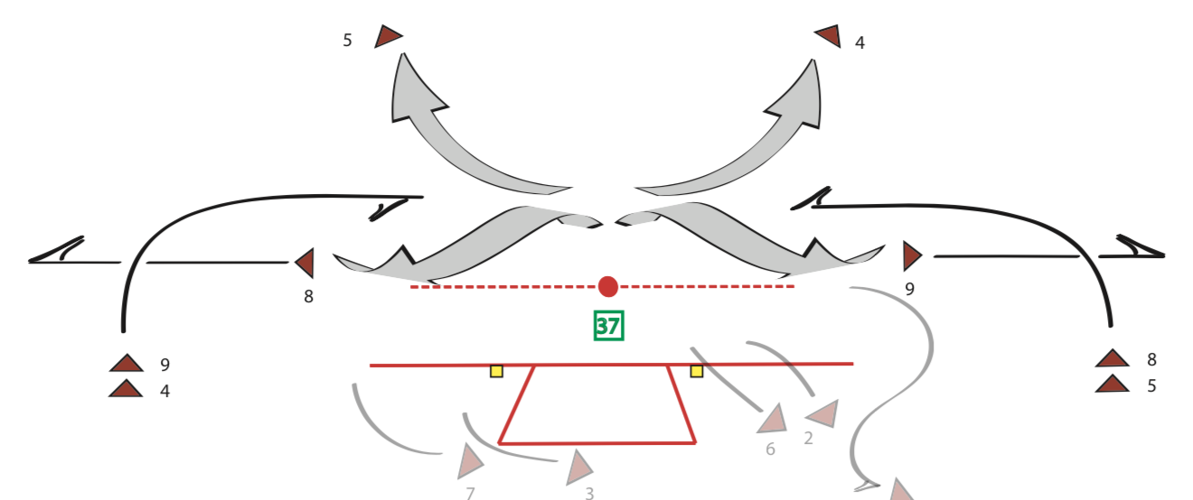
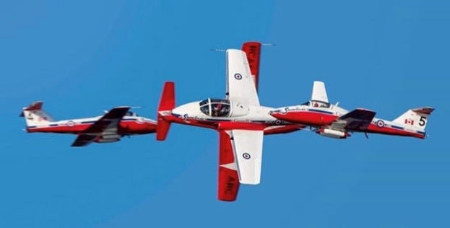
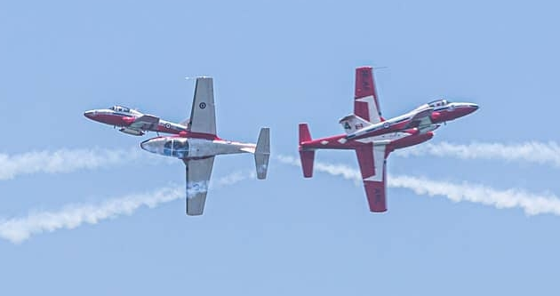
SOLO SERIES 4
Snowbirds 9,4 and 8,5 enter from stage left and right respectively and run-in along
the show line to execute the 4 way cross whereupon Snowbird 4,5 exit deadside to
rejoin with Snowbirds 1,2,3,6,7.
S4. 4 Way Cross

Slide 28
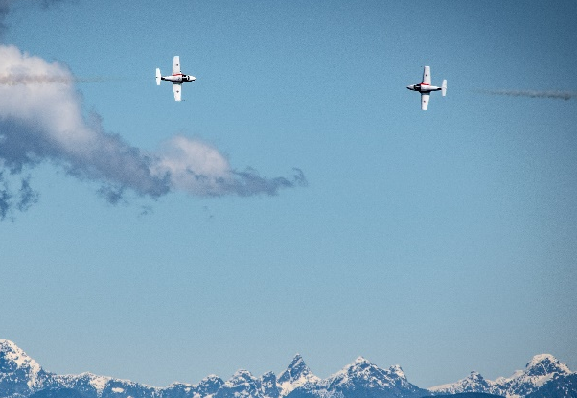
This is a permitted manoeuvre with the approval 1 Cdn Air Div Comd for aerobatic manoeuvre outside the sterile air display area below 1500 feet. BGA 100 Ch 11 Para 44.c(1)(a)
9
8
Solos reposition via a 270/90 Reversal to the 1500’ crowd line to conduct
an opposing 5G level turn before exiting Liveside
S4. 270/90 / CO360

Slide 29
1-7
8,9
SpeedBird T/S ∆ Wedge, reversal ∆ Arrow
Exit LS Stage Right to setup for DDR

Slide 30
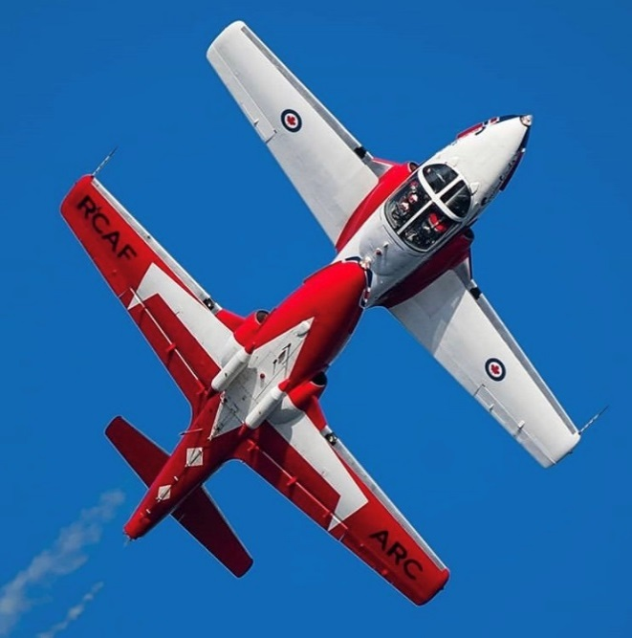
SOLO SERIES 5
9/8
Snowbird 8 conducts a slow negative barrel roll with Snowbird 9
maintaining a stacked canopy reference throughout.
S5. Mirror Roll

Slide 31
8
9
1-7
Double Diamond Roll

Slide 32
This is a permitted manoeuvre with the approval of 1 Cdn Air Div Comd for over-flight of the primary spectator area at 500 feet. BGA 100 Ch 11 Para 44.b(3)(e)
9
8
Solo Sneak Pass Rejoin to Vader

Slide 33
This is a permitted manoeuvre with the approval of 1 Cdn Air Div Comd for non aerobatic manoeuvre by multiple aircraft in formation with an energy vector toward the primary spectator area. BGA 100 Ch 11 Para 44.c(1)(c)
Vader Wrap ∆ Arrow Head Wrap ∆ Maple

Slide 34
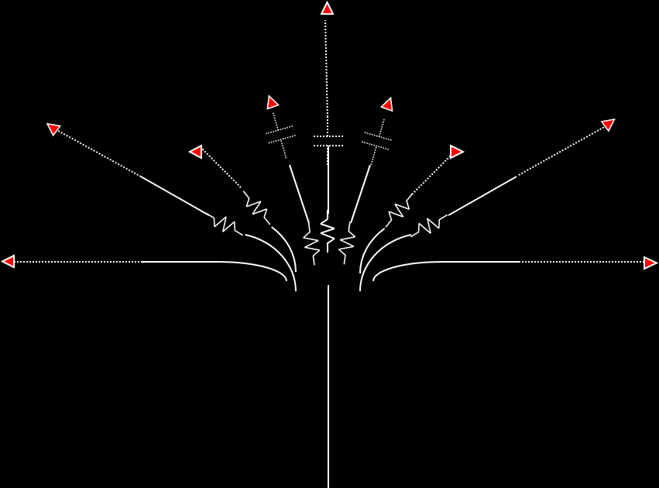

Running in from liveside, the Snowbirds ease up
and split. Lines are as depicted.
1
3
2
5
4
9
8
7
6
This is a permitted manoeuvre with the approval of 1 Cdn Air Div Comd for over-flight of the primary spectator area at 500 feet. BGA 100 Ch 11 Para 44.b(3)(e)
1
2
3
5
8
9
4
6
7
9 Plane Maple split

Slide 35
Rejoin order: 3-2-9-4-7-8-5-6
1
3
2
5
4
9
8
7
6
This is a permitted manoeuvre with the approval of 1 Cdn Air Div Comd for over-flight of the primary spectator area at 500 feet. BGA 100 Ch 11 Para 44.b(3)(e)
9 Plane Maple split rejoin to PALM WTR

Slide 36
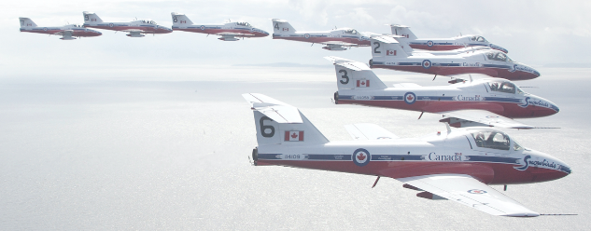
7, 9, 4, 3, 1, 2, 5, 8, 6
Palm ∆ Big Vic ∆ To 9-Plane Line Abreast

Slide 37
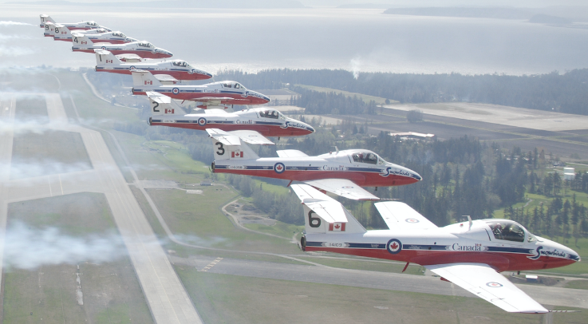
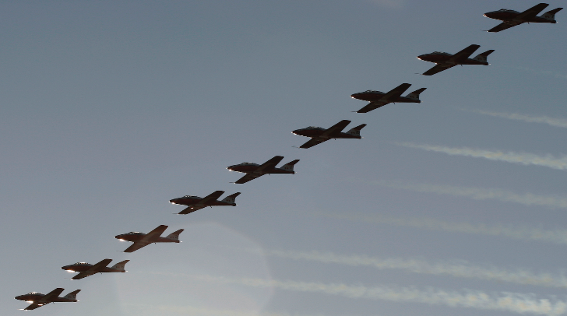
7, 9, 4, 3, 1, 2, 5, 8, 6
This is a permitted manoeuvre with the approval of 1 Cdn Air Div Comd for over-flight of the primary spectator area at 500 feet. BGA 100 Ch 11 Para 44.b(3)(e)
∆ To BA WTR ∆ Trail

Slide 38
In the United States, this will
be flown non-aerobatic.
Battle of Britain (done in trail 1-9) to land

