Slide 1


431 (AD) SQN 2021 Non Aerobatic Display
The following is a pictorial description of the proposed 2021 NAD
Manoeuvres have been classified as follows:
  Permitted Manoeuvres as per BGA 100 Ch 11
  Permitted Manoeuvres requiring Comd approval as per BGA 100 Ch 11
  Prohibited Manoeuvres as per BGA 100 Ch 11 waiver required

Slide 2

The weather limits for each of the Snowbirds performances are:
High Show 5000 feet ceiling and 5 statute miles visibility
Low show 1500 feet ceiling and 5 statute miles visibility
NAD Show 1500 feet and 5 statute miles visibility.
If doing the Maple Split → High Show limits
The BGA-100 requires a minimum visibility of three statute miles for any air displays. The Snowbirds have raised the minimum visibility of the high and low show displays as an added safety measure due to the complexity of the rejoins post splits.

Slide 3


Slide 4
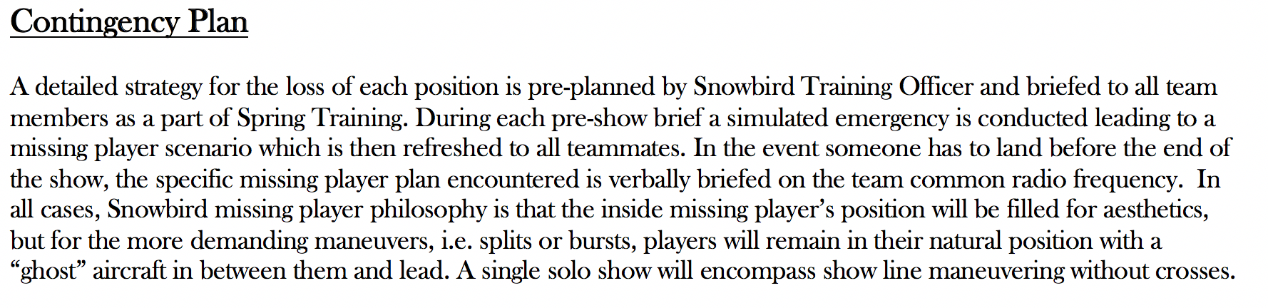
All Players
Missing Right Inner
Missing Line A Stern

Slide 5
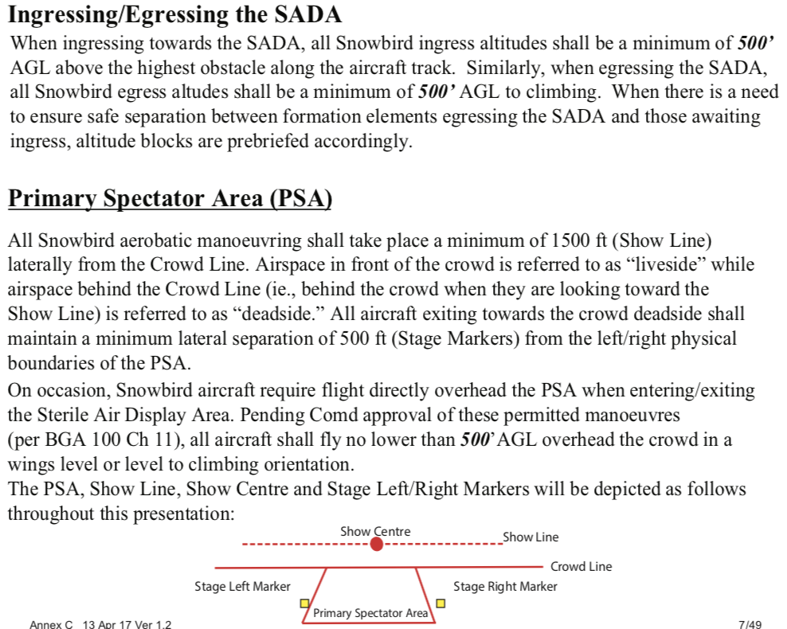

Slide 6
Air Display Flight
Snowbird 1 – Major Jean-Francois Dupont, Team Lead
Snowbird 2 – Capt Arpit Mahajan, Inner Right Wing
Snowbird 3 – Capt Ave Pyne, Inner Left Wing
Snowbird 4 – Capt Patrice Powis-Clement, First Line Astern
Snowbird 5 – Major Bassam Mnaymneh, Second Line Astern
Snowbird 6 – Capt Steven Sparks, Outer Right Wing
Snowbird 7 – Major Brett Parker, Outer Left Wing
Snowbird 8 – Capt Logan Reid, Lead Solo
Snowbird 9 – Major Taylor Evans, Opposing Solo
Snowbird 10 – Capt Eric Temple, Coordinator
Snowbird 11 – Capt Steven MacDonald, Coordinator

Slide 7
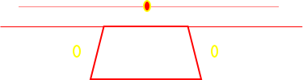
431 (AD) SQN 2021 NAD
Overhead pictorial with top-side and underside depictions.

Slide 8
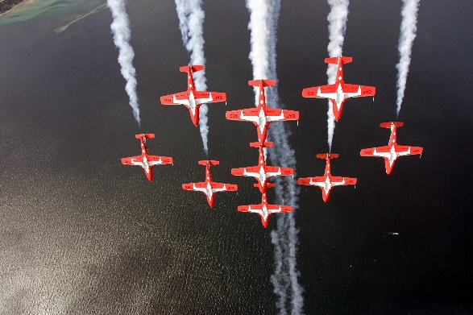
INK
BA
Vulcan Run-in  Big Arrow  INUK  Canuck

Slide 9
UDR  Canuck, Canuck BS

Slide 10
UDR  Big Wedge T/S  Big Diamond

Slide 11
Overhead Big Diamond Pass ∆ Vader

Slide 12
Vader Wrap ∆ Arrow Head ∆ Maple

Slide 13
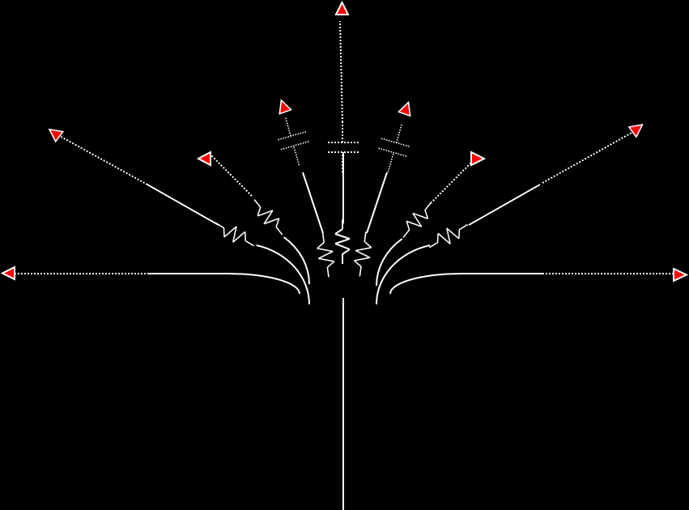

Running in from liveside, the Snowbirds ease up
and split. Lines are as depicted.
1
3
2
5
4
9
8
7
6
This is a permitted manoeuvre with the approval of 1 Cdn Air Div Comd for over-flight of the primary spectator area at 500 feet. BGA 100 Ch 11 Para 44.b(3)(e)
1
2
3
5
8
9
4
6
7
9 Plane Maple split

Slide 14
Rejoin order: 3-2-9-4-7-8-5-6
1
3
2
5
4
9
8
7
6
This is a permitted manoeuvre with the approval of 1 Cdn Air Div Comd for over-flight of the primary spectator area at 500 feet. BGA 100 Ch 11 Para 44.b(3)(e)
9 Plane Maple split rejoin to PALM WTR

Slide 15
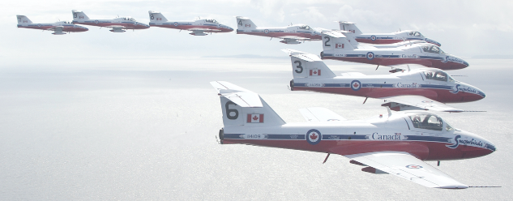
7, 9, 4, 3, 1, 2, 5, 8, 6
Palm ∆ Big Vic ∆ To 9-Plane Line Abreast

Slide 16
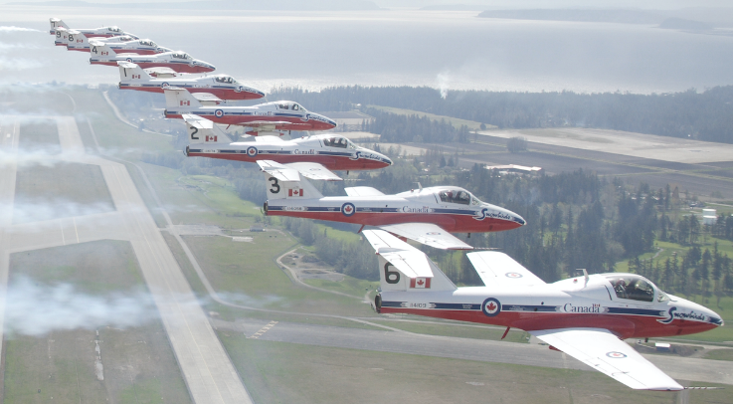
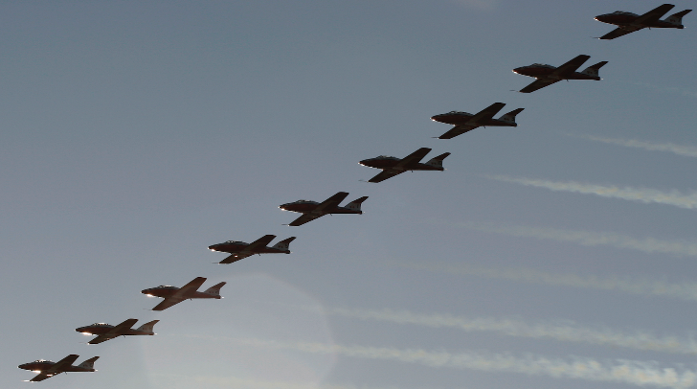
7, 9, 4, 3, 1, 2, 5, 8, 6
This is a permitted manoeuvre with the approval of 1 Cdn Air Div Comd for over-flight of the primary spectator area at 500 feet. BGA 100 Ch 11 Para 44.b(3)(e)
∆ To Big Diamond WTR

Slide 17

In the United States, this will
be flown non-aerobatic.
Battle of Britain (done in trail 1-9) to land

Slide 18
Enjoy the show!

