Slide 1
Proposed Changes for Capital Area Airports
District of Columbia, Maryland and Virginia Congressional Delegations
Marie Kennington-Gardiner Eastern Regional Administrator (Acting)
Elizabeth L. Ray Vice President, Mission Support Services
August 15, 2017

Slide 2
Agenda
Overview of Capital Area Airspace
Importance of DC in the National Airspace System (NAS)
Critical component of the Northeast Corridor airspace configuration
Complexity/Challenges in the Capital Area Airspace
Ronald Reagan Washington National Airport (DCA)
Dulles International Airport (IAD)
Baltimore Washington International Thurgood Marshall Airport (BWI)
Air Traffic Control

Slide 3
Agenda (cont.)
Community Engagement
Public Concerns FAA Has Been Asked to Address
The Role of the FAA
Responsibilities of the FAA, the Airport Authority, and the Airlines
Capital Area Airspace: FAA Update
DCA Working Group History
DCA Working Group Request
DCA Proposal
FAA is Exploring Changes in Additional Areas

Slide 4
Capital Area Airspace

Slide 5
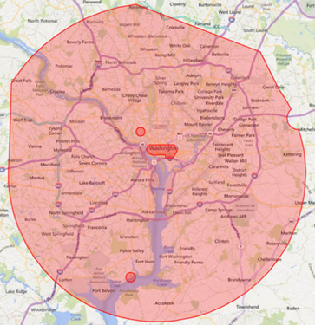
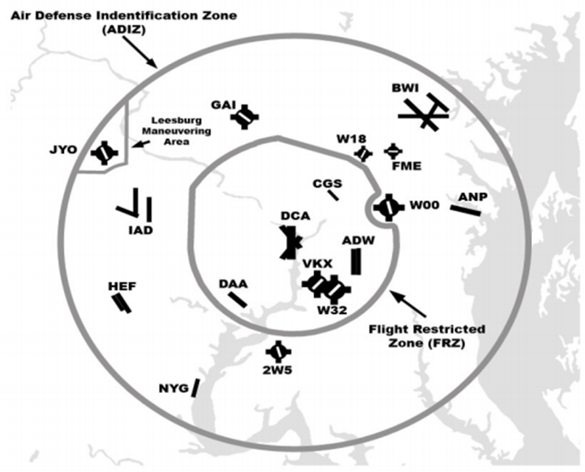
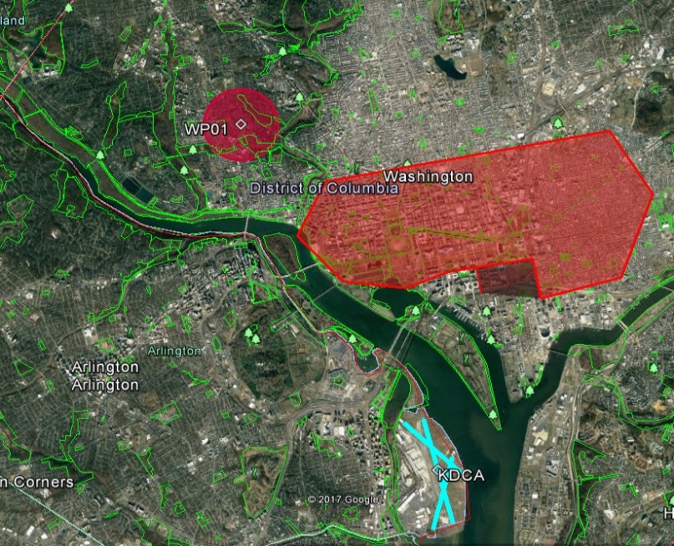
Capital Area Airspace: Complexity/Challenges
DC’s Restricted Airspace. The Air Defense Identification Zone (ADIZ), Prohibited Areas (P-56A and P-56B,) and the Flight Restricted Zone (FRZ) – all create unique challenges in developing aircraft procedures.

Slide 6
Capital Area Airspace: Air Traffic Control
Legend: Departures Arrivals

Slide 7
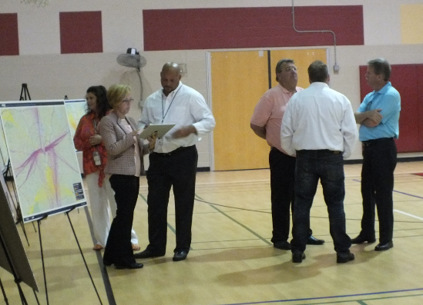
Capital Area Airspace: Aviation and Community Engagement
Elected Official, Airport, Airline, and Community Engagement Opportunities
The need for and level of engagement will vary based on project circumstances

Slide 8
Capital Area Airspace: Public Concerns
Flight Schedules
Early and late departures/arrivals are of particular concern to communities
Noise Calculation
Concentration and Low Altitude of flight tracks
Methodology is viewed as “unfair”
Dispersion of flight tracks and higher altitudes are preferred
FAA Environmental Process

Slide 9
Capital Area Airspace: Responsibilities
Delineation of Basic Responsibilities
FAA – develop procedures (in compliance with NEPA), manages air traffic operations
Airlines – determine fleet mix and flight schedule based on customer demand
Airport Owner/Operator – Facility management and maintenance, community relations
Shared Partnership – SAFETY
FAA – regulate airline, airport, & aircraft for air worthiness & pilot certification
Airlines – manage internal safety programs in accordance with FAA guidelines
Airport Owner/Operator – Ensure compliance with all applicable FAA regulations

Slide 10
Capital Area Airspace: FAA Update
FAA’s History with the DCA Working Group
LAZIR–B
DCA Working Group Requests
Design a procedure to ensure that aircraft would fly further south before turning west to increase flight time over the Potomac River.
DCA Proposal
Notional Designs
Notional Designs Pros/Cons
North Flow Standard Instrument Departures
Additional Areas FAA is Exploring Changes
BWI
IAD
Runway 19 RNAV
FAA conduct a traffic analysis of north-flow departures and south-flow arrivals comparing 2014 and 2016 traffic that includes a lateral analysis, altitude analysis, and speed analysis.
FAA formation of a Working Group to address requests/proposals

Slide 11
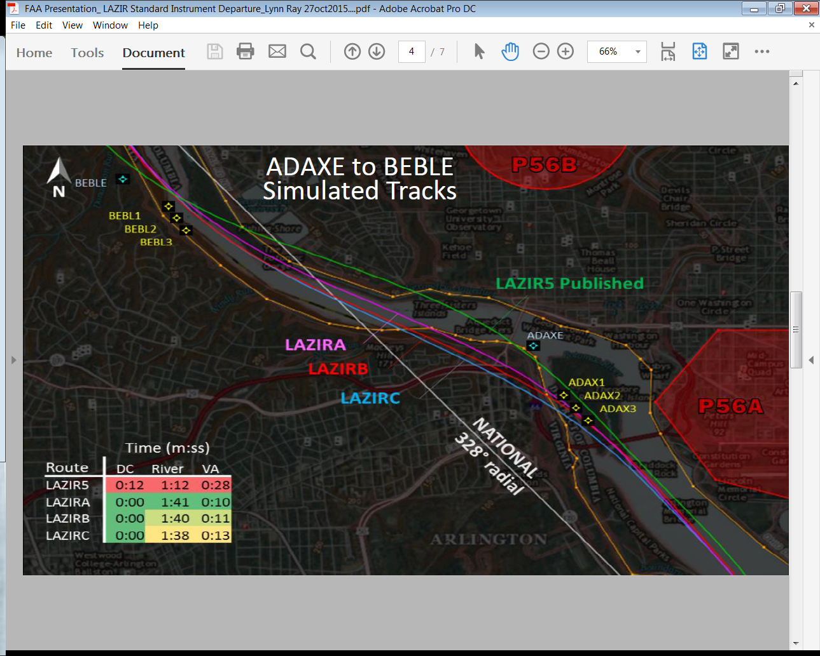
Capital Area Airspace: FAA Efforts, LAZIR-B

Slide 12
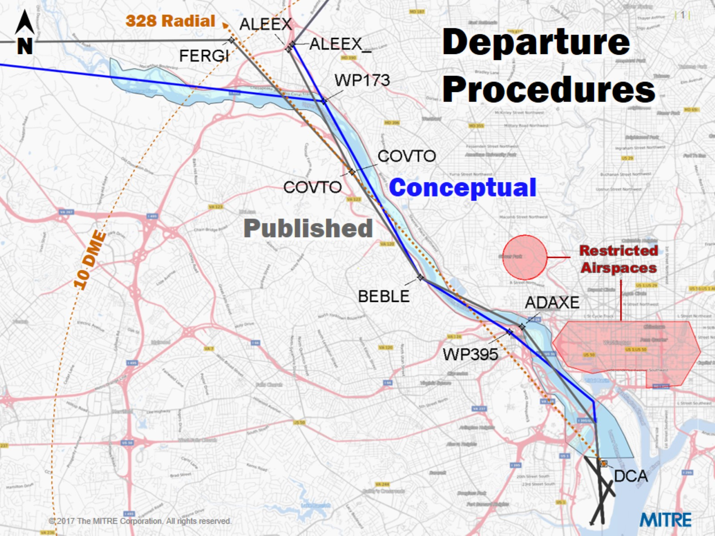
Capital Area Airspace: FAA Efforts, North Flow Departures
Most recently, the FAA presented this notional design with the idea of increasing time over water.
At this time, there is no agreement from the WG regarding the proposal.
The FAA is waiting for feedback from the WG before proceeding.

Slide 13
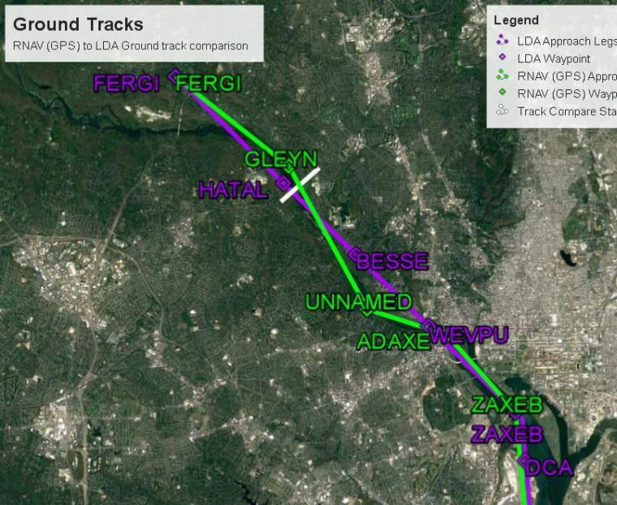
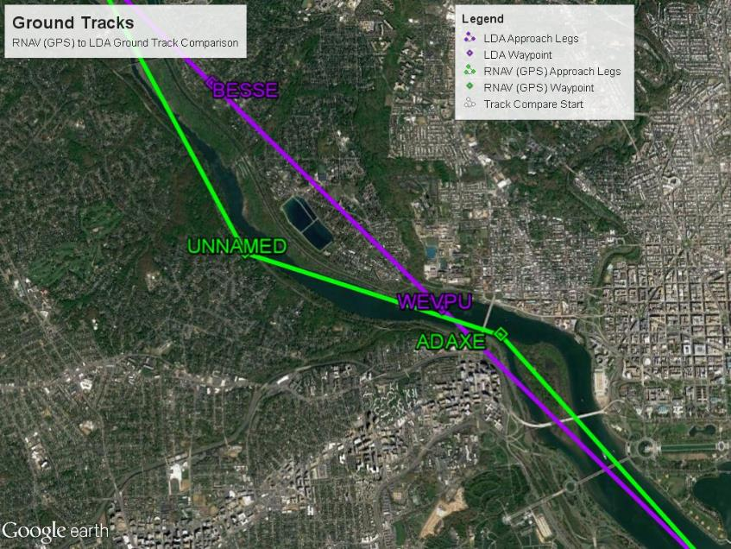
Capital Area Airspace: FAA Efforts, RNAV GPS 19 Arrival
Concept was to use advance technology to increase time over water
Purple is an existing procedure
Green is notional design
Full notional RNAV GPS 19
Cut-away to emphasize path over water

Slide 14
Capital Area Airspace: DCA Notional Designs

Slide 15
Capital Area Airspace Pros & Cons of Notional Designs
Honors DCA Working Group endorsement
Con
Creates a new departure flight path over an area that has not seen departure aircraft before
Consistent with goal to fly over water
Only modest noise reductions are expected for residents with existing concerns
Establishes collaborative relationship with the DCA Working Group
Pro

Slide 16
Additional Requested Changes
BWI
TERPZ: Community’s desire to disperse tracks
33L Arrivals: Concerns about aircraft direct SPLAT
IAD
Approval of Triple Simultaneous Approaches

Slide 17
Potential Changes: BWI Concepts

Slide 18
Potential Changes: BWI Concepts

Slide 19
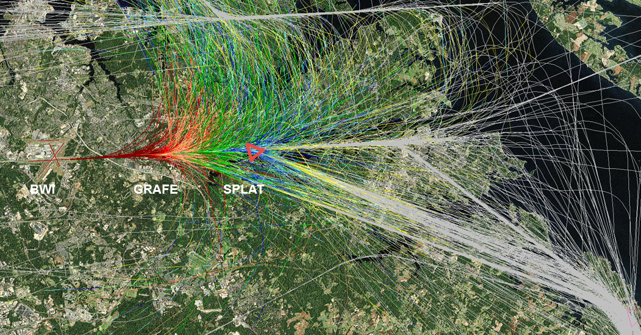
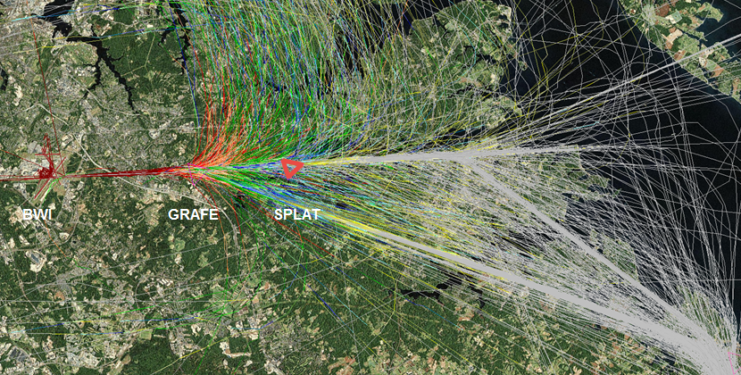
Potential Changes: BWI Concepts

Slide 20
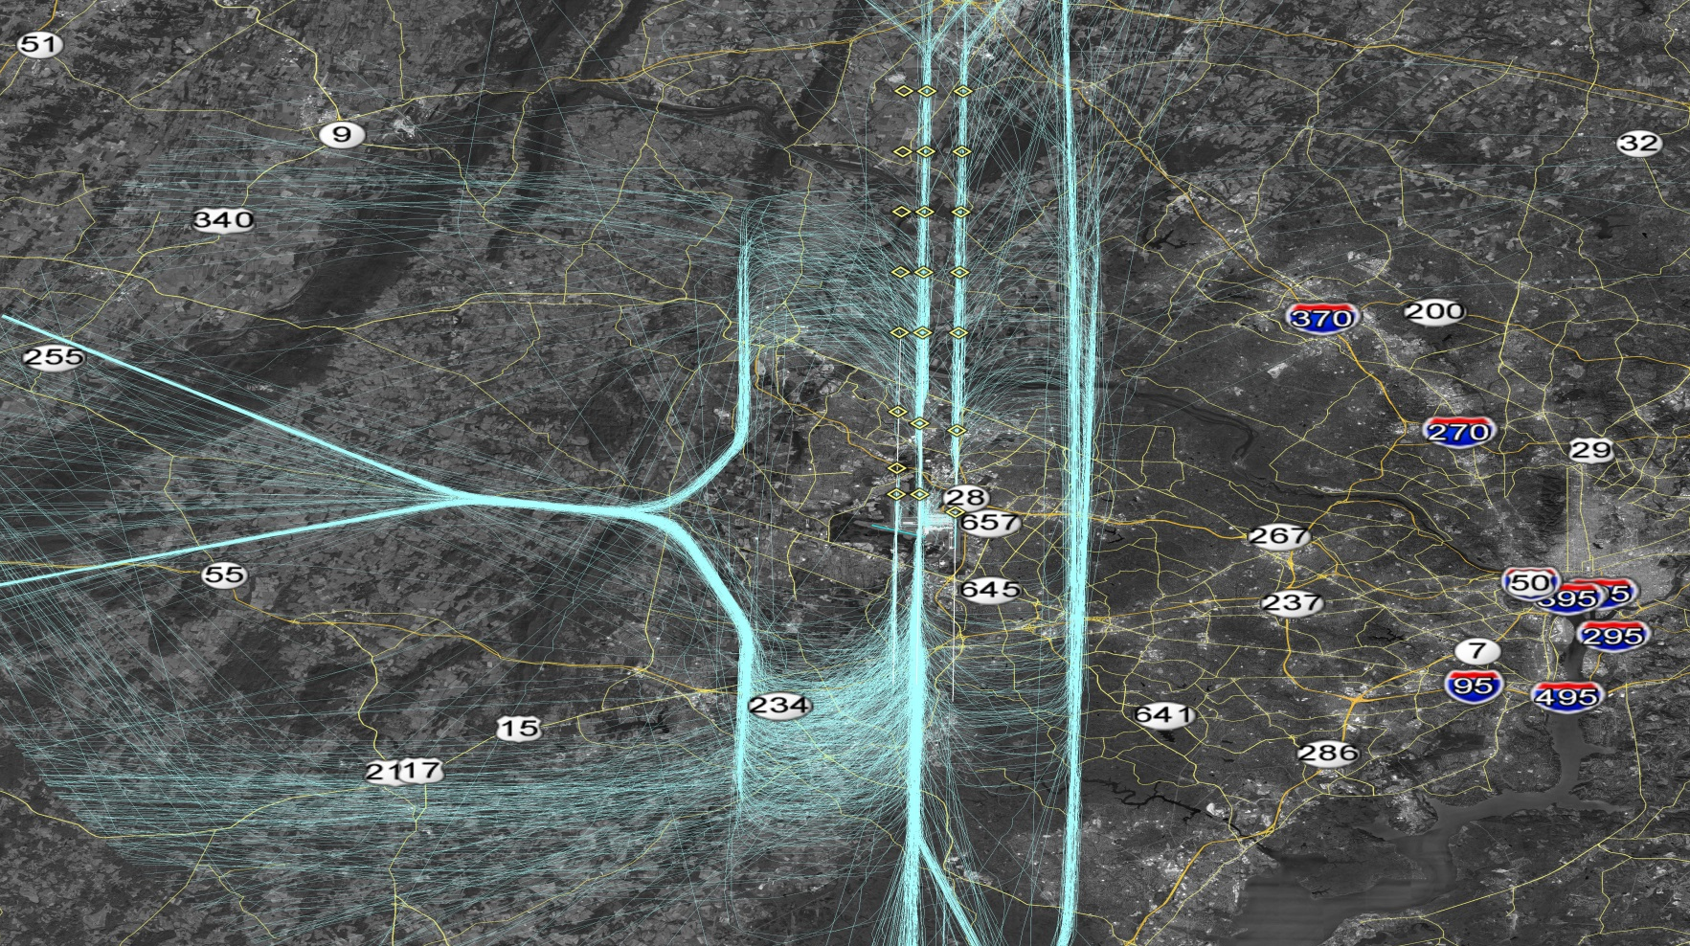
Potential Changes: IAD Concept
Triple Simultaneous Independent Instrument Approach Procedures (IAPs)

Slide 21
Capital Area Airspace: Re-cap
Overview of District of Columbia (DC) Airspace
Community Outreach
Public Concerns FAA Has Been Asked to Address
The Role of the FAA
Capital Area Airspace: FAA Update

Slide 22
Questions?

