Slide 1
Environmental Process for MSP Arrival Procedure Amendments September 21, 2016

Slide 2
Agenda
National Environmental Policy Act (NEPA)
FAA environmental process
Process and status of environmental review for arrival procedure amendments

Slide 3
National Environmental Policy Act (NEPA)
Broad national policy to protect and enhance the quality of the human environment
Requires Federal agencies to assess the environmental impacts of their proposed actions prior to finalizing decisions
Requires Federal agencies adopt their own procedures to supplement the regulations

Slide 4
FAA Environmental Policy
FAA Order 1050.1F Environmental Impacts: Policies and Procedures
Order 7400.2K Procedures for Handling Airspace Matters
Describes how the FAA is to implement NEPA specifically for FAA actions
Defines impact categories that require analysis
Sets thresholds of significant levels

Slide 5
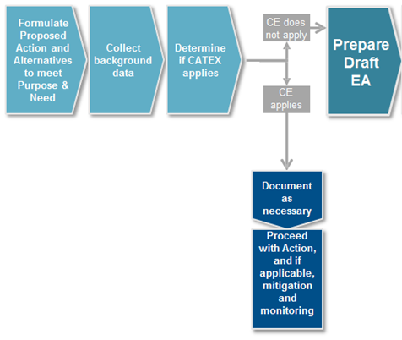
Typical Environmental Process

Slide 6
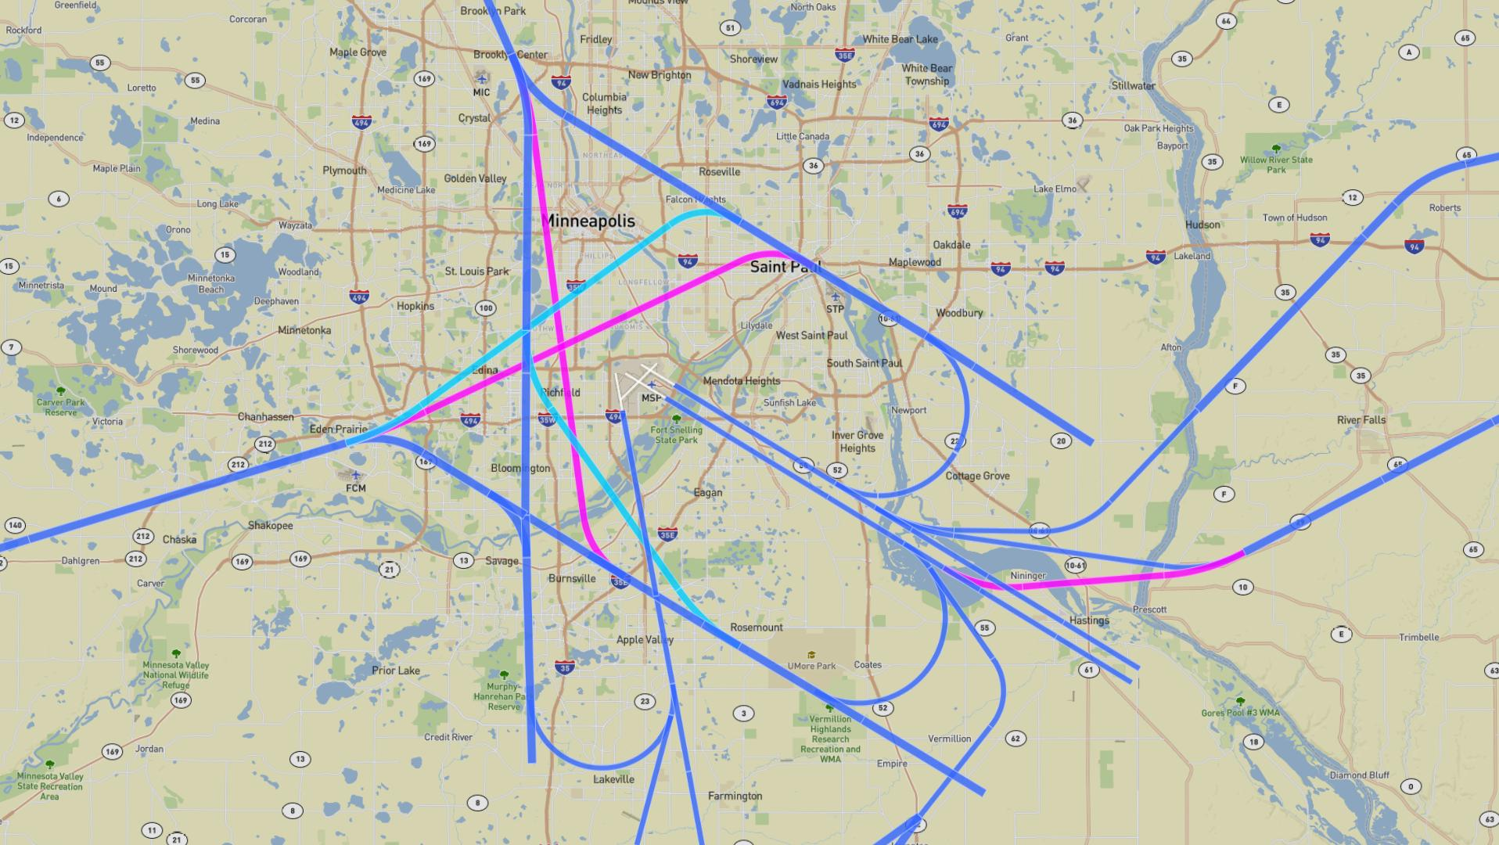
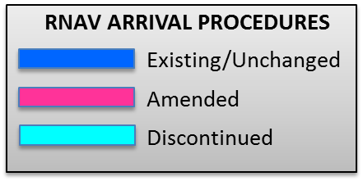
MSP Arrival Procedure Amendments

Slide 7
Environmental Review
Air Traffic Initial Environmental Review (IER)
Appendix 5 from Order 7400.2K
Considers Extraordinary Circumstances
Ensures NEPA compliance
Noise Screen
Looks at the possible change in noise from current conditions

Slide 8
Noise Screen Methodology
28 days of radar track data were selected for the MSP analysis
June 14 -20, 2015 October 18 - 24, 2015 December 13 - 19, 2015 March 13 - 19, 2016
Aircraft fleet mix
Day/night traffic ratios
Lowest point of an altitude range was used

Slide 9
Noise Screen Methodology
Aviation Environmental Design Tool (AEDT)
Baseline and Alternative tracks are run for comparison
Produces three outputs
Baseline noise exposure
Alternative noise exposure
Noise impact

Slide 10
Environmental Findings
Completed the IER and Noise Screen
No extraordinary circumstances identified
No significant or reportable noise identified
Significant if 1.5 dB increase at the DNL 65 dB noise exposure level
Qualifies for a CatEx under 5-6.5 i
Air traffic control procedures conducted at or above 3,000 feet AGL

Slide 11
Final Environmental Steps
Categorical Exclusion package sent to Central Service Center for signature by the Director
Available to the public

Slide 12
Thank you!

