Slide 1
ATO Cyber Day
ACG Cyber Tools

Slide 2
Cyber Tools Team, AJW-B4
Mission Statement
Enable stakeholders to make risk-informed cybersecurity decisions by automating all cybersecurity processes and functions and creating a data driven framework
Tools function
Automate all other cybersecurity processes and functions including but not limited to cyber security risk assessment, authorization documents, authorization workflows, POAM management etc.
Create a data driven framework for all tools to ensure objective and repeatable cybersecurity assessments

Slide 3
NORA Overview

Slide 4
NORA: Standardized Measurement

Slide 5
NORA Benefits to Stakeholders

Slide 6
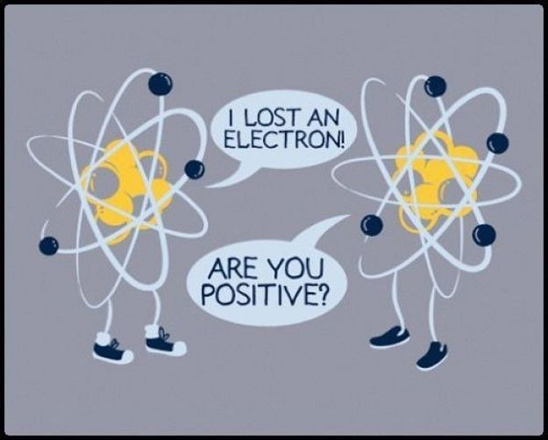
Authority to Operate Automation Module (ATOM)
ACG Cyber Tools: Authorization Management

Slide 7
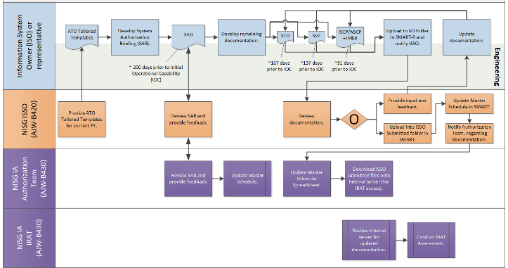
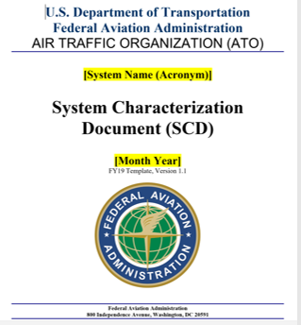
ATOM
Authorization Process/Workflow Automation
Authorization Documentation Automation/Digitization (SCD, ISCP, NSCP)
Support data calls

