Slide 1
FAA PAVEAIR Update
RPD 143

Slide 2
Nondestructive Airport Pavement Testing
(RPD 143)
Contract Funds ($K)

Slide 3
FAA PAVEAIR Status
January-June 2013 Visits: 1.1 Million
Databases Created since release: > 400
Some databases have a large number of airports, such as Utah, Wyoming.
Registered Users since release: 942
Received several request to use the FAA PAVEAIR program, such as South Africa.

Slide 4
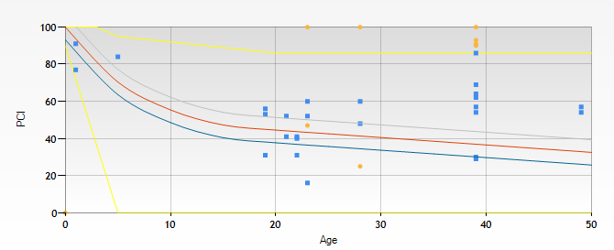
Prediction Modeling
• Assign pavement sections with similar construction and traffic patterns into a family model
Plot PCI deterioration curve
Prediction Modeling Library (Feb 2014)

Slide 5
Prediction Modeling Planned Updates
Support multiple databases - done
Update the curve fitting algorithm for better result
Create an algorithm to calculate Critical PCI from the family curve
Better support of the 40 year life project

Slide 6
Climate Module and Traffic Module
Investigate adding Traffic and Climate Module:
Currently FAA PAVEAIR uses Distresses for PCI calculation, Prediction, and M&R
Distresses are caused by Climate, or Traffic, but Climate and Traffic data is not used in PCI, Prediction and M&R
Investigate feasibility of directly using Traffic and Climate data in PAVEAIR calculation

Slide 7
Improve Life Cycle Cost Analysis
Review of FAA PAVEAIR / AirCost by an Engineering Economist
Elaborate on key elements of LCCA for both asphalt and concrete paving materials
Comparison with other LCCA programs / algorithms
Elaborate on issues, differences, and problems / deficiencies
Report of findings and proposal for further development
Users Group meeting to review and discuss

Slide 8
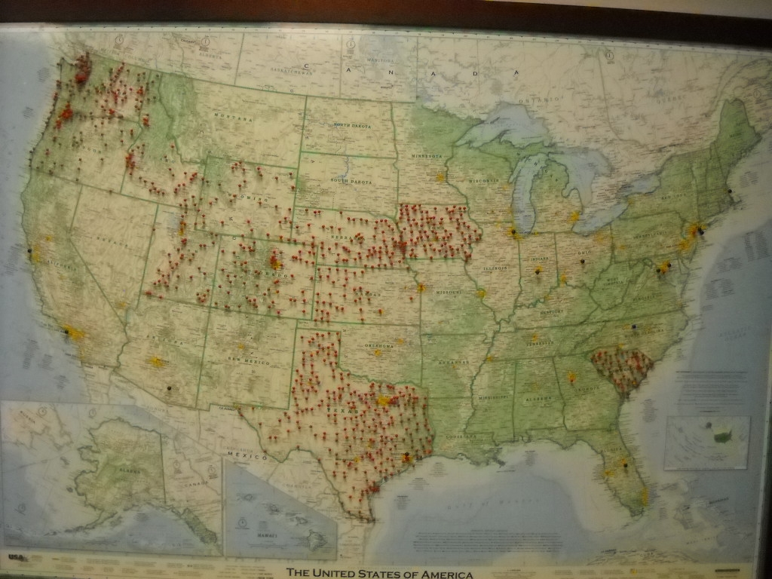
Airport Database Locations

Slide 9
Add Materials, Construction, and Cost Functions to FAA PAVEAIR
Collect airport pavement inventory, thicknesses, inspection, and work history data.
Also collect material type, material unit costs, M & R strategies, and traffic and climate considerations.
The intent is to create and populate a database repository of US airport pavements.

Slide 10
Add Materials, Construction, and Cost Functions to FAA PAVEAIR
In conjunction with the traffic and climate feasibility studies, the data repository will allow users to create pavement families for Prediction Modeling.
Follow on work will include design of Data Warehouses for data reporting and data mining and analysis.

Slide 11
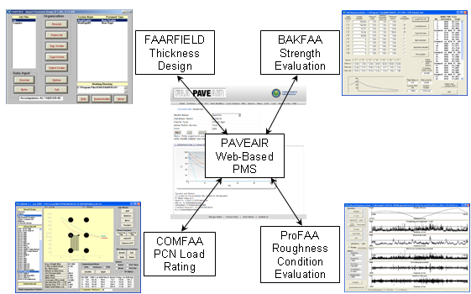
FAA Software Integration

Slide 12
Software Integration
Use FAA PAVEAIR as the data center for software integration
Data format agreement between FAA programs
Receive data from FAA Pavement Programs, such as COMFAA, FAARFIELD
Exchange calculated data between FAA programs

Slide 13
Pavement Software Conversions
Upgrade Visual Basic (VB6) to modern Windows Presentation Foundation (WPF)
Ensure compatibility with latest Microsoft Windows OS
All FAA applications to be run using the same technology
Prepare for future data sharing between applications
All source code under source control
Change logs

Slide 14
COMFAA Conversion
Second FAA pavement program to be converted
Same functionality
Similar interface
Interface design (XAML) kept as close to the original as possible
Works on all versions of Windows since XP, including Windows 8
Works on 32bit and 64bit OS

Slide 15
Software Conversion Status
BAKFAA
FAARFIELD
FEAFAA
ProGroove
A WPF version of ProFAA already exists
Evaluate differences between VB6 version and WPF version
Review ProVAL application

