Slide 1
RPD 134 NLA
RPD 140 COMPOSITES
RPD 152 ARFF
REDAC Briefing
September 10, 2013

Slide 2
ARFF Research Reports
Published Reports Since Last REDAC:
ARFF Strategies and Tactical Considerations for New Large Aircraft
Computational Flame Characterization of New Large Aircraft Immersed in Hydrocarbon Pool Fires
Development of Prototype Nozzles for Freighter Aircraft Fire Applications
Full-scale Evaluation of ARFF Tactics For Cargo Fires On Freighter Aircraft

Slide 3
ARFF Research Reports
Reports in Editing Cycle:
Characterization of the Flammability and Thermal Decomposition Properties of Aircraft Skin Composite Materials and Combustible Surrogates
Weight And Balance Behavior of a Freighter Aircraft During Cargo Fire Test Evaluations

Slide 4
ARFF Research Reports
Draft Reports Under Review:
Literature Review of Alternative Fuels in the Airport Environment and Their Impact on Aircraft Rescue and Firefighting Services
Development of A Firefighting Agent Application Test Protocol For Aircraft Fuselage Composites, Phase I – Glare
Penetration Study of Aluminum, GLARE and CFRP Panels
Experimental Flow Characterization and Computational Model Development of Aqueous Film-Forming Foam (AFFF) Firefighting Jets

Slide 5
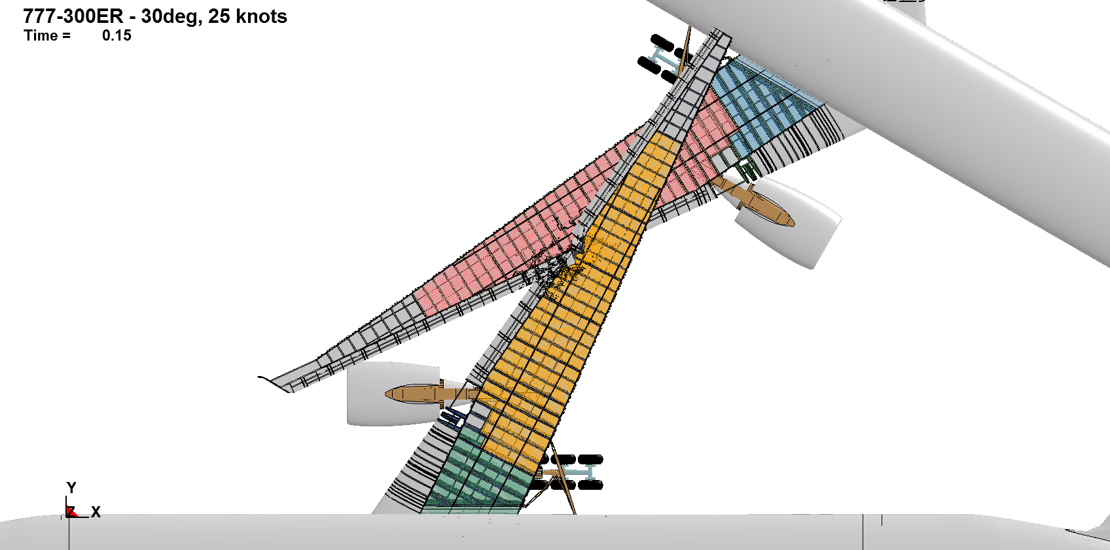
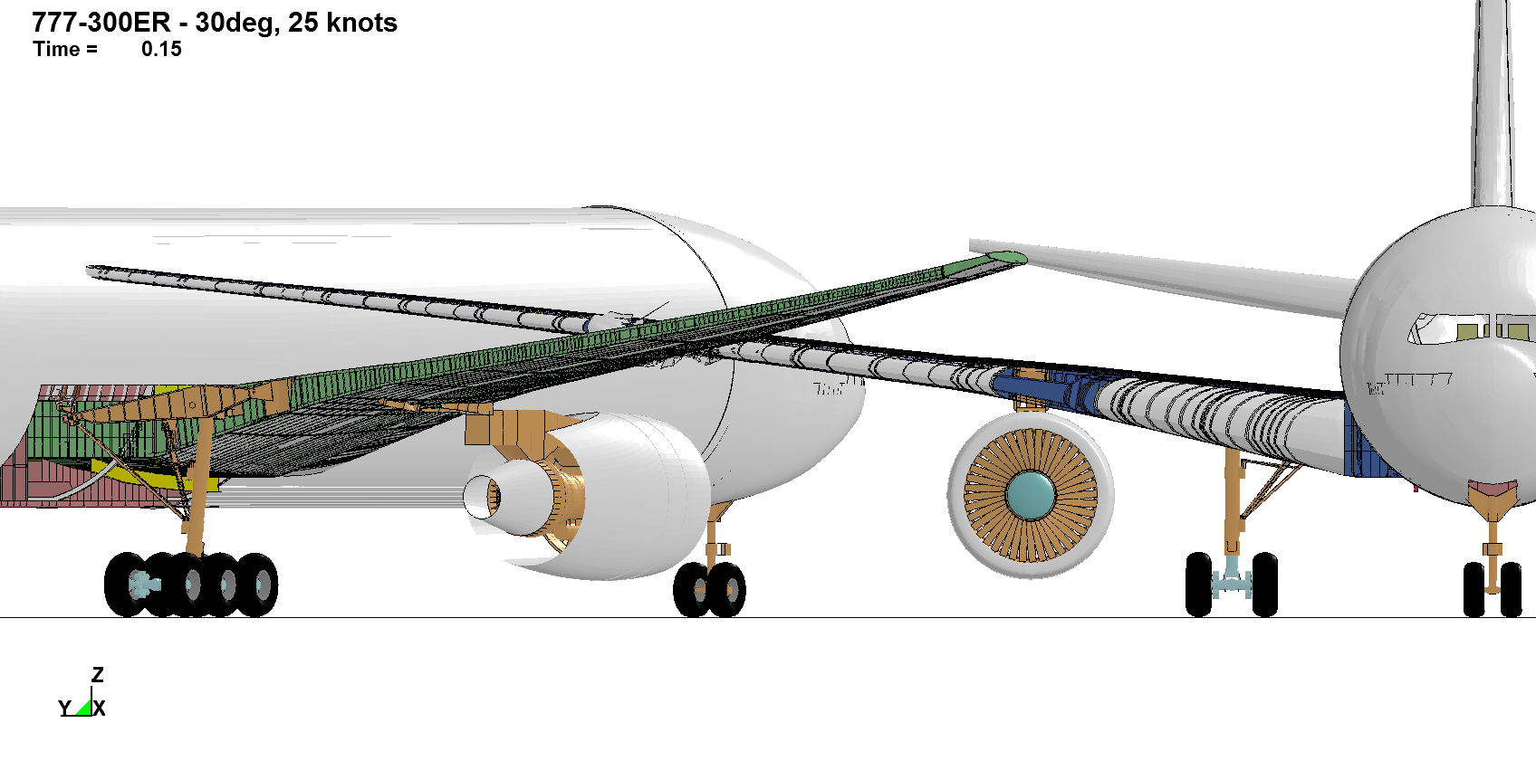
Crash Simulation of Transport Aircraft for Predicting Fuel Release

Slide 6
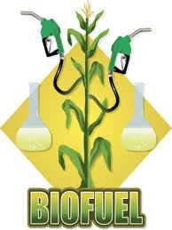
Aviation Bio-Fuel Fire Fighting Research
Do biofuels present any differences to the airport firefighting tactics, strategies, agents or equipment over petroleum based fuels?
Literature review being expanded and due October 2013.
Fire testing of fuels to begin in Late 2013.

Slide 7
Aviation Bio-Fuel Fire Fighting Research
Currently, there are two alternative jet fuel processes that have been approved by ASTM and are being used by airliners: Fischer-Tropsch Synthesis (FTS) and Hydroprocessed Esters and Fatty Acids (HEFA).
Both processes create Synthetic Paraffinic Kerosene (SPK) fuels.
USN and AFRL tests concluded that SPK fuels did not present a significant difference in the amount of agent used to extinguish a fire involving SPK.
The AFRL tests did show the some SPK fuel fires had higher heat flux values than Jet A fuels.
SPK fuel fire test from the French Department of Defense showed that some SPK did show faster burnthrough times when evaluating them using the NextGen Burner.

Slide 8
Aviation Bio-Fuel Fire Fighting Research
The alternative fuels that are being integrated into GSE vehicles are green diesel, biodiesel, liquid petroleum gas (LPG), compressed natural gas (CNG), and electricity.
Biodiesel has been known to self-combust out in the sunlight and because of its solvent behavior, biodiesel could cause leaks in storage tanks.
Fires near CNG and LPG storage tanks could pose the threat of a boiling expanding vapor explosion (BLEVE).

Slide 9
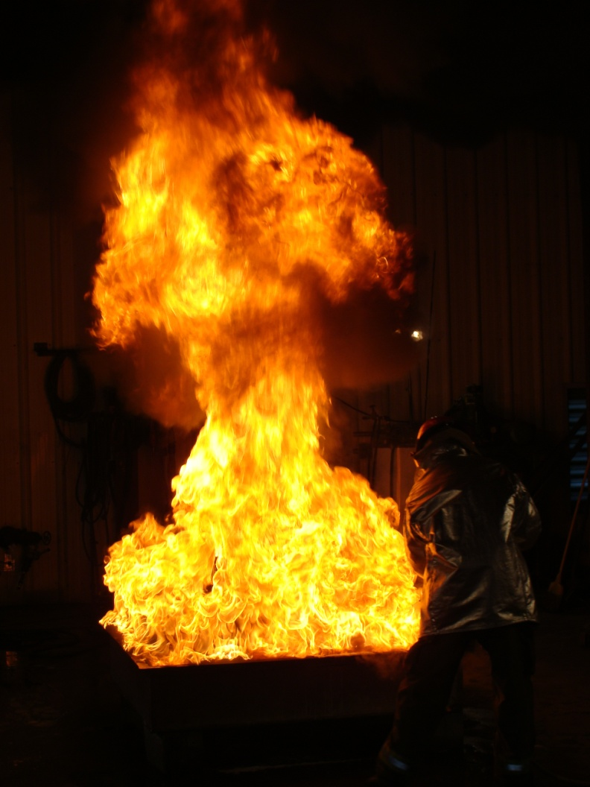
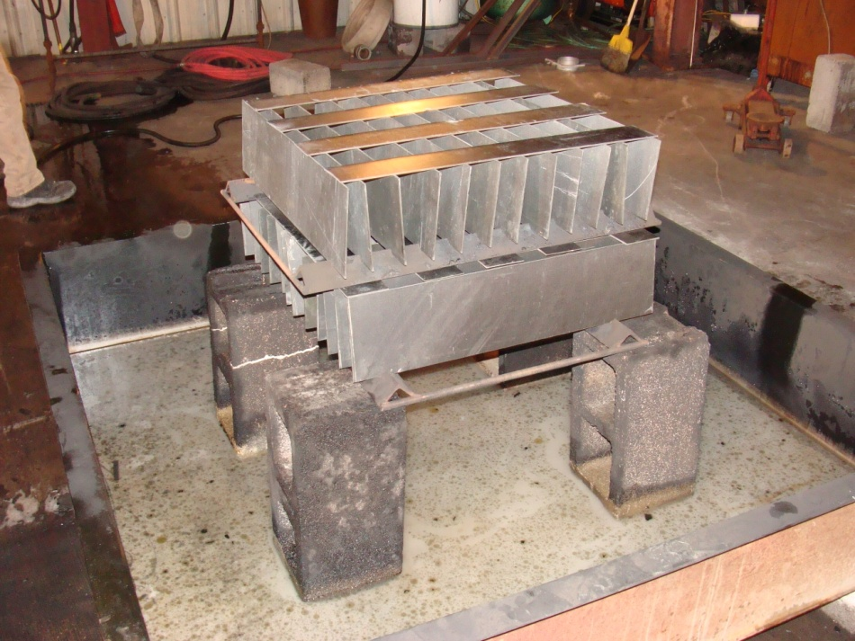
Complex Geometries – Crib Design

Slide 10
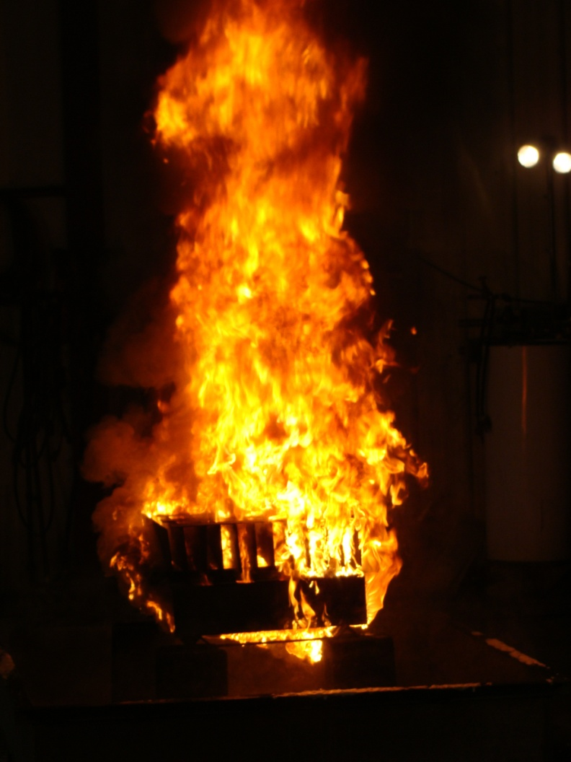
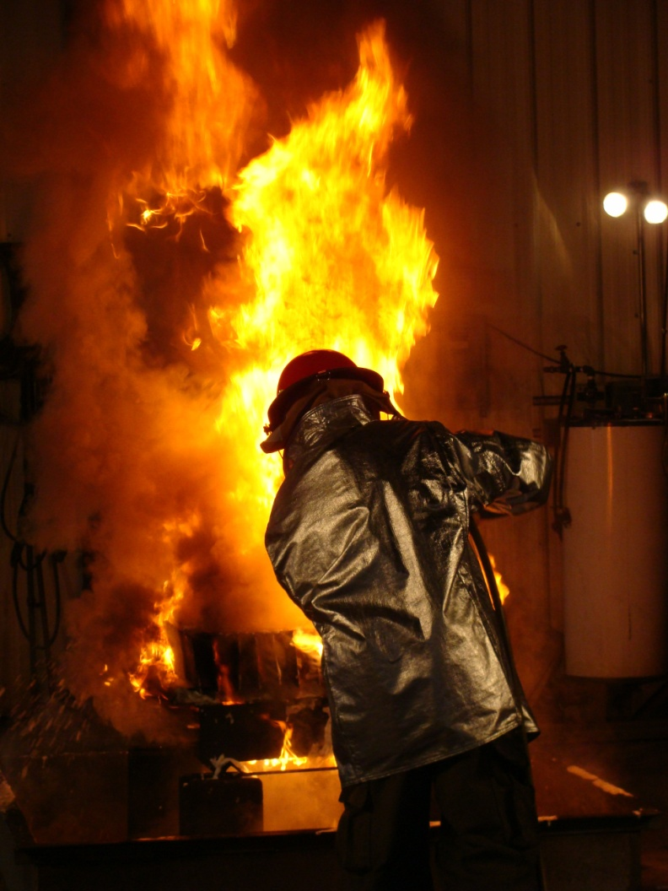
Complex Geometries – Crib Design

Slide 11
Composite Material Fire Fighting
The test methodology allowed the distinction of the relative burning characteristics of the materials.
GLARE material produced the smallest fire (lowest HRR) while the FRP produced the largest (highest HRR). The Garolite also produced a small fire (low HRR) due to its high glass cloth content.
Additional testing using the draft test method will assess the repeatability of the results and begin the development of a database for future comparisons.
Larger scale tests would validate the conclusions developed from the intermediate scale results.

Slide 12
Penetration Study of Aluminum, GLARE and CFRP Panels

Slide 13
Penetration Study of Aluminum, GLARE and CFRP Panels
The forces required to penetrate the GLARE and CFRP laminates are 3.3 - 6.4 (median 4.5) times higher than the force required to penetrate 0.04-in.-thick aluminum panel under normal penetration.
The effect of loading rate was negligible.
These results were used for the formulation of damage models for the simulation of the penetration process up to panel breakthrough.

Slide 14
Experimental Flow Characterization
Provide a better understanding of the ARFF agent application process using experimental flow characterization methods in support of developing a CFD modeling strategy capable of predicting mean airborne ARFF jet flow characteristics.
Characterize the effect aqueous film-forming foam (AFFF) additives have with respect to water jets entering stagnant air in terms of measured spray velocity, overall droplet dynamics, and ground accumulation behavior.
Of particular interest was studying the effect varying pressure, flow rate, and AFFF concentration has on the ARFF jetting process.
Research efforts in this study were focused on analyzing the “in-flight” portion of ARFF jet flows up until initial contact with the ground is made.

Slide 15
Experimental Flow Characterization

Slide 16
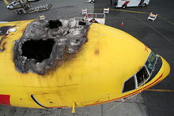
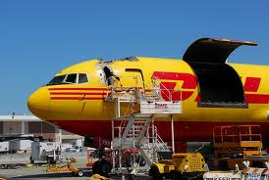
Freighter Aircraft Interior Fire Fighting
Cargo Liner Testing
Prototype Nozzle Development
Clean Agent Testing
Training Video Footage
Fuselage Breach
Aircraft Stability

Slide 17
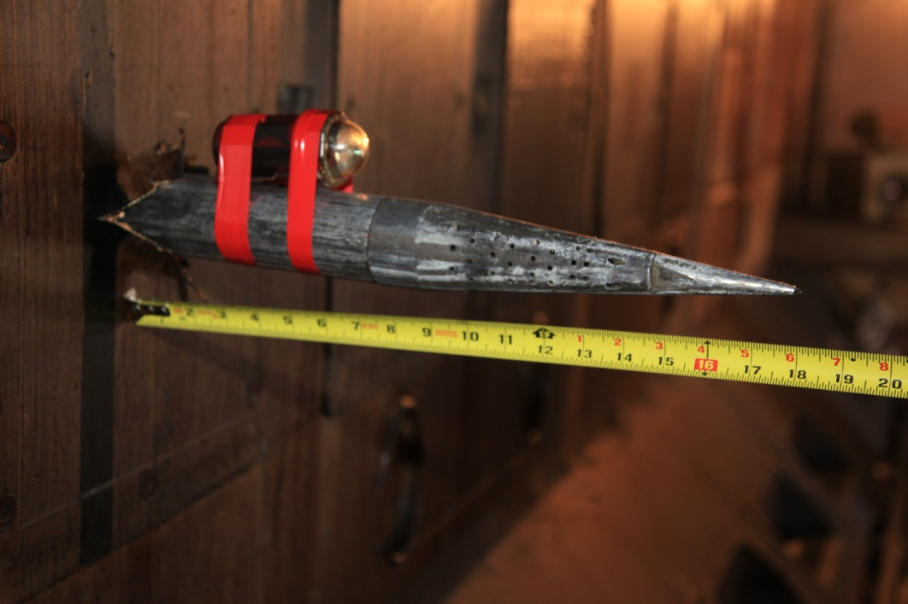
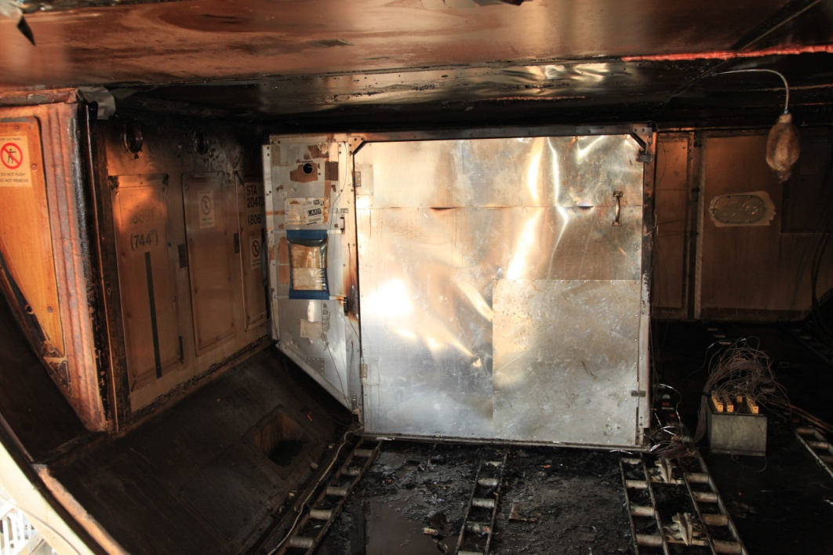
Clean Agent Tests
Using a Clean Agent (Halotron) in an indirect fire attack on LD3 container in lower cargo hold.

Slide 18
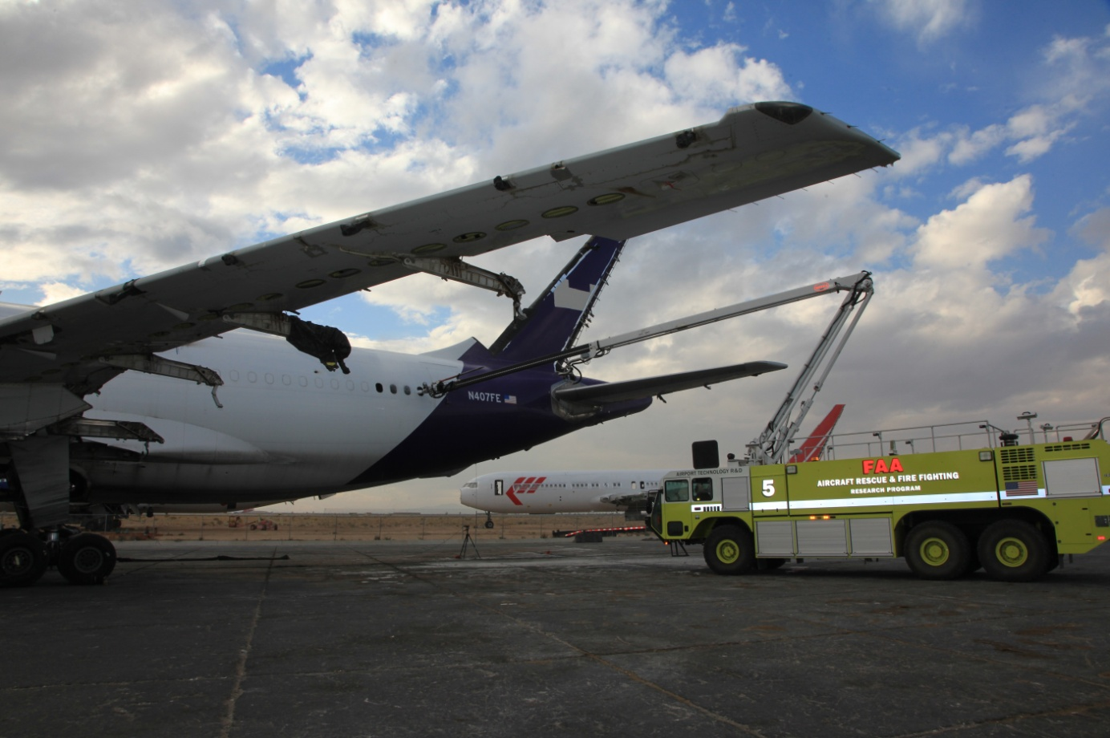
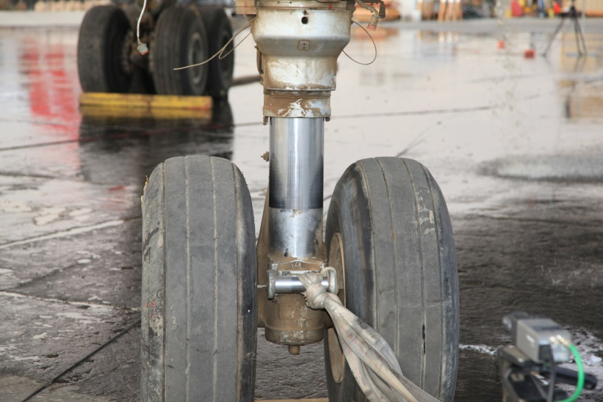
Weight And Balance Behavior of
Freighter Aircraft

Slide 19
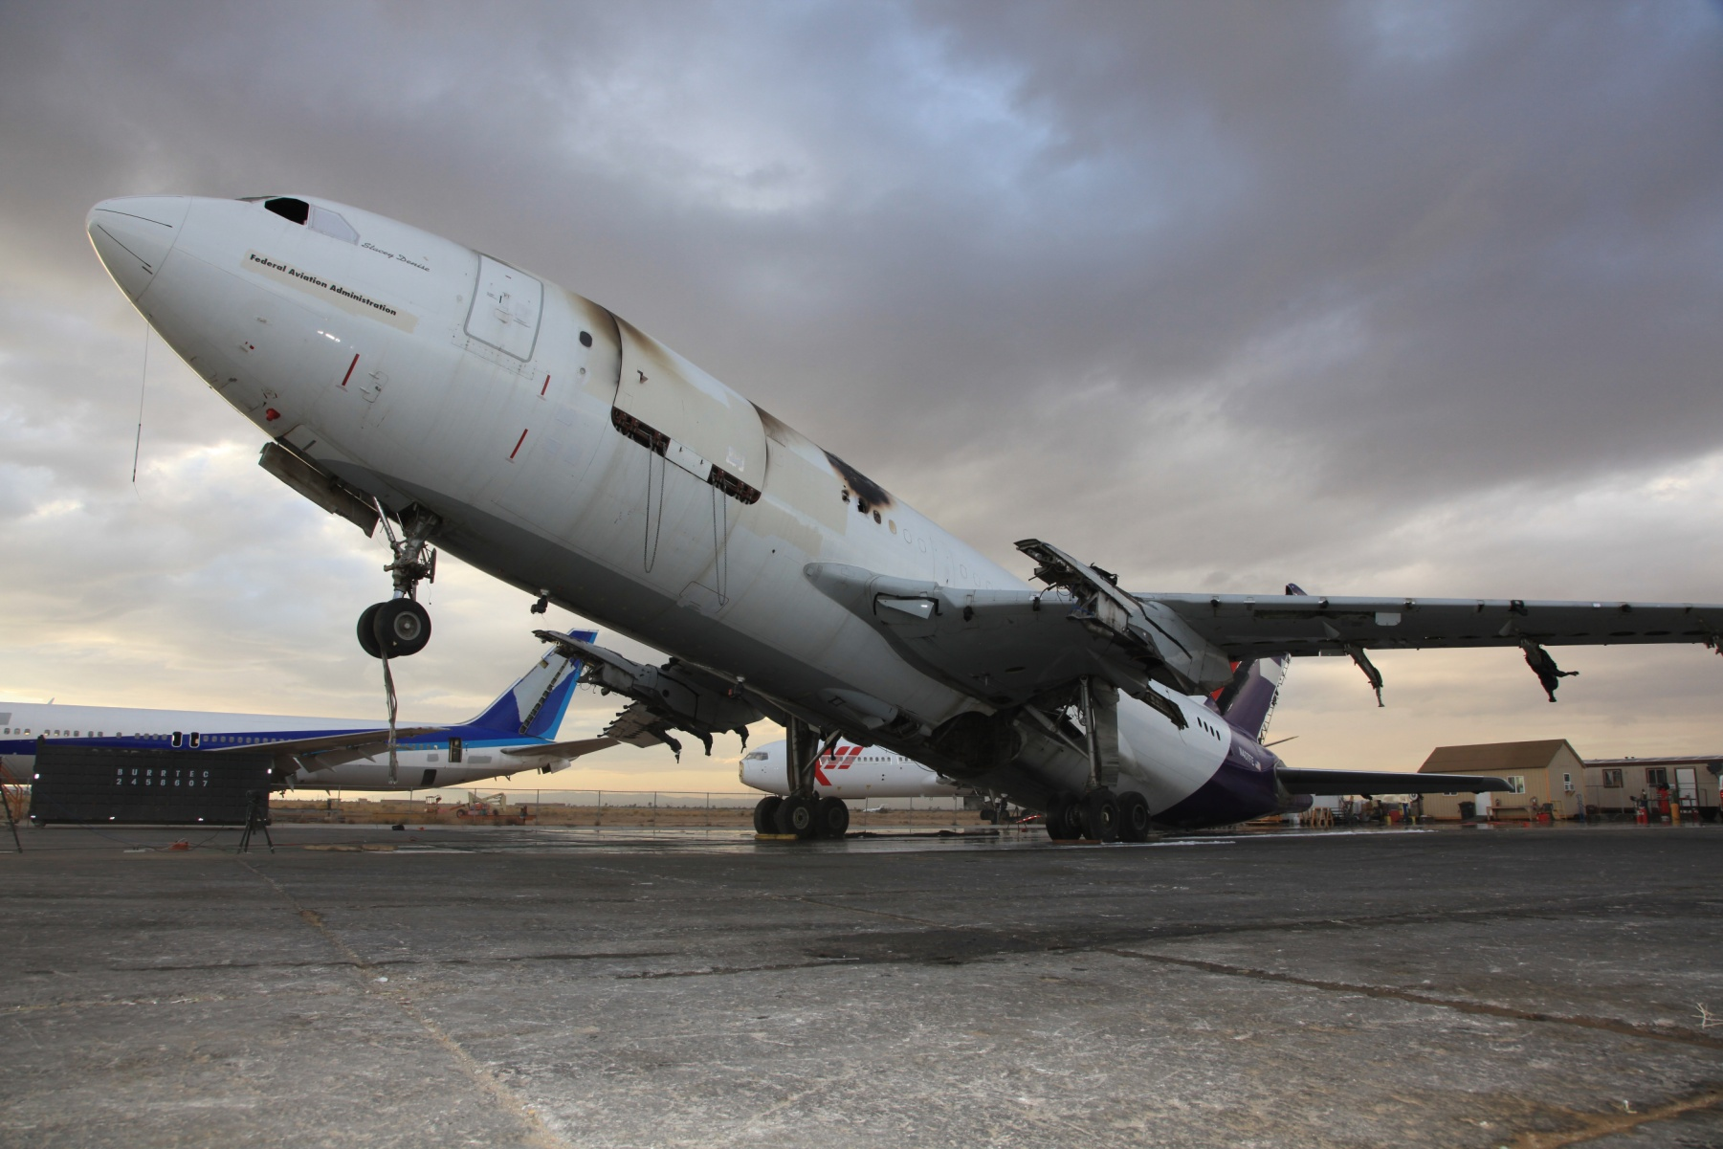
Weight And Balance Behavior of
Freighter Aircraft

Slide 20
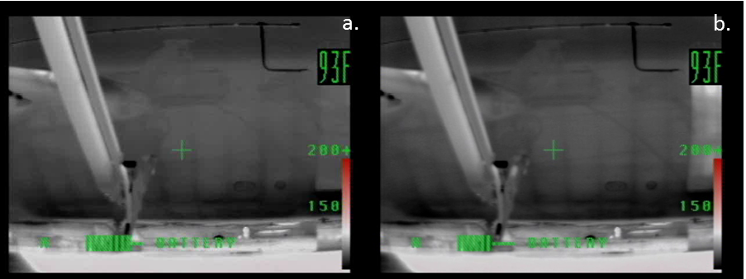
Thermal Imaging and FLIR

Slide 21
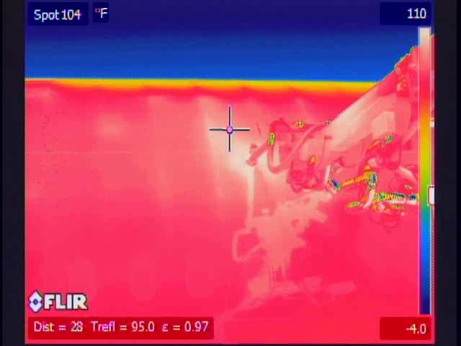
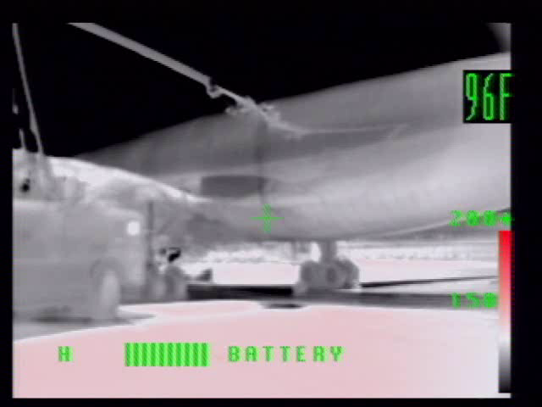
Thermal Imaging and FLIR

Slide 22
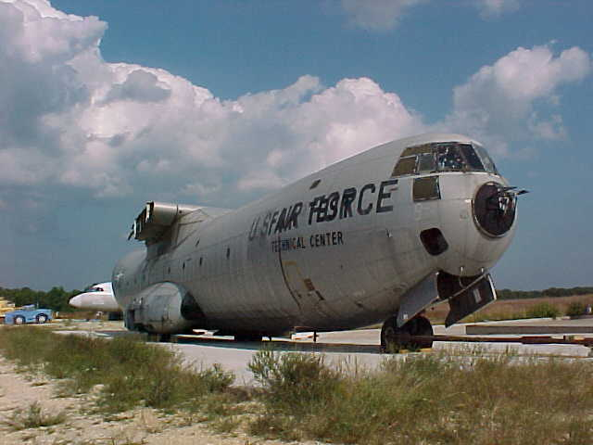
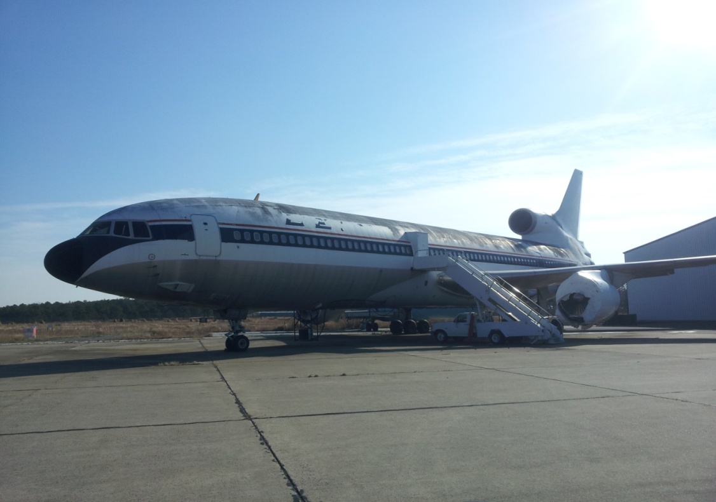
Fire Test Facility Upgrade
Doubled the size of the burn pad.
Updated test aircraft.

Slide 23
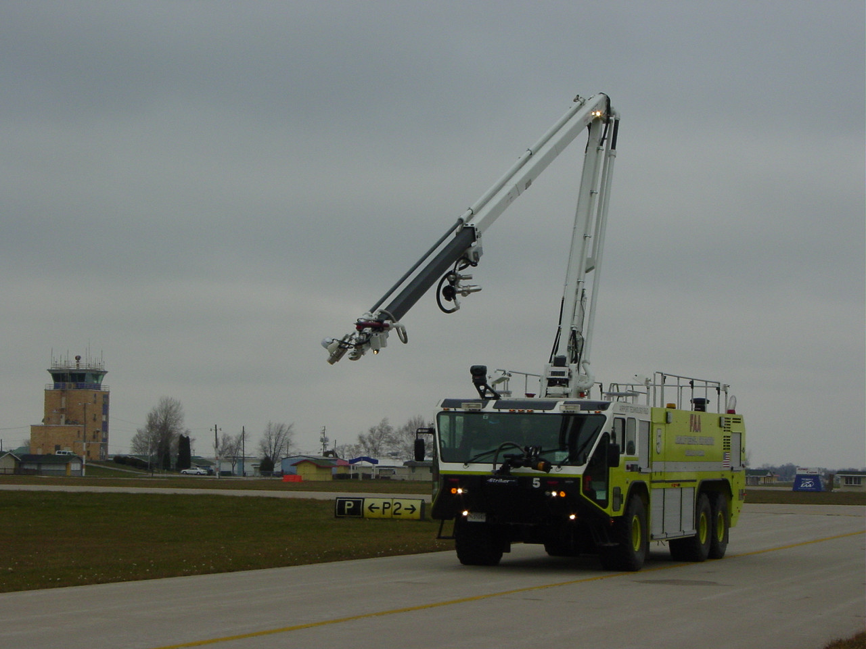
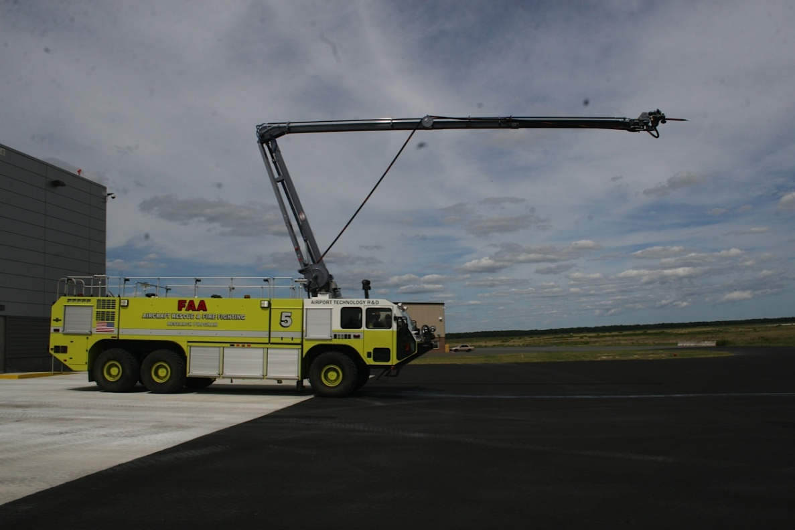
Snozzle Conversion
Updated Snozzle to new industry standards.

Slide 24
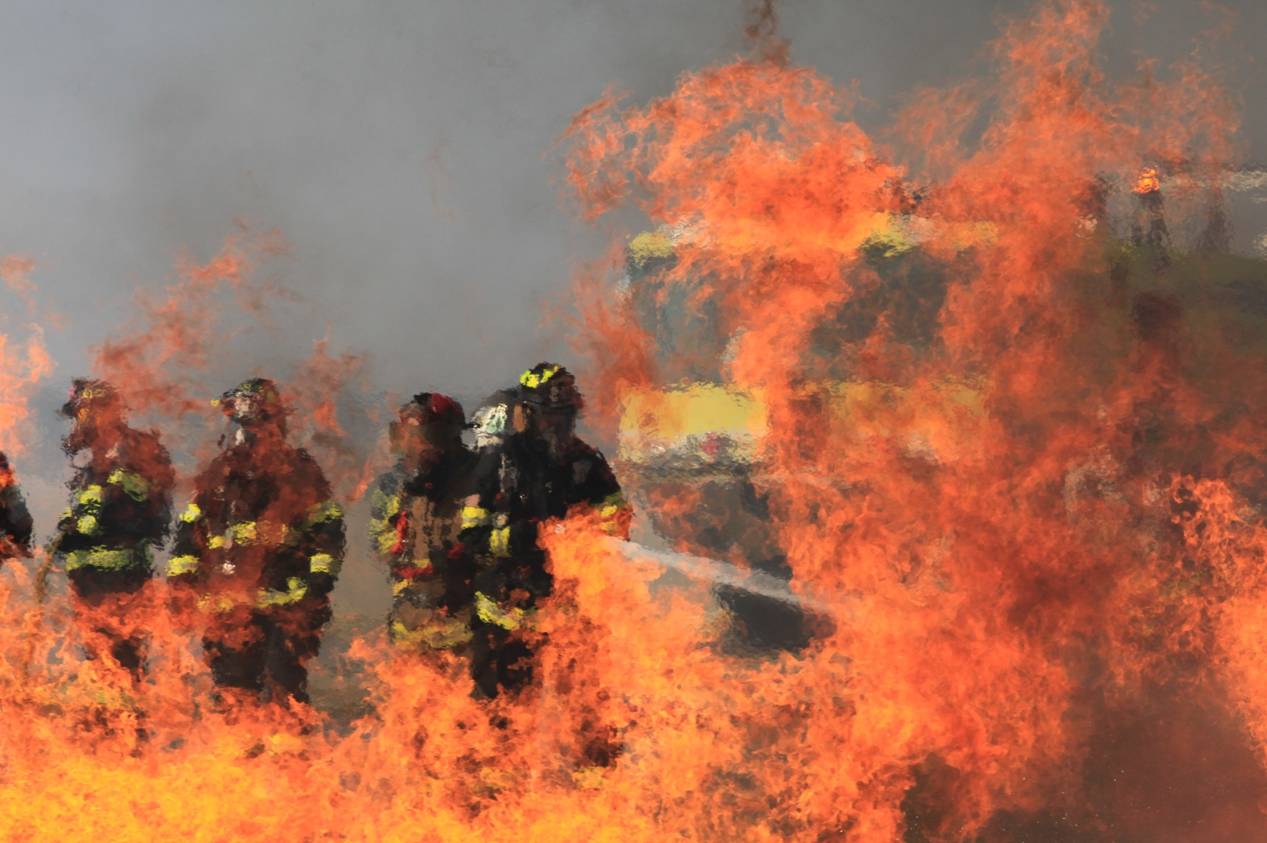
Questions?

