Slide 1
RPD-137
Field Instrumentation
Projects

Slide 2
FIELD INSTRUMENTATION AND TESTING
MAIN OBJECTIVE
  better understanding of long-term pavement behavior in the field under varied climatic and operating conditions, and
  improved characterization of paving materials.
  Improved pavement design and evaluation tools will conserve airport development funds and reduce the downtime of airfield pavements for construction and maintenance activities.

Slide 3
RPD – 137
Field Instrumentation projects –
  Continue data collection and analysis from
    Hartsfield-Jackson Atlanta International Airport, Atlanta, GA
    LaGuardia International Airport, New York City, NY
    JFK Intl. Airport, New York City, NY
    EWR Intl. Airport, Newark, NJ
  Denver International Airport Instrumentation project – Shut Down.

Slide 4
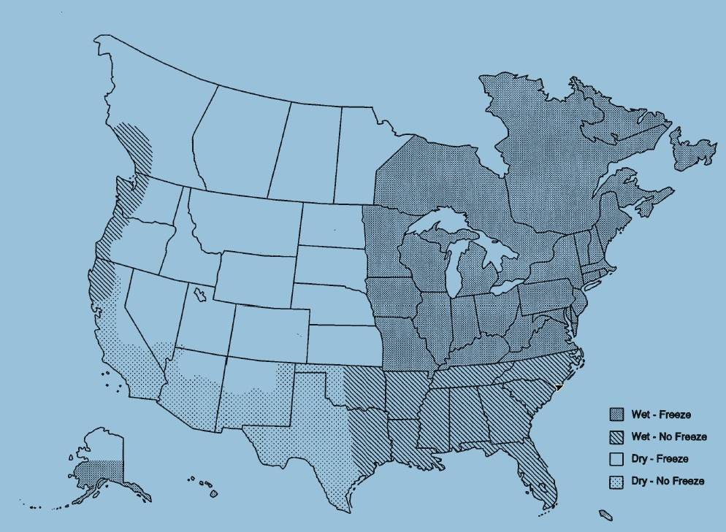
Current FAA Airport Instrumentation Projects
Newark Liberty International Airport, Newark – AC Overlay Pavement
JFK International Airport, NYC – PCC Pavement
Denver International Airport, Denver – PCC Pavement
LaGuardia Airport, NYC – AC Overlay Pavement
Hartsfield Jackson Atlanta International Airport – PCC Pavement

Slide 5
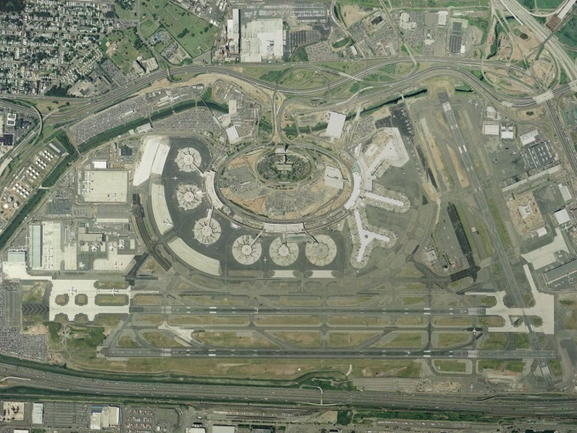


Slide 6
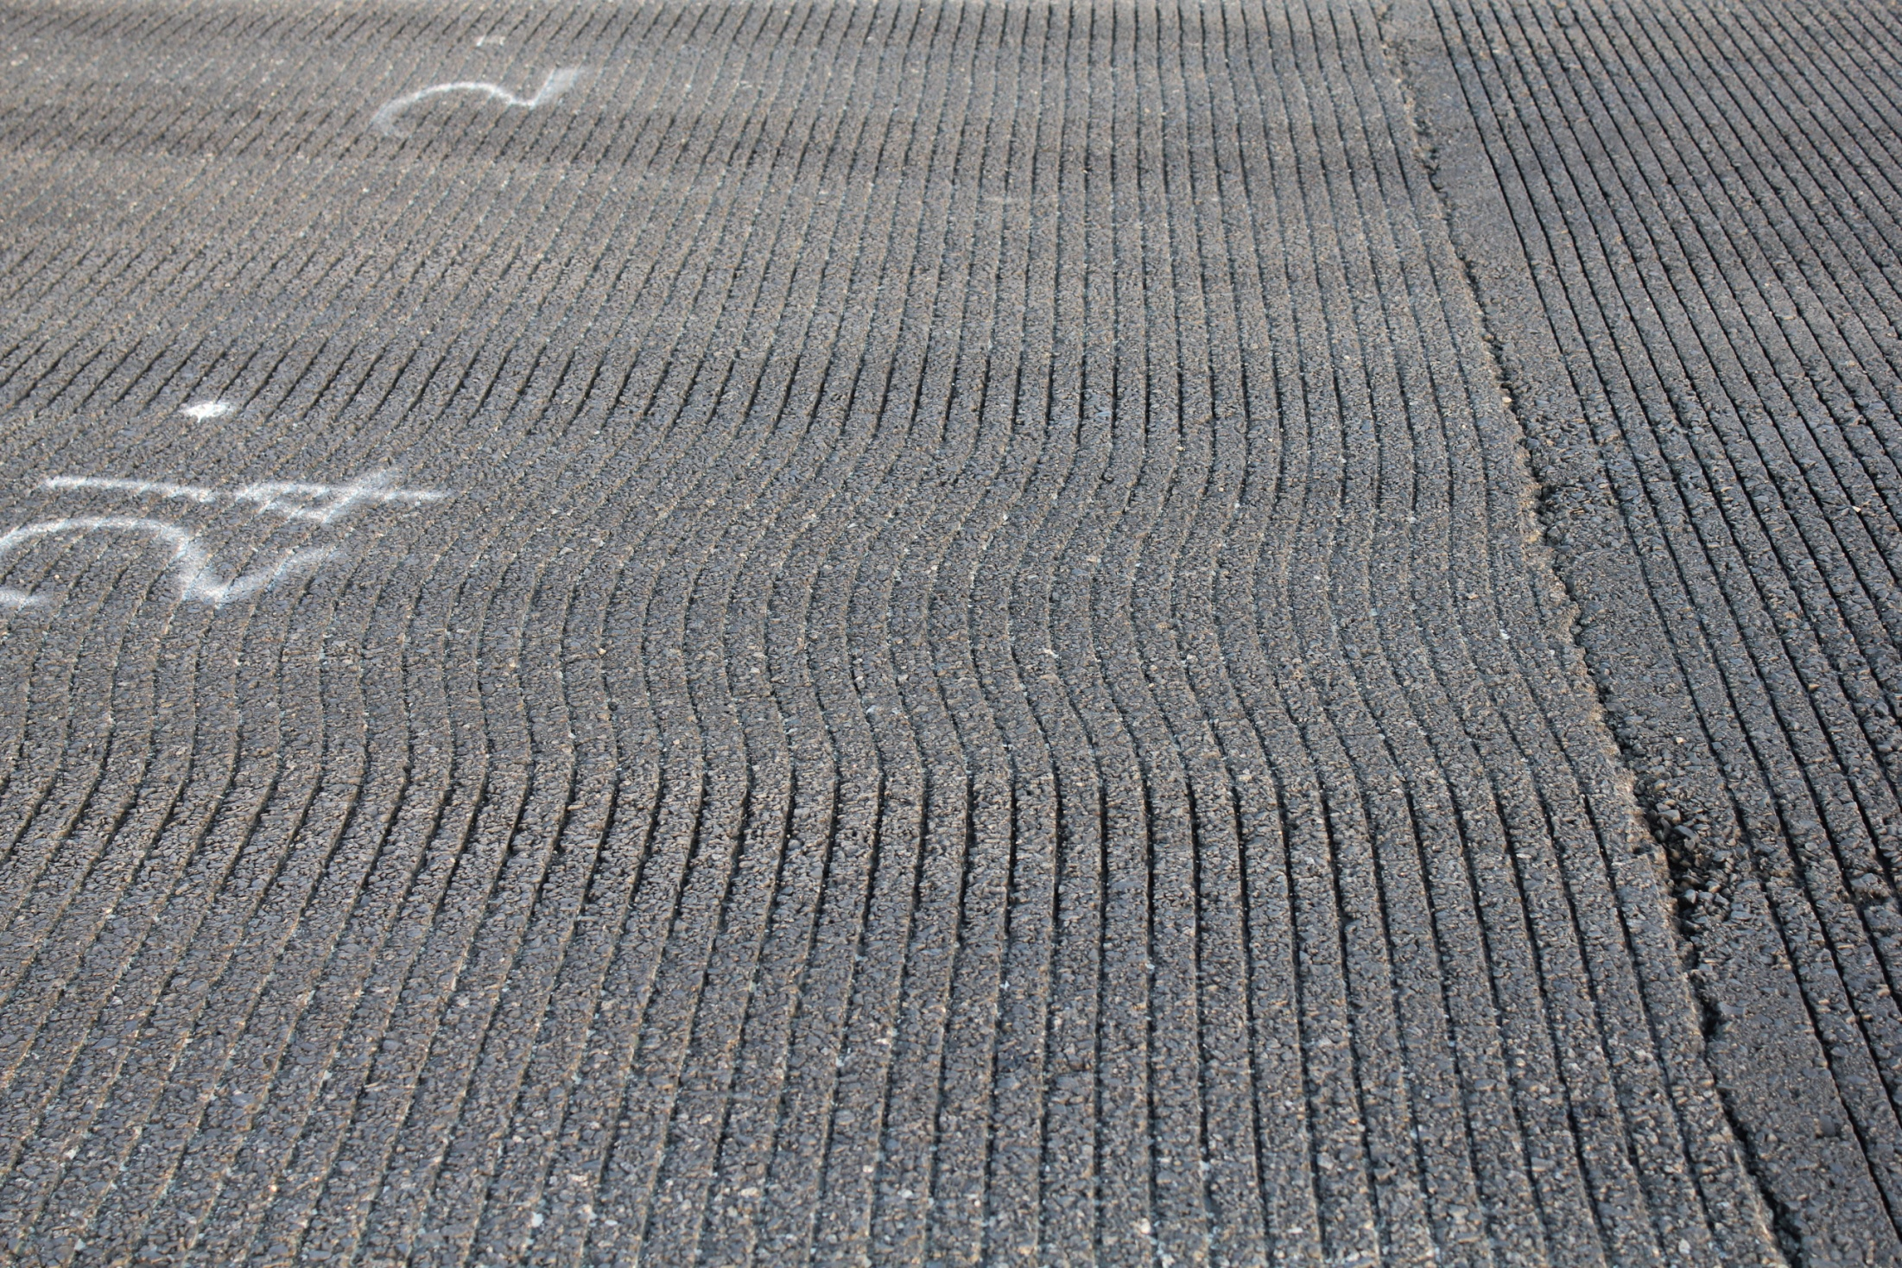

Slide 7
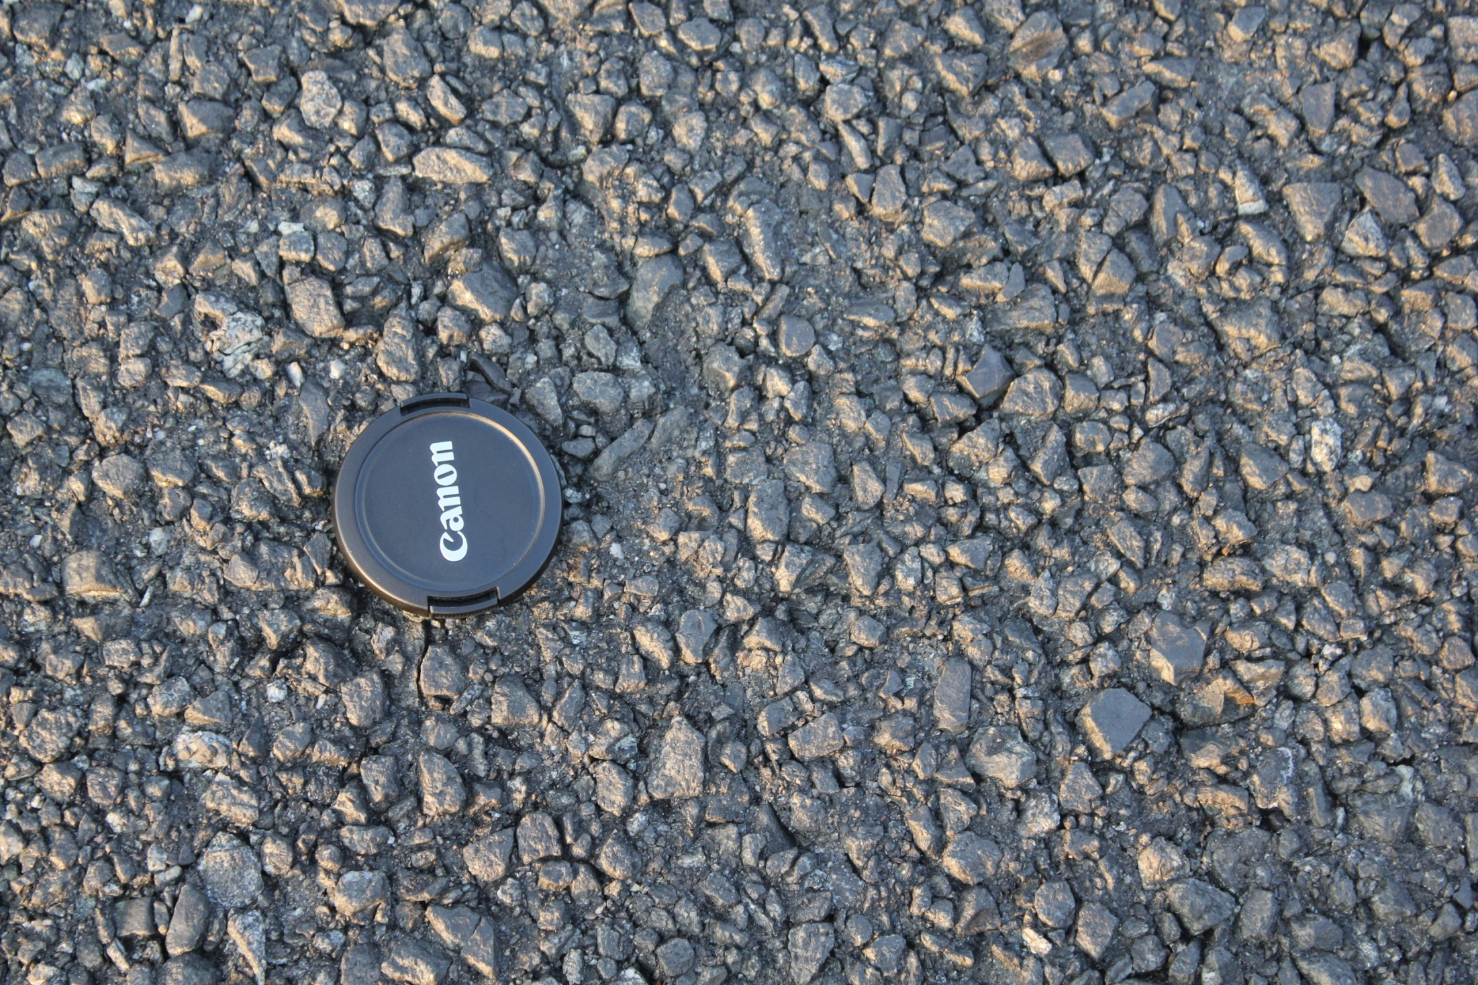

Slide 8
OBJECTIVE
Study slippage failures on Runway 4R-22L at EWR.

Slide 9
FIELD INSTRUMENTATION
Type of data collected:
- Pavement & air temperatures.
- HMA strains
- Top of milled surface
- Bottom of HMA Overlay
- Transverse and Longitudinal

Slide 10
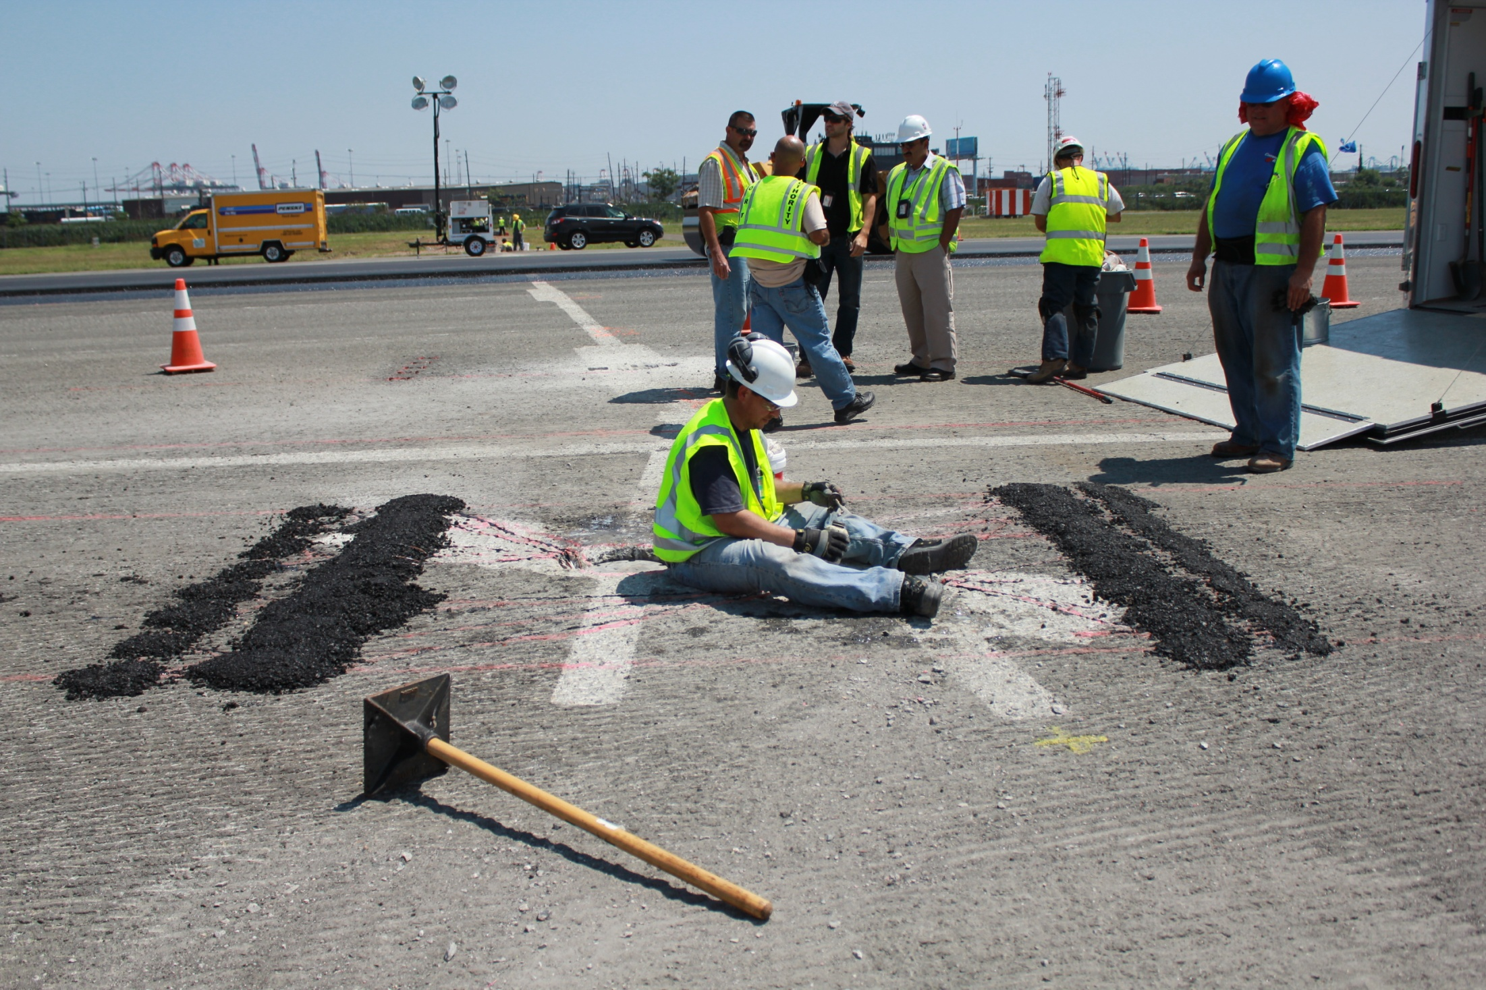

Slide 11
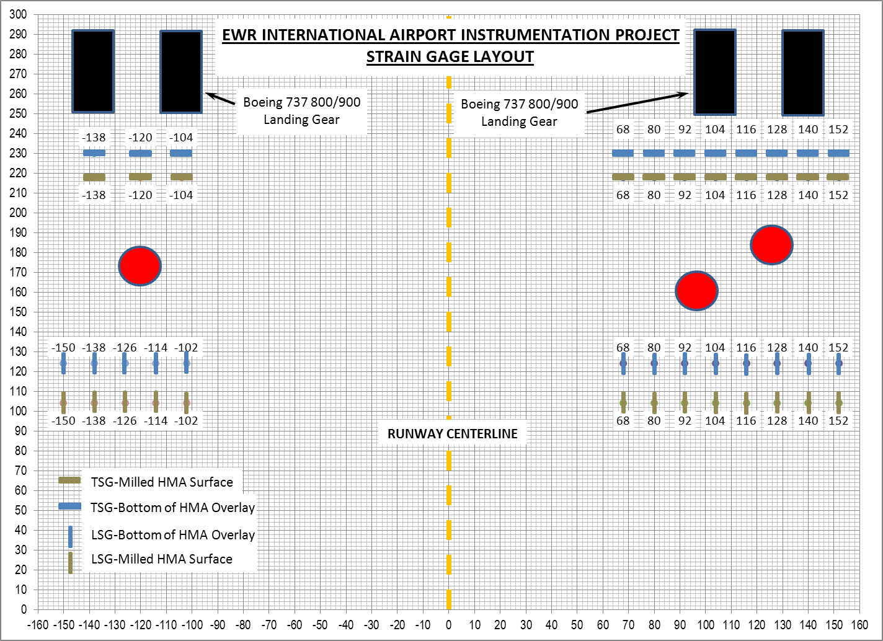
HIGH SPEED EXIT LEADLINE

Slide 12
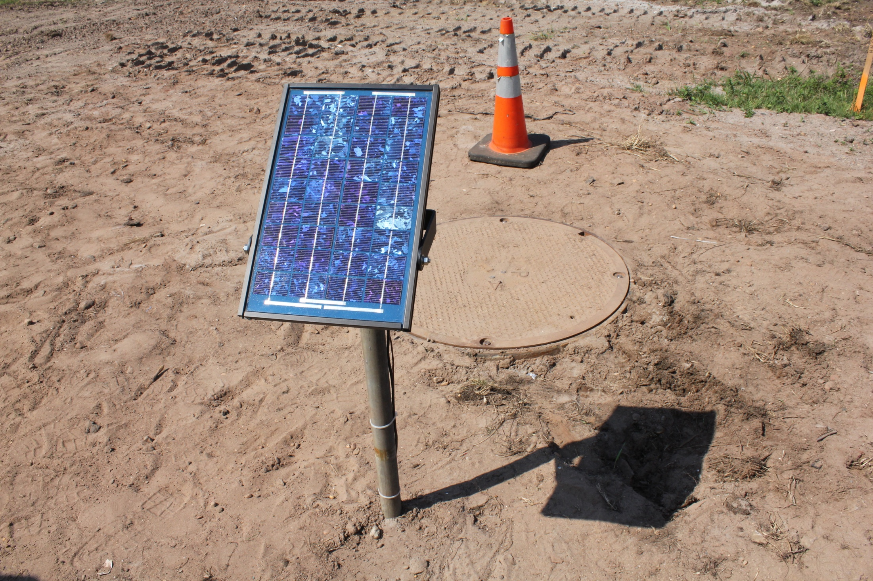

Slide 13
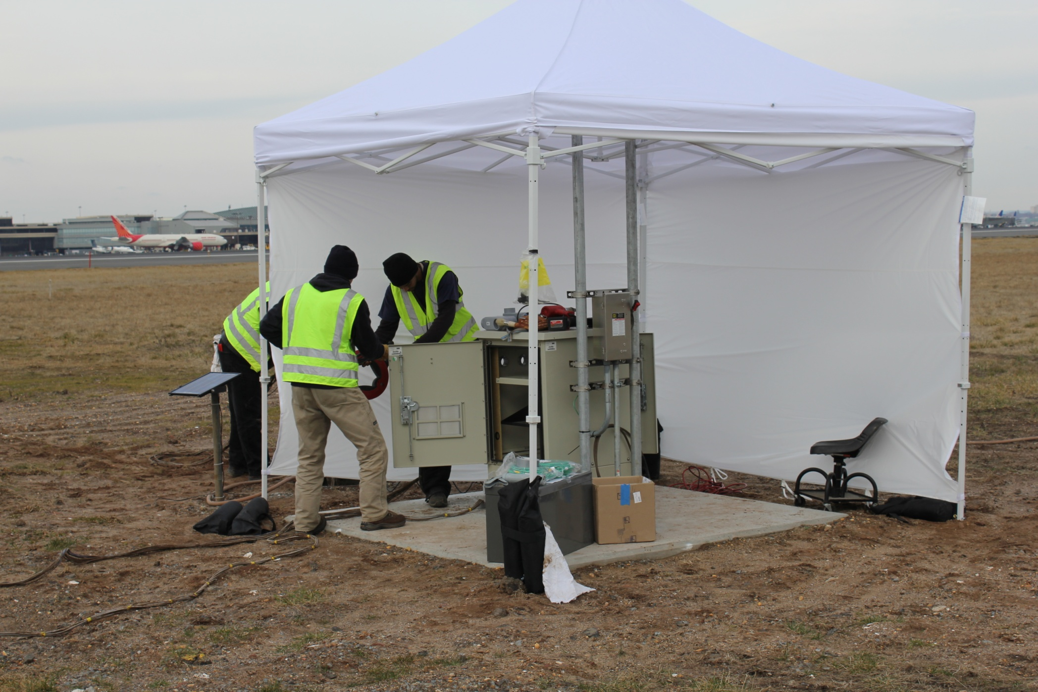

Slide 14
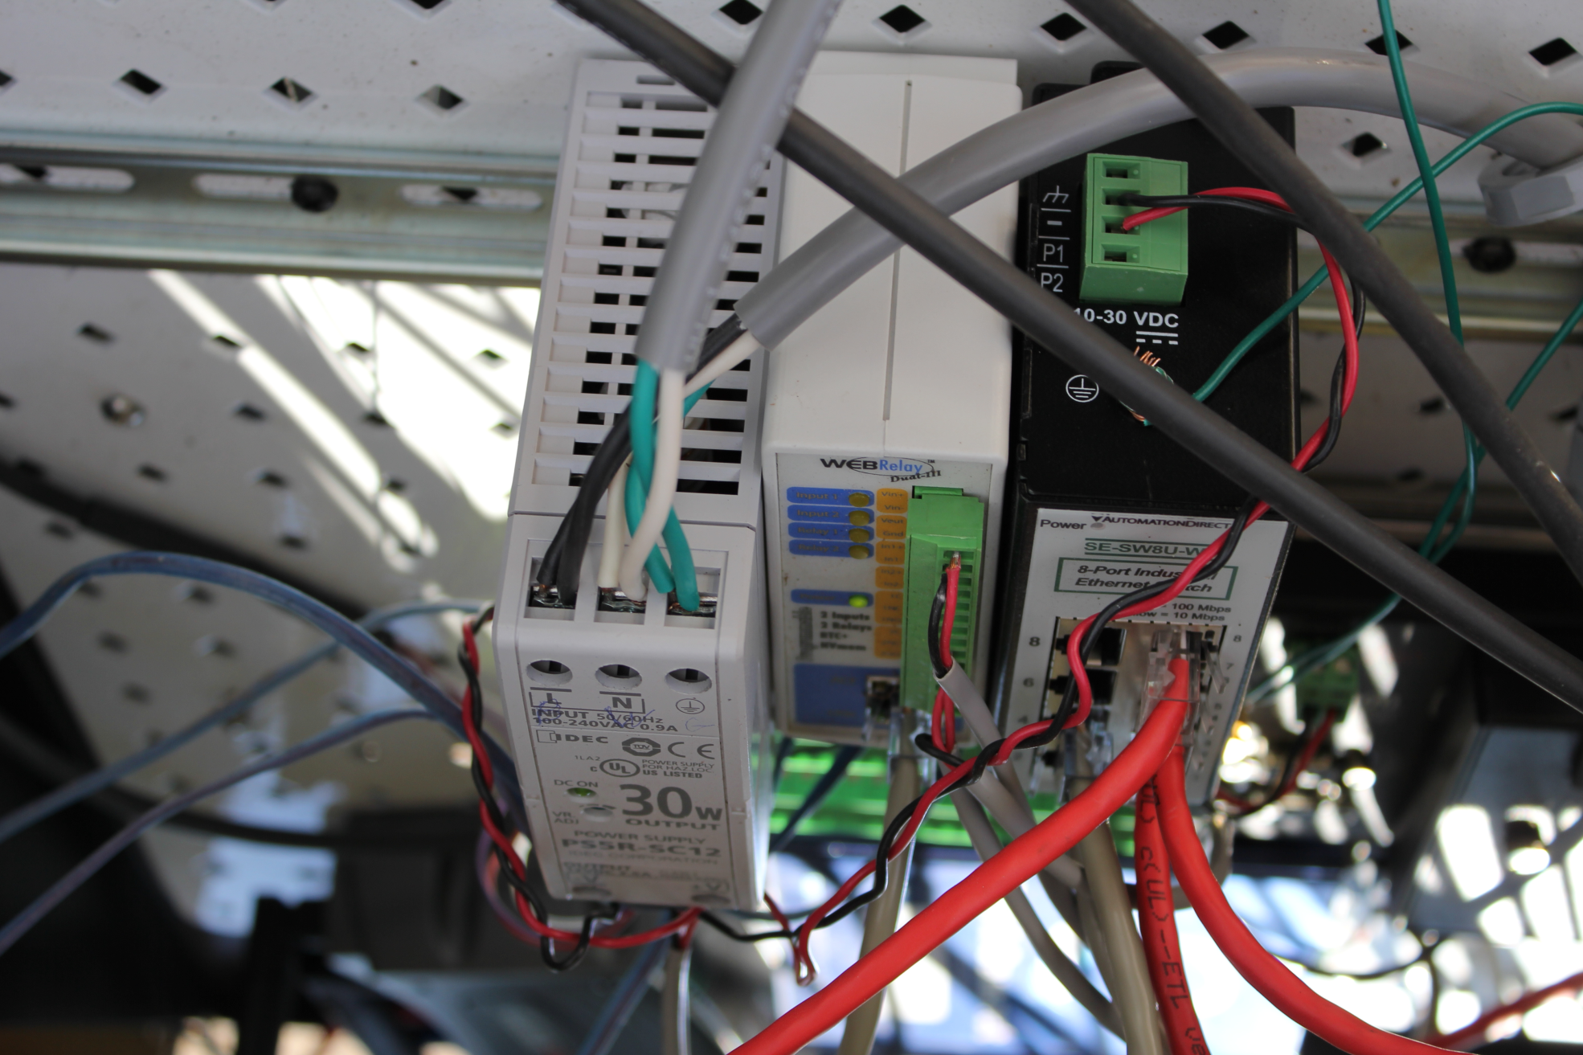

Slide 15
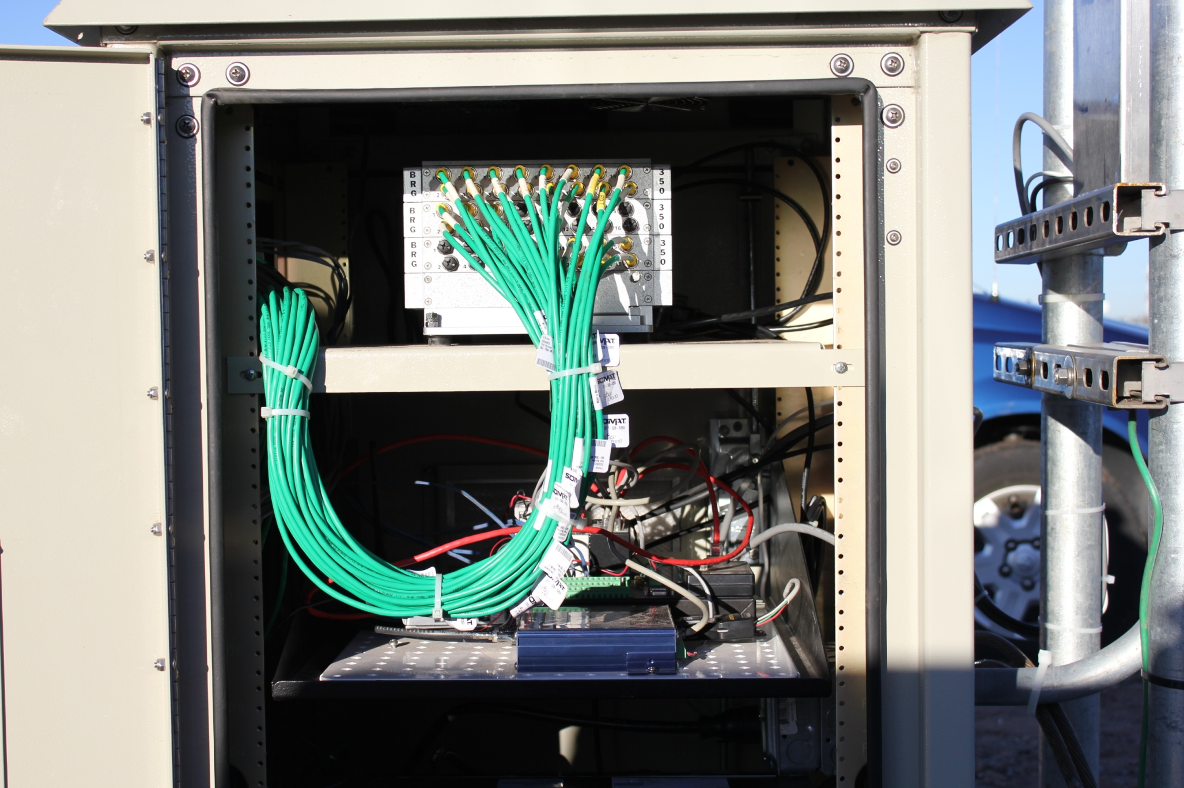

Slide 16
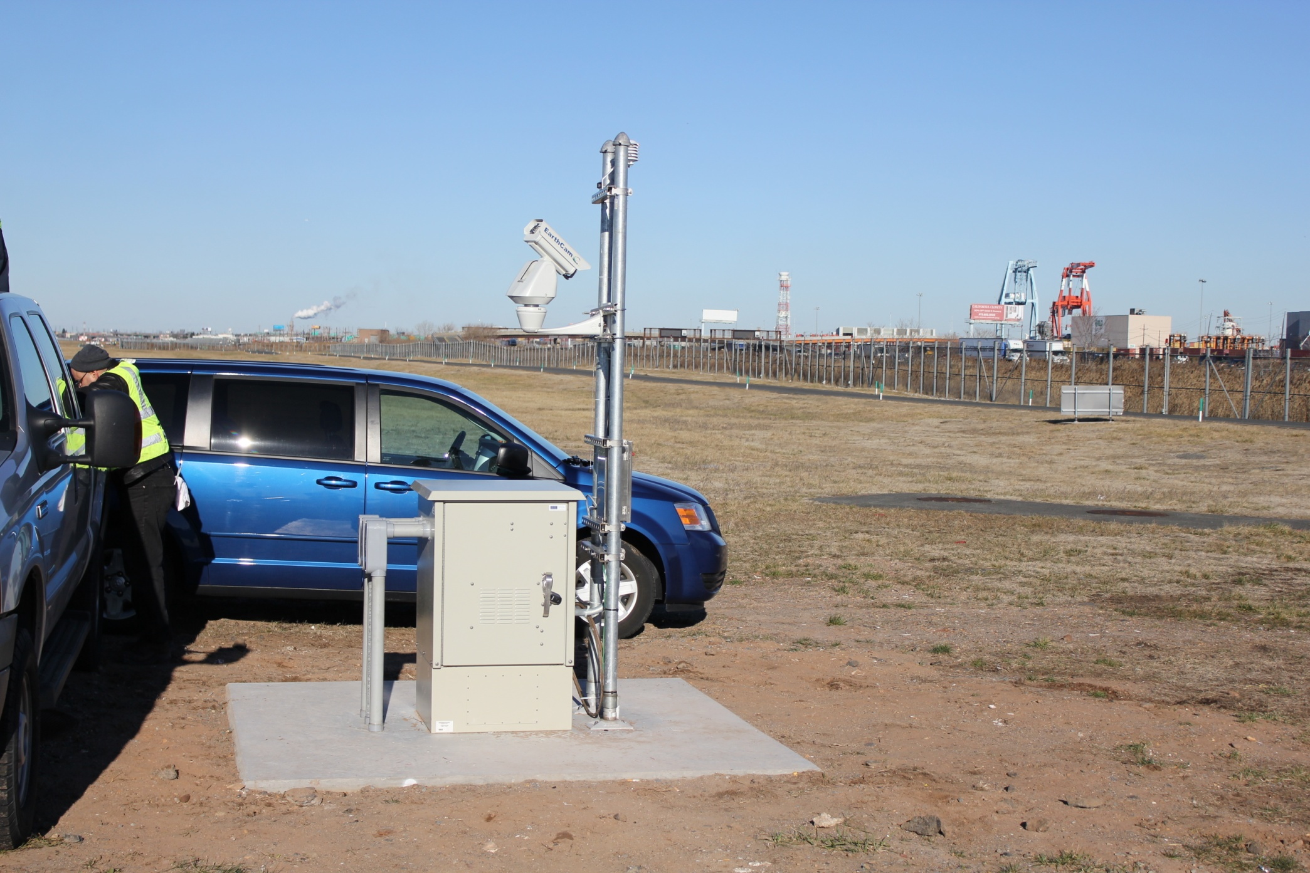

Slide 17
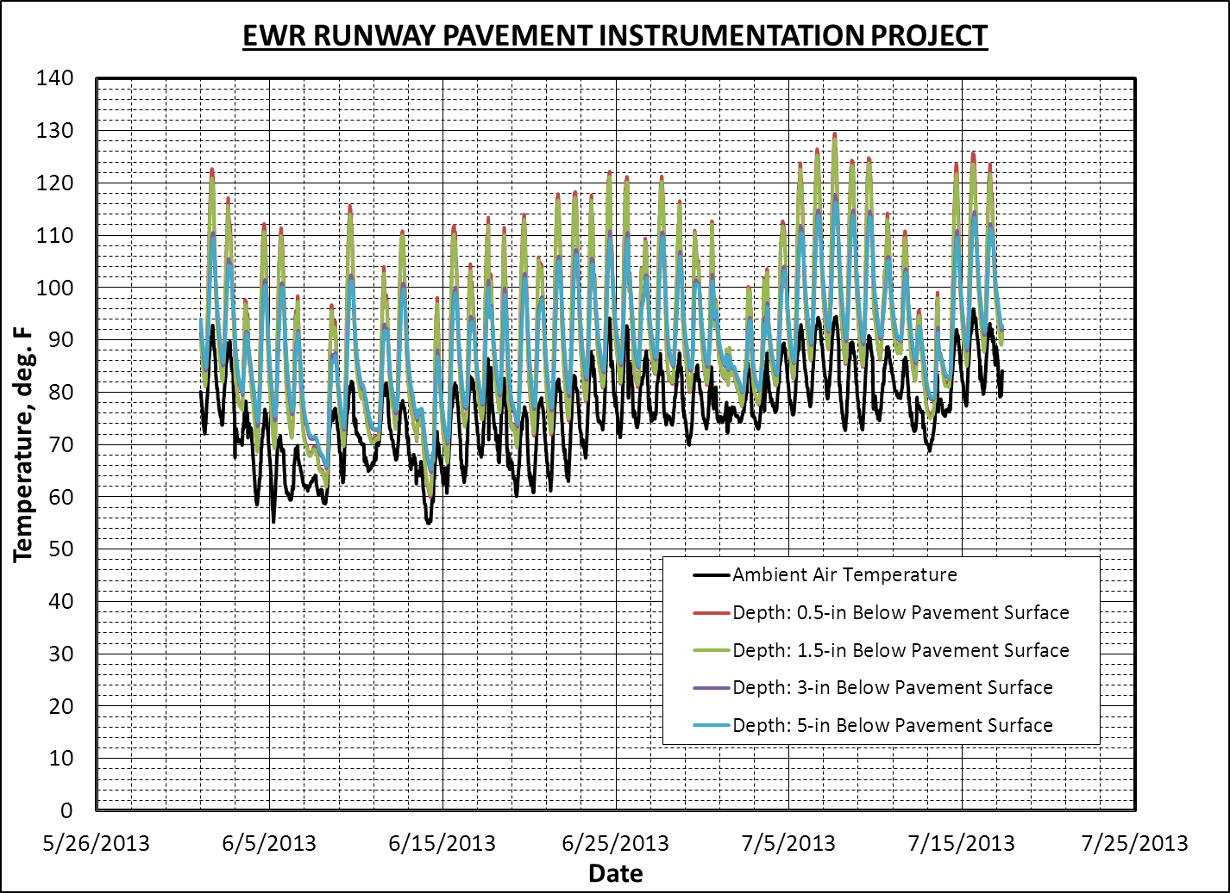

Slide 18
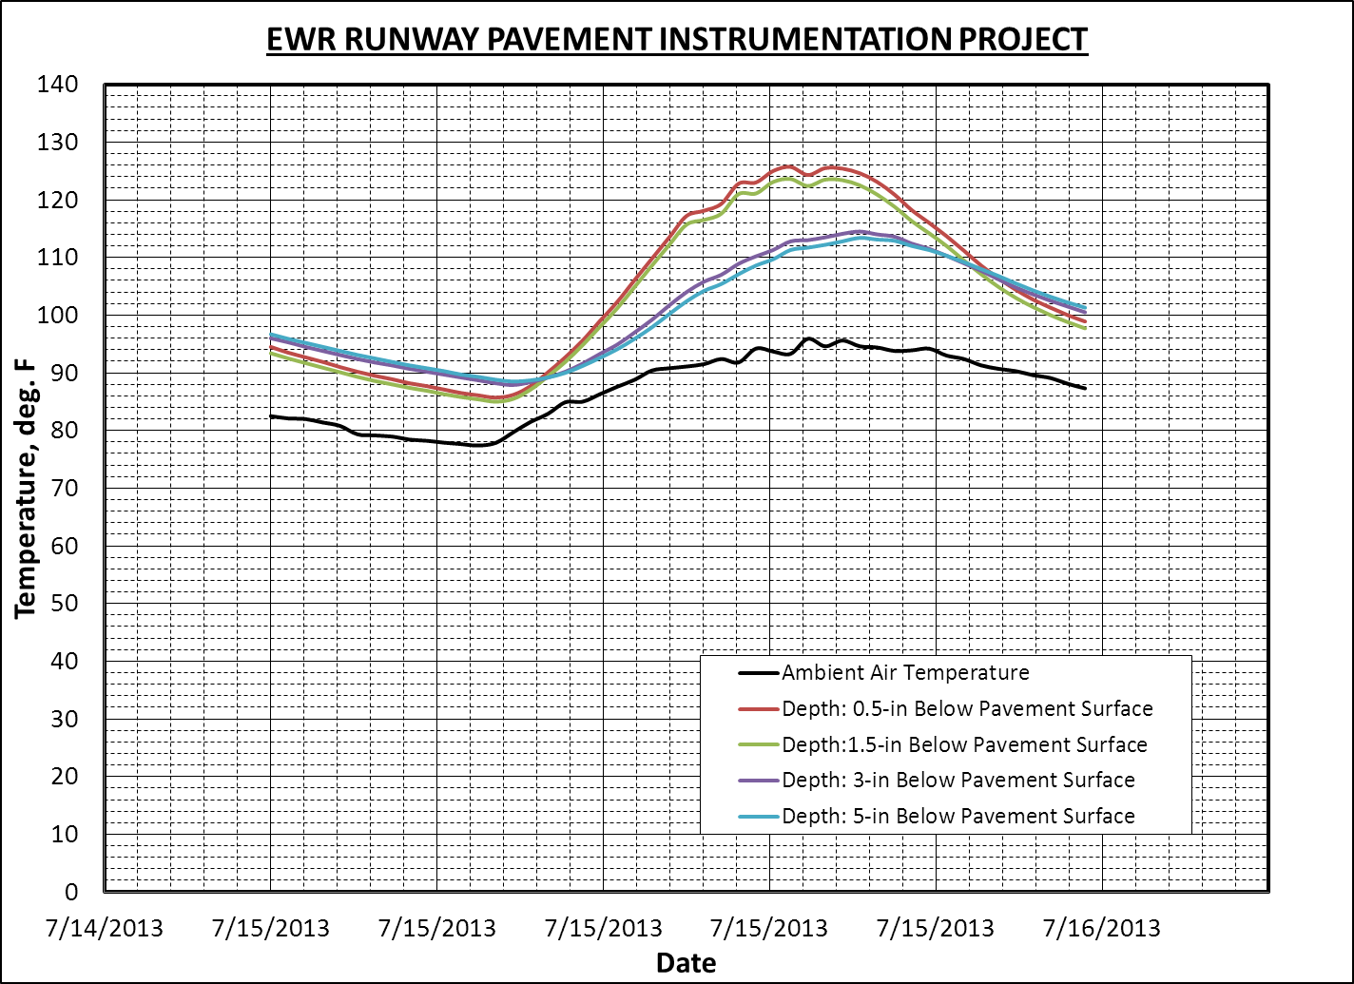

Slide 19
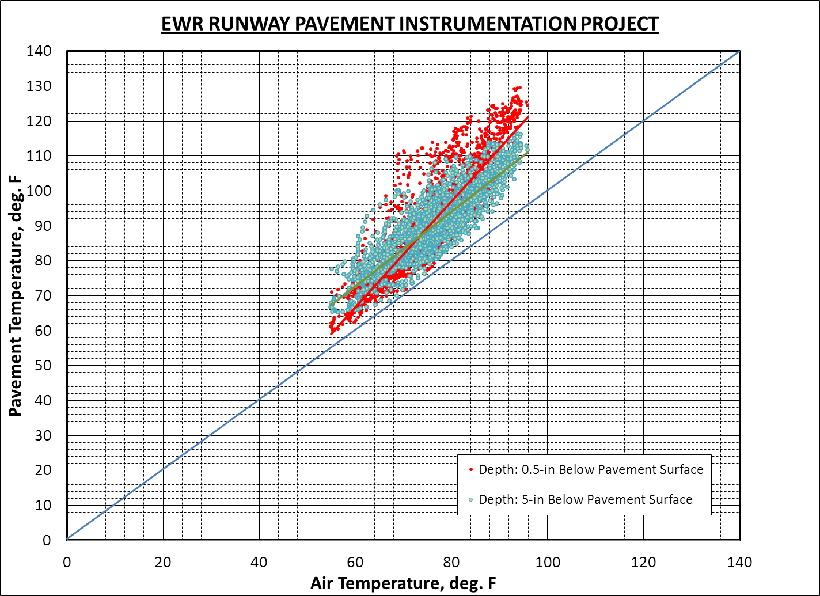

Slide 20
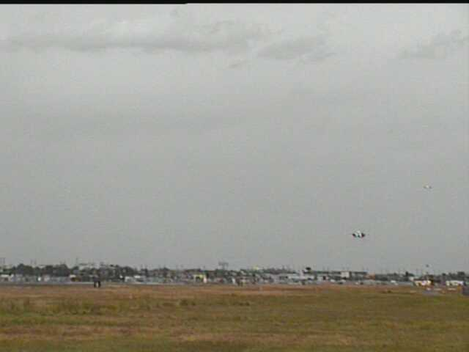


Slide 21
Date: 7/19/2013 B-737
HMA Overlay Bottom
Milled Surface Top

Slide 22
Date: 7/23/2013 B-737
Milled Surface Top
HMA Overlay Bottom

Slide 23
Date: 7/15/2013 B-737
Milled Surface Top
HMA Overlay Bottom

Slide 24
Date: 7/15/2013 B-737
Milled Surface Top
HMA Overlay Bottom

Slide 25
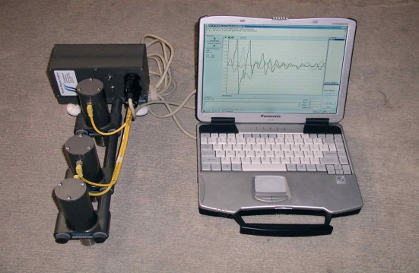
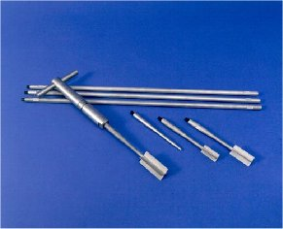
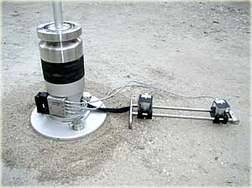
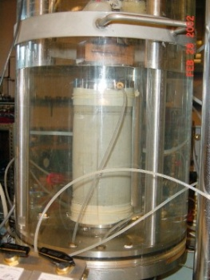
RPD – 137
Subgrade Characterization –
  In-situ tests and laboratory tests
    JFK Intl. Airport, New York City, NY
    Newark Intl. Airport, Newark, NJ
    Port Columbus Intl. Airport, Columbus, Ohio
  Laboratory Tests Underway

Slide 26
Nano-Engineered Smart Tarmacs for Detecting Distributed Surface and Subsurface Pavement Damage

Slide 27
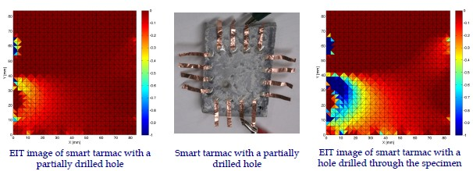
Nano-Engineered Smart Tarmacs for Detecting Distributed Surface and Subsurface Pavement Damage
Nano-Engineering and Smart Structures Technologies (NESST) Laboratory at UC Davis
Northern California Nanotechnology Center (NC2) at UC Davis
Structural Engineering Research Laboratory (SERL) at UC Davis
Laboratory for Intelligent Structural Technology (LIST) at University of Michigan

Slide 28
Airport Pavement Condition Monitoring Using Self-powered Wireless Active Sensing System
University of North Texas
University of Minnesota

