Slide 1
Airport Technology R&D Team
RPD-150: Wildlife Hazard Mitigation R&D
REDAC Subcommittee
Ryan E. King
September 11, 2013

Slide 2
Wildlife Hazard Mitigation (RPD 150)
Topics:
Data and Information Systems
Wildlife Management and Control
Wildlife Technology
FY13 Funding = $2,650K
FY14 Funding = $2,500K
FY15 Funding = $2,500K
Notes:
Reducing the likelihood of wildlife collisions with aircraft is a multi-faceted challenge addressed by efforts depicted here.

Slide 3
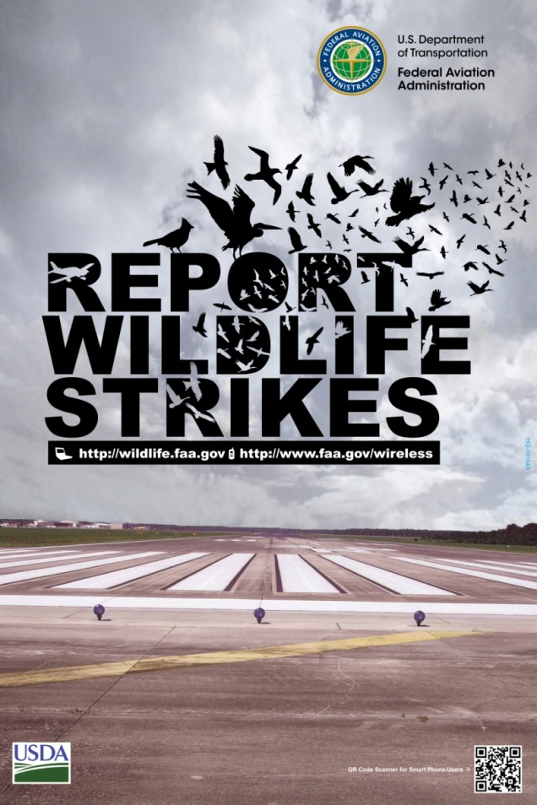
DATA & INFORMATION
Strike Reporting
Report Processing
Public Database

Slide 4
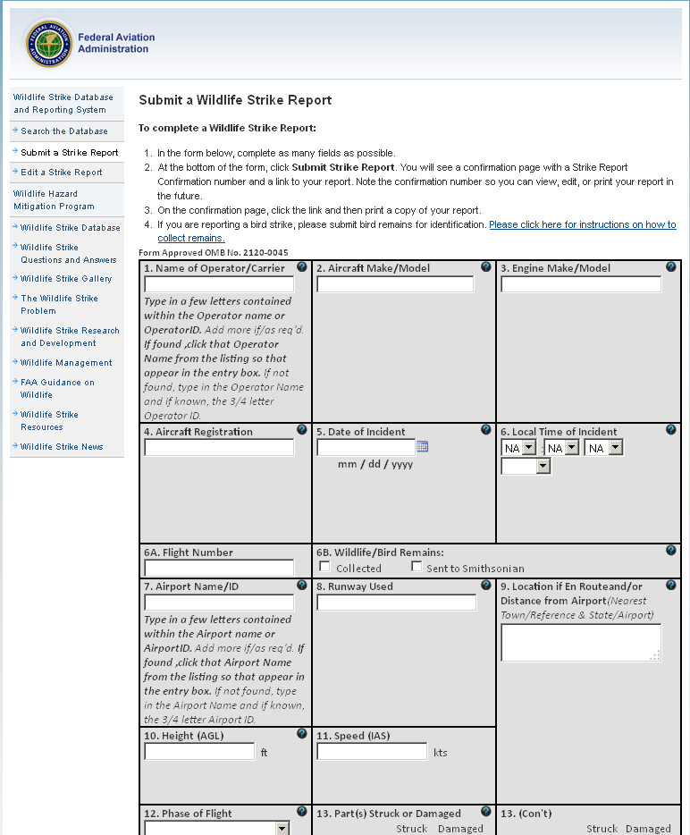
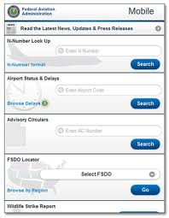
Reporting
Voluntary
Electronic
Hardcopy Form
Smart phone compatible
http://wildlife.faa.gov/strikenew.aspx
Notes:
Reporting is voluntary but encouraged.
Users can report strikes on a paper form, on the FAA website (http://wildlife.faa.gov), or via a special site for mobile devices at http://www.faa.gov/mobile

Slide 5

Report Processing
Workflow
START
START
END

Slide 6
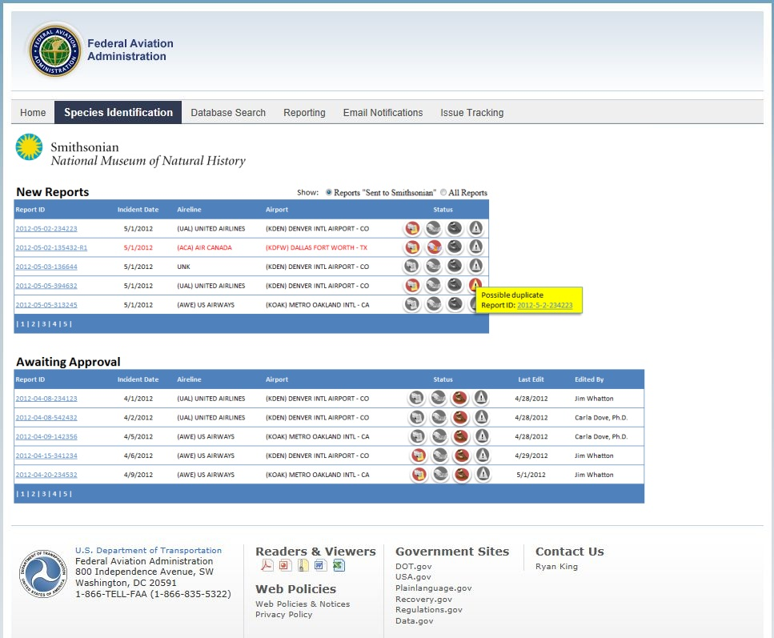
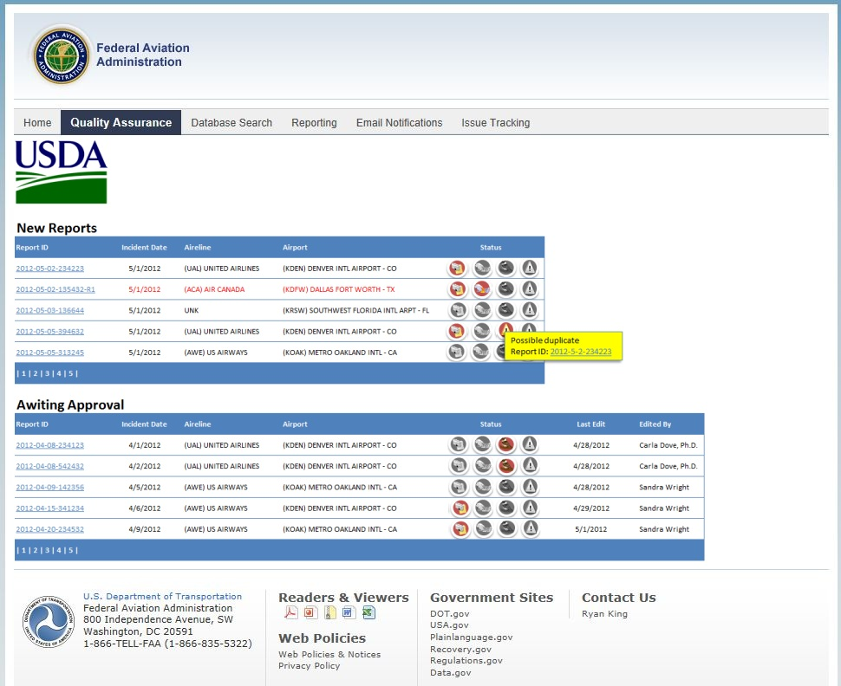
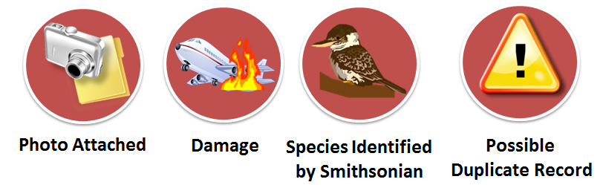
Validation
Notes:
Developed to provide a user friendly interface to accommodate significant increases in quality control/quality assurance and species identification while reducing the time it takes each report to be published to the online DB.

Slide 7
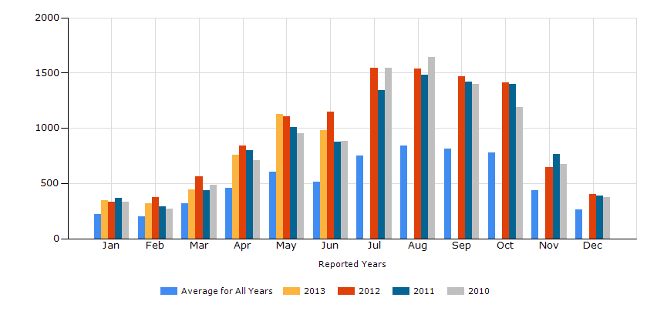
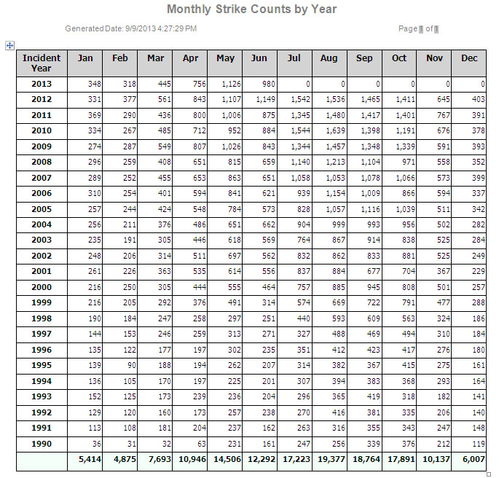
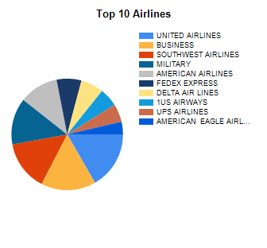
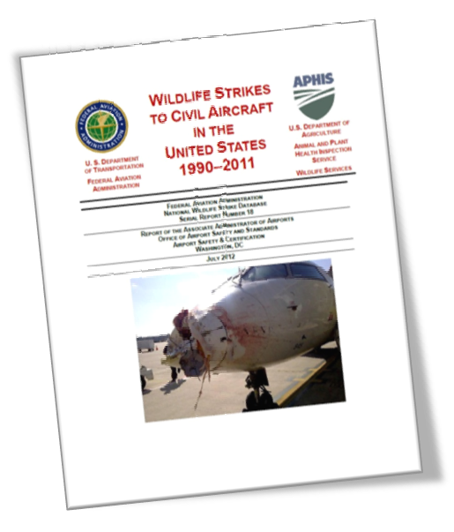
Data Products

Slide 8
Strikes and Phases of Flight
Cruise
FINAL APPROACH & LANDING
Climb
Takeoff Run
Landing Roll
Strikes
19%
18%
7%
39%
17%
Notes:
I included these figures to show how the DB can help us understand where strike risks present themselves on the airport.
UPDATE validated strikes figure

Slide 9
Birdstrike Numbers
Total Count: 145,123+ (through June 2013)
2013 Year-to-date Total: 8095 (raw)
22 Year Period 1990-2011
  97.1% of wildlife strikes involve birds
  Number of reported strikes increased from 1804 in 1990 to 10,083 in 2011
  About 26 strikes are reported per day
  Number of reported damaging strikes has declined in recent years
  It is estimated that about 39% of strikes are reported
Notes:
We are now p to over 125,000 validated strike reports and on pace to have expected level of reporting for 2011.

Slide 10
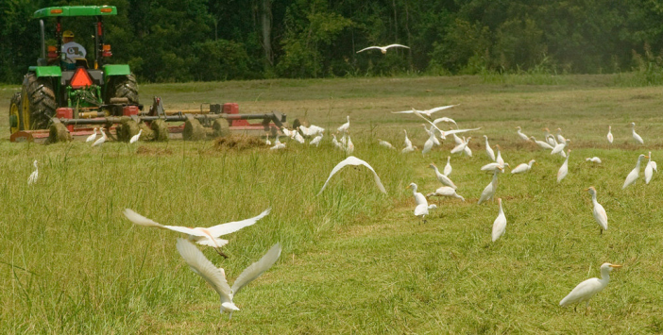
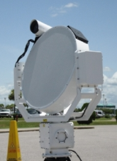
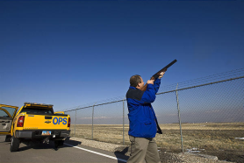
Management of Wildlife Hazards at Airports
USDA/APHIS/Wildlife Services
Habitat management practices and Land-use Studies
Control and harassment of hazardous species

Slide 11
USDA IAA Research Activities
Behavior of Hazardous Species
  Tracking Bird Movements
  Bird use of surrounding properties
  Response to Object Approach
  Perception of Light
  Long Range Acoustic Devices
Land-use Opportunities
  Biofuel Crops on and near Airports
  Solar Arrays on and near Airports
Reducing Attractiveness of Airport Property
  Earthworm control at airports
  Enhancing Perceived Threat of Predation
Notes:
To exploit the sensory and perception capabilities of birds in deterring them from aircraft and other selected locations, we must first quantify those capabilities.
The sensitivities of birds to visual (color, color combinations, pattern, pulse rate) information are known for only a few species; most of these are either small songbirds or domestic species (e.g., chickens, ducks, pigeons).

Slide 12
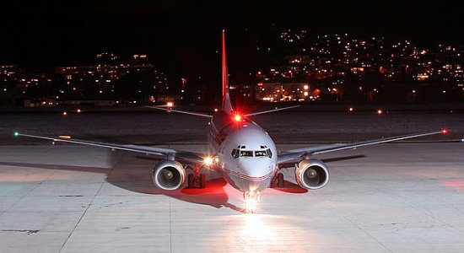
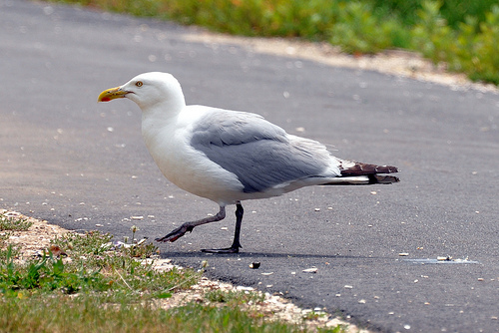
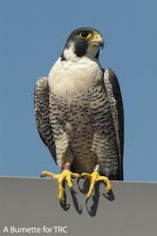
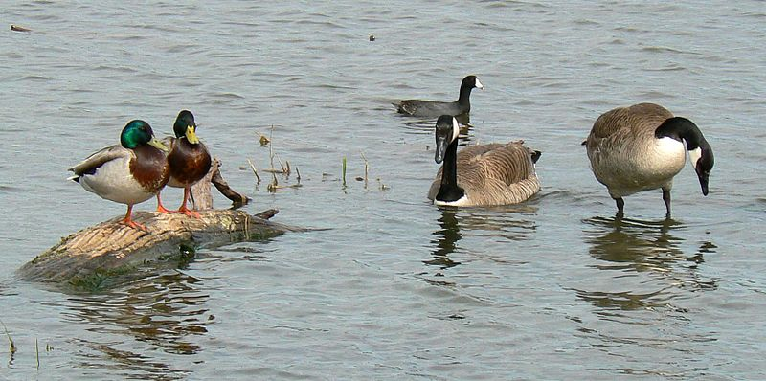
Enhancing Avian Detection and Response to Aircraft Perception of Light - USDA/APHIS/WS/NWRC and Purdue University
Objective: Make airplanes conspicuous to birds that cause damaging strikes

Slide 13
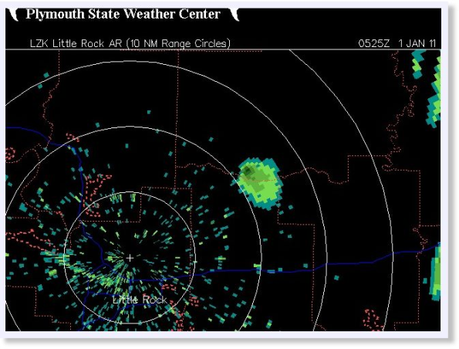
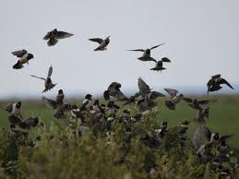
TECHNOLOGY
Detection/Sensor Technologies
Concepts of Operation

Slide 14
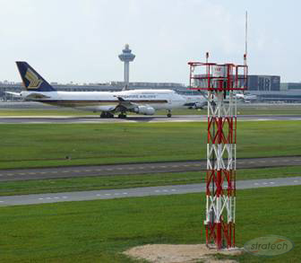
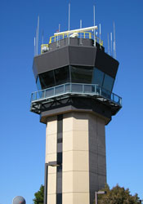
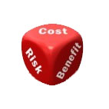
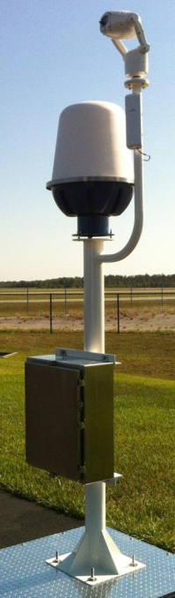
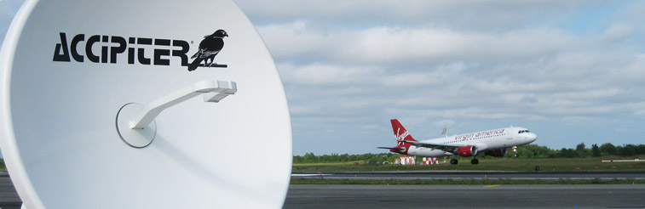
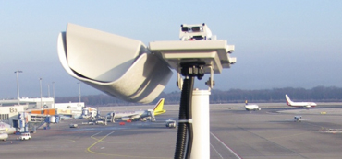
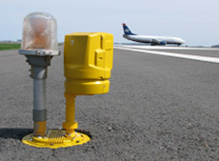
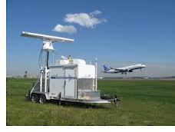
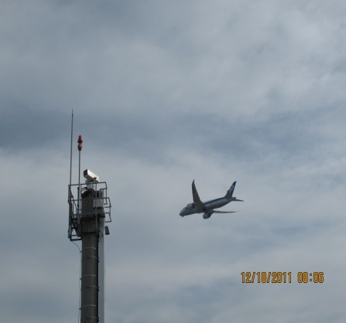
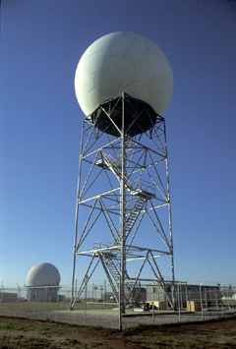
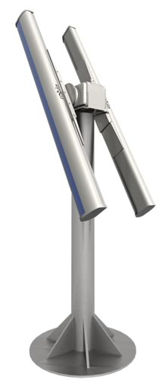
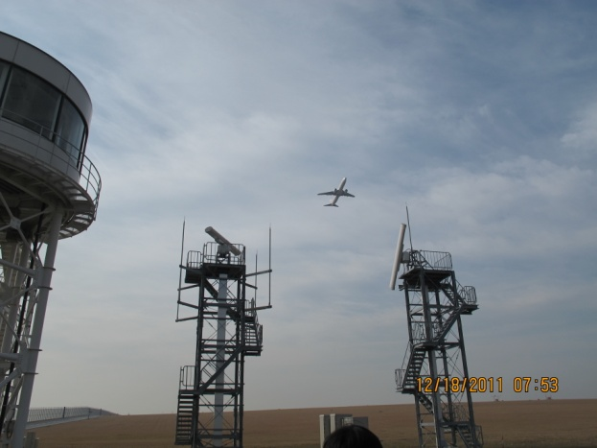
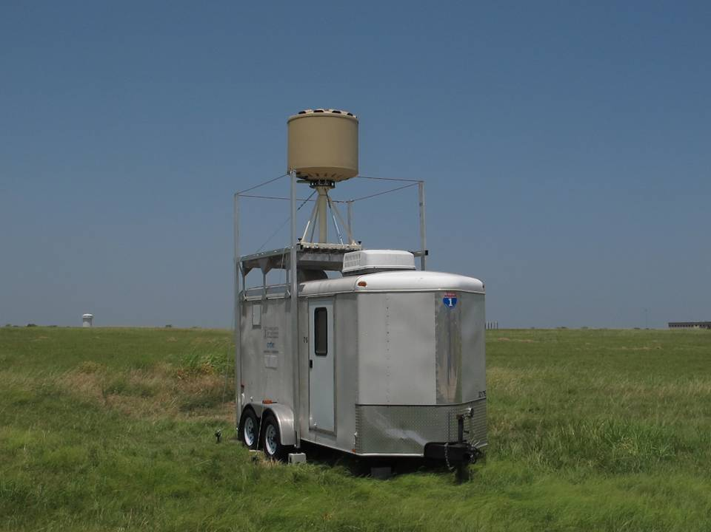
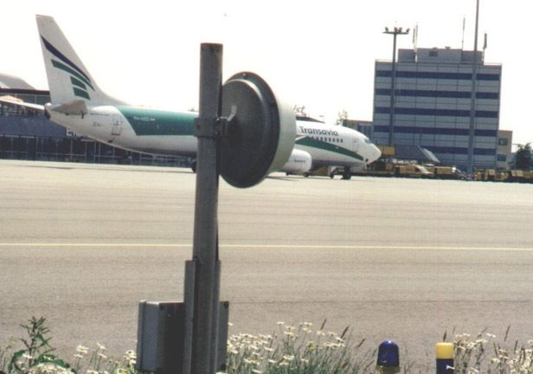
TECHNOLOGY
Notes:
When you consider the vast array of individual sensors that are watching overlapping space within the airport environment to serve different purposes, you can begin to see the limitations of silo thinking.

Slide 15

FAA Bird Radar Progression
Seattle Tacoma
Dallas Fort Worth
Chicago O’Hare
NAS Whidbey Island
Technical Evaluation
Deployment
Validation
Significant Findings
Commercial bird radars are suitable for detecting and tracking birds on and around an airport
Can provide real-time alerts of bird activity in operational areas
Operations
Air Traffic Control

Slide 16
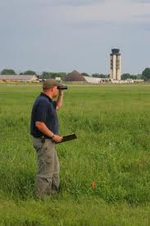
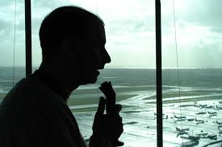
Operational Integration
Strategic: Wildlife Management
Radar applications intended to improve the understanding of local and regional bird movement in relation to the airport and aircraft flight paths (basically the use of radars in general wildlife management.)
Tactical: Operational Decisions
Application of the radar in a “real-life” environment, where radar information is being used for operational decisions, including flight path changes to avoid a bird/aircraft collision.
In 2009, a position paper on avian radar [4] by the Dutch Airline Pilots Association, Vereniging van Nederlandse Verkeersvliegers (VNV), introduced an important concept for airport use: strategic and tactical applications.
Notes:
The use of radar comes down to two primary concepts of operation; Strategic and Tactical.
We’ve made great strides on the strategic side, and are now engaging in Tactical applications which will be key to any use of the radar information in the Air Traffic Control environment.

Slide 17
Information Consumers
Airport Operations/Wildlife Biologists (Strategic/ Tactical)
  Identify daily and seasonal bird movements
    Assist in wildlife mitigation
  Survey airspace and detect wildlife threats to aircraft
    Transfer information to ATC (current)
Air Traffic Controller (Tactical)
  Provide “advisories” to pilots on bird activity
  Proactive approach to incident/accident prevention
Pilots (Tactical)
  Make informed decisions to reduce threat of incident/accident

Slide 18
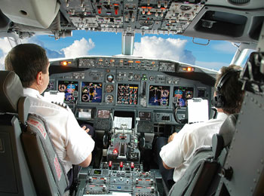
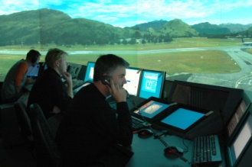
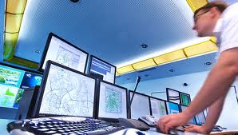
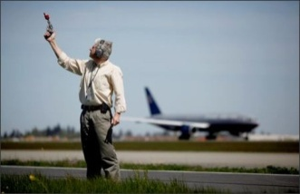
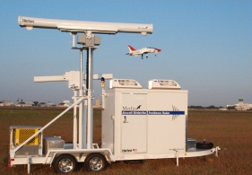
Operational Integration
Single Sensor - Multiple Users
Pilots
ATC
ACC
Airport Operations/Wildlife Biologist
Radar Data

Slide 19
Integrating Bird Radar into ATC
Bird Radar Display Assessments
Three vendors – Various display concepts
This assessment is NOT to determine which vendor has the best display/system
Develop the framework for a prototype ATC bird radar display/alerting system
Next Steps:
  Work with NextGen’s Advanced Operational Concepts Division (ANG-C4) to develop CONOPS

Slide 20
BSTAR

Slide 21
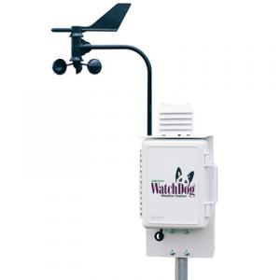
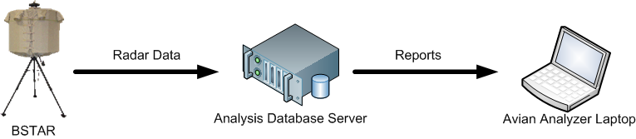
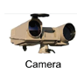

BSTAT – Data Management Subsystem
Data Management
  Capture, store, and index extremely large amounts of data
    Radar Data (3D position, time, velocity, biomass)
    Camera Data (snapshots and/or short video clips)
    Meteorological Data
Data Mining/Trend Analysis Tools
  Powerful Analysis Suite
    Powerful filters allow viewing of very specific datasets
    Predict future trends (season-to-season, year-to-year, etc)
    Mine data to reveal past trends
  Visually Display Data
    Map/location based data analysis (2D/3D)
    Plot based data analysis (cartesian, polar)
    Time based data analysis (hour, day, season, year)
  Report Generation
    Automated Periodic Reports (daily, weekly, etc)
    Custom Reports
  Sophisticated Database Queries
    Region based data analysis
    Time based data analysis (reoccurring, relative time, seasonal, etc)
    Customizable queries
  Playback
    Play back all data or a subset (based on location, time, etc)
    Play in real-time, slow speed, or fast speed
Designed to Fit Multiple Levels of Users
  Wildlife experts and management
  Airport operations
  Developers and engineers
Meteorological
System/Feed
Met
Data
Camera
Data
Radar
Data
BSTAT Database Server
BSTAT Analysis Laptop

Slide 22
BSTAT(istics)

Slide 23
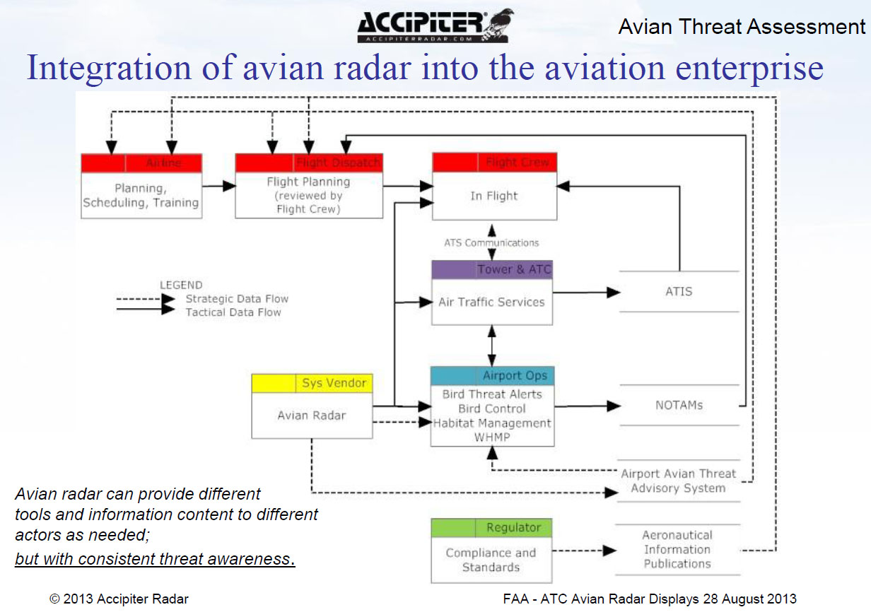
Accipiter

Slide 24
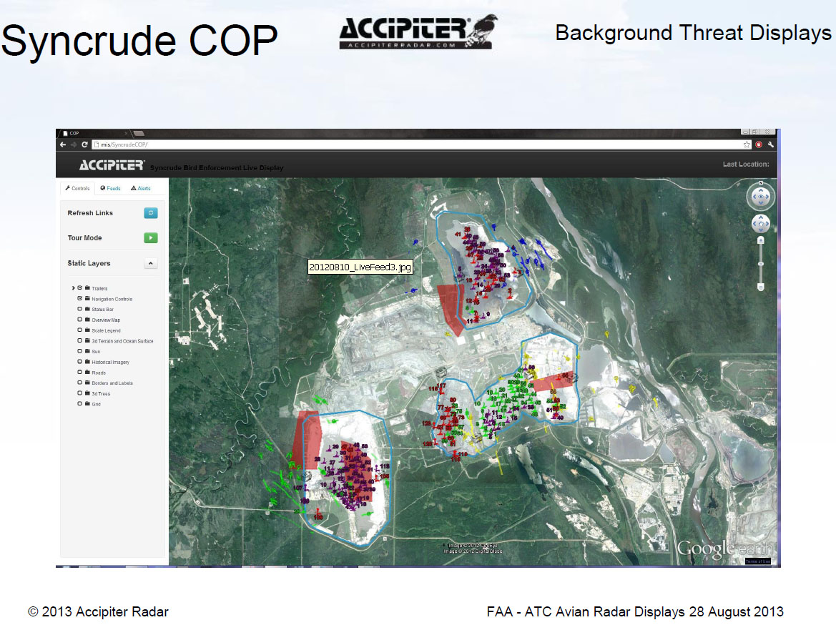

Slide 25
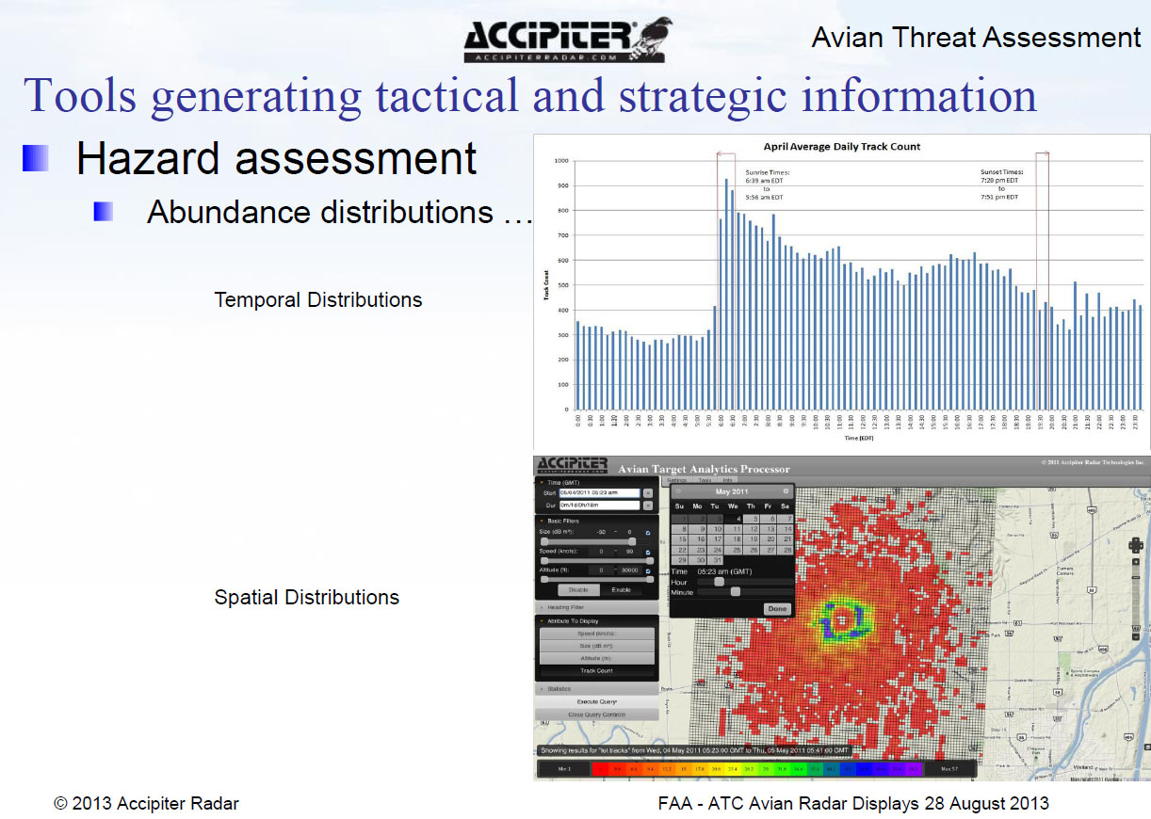

Slide 26
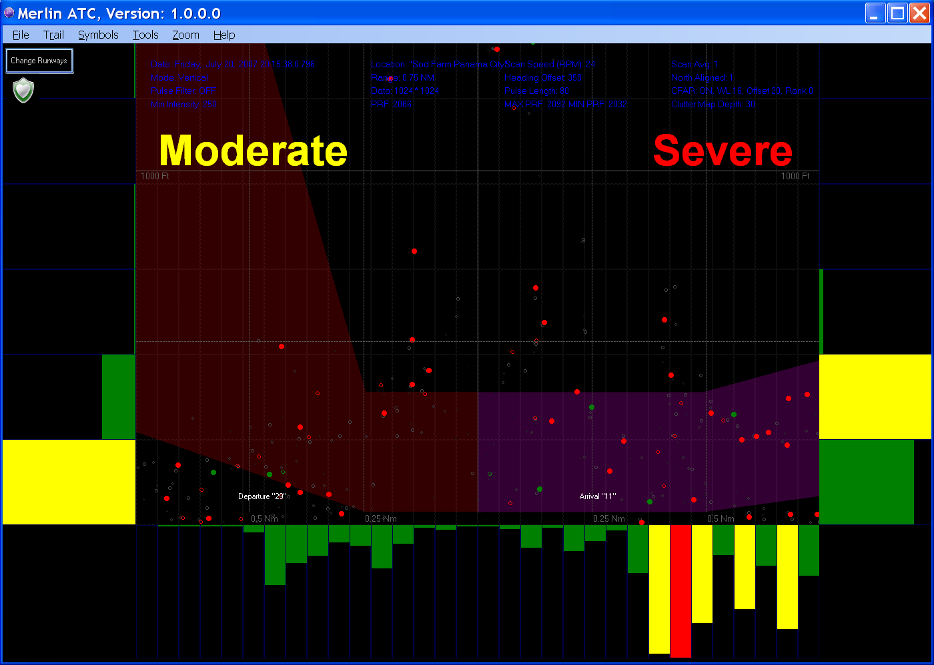
Moderate and Severe Risk
Image shows low in the departure corridor and moderate in the approach corridor, the yellow and red captions stand out when risk is elevated

Slide 27
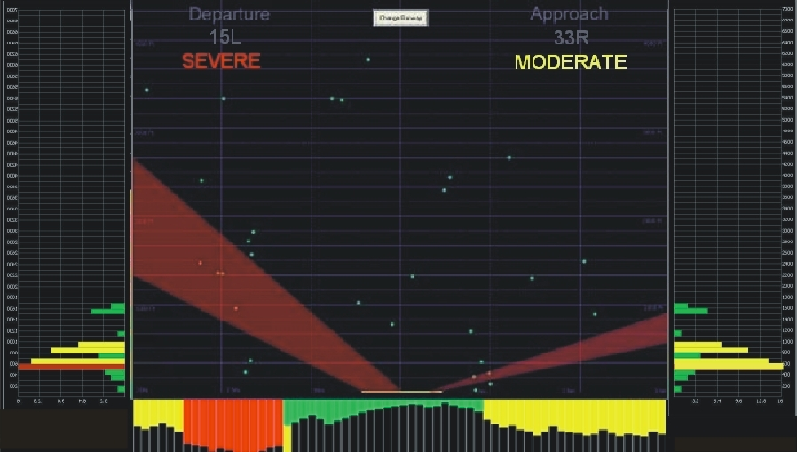
Variants of Merlin ATC
Resolution of vertical and horizontal data bars is higher
Separate risk determination for approach & departure corridors
Displays MERLIN risk onto screen with audible & messaging options (text, email etc which can drive you nuts – only want it at specific time, on duty, on final etc)

Slide 28
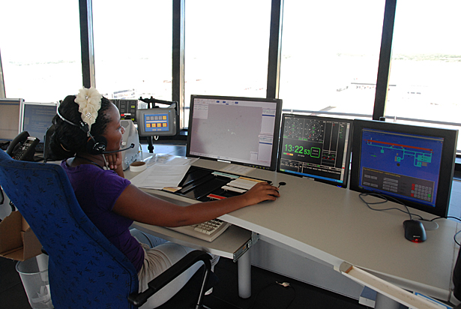
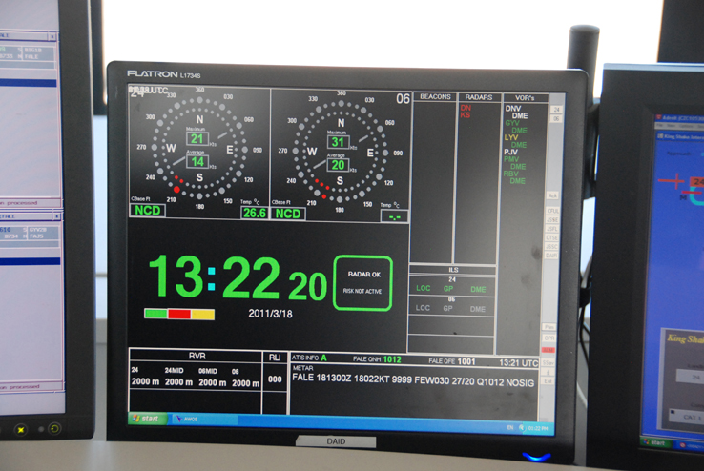
DeTect
What does the tower see?

Slide 29

Rethinking the process
(These are supposed to be silos)
Bird Radar
Weather Radar
Security Cameras
Surface Surveillance
Wildlife Biologist
ATC/Pilot
OPS/Security
ATC/Ops

Slide 30
COMPOSITION
Notes:
When you consider the vast array of individual sensors that are watching overlapping space within the airport environment to serve different purposes, you can begin to see the limitations of silo thinking.

Slide 31
Multi-Sensor Processing
FOD Sensors
Bird Sensors
Security Sensors
LCSS Sensors
ASDE-X Sensors
Weather
Sensors
Other
Sensors
ATC
Wildlife
Control
OPS
Security

Slide 32
For more information:
http://wildlife.faa.gov
Ryan King
ryan.king@faa.gov

Slide 33
Supplemental Information

Slide 34

An Analogy
Notes:
Remember when this is how you bought fountain drinks?

Slide 35

Many sources
Select

Slide 36

End User Preference/Application

Slide 37

Output/Display
From many sources, just the right mix of ingredients gives the end user what he/she desires for their particular purposes.
Now what do they do with it?

Slide 38


Consumption/Use

Slide 39
Summary
Many Sources of Surveillance Data
  (i.e. kinds of soda)
Type(s) of data source is selected based on what the end user wants
  (i.e. Coke Zero based)
Output/Display of information can be a combination of data from several sources
  (e.g. Lemon-flavored Coke Zero)
Use of the information is based on specific procedures defined by the user
  (i.e. tilt head back and drink or pour it into a recipe)

Slide 40
Band name | Frequency range | Wavelength range | Notes
HF | 3–30 MHz | 10–100 m | coastal radar systems, over-the-horizon radar (OTH) radars; 'high frequency'
P | < 300 MHz | 1 m+ | 'P' for 'previous', applied retrospectively to early radar systems
VHF | 30–300 MHz | 1–10 m | Very long range, ground penetrating; 'very high frequency'
UHF | 300–1000 MHz | 0.3–1 m | Very long range (e.g. ballistic missile early warning), ground penetrating, foliage penetrating; 'ultra high frequency'
L | 1–2 GHz | 15–30 cm | Long range air traffic control and surveillance; 'L' for 'long'
S | 2–4 GHz | 7.5–15 cm | Moderate range surveillance, Terminal air traffic control, long-range weather, marine radar; 'S' for 'short'
C | 4–8 GHz | 3.75–7.5 cm | Satellite transponders; a compromise (hence 'C') between X and S bands; weather; long range tracking
X | 8–12 GHz | 2.5–3.75 cm | Missile guidance, marine radar, weather, medium-resolution mapping and ground surveillance; in the USA the narrow range 10.525 GHz ±25 MHz is used for airport radar; short range tracking. Named X band because the frequency was a secret during WW2.
K_{u} | 12–18 GHz | 1.67–2.5 cm | high-resolution
K | 18–24 GHz | 1.11–1.67 cm | from German kurz, meaning 'short'; limited use due to absorption by water vapour, so K_{u} and K_{a} were used instead for surveillance. K-band is used for detecting clouds by meteorologists, and by police for detecting speeding motorists. K-band radar guns operate at 24.150 ± 0.100 GHz.
K_{a} | 24–40 GHz | 0.75–1.11 cm | mapping, short range, airport surveillance; frequency just above K band (hence 'a') Photo radar, used to trigger cameras which take pictures of license plates of cars running red lights, operates at 34.300 ± 0.100 GHz.
mm | 40–300 GHz | 7.5 mm – 1 mm | millimetre band, subdivided as below. The frequency ranges depend on waveguide size. Multiple letters are assigned to these bands by different groups. These are from Baytron, a now defunct company that made test equipment.
V | 40–75 GHz | 4.0–7.5 mm | Very strongly absorbed by atmospheric oxygen, which resonates at 60 GHz.
W | 75–110 GHz | 2.7–4.0 mm | used as a visual sensor for experimental autonomous vehicles, high-resolution meteorological observation, and imaging.
UWB | 1.6–10.5 GHz | 18.75 cm – 2.8 cm | used for through-the-wall radar and imaging systems.

Slide 41
Avian Radar Advantages
Remote Data Collection and Visualization
Effective under conditions that are difficult for human observers (e.g. night, fog, etc.)
Unbiased (i.e. is not influenced by known patterns and is not distracted)
Collects data faster than human observer
Able to detect birds beyond human detection capabilities (i.e. higher altitudes and further distances)

