Slide 1
Construction Update

Slide 2
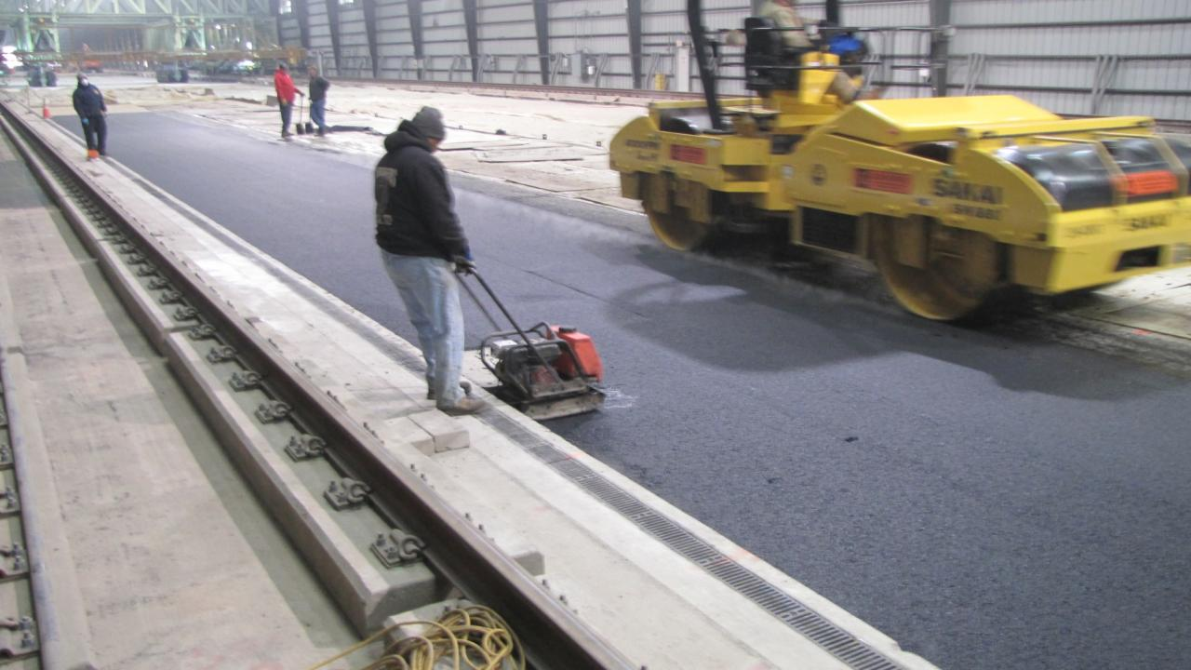
CC7 Completion of Perpetual Pavement Sections

Slide 3
Construction Cycle 7
As we last left CC7…
  Winter weather forced shut down of the construction of CC7 by December 20th
  North half of CC7, Perpetual Pavement Test Sections, was completed
  Work Remaining:
    6 inch P-209 Base Course on South half, Overload Test Sections
    3 inch P-401 HMA on South half

Slide 4
CC7- Resumed April 2014
Proof roll P-154 sub base course
  April 25, 2014
Place and compact P-209 base course
  April 29-30, 2014
Characterization tests on P-209
  May 1-2, 2014
Install Asphalt Strain Gages
  May 5-6, 2014

Slide 5
CC7- Resumed April 2014
Place 3 inch P-401 HMA
  May 7, 2014
CC7 / CC8 Transition
  June 19 – July 21, 2014
Install Multi Depth Deflectometers
  July 11-17, 2014
Paint Striping
  July 22, 2014

Slide 6
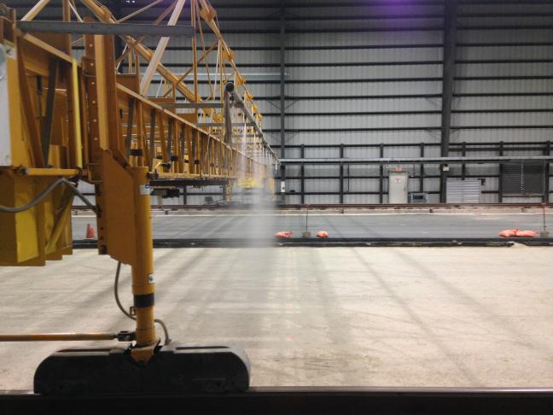
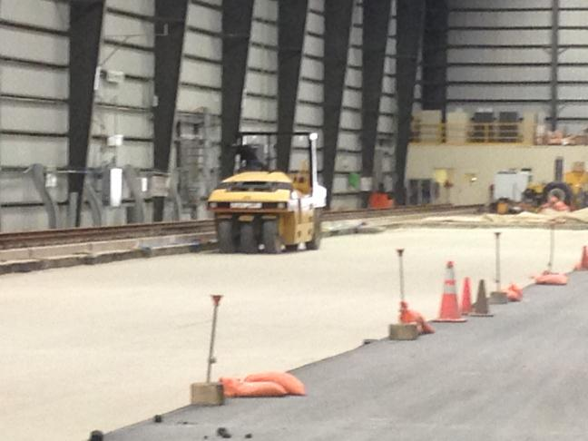
CC7 - Proof Roll Sub base

Slide 7
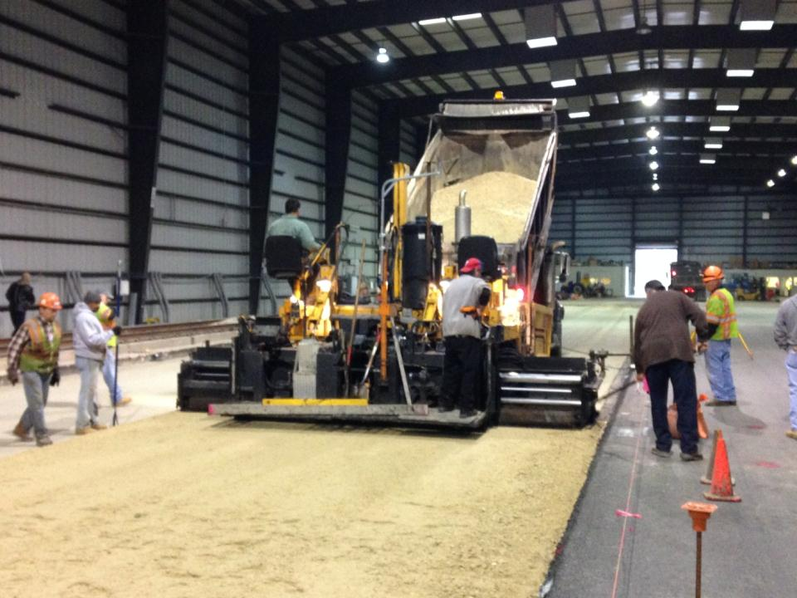
CC7- Place P-209 Base Course

Slide 8
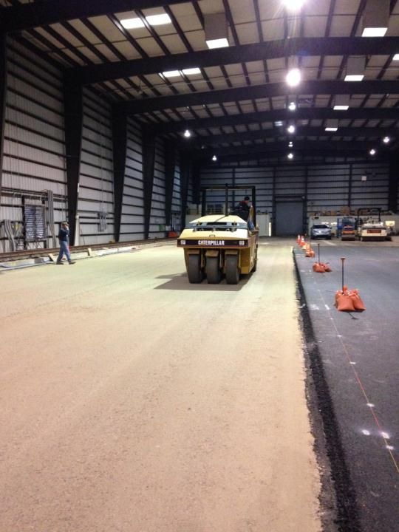
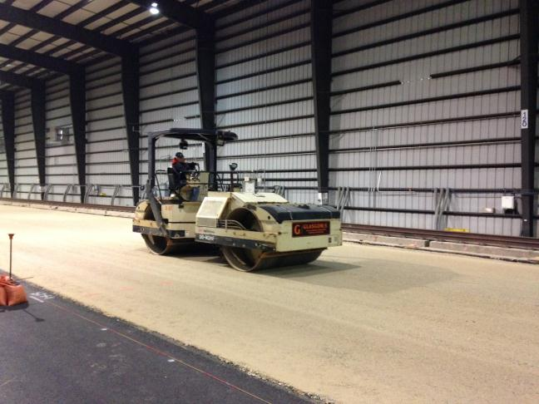
CC7- Compact Base Course

Slide 9
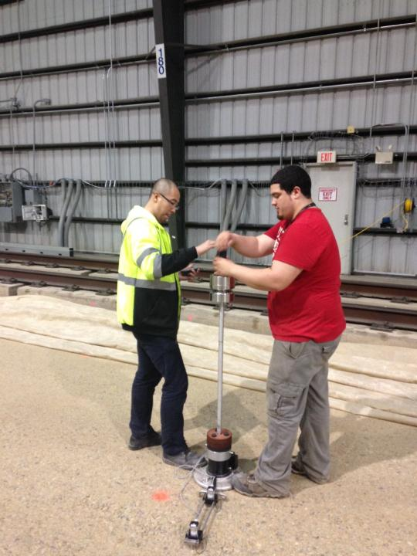
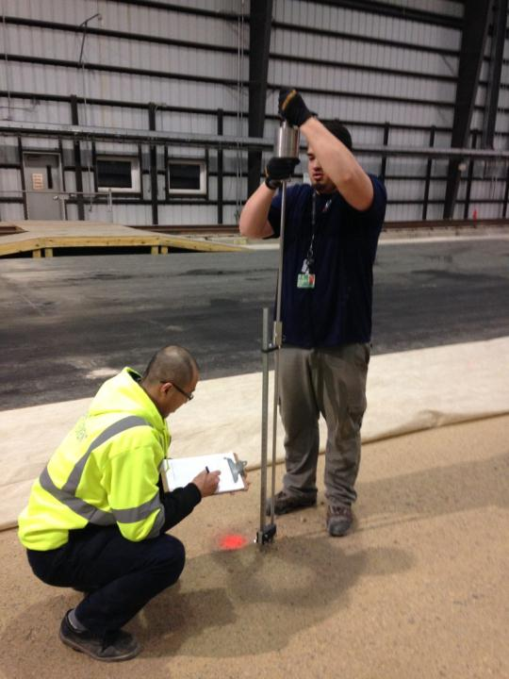
CC7 Characterization of P-209

Slide 10
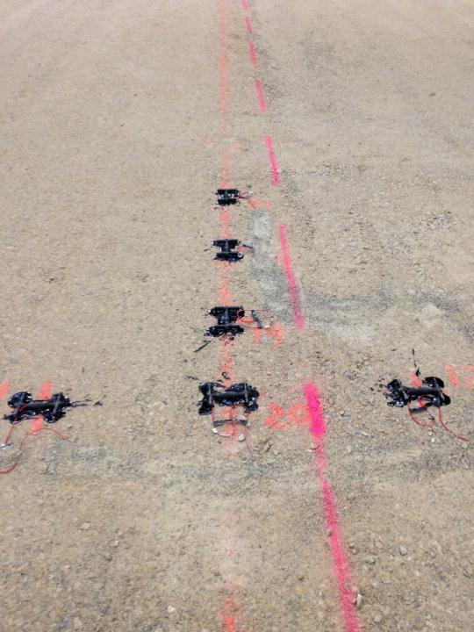
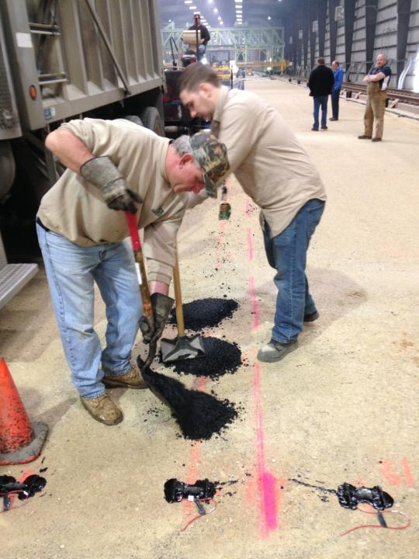
CC7 – Asphalt Strain Gages

Slide 11
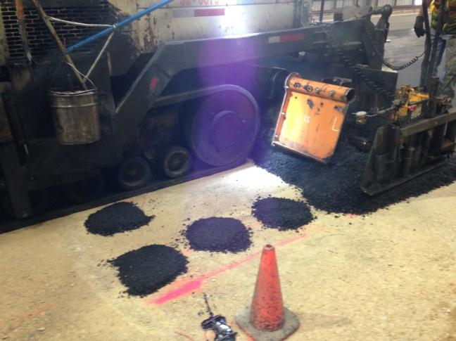
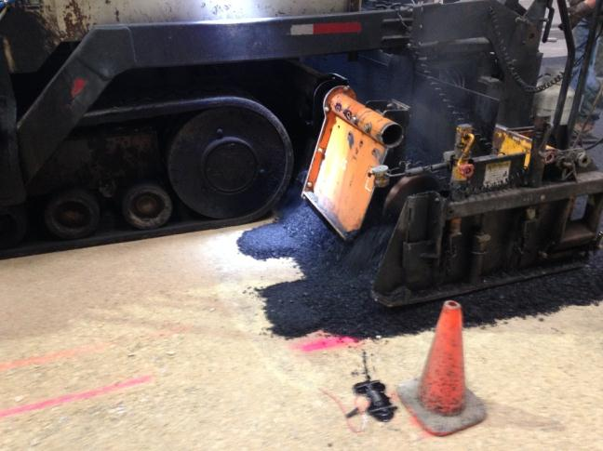
CC7- Paving Over ASG’s

Slide 12
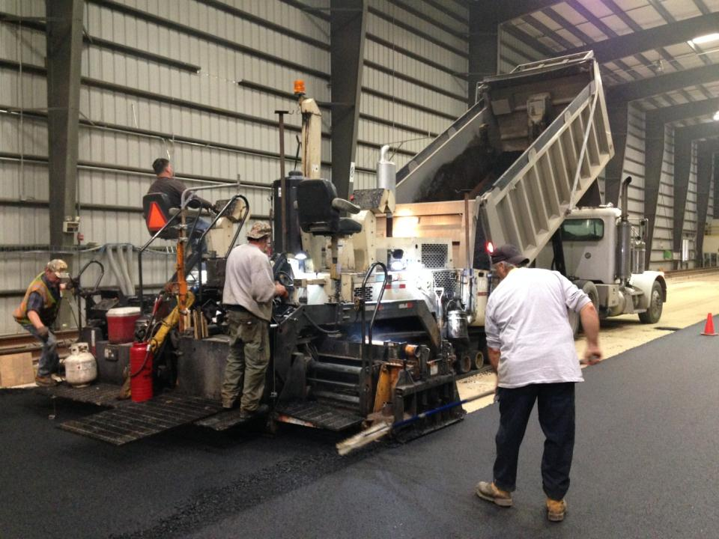
CC7 – Final Paving Lane

Slide 13
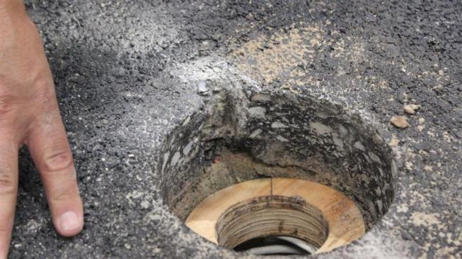
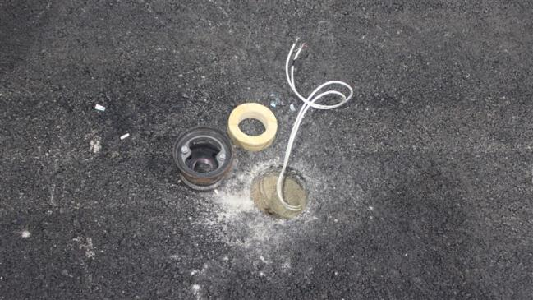
CC7- Multi Depth Deflectometers

Slide 14
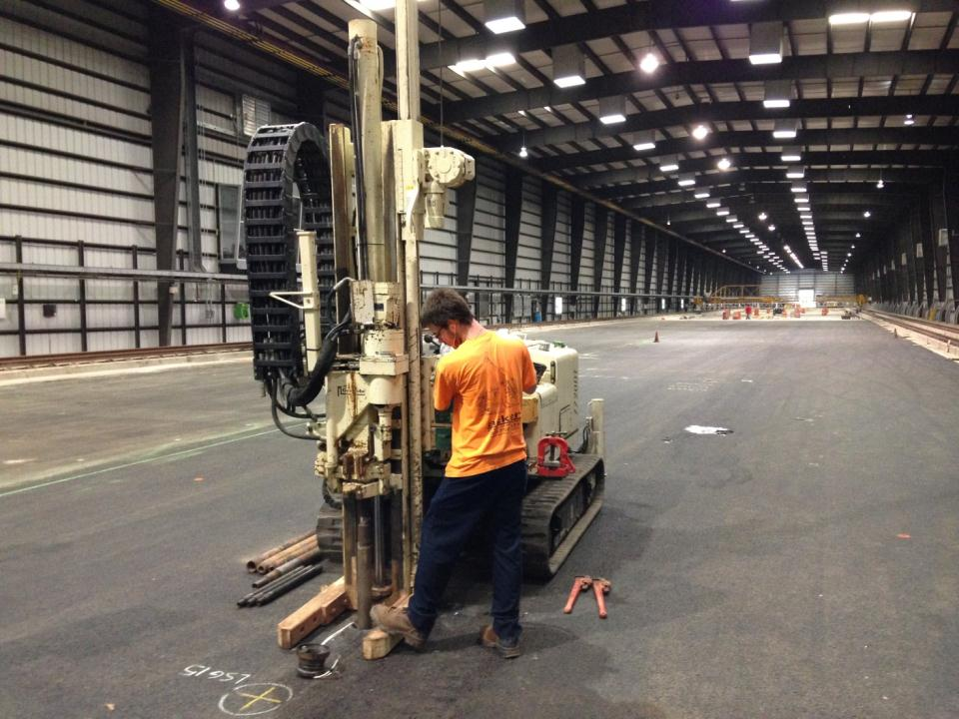
CC7 – MDD Installation

Slide 15
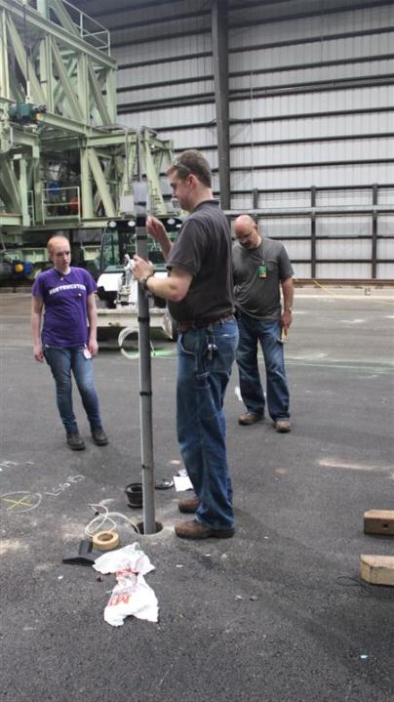
CC7- MDD Installation

Slide 16
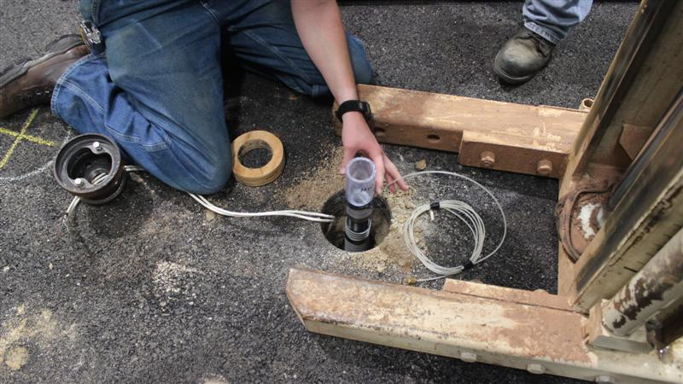
CC7- MDD Installation

Slide 17
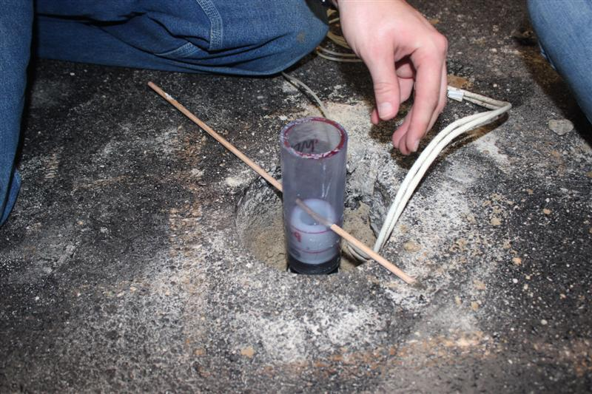
CC7- MDD Installation

Slide 18
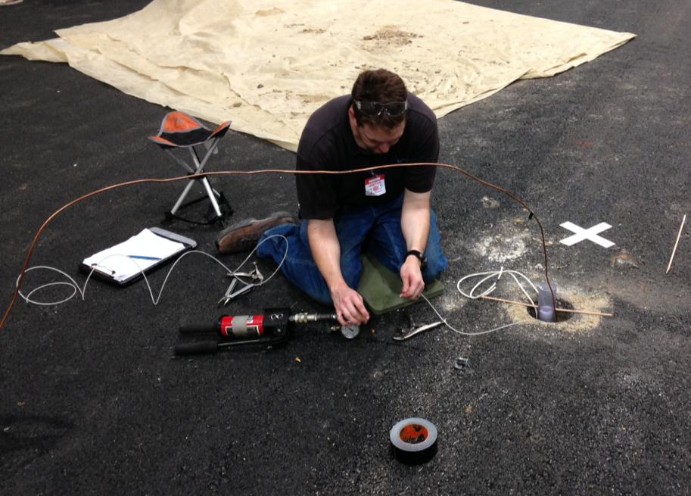

Slide 19
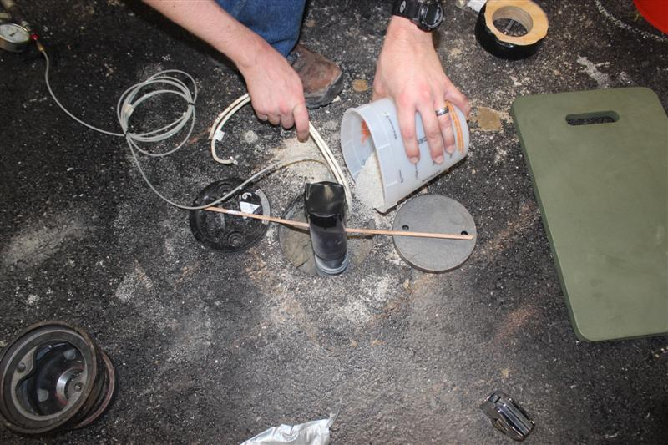
CC7- MDD Installation

Slide 20
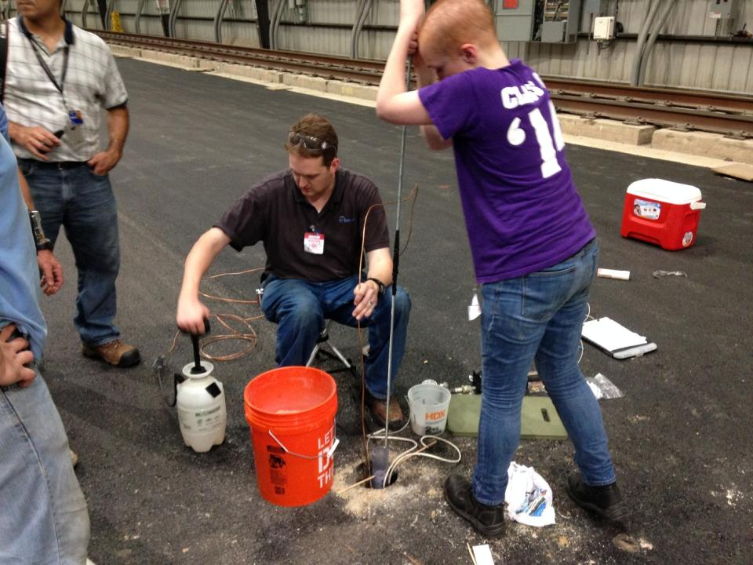
CC7- MDD Installation

Slide 21
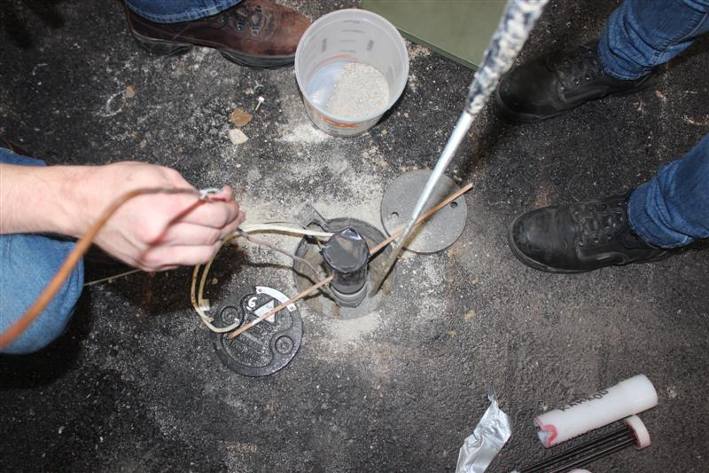
CC7- MDD Installation

Slide 22
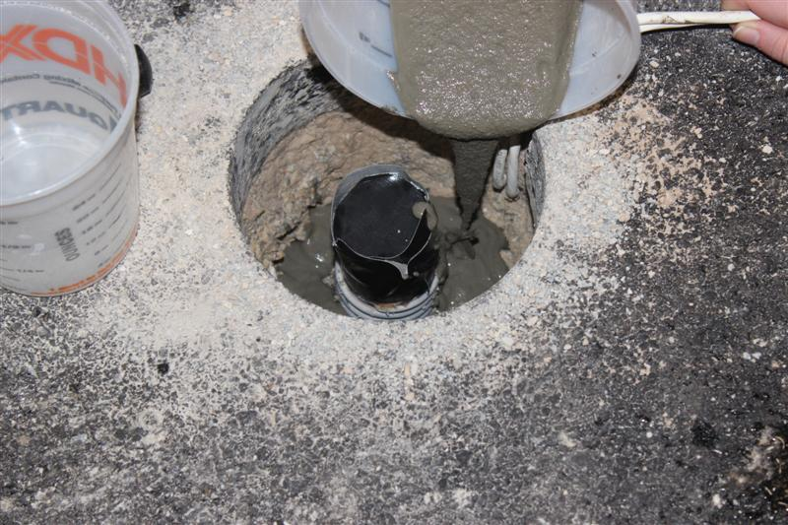
CC7- MDD Installation

Slide 23
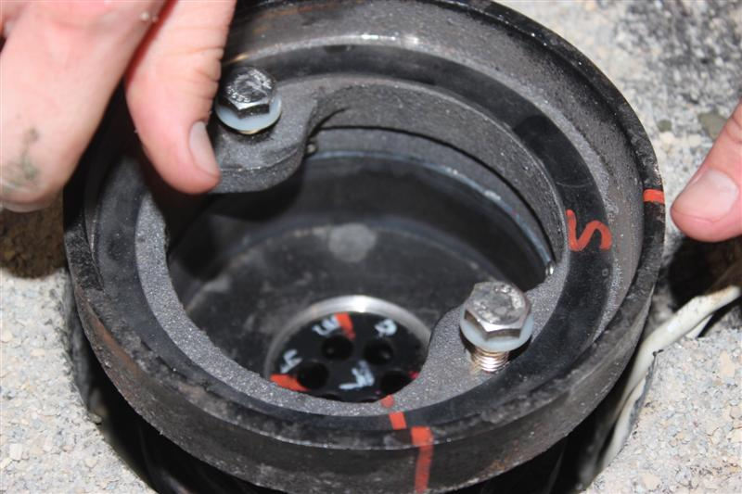
CC7- MDD Installation

Slide 24
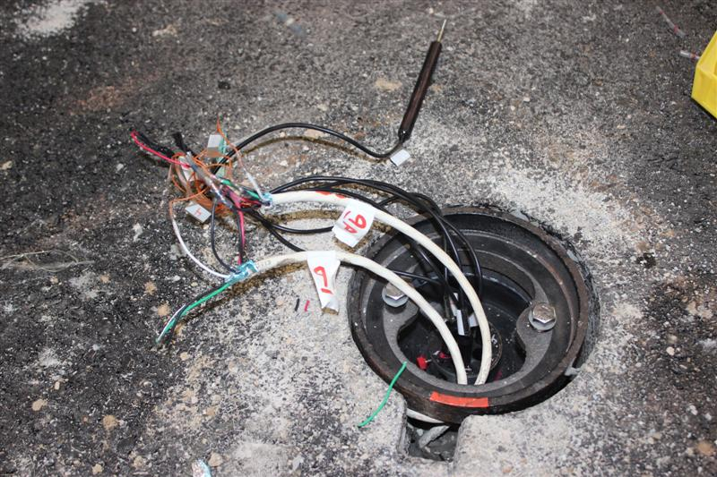
CC7- MDD Installation

Slide 25
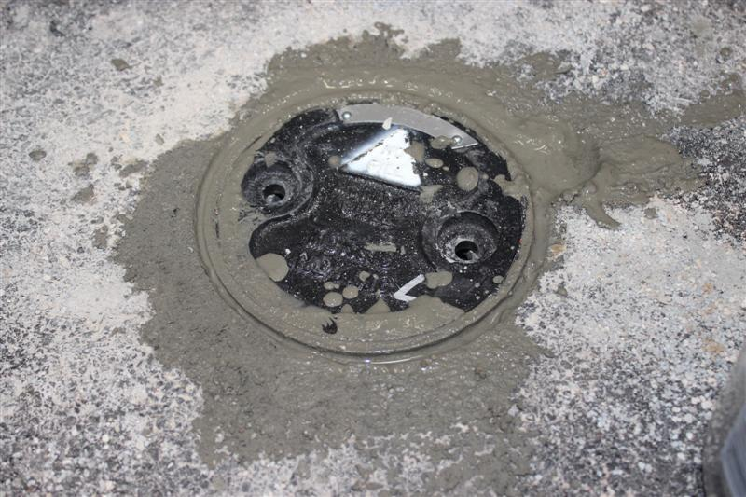
CC7- MDD Installation

Slide 26
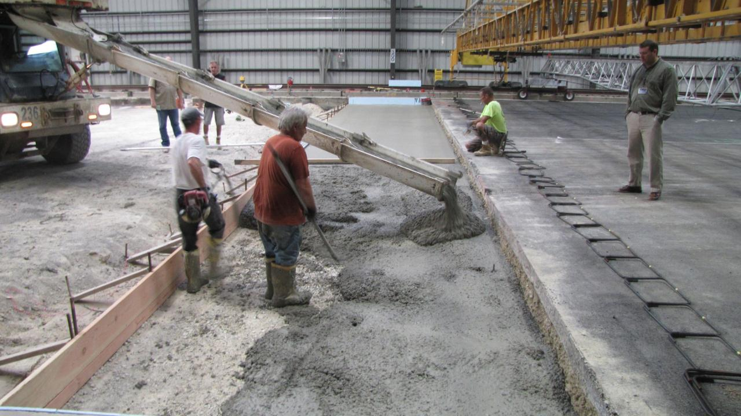
CC7 / CC8 Transition

Slide 27
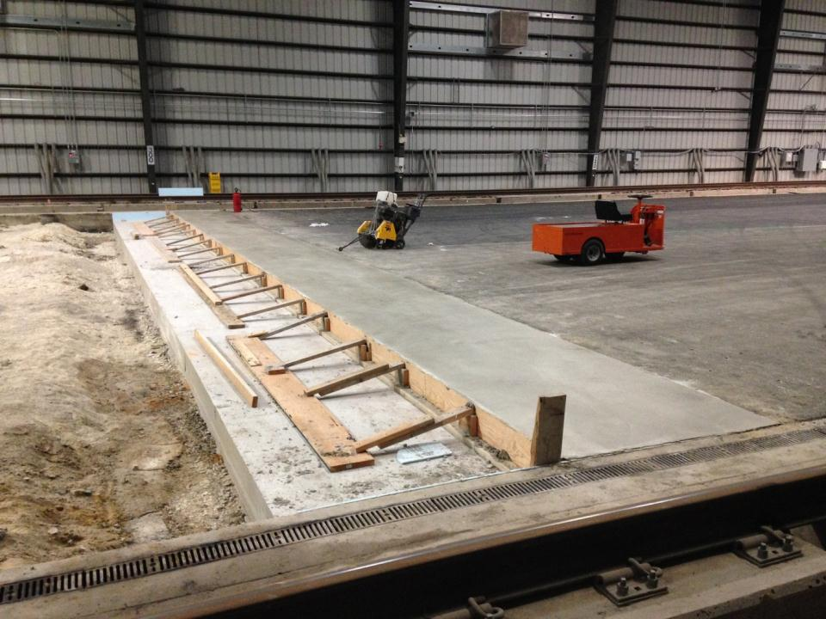
CC7 / CC8 Transition

Slide 28
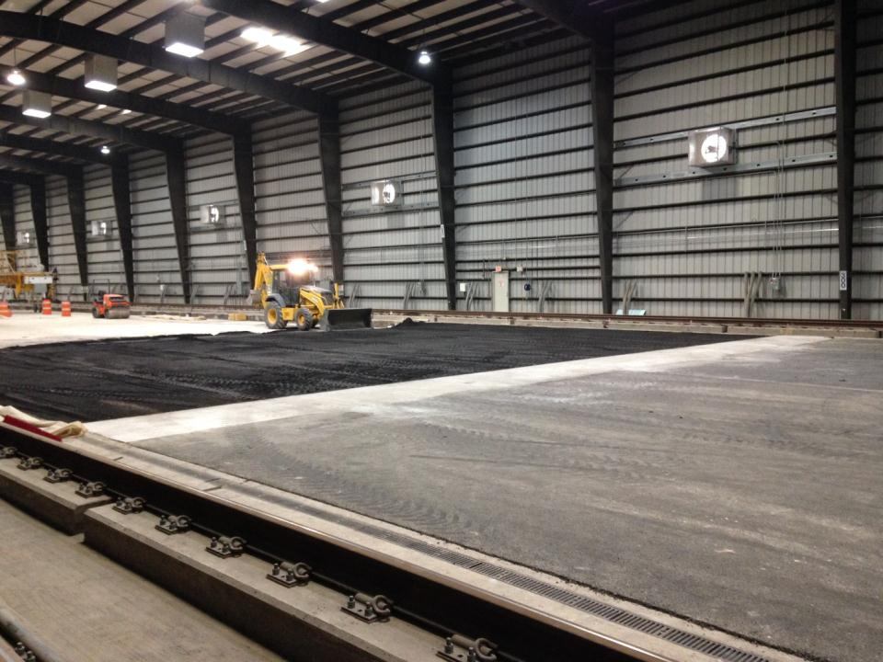
CC7 / CC8 Transition

Slide 29
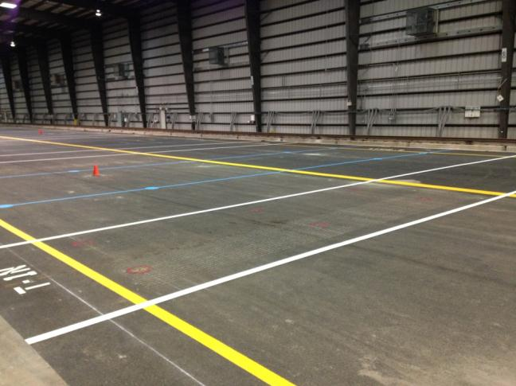
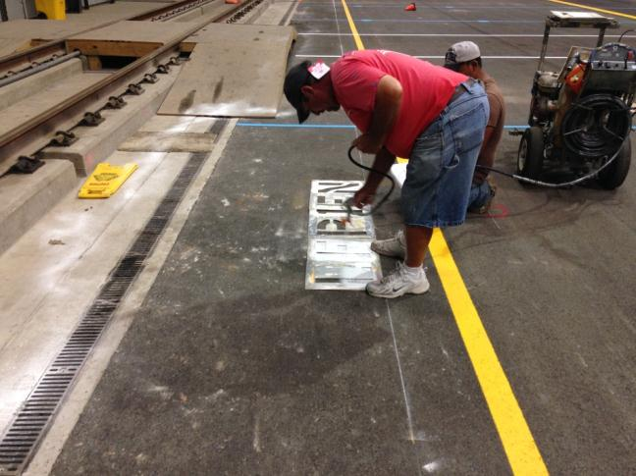
CC7 Striping

Slide 30
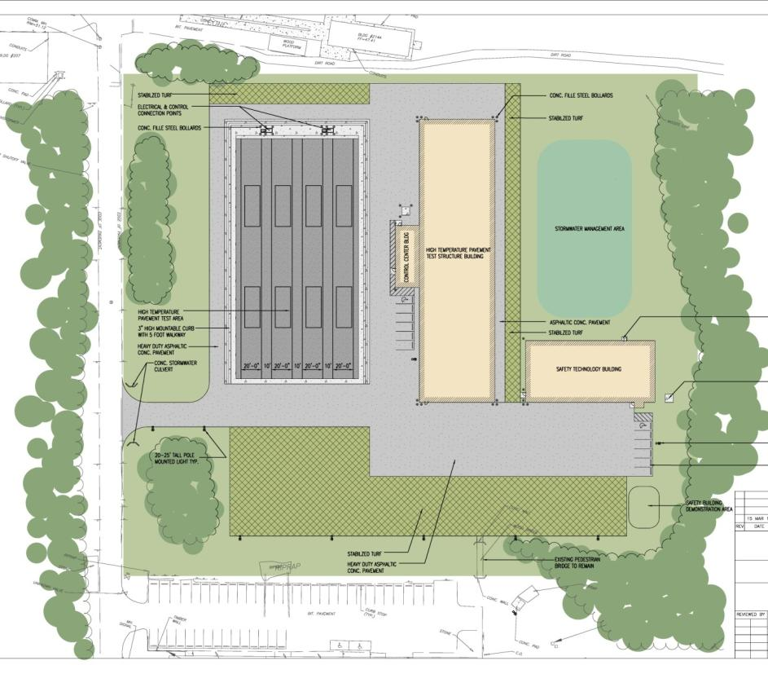
High Temp. Pavement Test Facility and Safety Technology Building

Slide 31
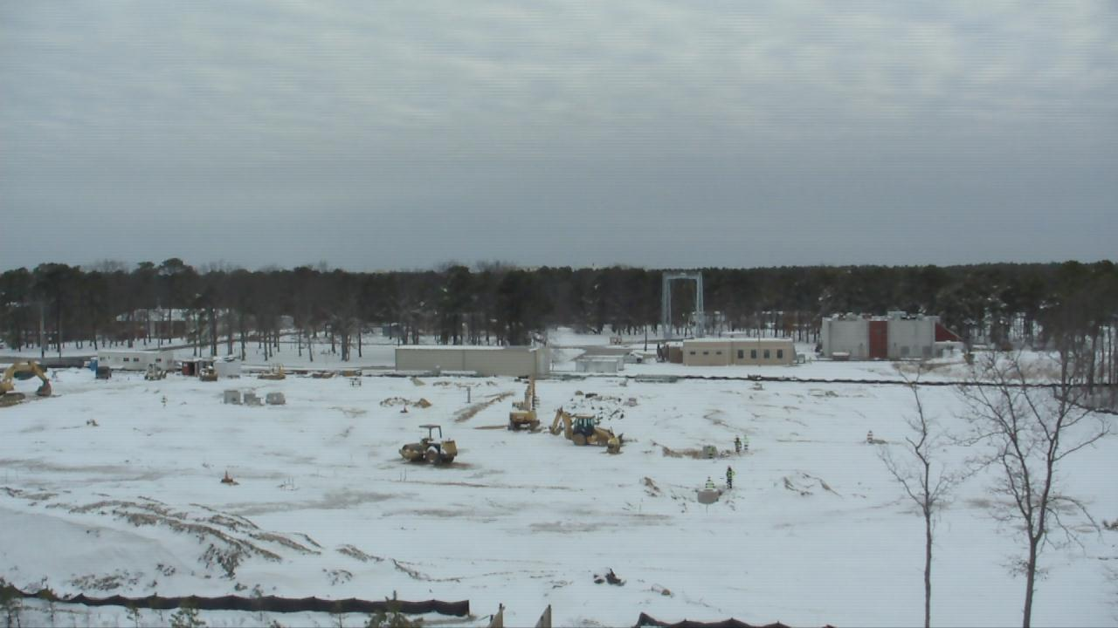
HTPTF and Safety Technology Bldg.

Slide 32
HTPTF and Safety Technology Bldg.
From the FAA Construction Inspector’s Log:
10 Mar 2014 - Long cold winter. Base closed multiple time for snow. Project stalled many times for snow and frozen ground. Hopefully winter is about done…

Slide 33
HTPTF and Safety Technology Bldg.
November 2013 through March 2014:
  Site Clearing and grubbing
  Underground Utilities
    Electric
    Telecom
    Sanitary Sewer
    Storm Water System
    Domestic Water
  Site Grading
  Partial Footers for Tension Membrane Building

Slide 34
HTPTF and Safety Technology Bldg.
April through August 5
  All underground utilities complete
  Foundations and walls poured for the HTPTF building
  Footers and slab poured for the control building
  Footers and grade beam walls poured for the STB
  Radiant floor heat system installed for STB
  Slab poured for STB
Current Completion Date is Jan 2015

Slide 35
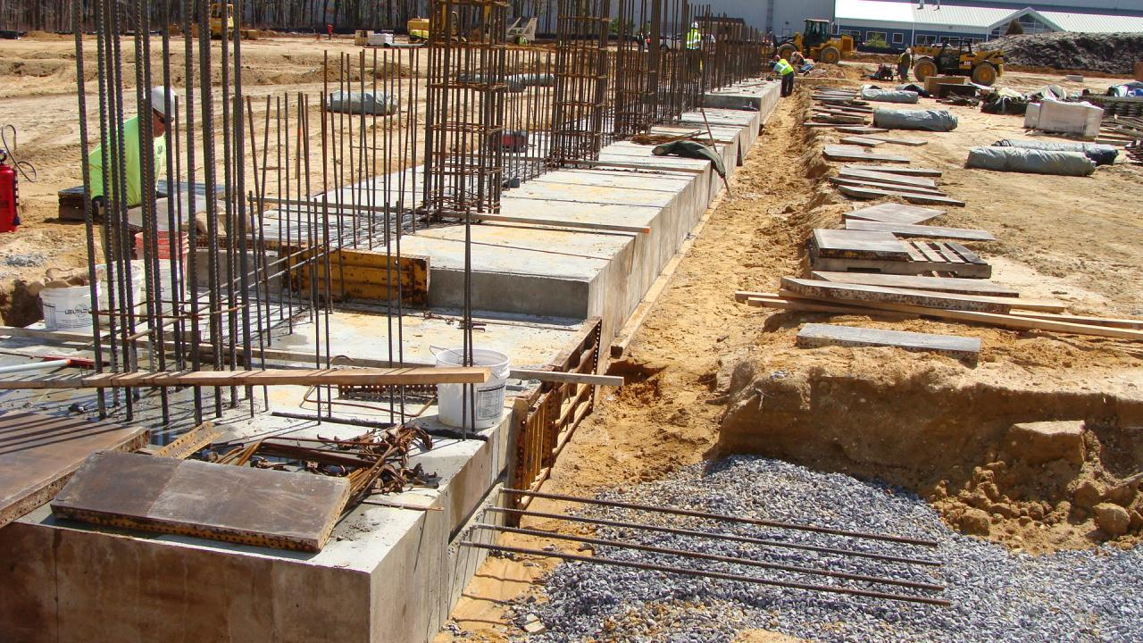
HTPTF & Control Bldg. Footers

Slide 36
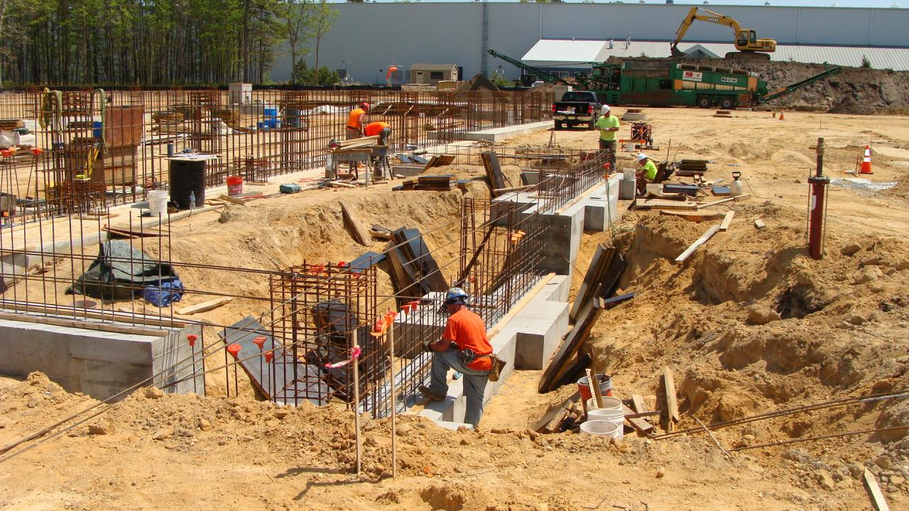
HTPTF & Control Bldg. Footers

Slide 37
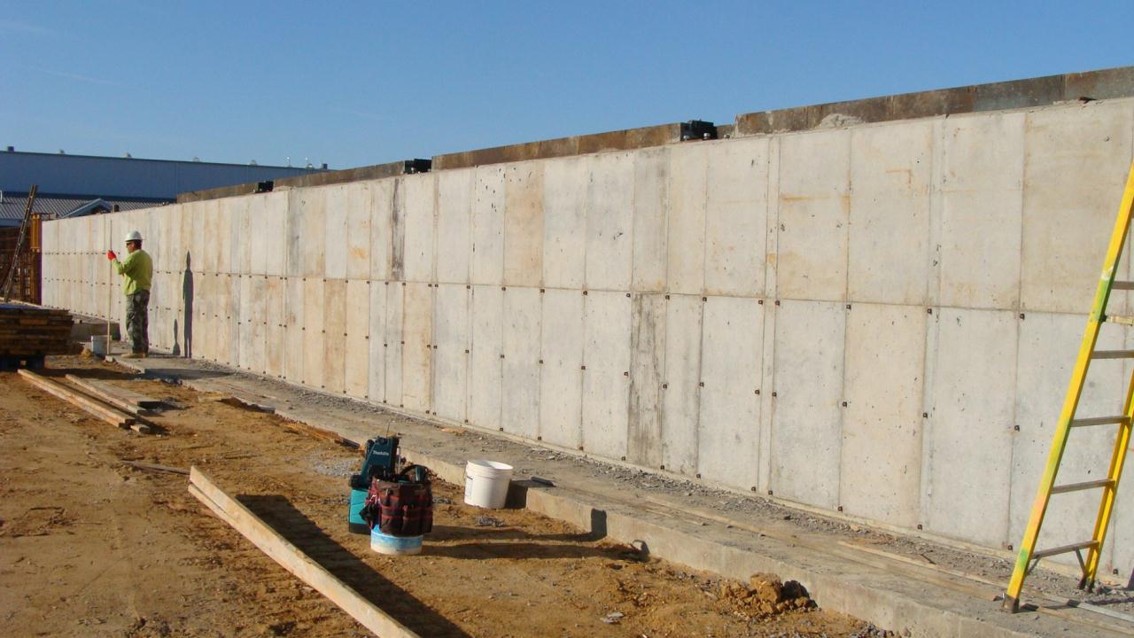
HTPTF Building Walls

Slide 38
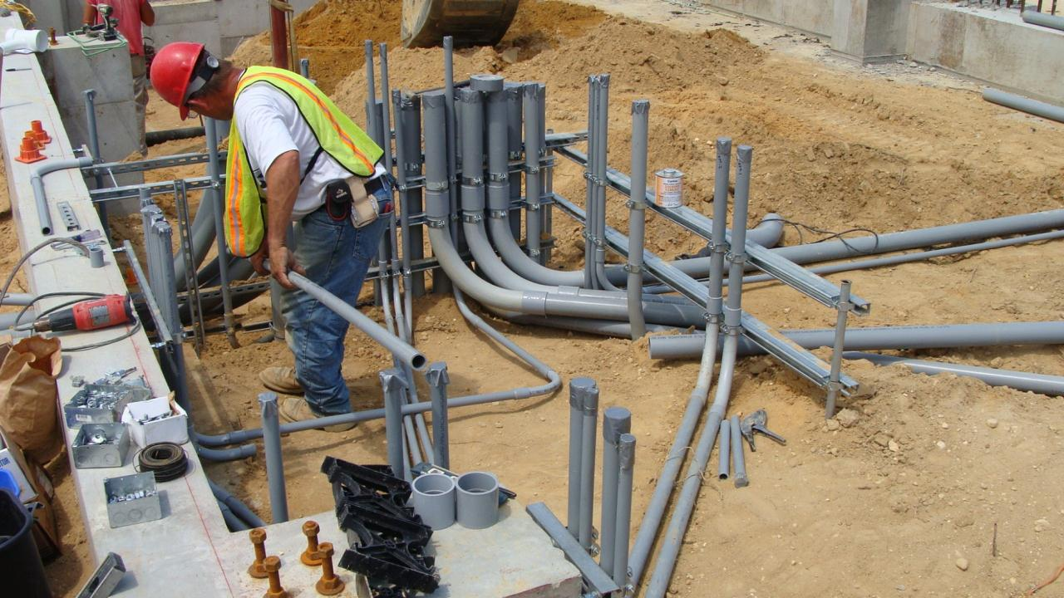
HTPTF

Slide 39
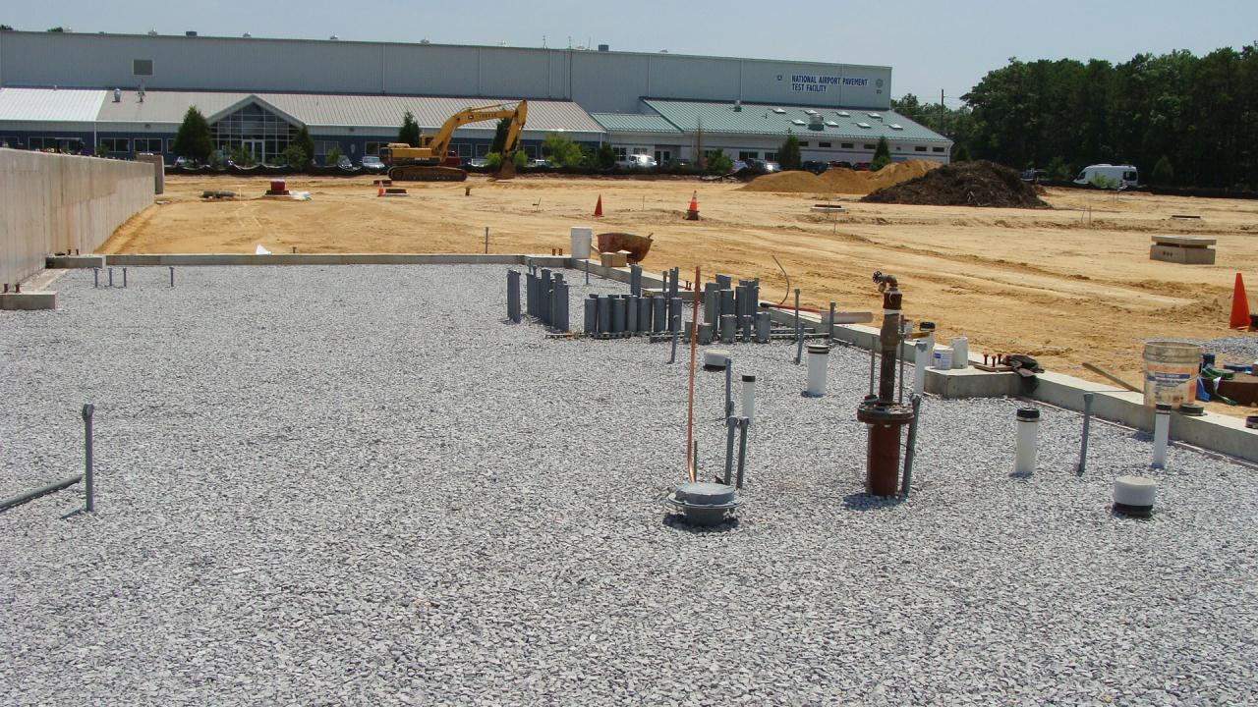
Control Bldg. – Prepped for Slab

Slide 40
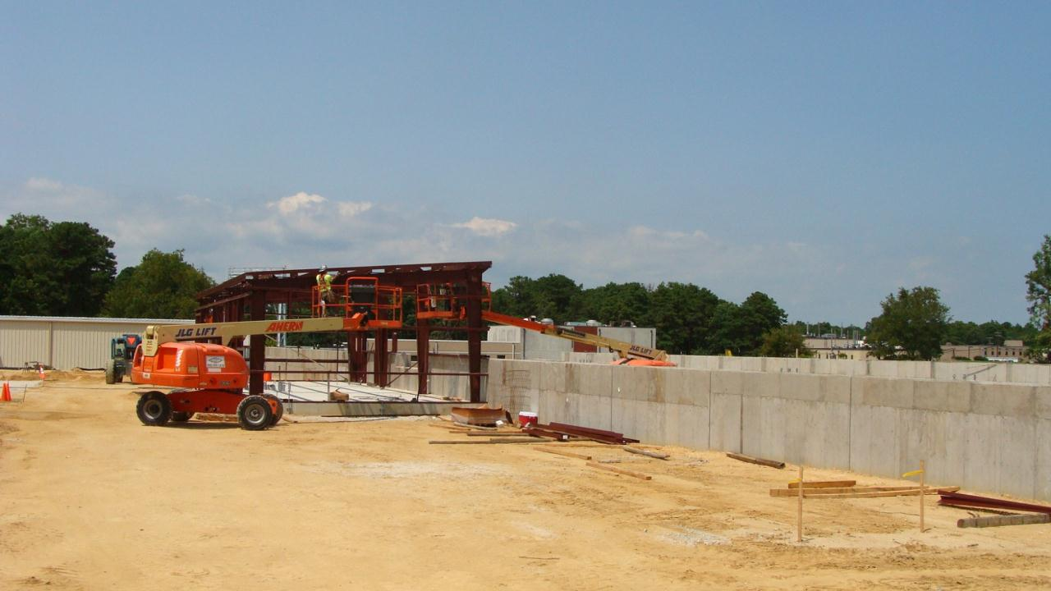
HTPTF Control Bldg. Steel

Slide 41
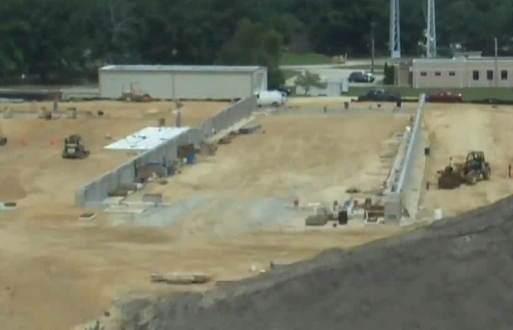
HTPTF Foundations and Walls

Slide 42
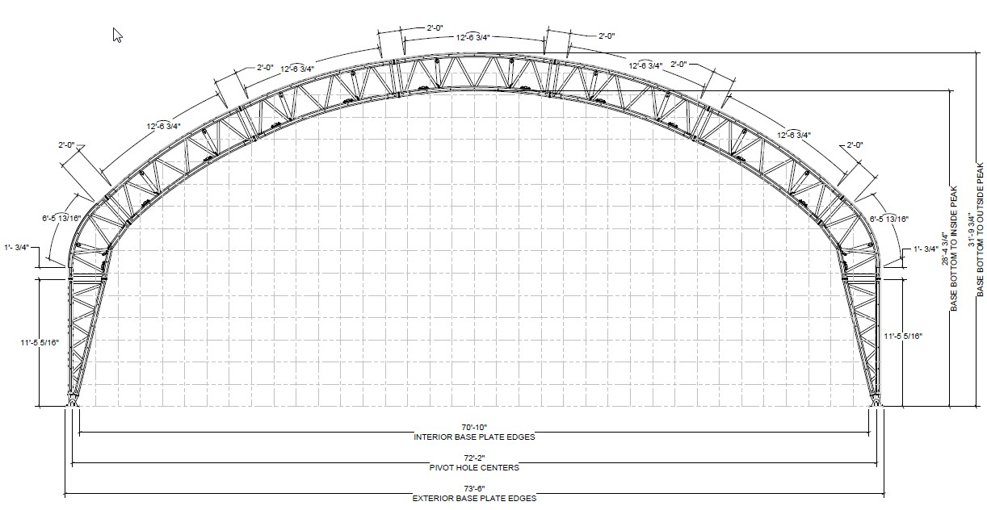
HTPTF Building Profile

Slide 43
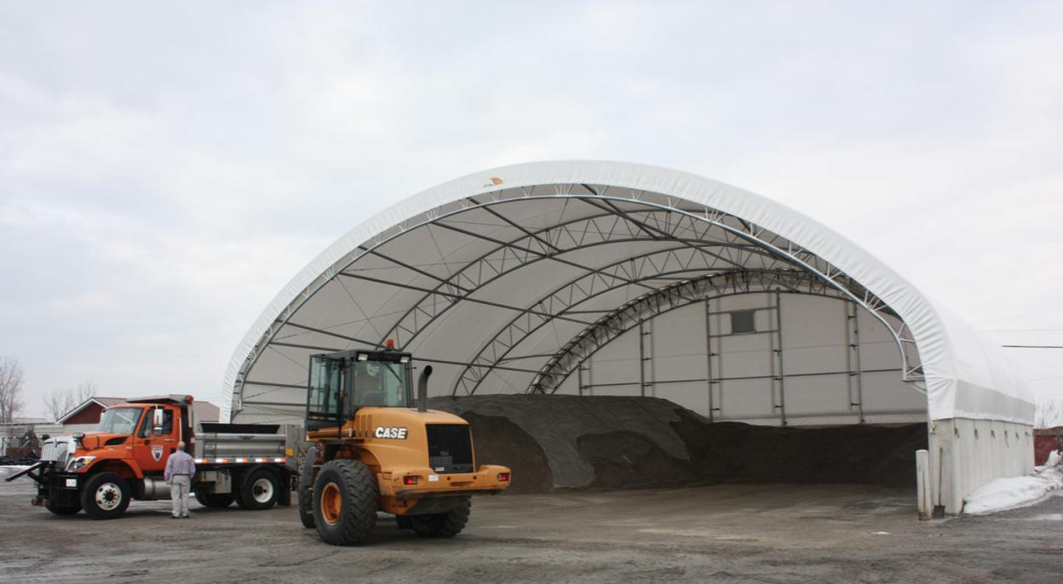
HTPTF Building Example

Slide 44
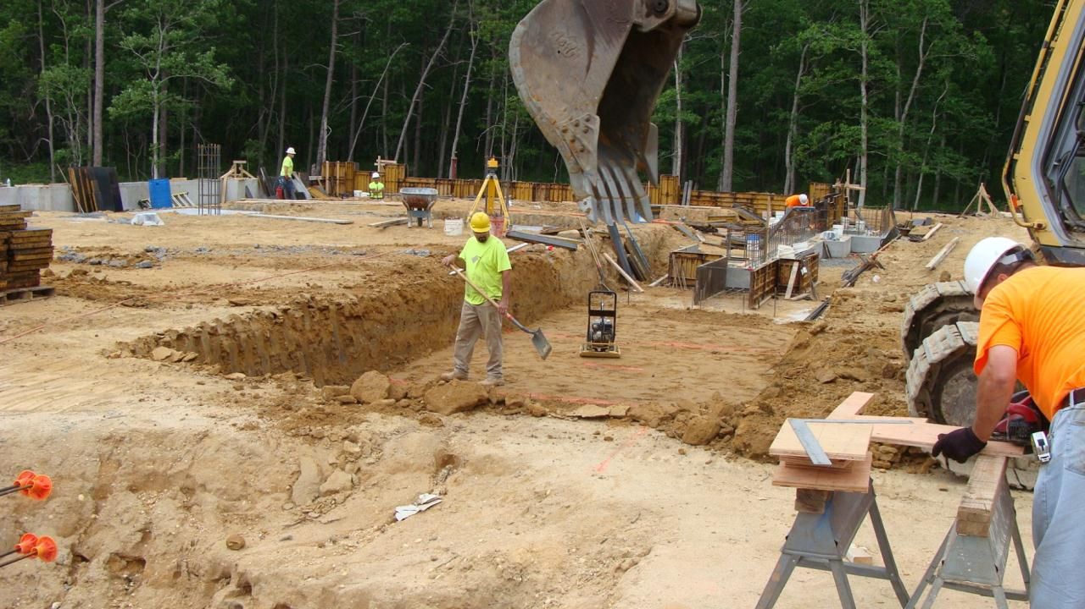
STB – Footers and Grade Beam

Slide 45
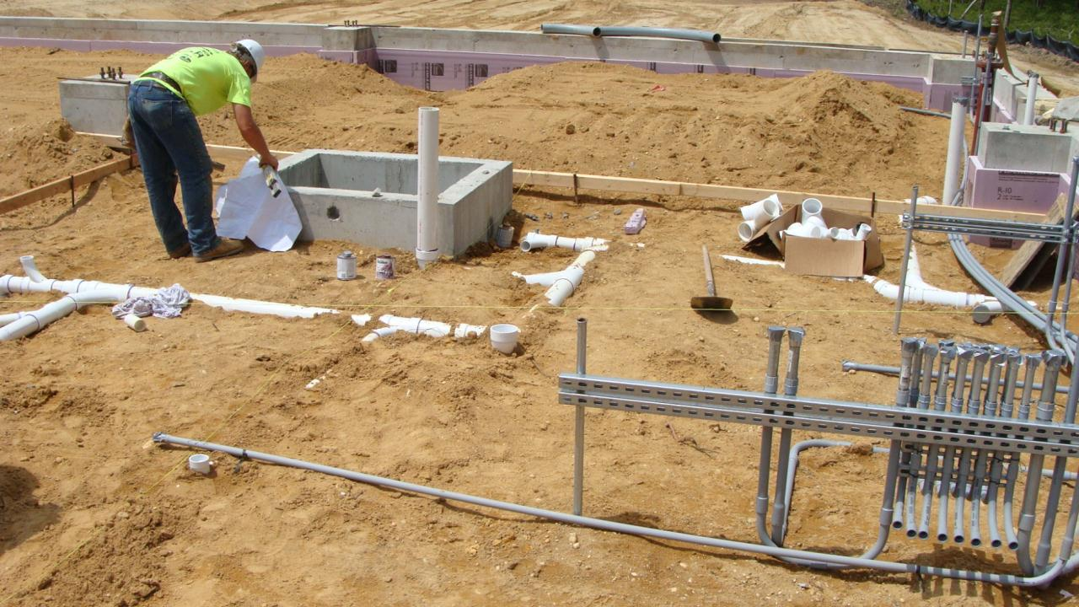
STB – Under Slab Works

Slide 46
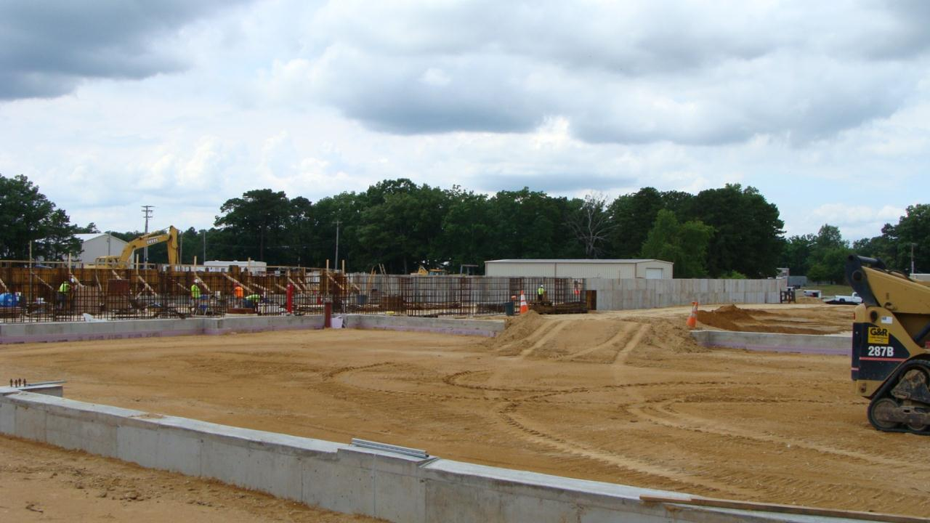
STB – Footers and Grade Beam

Slide 47
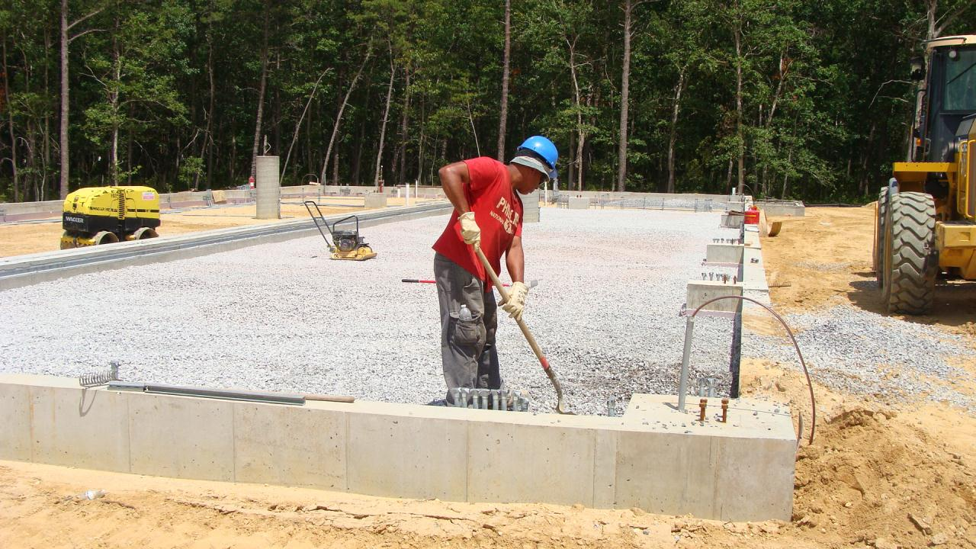
STB – Prepping for Slab

Slide 48
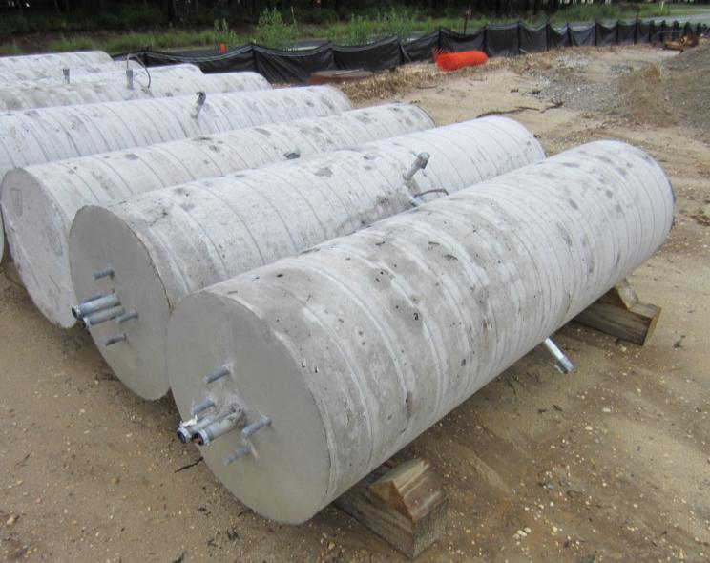
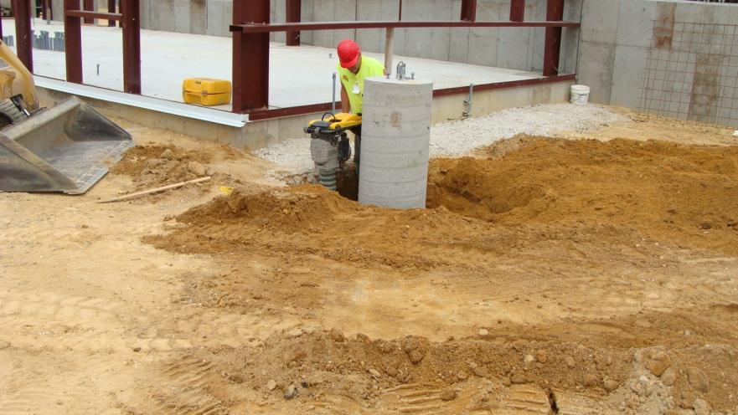
HTPTF and STB - Site Lighting

Slide 49
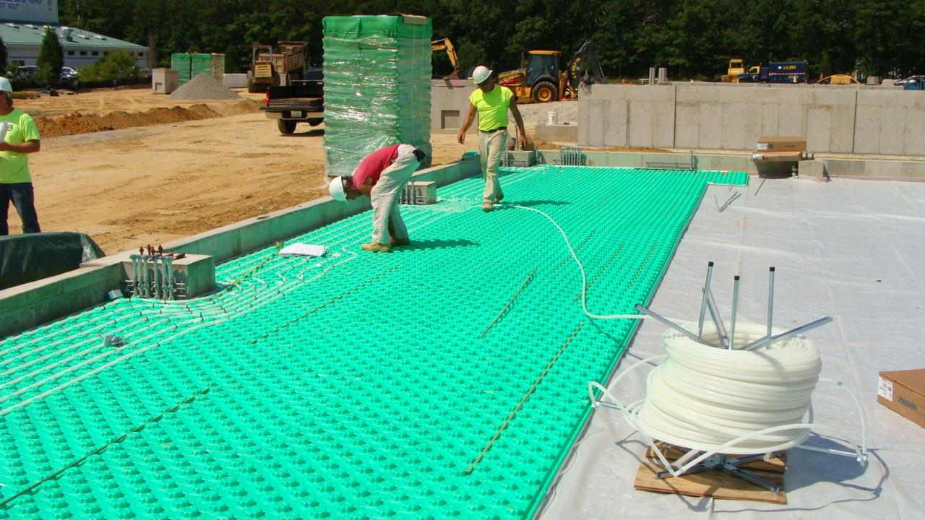
STB Radiant Floor Heat

Slide 50

HTPTF and STB 8/11/14

Slide 51
Time Lapse Video
QUESTIONS / COMMENTS?
Murphy.Flynn@faa.gov
609-485-5318

