Slide 1
Overview of the Surface Safety Initiatives Team (SSIT) and Comprehensive Airport Review and Assessment (CARA) Teams
Presented to: REDAC Subcommittee
By: Mike DiPilato
Date: August 13, 2014

Slide 2
Overview
Roles and Responsibilities
Surface Safety Initiatives Team (SSIT)
Comprehensive Airport Review and Assessment (CARA) Teams
Comprehensive Airport Review Plan (CARP)
Boston and DFW*
SSITs Next Steps
Project Schedule

Slide 3
Surface Safety Initiatives Team (SSIT)
Developed in Response to Re-baselining the RWSL Program and Removal of LCGS Prototypes
Large Cost Increases
Charters CARA Teams
Identify Operational Shortfalls
Provides Guidance and Direction to CARA Teams
Oversees Alternatives Assessment and Benefits Case Teams

Slide 4
SSIT Organization
OFFICE OF AIRPORTS:
Jim White
NATCA
NextGen
Office of Airports
SAFETY AND TECHNICAL TRAINING:
Jeff Stewart
Aviation Safety
Policy Internal Affairs and Environmental
ATO Offices
Safety and Technical Training
Program Management Organization
System Operations Services
Mission Support

Slide 5
Comprehensive Airport Review and Assessment (CARA) Team
NOT AN INSPECTION!!!
Different than an RSAT
Identify Operational Shortfalls
“Desk Review”
Data Review
Document Review
Brainstorming
Draft the Comprehensive Airport Review Plan (CARP)

Slide 6
Participating Airports
GEG
MHT
BOS
RNO
SJC
LGB
SAN
DFW
RWSL Airports
LCGS Airports

Slide 7
Core CARA Team Organization
CARA Team Lead:
Runway Safety
Program Manager
Airport Management
ATCT Management
NATCA
FAA Airport District Office
FAA Airport Safety R&D
SSIT

Slide 8
CARA Sub-Teams
Airport/Airlines (Pilots)
ATCT/NATCA
Tech Ops
Flight Standards
Airport District Office (ADO)
Air Traffic Service Center

Slide 9
Comprehensive Airport Review Plan (CARP)
BOSTON
Shortfalls
Planned Removal of RWSLs
Use of Runways as Taxiways
Hot Spots 1 and 4
Hot Spots 2 and 3
Airport Layout/Cockpit Workload
RSAT Action Item
Aircraft Lined up to Land on a Taxiway
**Completed on June 18, 2014**
DFW
Shortfalls
Planned Removal of RWSLs
Limitations with Vehicle Squitters
Hot Spots?
Coded Taxiway Routes
B747-8 Taxiing Procedures
Non-Standard Taxiway Geometry
Wide Expanses of Pavement
3 Node Taxiways
**Available for comment by September 30, 2014**

Slide 10
SSITs Next Steps
Review the CARP
Form Alternative Analysis and Benefits Case Teams:
Surface Technology
Airport Design and Procedures
Air Traffic Procedures and Policies
Identify Alternatives for each Shortfall
Rank and Recommend Alternatives based on:
Cost
Benefit
Impact

Slide 11
Project Schedule
Airport | CARA Process | CARP
WAVE 1
Boston | February 26th – April 26th 2014 | June 18th
DFW | April 25th – July 29th 2014 | September 30th
WAVE 2
San Diego | August 12th – November 2014 | Q1 2015
Reno | August 19th – November 2014 | Q1 2015
WAVE 3
Long Beach | September 23rd – December 2015 | Q1 2015
Spokane | September 24th – December 2015 | Q1 2015
San Jose | September 25th – December 2015 | Q1 2015
Manchester | TBD | TBD

Slide 12
Questions?
Mike DiPilato
Airport Operations Research Analyst
SRA
Email: mike_dipilato@sra.com
Phone: 609-601-6800 x144

Slide 13
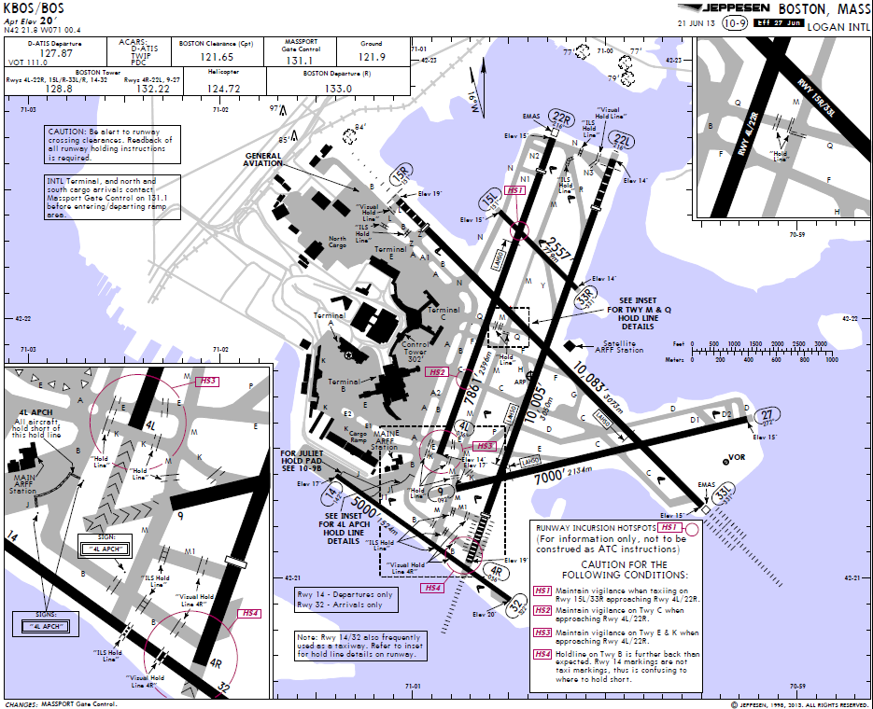

Slide 14
