Slide 1
RPD 135
High Temperature Pavement Test Facility
(Airport Pavement Test Vehicle)

Slide 2
High Temperature Pavement Test Facility- RPD 135
Contract Funds ($K)
Projects | FY14 | FY15 | FY16
Maintenance and Equipment | 100 | 50 | 100
Set-up Database, Process and Analyze Data | 75 | 150 | 200
Test Pavement Construction | 600 | 200 | 300
Data Acquisition System & Instrumentation | 150 | 50 | 200
APTV Building Construction & Testing | 175 | 0 | 0
APTV Operation | 0 | 300 | 0
TOTAL | $ 1,100 | $ 750 | $ 800

Slide 3
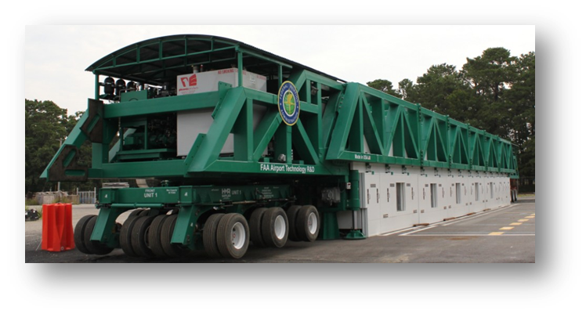
APTV/HVS-A

Slide 4
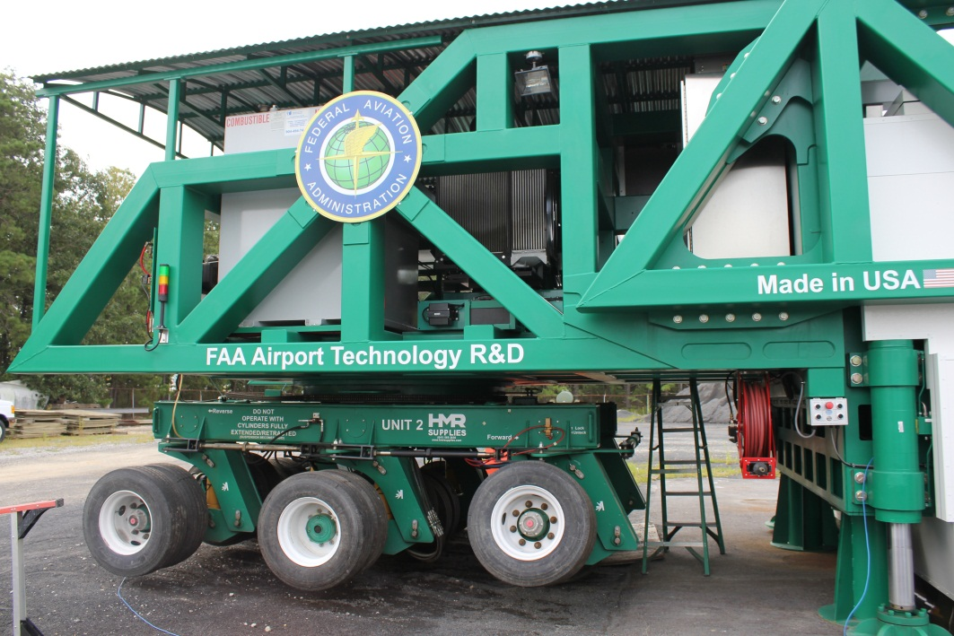
AIRPORT Pavement Test Vehicle
Heavy Vehicle Simulator – Airport Version (HVS-A)
  Wheel loads - 10,000 to 100,000 lbs.
  Pavement temperatures up to 150°F
  Test speeds - 0.17 to 5 mph
  Single and Dual-Wheel configuration.
  Single wheel will be radial aircraft tires size 52x21.0R22
  Dual wheel assembly is designed to accommodate smaller tires (B-737-800)
  Wander Width – 6 feet
  FAA Acceptance – November 1, 2013

Slide 5
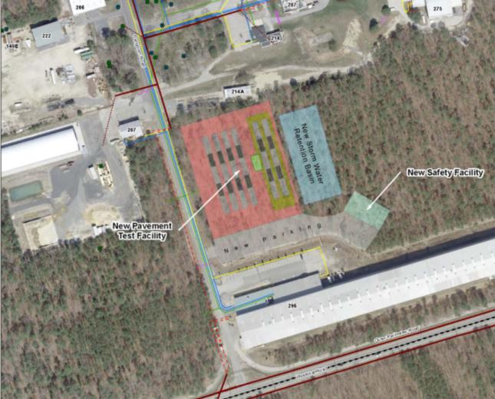
HVS-A Test Pavement
Location in 207 Yard

Slide 6
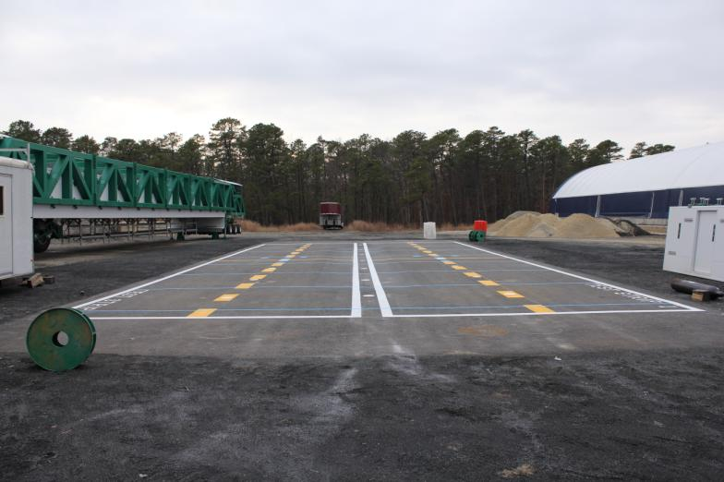
HVS-A Acceptance Test Strips

Slide 7
HVS-A Acceptance Test Strips
PAVEMENT CROSS-SECTION

Slide 8
HVS-A Acceptance Test Strips

Slide 9
HVS-A TS: Response and Traffic Tests

Slide 10
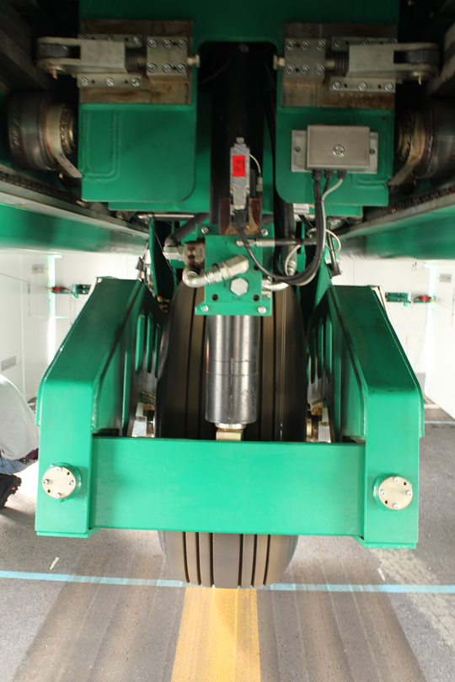
HVS-A ACCEPTANCE TEST STRIPS
Objectives:
Study the effects of Tire Pressure on
performance of HMA layer.
Tests:
Response Tests.
Traffic Tests.

Slide 11
HVS-A TS: RESPONSE TESTS
Tire pressure: 210-psi Test Strip-1
254-psi Test Strip-2
Pavement Temperature: 140 deg. F measured at a depth of 1-inch below pavement surface.
Test Speed: 2-mph
Wheel loads: 30,000-lbs, 40,000-lbs, 50,000-lbs.

Slide 12
HVS-A TS: TRAFFIC TESTS
Tire pressure: 210-psi Test Strip-1
254-psi Test Strip-2
Pavement Temperature: 140 deg. F measured at a depth of 1-inch below pavement surface.
Test Speed: 2-mph
Wheel loads: 61,300-lbs.

Slide 13
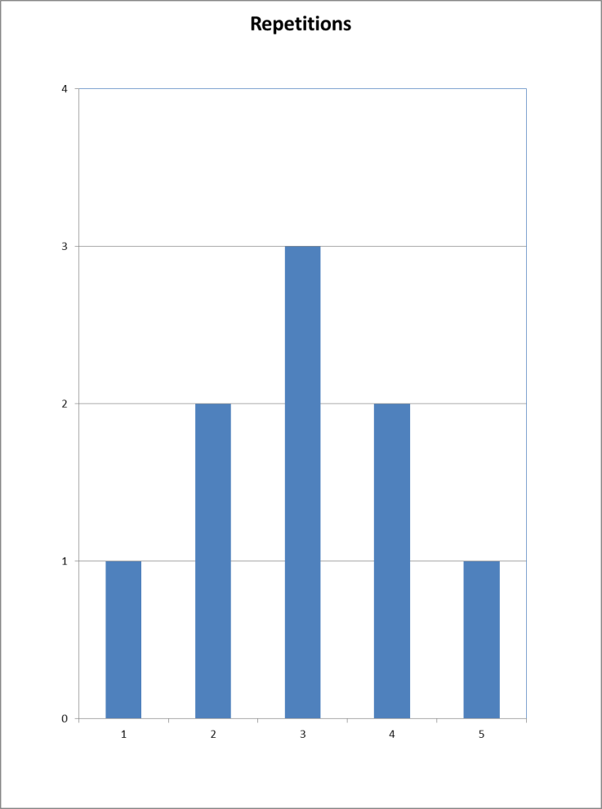
HVS-A TS: Wander Pattern

Slide 14
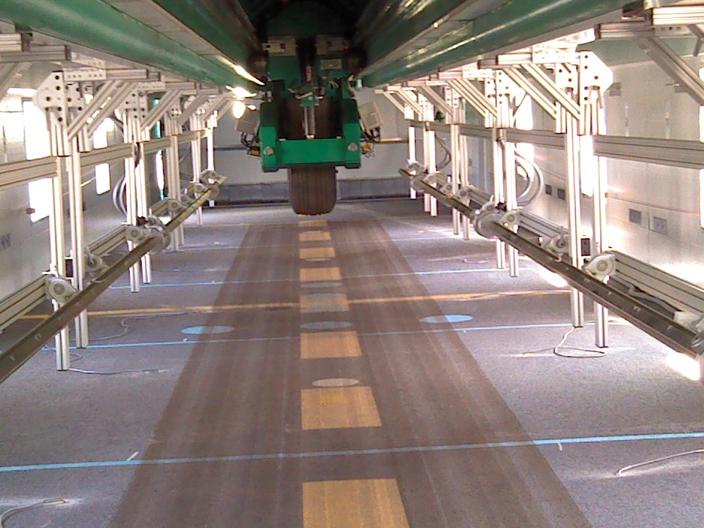
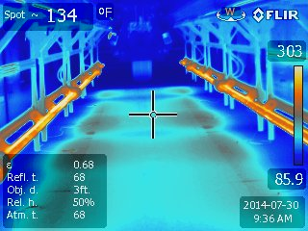
HVS-A TS: Response and Traffic Tests

Slide 15
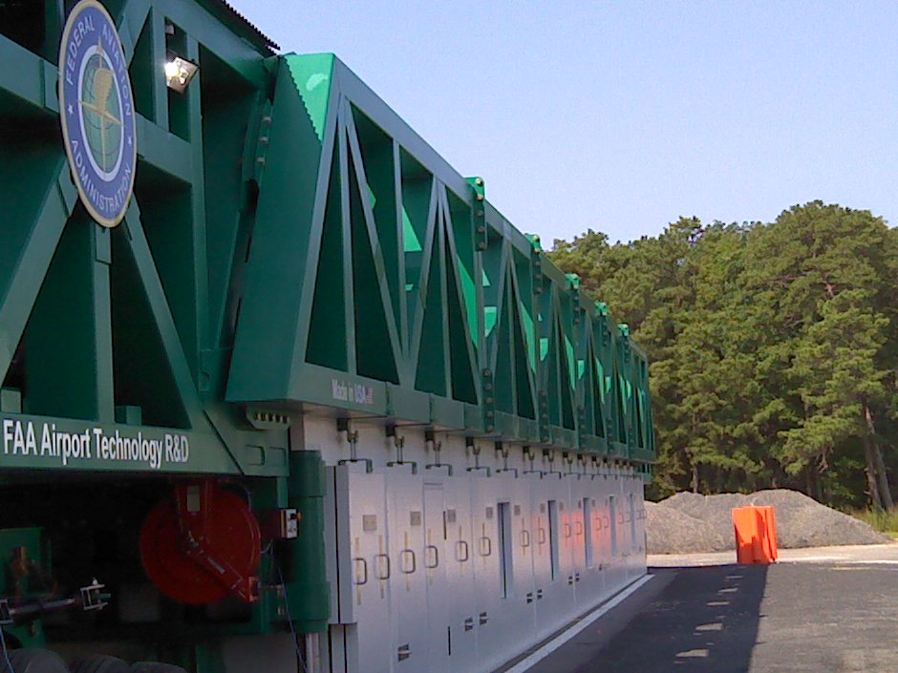
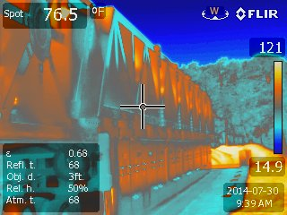
HVS-A TS: Response and Traffic Tests

Slide 16
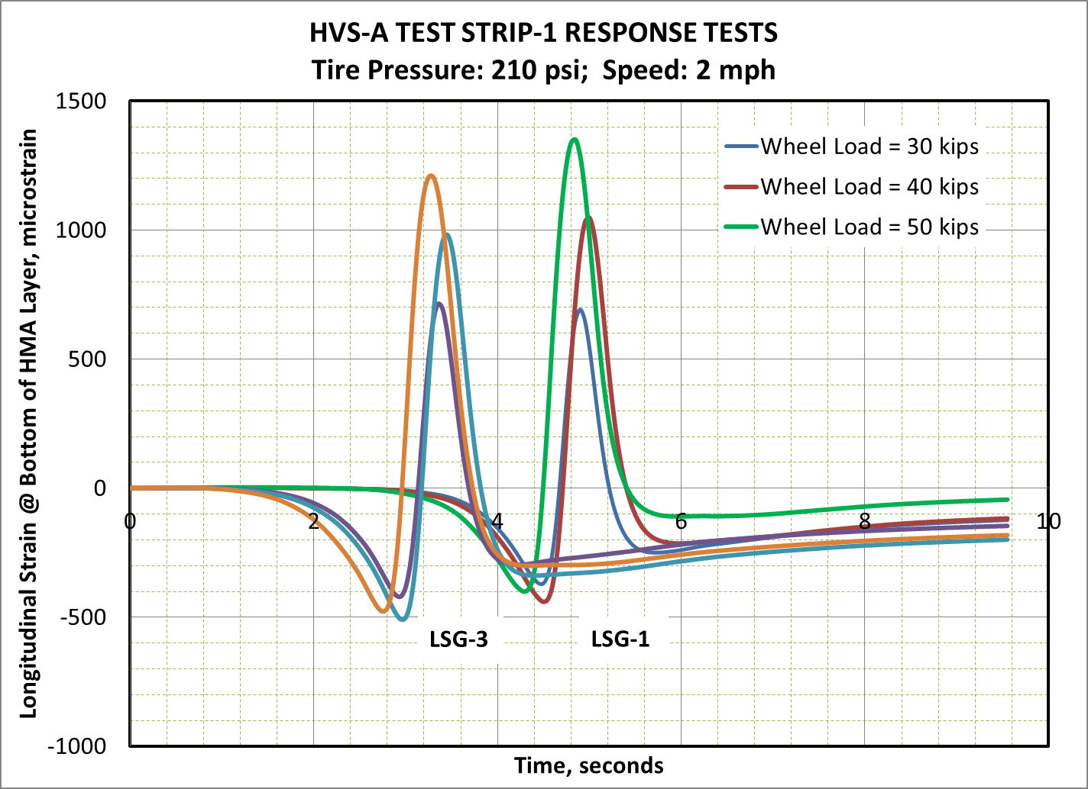
HVS-A TS: Response Tests

Slide 17
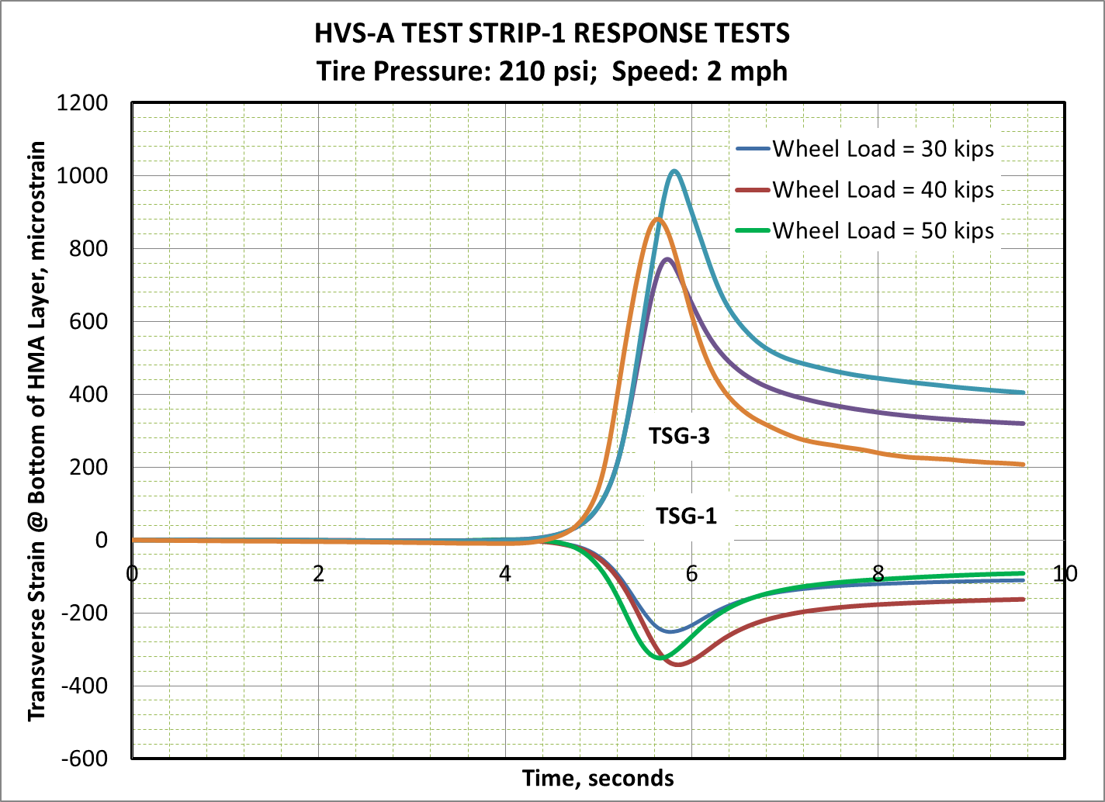
HVS-A TS: Response Tests

Slide 18
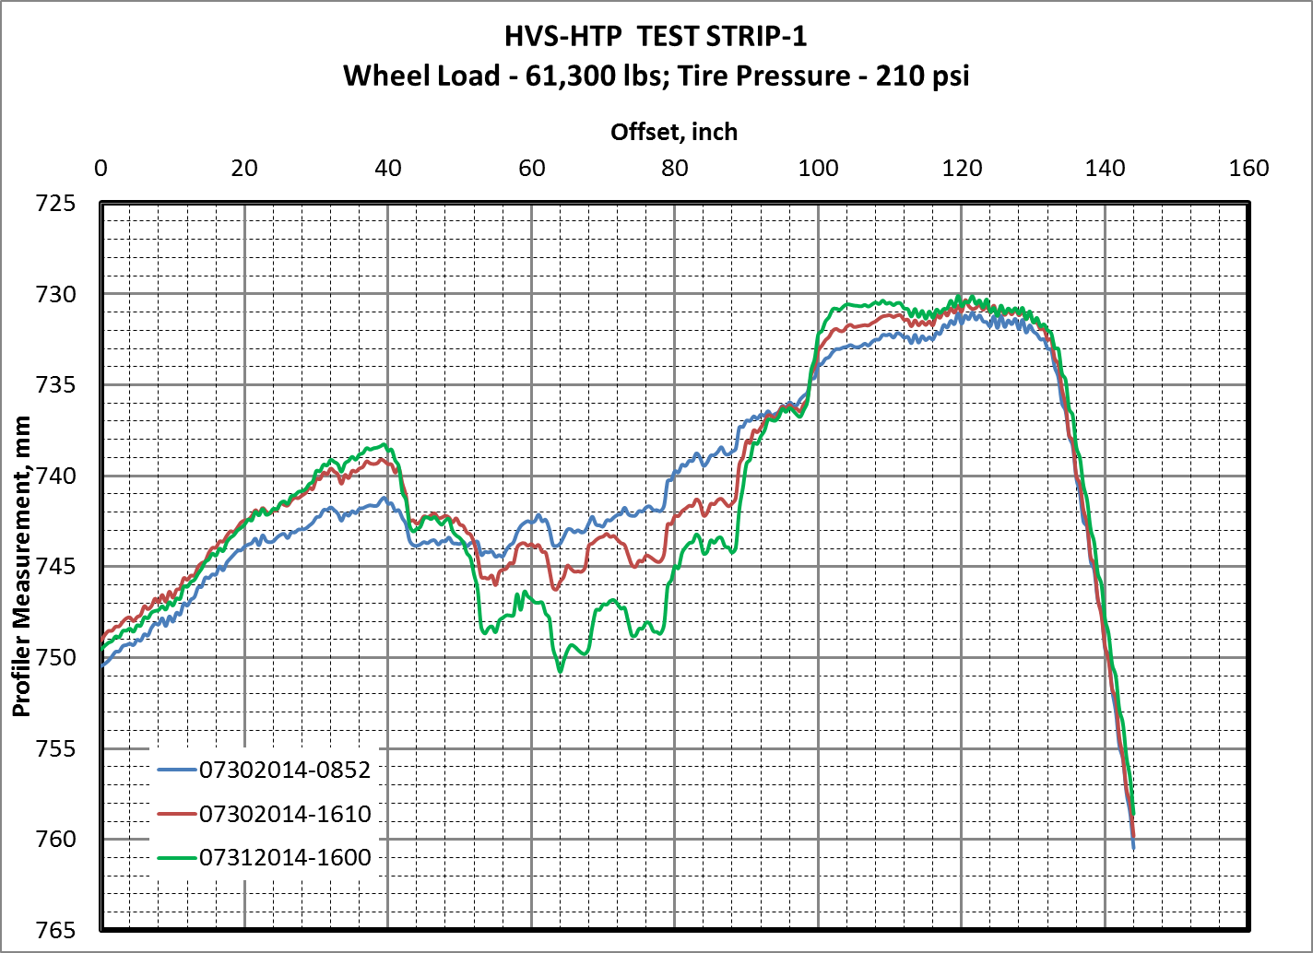
HVS-A TS: Profiles
Pre-Response Tests
Post-Response Tests (54 Passes)
Traffic Tests (18 Passes @ 61,300 lbs wheel load)

Slide 19
Future Research
EVALUATION OF NEW ASPHALT TECHNOLOGIES FOR AIRFIELD PAVEMENTS
Warm Mix Asphalt, Stone Matrix Asphalt, Polymer Modified Binders,
RAP Mixes, Full-Depth Rehabilitation
PROBLEM: Lack of Guidance/Standards/Specifications
Lack of Performance Data
Laboratory Performance Evaluation
Full-Scale APT
HTPTF/APTV
Field Performance Evaluation
Evaluate:
Rutting
Fatigue
Moisture Susceptibility
Durability
Low Temperature Cracking
Full-Scale APT:
Rutting
Fatigue
Tire Pressure Effects
RAP Content
Compare to P-401 HMA
Field Projects:
Lab Evaluation of Field Mixes
Construction Evaluation
Evaluate:
Mix Design Production, Construction
Support from AAS-100, ADO

Slide 20
HTPTF-Construction Cycle 1
Objectives:
Study the effects of Tire Pressure on performance of HMA layer.
Study the effect of polymer modified binder on HMA layer performance.
Evaluate the performance of Warm Mix Asphalt under aircraft wheel load.

Slide 21
MATERIAL
P401
HMA
P401
HMA
WMA
WMA
P401
HMA
WMA
254
psi
254
psi
254
psi
254
psi
254
psi
254
psi
TIRE
PRESSURE
214
psi
214
psi
214
psi
214
psi
214
psi
214
psi
BINDER
TYPE
PG
64-22
PG
76-22
PG
64-22
PG
76-22
PG
76-22
PG
76-22

Slide 22
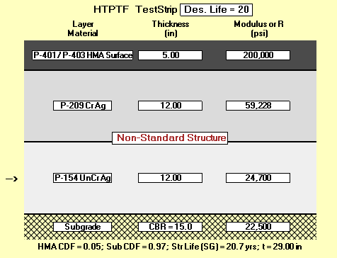
HTPTF Cross Sections

Slide 23
Future Research
“Green” technologies such as Warm Mix Asphalt
Stone Matrix Asphalt
Recycled Asphalt Pavement
Polymer Modified Binders
Shear failure of HMA
Performance of HMA overlays on
  Flexible Pavements
  Rigid Pavements

Slide 24
Future Research
Use of Additives and Nanoparticles to Improve Performance of Airport Pavement Materials
Evaluate the use of Additives and Nanoparticles for Improved Performance of Airport Pavement Materials
Develop Standards/Specifications and Guidelines for Pavement Materials that have been modified with Nanoparticles and other Additives.

Slide 25
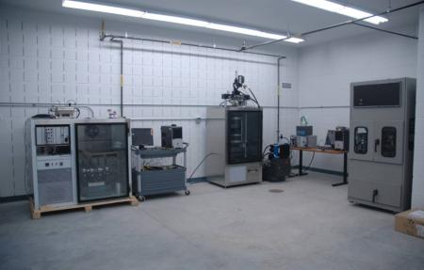
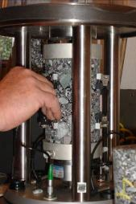
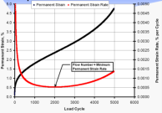
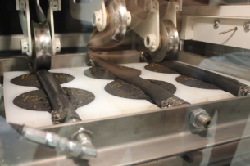
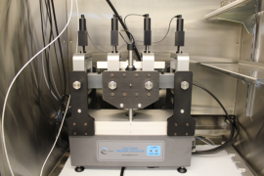

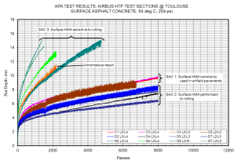
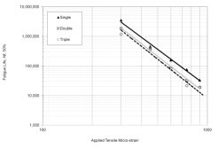
LABORATORY CHARACTERIZATION

Slide 26
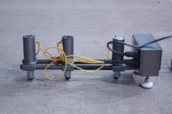
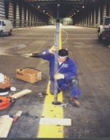
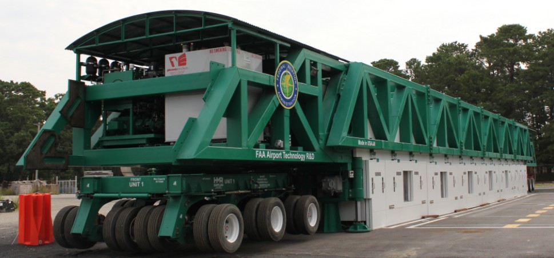
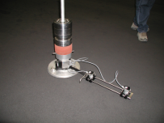
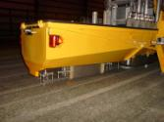
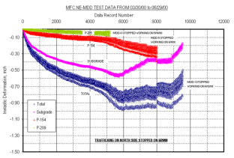
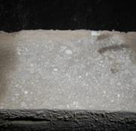
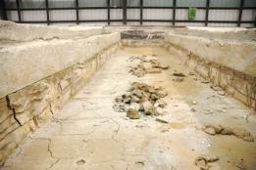
FULL SCALE APT

Slide 27
