Slide 1
40-Year Design Life Initiative
RPD 145
REDAC Subcommittee on Airports
David R. Brill, P.E., Ph.D.
August 13, 2014

Slide 2
Pavement Design and Evaluation
(RPD 145)
Contract Funds ($K)

Slide 3
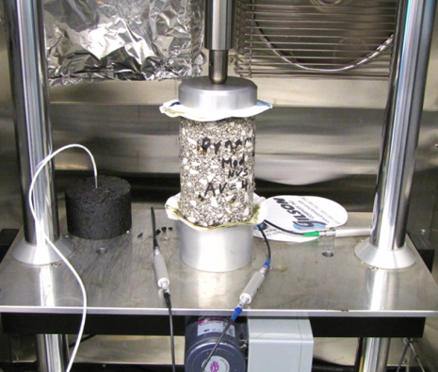
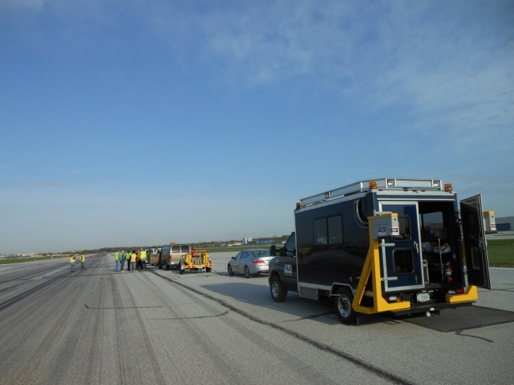
40-Year Pavement Life Extension
Runway data collection.
  4-year project - in year 3.
  Construction and performance data on medium- and large-hub runway pavements.
  Field data collection.
FAA PAVEAIR database development (PA40).
Performance/pavement life model development.

Slide 4
Runway Data Collection
4-year project began in 2012 to collect extensive construction and performance data on a selection of medium- and large-hub runway pavements.
  Goal is to support development of 40-year life standards.
  Split between existing runways with approximately 20 years (or more) of service and new AIP-funded projects.
  Both flexible and rigid runways.
  A subset of selected airports will be visited for comprehensive field data collection.
Year 1 and 2 runway data collection is complete.
Current efforts focus on populating the databases.

Slide 5
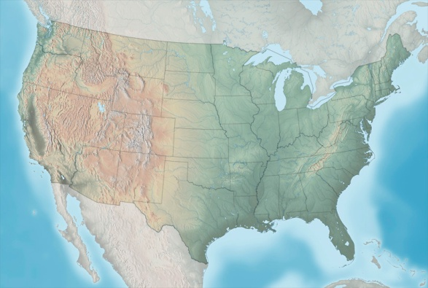

Year 1 Airport Locations
SEA
BOS
LGA
CMH
IAD
TUS
IAH
Large Hub
Medium Hub
Site designated for field data collection

Slide 6
Year 2 Airport Locations
ORD
IND
SFO
BWI
DCA
LAX
GSO
MCO
Large Hub
Medium Hub
Site designated for field data collection
Small Hub

Slide 7
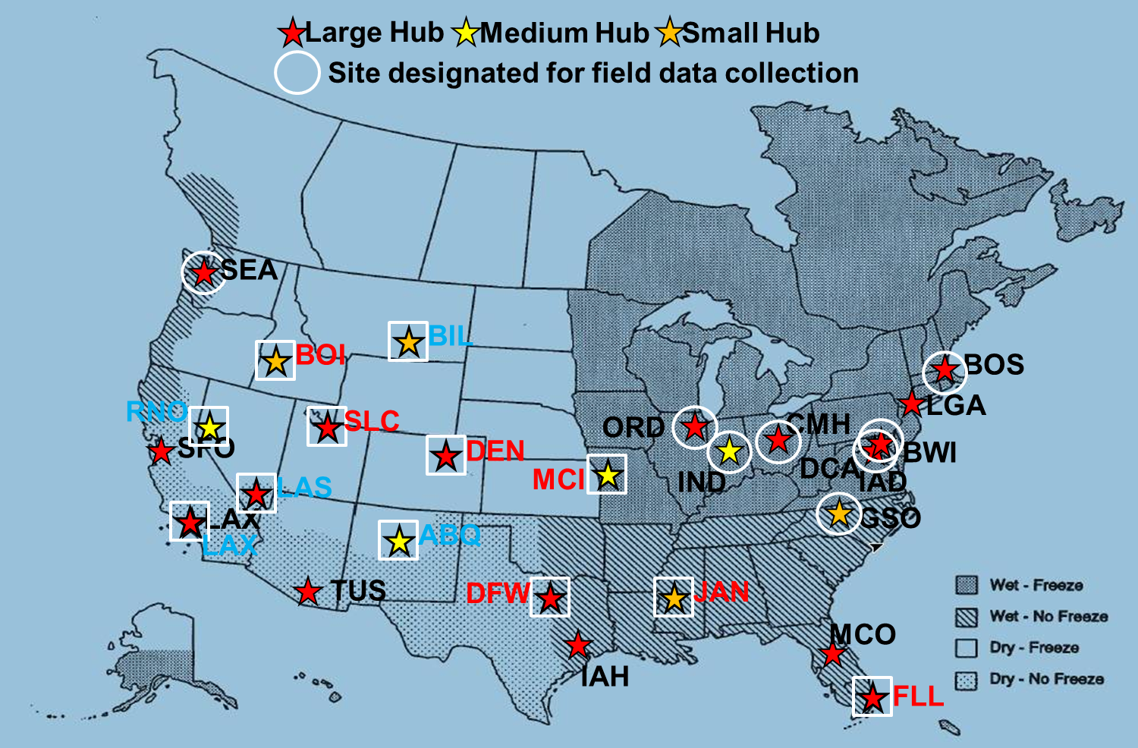
Year 3 Proposed Locations with Climatic Zones

Slide 8
RECOMMENDED RUNWAYS FOR DATA COLLECTION - PHASE III
Site | Criteria | Field Test | Airport | Status | LTTP Climatic Region | Runways | Surface Type | Age
1 | New PCC | Yes | Fort Lauderdale FLL | Large Hub | Wet-No Freeze | 10R/28L, (8,000 x 150 ft) | PCC | Opened Sept 2013
2 | New AC | Yes | Jackson MS JAN | Small Hub | Wet-No Freeze | 16L-34R | AC | New
3 | Old AC | Yes | Salt Lake City SLC | Large Hub | Dry-Freeze | 16L-34R (12,000 X 150 ft) | AC | >30 years; AC O/L 3 yrs ago
4 | Old PCC | Yes | Salt Lake City SLC | Large Hub | Dry-Freeze | 16R-34L (12,000 X 150 ft) | PCC | 29 years
5 | Old PCC | No | Denver DEN | Large Hub | Dry-Freeze | 7-25 (12,000 x 150 ft) 8-26 (12,000 x 150 ft) 16L-34R (12,000 x 150 ft) 16R-34L (16,000 x 200 ft) 17L-35R (12,000 x 150 ft) 17R-35L (12,000 x 150 ft) | PCC PCC PCC PCC PCC PCC | 19 years old; 5 runways constructed in 1992; opened to traffic in Feb1995; 6th runway in 2003, 11 years old
6 | Old AC | No | Kansas City MCI | Medium Hub | Dry-Freeze (on border with Wet-Freeze) | 9,500 x 150 ft) | AC | > 30 years; no age for last O/L
7 | Old AC | No | Boise BOI | Small Hub | Dry-Freeze | 10L-28R (10,000 x 150 ft) 10R-28L (9,800 x 150 ft) | AC AC | Constructed in 1940’s; problems with asphalt stripping; replaced 12 inches 2 years ago
8 | Old PCC | No | Dallas-Ft Worth DFW | Large Hub | Wet No-Freeze | 18L-36R (13,400 x 200 ft) | PCC | 40 years old
 |  |  | Alternate Sites
A1 | Old PCC |  | McCarran LAS | Large Hub | Dry No-Freeze | 01R-19L (9,770 x 150 ft) | PCC | 20 years old; will reconstruct next year
A2 | Old PCC |  | Reno-Tahoe RNO | Medium Hub | Dry-Freeze | 16L-34R (9,000 x 150 ft) | PCC | 20 years
A3 | Old PCC |  | Los Angeles LAX | Large Hub | Dry-No Freeze | 25R 24R 24L | PCC PCC PCC | > 30 years > 30 years > 30 years
A4 | Old AC | No | Billings Logan BIL | Small Hub | Dry-Freeze | 10L-28R (10,500 x 150 ft) | AC | >30 years; AC O/L last year
A5 | Old PCC | No | Albuquerque ABQ | Medium Hub | Dry-Freeze | 08-26 (13,800 x 150 ft | PCC | approx 25 years old

Slide 9
Year 3 Airport Locations - Issues
Attempt to identify airports in climatic zones missed in Years 1 and 2.
Still difficult to in identify candidate new HMA runways.
  JAN 16L-34R has been identified but is small hub.
Specific sites for field data collection to be determined.

Slide 10
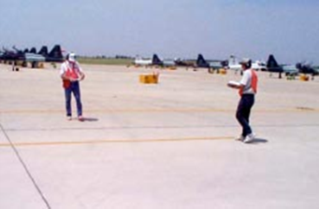
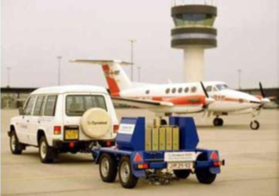
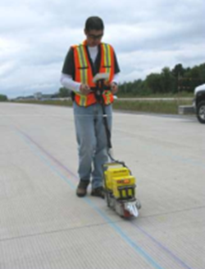
40-Year Life –
Runway Data Collection
All Airports
Design and construction data (with costs).
Maintenance activities and costs.
Pavement performance data. PCI, friction, roughness, groove condition, etc. Not limited to current fields in FAA PAVEAIR.
Traffic history (aircraft type, history, weight).
Field Data
PCI (visual survey).
Heavy Falling-Weight Deflectometer (HWD).
Material samples (concrete and asphalt) for laboratory characterization. Sample testing will be done at the NAPTF lab.
Longitudinal roughness profiles (SurPRO) & FAA portable profiler (if feasible).
Grooving (longitudinal texture) data.
Laser imaging by FAA (if feasible).

Slide 11
FAA PAVEAIR Implementation
Data collected falls into 2 categories:
  Exists in current FAA PAVEAIR (e.g., PCI, certain maintenance activities).
  Not in the current version of FAA PAVEAIR.
All collected data for the 40 year project will be stored in a dedicated, standalone FAA PAVEAIR implementation (“PA40”).
  Data are anonymized.
  No PA40 databases are accessible from the public FAA PAVEAIR implementation.
Enhanced functionality in PA40.

Slide 12
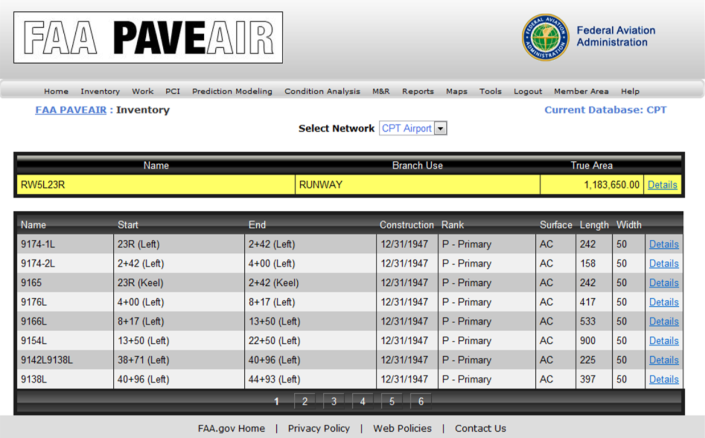
PA40 – PAVEAIR Databases
Enhanced Functionality
Fields for:
  HWD data, raw profile data, groove geometry data.
  Computed roughness indexes (ProFAA) and groove characteristics (ProGroove)
  Traffic data.
  Climate data.
  Structural layers and material properties.
Coordinate with FAA PAVEAIR development.

Slide 13
PA40 Organization Concept
Shaded area: Functionality in current FAA PAVEAIR
Functionality being added

Slide 14
Traffic Data
Historical runway traffic data (as opposed to design traffic data) are generally not available from airport engineers.
Available data sources:
  Airport operations (ASDE-X).
  FAA PBN Observer Dashboard
  https://pbn.mitre.org/pbnservices/pbn/FaaObserver.html
Data are available only for some recent years.

Slide 15
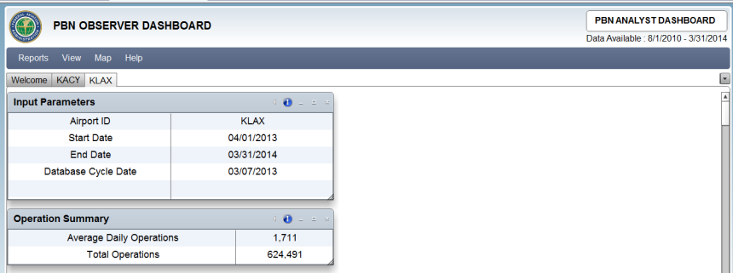
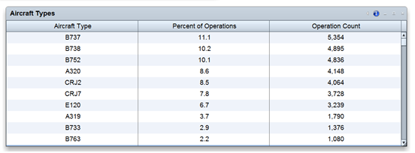
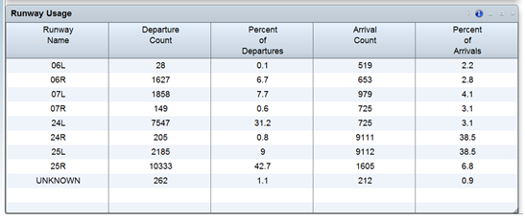
PBN Observer Dashboard
Database managed by MITRE Corp. for the FAA.
Traffic data available back to August 2010.
Usage data can be broken down by:
  Month
  Aircraft type
  Runway end
  Arrival/departure
MITRE has provided “deep” data for 4 airports so far.
Exploring ways to share data directly from the PBN database.

Slide 16
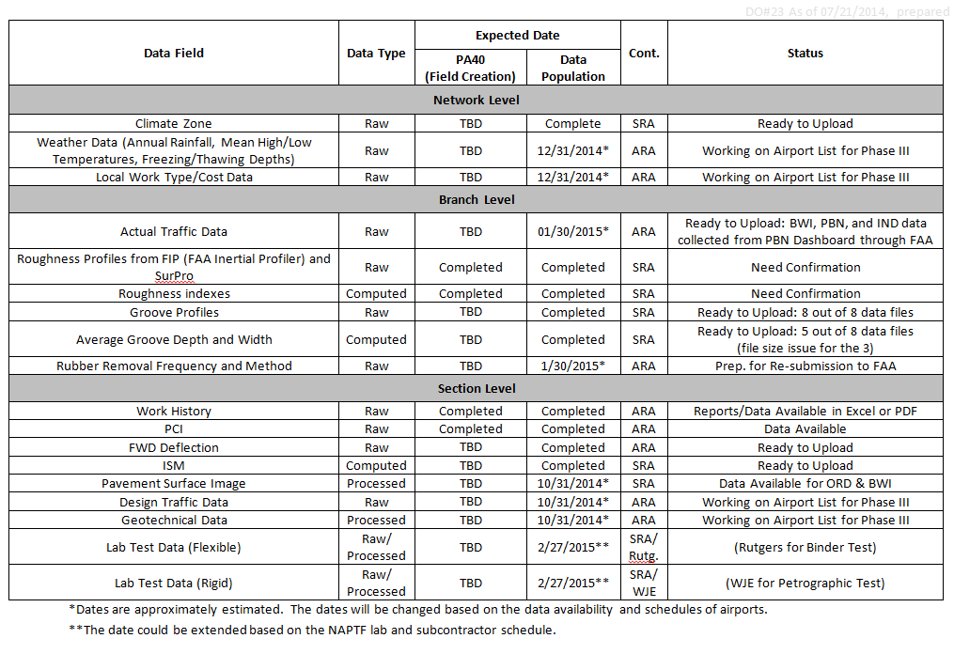
PA40 Data Population Schedule

Slide 17
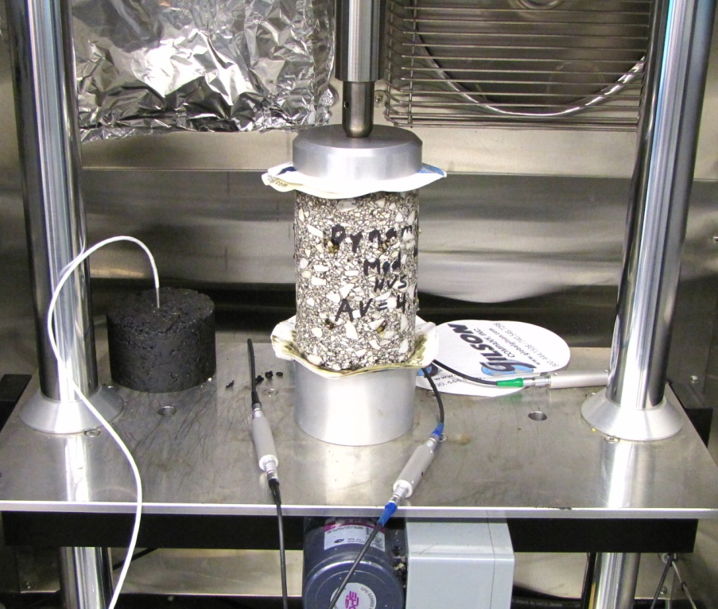
Laboratory Field Sample Testing
To date, material samples (both HMA and PCC) have been collected at 8 sites.
Material characterization testing is underway.
Most tests are being performed at the NAPTF lab by SRA personnel.
Some specialized tests (e.g., Hamburg rut test, binder extraction/analysis, PCC petrography) are being handled by outside labs.
Data will be added to PA40.
Dynamic Modulus Test of Core from Greensboro RWY 5L-23R

Slide 18
Lab Test Summary
No. | Test | No. Samples | Location | Comments
HMA
1 | IDT Dynamic Modulus | (3) | NAPTF Lab | Samples Reusable
2 | Indirect Tensile (IDT) Strength | 4 | NAPTF Lab
3 | Flow Number | 3 | NAPTF Lab
4 | Asphalt Pavement Analyzer (APA) | 4 | NAPTF Lab
5 | Hamburg Wheel Traffic | 4 | Rutgers
6 | Mixture Contents | 4 | Rutgers
Total
PCC
1 | Free-Free Modulus | (20) | NAPTF Lab | Samples Reusable
2 | Coefficient of Thermal Expansion | 3 | NAPTF Lab
3 | Flexural Strength | (8) | NAPTF Lab | Beams (IND only)
4 | Compressive Strength | 5 | NAPTF Lab
5 | Split Tensile Strength | 7 | NAPTF Lab
6 | Petrographic Analysis | 5 | TBD | Estimated no.
Total |  | 20 (8)

Slide 19
Developing New Performance Models
New performance models will relate design inputs to a future distress index (DL) incorporating structural and non-structural elements.
Current Design Procedures:
Inputs
  Structural Layers
  CBR or k-value
  Aircraft Traffic
  Concrete Strength (rigid)
Output
  Passes to structural failure*
  *defined as 2.5 cm upheaval for flexible pavements or 50% of slabs cracked for rigid pavements
40-Year Design:
Inputs
  Everything to the left, plus …
  Age, Climatic Data
  Soil/Material Properties
  Maintenance Data
  Airport Feature (runway, apron, etc.)
Outputs
  Passes to structural failure, plus …
  Roughness index prediction
  Surface friction prediction
  Other functional indexes

Slide 20
PA40 Data Analysis
Paper presented at 2014 FAA Airport Technology Transfer Conference:
Performance Trends in Airport Runway Pavements (J. Hall, R. Speir, H. Shirazi, E. Mustafa, and I. Song).
Analyzed PCI performance of 11 asphalt and concrete runways in PA40 database.
Predominant distress types observed:
  HMA runways: low-to-medium severity longitudinal/transverse cracking; low-severity weathering; low-severity patching.
  PCC runways: low-to-medium spalling; low-to-medium L/T/D cracking; low-severity patching; pop-outs.

Slide 21
Performance Trends in Airport Runway Pavements (continued)
Overall trends in performance:
  Most distresses materials/environment related, not load related.
  HMA pavements typically deteriorate to a PCI of 70 within 12-15 years, requiring a new surface.
  PCC pavements may last up to 40 years before a PCI of 70 is observed.
  Rate of deterioration following a resurfacing may be higher than for the original construction (HMA pavements).
Recommends including maintenance costs, and specifying “frequency and intensity” of maintenance activities, in design of new pavements.

Slide 22
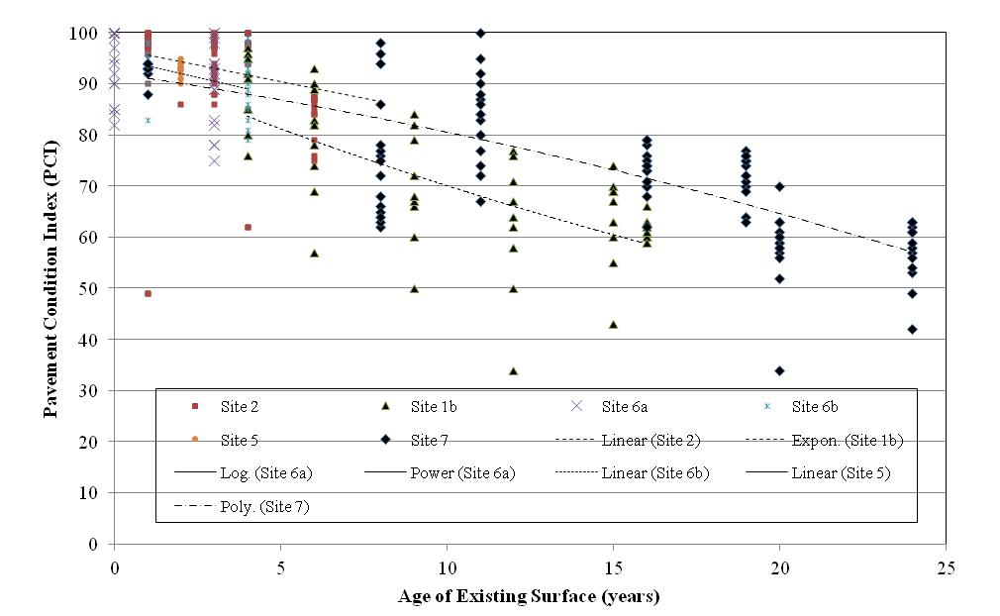
PCI Performance of Asphalt Concrete Runways

Slide 23
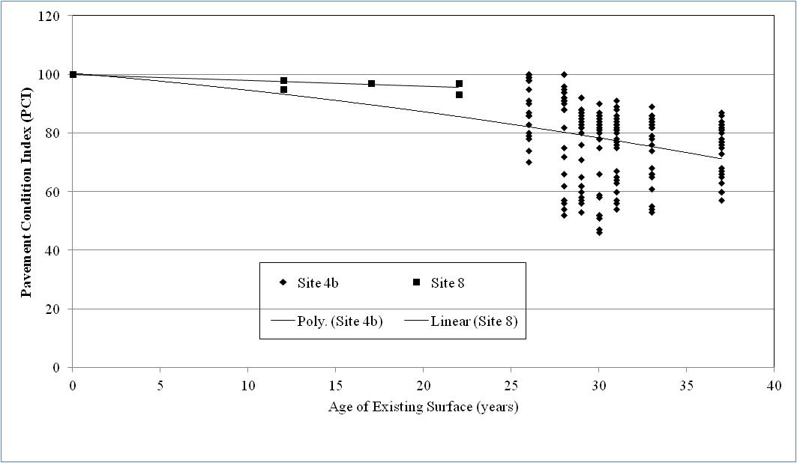
PCI Performance of PCC Runways

Slide 24
Project Schedule FY 2014-15
August 2014. Finalize airports/runways selected for Phase 3 data collection.
Fall 2014. Site visits/data collection planned for Phase 3 airports.
November/December 2014. Summaries of Ph. 3 data and field data reports.
February 2015. Complete upload of actual traffic data for Ph. 1 and 2.
May 2015. Complete upload of Ph. 3 data to PA40.
May 2015. Implement functional index prediction model capability in PA40.

