Slide 1
Airport Technology R&D Branch
Airport Safety Section
Wildlife Hazard Mitigation R&D
REDAC Subcommittee
Jim Patterson (for Ryan King)
August 12, 2014

Slide 2
Wildlife Hazard Mitigation R&D Program (RPD 150)
Outcomes
Reduce wildlife strike risks to aircraft
More accurate and timely wildlife strike advisories
Rationale
More accurate and timely information on historical and current wildlife hazards at and near airports will reduce the risk of a severe, potentially catastrophic strikes.
Contract Funds ($K)‏
FY14
FY15
FY16
Wildlife Hazards Management
$ 715
$ 650
$ 675
Detection and Deterrent Technology
$ 1200
$ 1290
$ 1225
Wildlife Hazards Information Systems
$ 585
$ 560
$ 600
Total (R&D Tasks)
$2500
$2500
$2500
Strike DB Admin, Analysis and Outreach
$265*
$275*
$270*
Identification Techniques
$150*
$160*
$155*
Total (Operation Tasks)
$415
$435
$425
* WA LOA OPS Funds

Slide 3
Presentation Outline
1. Wildlife Surveillance Concept
2. Artificial Turf
3. Overall Wildlife Program
Overview
Schedule
Objectives
Data Collection and Testing Update
Update

Slide 4
Bird Radar Air Traffic Control Applications
“Wildlife Surveillance Concept”

Slide 5
Overview
Goal:
Advance technological concepts (i.e. bird radar) for reducing bird strikes at airports to the ATC environment
Method:
Leverage appropriate agency resources and expertise via a Service Level Agreement (SLA) between ANG-C43 Concept Development and Validation Branch and ANG-E261 Airport Safety R&D Section

Slide 6
Schedule Three Phase Development
NWSRC?
Notes:
NextGen Surveillance Weather Radar Capability (NSWRC) Program

Slide 7
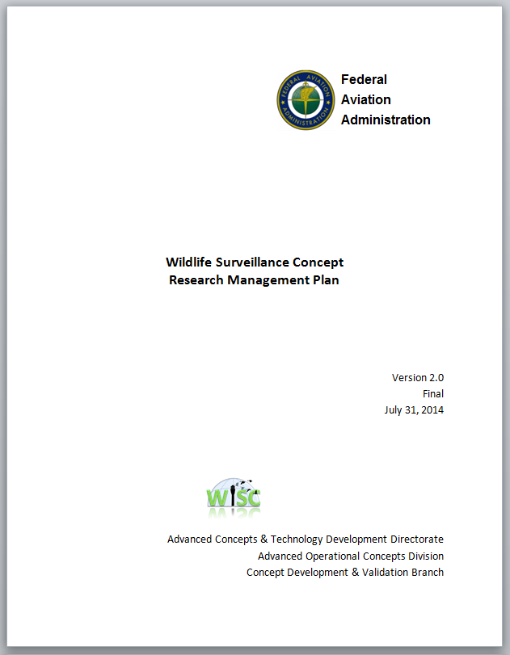
Schedule of Deliverables
No. | Title | Start | Completion
Completed Deliverables
1 | WiSC Literature Review | Sept ‘13 | Oct ‘13
2 | Bird Radar Vendor Demonstrations (*ANG-261 Product) | Aug ‘13 | Sep ‘13
3 | Knowledge Elicitation Activity Test Plan | Sep ‘13 | Sep ‘13
4 | Research Management Plan (Version 0.9) | Sep ‘13 | Jan ‘14
5 | Knowledge Elicitation Activity I Draft Report | Feb ‘14 | Mar ’14
6 | Knowledge Elicitation Activity I Final Report | Mar ‘14 | Apr ‘14
7 | Concept of Operations Document (version .9) | Sep ‘13 | Apr ‘14
8 | Research Management Plan (version 2.0) | Jun ‘14 | Jul ‘14
Initiated Activities
9 | Knowledge Elicitation Activity II Site Visits | Aug ‘14 | Aug ‘14
10 | Knowledge Elicitation Activity II Trip Report(s) | Aug ‘14 | Aug’ 14
11 | Shortfall Analysis Report | Aug ‘14 | Aug ‘14
Planned Activities
12 | HITL Laboratory Demonstration Test Plan | Aug ‘14 | Oct ‘14
13 | HITL Laboratory Demonstration Final Report | Oct ‘14 | Dec ‘14
14 | Concept of Operations Document (version 2.0) | Jul ‘14 | Sep ‘15
15 | WiSC Concept Socialization Briefing | Oct ‘14 | Jan ‘15
16 | Preliminary Benefits Analysis | TBD | TBD
17 | Validation HITL Test Plan | TBD | TBD
18 | Validation HITL Draft Report | TBD | TBD
19 | Validation HITL Final Report | TBD | TBD
20 | Preliminary Requirements Document | TBD | TBD
21 | Concept of Operations Document (version 2.0) | TBD | TBD
RMP 2.0

Slide 8
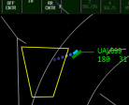
Concept Overview
Bird Activity
Today
Pilot
Supervisor
Other controller
Airport Ops
Visual
Observation
Verbal
Communications
Wildlife Biologist
Avian Radar
.
Textual and/or
Radar
Observation
.
.
.
.
.
.
.
Graphical Display
WiSC
Notes:
USAIR 1549
http://www.birdstrike.org/ (Stats)
http://www.nytimes.com/2013/10/18/opinion/those-hazardous-flying-birds.html?_r=0 (Premature landing)
http://www.airspacemag.com/snapshot/129382153.html (photo)

Slide 9
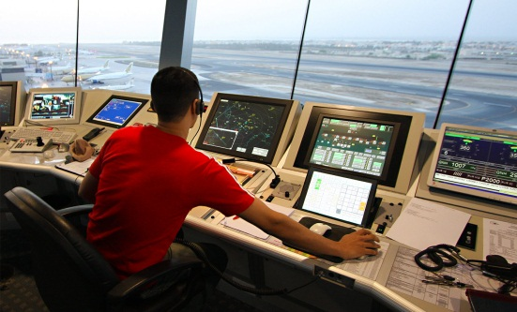
WiSC Benefits
Controllers receive more timely and accurate representations of wildlife threats.
The information is presented in a way that best supports decision-making processes and
Maximizes benefits to the NAS while minimizing any impact on controller workload.

Slide 10
WiSC Improvements
The research team anticipates that WiSC will improve ATC operations in the following ways:
Improved safety due to reduced aircraft-bird strike incidents,
Reduced aircraft, equipment, and property damage due to reduced aircraft-bird strike incidents,
Increased situational awareness for controllers and pilots, particularly through improved localization of bird threats,
Reduced need for controller visual monitoring of avian activity due to the availability of radar to identify these threats,
Higher controller confidence in avian threat information due to enhanced up-to-date, radar- based data, and the
Potential to leverage enhanced decision support to aid controllers’ in identifying legitimate bird strike hazard conditions.

Slide 11
Artificial Turf and Tortoises Sanford-Orlando International Airport
Objectives
To assess suitability of artificial turf to dissuade gopher tortoises from burrowing in the RSA
To assess the durability of artificial turf in the RSA when exposed to vehicular traffic including ARFF trucks, OPS trucks and high pressure (185psi) braked aircraft tires.

Slide 12
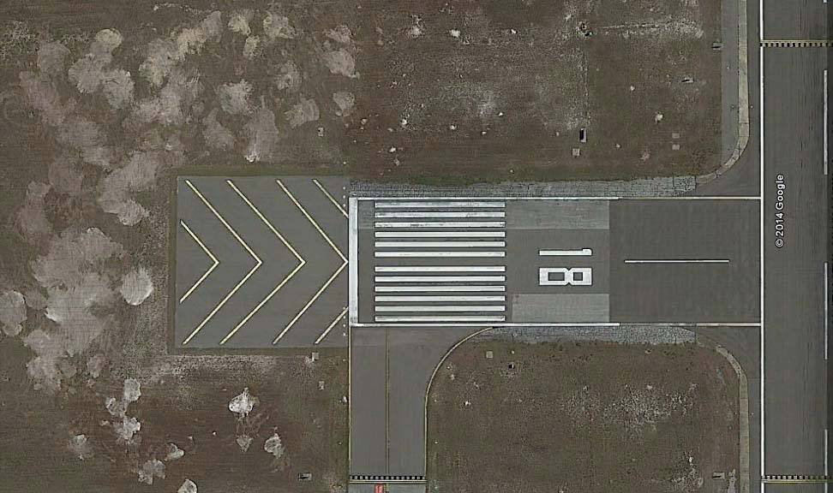
Test Lane Configurations
Acceleration Zone
Maintain Speed Zone
Deceleration Zone
Notes:
Test lanes were configured in a manner that would provide the longest distances for traversing the turf at speed and coming to a stop safely within the confines of the turf.
Consideration was give to the type of vehicle and its performance capabilities i.e. acceleration, deceleration, steering etc.
The lanes were also designed so that the subject vehicles would traverse and brake on both densities of turf material. You can see the difference between the shaded green areas. The lighter shade indicates a section with the lower density turf and the darker shade indicates the lower density material.

Slide 13
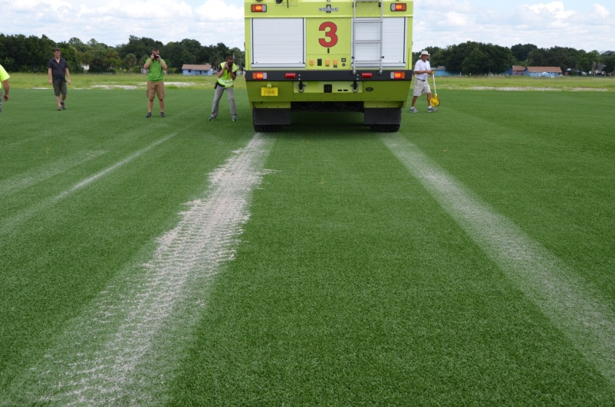
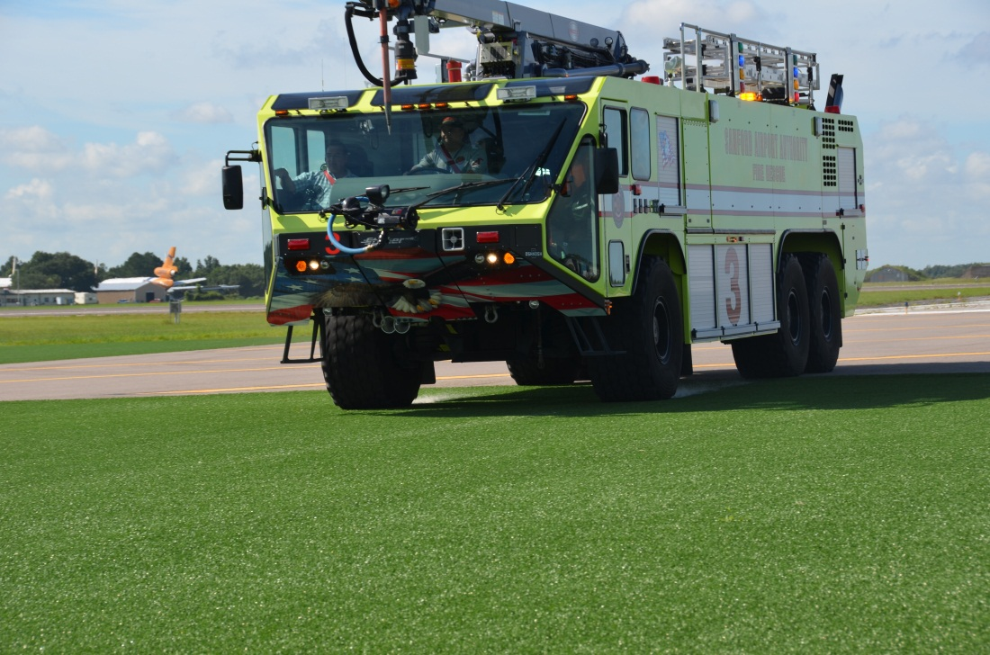
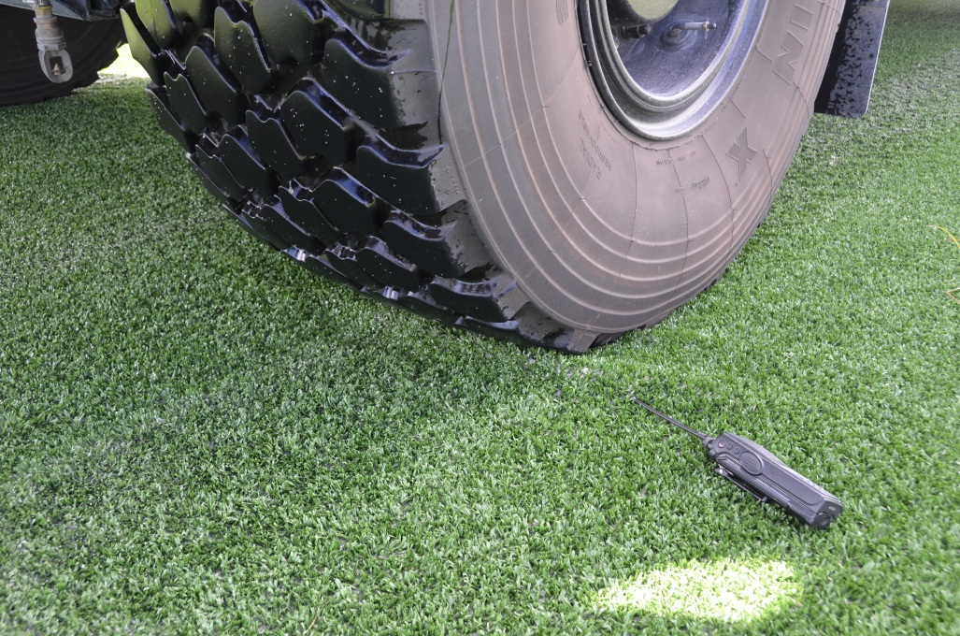
ARFF Truck Fully Loaded Braking Dry
Slight Ripple in front of tire.
Disappeared when tire was removed.
Notes:
ARFF Truck test speeds were determined based on what the driver would actually maneuver the truck at during emergency operations and in particular while approaching a disabled aircraft within the RSA.
During testing, the weight of the vehicle combined with the speed caused the ballast sand to kick up during passage and then settle in the tread indentations. (Top Right)

Slide 14
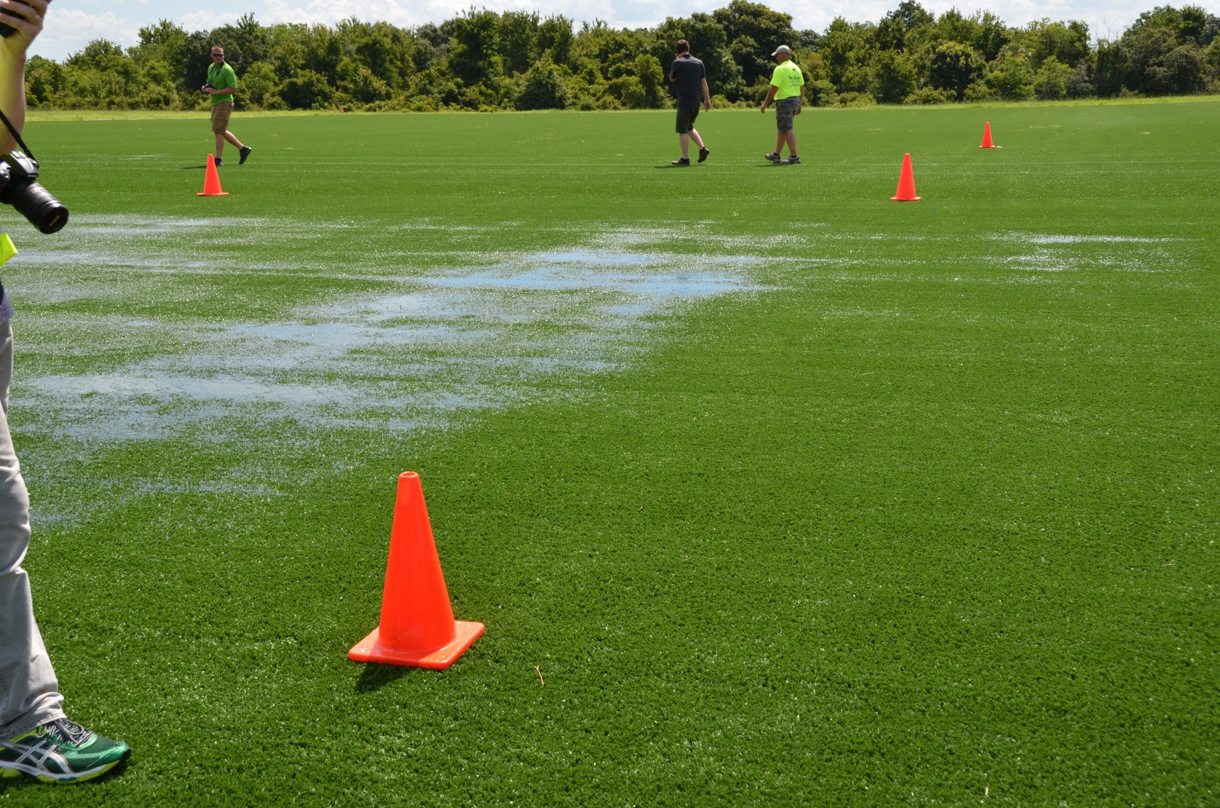
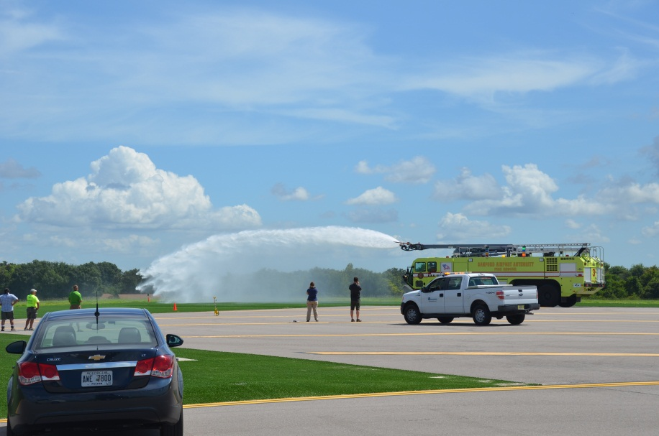
Artificial Turf Durability Flooded Conditions
Notes:
After dry testing, the elevated boom/nozzle on the ARFF truck was used to produce wet conditions via simulated “rain”.

Slide 15
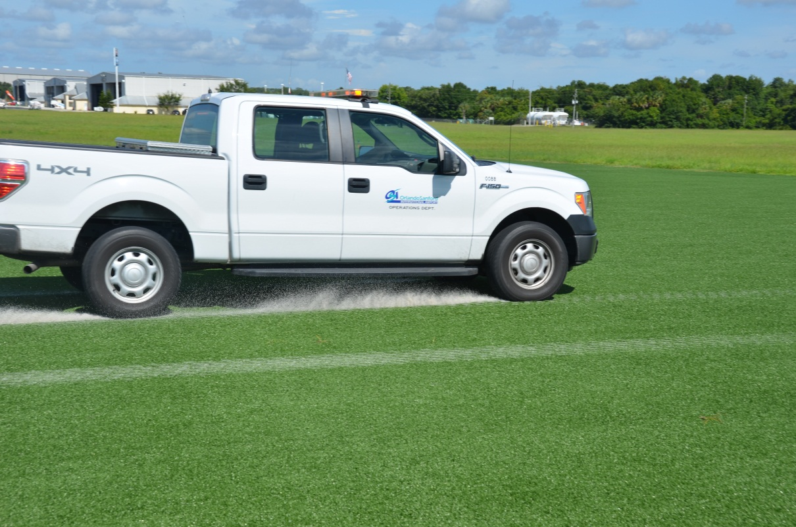
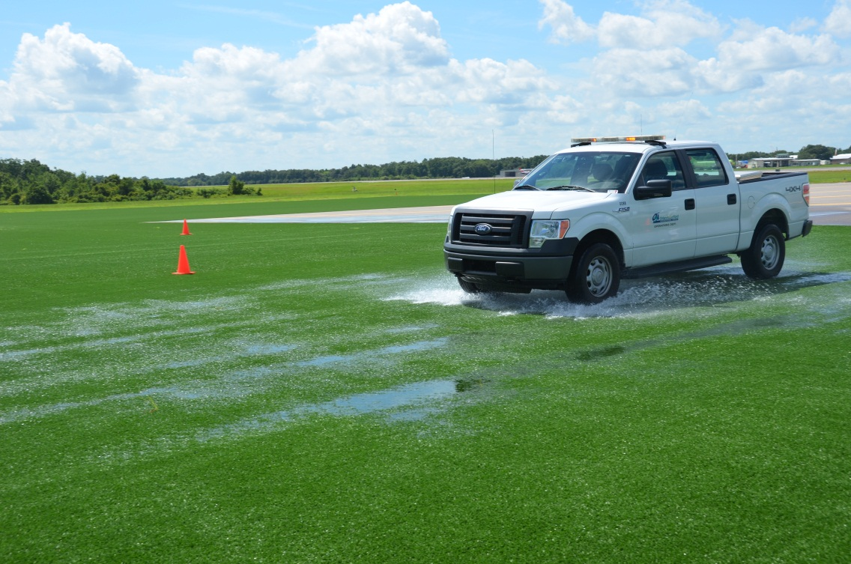
OPS Truck Braking (Wet and Dry)
Notes:
The operations vehicle decelerated to a stop on the test sections from speeds of 20, 30 and 40 mph on both wet/flooded and dry conditions.
We presumed that the dry braking would impose the greatest stress on the turf material while the flooded conditions would produce the best opportunity for slippage during braking.
As you can see in the top photo, the ballast sand kicked up during vehicle passage and then settled on the surface.

Slide 16
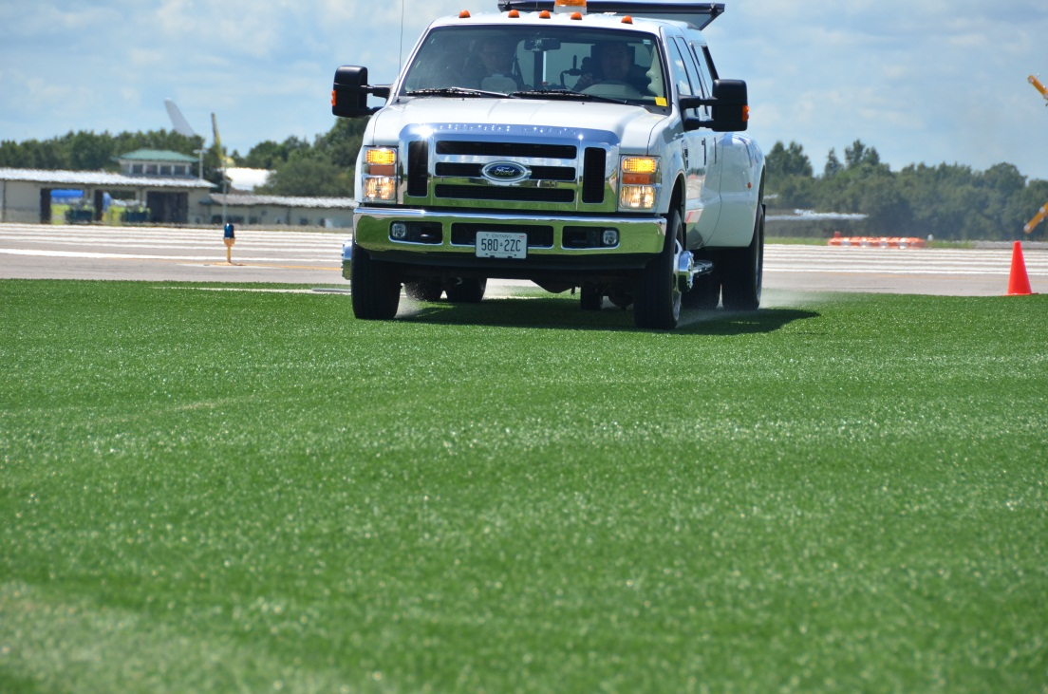
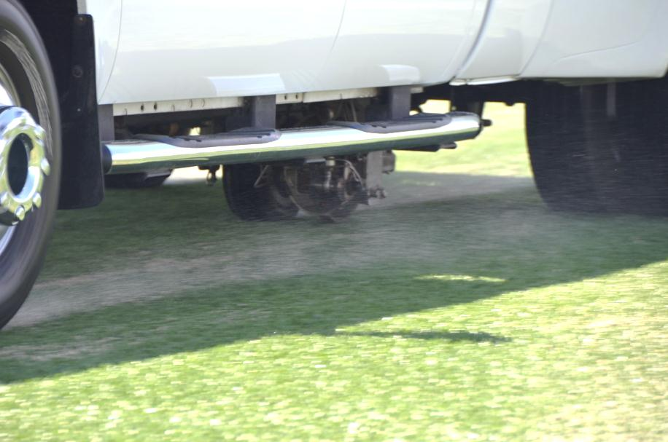
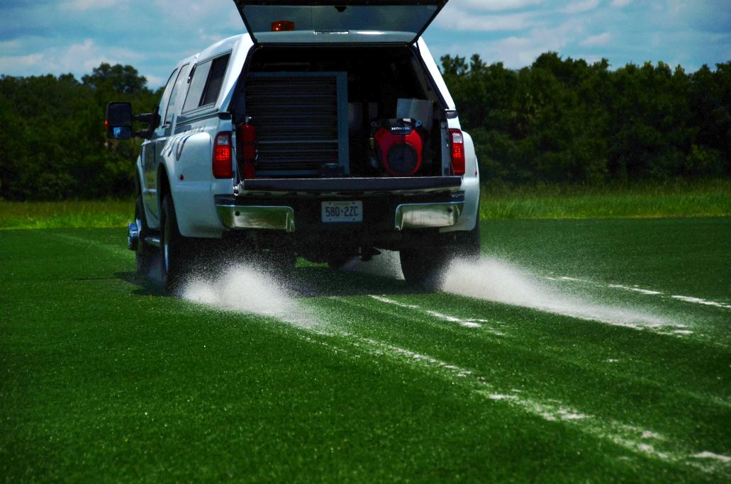
Braking Availability Tester (BAT)
185psi Aircraft Tire with ABS
Notes:
The Braking Availability Tester (BAT) was utilized to expose the turf to high tire pressures and aircraft anti-skid braking systems.
These runs were performed under both wet and dry conditions.

Slide 17
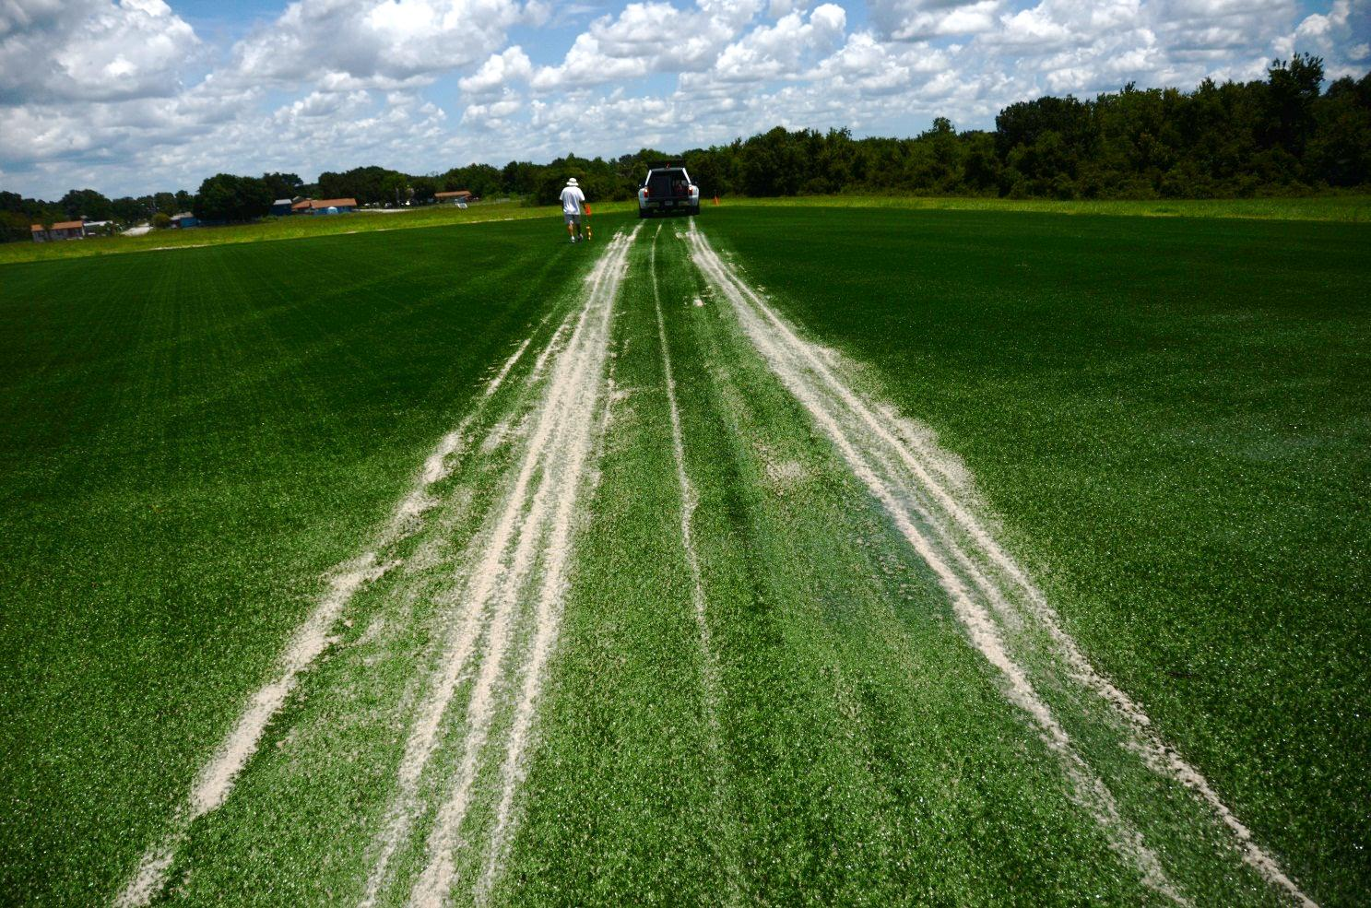
Multiple Runs Ballast brought to surface
Notes:
Multiple test runs were performed with each vehicle. In this picture, you can see the sand ballast that has been kicked up by the passing tires.
The ballast was observed to return to a subsurface location after rain. Any ballast that appeared to be consolidated in an area was raked, swept and blown back into pre-test locations after testing.

Slide 18
Overall Wildlife Program
USDA
New 4-year IAA agreement
Smithsonian –
Year 2 of multi-year agreement
Center of Excellence for Airport Technology (CEAT) –
New Grant Awarded

Slide 19
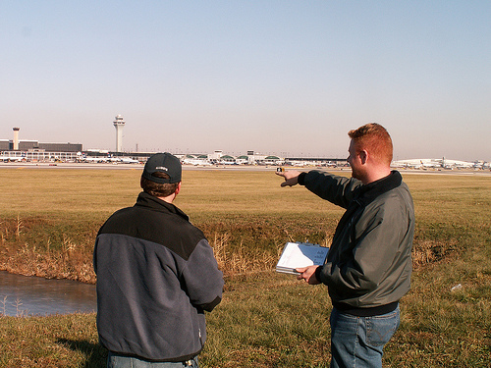
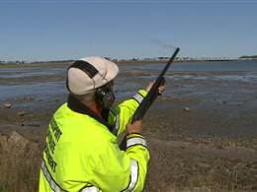
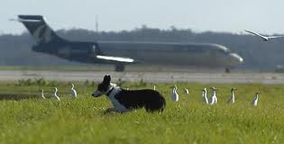
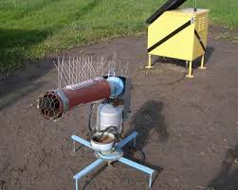
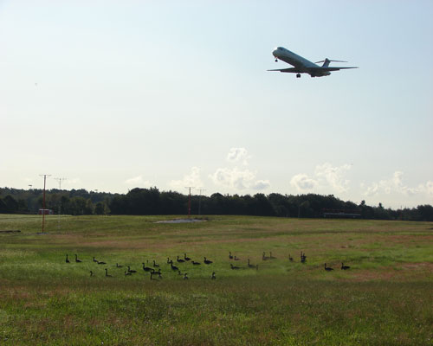
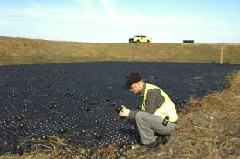
Overall Wildlife Program Update
New 4 Year Interagency Agreement Signed with USDA
Mod 1: $1,427,063
Operations Tasks DB: $264,298
Operations Tasks Outreach: $260,000
Research Tasks Year 1: $902,765

Slide 20
Summary Continuing Activities & Future Direction
Habitat Management (USDA/Academia)
Species Control Methods and Tools (USDA/Academia)
Lighting on Aircraft and Airports (USDA/FAA-AVS)
Bird Radar
Airport Ops Integration
Expanded Coverage i.e. NEXRAD at DFW
NextGen Surveillance & Weather Radar Capability (NSWRC)
Air Traffic Control
Multi-Sensor Integration
Radar, Cameras, Thermal, etc.
Strike Reporting
Expanded Sources
Improved/Efficient Data Handling
Public Accessibility/Interaction

Slide 21
For more information:
http://wildlife.faa.gov
Ryan King
ryan.king@faa.gov

Slide 22
NSWRC
Back to Presentation
NextGen Surveillance Weather Radar Capability (NSWRC) Program
As the current radars that perform weather and aircraft surveillance over the United States age, they must be sustained through service life extension programs or replaced. In the latter case, the radars can be replaced by multiple types of radars with different missions or they can be replaced by scalable multifunction phased array radars (MPARs). State-of-the-art active phased array systems have the potential to provide improved capabilities such as earlier detection and better characterization of hazardous weather phenomena, 3D tracking of noncooperative aircraft, better avoidance of unwanted clutter sources such as wind farms, and more graceful performance degradation with component failure. As the U.S. aviation community works toward realizing the Next Generation Air Transportation System (NextGen), achieving improved capabilities for aircraft and weather surveillance becomes critical, because stricter observation requirements are believed to be needed. Hence, the Federal Aviation Administration (FAA) is considering the MPAR as a possible solution to their NextGen Surveillance and Weather Radar Capability (NSWRC).
Cost is one hurdle to the deployment of a modern phased array radar network. One way of lowering the overall cost is to reduce the total number of radars. Because of the overlap in coverage provided by the current radar networks, a unified MPAR replacement network can potentially decrease the total number of radars needed to cover the same airspace. An earlier analysis conducted by MIT Lincoln Laboratory concluded that 510 legacy radars could be effectively replaced by 334 MPARs over the contiguous United States (CONUS). There was, however, some uncertainty whether the spatial resolution used in the terrain blockage calculations was fine enough to accurately depict radar coverage, and also if terminal area coverage was being adequately addressed. This study revisits the siting analysis using a much finer spatial resolution, expands the coverage domain to include all fifty states and U.S. territories, adds the Air Force long-range surveillance radars (FPSs) to the legacy pool, and allows scaling by number of faces per radar. The aim is to provide an estimate of the minimum number of MPARs needed to replace the existing radar coverage. We also provide an extensive statistical compilation of legacy versus MPAR coverage for various observational performance parameters.

