Slide 1
RPD-137
Field Instrumentation and Testing

Slide 2
Field Instrumentation and Testing
(RPD 137)
Contract Funds ($K)

Slide 3
FIELD INSTRUMENTATION AND TESTING
MAIN OBJECTIVE
  better understanding of long-term pavement behavior in the field under varied climatic and operating conditions, and
  improved characterization of paving materials.
  Improved pavement design and evaluation tools will conserve airport development funds and reduce the downtime of airfield pavements for construction and maintenance activities.

Slide 4
RPD – 137
Field Instrumentation projects –
  Continue data collection and analysis from
    LaGuardia International Airport, New York City, NY
    JFK Intl. Airport, New York City, NY
    EWR Intl. Airport, Newark, NJ
  Shut Down
    Denver International Airport Instrumentation project
    Hartsfield-Jackson Atlanta International Airport, Atlanta, GA

Slide 5
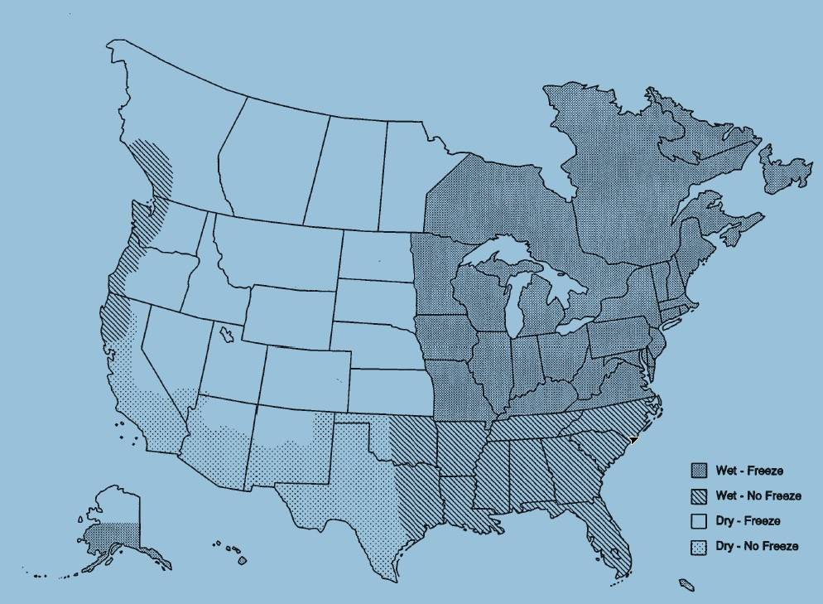
Current FAA Airport Instrumentation Projects
Newark Liberty International Airport, Newark – AC Overlay Pavement
JFK International Airport, NYC – PCC Pavement
Denver International Airport, Denver – PCC Pavement
Baltimore Washington International Airport, Baltimore
LaGuardia Airport, NYC – AC Overlay Pavement
Hartsfield Jackson Atlanta International Airport – PCC Pavement

Slide 6
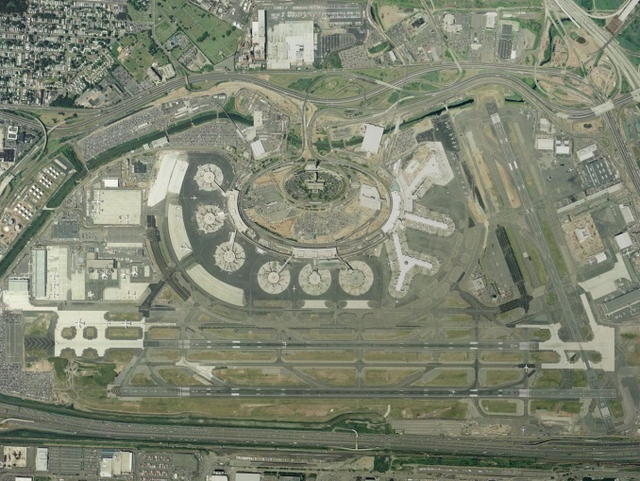

Study slippage failures on Runway 4R-22L at EWR.

Slide 7
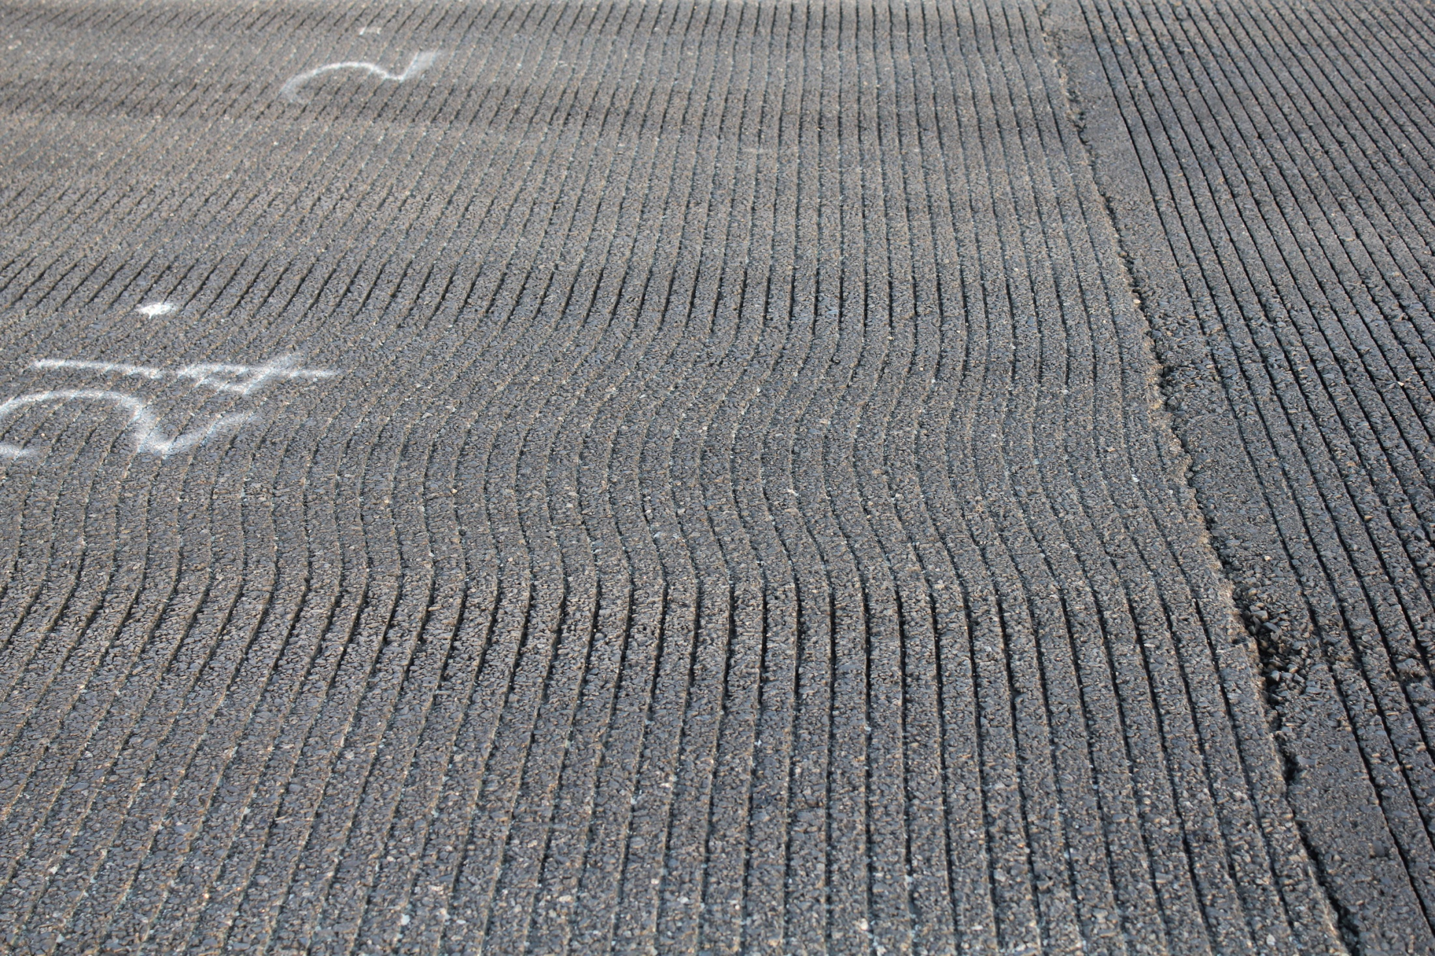

Slide 8
Date: 7/19/2013 B-737
HMA Overlay Bottom
Milled Surface Top

Slide 9
Date: 7/23/2013 B-737
Milled Surface Top
HMA Overlay Bottom

Slide 10
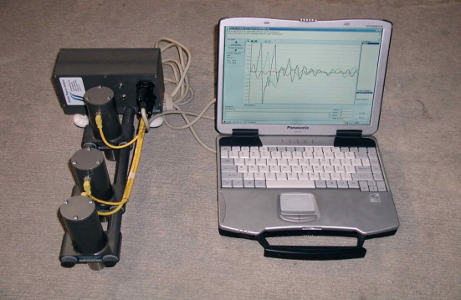
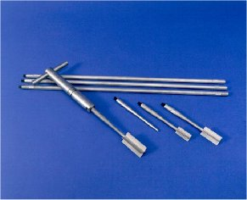
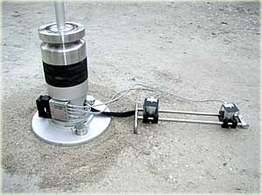
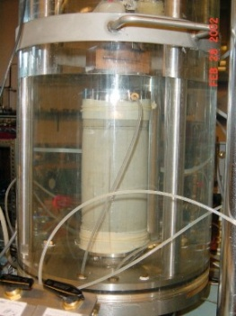
RPD – 137
Pavement Material Characterization –
  In-situ tests and laboratory tests
    JFK Intl. Airport, New York City, NY (JFK).
    Port Columbus Intl. Airport, Columbus, Ohio (CMH).
    Detroit Metropolitan Wayne County Airport, Michigan (DTW).

Slide 11

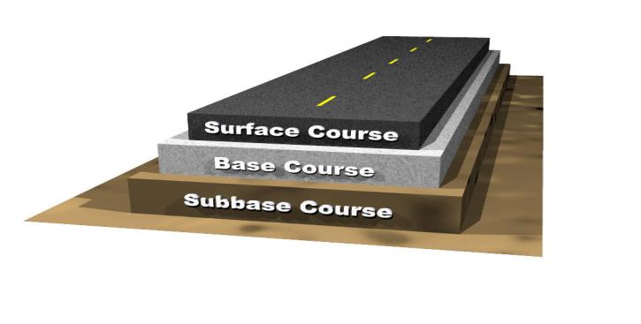
Pavement Material Characterization
Ground Water Table, Freeze-Thaw

Slide 12
Pavement Materials - 10-Year R&D Plan

Slide 13
Pavement Material Characterization
Current Material Requirements
  Gradations
  Compaction (Moisture/Density)
  Volumetrics, stability, flow
  CBR (for Subgrades)
Inputs for Design Procedure (current state)
  Only CBR (for subgrades)
  Subgrade modulus computed as E = 1500*CBR
  No other mechanical property of unbound materials is used.
  Modulus is calculated internally as a function of layer thickness and subgrade CBR.
  AC modulus fixed at 200-ksi.

Slide 14
Pavement Material Characterization
FAA advisory circulars lack guidance on the use of sustainable, environmentally friendly, recycled, and newer materials such as SMA, WMA, RAS, etc.
Limited knowledge is available on the effect of high tire pressures and heavy gear loads on pavement material performance under full-scale loading.

Slide 15
Pavement Material Characterization
The cost of using better quality material to improve pavement performance (life) cannot be justified using current guidance.
Advances in pavement material testing techniques and knowledge gained in material behavior and characterization over the years is not used in the FAA pavement thickness design procedure.

Slide 16
Pavement Material Characterization
Need to Consider Realistic Material Behavior
Develop inputs for design procedure based on mechanical properties of materials (such as resilient modulus, shear strength, etc.)

Slide 17
Pavement Material Characterization
Desirable characteristics for test procedure
  simple to perform,
  measures mechanical properties of soil,
  repeatable, and
  not overly expensive.

Slide 18
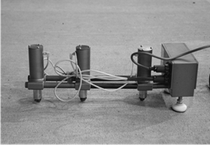
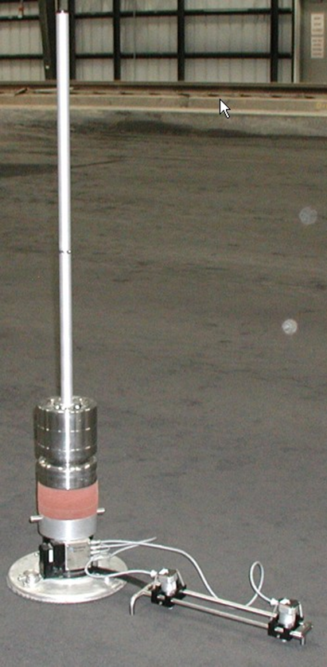
Pavement Material Characterization
DPSPA
IN-SITU MATERIAL TESTS
LWD
VANE SHEAR

Slide 19
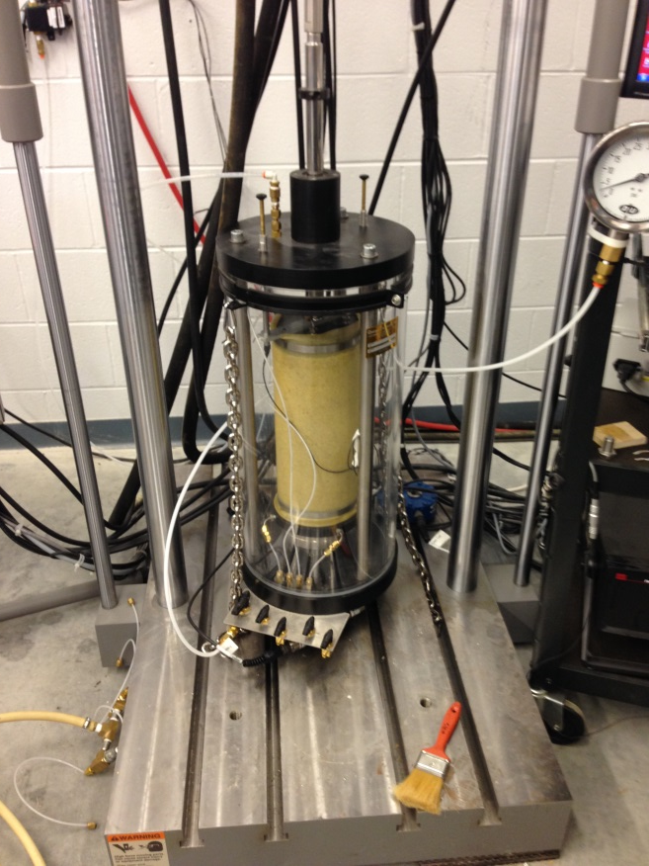
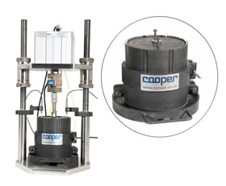
Pavement Material Characterization
Precision Unbound Material Analyser
Dynamic Triaxial Test
LABORATORY MATERIAL TESTS

Slide 20
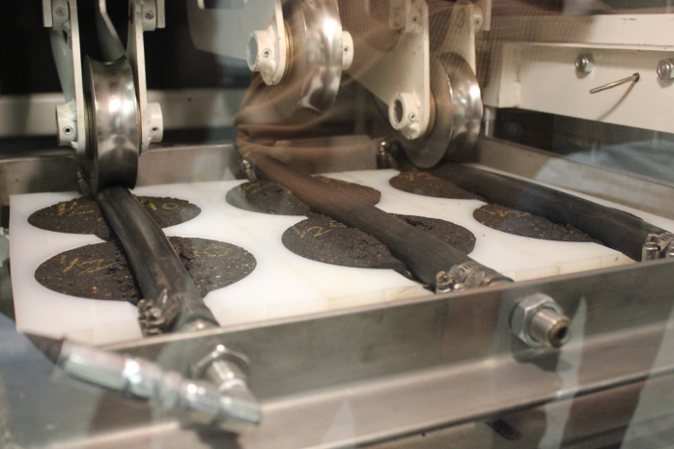
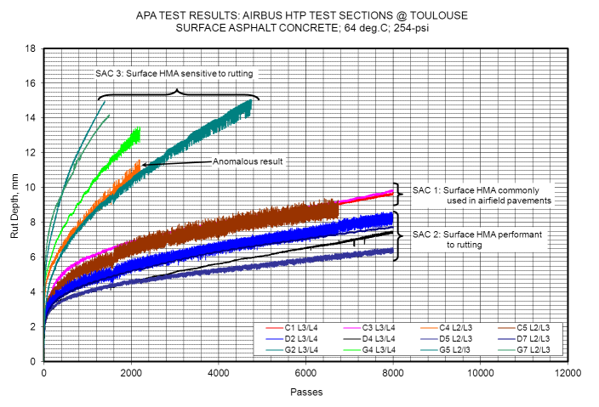
Pavement Material Characterization
Asphalt Pavement Analyser (APA)
LABORATORY MATERIAL TESTS

Slide 21
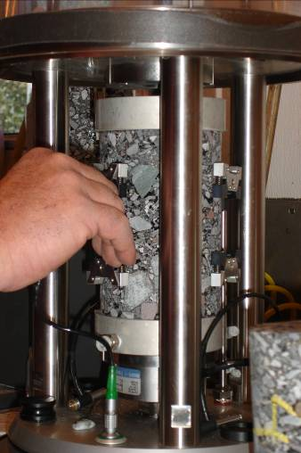
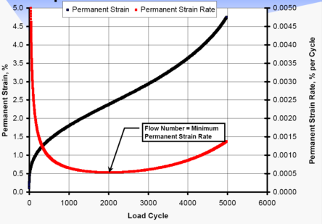
Pavement Material Characterization
Asphalt Mixture Performance Tester (AMPT)
LABORATORY MATERIAL TESTS

Slide 22
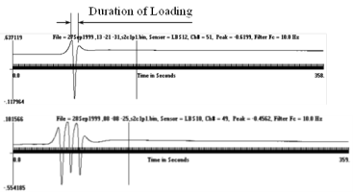
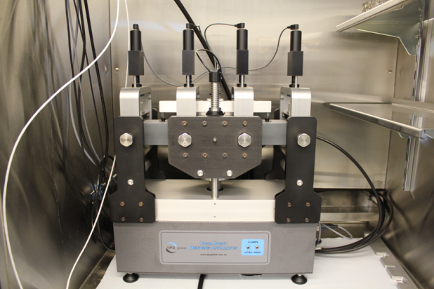
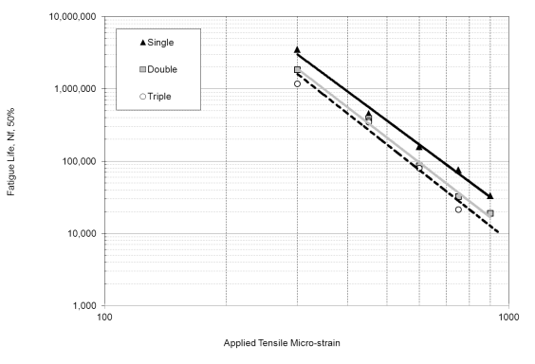
Pavement Material Characterization
Asphalt Beam Fatigue Tests
LABORATORY MATERIAL TESTS

Slide 23
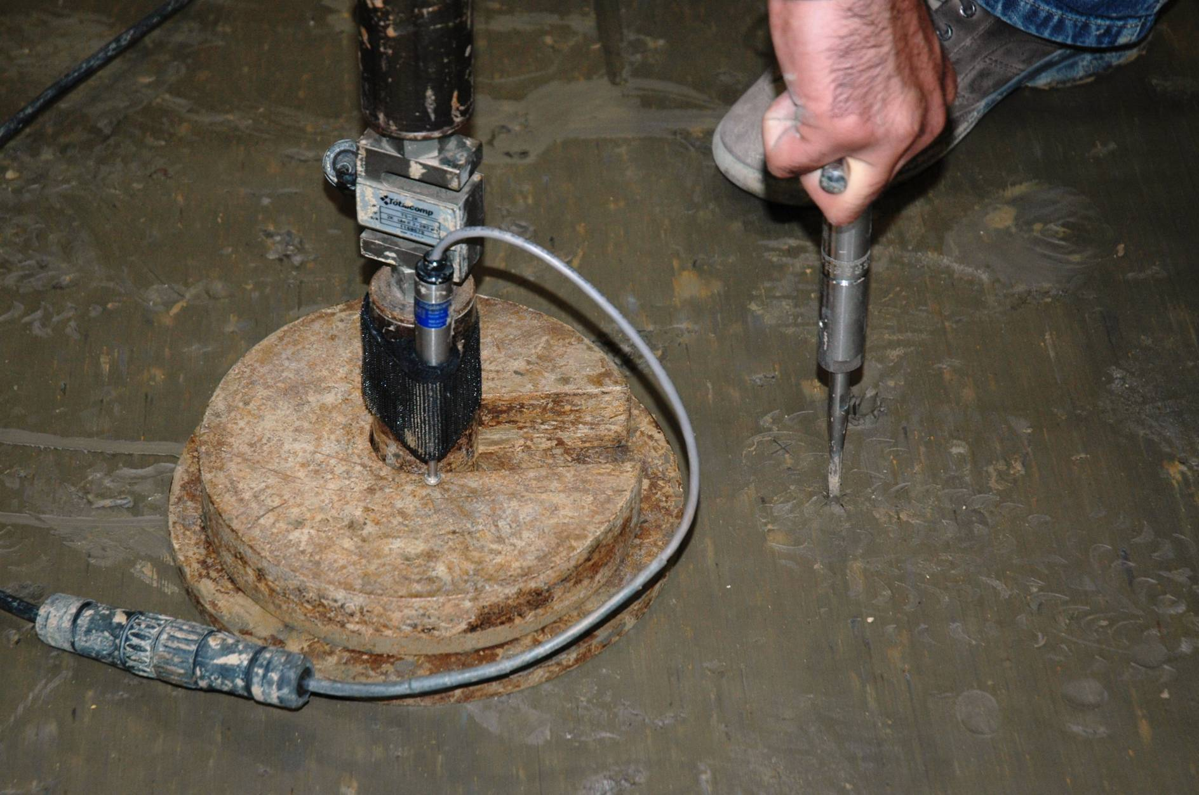

Slide 24
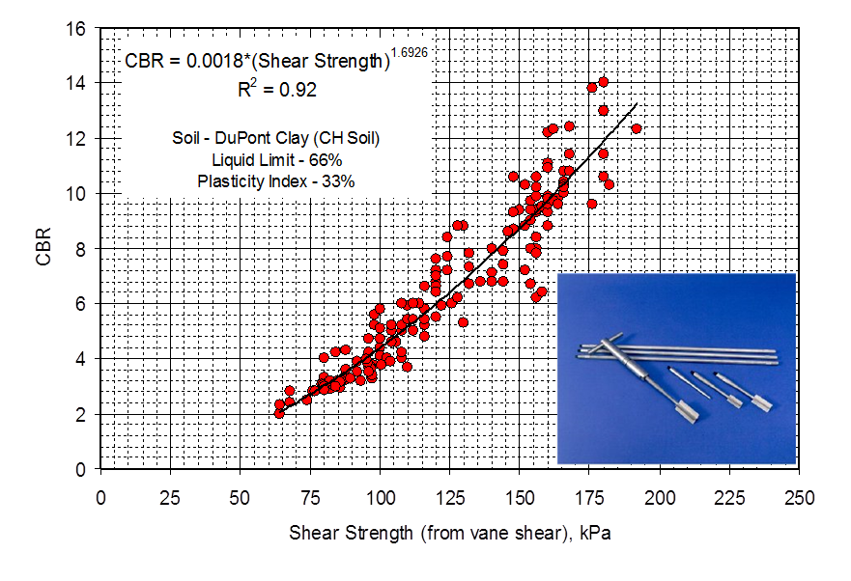
Pavement Material Characterization

Slide 25
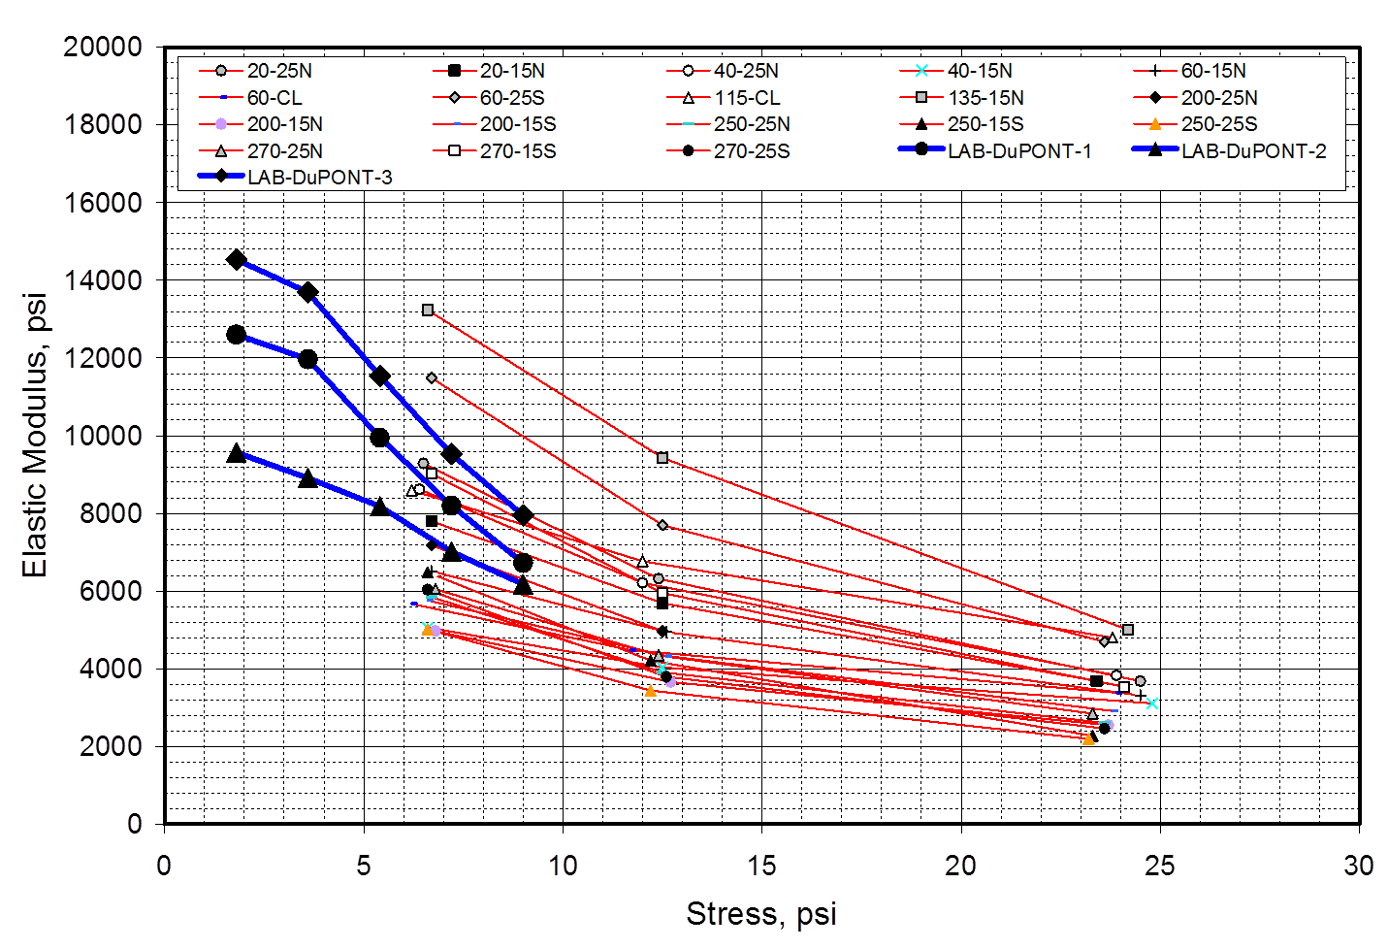
Pavement Material Characterization

Slide 26
Pavement Material Characterization
COV
25.1%
9.3%
8.6%
7.6%
9.0%
8.3%
7.0%
11.0%
14.0%
27.6%
27.4%
22.0%
26.6%
26.0%
22.8%
25.2%
20.9%
18.0%
18.2%
19.4%
16.5%
17.8%

Slide 27
Nano-Engineered Smart Tarmacs (NEST) for Detecting Distributed Surface and Subsurface Pavement Damage
Objective:
To develop nano-engineered smart tarmacs (NEST) that can nondestructively detect the severity and location of airport pavement damage.
NEST will measure deformation and damage directly and will identify (in near-real-time and wirelessly) the location and size of surface and subsurface damage.
NEST will eliminate the need for tedious, and expensive conventional methods currently being used.

Slide 28
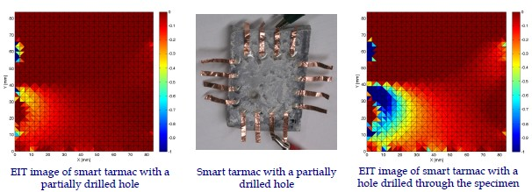
Nano-Engineered Smart Tarmacs (NEST) for Detecting Distributed Surface and Subsurface Pavement Damage
Nano-Engineering and Smart Structures Technologies (NESST) Laboratory at UC Davis
Northern California Nanotechnology Center (NC2) at UC Davis
Structural Engineering Research Laboratory (SERL) at UC Davis
Laboratory for Intelligent Structural Technology (LIST) at University of Michigan

Slide 29
Nano-Engineered Smart Tarmacs (NEST) for Detecting Distributed Surface and Subsurface Pavement Damage
Nano-Engineering and Smart Structures Technologies (NESST) Laboratory at UC Davis
Northern California Nanotechnology Center (NC2) at UC Davis
Structural Engineering Research Laboratory (SERL) at UC Davis
Laboratory for Intelligent Structural Technology (LIST) at University of Michigan

Slide 30
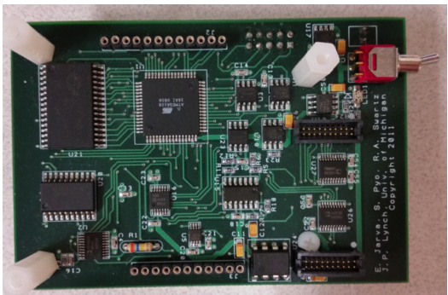
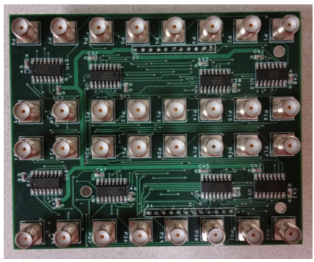
Nano-Engineered Smart Tarmacs (NEST) for Detecting Distributed Surface and Subsurface Pavement Damage
Main board of the wireless impedance analyzer
16 multiplexed sensing channels are integrated with a digital synthesizer for interrogating and measuring the response of smart tarmac

