Slide 1
Full-Scale Testing
Overload Update
REDAC Subcommittee on Airports
David R. Brill, P.E., Ph.D.
August 25, 2015

Slide 2
CC7 Overload Test Objectives
Develop rational overload criteria for flexible pavements.
Consider criteria in terms of:
Percent by which the ACN of the overloading gear exceeds the reported PCN of the pavement.
Used pavement life expressed as cumulative damage factor (CDF).
Effect of overload gear configuration (D, 2D, 3D).
Compare the results to current ICAO standards published in Annex 14.

Slide 3
Current ICAO Overload Criteria
ICAO Annex 14, “Aerodrome Design and Operations,” defines the following overload criteria:
for flexible pavements, occasional movements by aircraft with ACN not exceeding 10 per cent above the reported PCN should not adversely affect the pavement;
for rigid or composite pavements, in which a rigid pavement layer provides a primary element of the structure, occasional movements by aircraft with ACN not exceeding 5 per cent above the reported PCN should not adversely affect the pavement;
the annual number of overload movements should not exceed approximately 5 per cent of the total annual aircraft movements.
In addition, overloads should not be allowed on pavements exhibiting distress or failure, or during periods of thaw.
The airport authority should review the pavement condition regularly, and review overload criteria periodically.

Slide 4
CC7 Test Item Layout

Slide 5
CC7 Overload Test Items
40-ft. (12.2-m) test items separated by 10-ft. (3 m) transitions.
CBR 5 (subgrade category C)
All 6 test items have the same structure.
Thin HMA sections represent GA airports receiving occasional overload operations.
3 in. P-401
6 in. P-209
P-154 thickness designed to give nominal PCN = 35/F/C.
Assumed “lifetime” traffic of 27,000 passes of NAPTF 72,000-lb. dual gear (36,000 lbs. per wheel).
Use COMFAA 3.0 to compute PCN.

Slide 6
Instrumentation Layout (LFC1-S)
TSG – Transverse Strain Gage
LSG – Longitudinal Strain Gage
MDD – Multi-Depth Deflectometer
PC – Pressure Cell
MS – Moisture Sensor
SS – Suction Sensor
T – Thermocouple

Slide 7
General Test Procedures
ACN-Based Overload Test Items:
Traffic at “normal” load (D-36) until rate of rut depth accumulation (RRDA) stabilizes*.
Increase load to 110% PCN. Traffic until RRDA stabilizes, but not more than 1350 passes (5% lifetime traffic).
Resume traffic at normal load. Observe any change in RRDA or other responses (MDD, strain).
Increase load to 120% PCN and traffic until RRDA stabilizes.
Repeat steps 3 & 4 following the overload schedule. Continue until failure is observed.
* “Stable” is defined as an approximately constant rate of total rut depth accumulation with applied passes, following any initial shakedown phase.
CDF-Based Overload Test Items:
Traffic at “normal” load (D-36) until rate of rut depth accumulation (RRDA) stabilizes*.
Apply one wander pattern at overload designed to consume CDF = 0.1.
Resume traffic at normal load. Observe any change in RRDA or other responses (MDD, strain).
Apply one wander pattern at overload designed to consume CDF =0.25.
Resume traffic at normal load. Observe any change in RRDA or other responses (MDD, strain).
Apply one wander pattern at overload designed to consume CDF =0.5.
Resume traffic at normal load. Observe any change in RRDA or other responses (MDD, strain).
Apply one wander pattern at overload designed to consume CDF =1.0.
If Step 6 does not fail the test item, return to normal load(dual) and traffic until the pavement behavior stabilizes or failure is observed.
Repeat Steps 8 and 9 until failure.

Slide 8
Overload Schedules
✓ Indicates that overload has been completed.
ACN-Based Overload Test Items LFC S-1, 2, 3
CDF-Based Overload Test Items LFC S-3, 4, 5
ACN Criterion
Gear Type | Overload | ACN | Passes | Wheel Load, lbs.¹
D | 100% PCN | 35.02 | N/A | 36,000
D✓ | 110% PCN | 38.38 | N/A | 39,000
D✓ | 119% PCN | 41.82 | N/A | 42,000
D✓ | 126% PCN | 44.14 | N/A | 44,000
D | 146% PCN | 51.26 | N/A | 50,000
D | 164% PCN | 57.56 | N/A | 55,000
2D✓ | 110% PCN | 38.63 | N/A | 35,500
2D✓ | 121% PCN | 42.44 | N/A | 38,000
2D✓ | 130% PCN | 45.65 | N/A | 40,000
2D | 149% PCN | 52.31 | N/A | 44,000
2D | 175% PCN | 61.30 | N/A | 49,000
3D✓ | 111% PCN | 38.71 | N/A | 34,500
3D✓ | 120% PCN | 42.06 | N/A | 36,500
3D✓ | 130% PCN | 45.56 | N/A | 38,500
3D | 148% PCN | 51.91 | N/A | 42,000
3D | 171% PCN | 59.76 | N/A | 46,000
CDF Criterion
Gear Type | Overload | ACN | Passes | Wheel Load, lbs.²
D✓ | CDF = 0.09 | N/A | 66 (1 wander) | 46,000
D✓ | CDF = 0.25 | N/A | 66 (1 wander) | 52,000
D✓ | CDF = 0.49 | N/A | 66 (1 wander) | 57,000
D | CDF = 0.98 | N/A | 66 (1 wander) | 62,500
2D✓ | CDF = 0.10 | N/A | 66 (1 wander) | 40,500
2D✓ | CDF = 0.25 | N/A | 66 (1 wander) | 45,500
2D✓ | CDF = 0.51 | N/A | 66 (1 wander) | 50,000
2D | CDF = 0.98 | N/A | 66 (1 wander) | 54,500
3D✓ | CDF = 0.10 | N/A | 66 (1 wander) | 37,000
3D✓ | CDF = 0.25 | N/A | 66 (1 wander) | 41,500
3D✓ | CDF = 0.51 | N/A | 66 (1 wander) | 45,500
3D | CDF = 1.06 | N/A | 66 (1 wander) | 50,000
¹Based on COMFAA 3.0
²Based on FAARFIELD 1.4
Wheel loads are adjusted to the nearest 500 lbs. due to vehicle limitations.

Slide 9
CC7 Overload Test Summary
As of August 10, 2015
Test Phase | Dates | Vehicle |  | Test Items LFC1-S – LFC3-S | Test Items LFC4-S – LFC6-S | Description
 |  | Passes | Wanders | Passes | Passes
1 | 10/6/14 – 10/16/14 | 1-924 | 1-14 | 1-924 | 1-924 | Initial normal load
2 | 10/20/14 | 924-990 | 15 | - | 925-990 | 0.1 CDF Overload
 | 10/21/14 – 10/28/14 | 991-1650 | 16-25 | 925-1584 | - | 10% ACN Overload
3 | 10/29/14 – 11/13/14 | 1650-3168 | 26-48 | 1585-3102 | 991-2508 | Resume Normal Load
4 | 11/17/14 | 3169-3234 | 49 | - | 2509-2574 | 0.25 CDF Overload
 | 11/17/14 – 11/25/14 | 3235-4224 | 50-64 | 3103-4092 | - | 20% ACN Overload
5 | 12/2/14 – 12/4/14 | 4225-4752 | 65-72 | 4092-4620 | 2574-3102 | Resume Normal Load
 | 12/4/14 |  |  |  |  | Test suspended until June 2015
6 | 6/15/15 – 6/22/15 | 4753-5544 | 73-84 | 4621-5412 | 3103-3894 | Resume Normal Load
7 | 6/29/15 | 5545-5610 | 85 | - | 3895-3960 | 0.50 CDF Overload
 | 6/29/15 – 7/6/15 | 5611-6468 | 86-98 | 5413-6270 | - | 30% ACN Overload
8 | 7/8/15 – 8/10/15 | 6468-8778 | 99-133 | 6271-8580 | 3961-6270 | Resume Normal Load
Total |  | 8778 | 133 | 8580 | 6270

Slide 10
Rut Depth Monitoring
Physical 16-foot straight edge.
Rail-to-rail profile data.
Generates raw data files at 2.5 mm from Selcom laser.
Decimate to 25 mm.
Compute a virtual 16-ft. straight edge rut depth.
360° Ultra-High-Speed Laser Scanner (Leica Model P20)
New source of highly accurate profile data.
Use scans to correct rail-to-rail profiles for beam curvature.
Extracting transverse profiles from acquired scans is a time consuming process. We are working to improve efficiency.
Profile data are collected:
After every completed wander pattern (66 passes).
At intermediate passes on the zero track (24 and 48 passes) during overload or if deemed necessary.

Slide 11
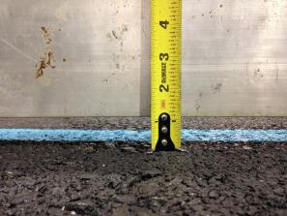
Rut Depth Monitoring
Rail-to-Rail Profiler
16-ft Straight Edge

Slide 12
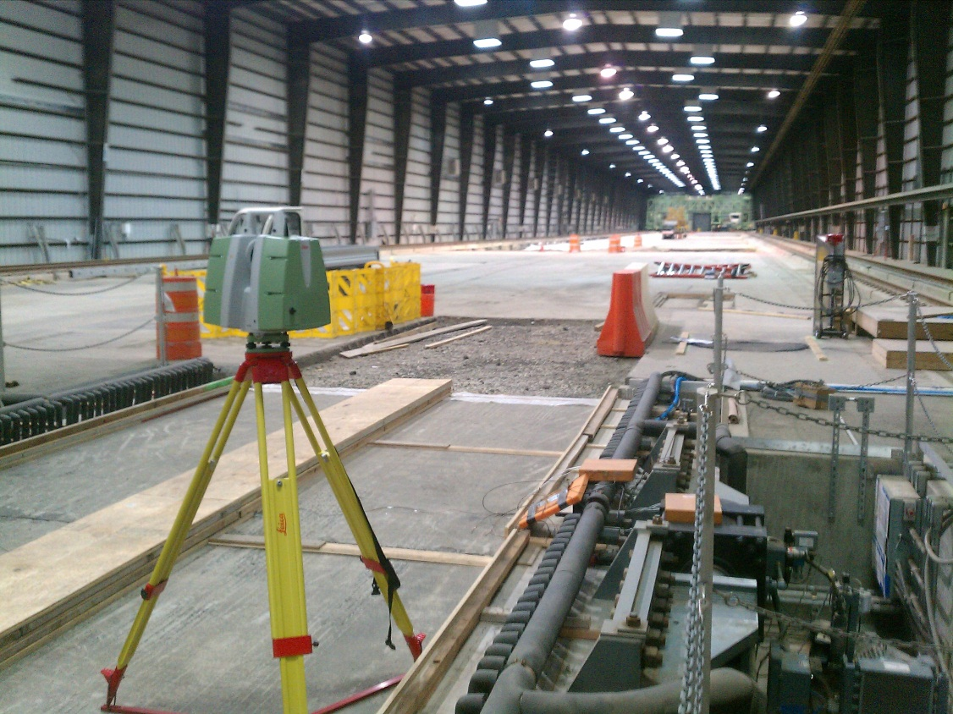
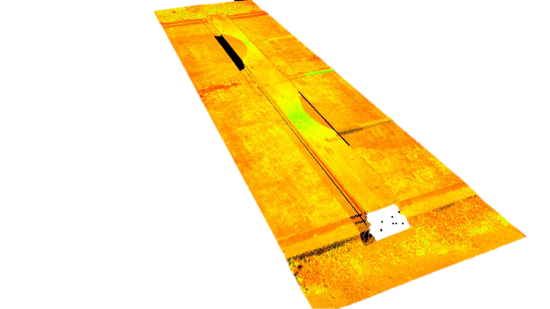
Ultra-high Speed Laser Scanner
Leica ScanStation P20
Scan of the Reflective Testing Rig

Slide 13
Average Rut Depth – LFC-1
2-Wheel Gear Overload

Slide 14
Average Rut Depth – LFC-2
4-Wheel Gear Overload

Slide 15
Average Rut Depth – LFC-3
6-Wheel Gear Overload

Slide 16
Rate of Surface Rutting – LFC-4
6-Wheel Gear Overload

Slide 17
Rate of Surface Rutting – LFC-5
4-Wheel Gear Overload

Slide 18
Rate of Surface Rutting – LFC-6
2-Wheel Gear Overload

Slide 19
MDD Rutting Measurement
A-C = Rut in P-154 D-F = Rut in P-152 (Subgrade) F = Total from surface

Slide 20
MDD Rut Accumulation (MDD-11)

Slide 21
Preliminary Observations
Observed an increase in the rate of rutting after overload of 0.5 CDF and 130% of PCN.
Number of wheels in overload gear does not appear to have a significant effect on permanent damage for the same ACN or CDF.
MDDs show rutting accumulates primarily in the P-154 subbase layer.
We will continue to traffic all test items to failure.

