Slide 1
Full-Scale Testing – Perpetual Pavement Update

Slide 2
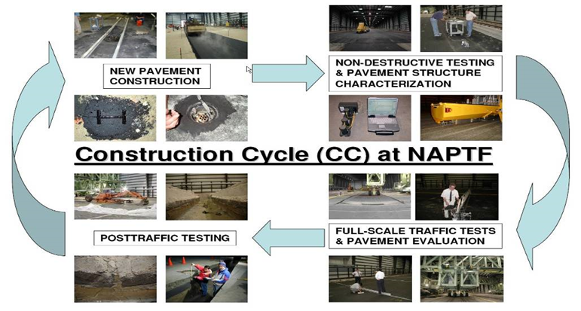
Construction Cycle at NAPTF

Slide 3
CONSTRUCTION CYCLE – 7 (CC-7)
PRIMARY OBJECTIVES
  Develop Perpetual Pavements Design criterion for airport pavements.
  Vertical strain threshold in the intermediate HMA layer to limit rutting.
  Horizontal strain threshold in the HMA base layer to prevent bottom-up fatigue cracking.
  Relationship between laboratory fatigue strain threshold and measured field HMA strains.
  Study strain distribution in the HMA layer.

Slide 4
PERPETUAL PAVEMENT
Perpetual Pavement is “an asphalt pavement designed and built to last longer than 50 years without requiring major structural rehabilitation or reconstruction, and needing only periodic surface renewal in response to distresses confined to the top of the pavement.”
[Perpetual Asphalt Pavements – A Synthesis, Asphalt Pavement Alliance]

Slide 5
CONSTRUCTION CYCLE – 7 (CC-7)
PRIMARY OBJECTIVES
  Verify/Refine/Modify fatigue model based on the ratio of dissipated energy change (RDEC)
  Overload (South Side Pavements)
  Determine allowable aircraft overload criteria for flexible pavement.

Slide 6
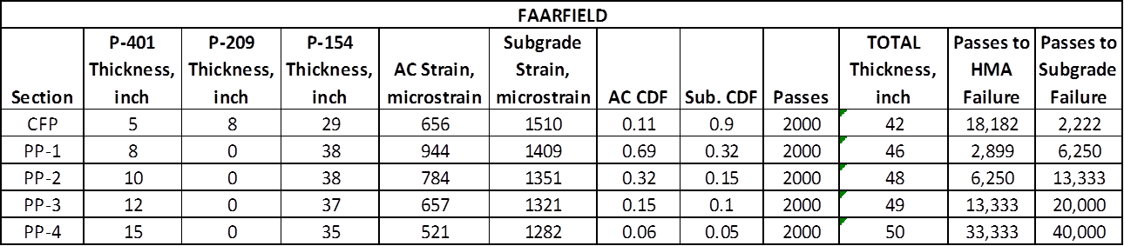
PERPETUAL PAVEMENT

Slide 7
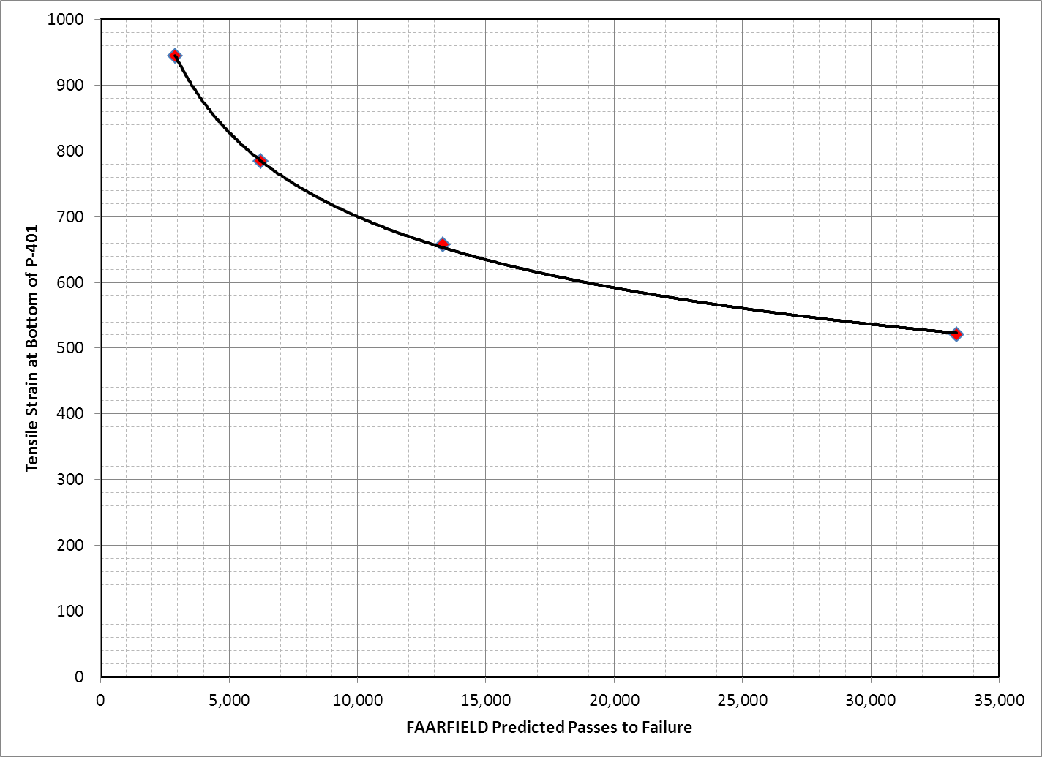
CC7 – PERPETUAL PAVEMENTS

Slide 8
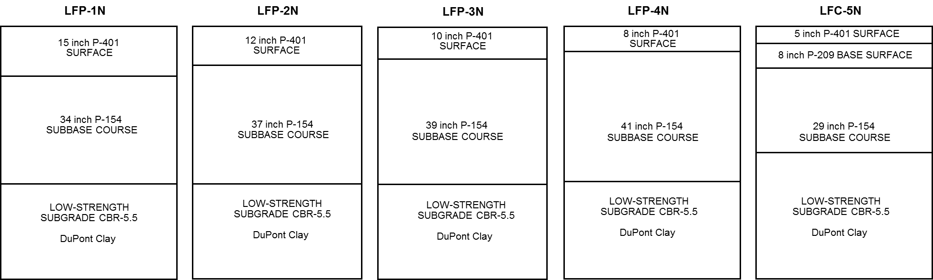
Pavement Cross Sections

Slide 9
Pavement Instrumentation
H-Bar Strain Gages (ASG)
Multiple Depth Deflectometers (MDD)
Fiber Optic Strain Plates

Slide 10
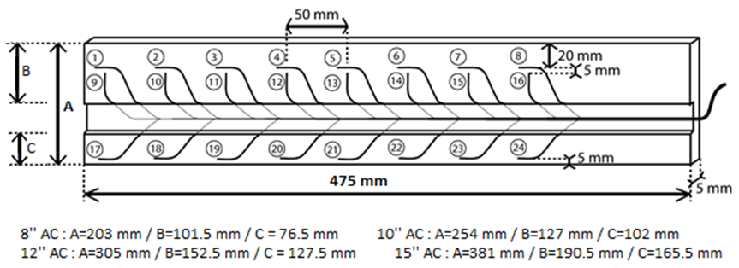
Fiber Optic Strain Plate

Slide 11
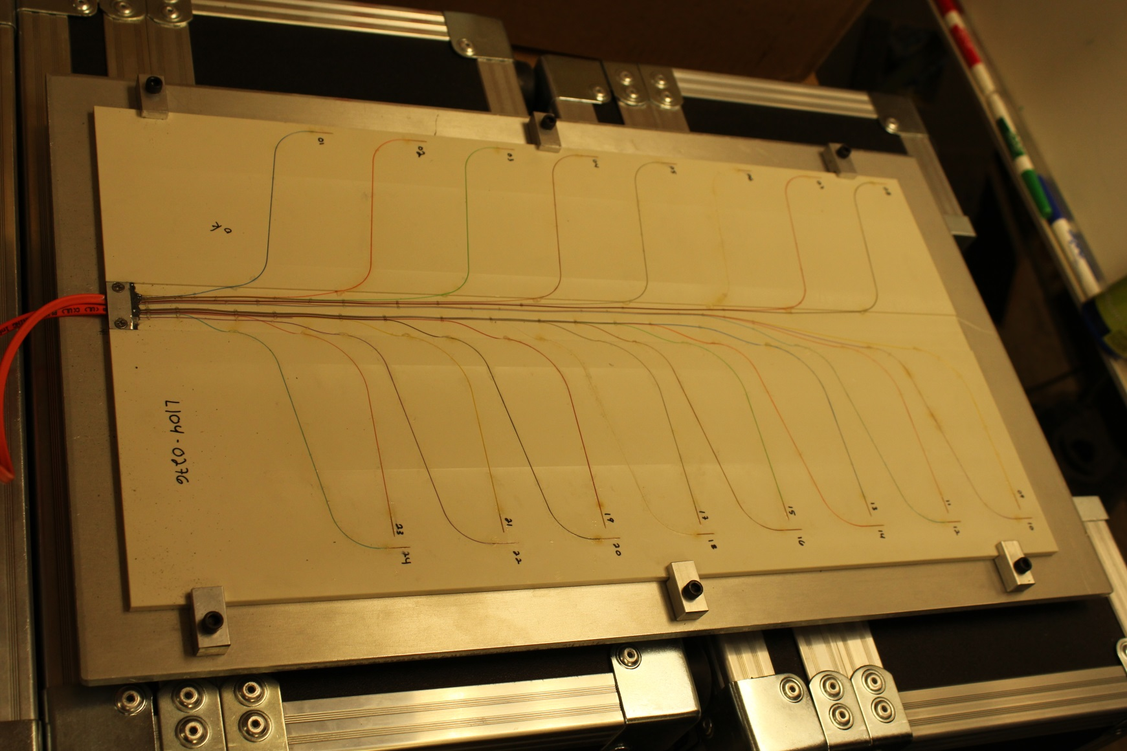
Fiber Optic Strain Plate
Polyphenylene Sulphide (PPS) Plate

Slide 12
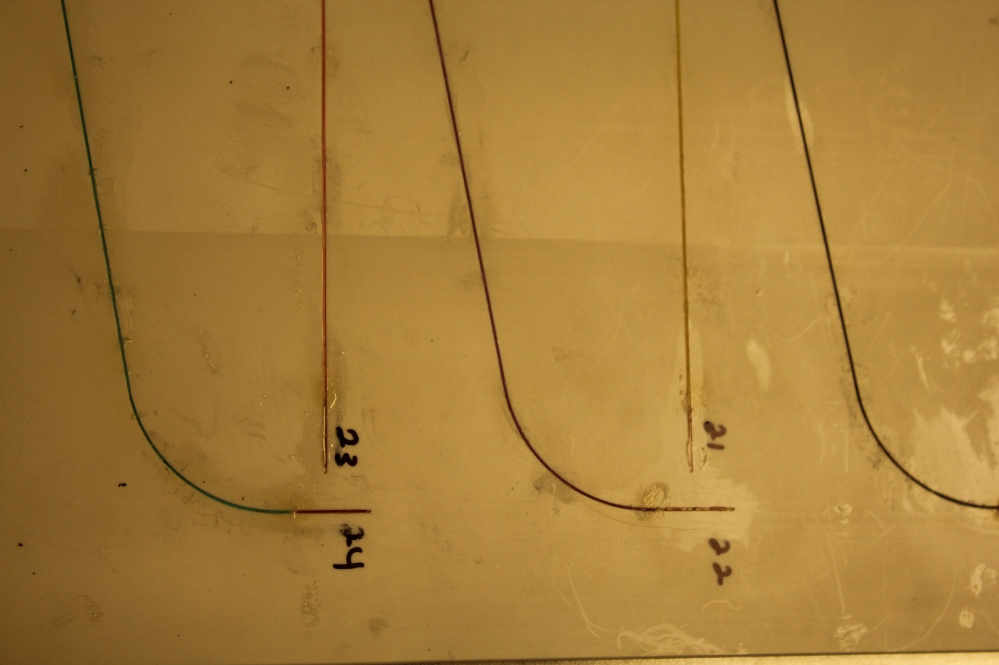
Fiber Optic Strain Plate - Principle

Slide 13
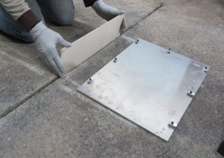
Fiber Optic Strain Plate - Installation

Slide 14
Heavy Weight Deflectometer (HWD) Tests
Uniformity of pavement structure (6 locations in each test section).
Effect of FOSP installation on pavement structure.
30.5-cm (12-inch) loading plate,
a pulse width of 30 msec, and
4 drop heights consisting of a 160-kN (36-kips) "seating drop" followed by impact loads of 53, 106, and 160 kN (12, 24, and 36 kips).

Slide 15
Heavy Weight Deflectometer (HWD) Tests

Slide 16
Heavy Weight Deflectometer (HWD) Tests
HMA Thickness, inch | HWD Test Section Summary |  |  |  | HWD Over FOSP
 |  | Deflection D0, mils | AREA, inch | ISM, kips/inch | Deflection D0, mils | AREA, inch | ISM, kips/inch
15 | Max. | 12.51 | 47.1 | 3133 | 11.89 | 45.35 | 3029
 | Min. | 11.49 | 45.8 | 2878
 | Mean | 12.06 | 46.5 | 2988
 | Std. Dev. | 0.39 | 0.6 | 97.7
 | COV, % | 3.26 | 1.2 | 3.3
12 | Max. | 17.07 | 44.8 | 2349 | 16.61 | 42.37 | 2168
 | Min. | 15.33 | 43.2 | 2109
 | Mean | 16.19 | 43.9 | 2227
 | Std. Dev. | 0.64 | 0.6 | 88.0
 | COV, % | 3.94 | 1.5 | 4.0
10 | Max. | 23.52 | 42.2 | 1786 | 22.92 | 38.92 | 1571
 | Min. | 20.15 | 39.6 | 1530
 | Mean | 21.55 | 40.8 | 1674
 | Std. Dev. | 1.15 | 0.8 | 87.1
 | COV, % | 5.34 | 2.1 | 5.2
8 | Max. | 29.16 | 38.5 | 1339 | 27.95 | 36.95 | 1288
 | Min. | 26.89 | 36.9 | 1235
 | Mean | 27.83 | 37.8 | 1294
 | Std. Dev. | 0.77 | 0.7 | 35.2
 | COV, % | 2.77 | 1.8 | 2.7

Slide 17
Summary:
Asphalt concrete strains were measured using fiber optic strain plates installed post construction in the test sections.
The strain plates allow for the measurement of near –surface compressive and tensile strains as well as tensile strains at the bottom of the AC layer over a 18-inch (45 cm) width across the wheel path.
The HWD deflection measurements showed that the installation of strain plates does not alter the pavement structure significantly and forms an integral part of the pavement structure.

Slide 18
Response Tests
3 speeds
  0.5, 1, 4 mph
3 Wheel Loads
  12, 24, 36 kips
5 Transverse Offsets
4 Gear Configurations
  1, 2, 4, 6 wheels

Slide 19
Traffic Tests:
Standard NAPTF wander pattern.
55 kips wheel load, 6-wheel gear.
Pavement Monitoring
  Straight Edge Rut Depth Measurements
  Surface profiles
  Crack maps

Slide 20
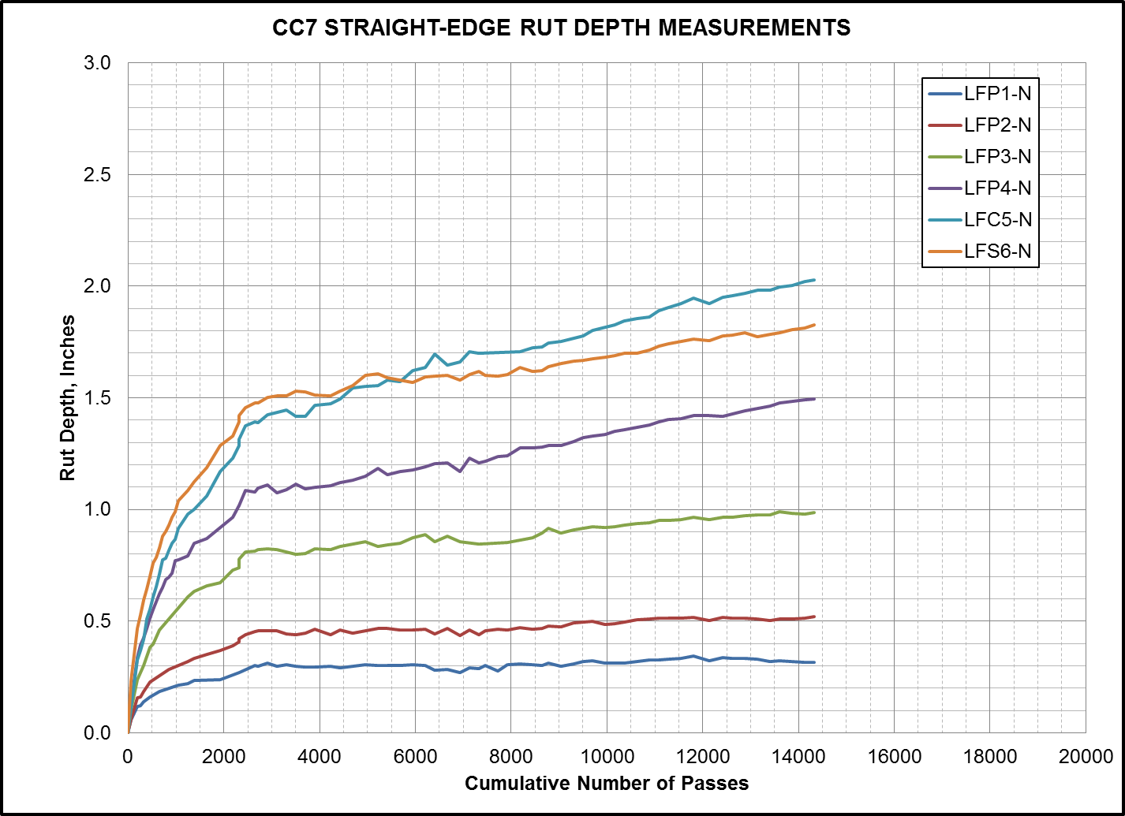

Slide 23
Summary:
Severe cracking in LFC-5N.
LFP-4N has comparatively less cracking/rutting compared to LFC-5N.
Very minor cracking in LFP-3N, cracks extending from LFP-4N.
No cracks in LFP-1N and LFP-2N.
Traffic tests to continue in Fall’2015.

Slide 24
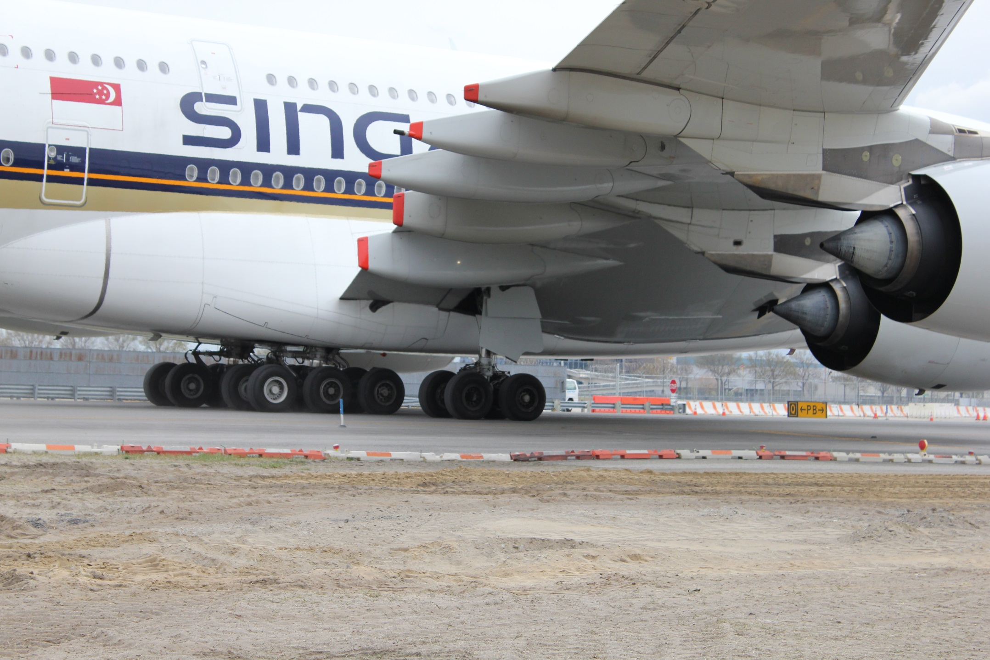
http://www.airporttech.tc.faa.gov
Thank you!

