Slide 1
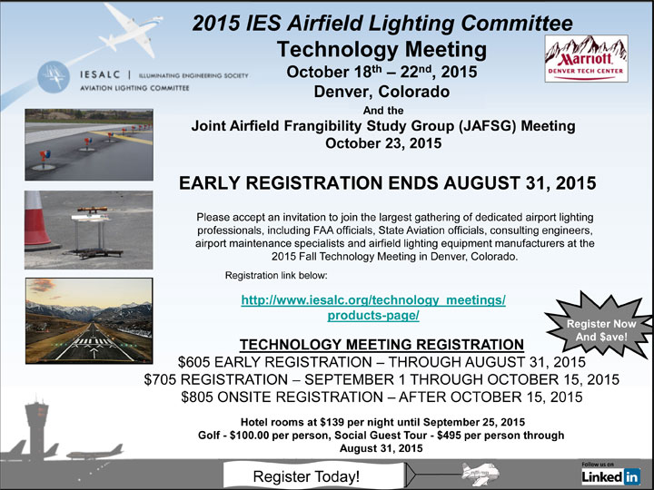
Our Mission - To study the application of light and lighting to spaces and functions involved in the operation of aircraft and spacecraft.
Who We Are - We are a committee formed under the Illuminating Engineering Society of North America. The committee was started on October 21, 1929. We are a non-profit organization comprised of members from all sources of general aviation lighting specialists, including engineers, manufacturers, designers, contractors, airport authorities, federal authorities (FAA & Transport Canada), US & Canadian military and general aviation from North America and around the world. We are a non-commercial technical committee.

