Slide 1
RPD 134 NLA
RPD 140 COMPOSITES
RPD 152 ARFF
REDAC Briefing
August, 2015

Slide 2
Current Firefighting Research Areas
Alternative Aviation Fuels
Composite Material Firefighting
FLIR Technologies
Compressed Air Foam (CAFS) Technology
AFFF Performance Testing
HRET Technology Enhancements
NLA Strategies and Tactics
Computational Modeling of ARFF Response
Use of Clean Agents in Cargo Fires

Slide 3
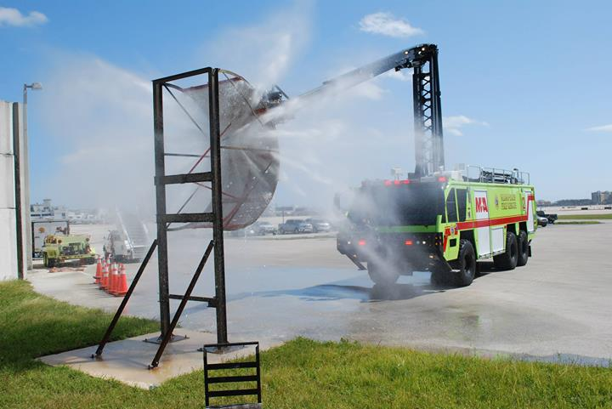
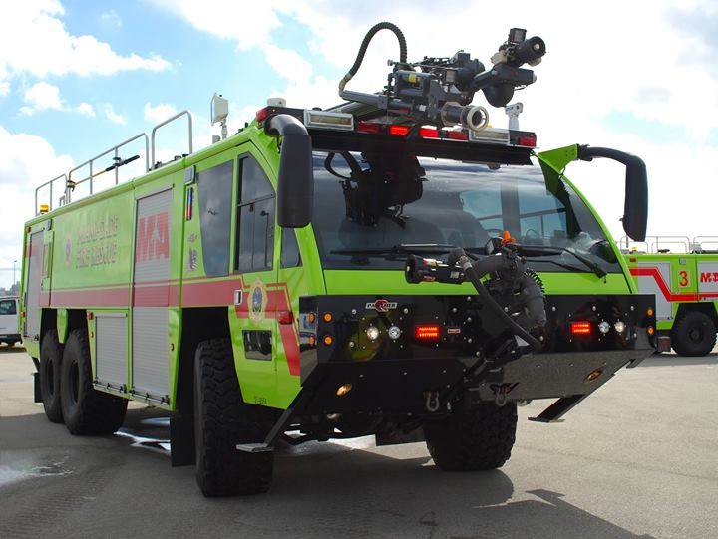
New Firefighting Systems for Class 4 & 5
ARFF Vehicles
Objectives
Research new firefighting systems and technologies which can be used on Class 4 and 5 ARFF vehicles as the primary discharge for extinguishing agent.
  CAFS
  High Pressure
International ARFF community moving towards these technologies however no performance based standards exist.
Procurement of new ARFF research vehicle (replacing 1992 E-One).
Conduct live fire testing and analysis of these technologies extinguishing fuel fires and compare the results with current vehicles.
Develop performance based standards for OEM’s to build to and airports to specify.

Slide 4
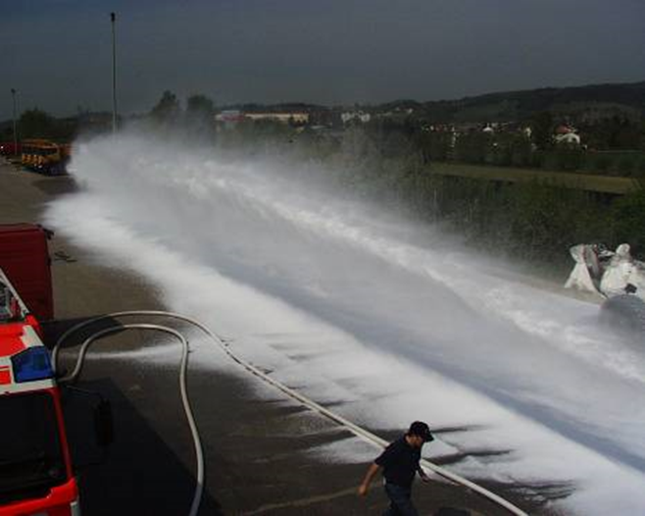
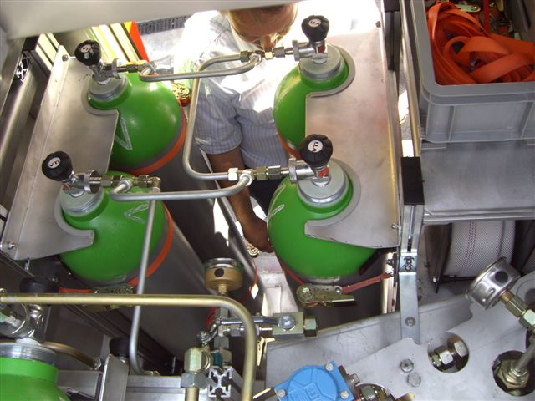
New Firefighting Systems for Class 4 & 5
ARFF Vehicles
Vehicle Facts
First Class 4/5 ARFF vehicle utilizing CAFS as a primary discharge in US.
  HRET and ASPN
  High flow, multi-position bumper turret
  Handlines
Capable of discharging in CAFS or standard modes to all discharges.
Capable of varying air injection to change expansion ratio of foam.
Capable of varying foam discharge rates.
Electronic foam proportioning with advanced flow monitoring for R&D evaluations.

Slide 5
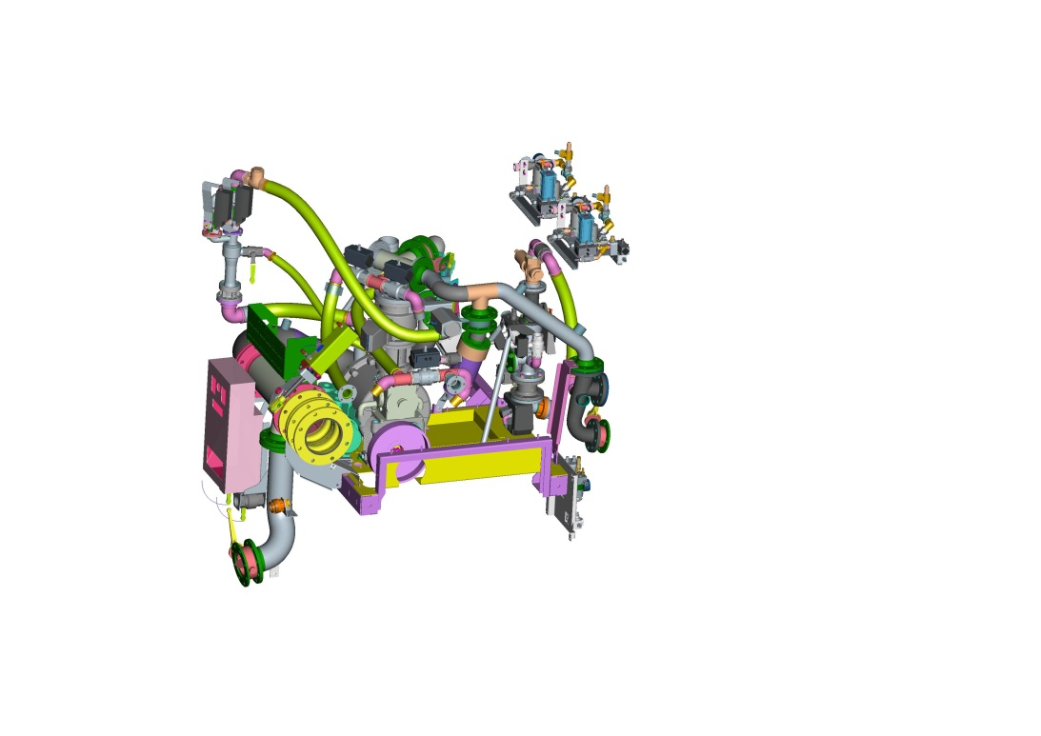
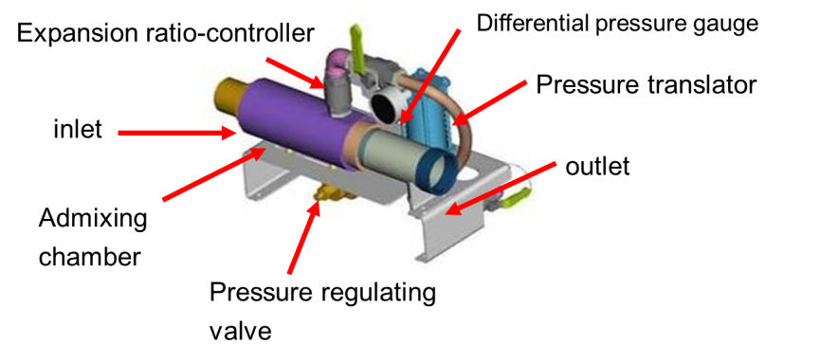
New Firefighting Systems for Class 4 & 5
ARFF Vehicles
Status
Performed a market survey (FAA project #16578, June 2014) for a new ARFF research vehicle with compressed air foam capability.
Vehicle manufacturer has been identified.
Specification document completed.
Procurement awarded September 2014.
Preliminary engineering drawings in progress.
OEM ordering pump, agents tanks and other components for assembly.
Assembly scheduled for late Fall 2015.

Slide 6














Fire Test Building Retrofit
Main
Search
Reports
Help
Governing Spec: MIL-F-24385F(1)
The Qualified Product List for the following governing specification was last updated on 19-DEC-2014
Doc
QA FSC QPL Number Governing Spec Doc Date Status
Title
Fire Extinguishing Agent, Aqueous Film-Forming Foam (AFFF) Liquid Concentrate, for Fresh and Sea Water
QPL Notes
Preamble Footnotes
SH 4210 QPL-24385 MIL-F-24385 05-AUG-1994 Active
Search > QPL > Government Parts > Manufacturer Parts
Based on the selected QPL above, Filter for: Filter by:
Based on the selected Government Part to the left, Filter for: Filter by:
--NONE--
--NONE--
Total part count = 2
Click on the appropriate link to see more. If not link, no qualified
source.
Green - Source is Certified, Yellow - Source is due for Certification, Red - Source is overdue for Certification. Contact QA for additional information. Total part count = 4 Click on the appropriate link to see more.
Page 1 of 1 1
Go to Page
Mfr Designation Source Name
CAGE Related
AER-O-WATER 3- EM
KIDDE FIRE FIGHTING, INC.
180 SHEREE BOULEVARD STE 3900
EXTON, PA 193411304 USA
http://kidde-fire.com
Test Reference: NRL Rpt. 6180-752A:CRF
Code Links
11939
[source POC]
Govt Designation
TYPE 3
TYPE 6
NSN
Spec Sheet
CSI Notes
[source
Plants]
Page 1 of 1 1
Go to Page
BUCKEYE 3% BFC-3MS AFFF BUCKEYE FIRE EQUIPMENT COMPANY, INC
110 KINGS RD
KINGS MOUNTAIN, NC 280862090 USA
57658
[source POC]
[source
Plants]
Test Reference: Test Rpt NRL 6180A:RS Dtd 20 Oct 2003, DCMA, Atlanta Ltr Dtd 12 Nov 2003
TYCO FIRE PRODUCTS LP
TYCO FIRE PROTECTION PRODUCTS
1 STANTON ST
MARINETTE, WI 541432542 USA
CHEMGUARD 3% AFFF C- 301MS
03670
[source
Plants]
TRIDOL M 3%
Test Reference: NRL Rpt. 6180-0047A:FWW 30 January 1997
KIDDE FIRE FIGHTING, INC.
180 SHEREE BOULEVARD STE 3900
EXTON, PA 193411304 USA
http://kidde-fire.com
Test Reference: NRL Rpt. 6180-0103A, 18 Feb 1994
11939
[source POC]
[source
Plants]
Page 1 of 1 1
Go to Page

Slide 7
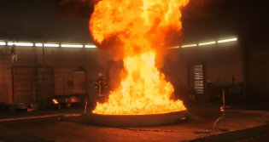
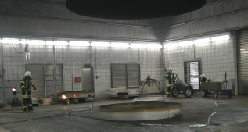
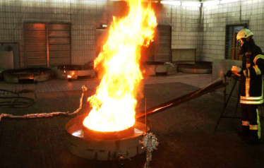
Fire Test Building Retrofit
Testing of Agents, Bio-fuels and Composites
Comparative Facilities

Slide 8
Fire Test Building Retrofit
The instrumented section shall consist of:
  gas temperature thermocouples
  calorimeters
  pressure probe
  gas sampling probe
  smoke density meter.
The hood calorimeter will be capable of accurately measuring the heat release rate of a 15 MW hydrocarbon pool fire (10’ Dia.).
Building will have color and FLIR video camera array.
Plenum
Funnel
Skirt
Hood
t
c
u
D
100,000 cfm
Blower

Slide 9
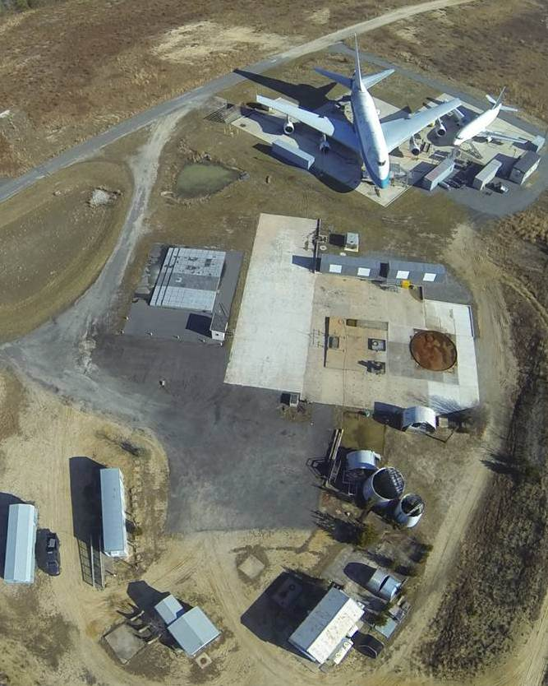
Status
FAA TC MPSB approval received May 19, 2015.
FAA 7460 obstruction evaluation approved July 22, 2015.
Current efforts:
  Finalizing A&E design statement of work.
  Determining what, if any, pollution prevention equipment would be required to meet the standards under the Clean Air Act.
1011 Test Aircraft
Office Trailer
Storage Shed
Pump House

Slide 10
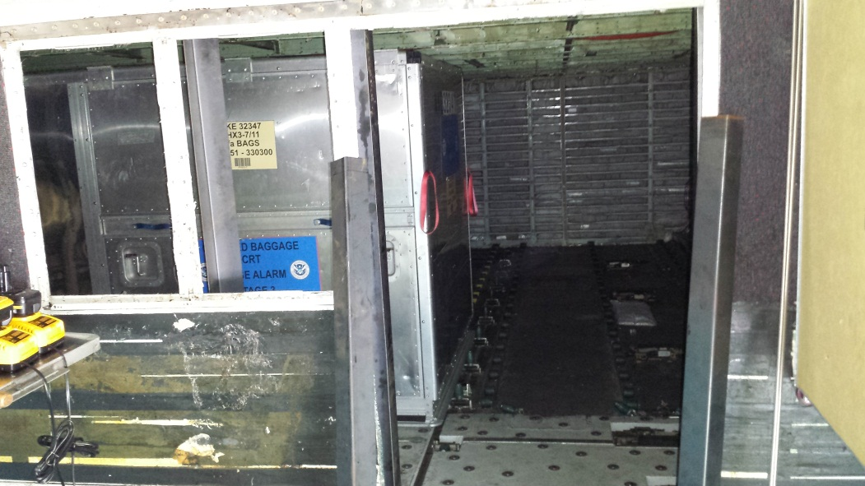
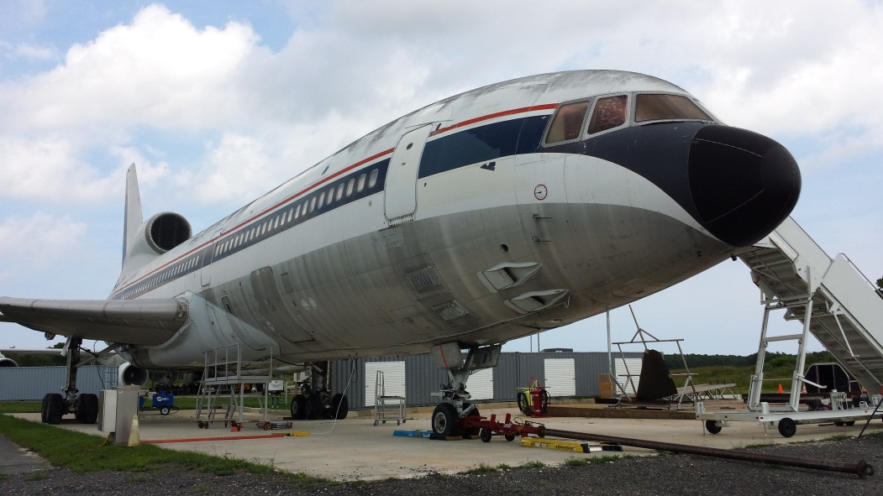
L1011 Test Aircraft
The FAA acquired an L1011 aircraft to be used as a test article for ARFF Fire Research.
Lower cargo hold was the first test chamber to be fabricated with clean agent cargo fire tests as the first project.
Thermocouple, oxygen analyzers, FLIR and color video instrumentation being installed.

Slide 11
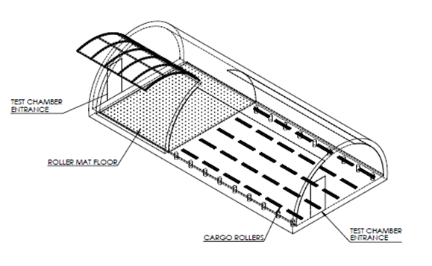
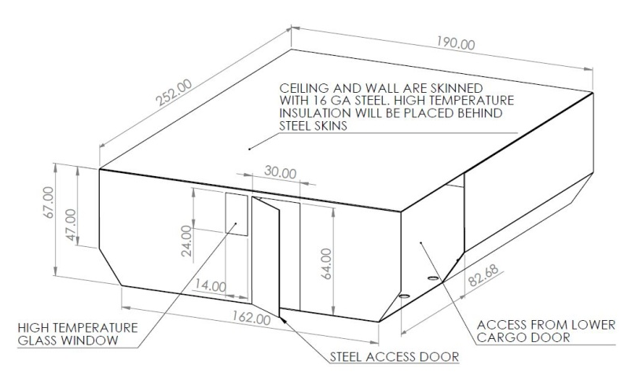
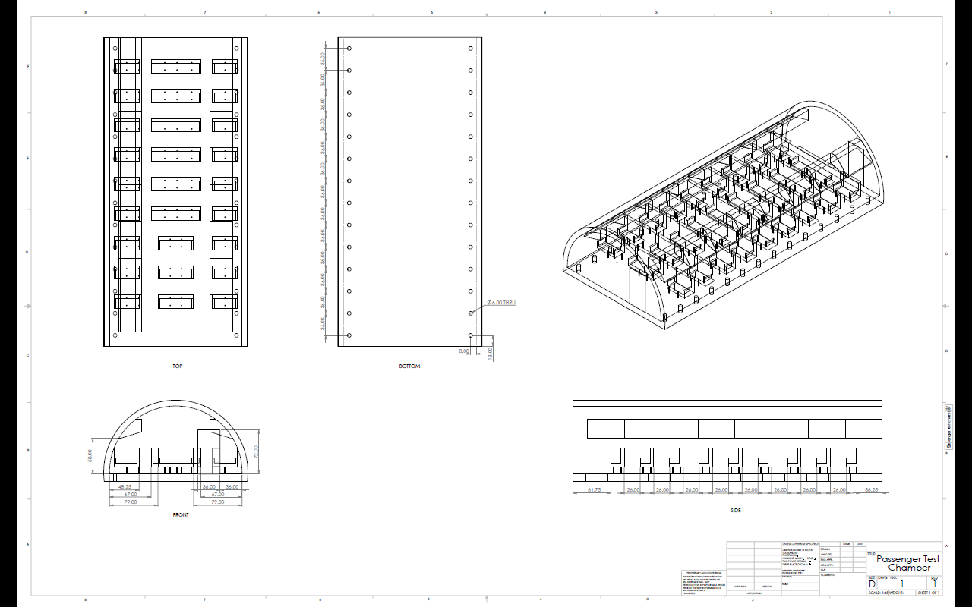
L1011 Test Aircraft
Test chambers will simulate the following:
  Passenger compartment
  Upper Freighter compartment
  Avionics Bay
  Lower Cargo Compartment

Slide 12
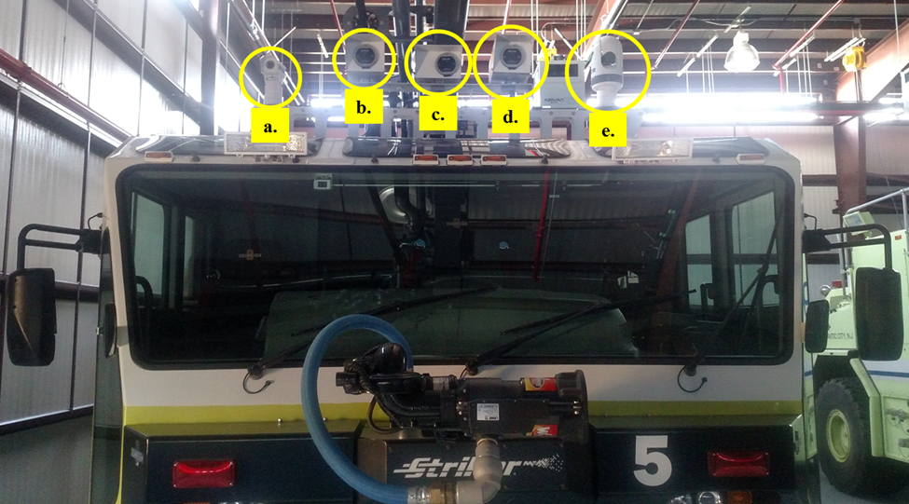
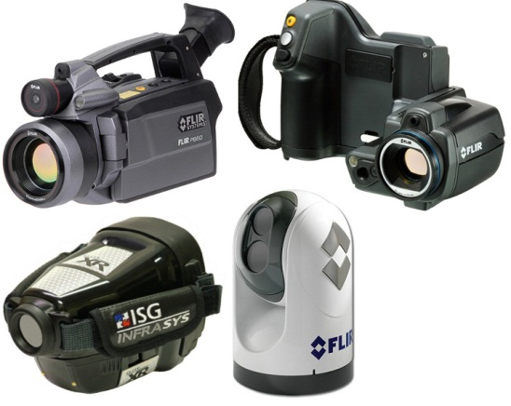
Thermal Imaging and FLIR

Slide 13
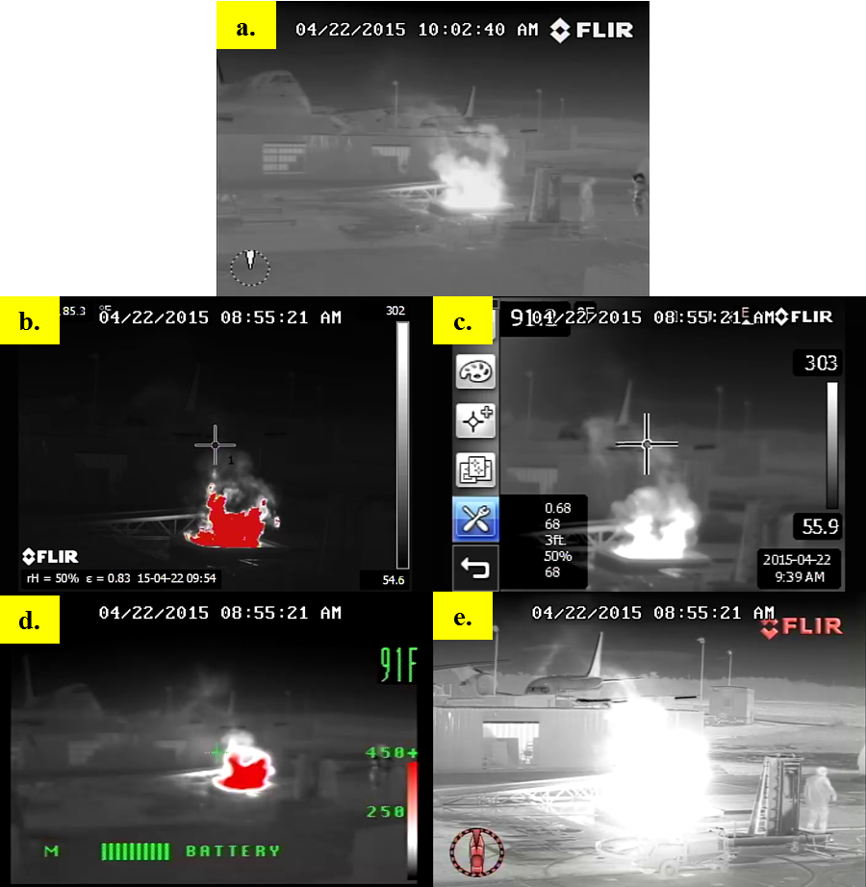
Thermal Imaging and FLIR

Slide 14
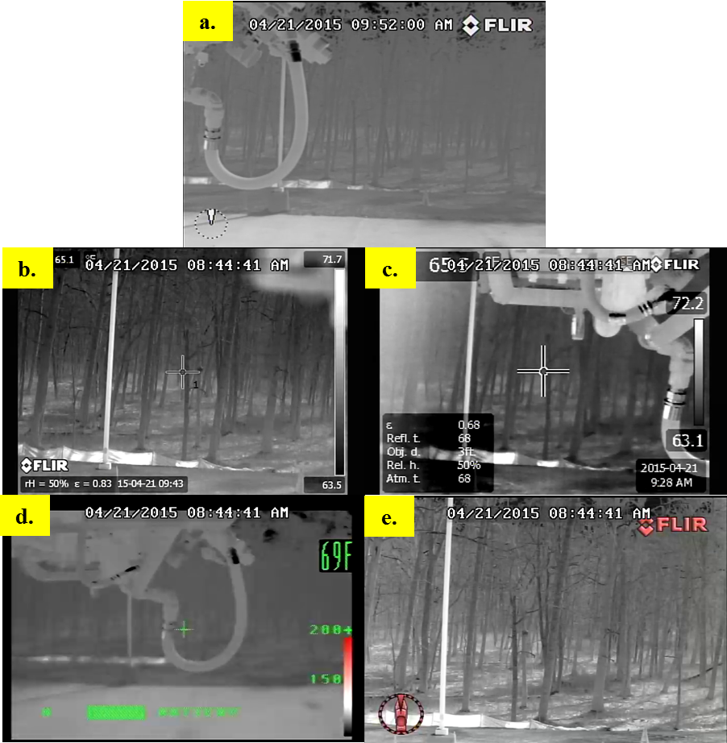
Thermal Imaging and FLIR

Slide 15
ARFF Research Reports
Published Reports Since Last REDAC:
Experimental Flow Characterization and Computational Model Development of Aqueous Film-Forming Foam (AFFF) Firefighting Jets
Intermediate-scale Evaluation of the Flammability and Suppression Agent Required for Aircraft Skin Composite Materials and Combustible Surrogates
Cutting Evaluations of Aircraft Grade Panels

Slide 16
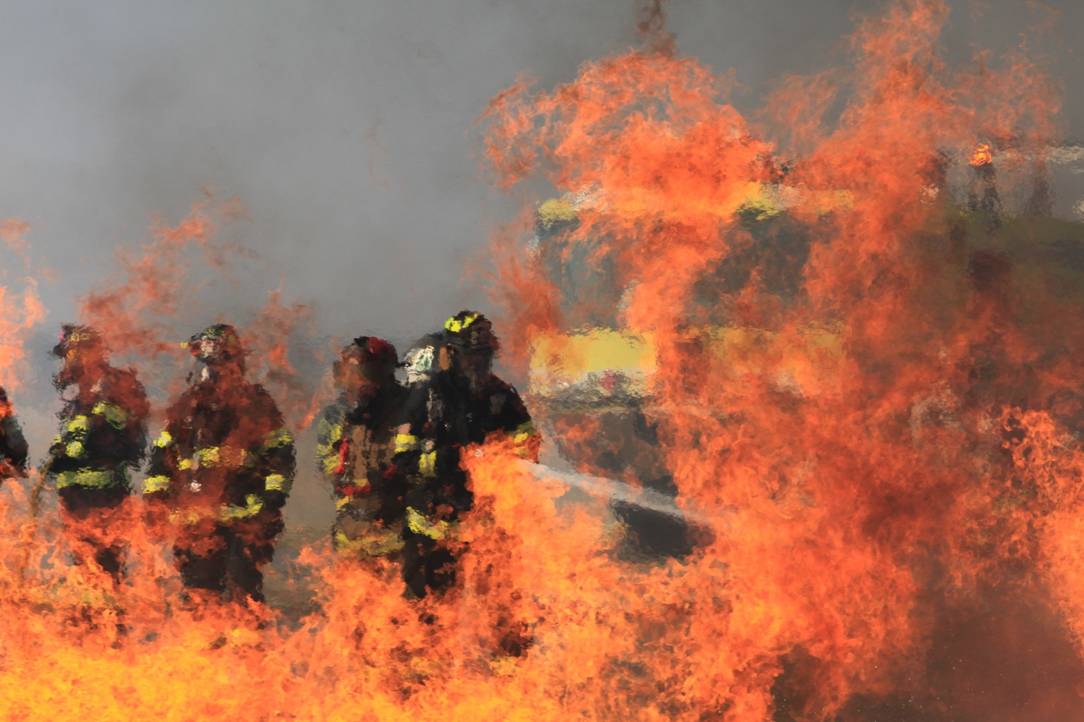
Questions?

