Slide 1
RPD 135
National Airport Pavement & Materials Research Center (NAPMRC)

Slide 2
High Temperature Pavement Test Facility- RPD 135
Contract Funds ($K)
Projects | FY15 | FY16 | FY17
Maintenance and Equipment | 50 | 100 | 100
Set-up Database, Process and Analyze Data | 150 | 200 | 400
Test Pavement Construction | 200 | 300 | 300
Data Acquisition System & Instrumentation | 50 | 200 | 100
APTV Operation / Warranty | 300 | 0 | 450
TOTAL | $ 750 | $ 800 | $ 1350

Slide 3
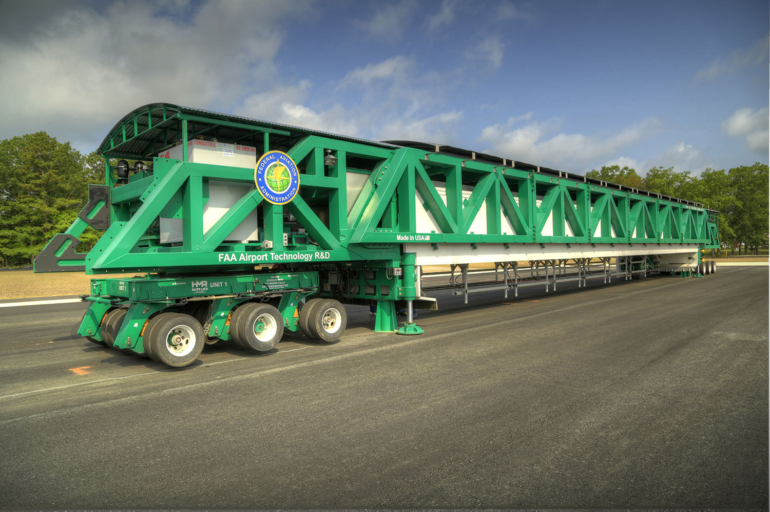
HVS-A

Slide 4
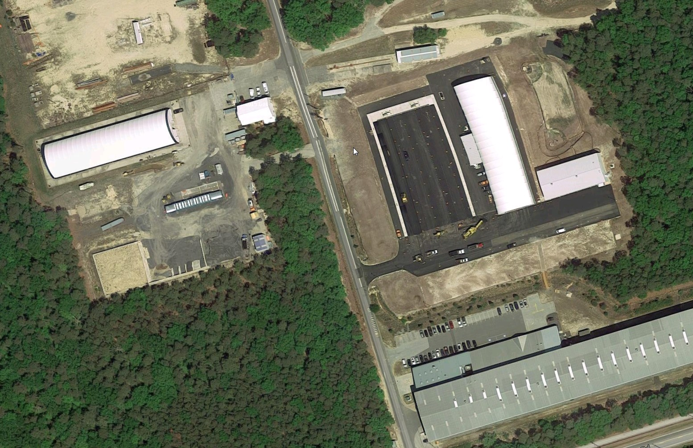

Slide 5
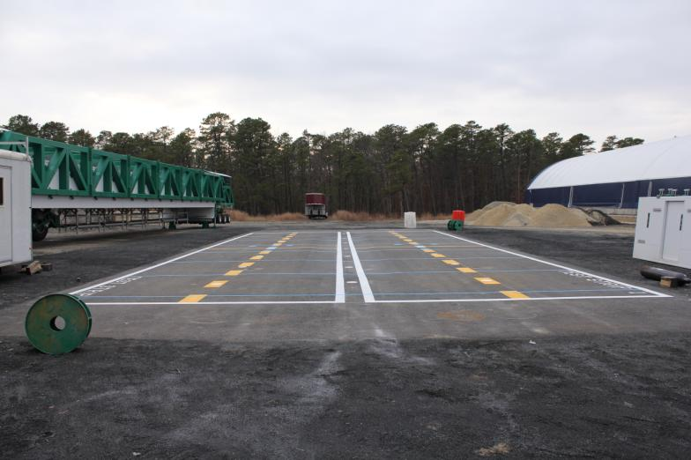
HVS-A Acceptance Test Strips

Slide 6
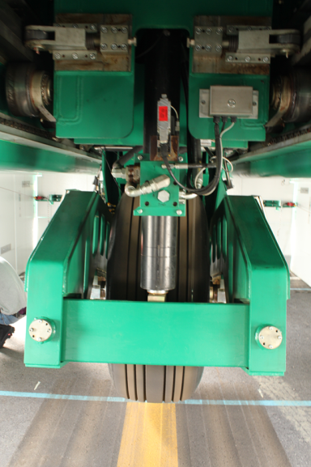
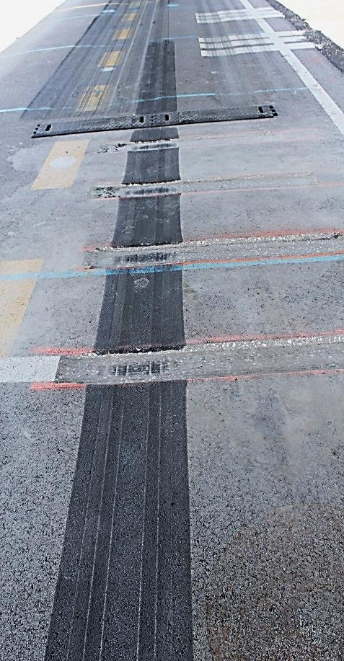
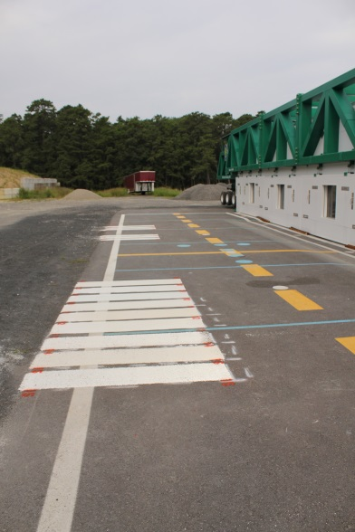
HVS-A ACCEPTANCE TEST STRIPS
Research Projects Completed – Pavement & Safety
Study the effects of Tire Pressure on
performance of HMA layer.
Tests on paint stripes for evaluation of Structured Methylmethacrylate (MMA) markings.
Performance tests on “Rumble Strips”. (Purdue University, PEGASAS)

Slide 7
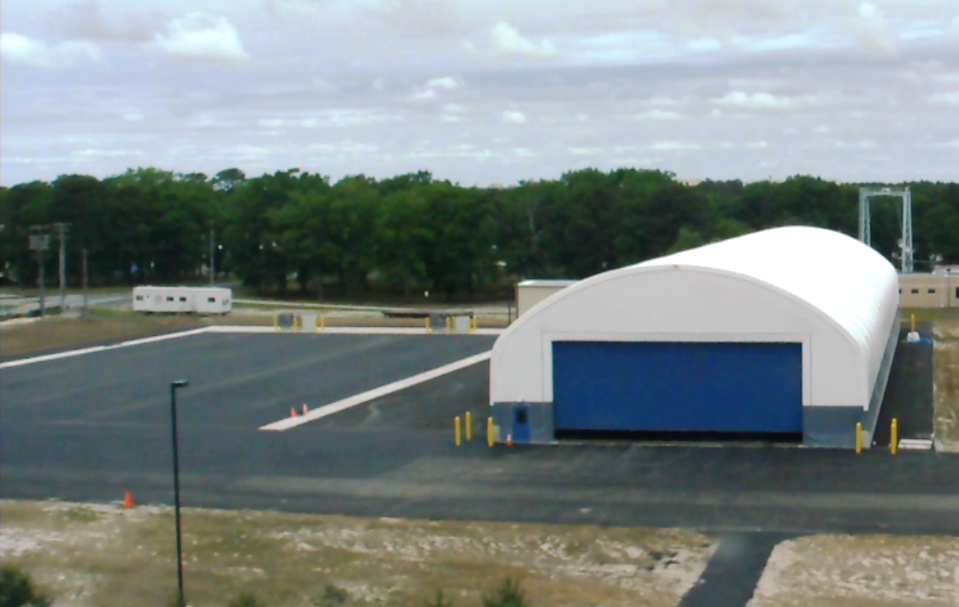
NAPMRC

Slide 8
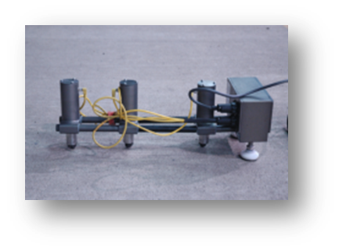
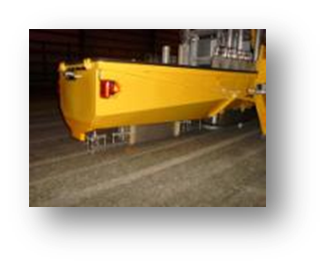
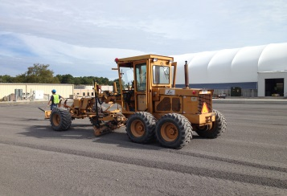
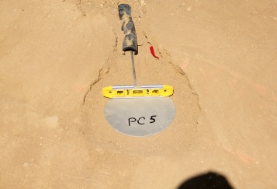
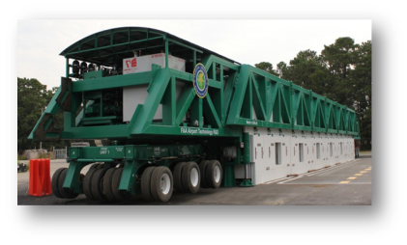
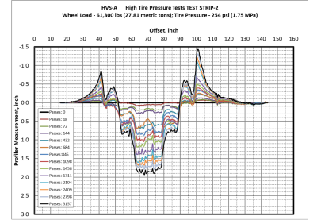
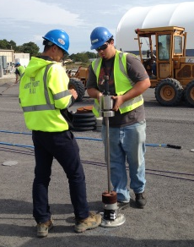

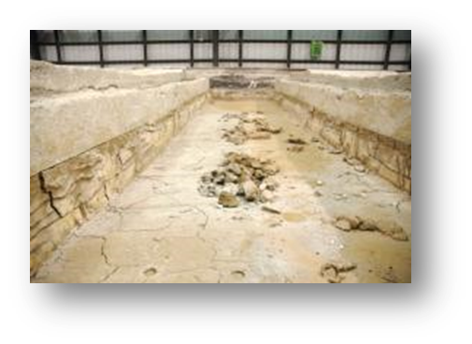
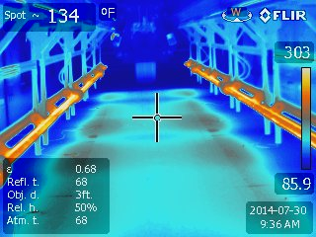
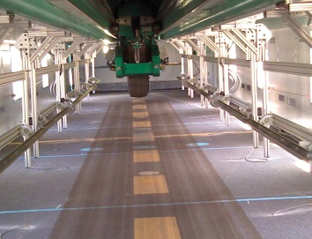
Objectives, Pavement
Construction, Sensors
NDT & Pavement
Characterization
TEST CYCLE (TC) AT NAPMRC
Posttraffic Testing
Full-Scale APT,
Pavement Evaluation

Slide 9
MATERIAL
WMA
WMA
P401
HMA
P401
HMA
WMA
P401
HMA
254
psi
254
psi
254
psi
254
psi
254
psi
254
psi
TIRE
PRESSURE
NAPMRC
Test Cycle-1
(TC-1)
214
psi
214
psi
214
psi
214
psi
214
psi
214
psi
BINDER
TYPE
PG
76-22
PG
64-22
PG
76-22
PG
64-22
PG
76-22
PG
76-22

Slide 10
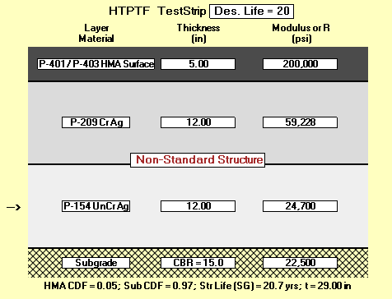
Pavement Cross Sections

Slide 11
HVS-A TC1: Wander Pattern

Slide 12
MATERIAL
P401
HMA
WMA
1
WMA
2
WMA
3
RAP
1
RAP
2
CRACKING
(test during
winter)
NAPMRC
Proposed
Test Cycle-2
(TC-2)
RUTTING
(test at high
temperature)
PG
76-22
PG
76-22
PG
76-22
PG
76-22
PG
64-22
PG
76-22
BINDER
TYPE

Slide 13
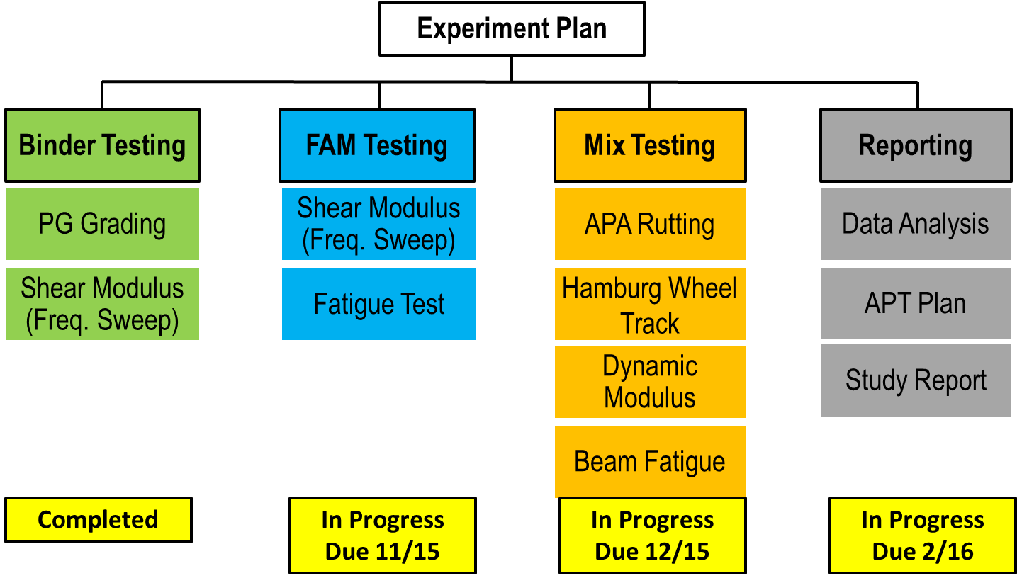
UCPRC Grant on RAP/RAS - Progress

Slide 14
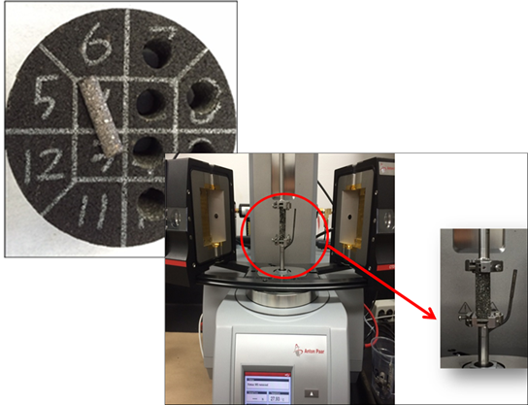
UCPRC Grant on RAP/RAS - Progress
Completed
  Characterization of asphalt binder, virgin aggregate, and RAP (California, New York and Alabama)
  Mix design for control (i.e., no RAP)
  Mix designs for high RAP mixes (25% and 40% binder replacement)
  Preparation of full-graded asphalt mixes
In progress
  Prepare verification FAM specimens (Complete by 09/2015)
  Testing FAM specimens (Complete by 11/2015)
  Testing full-graded mixes (Complete by 12/2015)
To do
  Analysis and prepare APT test plan and summary report (Complete by 02/2016)
For APT Tests
@ NAPMRC

Slide 15
Future Research
EVALUATION OF NEW ASPHALT TECHNOLOGIES FOR AIRFIELD PAVEMENTS
Warm Mix Asphalt, Stone Matrix Asphalt, Polymer Modified Binders,
RAP Mixes, Full-Depth Rehabilitation
PROBLEM: Lack of Guidance/Standards/Specifications
Lack of Performance Data
Laboratory Performance Evaluation
Full-Scale APT
NAPMRC
Field Performance Evaluation
Evaluate:
Rutting
Fatigue
Moisture Susceptibility
Durability
Low Temperature Cracking
Full-Scale APT:
Rutting
Fatigue
Tire Pressure Effects
WMA
RAP/RAS
Full Depth Reclamation
Compare to P-401 HMA
Field Projects:
Lab Evaluation of Field Mixes
Construction Evaluation
Evaluate:
Mix Design Production, Construction
Support from AAS-100, ADO

Slide 16
Heavy Vehicle Simulator – International Alliance
The HVS-IA is a voluntary association of Heavy Vehicle Simulator users, which has been established to promote interaction between users and to co-ordinate testing and the dissemination of test results.
Objectives of HVSIA
  Promote and share knowledge related to HVS technology;
  Establish a structure for ongoing interactions on topics related to pavement engineering with a specific focus on the HVS technology;
  Establish mechanisms for funding, monitoring and completing studies of common issues through the optimum participation of members;
  Provide expertise so that studies of interest can be expeditiously defined, managed and results reviewed;
  Optimize the use of resources through the coordination of HVS related research.
  It is assumed that all HVS owners will continue with their own research programs. The HVSIA activities are intended to complement and support the efforts of individual members.

Slide 17
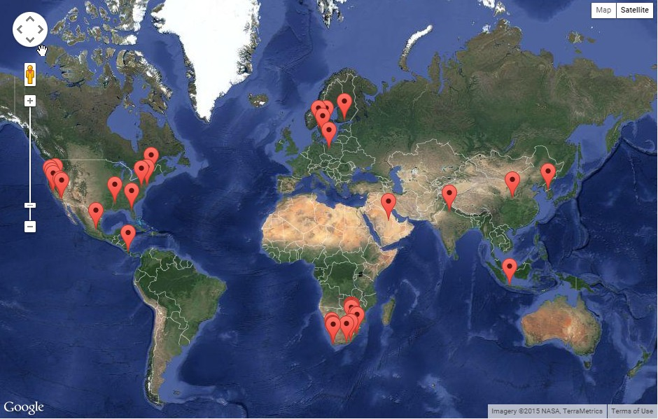
Heavy Vehicle Simulator – International Alliance

