Slide 1
40-Year Design Life Initiative (Updates)
RPD 145
REDAC Subcommittee on Airports
David R. Brill, P.E., Ph.D.
August 25, 2015

Slide 2
Pavement Design and Evaluation
(RPD 145)
Contract Funds ($K)

Slide 3
Project:
Doubling Pavement Life to 40 Years
FY 2017 Spending Plan:
Task | Planned ($K)
Performance Model Development | 300
PA40 Database Integration | 300
Field and Full-Scale Test Data Analysis | 100
Integrate Design and LCCA Models (Programming Tasks) | 200
Total | 900

Slide 4
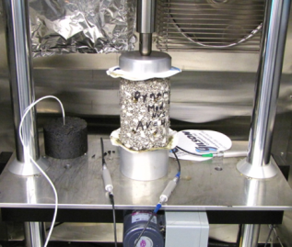
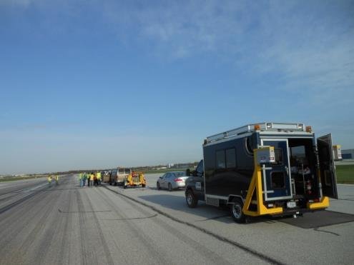
40-Year Pavement Life Extension
Runway data collection.
  4-year project –
  Completed year 3.
  Construction and performance data on medium- and large-hub runway pavements.
  Field data collection.
FAA PAVEAIR database development (PA40).
Pavement life model development.

Slide 5
Runway Data Collection
4-year project began in 2012 to collect extensive construction and performance data on a selection of medium- and large-hub runway pavements.
  Goal is to support development of 40-year life standards.
  Split between existing runways with approximately 20 years (or more) of service and new AIP-funded projects.
  Both flexible and rigid runways.
  A subset of selected airports will be visited for comprehensive field data collection.
Years 1 - 3 runway data collection is complete.
Current efforts focus on populating the databases.

Slide 6
Updated Runway List
Airport Code | Airport Name | Runway | Pavement / Age | Field Testing | Subcontractor | Comments
Asphalt Runways, >20 years
CMH | Port Columbus International | 10L-28R | Flexible / >20 | PCI / FWD / Inertial Profiler & SurPro | ARA | Prelim
BOS | General Edward Lawrence Logan Intl. | 04L-22R | Flexible / >20 | PCI / FWD / Inertial Profiler | Gemini | Prelim
BWI | Baltimore–Washington International | 10-28 | Flexible / >20 | PCI / FWD / Inertial Profiler & SurPro | ARA
TUS | Tucson International | 11L-29R | Flexible / >20 | No | Gemini
SFO | San Francisco International | 10L & 10R | Flexible / >50 | No | ARA
DCA | Ronald Reagan Washington National | 1-19 | Flexible / 40 | No | Gemini
LGA | LaGuardia | 4-22 | Flexible / >20 | No | ARA
SLC | Salt Lake City International | 16L-34R | Flexible / >20 |  | ARA
MCI | Kansas City International | 9-27 | Flexible / >30 | No | ARA | Med Hub
Concrete Runways, >20 years
IAD | Washington Dulles International | 01R-19L | Rigid / >20 | PCI / FWD / Inertial Profiler | Gemini | Prelim
IND | Indianapolis International | 5R-23L | Rigid / 23 | PCI / FWD / Inertial Profiler & SurPro | Gemini
SEA | Seattle-Tacoma International | 16C-34C | Rigid / >20 | No | ARA
LAX | Los Angeles International | 6R-24L | Rigid / 26 | No | Gemini
MCO | Orlando International | 17R-35L | Rigid / 24 | No | ARA
SLC | Salt Lake City International | 16R-34L | Rigid / 29 |  | ARA
DEN | Denver International | 17L-35R | Rigid / 19 | No | ARA
ATL | Hartsfield–Jackson Atlanta Intl. | 9L-27R | Rigid / >20 | No | ARA
DFW | Dallas/Fort Worth International | 18L-36R | Rigid / 40 | No | ARA
Asphalt Runways, <3 years
CMH | Port Columbus International | 10R-28L | Flexible / <3 | Inertial Profiler | ARA | Prelim
GSO | Piedmont Triad International | 5L-23R | Flexible / 3 | PCI / FWD / Inertial Profiler & SurPro | ARA | Small Hub
TUS | Tucson International | 03-21 | Flexible / <3 | No | Gemini
MIA | Miami International | 12-30 | Flexible / <1 |  | ARA
Concrete Runways, <3 years
SEA | Seattle-Tacoma International | 16R-34L | Rigid / <3 | PCI / FWD / Inertial Profiler | ARA | Prelim
ORD | Chicago O'Hare International | 10C-28C | Rigid / <1 | PCI / FWD / Inertial Profiler & SurPro | Gemini
IAD | Washington Dulles | 01C-19C | Rigid / <3 | No | Gemini
IAH | George Bush Intercontinental | 9-27 | Rigid / <3 | No | ARA
FLL | Fort Lauderdale–Hollywood Intl. | 10R-28L | Rigid / <1 |  | ARA

Slide 7
RUNWAYS FOR DATA COLLECTION - PHASE III
Site | Field Test | Airport | Hub | LTTP Climatic Region | Surface Type | Runway(s) | Age | Status
1 | Yes | Fort Lauderdale FLL | Large Hub | Wet-No Freeze | New PCC | 10R/28L, (8,000 x 150 ft) | Opened 18 Sept 2014 | Field Work Completed 2/15
2 | Yes | Miami MIA | Large Hub | Dry-Freeze | New AC | 12-30 | O/L 15 Sept. 2014 | Field Work Completed 2/15
3 | Yes | Salt Lake City SLC | Large Hub | Dry-Freeze | Old AC | 16L-34R (12,000 X 150 ft) | >30 years; AC O/L 3 yrs ago | Field work completed November 2014
4 |  |  |  |  | Old PCC | 16R-34L (12,000 X 150 ft) | 29 years
5 | No | Denver DEN | Large Hub | Dry-Freeze | Old PCC | 17L-35R (12,000 x 150 ft) | 19 years old; constructed in 1992; opened to traffic in Feb1995. | Coordinating to collect beam samples from RWY 17L-35R
6 | No | Kansas City MCI | Medium Hub | Dry-Freeze (on border with Wet-Freeze) | Old AC | 27 (9,500 x 150 ft) | > 30 years; no age for last O/L | Data collection ongoing
7 | No | Atlanta ATL | Large Hub | Wet No-Freeze | Old PCC | 9L-27R | Varies | Data collection ongoing
8 | No | Dallas-Ft Worth DFW | Large Hub | Wet No-Freeze | Old PCC | 18L-36R (13,400 x 200 ft) | 40 years old | Data collection ongoing

Slide 8
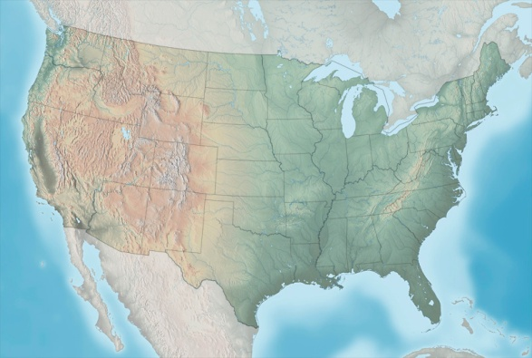

Year 1 Airport Locations
SEA
BOS
LGA
CMH
IAD
TUS
IAH
Large Hub
Medium Hub
Site designated for field data collection

Slide 9
Year 2 Airport Locations
ORD
IND
SFO
BWI
DCA
LAX
GSO
MCO
Large Hub
Medium Hub
Site designated for field data collection
Small Hub

Slide 10
Year 3 Airport Locations
SLC
DEN
MCI
ATL
DFW
Large Hub
FLL
Medium Hub
MIA
Site designated for field data collection

Slide 11
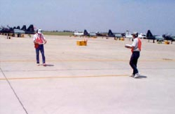
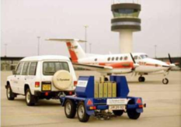
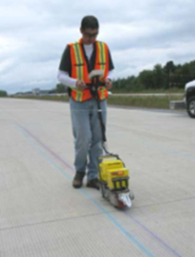
40-Year Life –
Runway Data Collection
All Airports
Design and construction data (with costs).
Maintenance activities and costs.
Pavement performance data. PCI, friction, roughness, groove condition, etc. Not limited to current fields in FAA PAVEAIR.
Traffic history (aircraft type, history, weight).
Field Data
PCI (visual survey).
Heavy Falling-Weight Deflectometer (HWD).
Material samples (concrete and asphalt) for laboratory characterization. Sample testing will be done at the NAPTF lab.
Longitudinal roughness profiles (SurPRO) & FAA portable profiler (if feasible).
Grooving (longitudinal texture) data.
Laser imaging by FAA (if feasible).

Slide 12
FAA PAVEAIR Implementation
Data collected fall into 2 categories:
  Exists in current FAA PAVEAIR (e.g., PCI, certain maintenance activities).
  Not in the current version of FAA PAVEAIR.
All collected data for the 40 year project will be stored in a dedicated, standalone FAA PAVEAIR implementation (“PA40”).
  Data are anonymized.
  No PA40 databases are accessible from the public FAA PAVEAIR implementation.
Enhanced functionality in PA40.

Slide 13
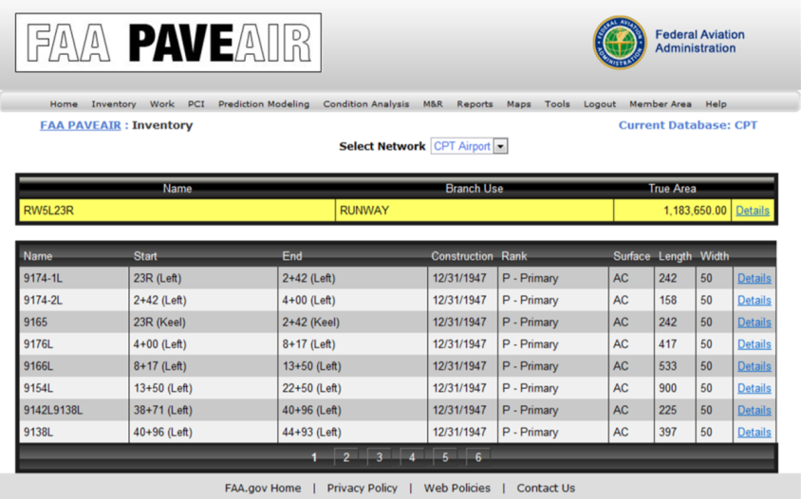
PA40 – PAVEAIR Databases
Enhanced Functionality
Fields for:
  HWD data, raw profile data, groove geometry data.
  Computed roughness indexes (ProFAA) and groove characteristics (ProGroove)
  Traffic data.
  Climate data.
  Structural layers and material properties.
Coordinate with FAA PAVEAIR development.

Slide 14
PA40 Organization Concept
Shaded area: Functionality in current FAA PAVEAIR
Functionality being added

Slide 15
PA40 – Current Work
Shaded area: Functionality in current FAA PAVEAIR

Slide 16
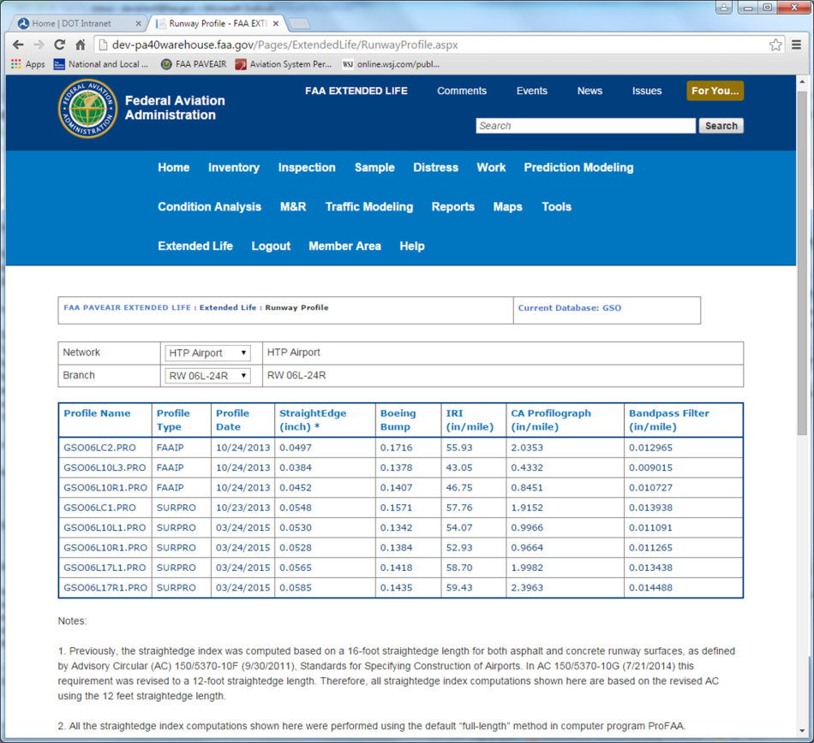
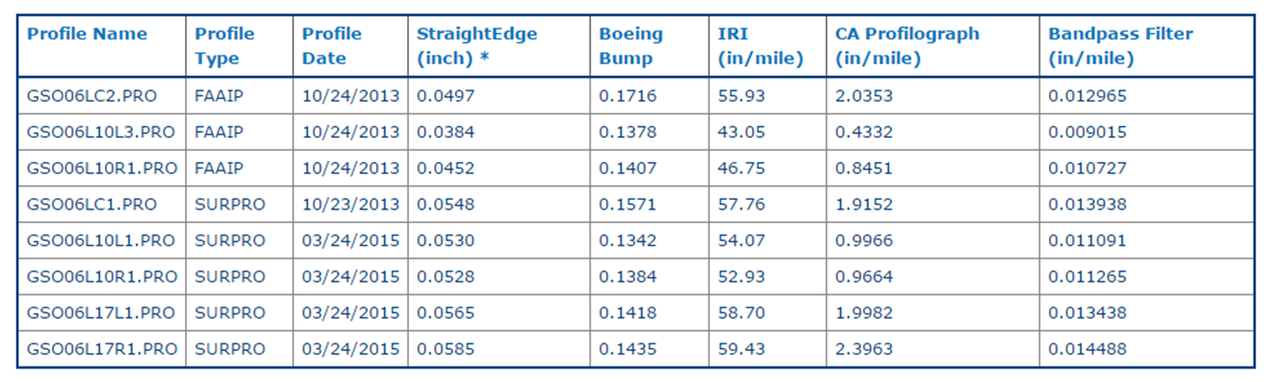
Profile Data in PA40 (GSO)
Computed roughness indexes based on ProFAA

Slide 17
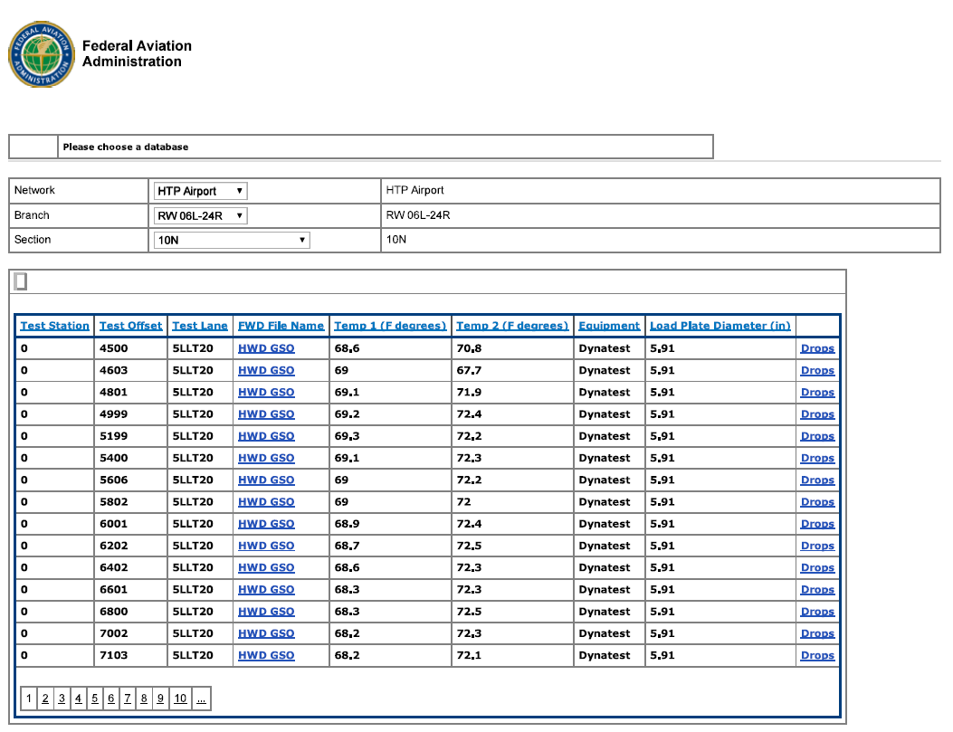
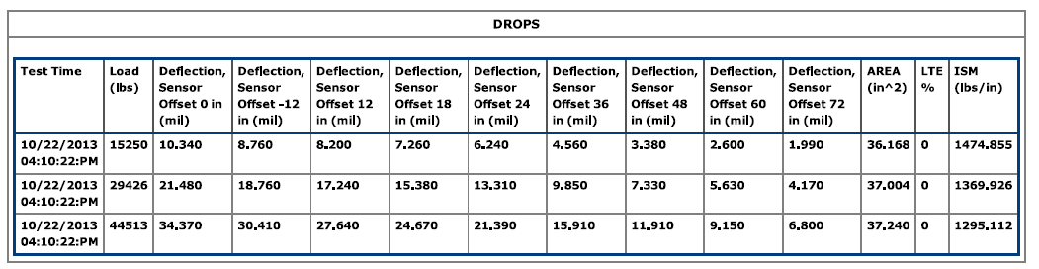
FWD Data in PA40 (GSO)
Computed structural indexes based on FWD drops

Slide 18
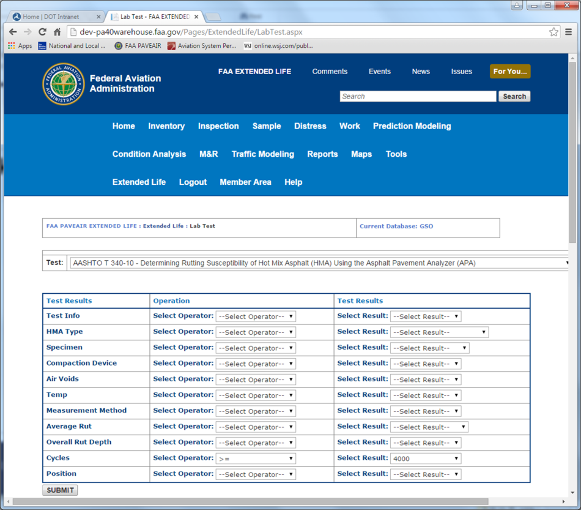
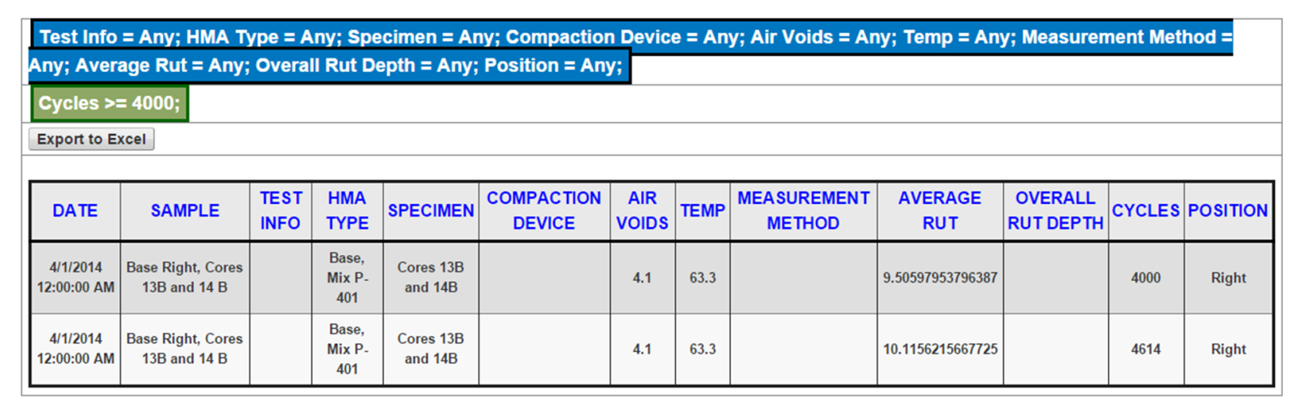
Lab Test Data in PA40 (GSO)
APA - Asphalt material performance test data

Slide 19
Traffic Data in PA40
Historical runway traffic data (as opposed to design traffic data) are generally not available from airport engineers.
Available data sources:
  ASDE-X (NAS data since 2012 stored at the WJHTC).
  PDARS (data for some airports back to 2010).
  Threaded Track Data (MITRE) – “fusion” of data from National Offload Program (NOP), ASDE-X and Enhanced Traffic Management System (ETMS).
Access NAS data via NPN shared services.
Avoid unnecessary data duplication.

Slide 20
Accessing ASDE-X Data via the NPN
Runway usage data searchable by:
Month/Year
Aircraft Type
Runway End
Arrival/Departure

Slide 21
Developing New Performance Models
New performance models will relate design inputs to a future distress index (DL) incorporating structural and non-structural elements.
Current Design Procedures:
Inputs
  Structural Layers
  CBR or k-value
  Aircraft Traffic
  Concrete Strength (rigid)
Output
  Passes to structural failure*
  *defined as 2.5 cm upheaval for flexible pavements or 50% of slabs cracked for rigid pavements
40-Year Design:
Inputs
  Everything to the left, plus …
  Age, Climatic Data
  Soil/Material Properties
  Maintenance Data
  Airport Feature (runway, apron, etc.)
Outputs
  Passes to structural failure, plus …
  Roughness index prediction
  Surface friction prediction
  Other functional indexes

Slide 22
Distress Level Formulation
DL quantifies serviceability. Therefore it must address three independent components of serviceability:
  Smooth ride (roughness).
  Provide tractive surface (friction).
  No loose pieces (FOD).
DL = f(friction, roughness, FOD)
Mathematical requirements: terms not strictly additive.
  Failure can be due to any one or a combination of components.
  Two “halfway failed” indices may not mean failure.
  Two “nearly failed” indices may mean a pavement is failed.
In general:
Note that structure is not explicitly part of DL, but is used in predicting the components.

Slide 23
Distress Level, End of Life, and LCCA
DL should contain enough information for LCCA.
DL_{lower} indicates pavement is no longer serviceable and maintenance is required.
Multiple treatments are considered for pavement at DL_{lower} during an iterative LCCA.
  Treatments that cannot raise DL to at least DL_{upper} are discarded.
  Treatments that cannot maintain DL above DL_{lower} reliably for 10 years or more are discarded.
  If complete reconstruction is optimum according to LCCA, end of serviceability is the end of life.

Slide 24
Definition of Airport Pavement Failure
If complete reconstruction is the best option according to LCCA, end of serviceability is equivalent to the end of life.
Therefore, pavement failure is a condition requiring full reconstruction, which means:
  Rigid: Replacement of PCC slabs, at a minimum.
  Flexible: Replacement of the HMA surface course and the base layer, at a minimum.
A more detailed definition was adopted by the SME group.

Slide 25
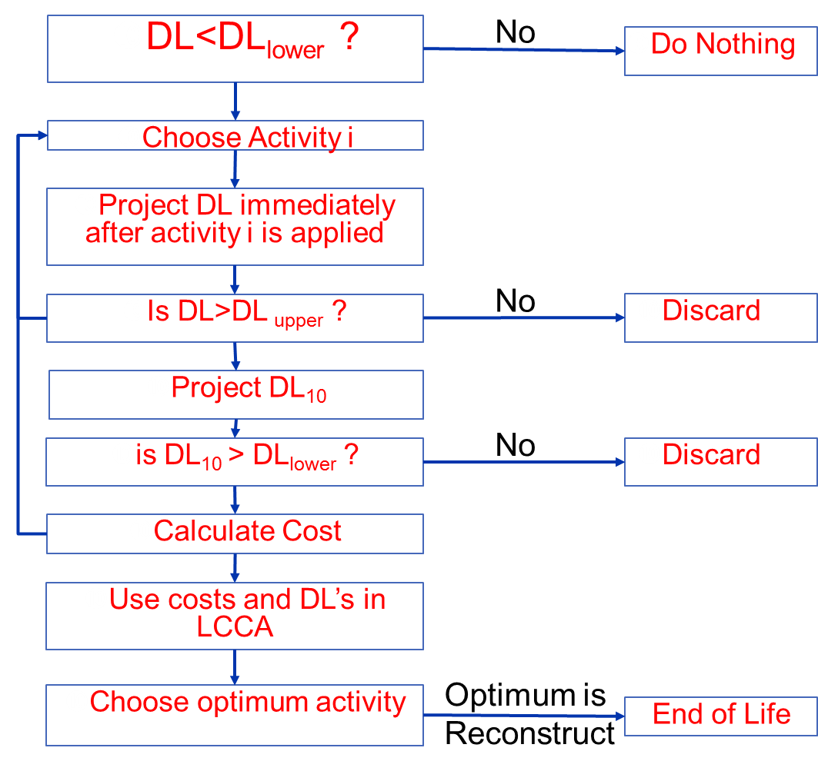
Flowchart

Slide 26
2015-16 R&D Plans
Up to 4 runways for additional field data.
  May been previously visited for field data collection (but not within the previous 24 months).
  Fill gaps in current database.
Develop access to traffic data in PA40.
Develop performance prediction curves.
  Current prediction modeling in PAVEAIR & PA40 is based on a “PCI-vs-Age” model.
  Develop “DL-vs-Age” family curves and parameters.
  Coordinate with R&D under RPD 156 (Q. Jia).

