Slide 1
Airport Technology R&D Team
RPD-150: Wildlife Hazard Mitigation R&D
UPDATE
REDAC Subcommittee
Ryan E. King
ANG-E261 Airport Safety Section
August 26, 2015

Slide 2
Wildlife Hazard Mitigation (RPD 150)
UPDATES:
50th Anniversary of FAA Strike Reporting
Launch of new Strike Report Validation and Update System expected in next 60 days
WiSC
BSTAR Deployment at BOS
Procurement of Interceptor
Other
Notes:
Reducing the likelihood of wildlife collisions with aircraft is a multi-faceted challenge addressed by efforts depicted here.

Slide 3
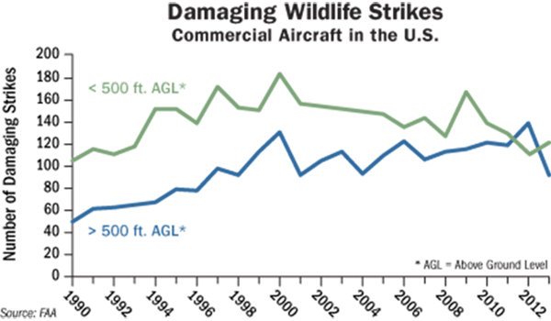
50th Anniversary of Strike Reporting
2015 marks the 50th anniversary of the first official FAA bird strike report being filed.
Since then, the value of strike reporting and species identification has been recognized as essential to establishing best practices for wildlife hazard management at airports
Recent increases in reporting show that since about 2000, strikes that involve damage to an aircraft have steadily declined for occurrences below 500 ft AGL – This is a testimony to improved wildlife hazard management practices at airports

Slide 4
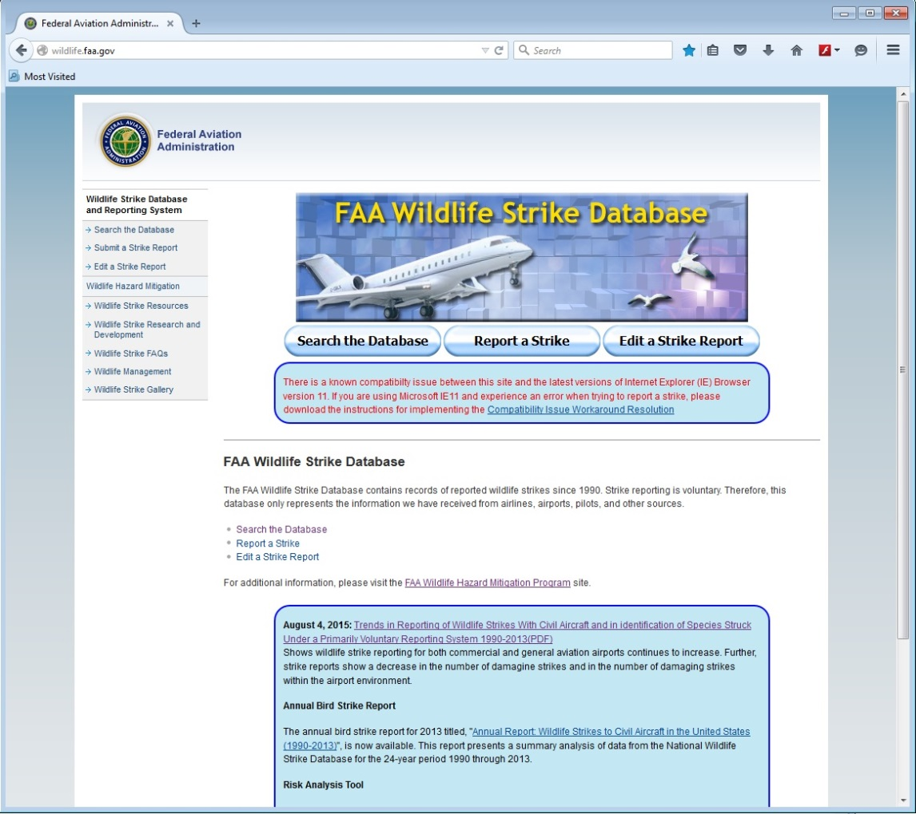
Updated and Upgraded Website & DB
The existing web wildlife.faa.gov website is not consistent with FAA standards for website appearance.
Existing Website

Slide 5
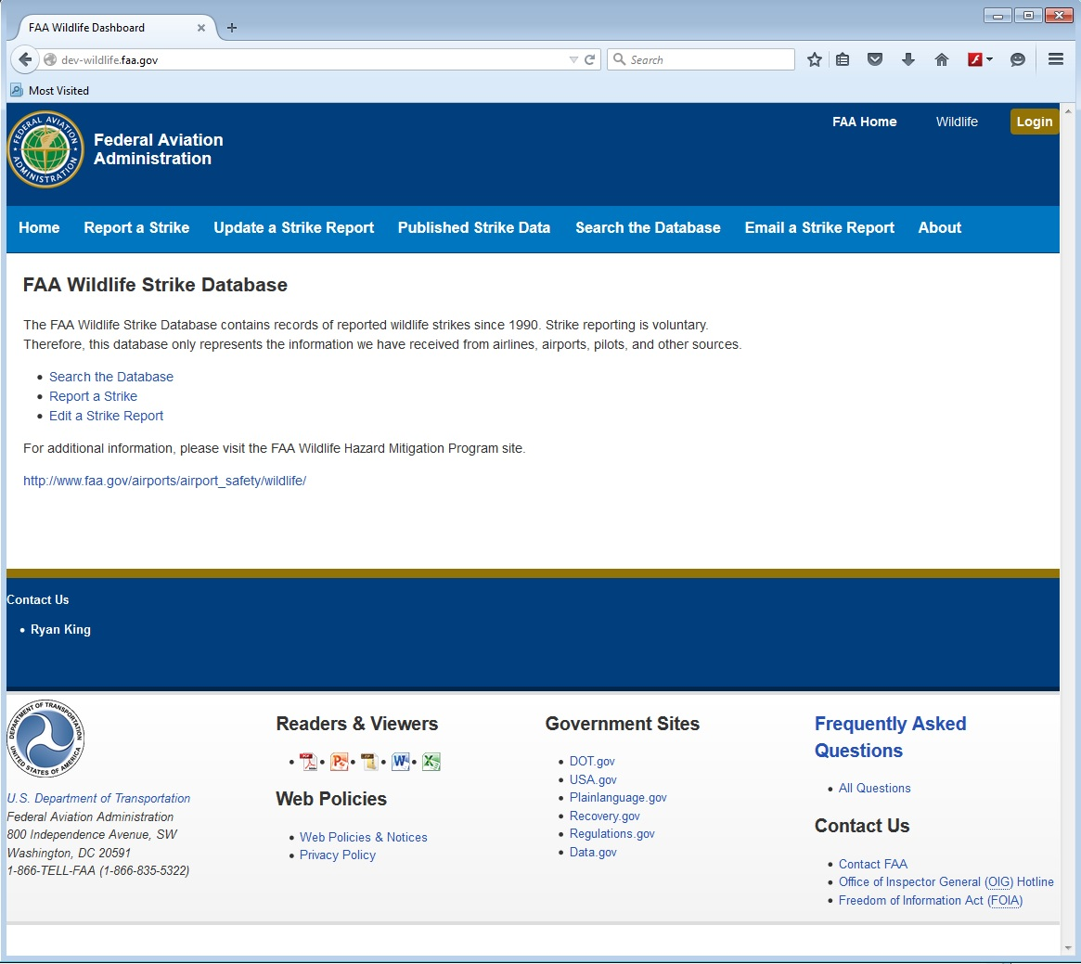
Features
New Website
Adheres to FAA web standards for appearance and is consistent with www.faa.gov
Login access for authorized FAA, USDA and Smithsonian users who administer the site, validate reports and provide species identification respectively
Custom interfaces for USDA and Smithsonian replace manual hard copy processing of strike reports
Once launched, the new site and data flow improvements will decrease lag time between a report being submitted and that report appearing on the public database from > 3 months down to < 24 hours.

Slide 6
“Wildlife Surveillance Concept) ANG-E26/ANG-C43 SLA
Coordination continues with ANG-C5, Office of Advanced Concepts and Technology to initiate support for next phase of research at BOS
Human-in-the-loop (HITL) laboratory demonstration Final Report ver. 2.0 completed
ANG-C43 reviewing draft WiSC socialization briefing
Revised Phase 3 Research Management Plan focusing of activities related to business case development following bird radar deployment at BOS
Continued developmetn of a WiSC ATCT Familiarization briefing to be used as an overview for field ATC personnel on the concept and progress of integrating bird radar information into the ATCT environment.

Slide 7
BSTAR Deployment at BOS
Trial deployment of an FAA (ANG-E26) owned BSTAR V2 bird radar system at BOS to demonstrate operational integration and provide cross-over to ATCT research activities under “WiSC”
Preliminary site selection completed with 7460 forms submitted for processing
Finalization of MOA between Massport and FAA to include AeroMacs research activities

Slide 8
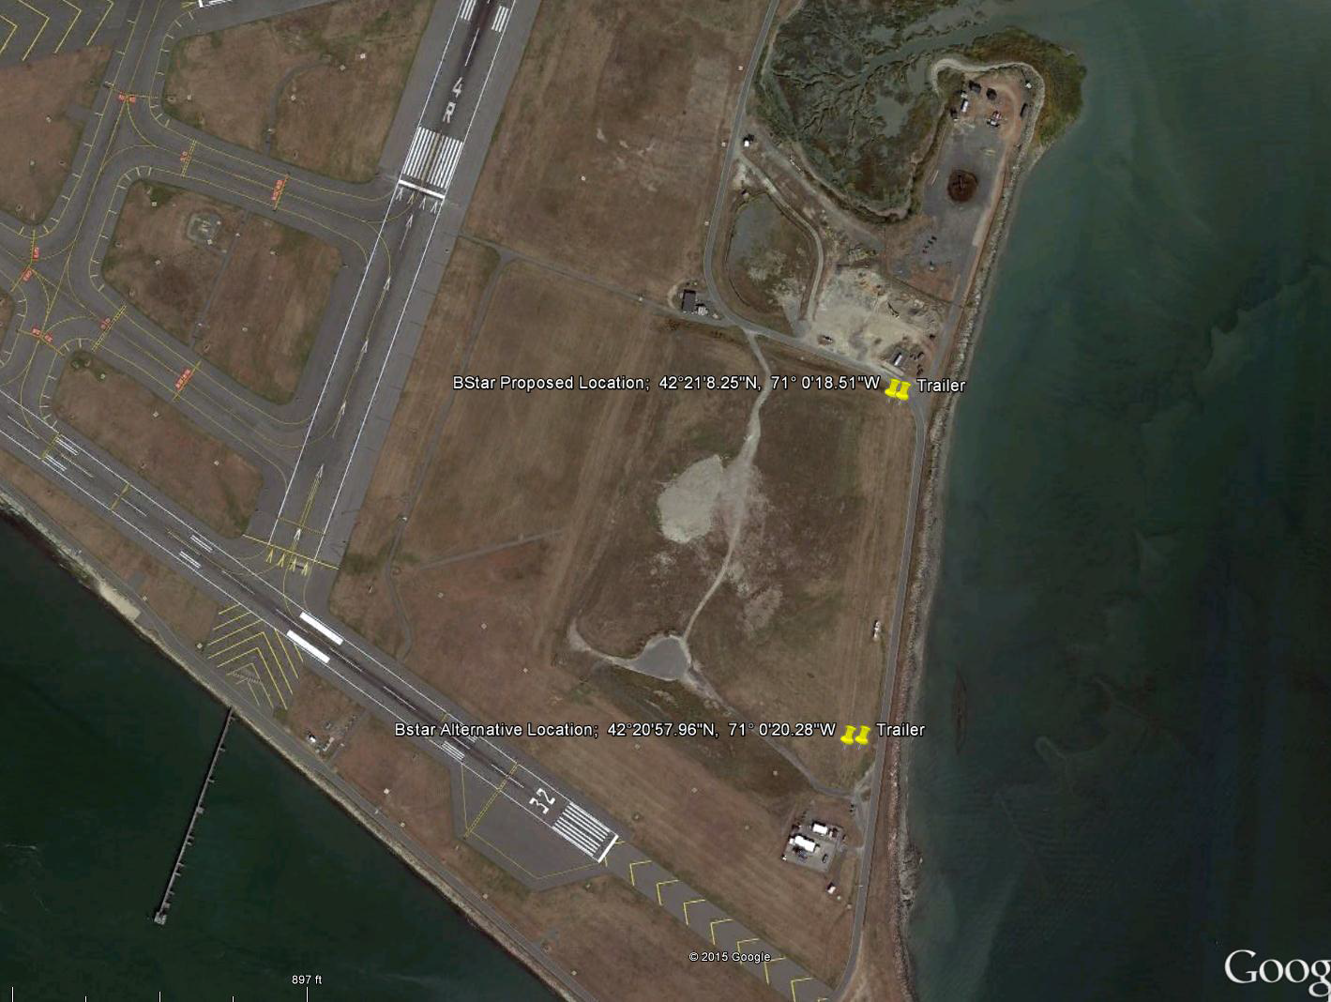
Proposed Locations for BSTAR
1
2

Slide 9
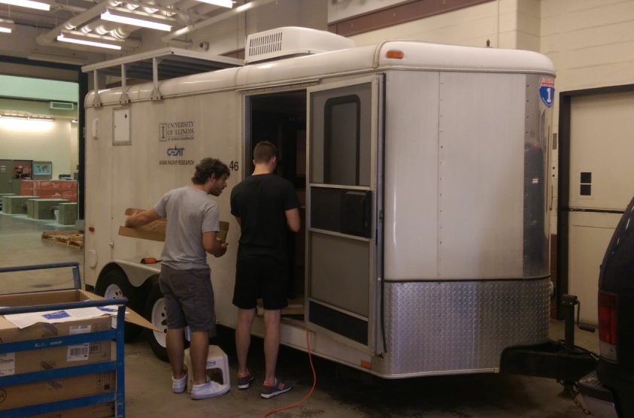
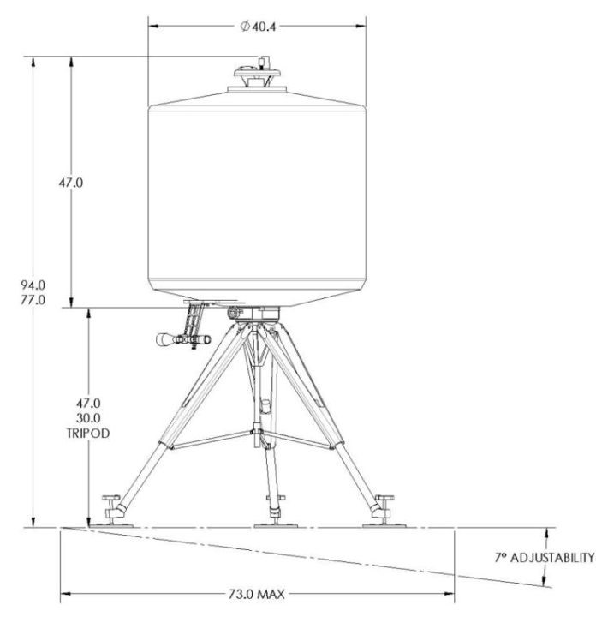
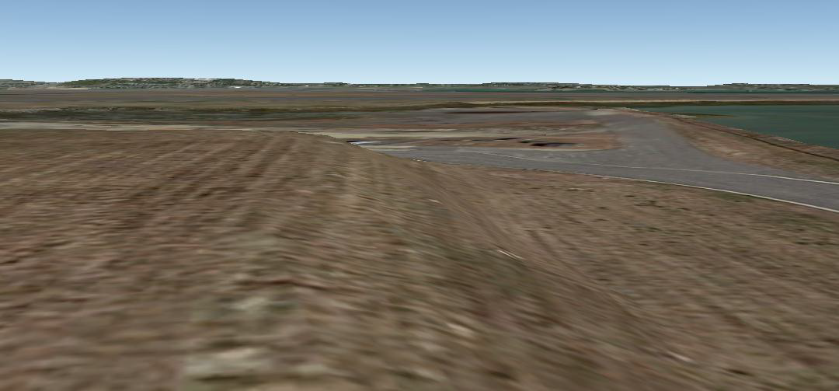
Components and placement
Radar
Support trailer

Slide 10
Pharovision Interceptor
Determination made to further assess performance and utility of Pharovision Optical target detection system
Procured an Interceptor – Lease ($30K/mos) v. Buy ($563K) analysis and application of the system to several Airport Safety R&D subjects justified purchase for a multi-purpose research asset.
Planned short term deployment at Naval Air Station Whidbey Island (NASWI) for technical performance tests
Longer term deployment to SLC
Supplement to collocated bird radar systems
Specialized application to White Pelican activity
Studies intended to support development of guidance of airports on use of technology

Slide 11
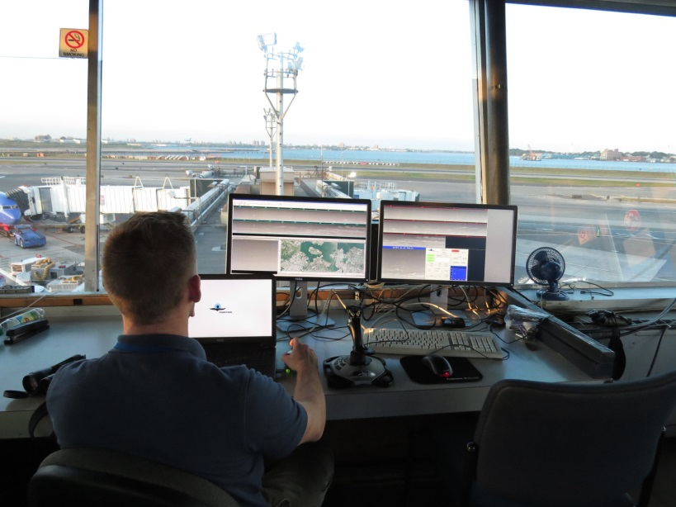
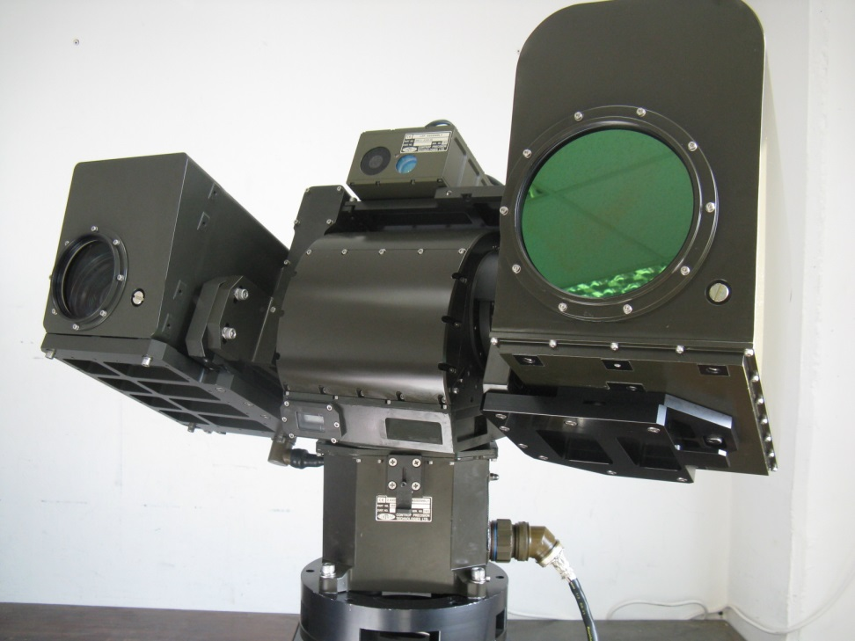
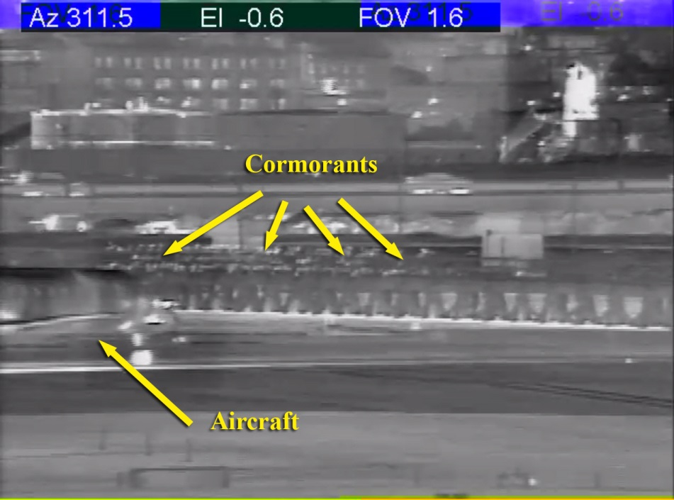
Pharovision Interceptor

Slide 12
Other
Bird Radar Operational Integration at DFW, SEA and SLC continues with support from Univ. of Illinois (CEAT) Team
JUP Project initiated - $75K project funded to Ohio University as part of Joint University Program to begin preliminary look in to potential data connections between bird radar and cockpit
Lights for bird deterrence
USDA continues bird perception of light studies
Lite Enterprises proposed high brightness, UV LED system for airport and aircraft applications to deter birds

Slide 13
For more information:
http://wildlife.faa.gov
Ryan King
ryan.king@faa.gov

