Slide 1
FACT3 Results
Identification of capacity-constrained airports

Slide 2
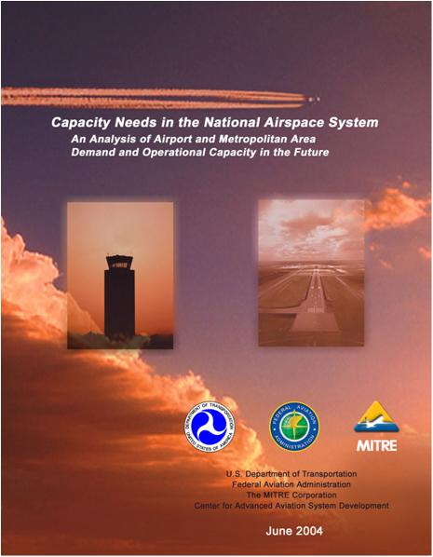
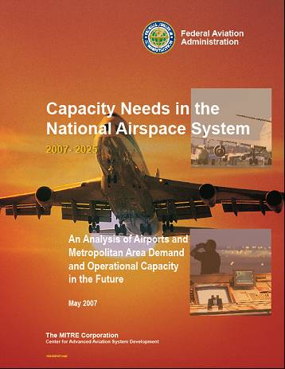
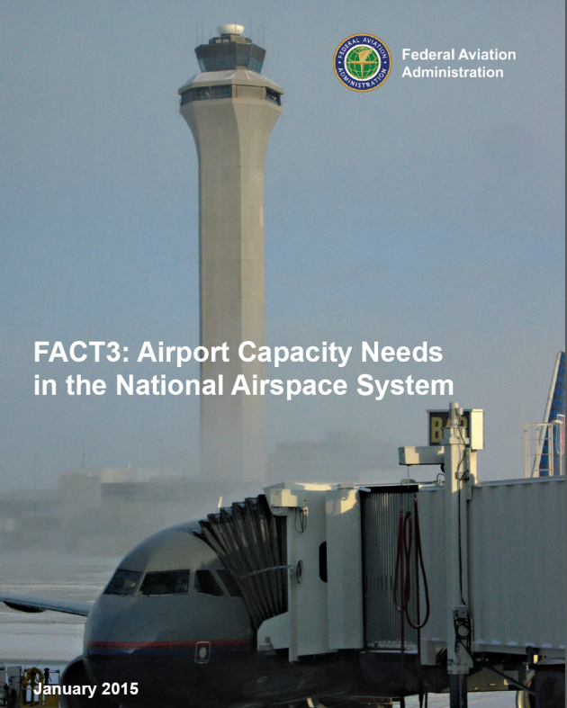
Future Airport Capacity Task (FACT):
Airport Capacity Needs in the National Airspace System
FACT3 is an update to FACT2 (2007) and FACT1 (2004)
Objectives:
  Which airports are at risk for significant delay and congestion, based on what we know today?
  Gap identification: Identify airports most likely to be congested and in need of more capacity in 2020 and 2030
  Used to inform more comprehensive airport-specific studies that would be conducted by the airport sponsor
  Understand the efficiency benefits of NextGen technology and procedure improvements, as well as identify airports where runway development remains necessary

Slide 3
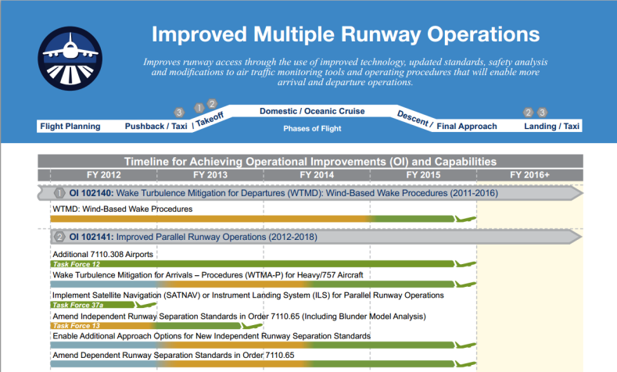
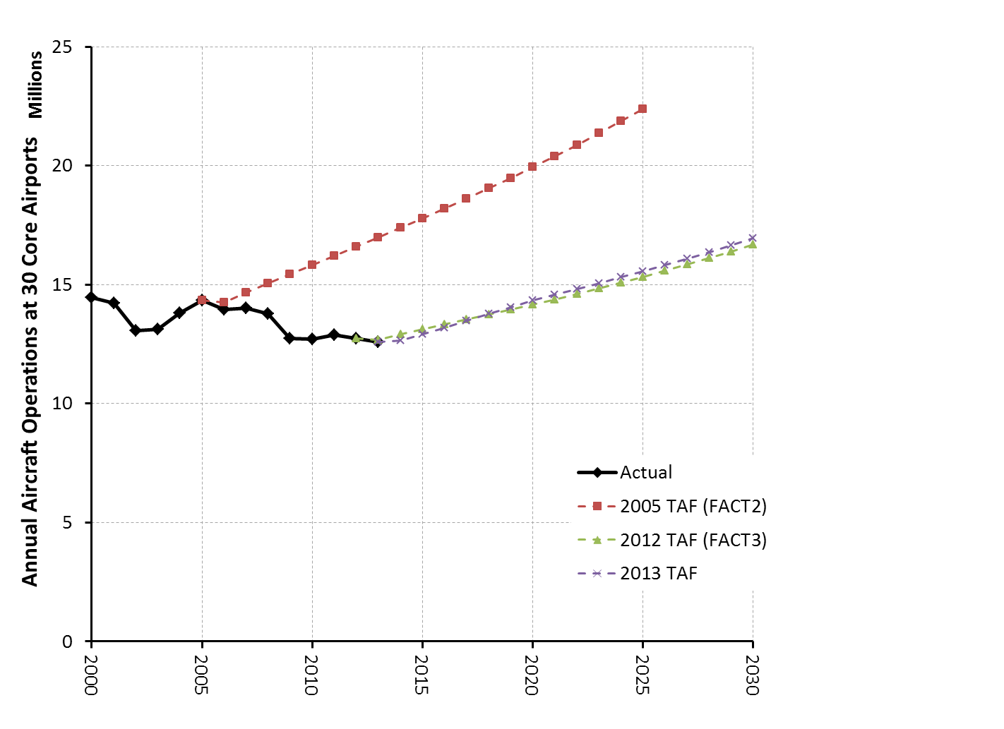
Significant Updates in FACT3
Since FACT2 was published in 2007:
  Base activity levels and forecasts have changed due to economic conditions and airline restructuring
  Completion of significant new infrastructure at hub airports
  NextGen plans and performance capabilities have matured
Enhanced system-wide model capabilities

Slide 4
Extensive Coordination across FAA
LOB/SO | Role
Airports | Overall study management and direction, for relevance to airport stakeholders Current airport development plans, including new runway infrastructure that has completed environmental review
Policy | Use of 2012 Forecast and Fleet Forecast evolution
Air Traffic Organization | Capacity Analysis Group: Annual Service Volumes Demand Days and trimming for 2020 and 2030 Traffic Ongoing delay monitoring and gate model data Wake Program
NextGen | MITRE Tasking NextGen Segment Implementation Plan (NSIP) Capacity alignment with NextGen benefit estimates

Slide 5
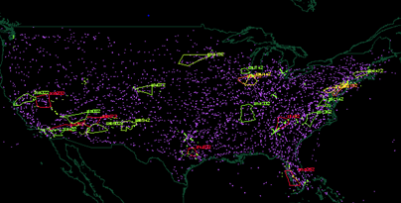
Two modeling approaches used in FACT3
Average Annual Delay
  Annual Service Volume (ASV) is computed by AJR Capacity Analysis Group at FAA Technical Center
  Detailed 24-hour airport simulation, repeat for selected runway configurations and weather scenarios
  Total annual delay = weighted sum over all runs
NAS-wide model
  MITRE
  Simulation of operational day, plans and progress of ~100,000 flights
  Medium resolution component model including capacity curves, taxi times, and gates
To be identified as capacity-constrained in FACT3, an airport must meet criteria under both modeling approaches

Slide 6
FACT3: Two Scenarios for each year (2020 and 2030)
Improvements | Scenarios
 | Reference: No Further Improvements beyond Near-term NextGen | Improvements: After Planned Improvements with Mid-Term NextGen and Runways
Existing airport infrastructure as of 2011
New or Extended Runways at FLL, ORD, and PHL
Near-term NextGen
Mid-term NextGen
New or Revised ATC Procedures, including Airspace Redesign
Existing noise abatement procedures
Gate development plans

Slide 7
NextGen Near- and Mid-Term Bundles
  Near-Term NextGen
  Mid-Term NextGen
Includes many of the NextGen capabilities that are expected to mature through 2015 -- Deployment underway or are expected soon
  Wake Turbulence Mitigation for Departures (WTMD) at 3 demo sites (IAH, MEM, SFO)
  Wake ReCategorization, Phase 1
  CSPO: Reduced minimum runway spacing
    3600-feet for dual independent approaches
    Additional dependent staggered approaches with 7110.308
Builds from Near-Term NextGen
  WTMD at remaining 7 sites
  Wake Turbulence Mitigation for Arrivals – Procedures for Heavy/757 Aircraft (WTMA-P)
  Increased delivery accuracy to runway
  OAPM Metroplex airspace improvements
  Additional fanned departure headings (ELSO)
Consistent with FAA NextGen Implementation Plan (NGIP)

Slide 8
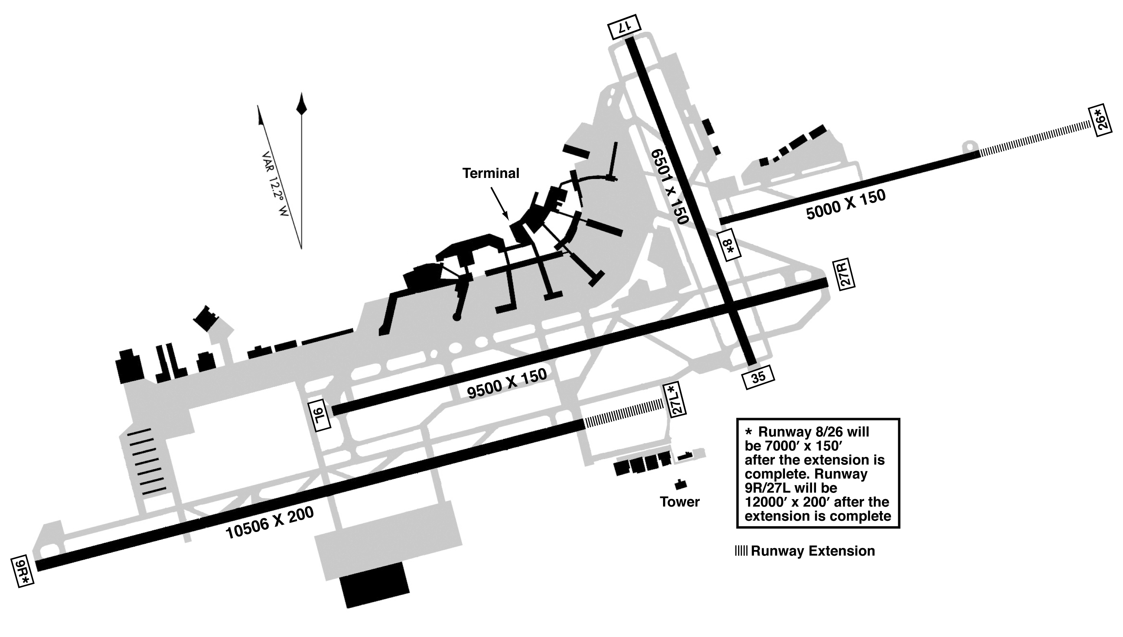
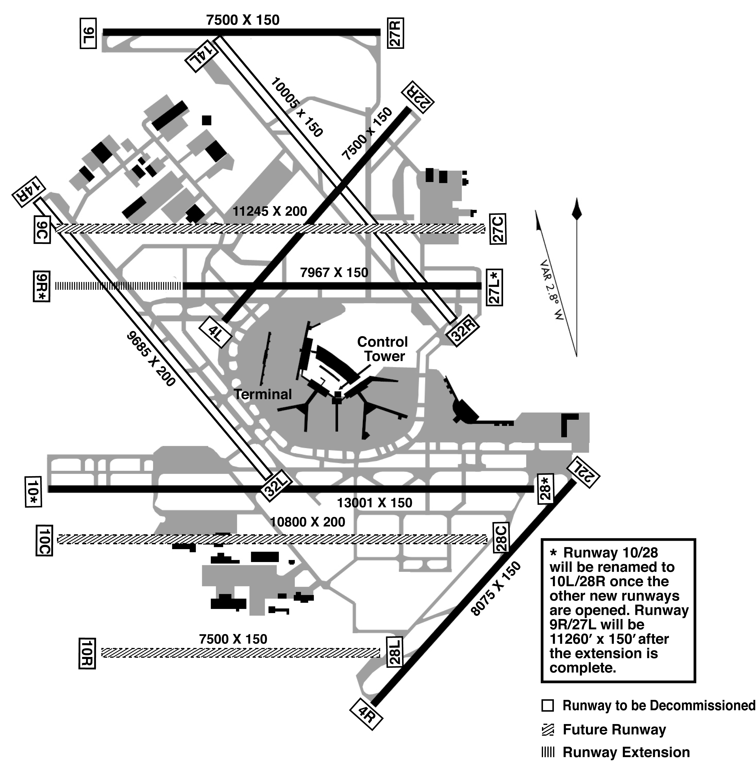
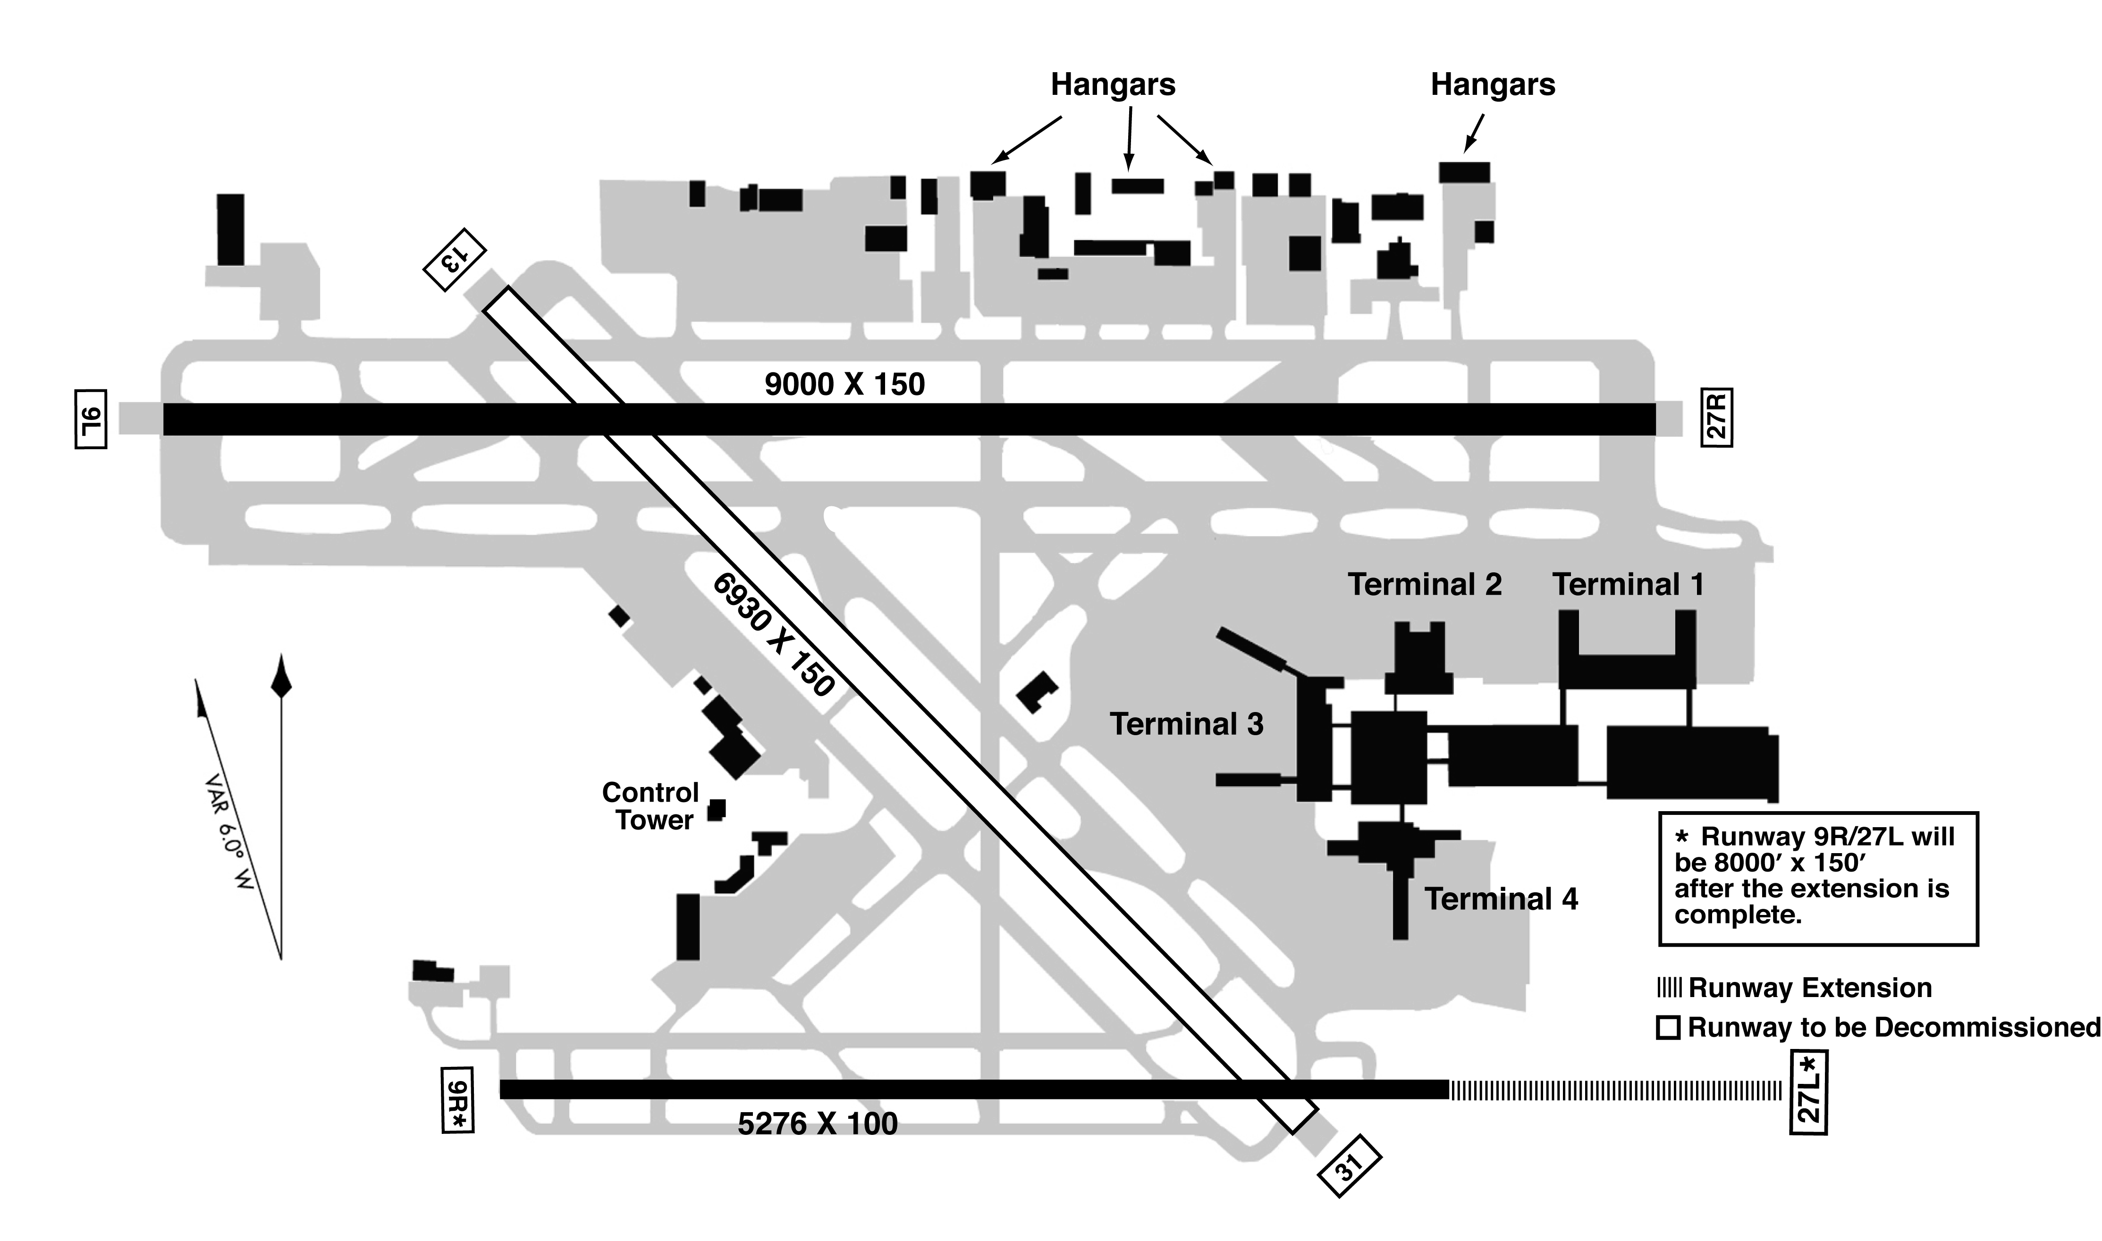
Runway Development
PHL
New Runway Infrastructure included in 2020 Improvement Scenario
New Runway Infrastructure included in 2030 Improvement Scenario
FLL
ORD

Slide 9
Overall, airports are less congested and more efficient
  Demand is down at some airports with structural changes in the industry
  Capacity has increased at many airports, with the combined benefit of adding 18 new runways and 7 extended runways at 21 large hubs since 2000
  Better schedule recovery after inclement weather clears
Constrained in reference case, but unconstrained if planned improvements are implemented
Constrained even after all planned improvements are implemented; additional capacity enhancement is needed. (Or constrained in base year)

Slide 10
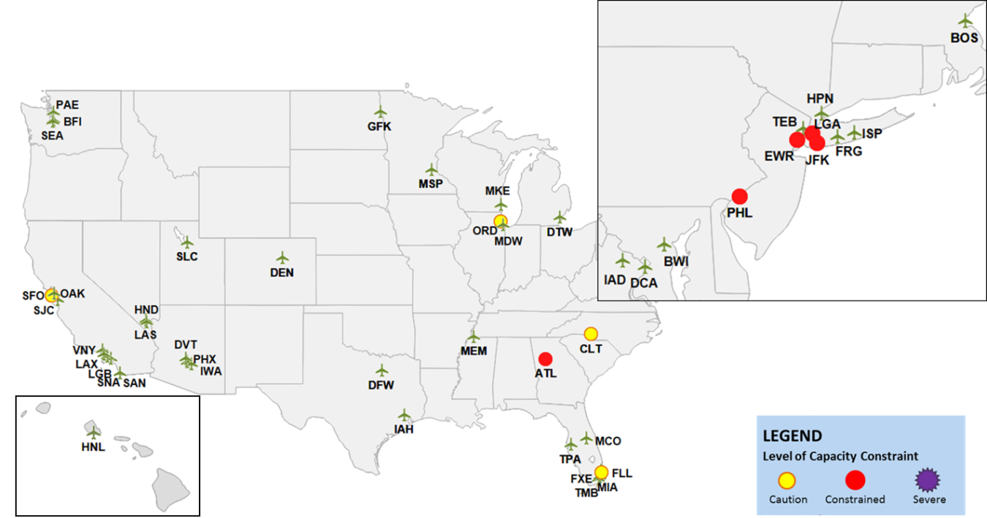
2011 Baseline Results
Airports in green were evaluated in FACT3 but generally are not congested
Five airports are meet congestion criteria
LEGEND
Level of Capacity Constraint
Caution Congested Severe

Slide 11
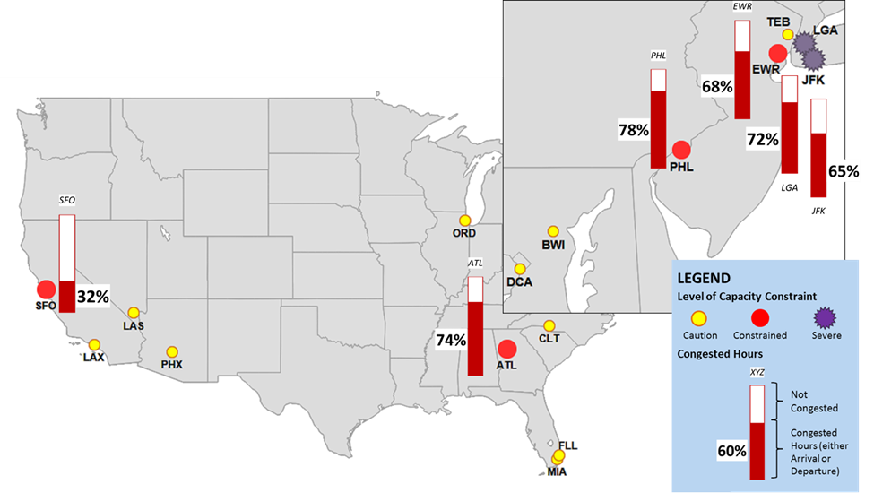
Airports Needing Additional Capacity in 2020
Reference Scenario: No Further Improvements beyond Near-term NextGen
6 congested airports, including 2 severe
Near-term NextGen
Mature capabilities, including:
Wake Re-Categorization
Parallel Runway Improvements

Slide 12
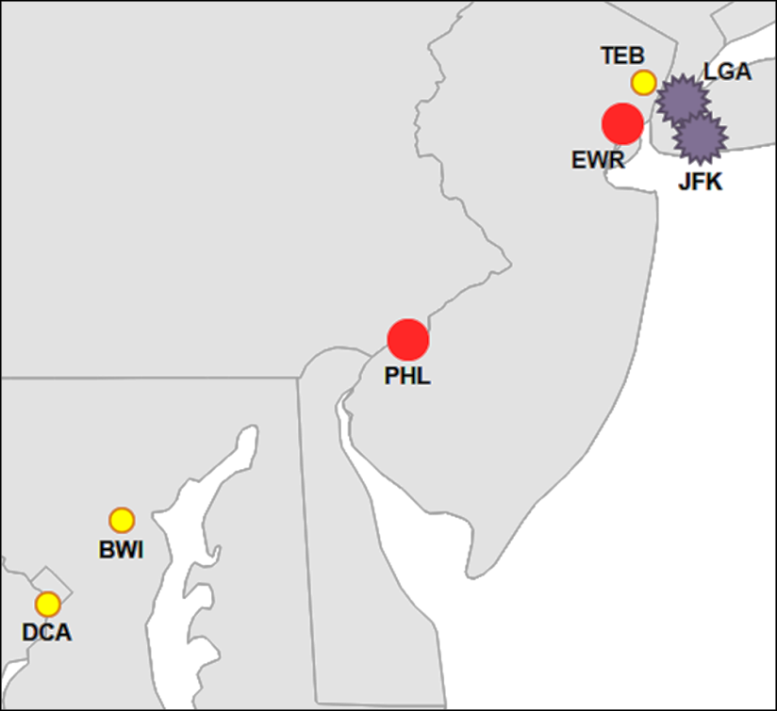
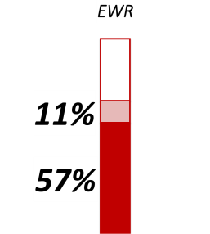
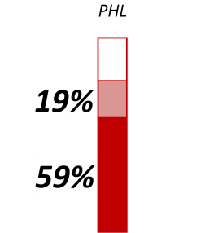
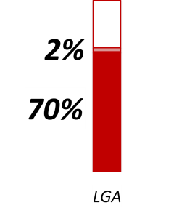
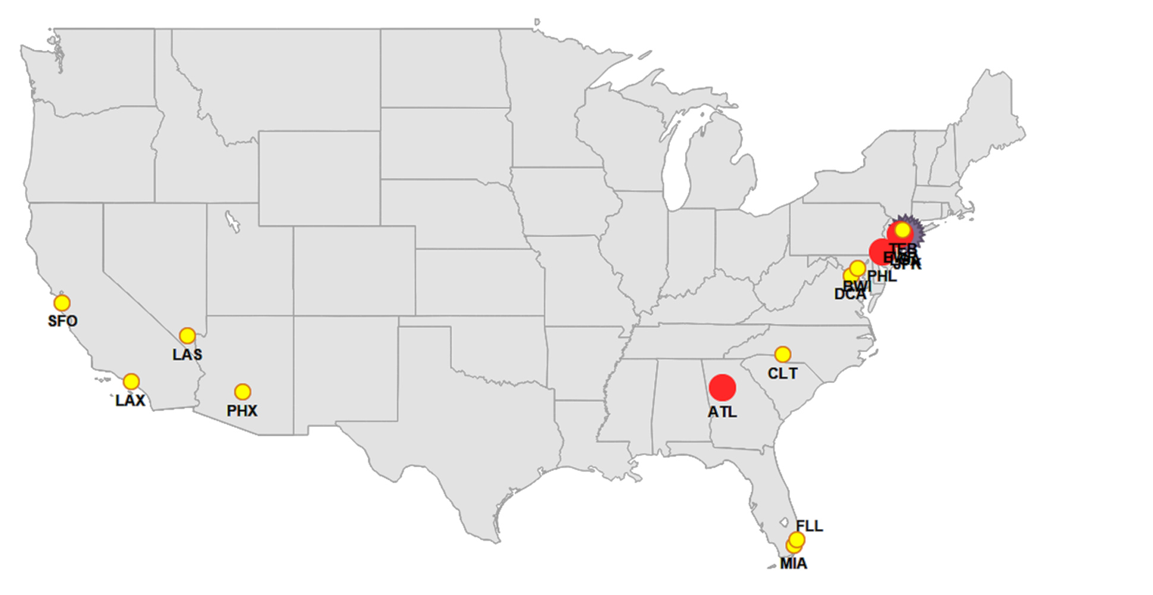
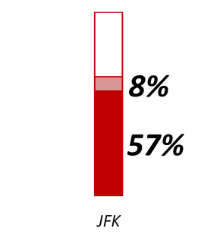
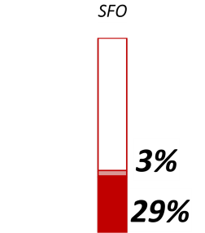
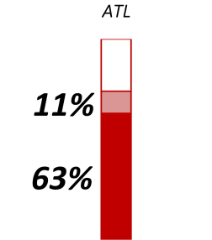
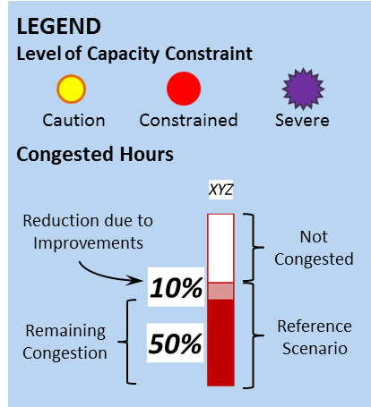
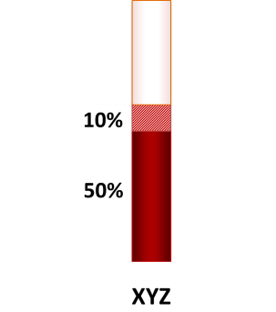
Airports Needing Additional Capacity in 2020
Improvements Scenario: After Planned Improvements with Midterm NextGen and Runways (FLL, ORD, PHL)
5 congested airports, including 2 severe
Midterm NextGen
Additional capabilities, including:
Wake Mitigation
PBN Fanned Departures
Improved Runway Delivery Accuracy
Runway Improvements
Completion of O’Hare Modernization Program (OMP)
FLL : south parallel 10R/28L extension
PHL: two runway extensions
LEGEND
Level of Capacity Constraint
Caution Congested Severe
Congested Hours
Reduction due to Mid-Term improvements
Uncongested
Mid-Term (plus Runways)
Near Term

Slide 13
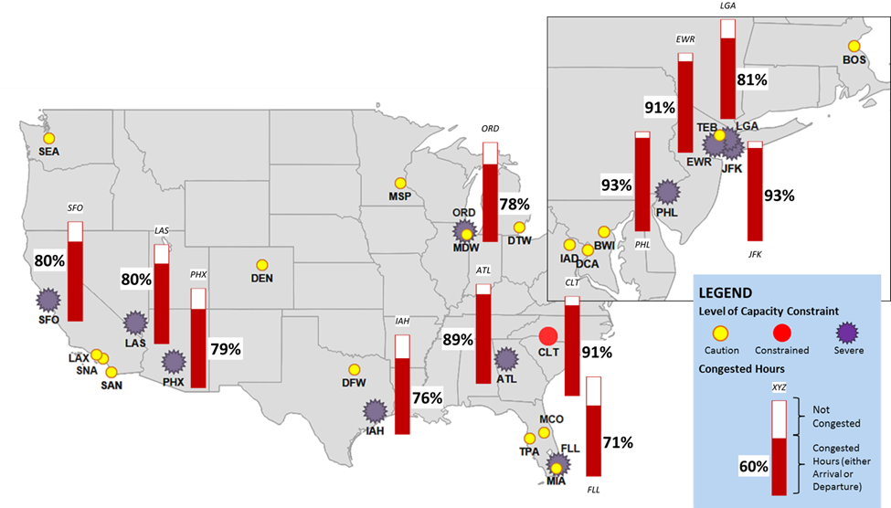
Airports Needing Additional Capacity in 2030
Reference Scenario: No Further Improvements beyond Near-term NextGen
12 congested airports, including 11 severe
Near-term NextGen
Mature capabilities, including:
Wake Re-Categorization
Parallel Runway Improvements

Slide 14
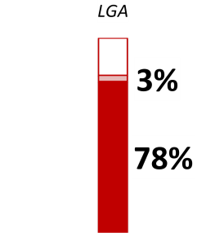
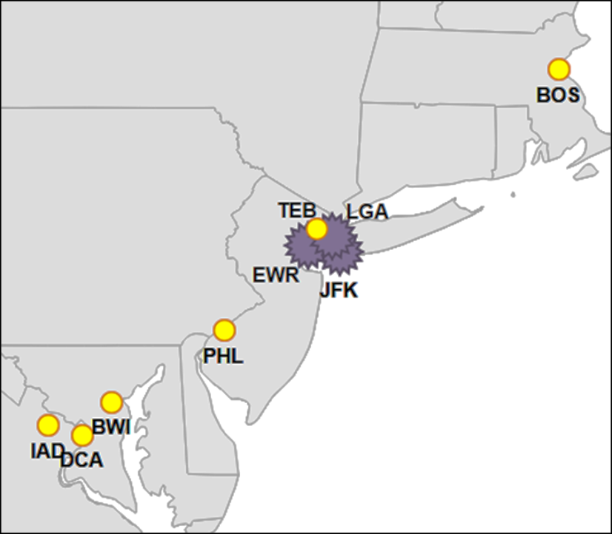
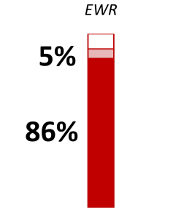
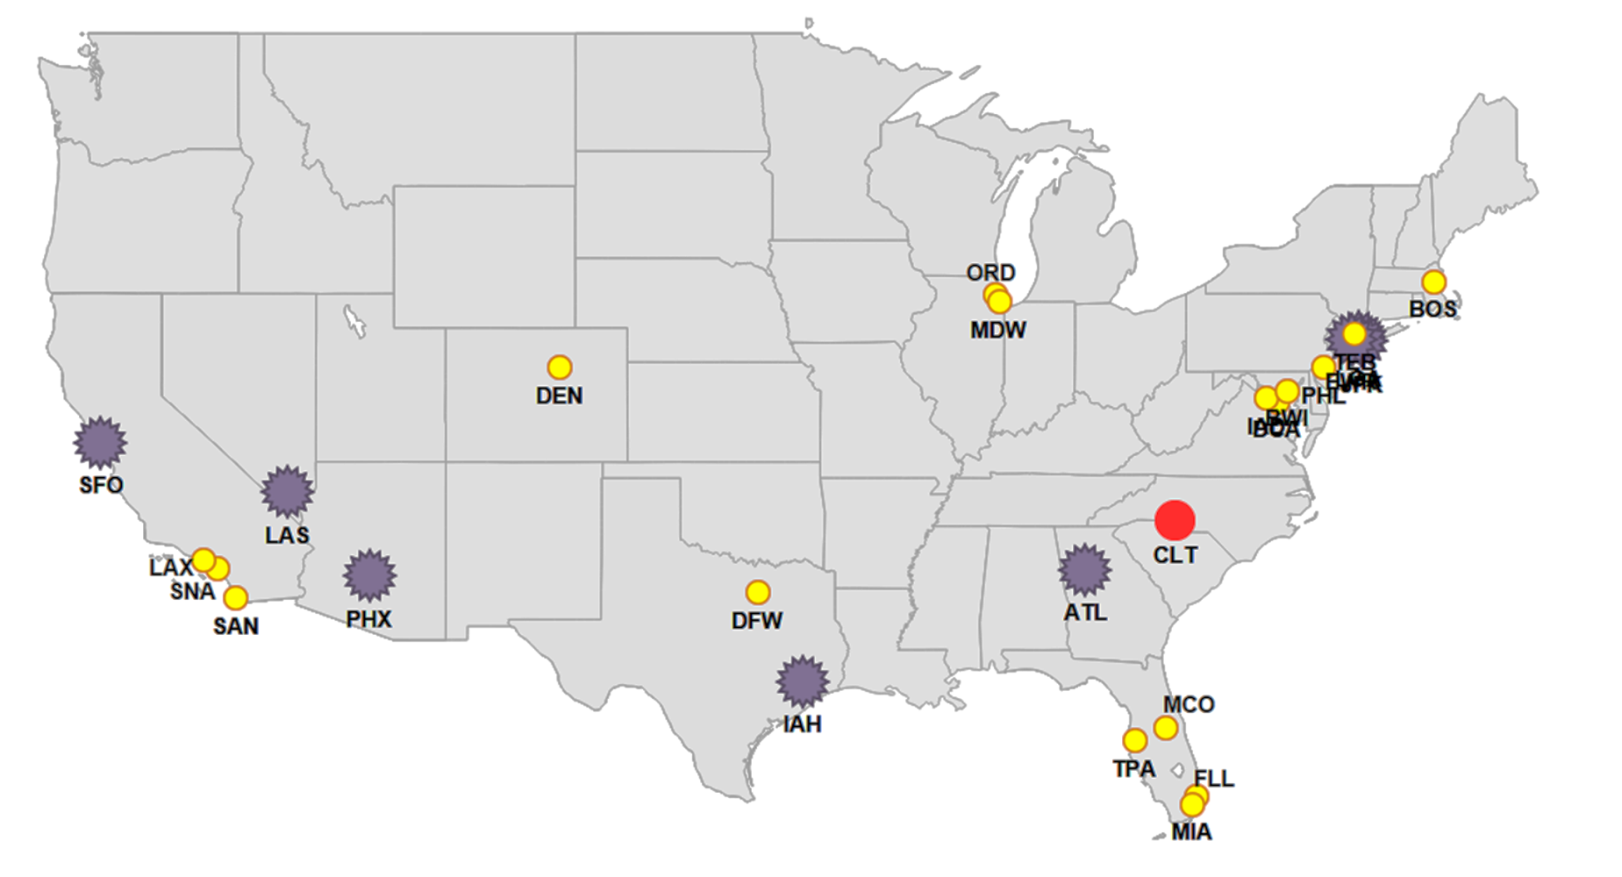
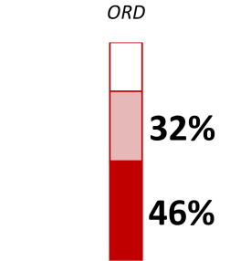
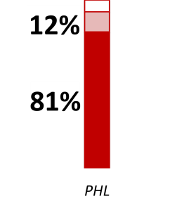
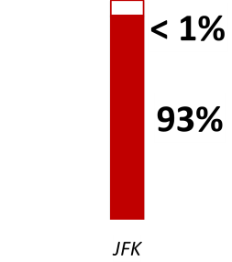
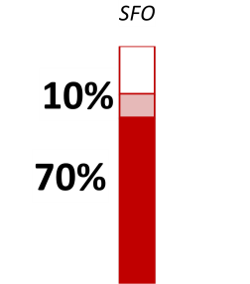
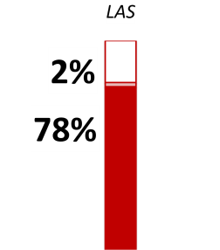
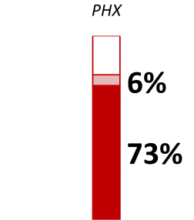
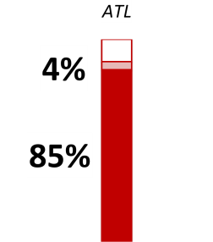
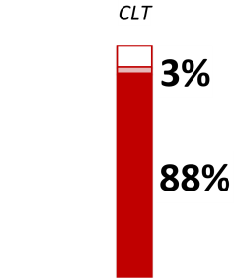
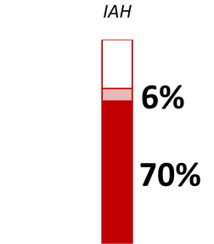
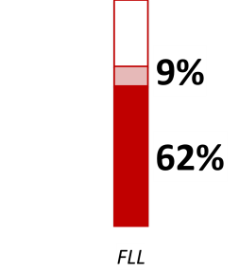
Airports Needing Additional Capacity in 2030
Improvements Scenario: After Planned Improvements with Midterm NextGen and Runways (FLL, ORD, PHL)
9 congested airports, including 8 severe
Midterm NextGen
Additional capabilities, including:
Wake Mitigation
PBN Fanned Departures
Improved Runway Delivery Accuracy
Runway Improvements
Completion of O’Hare Modernization Program (OMP)
FLL : south parallel 10R/28L extension
PHL: two runway extensions, and river parallel runway

Slide 15
What is the prediction for long-term capacity needs?
Looking forward in this decade, the US hub airport
system is in generally good shape with regards to capacity – except for certain high-demand airports that have had chronic congestion
Our focus should be on improving capacity, as well as reliability and predictability, at the chronically delayed airports
We’ve been successful at adding new capacity at many airports that now operate efficiently
Towards 2030, congestion could build at more airports across the NAS if demand grows as forecast. However, there is also substantial uncertainty about these long-term projections.
For the far-term, our best option is to emphasize effective planning for new capacity. Defined triggers will indicate when plans should transition into implementation.
Notes:
Notes:
Balance building capacity where reasonable to anticipate need
Public trust to ensure limited funds are used correctly and effectively

Slide 16
BACKUP

Slide 17
FACT2/3 Version Comparison
 | FACT 2 | FACT3
Forecast | 2005 TAF | 2012 TAF
Demand Schedules (NAS-Wide) | 2 (good and bad weather) | 16 days (actual weather) – trimmed to capacity when needed
Fleet Mix | Constant | Dynamic for NAS-Wide
Airports | 56 | 48 (including General Aviation)
Surface | None | Taxiway and gate factors in NAS-wide model
Models and Metrics | 2 models: ASV (average delay/op) NAS-Wide (average queue delay/op) | 2 models: ASV NAS-Wide (percentage of congested hours)

Slide 18
FACT3 Criterion Levels: Caution, Constrained, Severe
Annual Service Volume
Average Delay per Operation
NAS-wide Congested Hours*
>=50%
>=30%
>=20%
and
Severe
15
and
Constrained
7
OR
Caution
5
* Percent Congested Hours
(arrival or departure)
Based on most delayed top 10% hours (2011) across 30 Core airports
To be identified as capacity-constrained in FACT3, an airport must meet criteria under both modeling approaches
Notes:
Defining additional levels of capacity-constraint may be useful to present a more comprehensive evaluation
Some airports are expected to have delays just below the capacity-constrained criteria
A few airports are forecast to have delays that are substantially more severe
Three levels were defined
Constrained:
ASV delay >= 7 min and
Percentage of hours that are congested is at least 30%
Arrivals or departures
Severe: Higher levels of ASV delay and NAS-Wide delay
ASV delay >= 15 min and
More than 50% of hours are arrival- or departure-congested
Caution: Approaching or meets ASV or NAS-Wide criteria
ASV delay >= 5min or
More than 20% of hours are arrival- or departure-congested
Define arrival delay and departure delay
Only due to elements associated with the airport
Identify a saturated hour in 2011 Reference case model runs
Top 10 percent
Core airports, 0700-2259 local time
Identify airports with a significant number of saturated hours in the simulations
30% of the hours of interest
Either arrival or departure delay
Use same definition of saturated hour and same critical percentage in future scenarios
Given an arrival airport, the average delay over all flights that can be attributed to elements directly related to the arrival airport
Gate availability at arrival airport
Taxiway congestion at arrival airport
TRACON delay due to runway capacity at arrival airport
Airspace delay associated with (1) merging of arrival flows (2) spacing to accommodate downstream merging and runway capacity

Slide 19
Wake Re-Categorization (RECAT) Phase 1 – Aircraft Recat
Approach:
Provides new wake vortex categories and separations optimized to current fleet mixes and evaluated for potential future fleet mixes
  All current ICAO separations are assumed to be acceptably safe
  Used reasonable worst case wake strength from airport operational data
  Draft proposal: Six wake categories

Slide 20

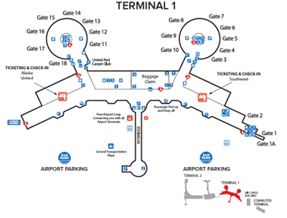
NAS-Wide Model Surface Components
Taxi Time Model
  Estimates additional taxi time as a function of arrival and departure operations
  Not a detailed taxiway model
Gate Resource
  Provides a general indication of gate delay and gate need
  Flights are assigned to a cluster of possible gates
  For 2030, will only track additional gates needed
    Cannot forecast airlines or gate assignments
Source: dreamstime.com
Sample Gate Diagram: Terminal 1 at San Diego International Airport

