Slide 1
New Capacity Model: runwaySimulator
REDAC Airport Subcommittee
Kent Duffy, APP-400
31-March-2015

Slide 2
Overview
ARP has worked with MITRE for tech transfer of the runwaySimulator model for public release
  Released in December 2014
  https://www.faa.gov/airports/planning_capacity/runwaysimulator/
  Validation report available online
Mid-level model: not as complex as SIMMOD/TAAM, but better than the Airfield Capacity Model (ACM)
Calculates sustainable hourly runway capacity
Availability and Training plans

Slide 3
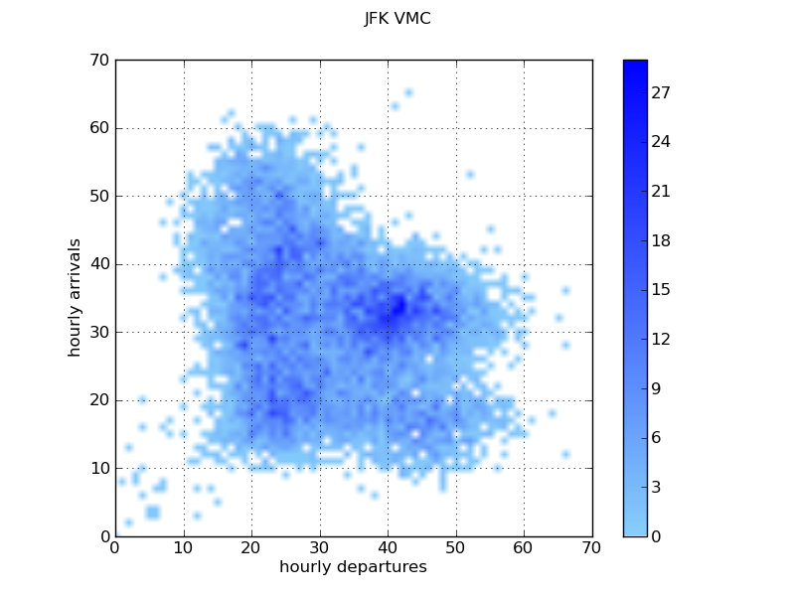
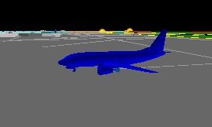

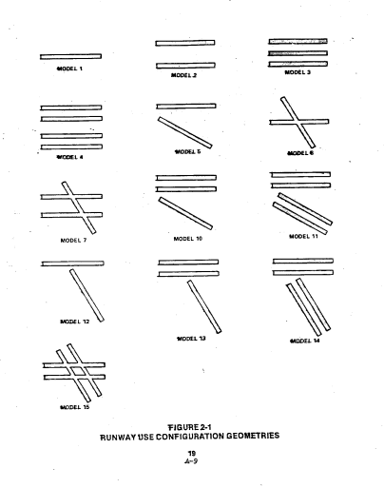


Model Levels
Analytical
Simulation
runwaySimulator
SIMMOD
ASPM Data (Statistical)
To fill a niche between quick but less flexible tools like ACM, and robust but time-consuming tools like TAAM or SIMMOD
TAAM
ADSIM/RDSIM
Airfield Capacity Model (ACM)
Less fidelity / Less time and expense
Greater fidelity / More time and expense

Slide 4
runwaySimulator can model complex Airport and ATC Operations
Fast-Time Simulation Model Developed Under MITRE’s Research Program
Model quantifies the number of arrivals and departures an airport is able to sustain
  Given a set of operating assumptions
  Under various weather conditions
A prototype of runwaySimulator was first developed between 2004-2006
runwaySimulator has been used extensively for MITRE’s sponsored work with FAA
  FACT3, Airport Capacity Profiles, NextGen Systems Analysis, Future Concepts

Slide 5
The Objective: Analyze Runway System Capacity for Complex Airport Operations and ATC Procedures
vs ACM
18% (Small)
30% (Small)
52% (Large)
18% (Small)
10% (Small)
29% (Large)
10% (Small)
HOU
10% (Small)
23% (Large)

Slide 6
An Example of Complex Runway Interaction to Model

Departures from Runways 34R and 05 use same departure fixes
  Must be separated by a minimum time
Departures on 05 must wait for arrivals on 34R to pass over runway

1 minute crossing time separation for dependent operations

34L
34R



05


Notes:
HANEDA Airport (Tokyo) with out RW 04/22.
For North flow operations, figure D, it was assumed that independent arrivals would use runways 34L and 34R while independent departures would use runways 34R and 05. To estimate the runway’s maximum capacity it as assumed that all aircraft could use either runway for departure. Because arrivals on 34R interact with departures on 05, the runwaySIMULATOR model does not release a departure until the arrival has passed the runway. In addition the runwaySIMULATOR model was used to estimate the capacity when the arrivals and departures were dependent, and for the most restrictive case when traffic from the north was restricted to runway 34R and southerly traffic was restricted to 34L and 05.
Fig D

Slide 7
Example of a Complex Separation Rule to Model
FAA Order 7110.308
FAA Order 7110.308 approved special dependent approaches at specific airports with runway spacing < 2500 ft
1.5 NM diagonal separation
  Only behind lead aircraft
  Only if lead aircraft is Small or Large
  Otherwise standard radar and wake vortex separations apply
Arrival separation depends on sequence of aircraft
Standard separation
1.5 NM
Standard separation
1.5 NM
18R
18L
Reference: FAA Order 7110.308, November 2008
< 2500 ft

Slide 8
Model captures tradeoffs between arrivals, departures, and operational changes
Output may be validated from ATC called rates and historic data

Slide 9
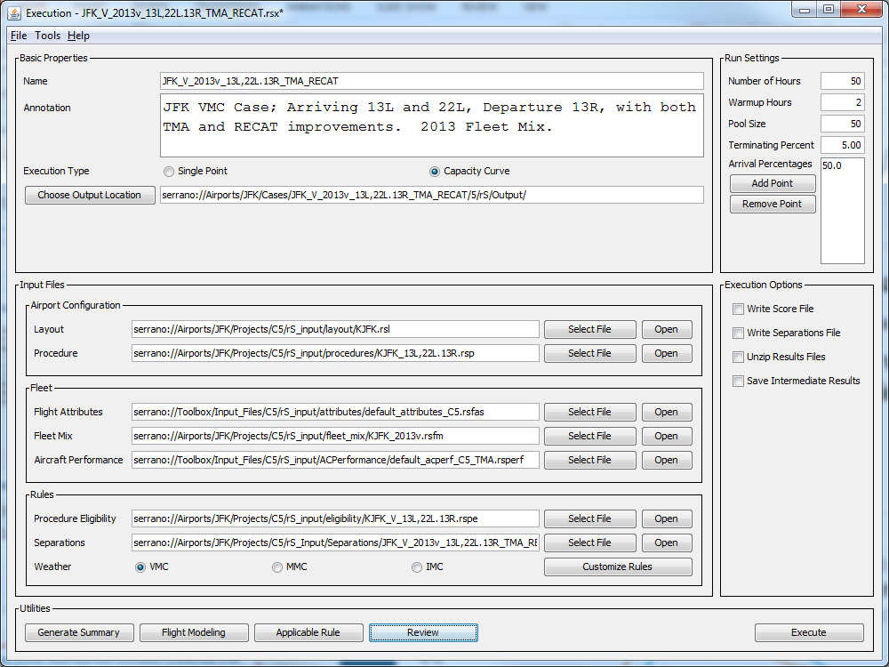
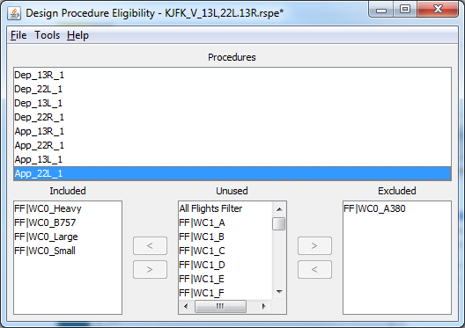
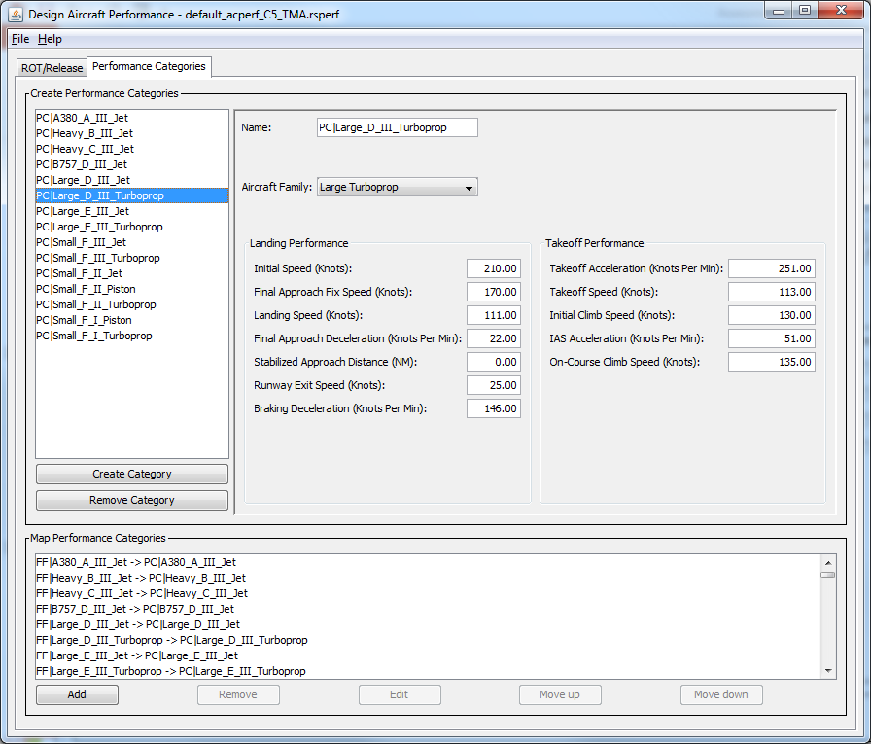
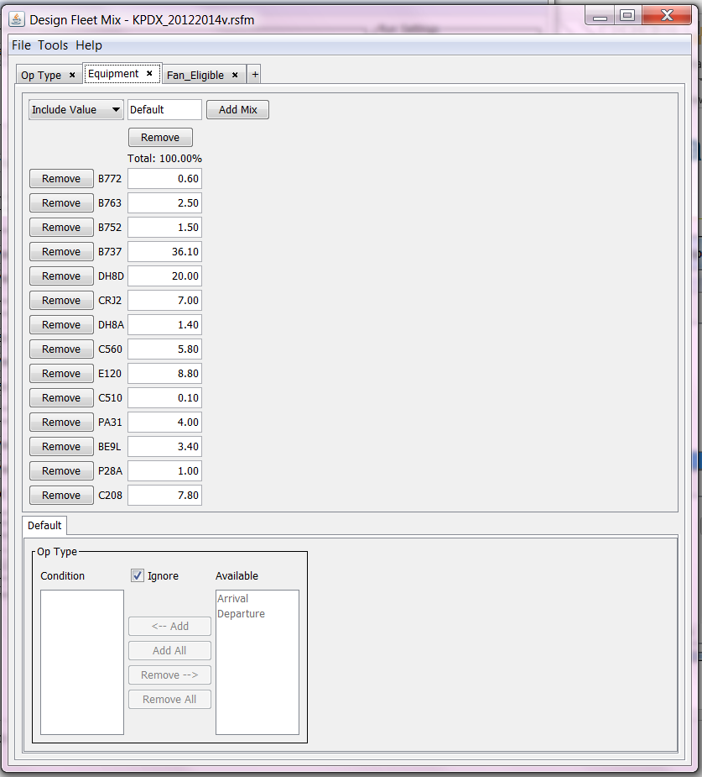
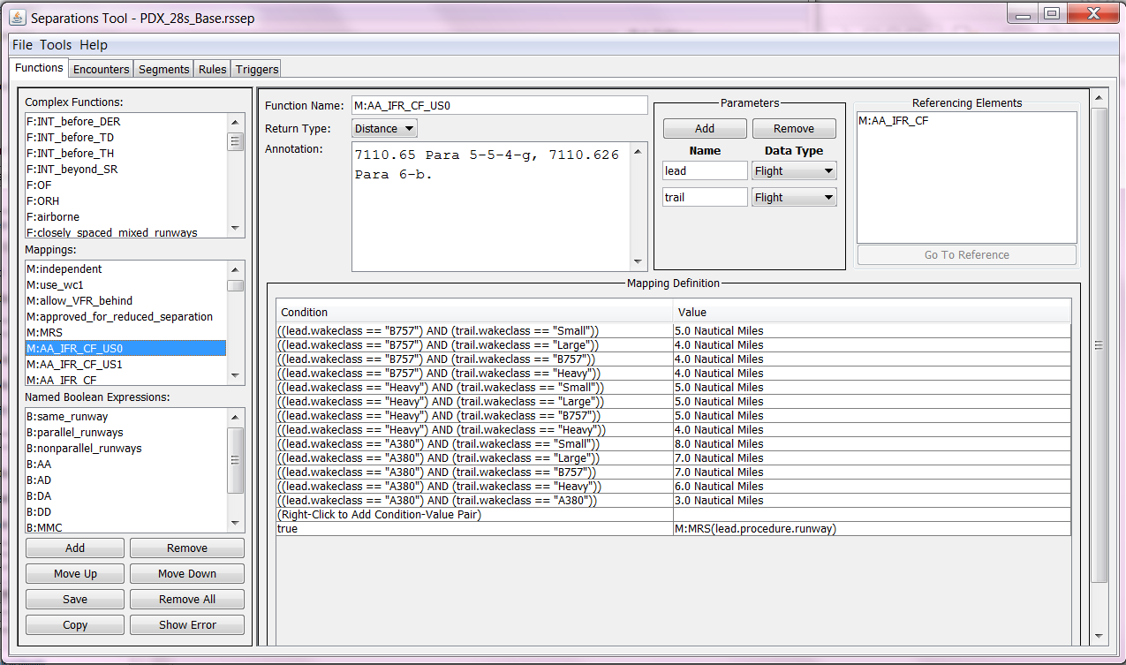
runwaySimulator inputs are modular
  Default inputs are provided for most components, but all can be tailored depending on the fidelity and depth of the modeling desired
  Component-based design allows efficient re-use for additional simulations
Notes:
This is an rS execution file, or rsx file. The user can swap various components to modify the scenario by selecting the “Select File” button and selecting the new file. This allows the user to reuse pre-existing components, which increases rS’s usability. The user can also open any component file from this view, allowing for easy access to each file for modifications or review.

Slide 10
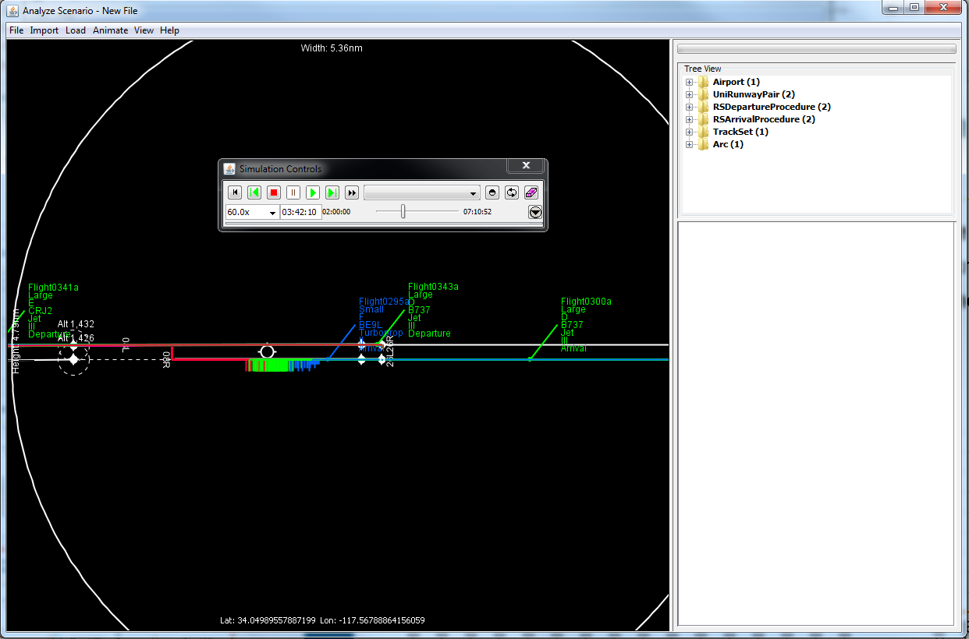
Animation
Notes:
This is a playback tool that can help the user ensure that the rules they are modeling are being enforced as the user wishes. Flights can be color coded by certain criteria which can also help the user identify what is happening.

Slide 11
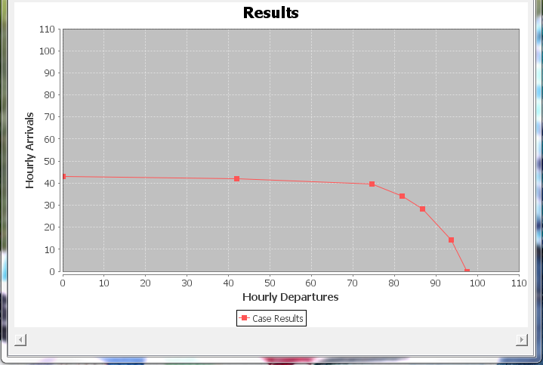
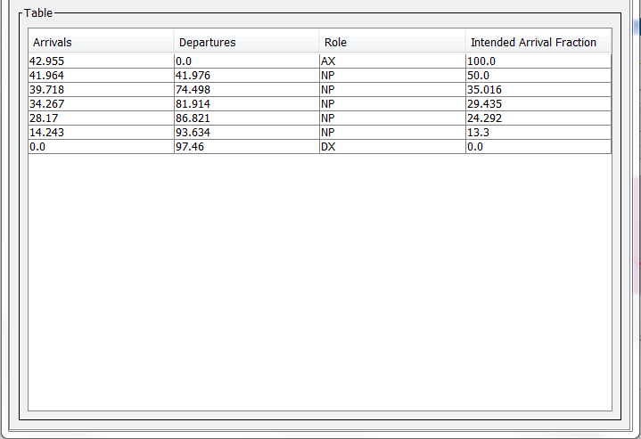
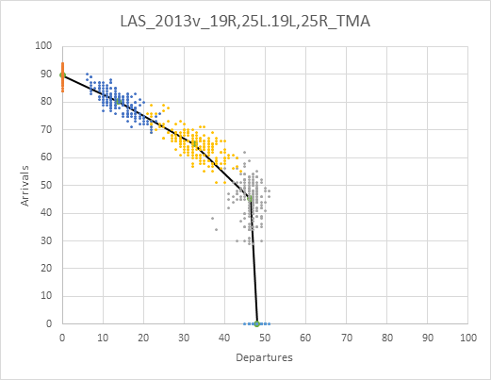
Capacity is the hourly throughput a runway system is able to sustain during periods of high demand
Provide capacity inputs to delay models
  E.g., NASA Delay Model, or system wide model
Give insight into what constrains capacity
  Arrival/departure tradeoffs, effects of weather and various modeling assumptions
Notes:
These are examples of the main output of rS – a capacity curve! The user can either see the information graphically or in a table format, which can be easily copied into Excel.

Slide 12
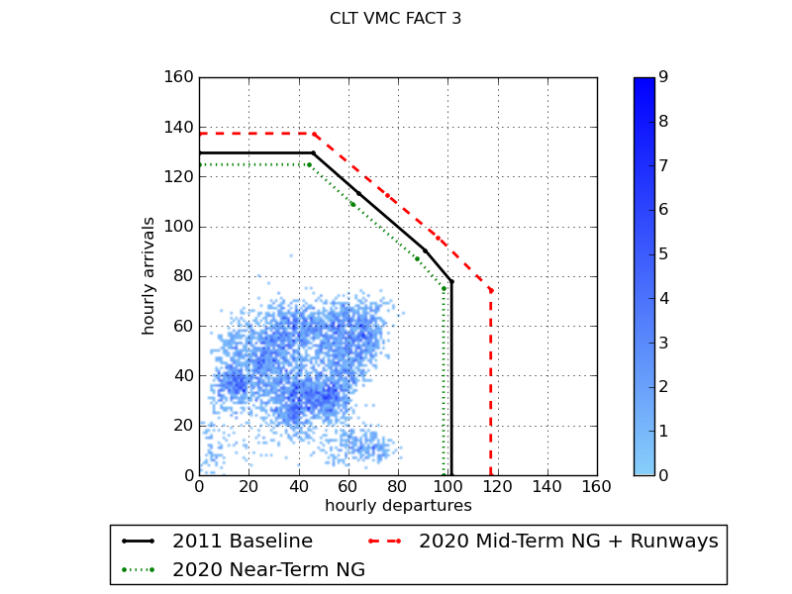
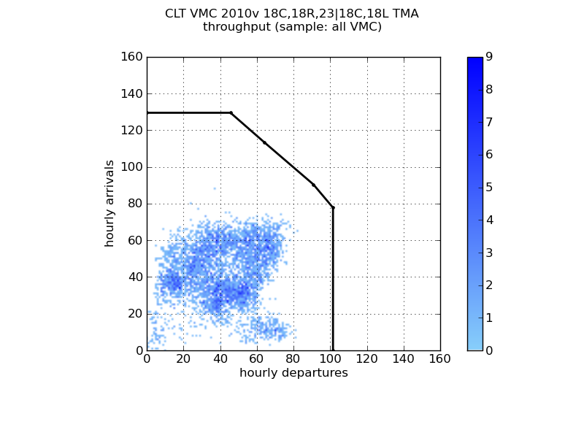
FACT3: VMC Capacity for CLT with Actual Hourly Traffic from ASPM
Near Term NextGen
  Wake Re-Categorization (RECAT) Phase 1
    Reduced wake vortex separation behind many Heavy (new Class C) aircraft
Mid-term NextGen
  Diverging departures
    RNAV departure routes allow reduced divergence
  Metering to Fixes within Terminal
    Assumed more accurate delivery to runway
2011 VMC Baseline

Slide 13
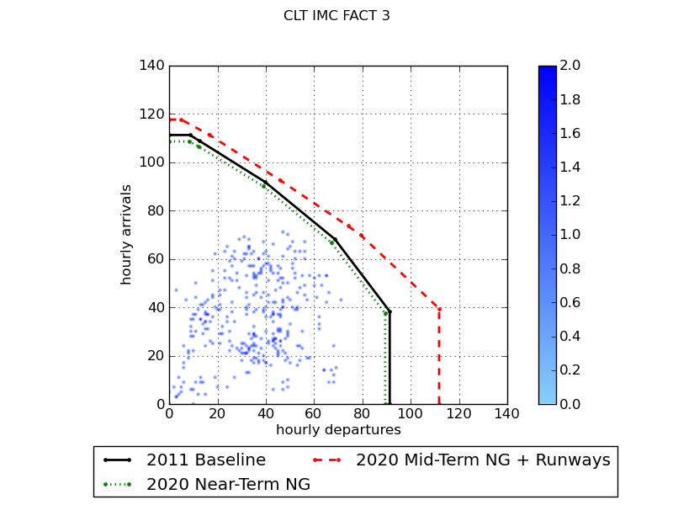
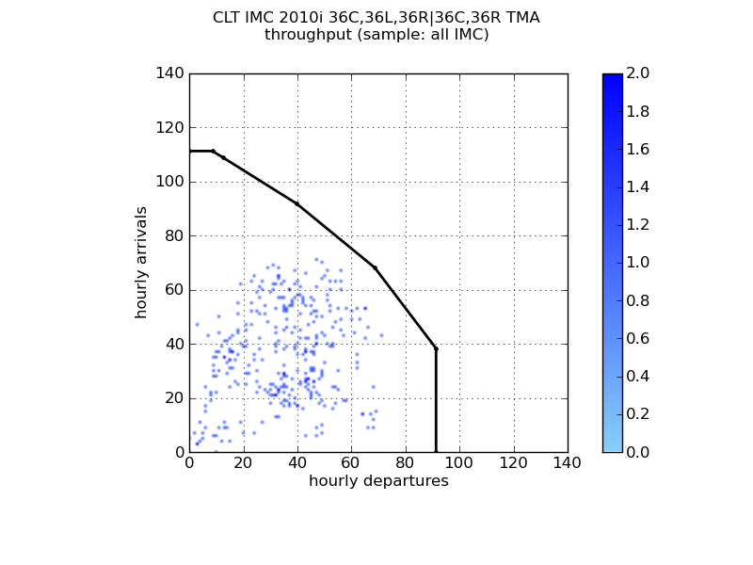
FACT3: IMC Capacity for CLT (< 1000-3) with Actual Hourly Traffic from ASPM
Near Term NextGen
  Wake Re-Categorization (RECAT) Phase 1
    Reduced wake vortex separation behind many Heavy (new Class C) aircraft
Mid-term NextGen
  Diverging departures
    RNAV departure routes allow reduced divergence
  Metering to Fixes within Terminal
    Assumed more accurate delivery to runway
2011 IMC Baseline
* Actual implementation subject to standard decision processes, including environmental reviews as required

Slide 14
License and Training
runwaySimulator available
  Domestic public use, as well as FAA and government use
  Requests for model from airports, airlines, consultants
  No cost for model, but must sign software license (except FAA) and attend training before getting software
Training:
  3-day training sessions held at MITRE in Virginia
  Begin in late March, with 8 sessions planned in FY15
  Web-based training possible for development in FY16

