Slide 1
New Facility Construction and Planning

Slide 2
Update – NAPMRC and Airport Safety Technology Building
Building 298 : National Airport Pavement Materials Research Center will be the main facility associated with the HVS-A
Building 299 : Airport Safety Technology Building will now house all ARFF and Friction Vehicles
Building 207 will now become fabrication shop supporting ARFF; Visual Guidance; Composite Material Fire Fighting; etc.

Slide 3
Last Presented – April 2014

Slide 4
Present Look of NAPMRC and ASTB

Slide 5
Current Status of Construction
Contract End Date Including All Modifications was March 10, 2015.
Only 23 days beyond original contract end date.
Buildings turned over to the FAA on March 10th.
Research paving was not placed during last year’s construction season

Slide 6
Current Status of Construction
Delays to Paving
Development of a gyratory mix compliant with P-401 specifications contained in AC 5370-10G proved very difficult
Issues attaining the required minimum Voids in the Mineral Aggregate, air voids and asphalt content
75 Gyrations seems to be problematic for all but the hardest aggregates.
Softer aggregates could barely achieve VMA but required low asphalt contents – detrimental to longevity
Consequently – Contract extended until May 22, 2015 for paving.

Slide 7
Bldg. 298 - Waiting for Asphalt

Slide 8
Bldg. 298 Office

Slide 9
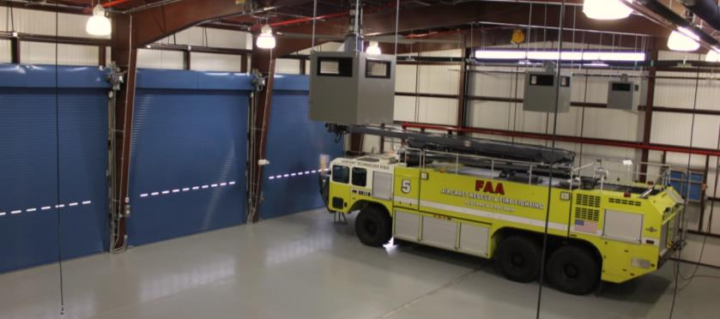
Airport Safety Technology Bldg. 299

Slide 10
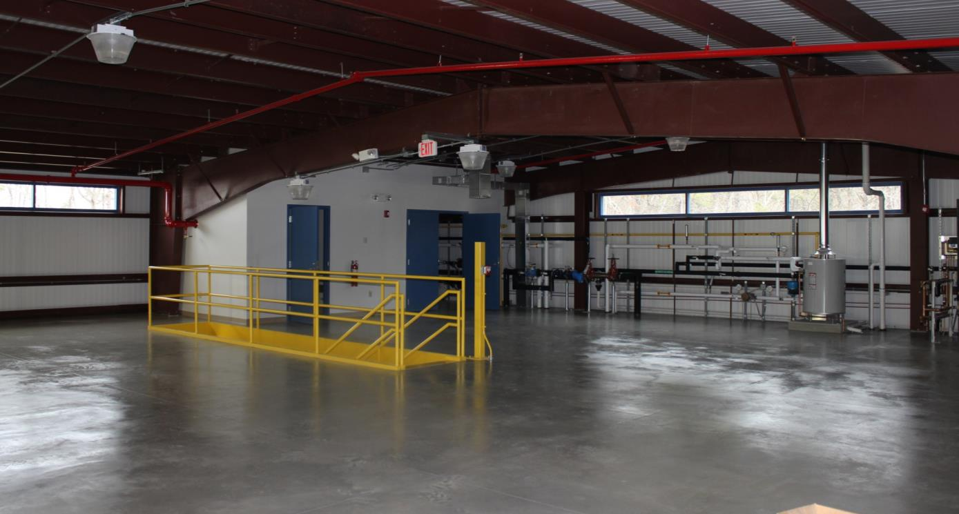
Bldg. 299

Slide 11
New Facilities – 2017 and Beyond
Photometric Laboratory
Airport Safety Tech Storage / Warehouse
NextGen Pavement Lab Expansion and Storage
Office Space

Slide 12
New Facilities – 2017 and Beyond
Photometric Laboratory
Size : 30 feet x 150 feet – 4500 sq. ft.
Relocate existing Autovidi indirect photometry system from current 20 ft. x 40 ft. lab at east end of bldg. 296
Procure full scale (100 ft. long) NIST traceable goniometer based photometric range which will enable FAA to become a certified lab

Slide 13
Projects Supported by Photometric Laboratory
Method to Determine End of Life for LED Fixtures
Electrical Infrastructure Research Team
Airport Pavement Linear Source Visual Aid
New Method of Measuring Photometrics of Non-Incandescent Lamps

Slide 14
New Facilities – 2017 and Beyond
Photometric Laboratory
Airport Safety Tech Storage / Warehouse
Estimated 6400 Sq. Ft.
Replace the 3200 Sq. Ft. used in Bldg. 288 Currently Used to Support Visual Guidance and Runway Surface Technology (Friction)
Friction Vehicles and Devices will be Housed in Bldg. 299
Bldg. 288 to then be utilized by Fire Safety Branch, ANG-E21

Slide 15
Bldg. 288 – Exceeding Capacity

Slide 16
New Facilities – 2017 and Beyond
Photometric Laboratory
Airport Safety Tech Storage / Warehouse
NextGen Pavement Lab Expansion and Storage

Slide 17
NG Pavement Lab Expansion
Increased Lab Capabilities – More Emphasis on Individual Pavement Materials
Estimated requirement of 10,000 sq. feet
Asphalt Binder Lab
Asphalt Mixing and Compaction Room
HMA Testing Room
Temperature Controlled Storage Area for Asphalt Materials
Sample storage
Research Office with Manager’s Desk

Slide 18
Changes To Existing Lab
Improved Aggregate and Soil Testing Capabilities
Expansion of Concrete Testing and Storage
Portion of Lab Space May be Used as Additional Office Space for Building 296

Slide 19
New Facilities – 2017 and Beyond
Photometric Laboratory
Airport Safety Tech Storage / Warehouse
NextGen Pavement Lab Expansion and Storage
Office Space

Slide 20
Office Space
Estimated Need of 6000 Sq. Ft. Based on the Size of our Program and Required on Site Support Staff
Proposed 20 Workstations
Meeting Facilities – Conference Room(s)
Visitor Office Space
Can be a Component of One or More of the Other Facilities.

Slide 21
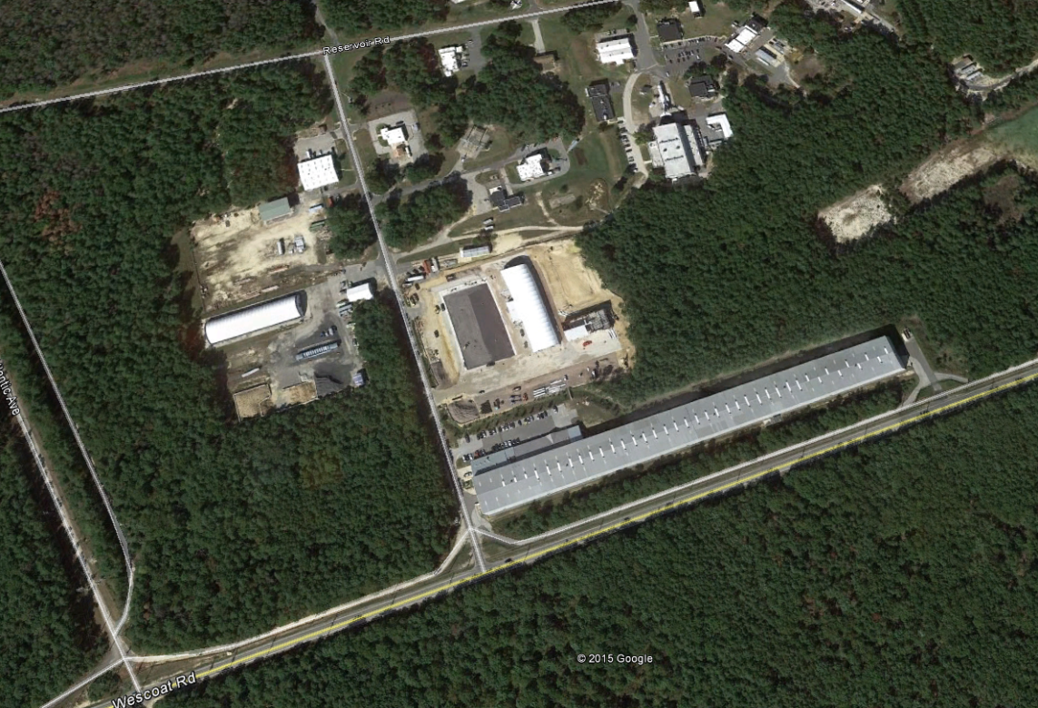
Proposed Locations for New Facilities

Slide 22
Location B – Other Site Impacts
Ground Water
Remediation
Project
High Voltage
Power Lines

Slide 23
Location B – Proposed Gate 12B Change Impacts
Proposed
Accel / Decel
Lanes

Slide 24
Location B Summary
Environmental Assessment Study will be Needed
Separate Hydrology Study
Development Cannot Affect Capture of Groundwater Plume
Review of Hydrology Study by EPA Hydrologist
Confined by High Voltage Lines to the West
Confined by Proposed Changes to Gate 12B Entrance
Personnel Need to Cross Pangborne Ave to go to Bldgs. 296, 298 & 299.

Slide 25
Location A
Water; Fire and Sewer Lines were Extended During
Current Construction

Slide 26
Location A Summary
Can utilize Existing Environmental Assessment Study
EA will only need to be updated
Reduced time and cost compared to Location B
Water, Fire and Sewer Lines have been Extended to the Site
Produces a More Centralized Campus
Does not Require Personnel to Cross Pangborne Ave. to go to Bldgs. 296, 298 or 299

Slide 27
Thank You

Slide 28
QUESTIONS / COMMENTS?
Murphy.Flynn@faa.gov
609-485-5318

