Slide 1
Planning & Environmental R&D Projects
FY16 & FY 17+
REDAC- Airports Subcommittee
Ralph Nicosia-Rusin Airport Capacity Program Manager New England Region
March 31, 2015

Slide 2
PLANNING TOOLS- FY16 requests
Runway Length Assessment for GA airports
Replacement for Runway Exit Design Integrated Model (REDIM)
Integration of aircraft design codes (AAC/ADG) with TFSMC-like tool to support efficient determination of existing critical aircraft
Application of simulation methods to taxiway improvements.

Slide 3
Runway Length Assessment
Problems with current practice:
Aircraft performance data can be difficult to obtain, particularly for multiple aircraft
Reliance on singe critical aircraft can be risky, given changes in fleet
If the single critical aircraft changes, so does the project
Using multiple aircraft provides a for a more robust planning justification, but is labor-intensive at GA airports
General challenges:
Aircraft performance curves are for flight planning, not airport planning.
Runways and associated airspace are long term investments not easily extended
Over design is wasteful and increases maintenance costs
Goal: develop a streamlined methodology to assess runway length needs for general aviation airports, given their role, fleet mix, and aircraft performance

Slide 4
Runway Length Assessment for GA Airports
Scope: Compile various datasets into a common database for statistical analysis that would be used to inform a future revision to the Runway Length AC
Datasets would include: airport role via ASSET, IFR traffic from the traffic flow system (TFMSC), and aircraft performance (manuals, certification, radar tracks)
IFR traffic is appropriate, since the more demanding aircraft such as jets and larger turboprops will usually be flying IFR
Would only need to assess the aircraft performance for predominant or demanding aircraft types
Once the data is compiled, trends in runway length use by airport role can be assessed
Note, the intent is not to develop a tool (at least not yet)

Slide 5
Integration of aircraft design codes (AAC/ADG) with TFMSC Activity Data
Problem
AAS has added new design parameters to 150/5300-13;
APP is developing new guidance on Critical Aircraft determinations (and documentation expectations)
FAA no longer has any reliable reference materials for identifying dimensional and operational properties of aircraft for this purpose
FAA field staff need an efficient tool for validating representations of sponsors and their consultants of design aircraft.

Slide 6
Integration of aircraft design codes (AAC/ADG) with TFMSC Activity Data
Scope:
Use output from existing MITRE tasking to compile/publish database of aircraft type to design category
Develop integrated report with Traffic Flow Management System Counts (TFMSC) to provide counts by design category/aircraft types
Several options to develop tool
Identify support to incorporate new aircraft, in future years
Benefits
Assure facility design is compatible with current users.
Reduce costs of this task in planning and design.

Slide 7
Replacement for Runway Exit Design Integrated Model (REDIM)
Scope
Develop tool or spreadsheet that is compatible with current software
Methodology:
Assess ASDE-X data to create exit probability curves for various aircraft based upon observed braking performance/deceleration
And/or: update database for new aircraft models
Provide output needed for optimizing location of exit taxiways, as well as input for capacity simulation software

Slide 8
Replacement for Runway Exit Design Integrated Model (REDIM)
Problem
Lacking up-to-date comprehensive tool to support emerging analytical needs
As an example: emphasis on eliminating complex taxiway geometry may alter runway occupancy times
REDIM was a fast tool for estimating exit probabilities given taxiway exit locations and design speeds using manufacturer’s data.
Not updated since early 1990’s
Software no longer compatible
Database out of date

Slide 9
Application of Simulation in Taxiway Design
Problem: Application of new taxiway geometry standards may negatively impact operations on airfields with high traffic volumes.
Questions/Issues:
When is simulation would beneficial for evaluating taxiway improvements?
What does it cost and how much time is required?
Are there any useful metrics besides taxiiing distances and times for evaluating controller workload and risk of incursions?
Scenario analysis vs. statistical reports.
Pitfalls to avoid.

Slide 10
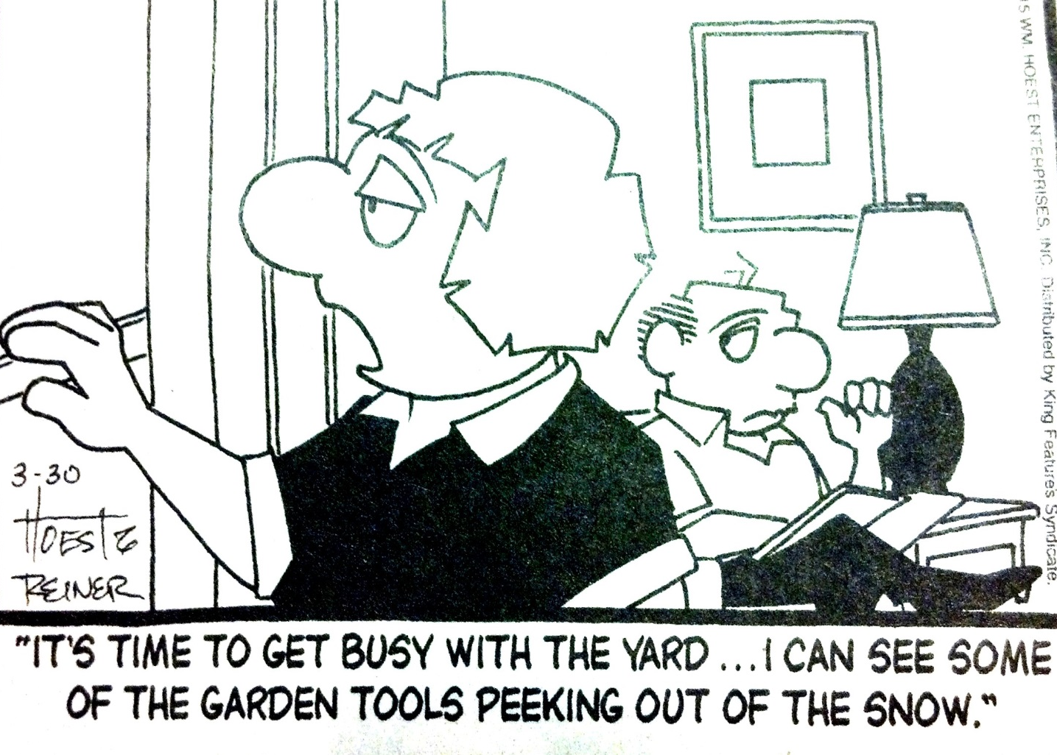
FY17 and beyond
FY17 and beyond
A New Englander’s View of the Future
Apologies to Bunny Hoest & John Reiner of “ The Lockhorns”

Slide 11
Proposals for future research FY17+
Developing a Next Generation of Airport Master Planning
Resiliency
Cost effective scoping
Robust Alternative Analysis
Analytical rigor
Reinvestment Criteria
Digital Tools
Manage Uncertainty
Fault Tolerance

Slide 12
Realizing the AGIS Vision FY17+
The Airports organization has provided a tremendous commitment and investment in AGIS.
Resources to develop AGIS have had to focus on system development, obstruction charting requirements, etc.
An infusion of additional resources and broader perspectives are required to produce the refinements required for realization of the benefits from Airports’ commitment and investment in AGIS.
Benefits
Requirements

Slide 13
Realizing the AGIS Vision FY17+
Refinement of eALP standard and 3-D design models
Tighten focus on essential purpose and elements of an ALP.
Tighten focus on functional opportunities of 3d digital ALP database.
Identify essential attributes that can be reliably maintained.
Provide flexibility for optional attribute fields.
Build FAA tools to evaluate compatibility with design standards at time of construction (“all approvals conditioned upon requirements contemporary with construction.)

Slide 14
Realizing the AGIS Vision FY17+
Refinement of eALP standard and 3-D design models
Maintain currency through NRA airspace review and as-built surveys.
Continue to produce paper plans as a complementary tool.
Viewing tools vs analytical tools.
Longer Term
Specify database architecture for linking airport facilities to planning documents, environmental studies and findings, and grant/PFC program funding databases.
Develop query tools using spatial relationships (centerline separation, runway length, line of sight criteria, etc.
Links/overlays with state/local government GIS data and plans
Enhance OE/AAA- 3d form versus point analysis

Slide 15
Realizing the AGIS Vision FY17+
Refinement of AGIS Survey Requirements
Project Design Surveys
What has long term value?
What links are required for smart retrieval
Coordination tools
Need for project management tools such as cut and fill, quantities, etc. for evaluating change orders or other needs.
Tracking of mitigation projects and activities
Any value in linking to inspection reports
Part 139 inspections and corrections

Slide 16
Realizing the AGIS Vision FY17+
Refinement of AGIS Survey Requirements
Airspace surveys
Obstruction Chart survey still relevant model?
OIS surfaces vs TERPS and Airport Design
Obstruction clearing surveys vs. controlling obstruction surveys
Master Plan surveys vs new approach surveys
Partial updates vs. full replacement surveys

Slide 17
Environmental Applications of GIS FY17+
Exchanging GIS data with other agencies to support land use planning, resource protection, NEPA processing, airport access planning, etc.

Slide 18
Forecasting Long Term Demand Shifts FY17+
We primarily forecast airline activity, not passenger demand.
Most forecast dependent on historic levels of activity.
Activity is determined by supply responses.
Extrapolating recent activity levels distorts understanding of needs.
Long term supply responds to demand shifts.

Slide 19
Forecasting Long Term Demand Shifts FY17+
Why cohort analysis?
Powerful determinants of demand
Income Levels
Occupations
Ethnicity
Business/Leisure Splits
Route Requirements
Differential Propensity to Fly
Less Uncertainty in Demographic Forecasts than Forecasts of Airline Industry

Slide 20
Understanding passenger needs FY17+
Data mining to understand O&D geography of passenger trips.
Matching HOV modes to passenger travel patterns.
Potential of new technology to provide HOV service requirements for airport passengers.

Slide 21
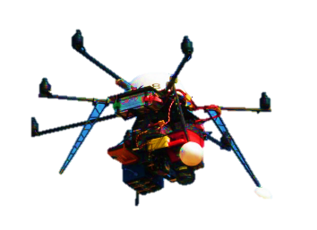
Safety Enhancements FY17+
Application of UAS technology to Airfield & Wildlife Management.
Autonomous programmed to remain below OFZ
Coupled with other systems such as bird radar, transponder,
FOD
Lights
Signs
Fence
Harasss and Mark

Slide 22
Safety Enhancements FY17+
Low Cost Active Runway Warning System for non towered airports.
Evaluation of storm protection technologies for improving resiliency of existing airfield infrastructure.
Evaluation of benefits/costs of linking non federal AWOS to National Airspace Data Interchange Network.
Using the Aviation Safety Information Analysis and Sharing (ASIAS) database for refining airport design and policy.

Slide 23
Air Emissions Screening Tool
Need a new screening tool to avoid the expense of modelling insignificant changes in emissions.
Old criteria did not require modelling for:
GA airports with less than 180,000 annual ops.
Commercial service airports with less than 1.3 M enplanements/180,000 annual ops.
AEE found no scientific basis for these specific criteria

Slide 24
Air Emissions Screening Tool
Research Issue:
Identify key parameters of airport actions that are determinants of significant air quality impacts.
Possible approaches:
Survey prior studies to extract the range of emissions generated by different actions.
Generate graphs of emissions by level of activity.
Benefits:
Saving in time and cost of EA’s for projects with no significant change in emissions.
Improve focus of EA on more relevant issues.

