Slide 1
Aviation Rumble Strip Project Update

Slide 2
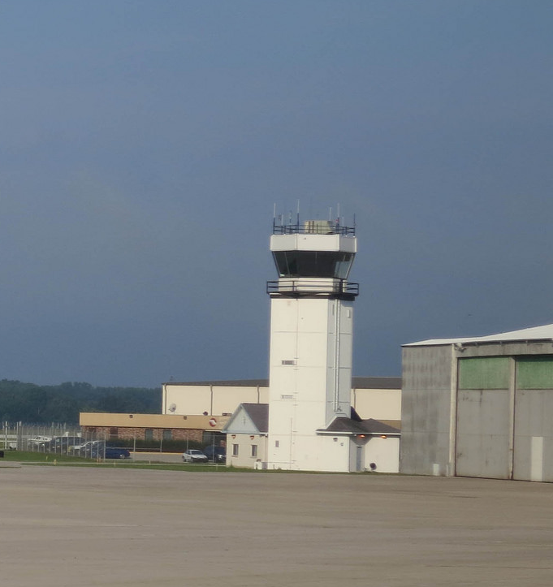
Project Motivation
Reduce runway incursions
Runway incursion per FAA: “Any occurrence at an aerodrome involving the incorrect presence of an aircraft, vehicle or person on the protected area of a surface designated for the landing and take off of aircraft”
Candidate Location for Rumble Strips
Enhanced
Taxiway Centerline
“Hold Short “
Notes:
CF - done

Slide 3
Utilizing a Center of Excellence
PEGASAS
Partnership to Enhance General Aviation Safety, Accessibility and Sustainability

Slide 4
Project Highlights
March 2014: Dialog with Prof. Bullock and Hubbard at Purdue to develop proposal to investigate use of Rumble Strips
June 3, 2014: Kickoff meeting at PEGASAS meeting
June 25, 2014: Raised Rumble installed at KLAF
July 16, 2014: Saw Cut Rumble installed at KLAF
Summer/Fall 2014: Testing
Nov 2014: Interim Report submitted confirming feasibility
Dec 2014: Phase II scope approved for additional research evaluating winter weather performance and set back locations
January 2015: Positive reception by aviation community at Transportation Research Board (TRB)
February 2015: Inquiry from Edwards Air Force Base regarding project

Slide 5
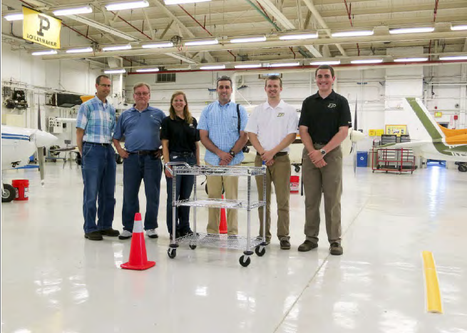
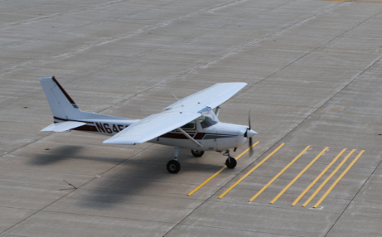
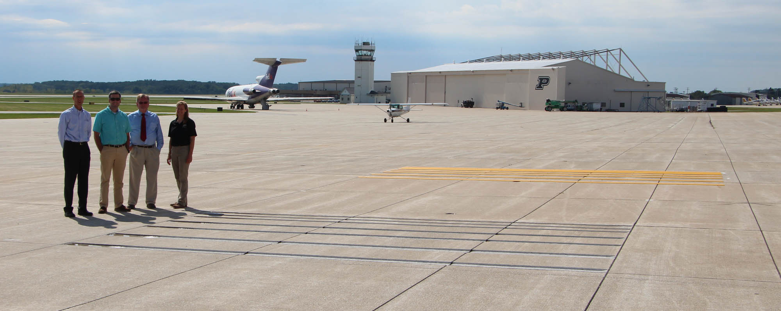
Strong Engagement with Purdue Team
Raised Rumble
Saw Cut Rumble

Slide 6
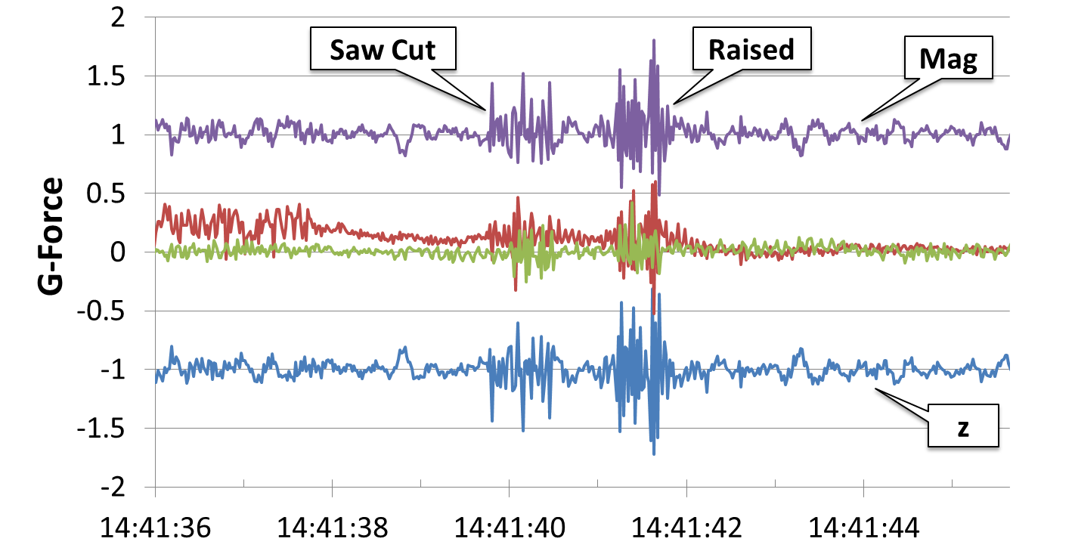
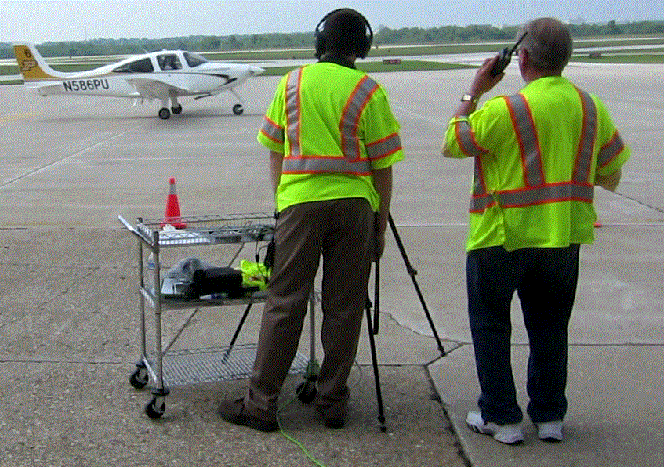
Acceleration Plots for Cirrus SR-20 Over Saw Cut and Raised Rumble Strips
QR code for video of test at 15 kts (15)
http://dx.doi.org/10.4231/R77D2S24
Aircraft taxing over rumble strips at 15 knots

Slide 7
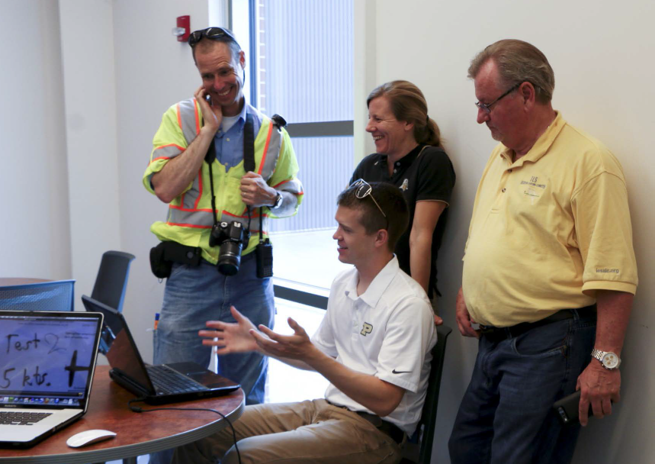
Summer 2014 Findings Presented at Transportation Research Board Washington DC (January 2015)

Slide 8
Research Team Provides Support for Andrews AFB Inquiry (February 2015)
Rumble strips planned for installation on ground vehicle road at Edwards AFB
Thane Lundberg contacted research team on February 3, 2015 for additional information on aviation rumble strip project
Information was presented to AFB personnel and decision was made to proceed with rumble strip installation
Grooved rumble strips successfully installed at critical intersections on ground vehicle roads at Denver International Airport in 2007
No ground vehicle incursions have occurred since installation
Other changes included revamping driver-training program and colorful warning signs to intersections where roads for airport vehicles cross or enter taxiways and runways

Slide 9
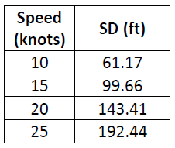
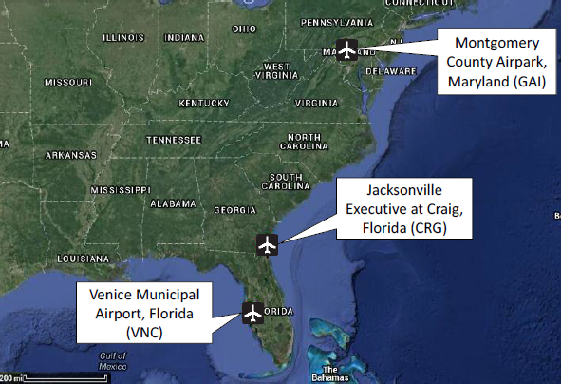
Completed Interim Report on Rumble Strip Placement at GA Airports (February 2015)
Utilized data from previous FAA taxiway deviation study
Stopping distance (SD) for aircraft based on ~ 4000 observed taxi speeds (V) for Group I and Group II aircraft at three GA airports
SD = V (5.06 + 0.105V) V = 85% observed taxiway speed
Recommended placement at beginning of enhanced taxiway centerline

Slide 10
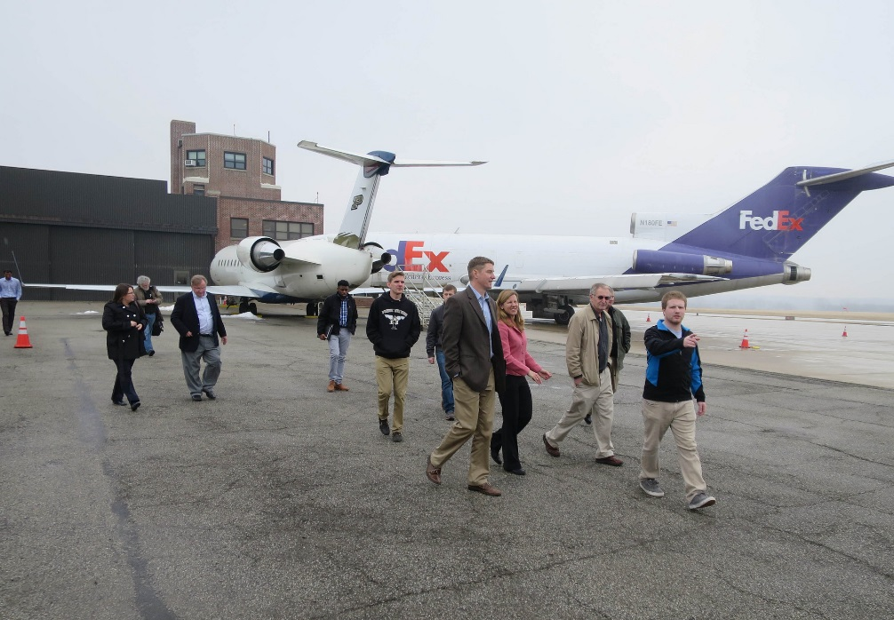
FAA Site Visit to Purdue (March 2015)
Assessed impact of snow plow operation on vertical edge saw cut rumble
Participation in Aviation Track of Purdue Road School

Slide 11
2015 Purdue Road School Transportation and Expo
In it’s 100th year, Purdue Road School attracts over 2,000 Indiana local and state officials, consultants, and suppliers each year. Important updates on pertinent transportation issues, as well as sessions on topics of general interest, are provided in the two-day conference.
Road School also hosts regional meetings of several affiliated professional groups, such as the County Surveyors Association and the Indiana Chapter of the Institute of Transportation Engineers.
Heated pavement project update was presented

Slide 12
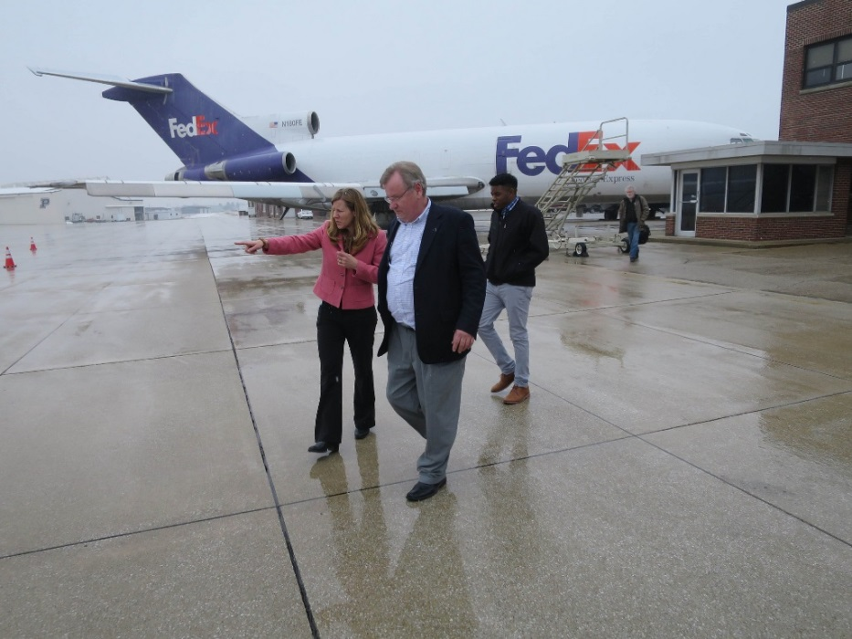
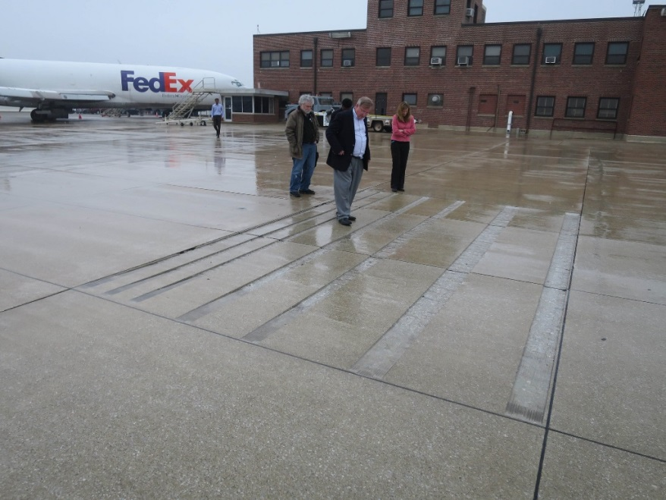
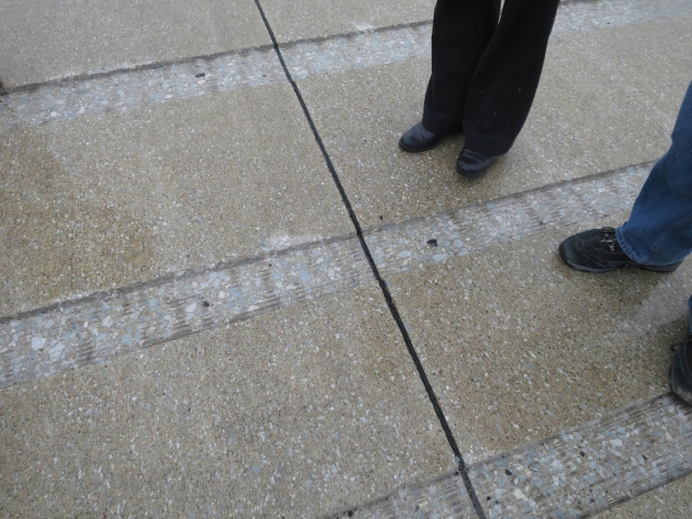
Modest edge damage on vertical edge. Improved 2015 installation will use beveled edge so rumble is trapezoidal (photos later in PPT)
Purdue Test Bed at KLAF March 2015

Slide 13
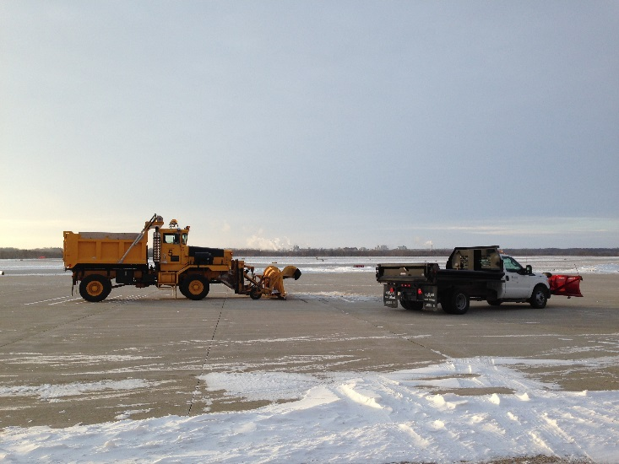
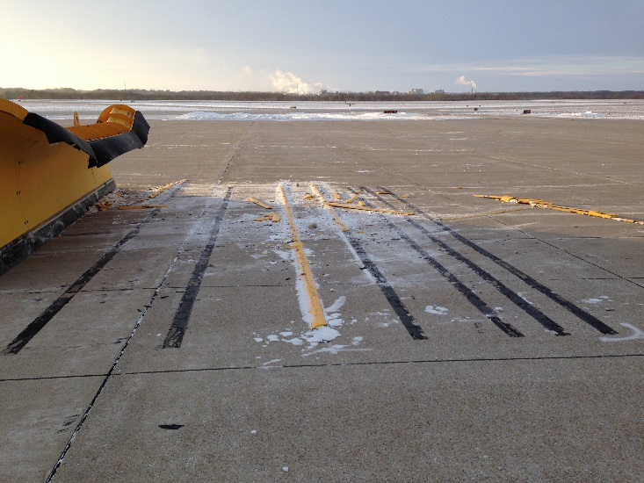
Winter Ops Considerations
Experience with roadway applications demonstrate viability of epoxy raised and saw cut rumble strips
Aviation groove studies suggest trapezoidal cut preferable to square cut for saw cut rumble strips
Preformed raised rumble strips may be appropriate in temperate climates that do not require snow removal

Slide 14
FY16

Slide 15
Phase II
Conduct additional field testing
Test Thermoplastic elevated strip
Select candidates a “most feasible” for Phase III - final field testing.

Slide 16
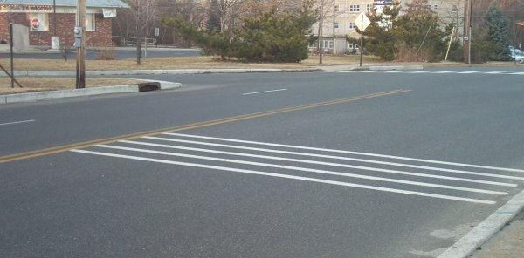
Thermoplastic Rumble Strips
3 layers of 125 mil thermoplastic

Slide 17
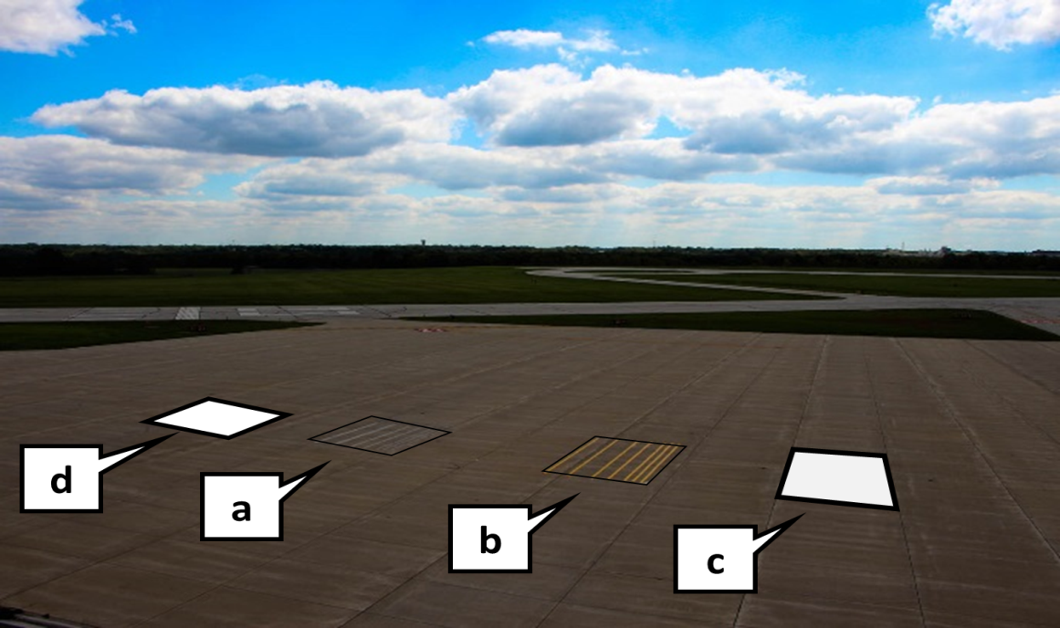
Site Photo: Approximate Location of Existing and 2015 Rumble Strip Test Bed (To Be Constructed Late Spring 2015)
a: Existing saw cut rumble strips (Square groove)
b: New saw cut rumble strips with 45 degree bevel (replace yellow raised) (Trapezoidal groove)
c: New thermoplastic raised rumble strips
d: Portable rumble strips (can be easily relocated)
(not to scale)

Slide 18
Phase III - Field Testing
Install strips in recommended location at GA airport(s) for ~one year validation test.
Publish Technical note on findings 6/30/16

Slide 19
Questions/Comments?

