Slide 1
RPD 134 NLA
RPD 140 COMPOSITES
RPD 152 ARFF
REDAC Briefing
March, 2015

Slide 2
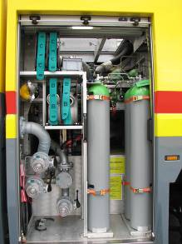
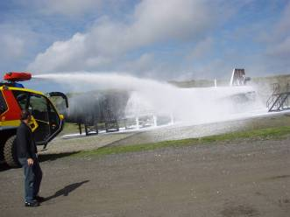
New Firefighting Systems for Class 4 & 5
ARFF Vehicles
Objectives
Research new firefighting systems and technologies which can be used on Class 4 and 5 ARFF vehicles as the primary discharge for extinguishing agent.
  CAFS
  High Pressure
International ARFF community moving towards these technologies however no performance based standards exist.
Procurement of new ARFF research vehicle (replacing 1992 E-One).
Conduct live fire testing and analysis of these technologies extinguishing fuel fires and compare the results with current vehicles.
Develop performance based standards for OEM’s to build to and airports to specify.

Slide 3
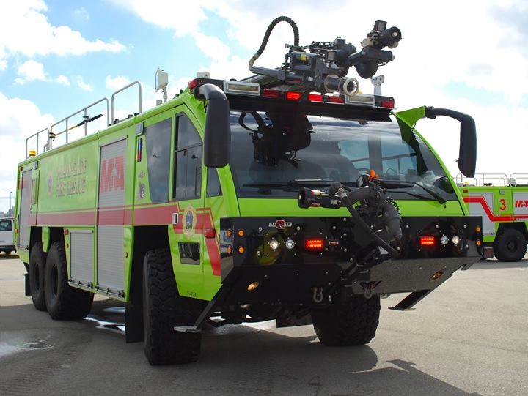
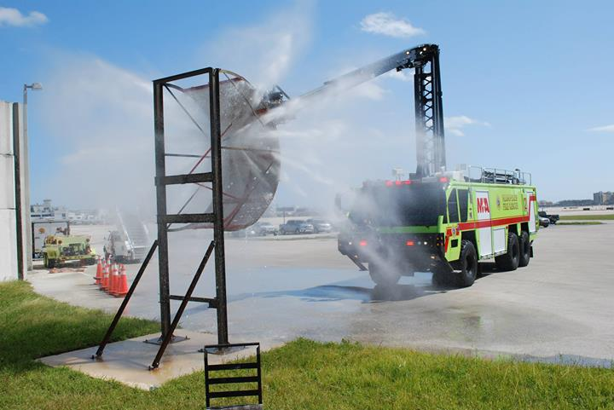
New Firefighting Systems for Class 4 & 5
ARFF Vehicles
Status
Performed a market survey (FAA project #16578, June 2014) for a new ARFF research vehicle with compressed air foam capability.
Vehicle manufacturer has been identified.
Specification document completed.
Procurement awarded September 2014.
Preliminary engineering drawings in progress.
OEM ordering pump, agents tanks and other components for assembly.
Assembly scheduled for late Fall 2015.

Slide 4
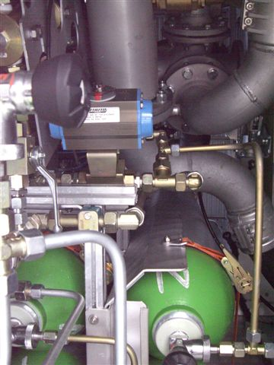
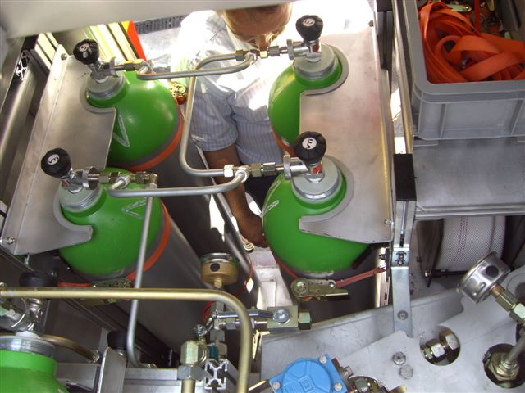
New Firefighting Systems for Class 4 & 5
ARFF Vehicles
Vehicle Facts
First Class 4/5 ARFF vehicle utilizing CAFS as a primary discharge in US.
  HRET and ASPN
  High flow, multi-position bumper turret
  Handlines
Capable of discharging in CAFS or standard modes to all discharges.
Capable of varying air injection to change expansion ratio of foam.
Capable of varying foam discharge rates.
Electronic foam proportioning with advanced flow monitoring for R&D evaluations.

Slide 5
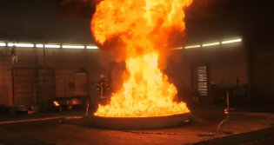
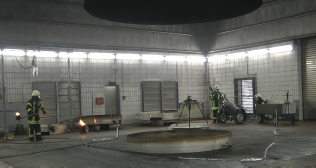
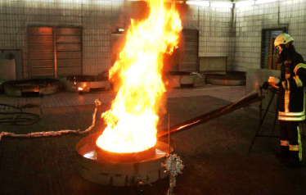
Fire Test Building Retrofit
Testing of Agents, Bio-fuels and Composites
Comparative Facilities

Slide 6
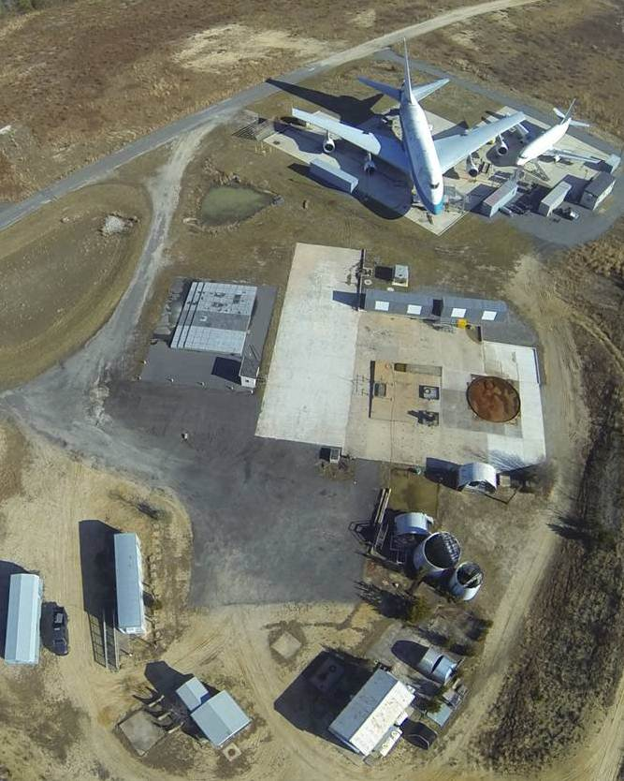
1011 Test Aircraft
Office Trailer
Storage Shed
Pump House

Slide 7
Fire Test Building Retrofit
Plenum
Funnel
Skirt
Hood
t
c
u
D
100,000 cfm
Blower

Slide 8
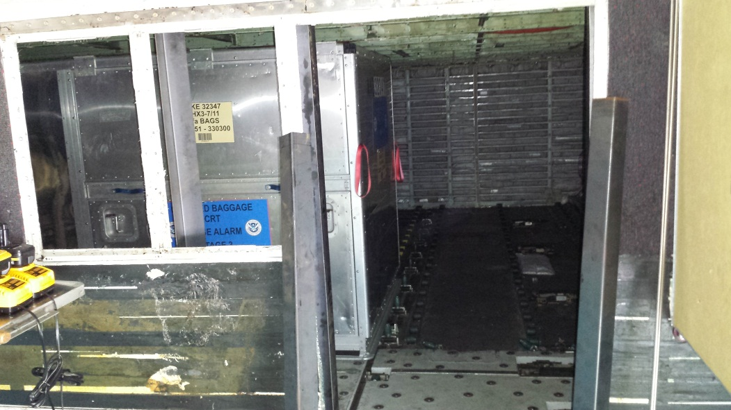
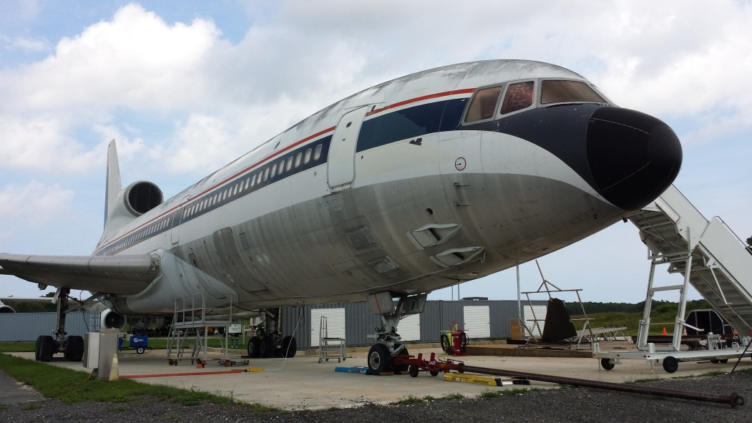
L1011 Test Aircraft
The FAA acquired an L1011 aircraft to be used as a test article for ARFF Fire Research.
Lower cargo hold was the first test chamber to be fabricated with clean agent cargo fire tests as the first project.
Thermocouple, oxygen analyzers, FLIR and color video instrumentation being installed.

Slide 9
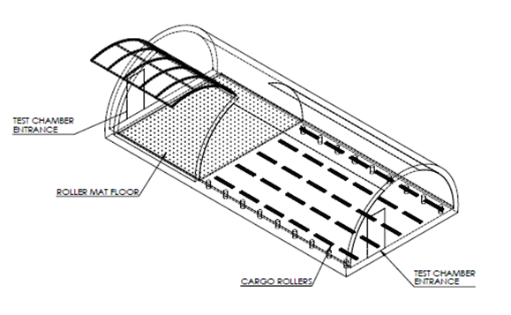
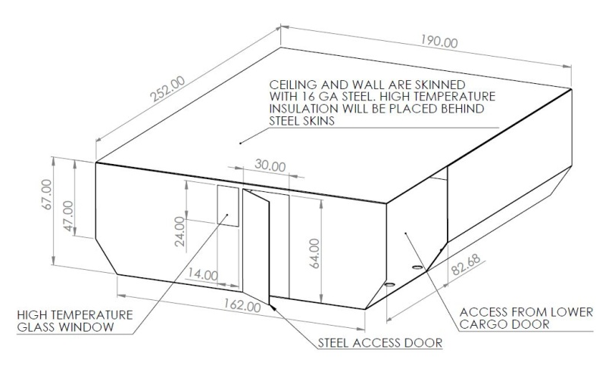
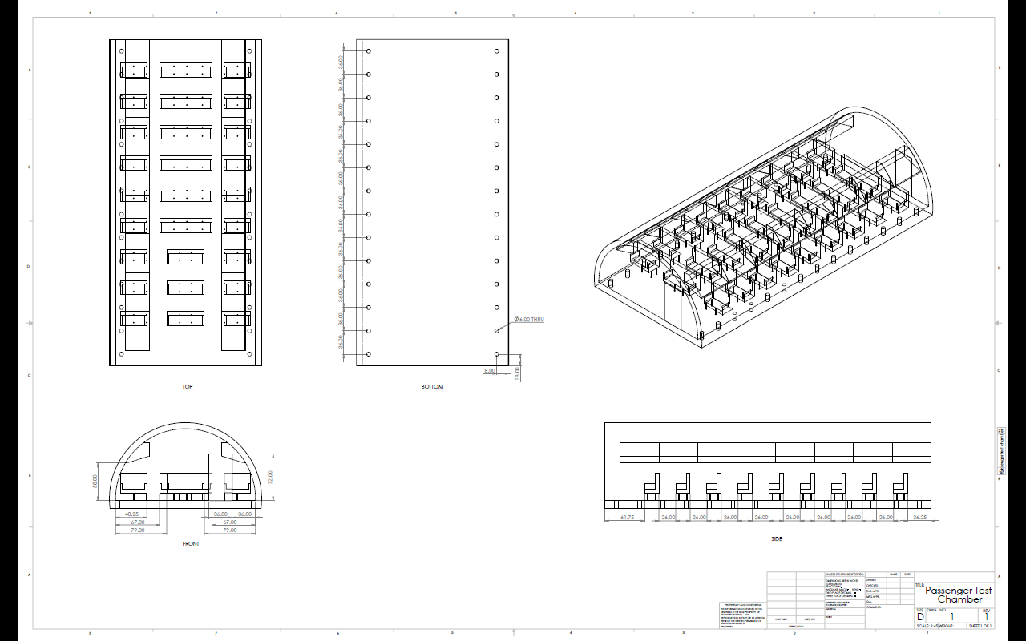
L1011 Test Aircraft
Test chambers will simulate the following:
  Passenger compartment
  Upper Freighter compartment
  Avionics Bay
  Lower Cargo Compartment

Slide 10
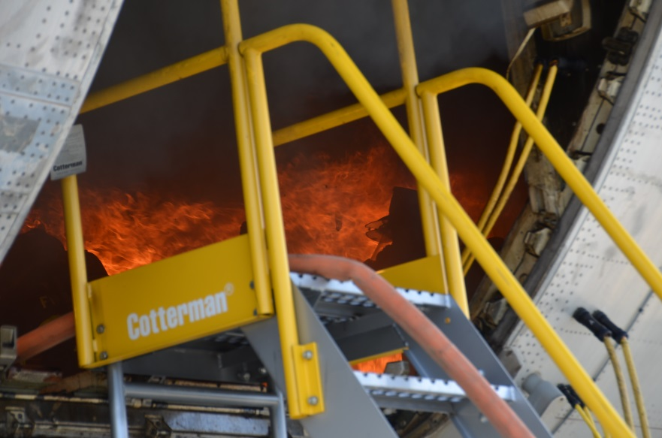
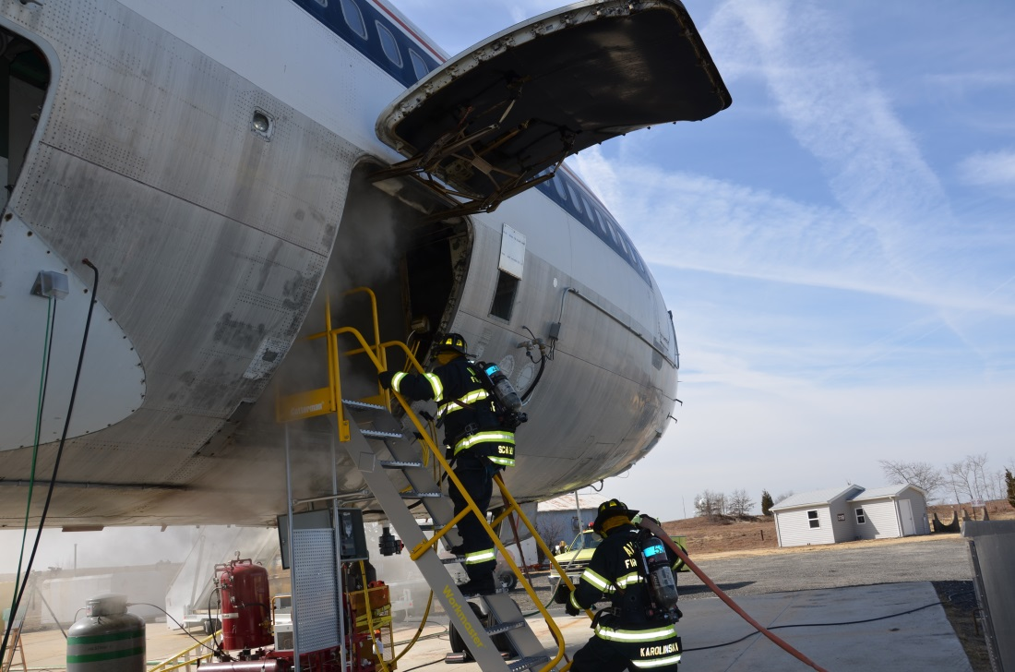
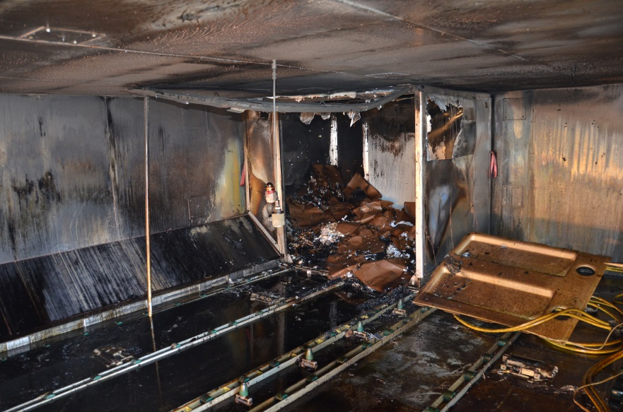
Status of Other ARFF Project
Clean Agent Performance in Cargo Compartment Fires
  Testing Underway
  Data analysis and report writing underway late Spring.

Slide 11
Status of Other ARFF Project
Aviation Bio-Fuel Fire Fighting Research
  PEGASAS - Purdue University
    Physical and chemical properties to be studied:
      Chemical Composition (GCxGC/MS).
      Net Heat of Combustion
      Flash Point
      Kinematic Viscosity
      Density
      Cloud Point and Freeze Point
      Minimum ignition energy
      Flame propagation rate

Slide 12
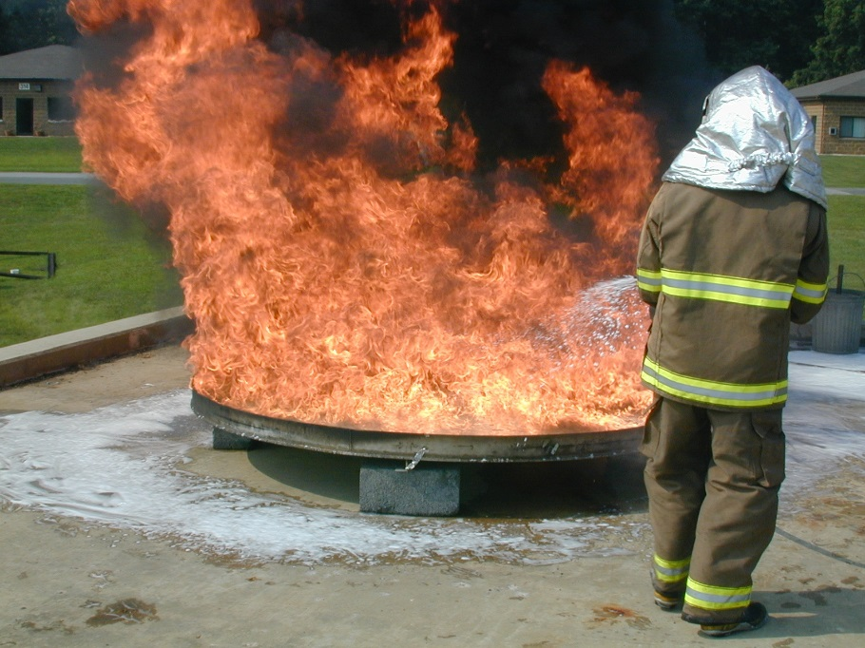
Status of Other ARFF Project
ICAO vs. MilSpec – Test Variabilities
  Foam concentrates (MIL SPEC and ICAO)
  Fuels (Heptane and Jet-A)
  Discharge techniques (Fixed and Manual)
  Pre-burn times (10 and 60 sec)
  Discharge Nozzles

Slide 13
ARFF Research Reports
Published Reports Since Last REDAC:
Penetration Study of Aluminum, Glass Fiber-Reinforced Aluminum Laminate, and Carbon Fiber-Reinforced Plastic (DOT/FAA/TC-14/33)

Slide 14
ARFF Research Reports
Reports in Editing Cycle:
Experimental Flow Characterization and Computational Model Development of Aqueous Film-Forming Foam (AFFF) Firefighting Jets
Intermediate-scale Evaluation of the Flammability and Suppression Agent Required for Aircraft Skin Composite Materials and Combustible Surrogates
Cutting Evaluations of Aircraft Grade Panels

Slide 15
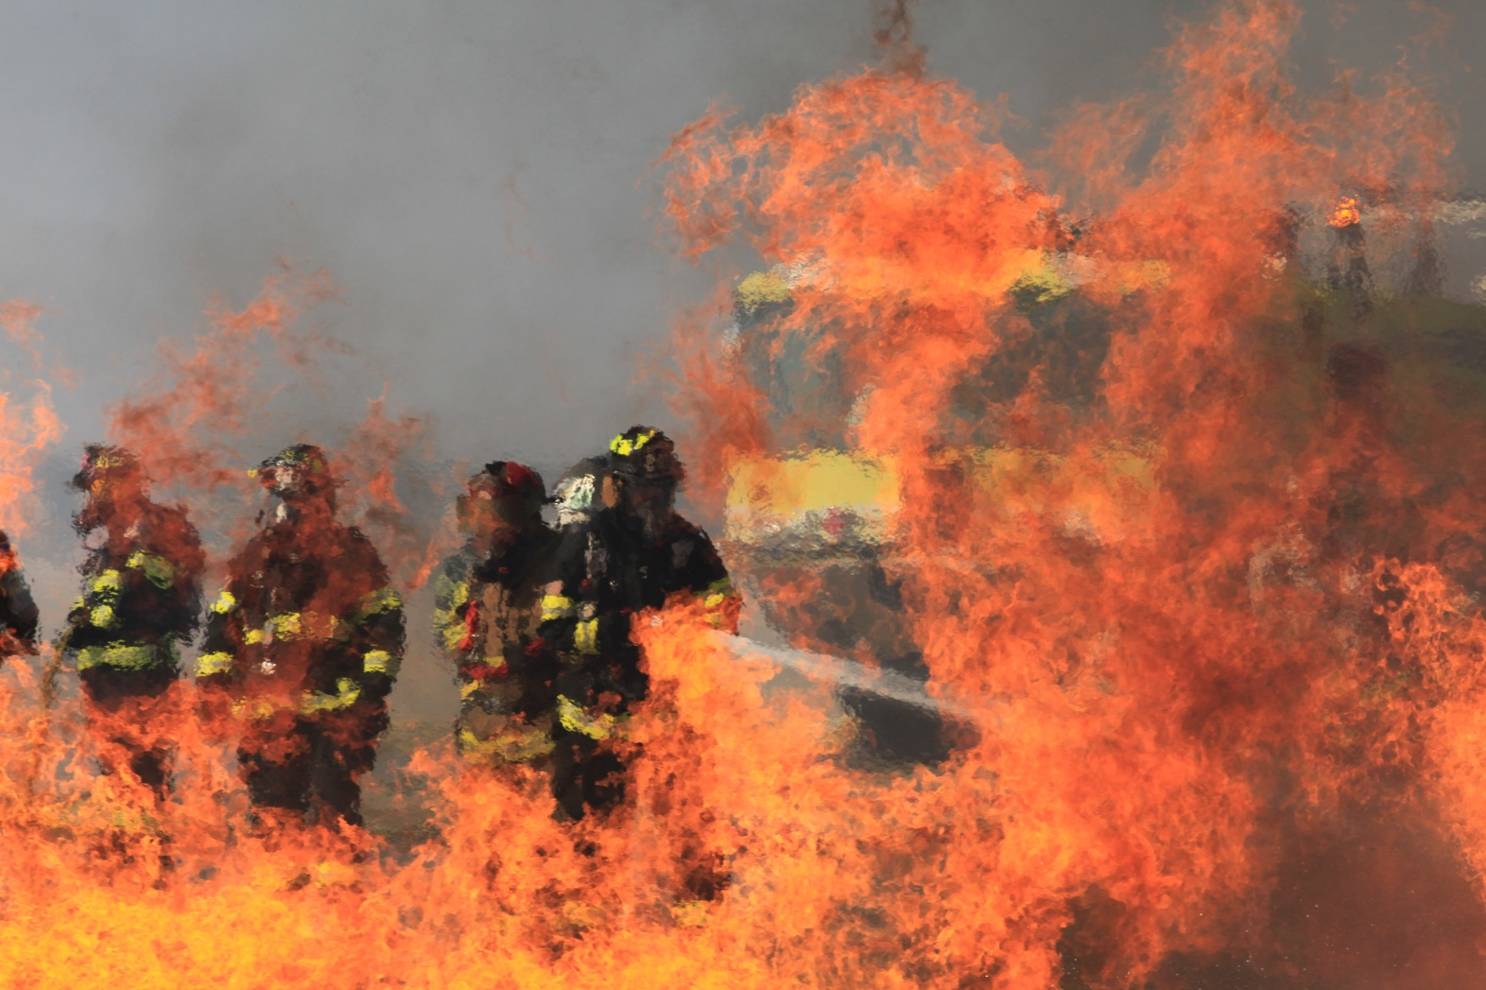
Questions?

