Slide 1
RPD 135
National Airport Pavement & Materials Research Center (NAPMRC)

Slide 2
High Temperature Pavement Test Facility- RPD 135
Contract Funds ($K)
Projects | FY15 | FY16 | FY17
Maintenance and Equipment | 50 | 100 | 100
Set-up Database, Process and Analyze Data | 150 | 200 | 400
Test Pavement Construction | 200 | 300 | 300
Data Acquisition System & Instrumentation | 50 | 200 | 100
APTV Operation / Warranty | 300 | 0 | 450
TOTAL | $ 750 | $ 800 | $ 1350

Slide 3
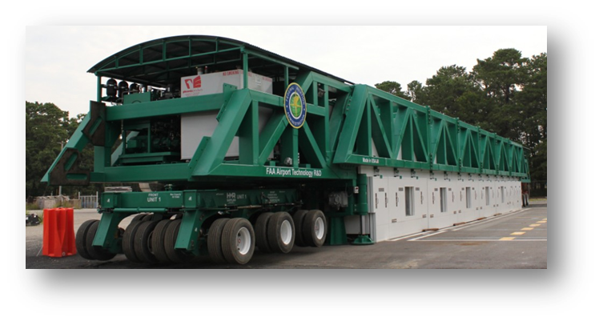
APTV/HVS-A

Slide 4
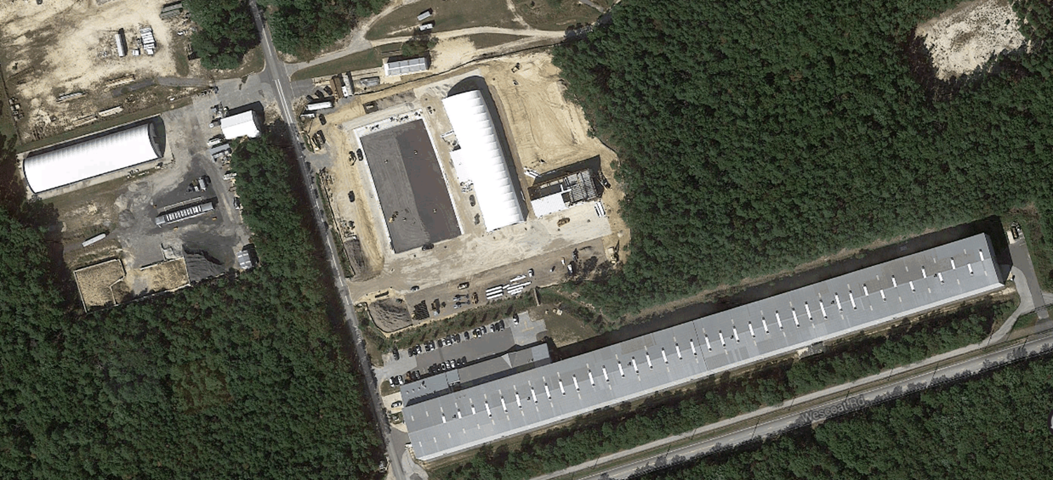
HVS-A Test Pavement

Slide 5
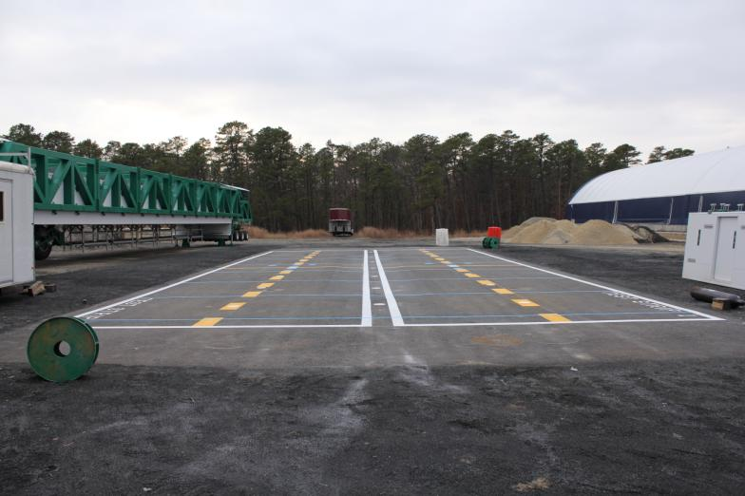
HVS-A Acceptance Test Strips

Slide 6
HVS-A Acceptance Test Strips
PAVEMENT CROSS-SECTION

Slide 7
HVS-A Acceptance Test Strips

Slide 8
HVS-A TS: Response and Traffic Tests

Slide 9
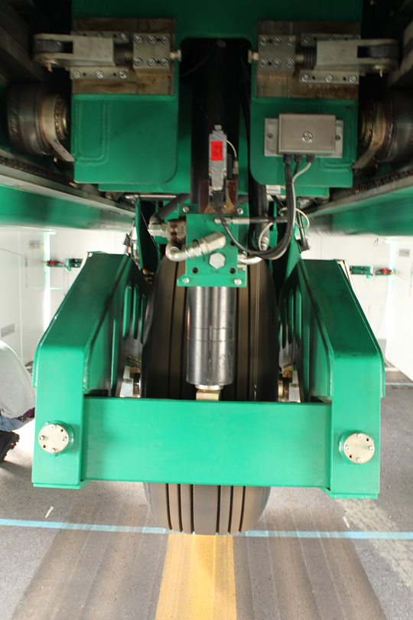
HVS-A ACCEPTANCE TEST STRIPS
Objectives:
Study the effects of Tire Pressure on
performance of HMA layer.
Tests:
Response Tests.
Traffic Tests.

Slide 10
HVS-A TS: TRAFFIC TESTS
Tire pressure: 210-psi Test Strip-1
254-psi Test Strip-2
Pavement Temperature: 120 deg. F measured at a depth of 1-inch below pavement surface.
Test Speed: 2-mph
Wheel loads: 61,300-lbs.
Failure Criterion: 1-inch surface rut

Slide 11
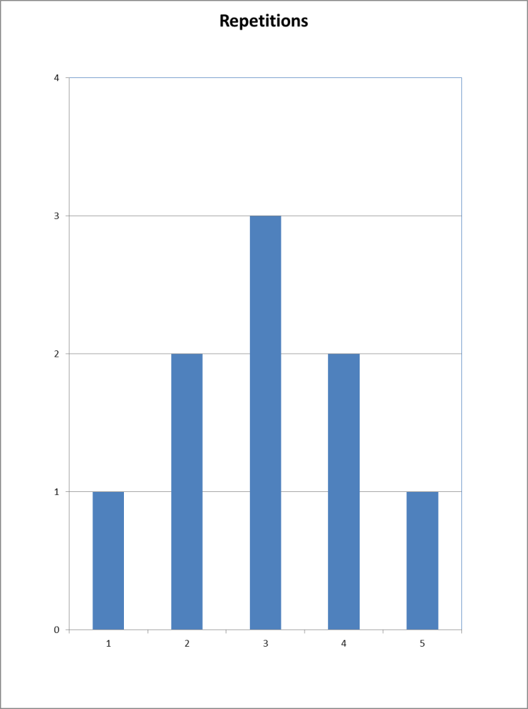
HVS-A TS: Wander Pattern

Slide 12
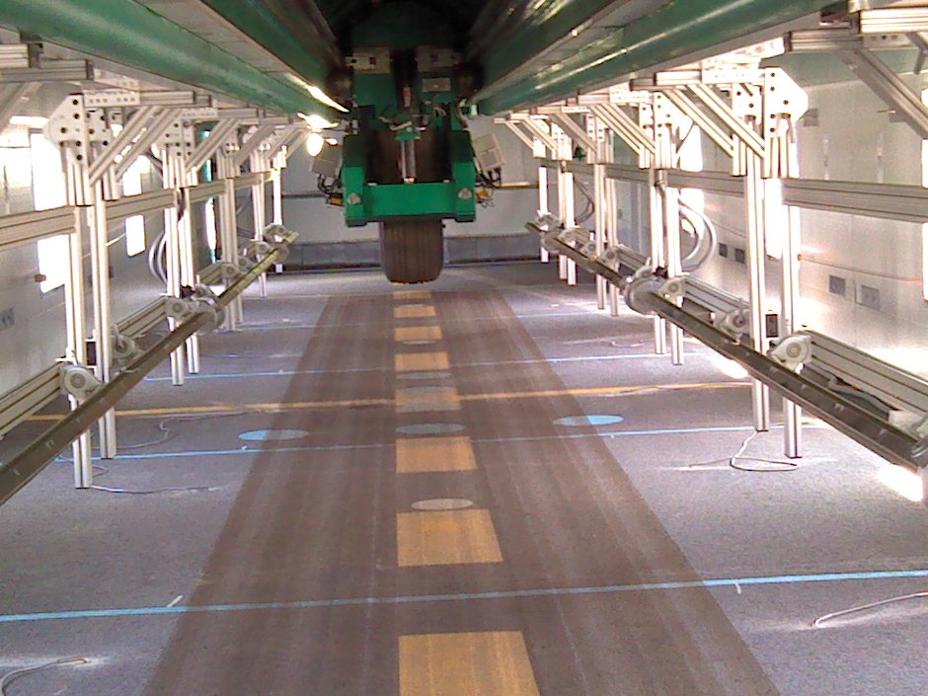
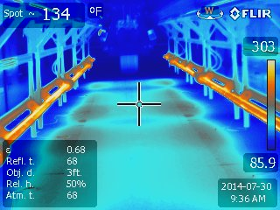
HVS-A TS: Response and Traffic Tests

Slide 13
HVS-A TS: Traffic Tests

Slide 14
HVS-A TS: Traffic Tests

Slide 15
HVS-A TS: Traffic Tests

Slide 16
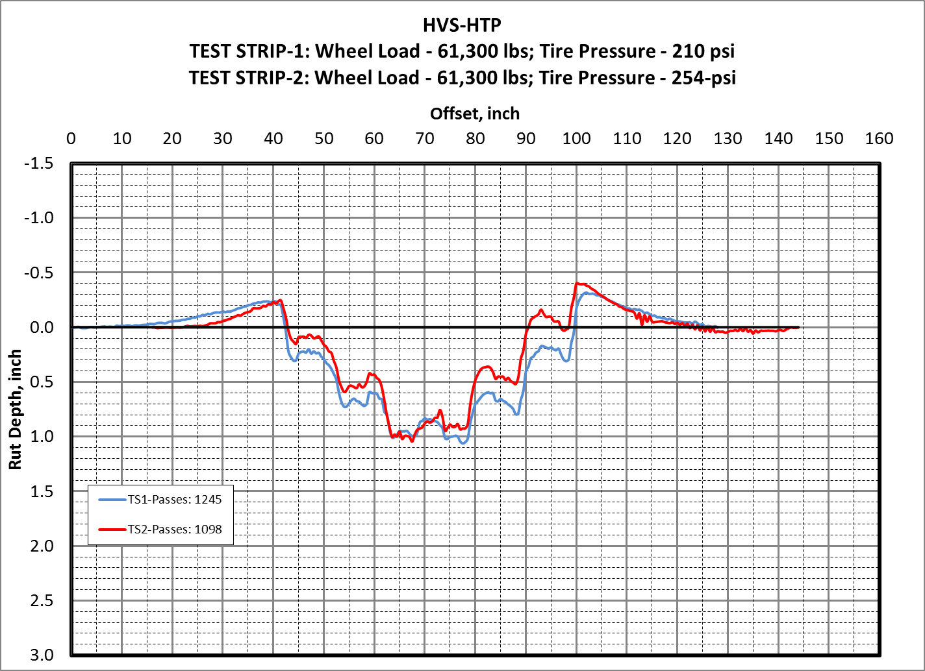
HVS-A TS: Traffic Tests
Comparison of Surface Profiles at
Failure Criterion (1-in. rut)

Slide 17
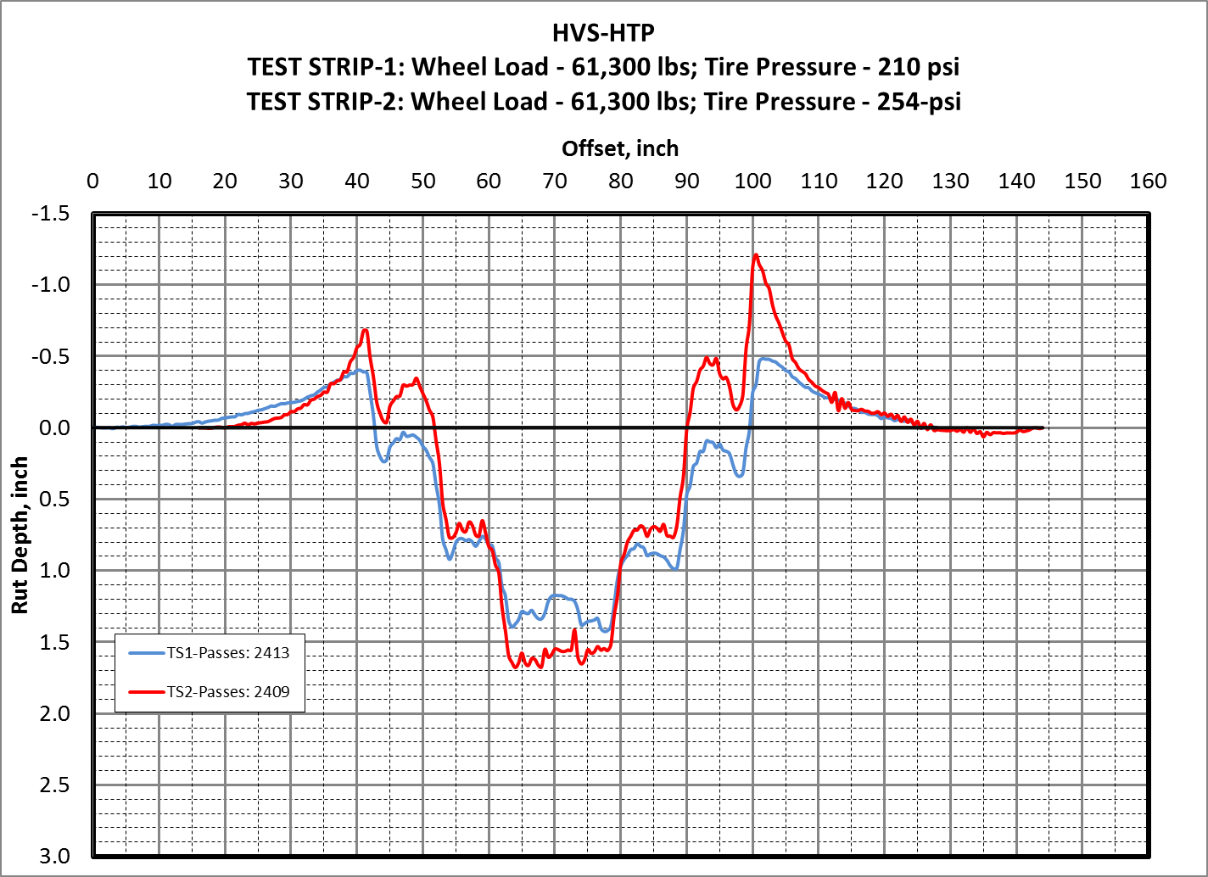
HVS-A TS: Traffic Tests
Comparison of Surface Profiles at
2400 passes

Slide 18

TEST STRIP-2: Wheel Load - 61,300 lbs; Tire Pressure - 254-psi

Slide 19

TEST STRIP-2: Wheel Load - 61,300 lbs; Tire Pressure - 254-psi

Slide 20
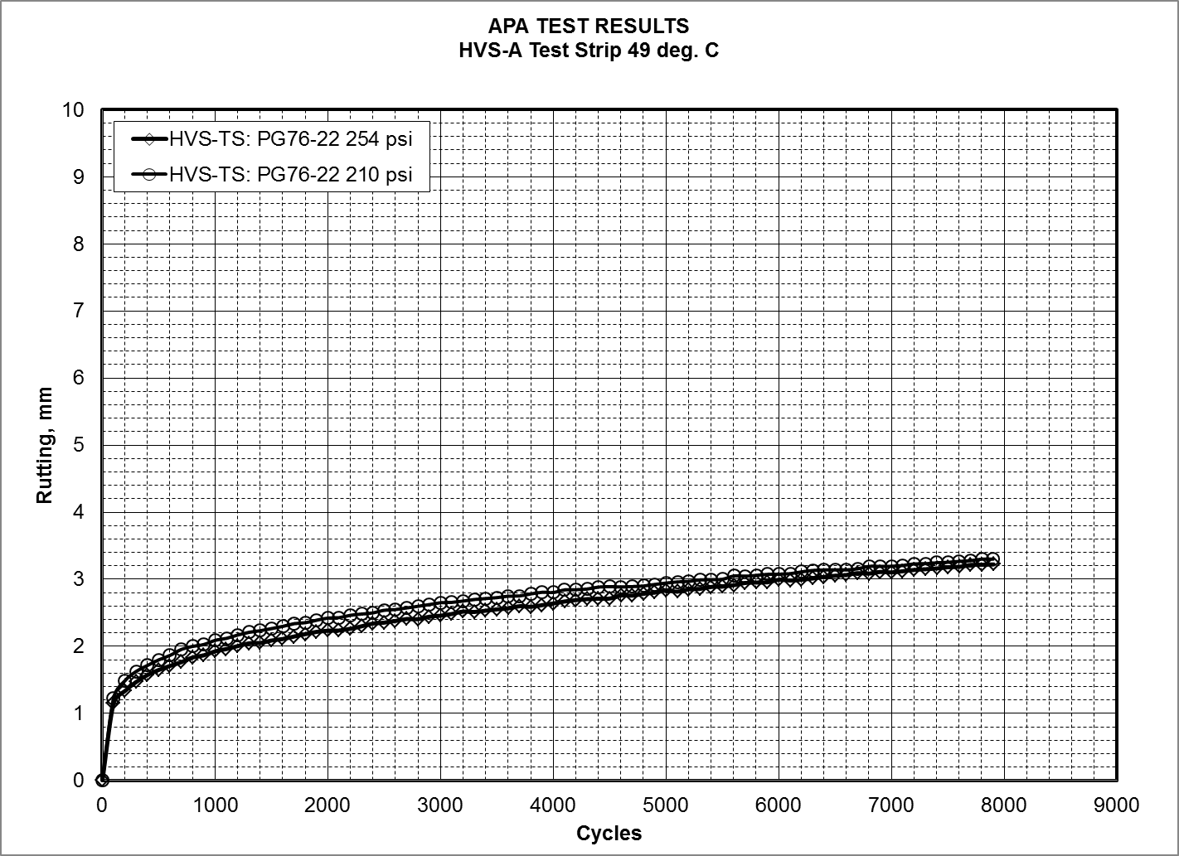
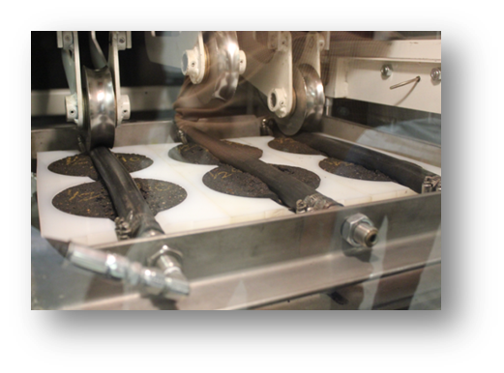

Slide 21
Future Research
EVALUATION OF NEW ASPHALT TECHNOLOGIES FOR AIRFIELD PAVEMENTS
Warm Mix Asphalt, Stone Matrix Asphalt, Polymer Modified Binders,
RAP Mixes, Full-Depth Rehabilitation
PROBLEM: Lack of Guidance/Standards/Specifications
Lack of Performance Data
Laboratory Performance Evaluation
Full-Scale APT
NAPMRC
Field Performance Evaluation
Evaluate:
Rutting
Fatigue
Moisture Susceptibility
Durability
Low Temperature Cracking
Full-Scale APT:
Rutting
Fatigue
Tire Pressure Effects
WMA
RAP/RAS
Full Depth Reclamation
Compare to P-401 HMA
Field Projects:
Lab Evaluation of Field Mixes
Construction Evaluation
Evaluate:
Mix Design Production, Construction
Support from AAS-100, ADO

Slide 22
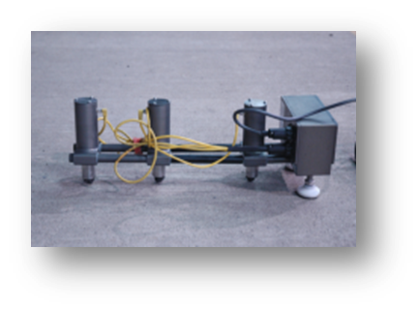
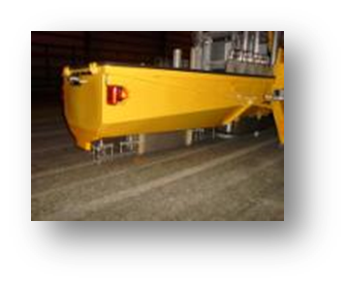
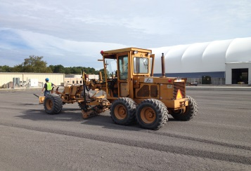
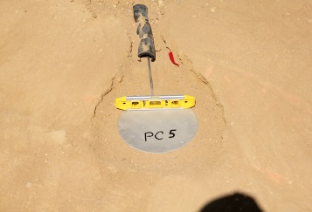

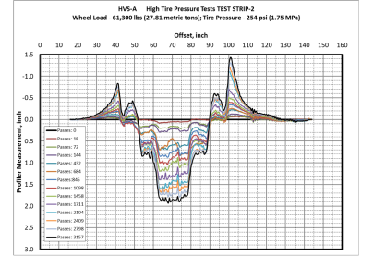
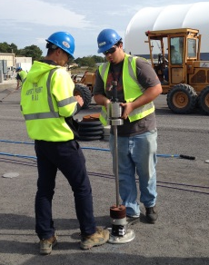

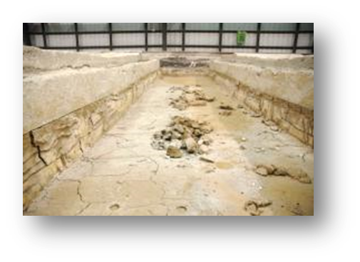

Objectives, Pavement
Construction, Sensors
NDT & Pavement
Characterization
TEST CYCLE (TC) AT NAPMRC
Posttraffic Testing
Full-Scale APT,
Pavement Evaluation

Slide 23
MATERIAL
P401
HMA
P401
HMA
WMA
WMA
P401
HMA
WMA
254
psi
254
psi
254
psi
254
psi
254
psi
254
psi
TIRE
PRESSURE
NAPMRC
Test Cycle-1
(TC-1)
214
psi
214
psi
214
psi
214
psi
214
psi
214
psi
BINDER
TYPE
PG
64-22
PG
76-22
PG
64-22
PG
76-22
PG
76-22
PG
76-22

Slide 24
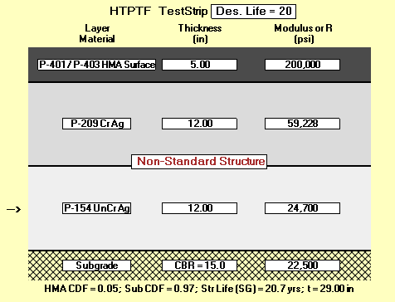
Pavement Cross Sections

Slide 25
MATERIAL
P401
HMA
WMA
1
WMA
2
WMA
3
RAP
1
RAP
2
CRACKING
(test during
winter)
NAPMRC
Proposed
Test Cycle-2
(TC-2)
RUTTING
(test at high
temperature)
PG
76-22
PG
76-22
PG
76-22
PG
76-22
PG
64-22
PG
76-22
BINDER
TYPE
ALL TESTS at
:254 psi tire pressure
: 70,000 lbs wheel load

Slide 26
Future Research
Use of Additives and Nanoparticles to Improve Performance of Airport Pavement Materials
Evaluate the use of Additives and Nanoparticles for Improved Performance of Airport Pavement Materials
Develop Standards/Specifications and Guidelines for Pavement Materials that have been modified with Nanoparticles and other Additives.
LITERATURE REVIEW CURRENTLY UNDERWAY

