Slide 1
RPD-137 Field Instrumentation and Testing

Slide 2
Field Instrumentation and Testing (RPD 137)
Contract Funds ($K)

Slide 3
RPD – 137
Field Instrumentation projects –
Continue data collection and analysis from
LaGuardia International Airport, New York City, NY
JFK Intl. Airport, New York City, NY
EWR Intl. Airport, Newark, NJ

Slide 4
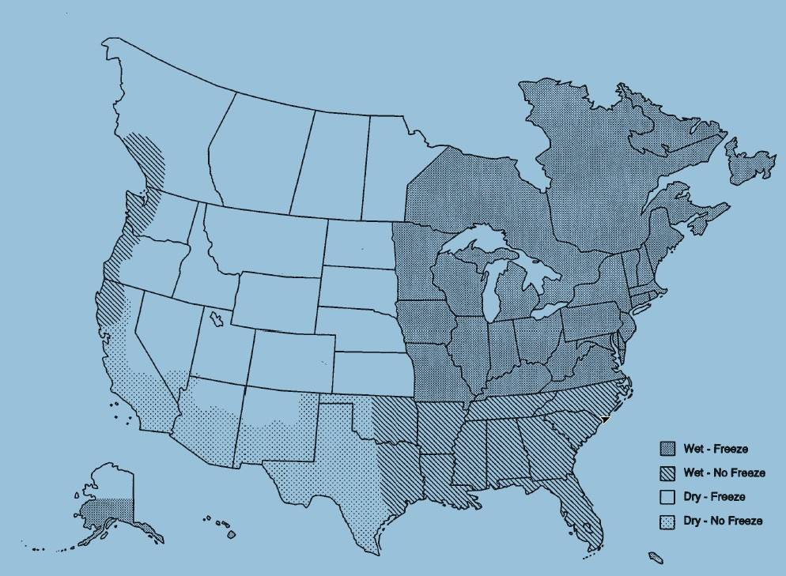
Current FAA Airport Instrumentation Projects
Newark Liberty International Airport, Newark – AC Overlay Pavement
JFK International Airport, NYC – PCC Pavement
Baltimore Washington International Airport, Baltimore
LaGuardia Airport, NYC – AC Overlay Pavement

Slide 5
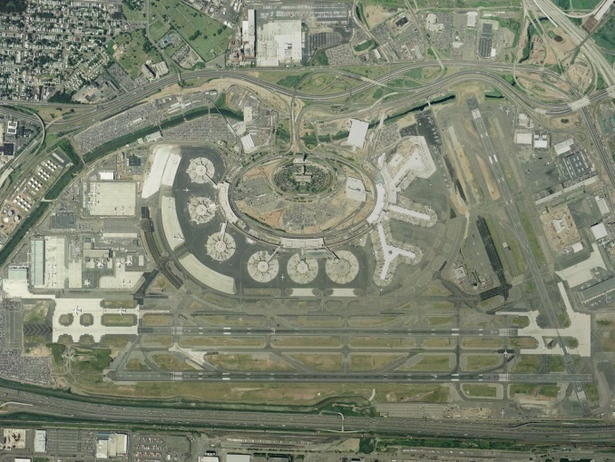
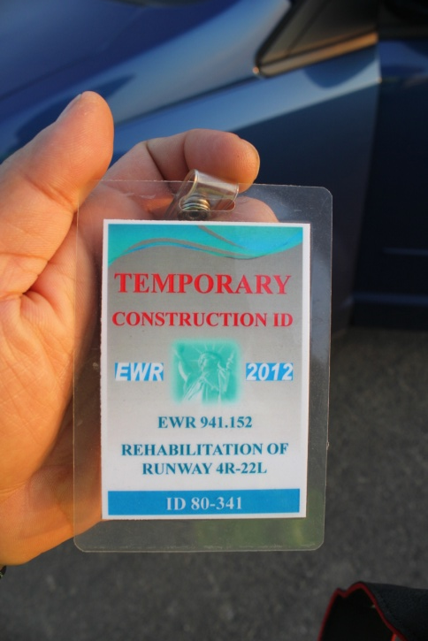
Study slippage failures on Runway 4R-22L at EWR.

Slide 6
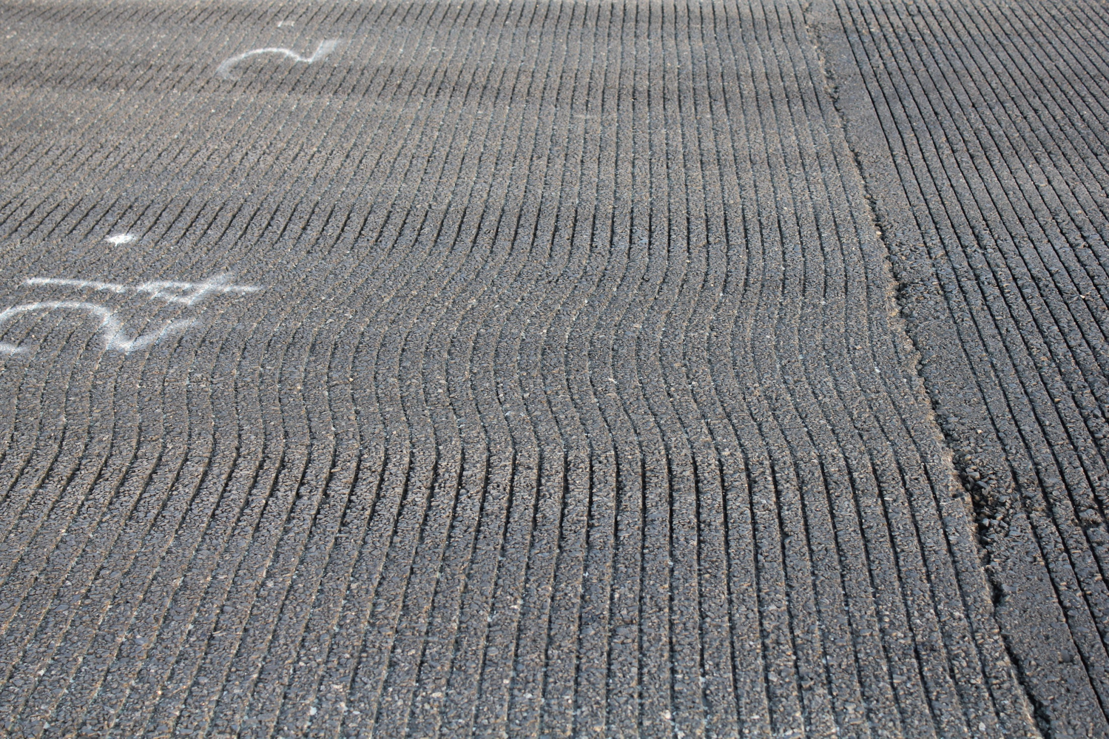

Slide 7
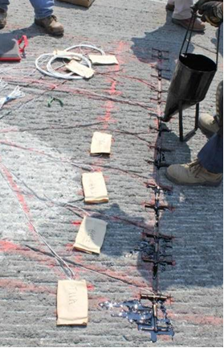
Installation of Asphalt Strain Gages
Base layer strain gages are embedded in the milled surface
Overlay gages are placed on top of the milled surface
All wires are connected in lighting cans

Slide 8
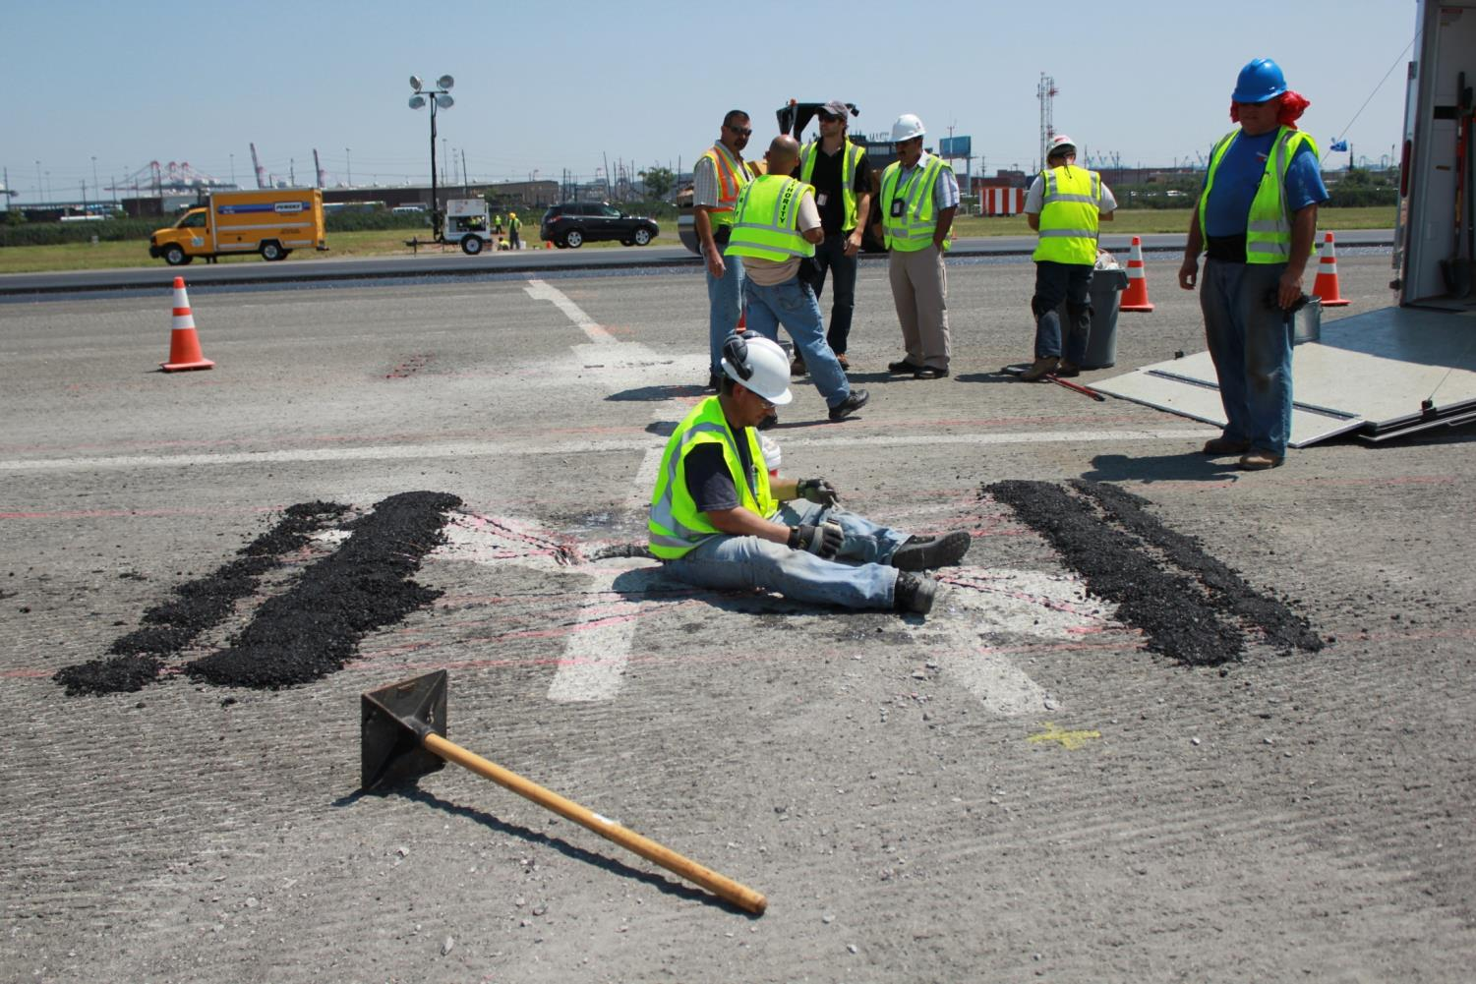

Slide 9
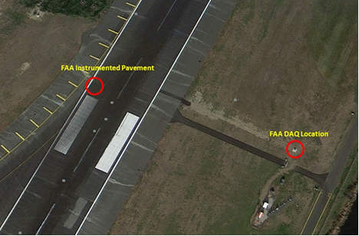
Newark Strain Gage Installation Location
High-Speed Taxiway N of Newark Liberty International Airport

Slide 10
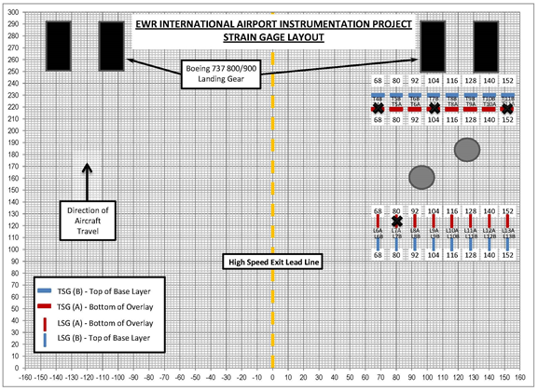
Strain Gage Layout at EWR

Slide 11
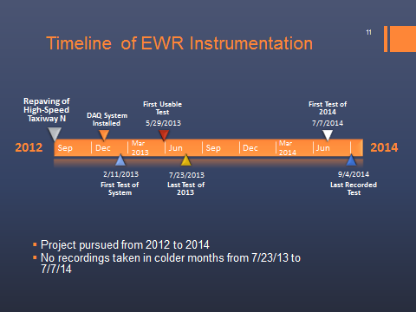

Slide 12
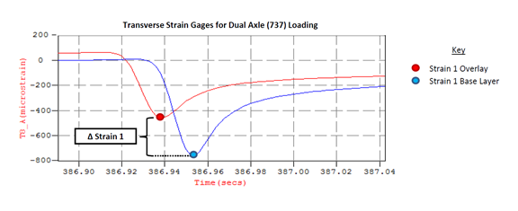
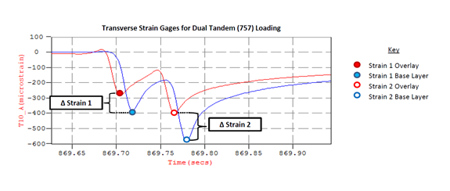
Cataloguing Transverse Strain Gage Responses
Transverse Dual Wheel (wheel away from gage pair, no delamination evidence)
Transverse Dual Tandem (wheel away from gage pair, no delamination evidence)
←Tension Compression→
←Tension Compression→

Slide 13
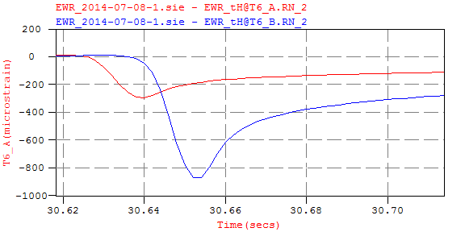
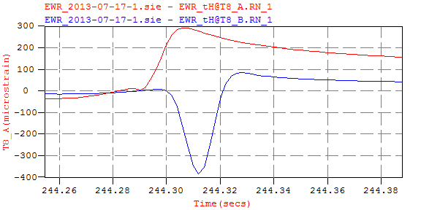
Delamination Evidence in Strain Responses
Early indications: large discrepancy between responses but no inversion.
Can be a clue that delamination is starting to occur, but is not analyzed as delamination evidence.
Delamination evidence: bottom of overlay gage in tension (A), top of base layer gage in compression (B), very high ΔStrain value.
Overlay
Base Layer
←Tension Compression→
Overlay
Base Layer
←Tension Compression→

Slide 14
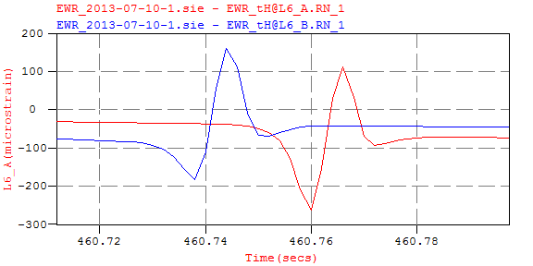
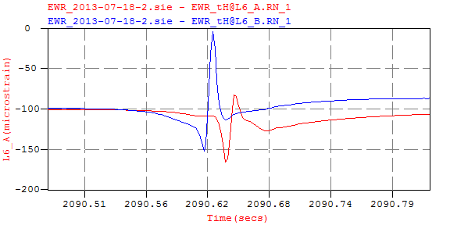
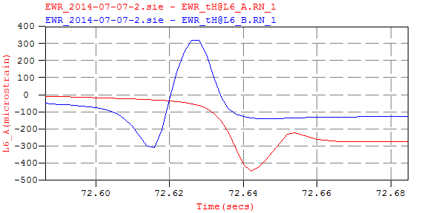
Progression of Delamination: LSG-6
Overlay
Base Layer
Overlay
Base Layer
←Tension Compression→
←Tension Compression→
No Delamination
Early Indications
Top left: July 10th, 2013
Top right: July 18th, 2013
Bottom right: July 7th, 2014
Overlay
Base Layer
←Tension Compression→
Delamination

Slide 15
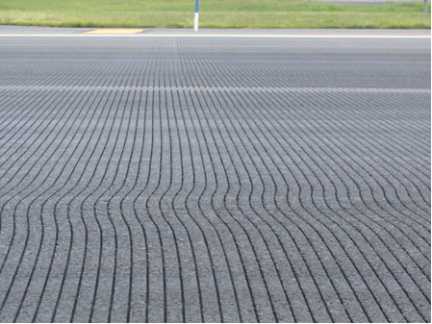
Courtesy of PANYNJ 2014

Slide 16
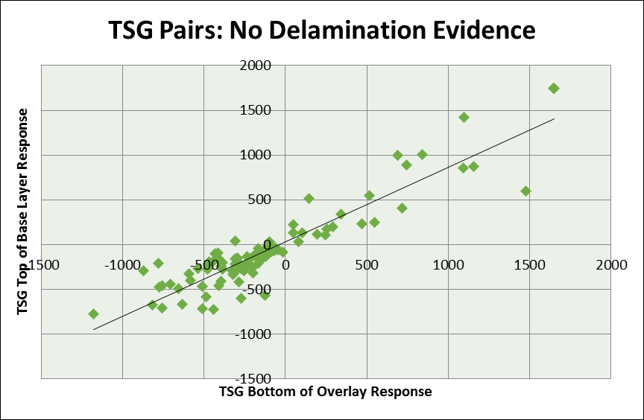
Transverse ASG Responses with No Delamination Evidence
← Compression Tension →
Correlation = 0.92
← Compression Tension →

Slide 17
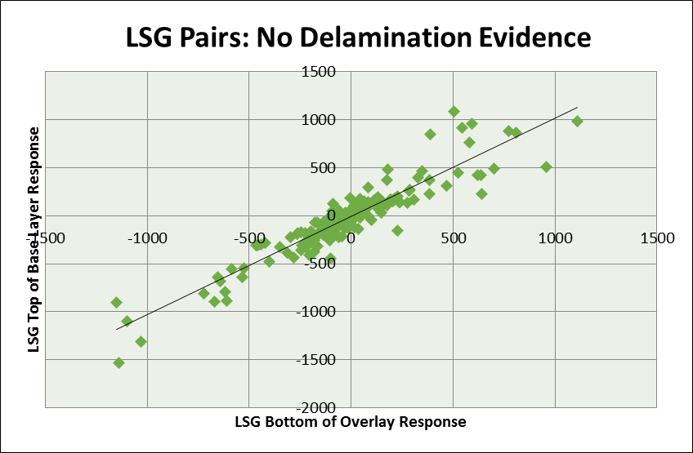
Longitudinal ASG Responses with No Delamination Evidence
← Compression Tension →
← Compression Tension →

Slide 18
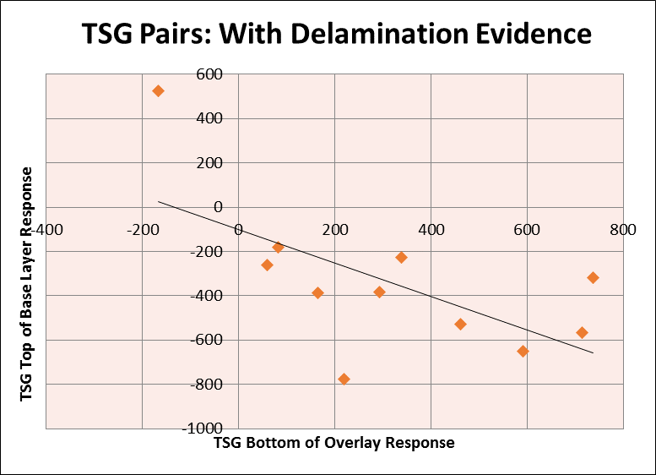
Transverse ASG Responses with Delamination Evidence
← Compression Tension →
← Compression Tension →

Slide 19
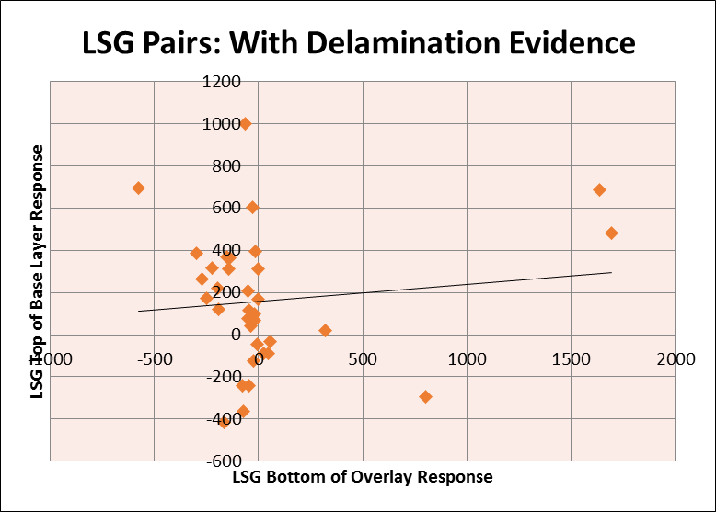
Longitudinal ASG Responses with Delamination Evidence
← Compression Tension →
← Compression Tension →

Slide 20
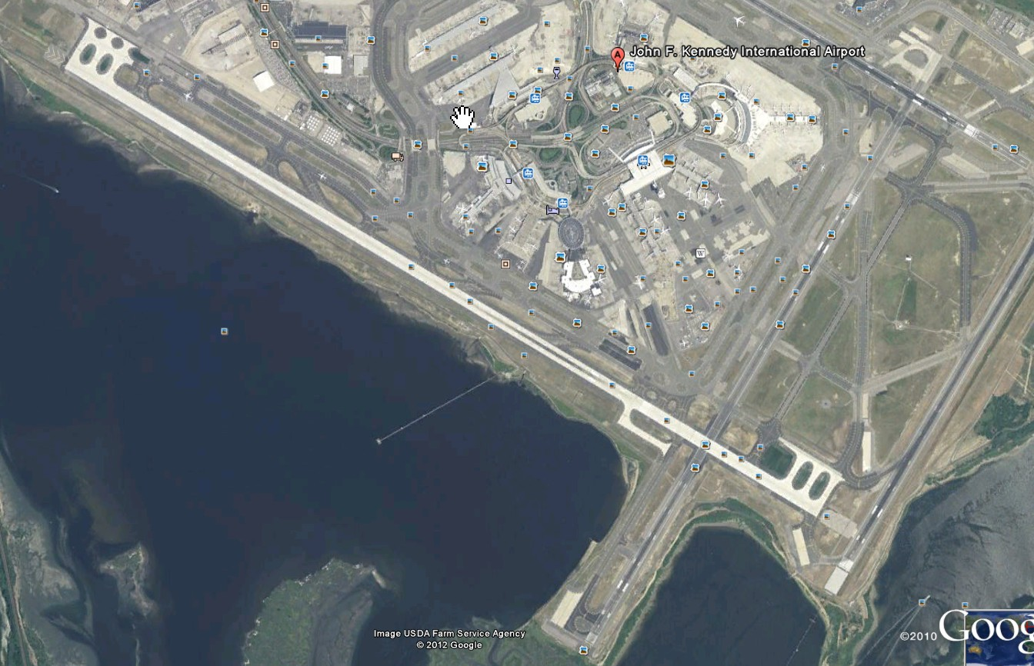
JFK Runway 13R-31L Reconstruction Project
4,443 m long, 61 m wide
Completed in 2 phases
Taxiway-Z

Slide 21
PROJECT SPECIFIC OBJECTIVES
Study curling in slabs (wet-freeze climatic region)
Measure total strain and load induced strain in slabs under multi-gear aircraft such as A-380, B-777, B-747, etc.
Measure load induced strain at an offset under multi-gear aircraft such as A-380, B-777, B-747, etc.

Slide 22
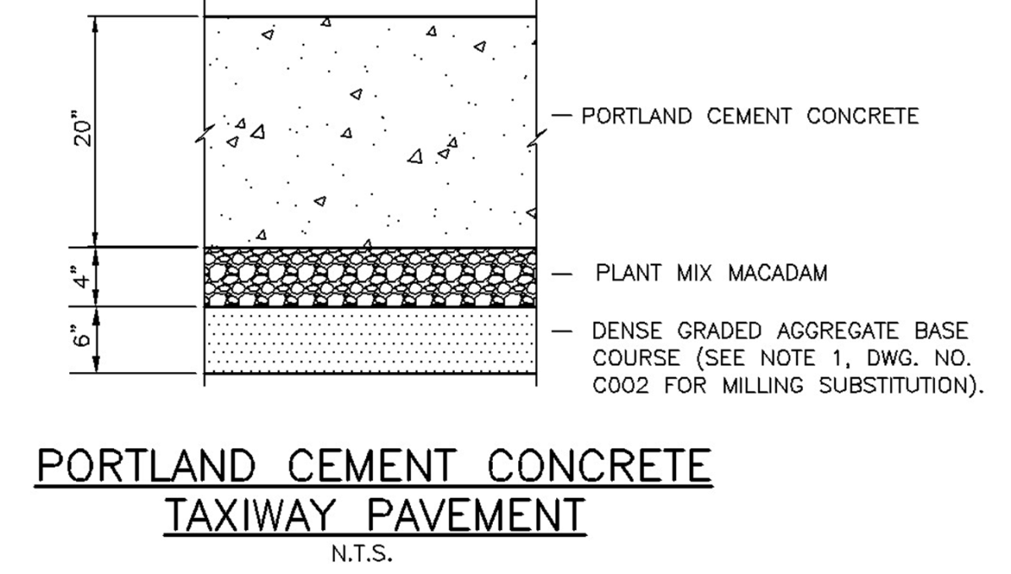
RUNWAY 13R-31L RECONSTRUCTION PROJECT

Slide 23
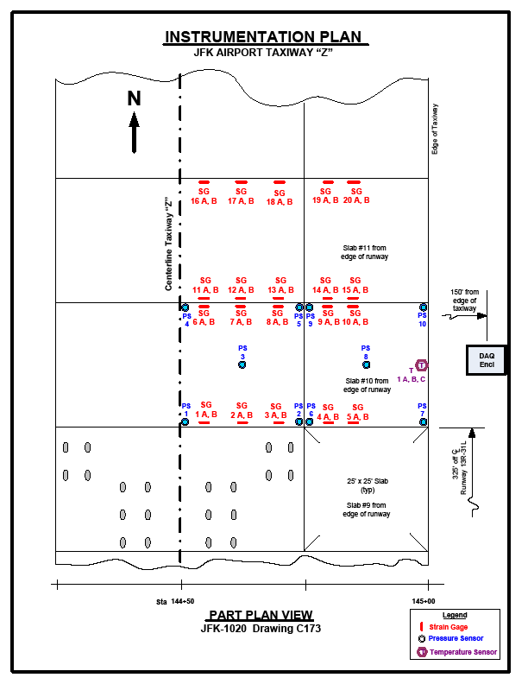
SENSOR LAYOUT
Slab Size: 7.62 m x 7.62 m
48 strain gages
10 Pressure Cells
Temperature Gages

Slide 24
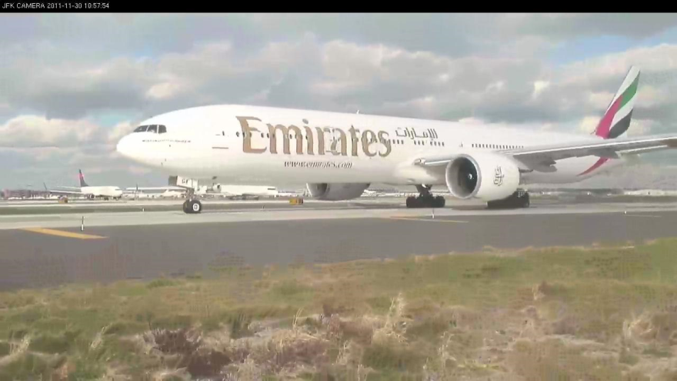
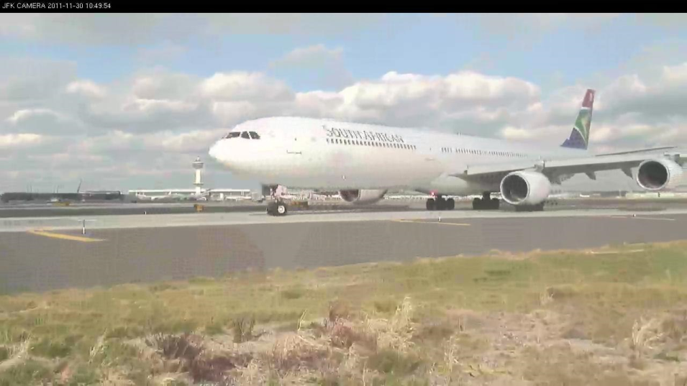
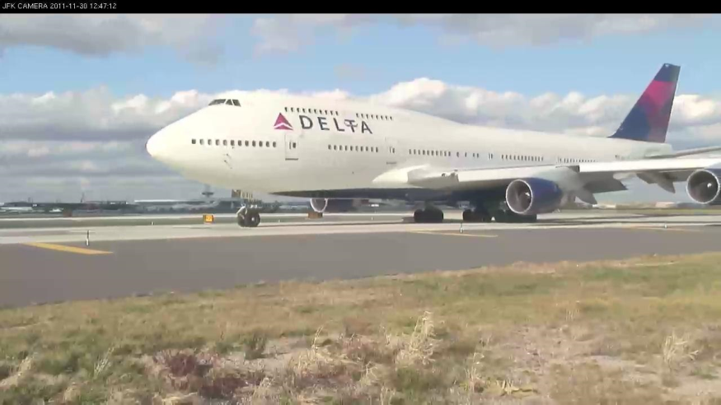
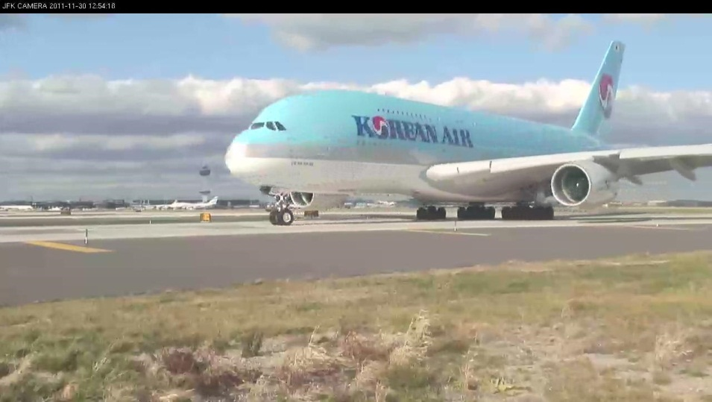
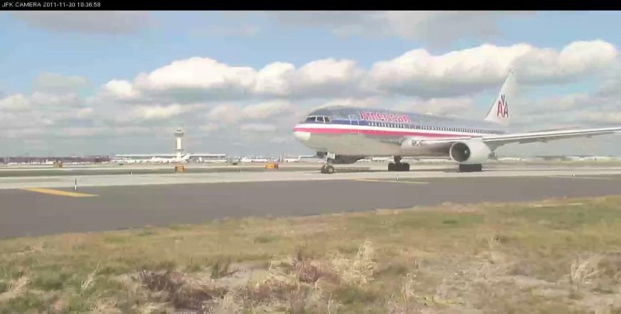

Slide 26
28 με (T)
31 με (T)
23 με (T)

Slide 27

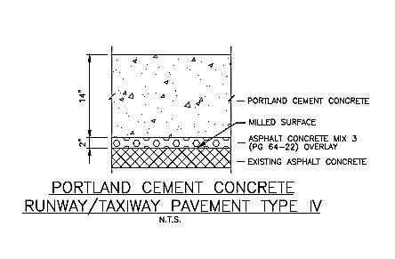
RUNWAY 4L-22R RECONSTRUCTION PROJECT
PCC Slab Thickness using
FAA Standard Flexural Strength (700 psi)
PCC Slab Thickness using 950 psi
(Mean – 1 Std. Dev.) Flexural Strength

Slide 28


JFK Runway 4L-22R RSA Compliance/Runway
Reconstruction Project
Taxiway-J
2015
Taxiway-Z Instrumented
In 2010

