Slide 1
40-Year Design Life Initiative (Updates)
RPD 145
REDAC Subcommittee on Airports
David R. Brill, P.E., Ph.D.
April 1, 2015

Slide 2
Pavement Design and Evaluation
(RPD 145)
Contract Funds ($K)

Slide 3
Project:
Doubling Pavement Life to 40 Years
FY 2017 Spending Plan:
Task | Planned ($K)
Performance Model Development | 300
PA40 Database Integration | 300
Field and Full-Scale Test Data Analysis | 100
Integrate Design and LCCA Models (Programming Tasks) | 200
Total | 900

Slide 4
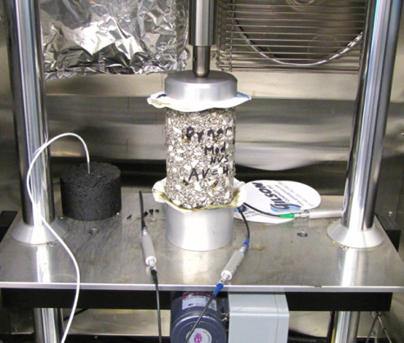
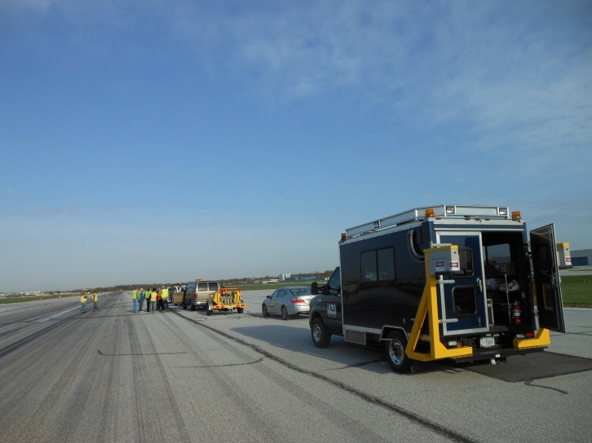
40-Year Pavement Life Extension
Runway data collection.
  4-year project - in year 3.
  Construction and performance data on medium- and large-hub runway pavements.
  Field data collection.
FAA PAVEAIR database development (PA40).
Pavement life model development.

Slide 5
Runway Data Collection
4-year project began in 2012 to collect extensive construction and performance data on a selection of medium- and large-hub runway pavements.
  Goal is to support development of 40-year life standards.
  Split between existing runways with approximately 20 years (or more) of service and new AIP-funded projects.
  Both flexible and rigid runways.
  A subset of selected airports will be visited for comprehensive field data collection.
Year 1 and 2 runway data collection is complete.
Current efforts focus on populating the databases.

Slide 6
Updated Runway List
Airport Code | Airport Name | Runway | Pavement / Age | Field Testing | Subcontractor | Comments
Asphalt Runways, >20 years
CMH | Port Columbus International | 10L-28R | Flexible / >20 | PCI / FWD / Inertial Profiler & SurPro | ARA | Prelim
BOS | General Edward Lawrence Logan Intl. | 04L-22R | Flexible / >20 | PCI / FWD / Inertial Profiler | Gemini | Prelim
BWI | Baltimore–Washington International | 10-28 | Flexible / >20 | PCI / FWD / Inertial Profiler & SurPro | ARA
TUS | Tucson International | 11L-29R | Flexible / >20 | No | Gemini
SFO | San Francisco International | 10L & 10R | Flexible / >50 | No | ARA
DCA | Ronald Reagan Washington National | 1-19 | Flexible / 40 | No | Gemini
LGA | LaGuardia | 4-22 | Flexible / >20 | No | ARA
SLC | Salt Lake City International | 16L-34R | Flexible / >20 |  | ARA
MCI | Kansas City International | 9-27 | Flexible / >30 | No | ARA | Med Hub
Concrete Runways, >20 years
IAD | Washington Dulles International | 01R-19L | Rigid / >20 | PCI / FWD / Inertial Profiler | Gemini | Prelim
IND | Indianapolis International | 5R-23L | Rigid / 23 | PCI / FWD / Inertial Profiler & SurPro | Gemini
SEA | Seattle-Tacoma International | 16C-34C | Rigid / >20 | No | ARA
LAX | Los Angeles International | 6R-24L | Rigid / 26 | No | Gemini
MCO | Orlando International | 17R-35L | Rigid / 24 | No | ARA
SLC | Salt Lake City International | 16R-34L | Rigid / 29 |  | ARA
DEN | Denver International | 17L-35R | Rigid / 19 | No | ARA
ATL | Hartsfield–Jackson Atlanta Intl. | 9L-27R | Rigid / >20 | No | ARA
DFW | Dallas/Fort Worth International | 18L-36R | Rigid / 40 | No | ARA
Asphalt Runways, <3 years
CMH | Port Columbus International | 10R-28L | Flexible / <3 | Inertial Profiler | ARA | Prelim
GSO | Piedmont Triad International | 5L-23R | Flexible / 3 | PCI / FWD / Inertial Profiler & SurPro | ARA | Small Hub
TUS | Tucson International | 03-21 | Flexible / <3 | No | Gemini
MIA | Miami International | 12-30 | Flexible / <1 |  | ARA
Concrete Runways, <3 years
SEA | Seattle-Tacoma International | 16R-34L | Rigid / <3 | PCI / FWD / Inertial Profiler | ARA | Prelim
ORD | Chicago O'Hare International | 10C-28C | Rigid / <1 | PCI / FWD / Inertial Profiler & SurPro | Gemini
IAD | Washington Dulles | 01C-19C | Rigid / <3 | No | Gemini
IAH | George Bush Intercontinental | 9-27 | Rigid / <3 | No | ARA
FLL | Fort Lauderdale–Hollywood Intl. | 10R-28L | Rigid / <1 |  | ARA

Slide 7
RUNWAYS FOR DATA COLLECTION - PHASE III
Site | Field Test | Airport | Hub | LTTP Climatic Region | Surface Type | Runway(s) | Age | Status
1 | Yes | Fort Lauderdale FLL | Large Hub | Wet-No Freeze | New PCC | 10R/28L, (8,000 x 150 ft) | Opened 18 Sept 2014 | Field Work Completed 2/15
2 | Yes | Miami MIA | Large Hub | Dry-Freeze | New AC | 12-30 | O/L 15 Sept. 2014 | Field Work Completed 2/15
3 | Yes | Salt Lake City SLC | Large Hub | Dry-Freeze | Old AC | 16L-34R (12,000 X 150 ft) | >30 years; AC O/L 3 yrs ago | Field work completed November 2014
4 |  |  |  |  | Old PCC | 16R-34L (12,000 X 150 ft) | 29 years
5 | No | Denver DEN | Large Hub | Dry-Freeze | Old PCC | 17L-35R (12,000 x 150 ft) | 19 years old; constructed in 1992; opened to traffic in Feb1995. | Coordinating to collect beam samples from RWY 17L-35R
6 | No | Kansas City MCI | Medium Hub | Dry-Freeze (on border with Wet-Freeze) | Old AC | 27 (9,500 x 150 ft) | > 30 years; no age for last O/L | Data collection ongoing
7 | No | Atlanta ATL | Large Hub | Wet No-Freeze | Old PCC | 9L-27R | Varies | Data collection ongoing
8 | No | Dallas-Ft Worth DFW | Large Hub | Wet No-Freeze | Old PCC | 18L-36R (13,400 x 200 ft) | 40 years old | Data collection ongoing

Slide 8
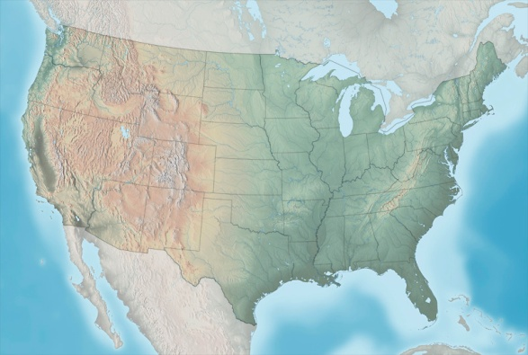

Year 1 Airport Locations
SEA
BOS
LGA
CMH
IAD
TUS
IAH
Large Hub
Medium Hub
Site designated for field data collection

Slide 9
Year 2 Airport Locations
ORD
IND
SFO
BWI
DCA
LAX
GSO
MCO
Large Hub
Medium Hub
Site designated for field data collection
Small Hub

Slide 10
Year 3 Airport Locations
SLC
DEN
MCI
ATL
DFW
Large Hub
FLL
Medium Hub
MIA
Site designated for field data collection

Slide 11
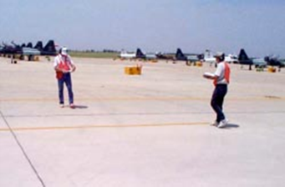
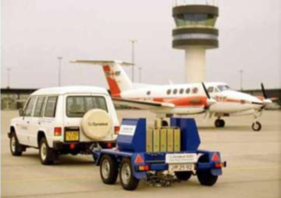
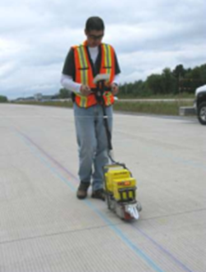
40-Year Life –
Runway Data Collection
All Airports
Design and construction data (with costs).
Maintenance activities and costs.
Pavement performance data. PCI, friction, roughness, groove condition, etc. Not limited to current fields in FAA PAVEAIR.
Traffic history (aircraft type, history, weight).
Field Data
PCI (visual survey).
Heavy Falling-Weight Deflectometer (HWD).
Material samples (concrete and asphalt) for laboratory characterization. Sample testing will be done at the NAPTF lab.
Longitudinal roughness profiles (SurPRO) & FAA portable profiler (if feasible).
Grooving (longitudinal texture) data.
Laser imaging by FAA (if feasible).

Slide 12
FAA PAVEAIR Implementation
Data collected falls into 2 categories:
  Exists in current FAA PAVEAIR (e.g., PCI, certain maintenance activities).
  Not in the current version of FAA PAVEAIR.
All collected data for the 40 year project will be stored in a dedicated, standalone FAA PAVEAIR implementation (“PA40”).
  Data are anonymized.
  No PA40 databases are accessible from the public FAA PAVEAIR implementation.
Enhanced functionality in PA40.

Slide 13
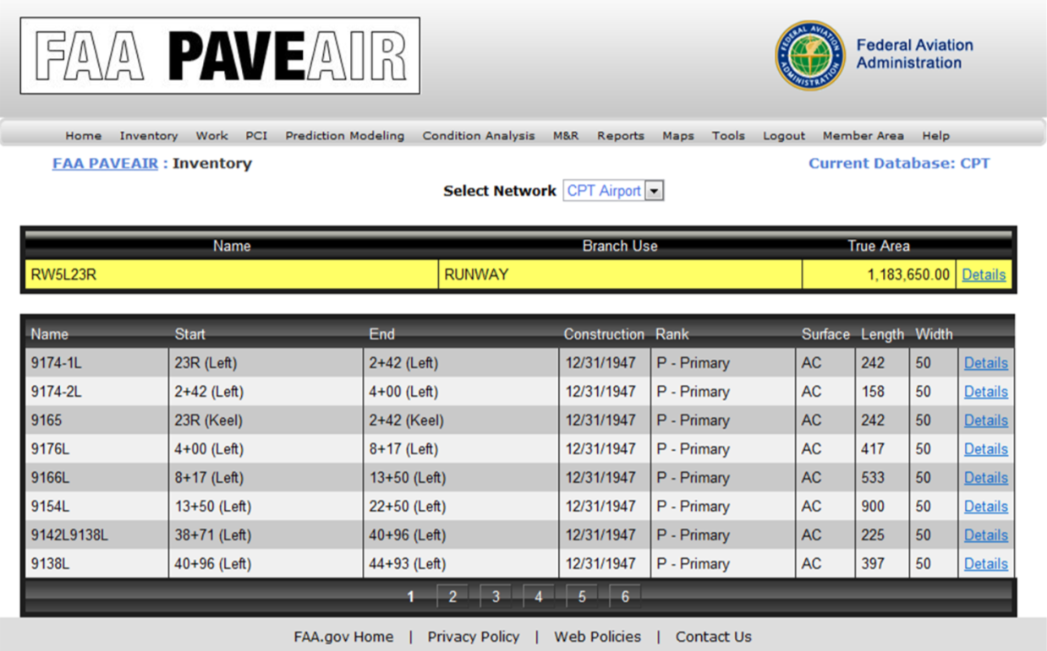
PA40 – PAVEAIR Databases
Enhanced Functionality
Fields for:
  HWD data, raw profile data, groove geometry data.
  Computed roughness indexes (ProFAA) and groove characteristics (ProGroove)
  Traffic data.
  Climate data.
  Structural layers and material properties.
Coordinate with FAA PAVEAIR development.

Slide 14
PA40 Organization Concept
Shaded area: Functionality in current FAA PAVEAIR
Functionality being added

Slide 15
PA40 – Current Work
Shaded area: Functionality in current FAA PAVEAIR

Slide 16
Traffic Data
Historical runway traffic data (as opposed to design traffic data) are generally not available from airport engineers.
Available data sources:
  Airport operations (ASDE-X).
  FAA PBN Observer Dashboard
  https://pbn.mitre.org/pbnservices/pbn/FaaObserver.html
Data are available only for some recent years.

Slide 17
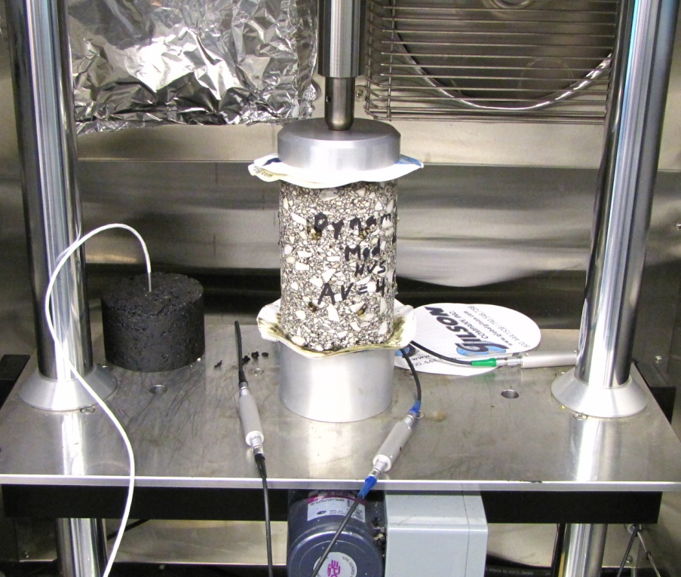
Laboratory Field Sample Testing
To date, material samples (both HMA and PCC) have been collected at 10 sites.
Material characterization testing is underway.
Most tests are being performed at the NAPTF lab by SRA personnel.
Some specialized tests (e.g., Hamburg rut test, binder extraction/analysis, PCC petrography) are being handled by outside labs.
Data being added to PA40.
Dynamic Modulus Test of Core from Greensboro RWY 5L-23R

Slide 18
Lab Test Summary
No. | Test | No. Samples | Location | Comments
HMA
1 | IDT Dynamic Modulus | (3) | NAPTF Lab | Samples Reusable
2 | Indirect Tensile (IDT) Strength | 4 | NAPTF Lab
3 | Flow Number | 3 | NAPTF Lab
4 | Asphalt Pavement Analyzer (APA) | 4 | NAPTF Lab
5 | Hamburg Wheel Traffic | 4 | Rutgers
6 | Mixture Contents | 4 | Rutgers
Total
PCC
1 | Free-Free Modulus | (20) | NAPTF Lab | Samples Reusable
2 | Coefficient of Thermal Expansion | 3 | NAPTF Lab
3 | Flexural Strength | (8) | NAPTF Lab | Beams (IND only)
4 | Compressive Strength | 5 | NAPTF Lab
5 | Split Tensile Strength | 7 | NAPTF Lab
6 | Petrographic Analysis | 5 | TBD | Estimated no.
Total |  | 20 (8)

Slide 19
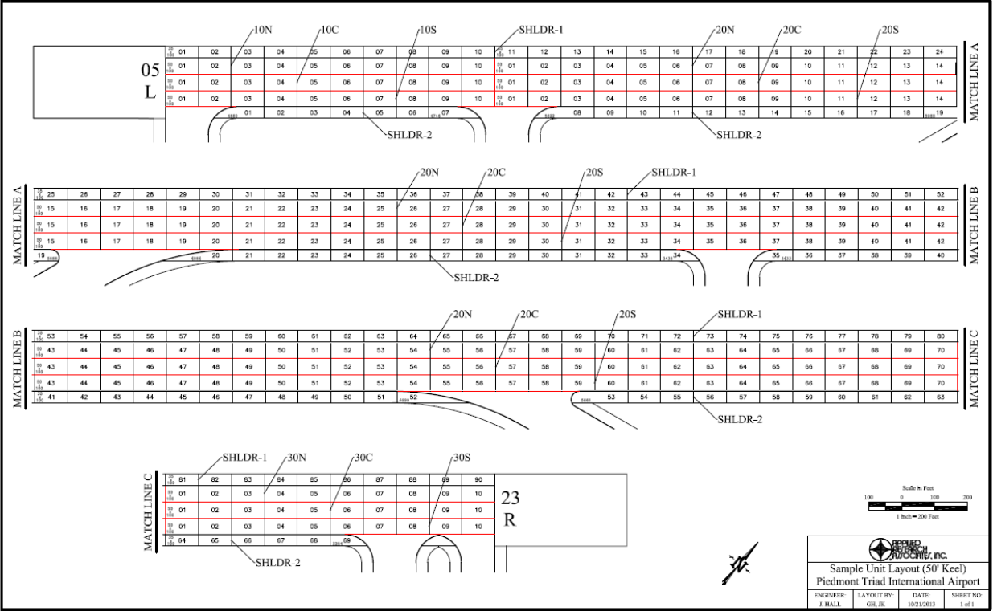
Example: GSO RWY 5L-23R
Core Locations
Drop Locations

Slide 20
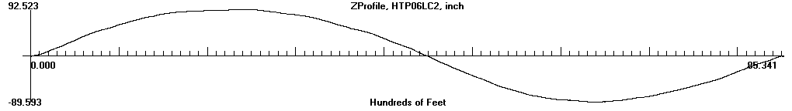
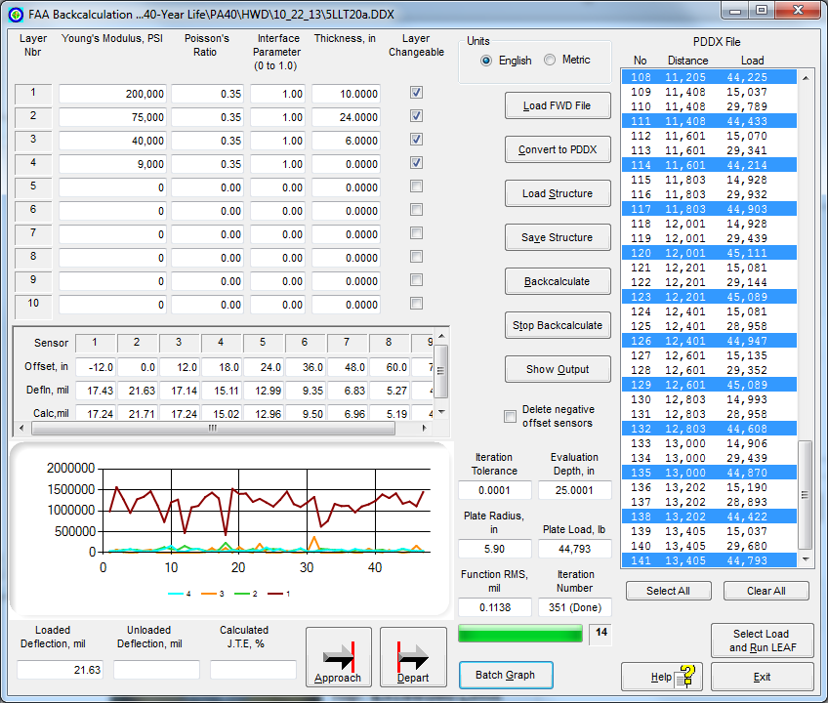
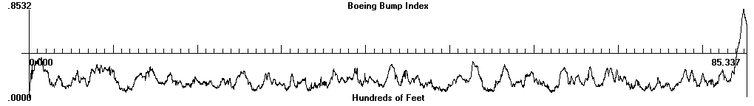
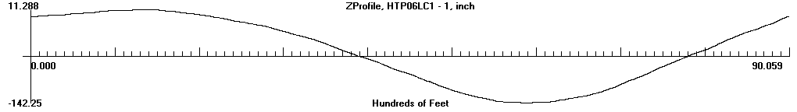
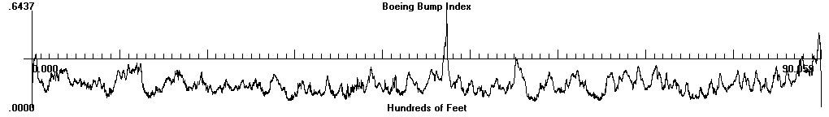
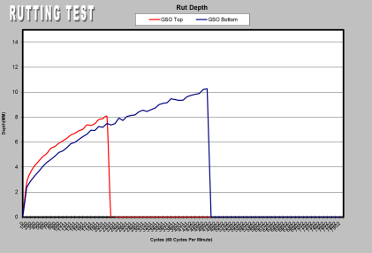
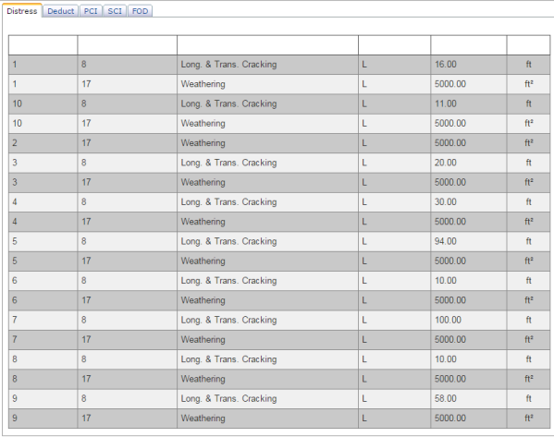
GSO RWY 5L-23R Index Values
Age of Runway < 3 Years
FAA Inertial Profiler: BBI = 0.1716
FWD Data
➔ Avg. ISM = 2011 kip/in.
SurPRO:
BBI = 0.1571
CORE C13
Section | PCI
10C | 90
10N | 92
10S | 91
20C | 91
20N | 94
20S | 93
30C | 94
30N | 94
30S | 94
Distress Survey ➔ PCI
CORE C14
APA Rut Test –
Rutting at 4000 Cycles:
Bottom: 9.51 mm
Top: Exceeded Limit

Slide 21
Developing New Performance Models
New performance models will relate design inputs to a future distress index (DL) incorporating structural and non-structural elements.
Current Design Procedures:
Inputs
  Structural Layers
  CBR or k-value
  Aircraft Traffic
  Concrete Strength (rigid)
Output
  Passes to structural failure*
  *defined as 2.5 cm upheaval for flexible pavements or 50% of slabs cracked for rigid pavements
40-Year Design:
Inputs
  Everything to the left, plus …
  Age, Climatic Data
  Soil/Material Properties
  Maintenance Data
  Airport Feature (runway, apron, etc.)
Outputs
  Passes to structural failure, plus …
  Roughness index prediction
  Surface friction prediction
  Other functional indexes

Slide 22
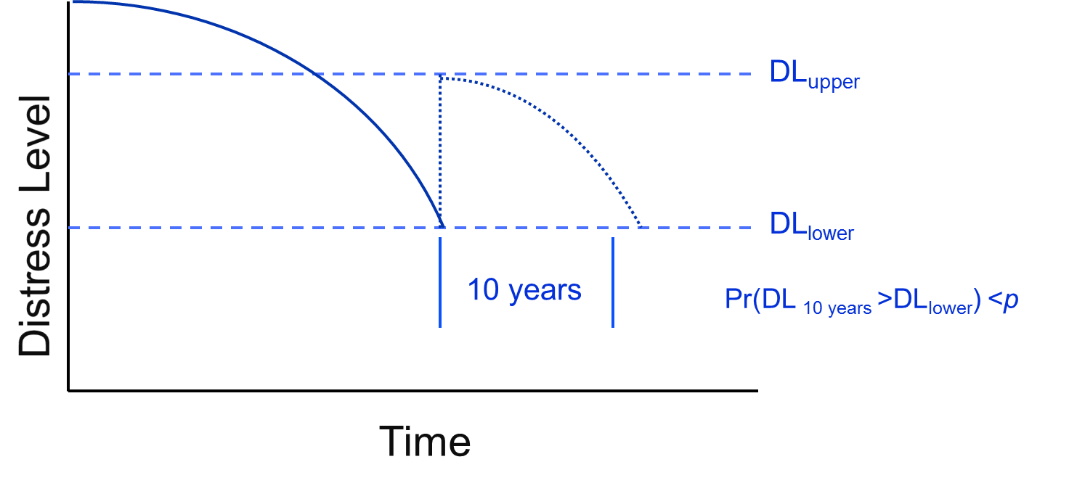
Pavement Life Definition
Graphical Representation
End of Serviceability
Based on ARA Presentation, January 2015

Slide 23
Pavement Life Definitions
Serviceability: Comparison of pavement’s actual behavior and performance to an expectation.
  Does this pavement do what we want?
  Not an inherent property since it is a comparison.
Distress Level (DL): A quantification of serviceability to enable repeatable assessment and comparison of pavement.
End of Serviceability: The point in time when a pavement no longer meets expectations.

Slide 24
Pavement Life Definitions
Serviceability: Comparison of pavement’s actual behavior and performance to an expectation.
  Does this pavement do what we want?
  Not an inherent property since it is a comparison.
Distress Level (DL): A quantification of serviceability to enable repeatable assessment and comparison of pavement.
End of Serviceability: The point in time when a pavement no longer meets expectations.
End of Life: The point in time when a pavement is not serviceable and cannot be made serviceable (for 10 more years) through maintenance or repair.

Slide 25
Reconstruction and End of Life
Pavement is at its end of life if LCCA shows reconstruction is the optimum solution.
LCCA recommending anything less than complete replacement does NOT indicate the end of pavement life.
  There is value left in place.
  If you aren’t completely removing it, there must be some contribution to serviceability remaining.

Slide 26
Revised Definition of Pavement Full Reconstruction (SME Group)

Slide 27
Distress Level Formulation
DL quantifies serviceability. Therefore it must address three independent components of serviceability:
  Smooth ride (roughness).
  Provide tractive surface (friction).
  No loose pieces (FOD).
DL = f(friction, roughness, FOD)
Mathematical requirements: terms not strictly additive.
  Failure can be due to any one or a combination of components.
  Two “halfway failed” indices may not mean failure.
  Two “nearly failed” indices may mean a pavement is failed.
In general:
Note that structure is not explicitly part of DL, but is used in predicting the components.

Slide 28
Distress Level, End of Life, and LCCA
DL should contain enough information for LCCA.
DL_{lower} indicates pavement is no longer serviceable and maintenance is required.
Multiple treatments are considered for pavement at DL_{lower} during an iterative LCCA.
  Treatments that cannot raise DL to at least DL_{upper} are discarded.
  Treatments that cannot maintain DL above DL_{lower} reliably for 10 years or more are discarded.
  If complete reconstruction is optimum according to LCCA, end of serviceability is the end of life.

Slide 29
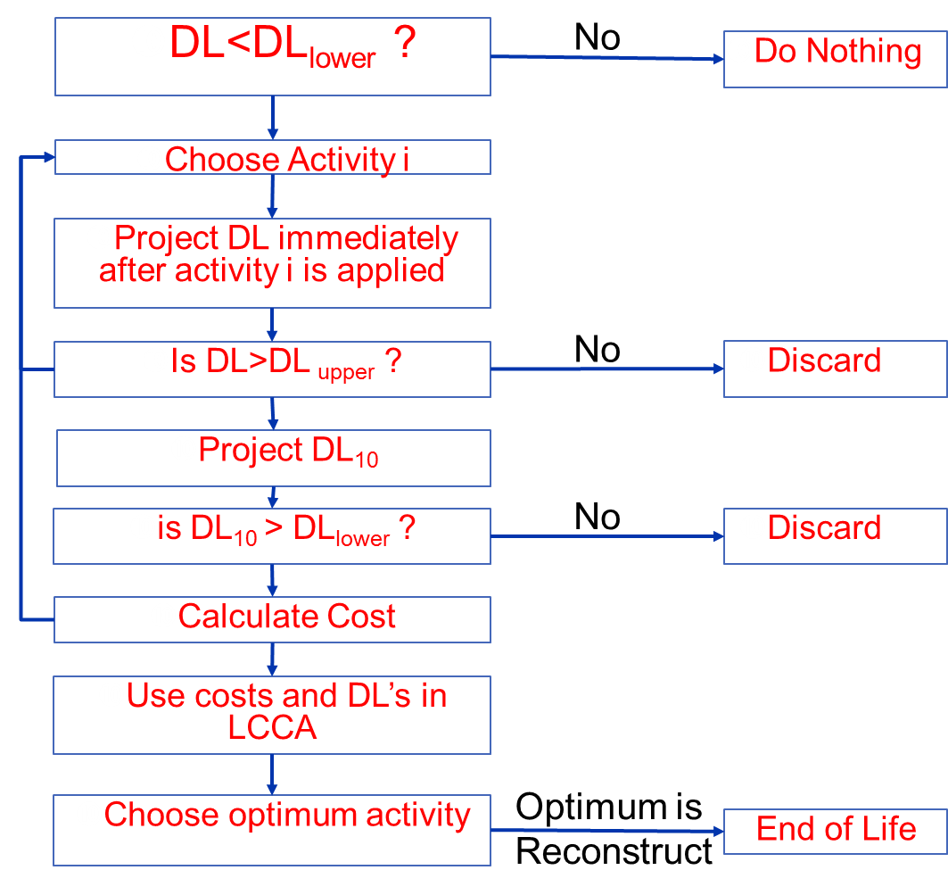
Flowchart

