Slide 1
Airport Technology R&D Branch
Airport Safety Section
Wildlife Hazard Mitigation R&D
REDAC Subcommittee
Ryan King
March 31, 2015

Slide 2
Outline
WiSC
HITL
Avian Perception for Avoidance
AN/TPQ-49 – BSTARS
Airport and Weather Radars
Optical Sensors
Multi-Sensor Integration
(Time Permitting – Other stuff)

Slide 3

Bird Radar in
Air Traffic Control Applications
Wildlife Surveillance Concept

Slide 4
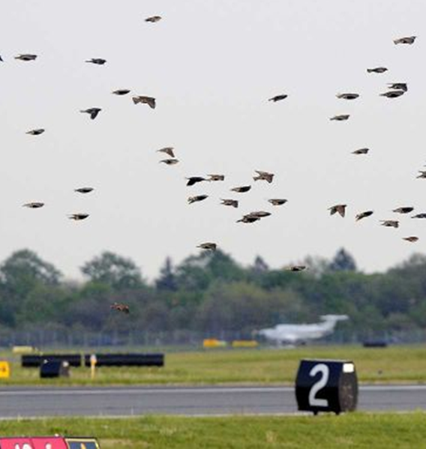
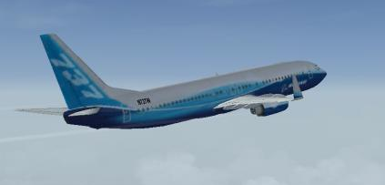
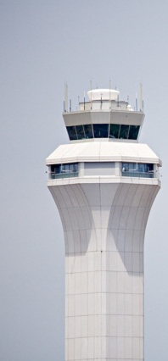
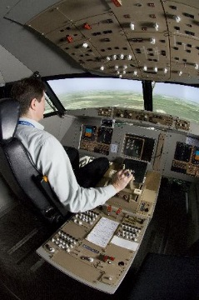
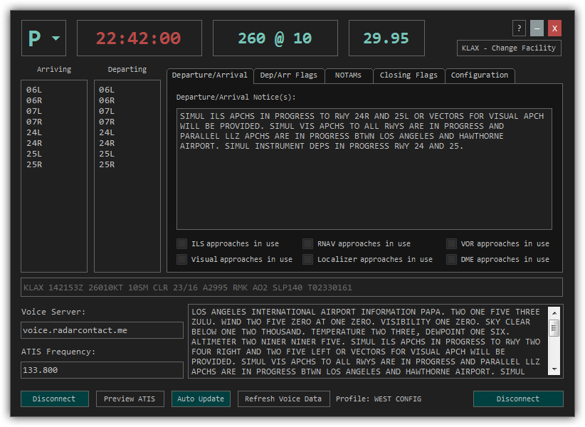
As-Is Operations
Bird Activity
Today
Verbal
Comm.
Visual
Observation
Pilot
Tower Personnel
Airport Ops
Wildlife Biologist
ATIS

Slide 5
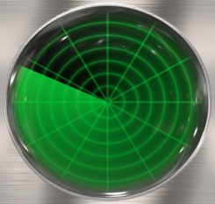
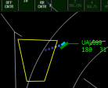
As-Is Operations
Bird Activity
Today
Verbal
Comm.
Visual
Observation
Pilot
Tower Personnel
Airport Ops
Wildlife Biologist
Bird
Threat
Display
Avian Radar
.
ATIS
Radar
Observation
.
.
.
.
.
.
.
WiSC
Diagram Adapted from FAA Graphic

Slide 6
Wildlife Surveillance Concept
Human-in-the-Loop Simulation
3/17/15 – 3/26/15

Slide 7
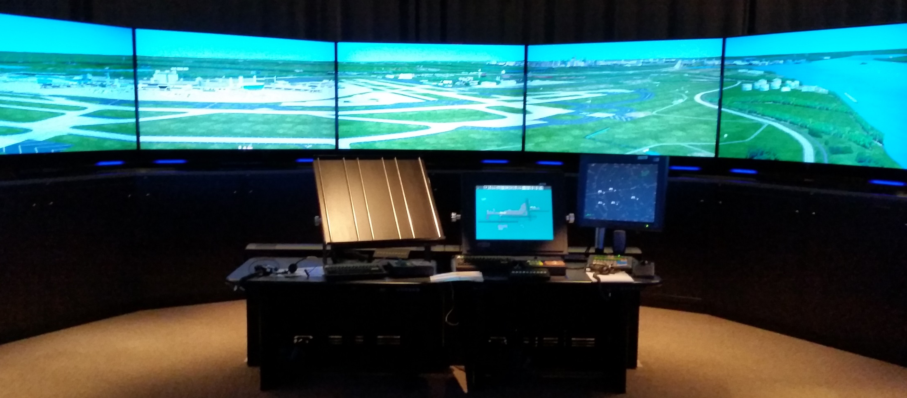
Air Traffic Control Tower Simulator

Slide 8
Experimental Conditions
Baseline (PIREPS)
  Simulating current operations. Pilots will report bird activity.
WiSC Target
  Avian radar information provided as a target on radar display.
WiSC Text
  Avian radar information provided as text on radar display.
WiSC Supervisor
  Avian radar information passed from supervisor to controller.

Slide 9
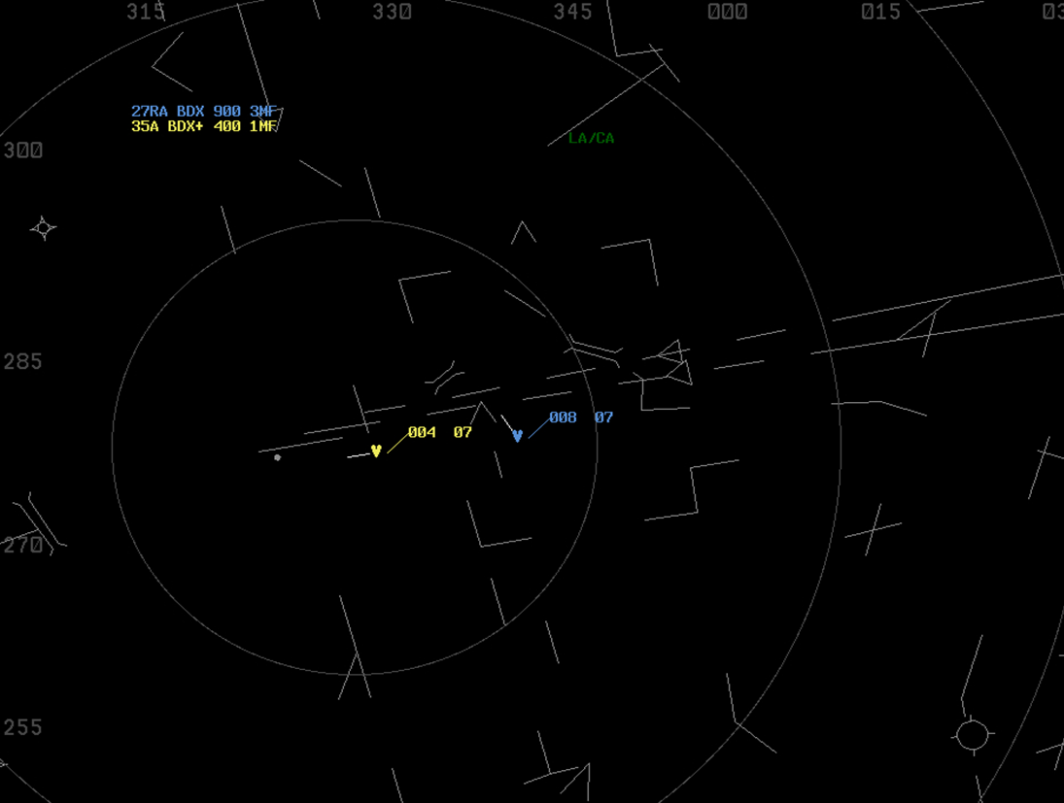
WiSC Target Interface
Position symbol provides precise location information
Color coded by threat level (yellow = more significant)
Direction of flight line
Altitude
Speed
Target disappears when no longer a threat

Slide 10

WiSC Text Interface
Significant Bird Activity
Bird Activity
“+”
  27RA BDX 900 3MF
  35A BDX+ 400 1MF
Blue Text
Yellow Text
Text appears on display when threat is present
Aural tone accompanies new text information
Threat level is coded by color and symbol (+)
Text disappears when no longer a threat

Slide 11
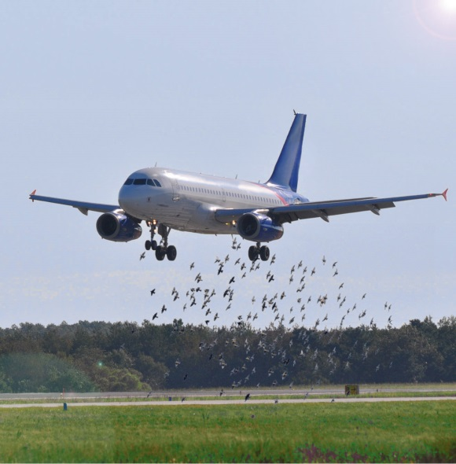
WiSC FY16/17 Plans
Concept Socialization
Benefits Case
  Using field data established via radar deployment at KSLC, and 12 months of bird activity data, build a benefits case i.e. before/after comparison
Participants
  CEAT University of Illinois – Radar Deployment
  ANG-C43 – Concept Socialization and Management
  MITRE – Benefits Case

Slide 12
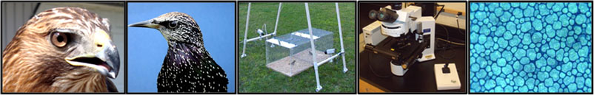
Perception
USDA/Purdue Univ.
Quantifying Visual Perception
  Excellent work on identifying a “sweet spot” of visual perception (pigment, spatial and temporal) for most damaging species and then tailoring conspicuous visuals cues for deterrence
    Detection
    Visual Attention
    Begin Response
    Avoidance
Integrate AVS into adoption and funding

Slide 13
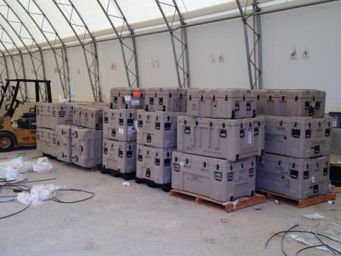
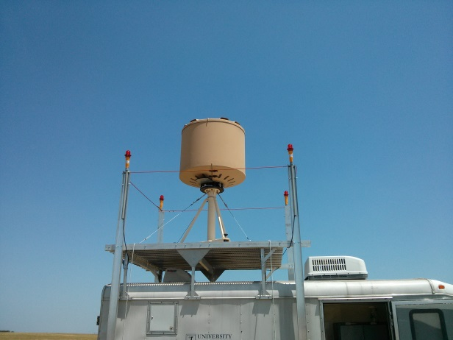
AN/TPQ-49 Radars
BSTAR
We acquired (10) AN/TPQ-49 LCMR Systems from US Army (Surplus) in July 2014
In support of WiSC
  Install @ KBOS
  Install @ KSLC

Slide 14
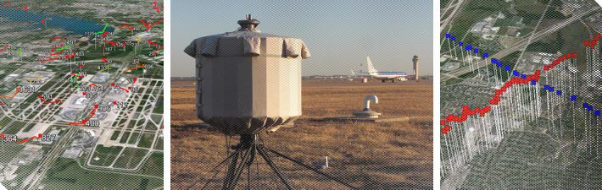
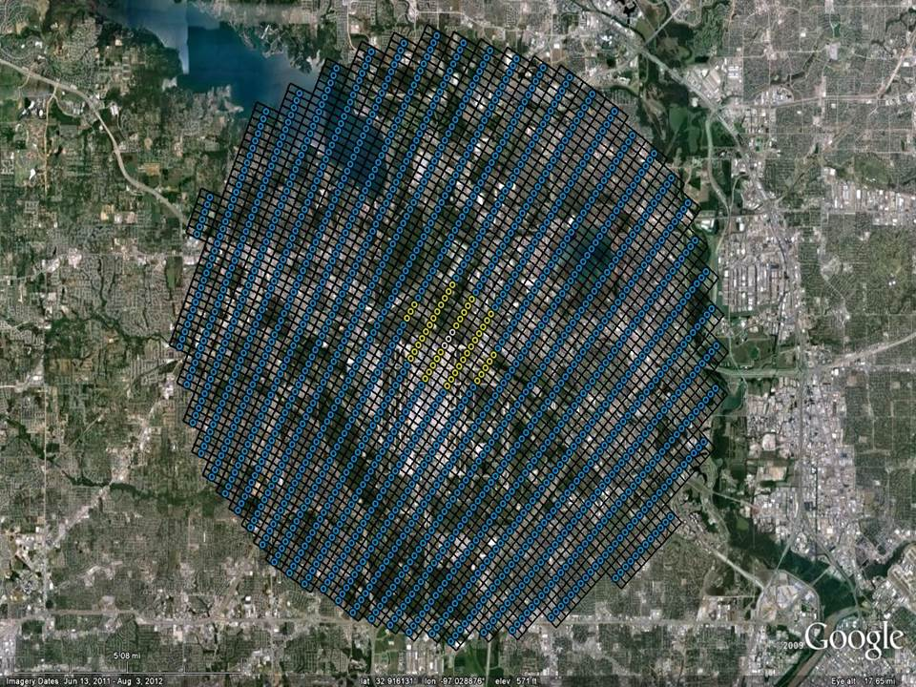
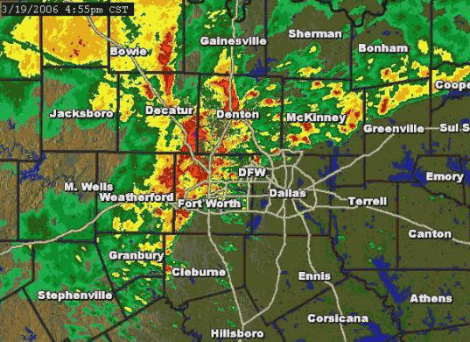
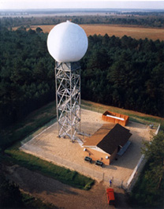
Bird/Weather Radars
Expanded Coverage
Local Airport Bird Radar
Terminal Doppler Weather Radar

Slide 15
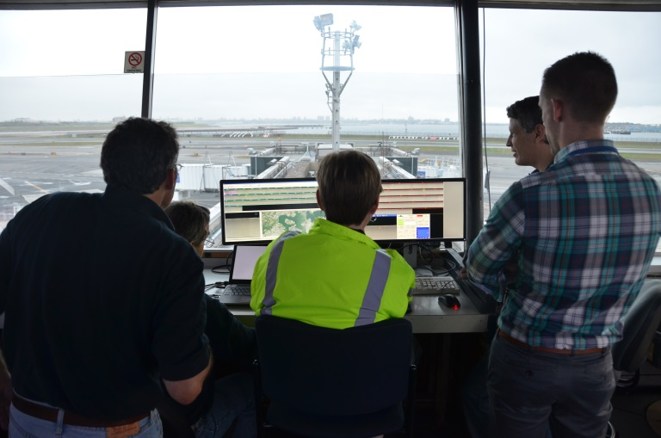
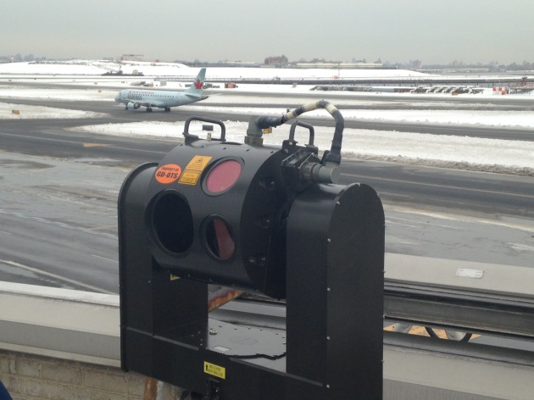
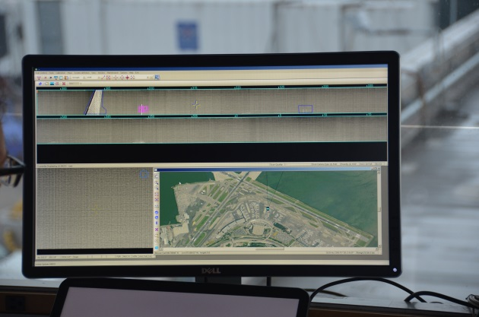
Optical Sensors
Demonstration at LGA
  (Oct. 2014 – Jan. 2015)
  Pharovision “INTERCEPTOR”
System Technical Assessment
  June 2015 – Oct. 2015
  Deployed at NASWI
Airport Operational Integration
  Deploy at KSLC
  Oct. 2015 – Oct. 2016
Draft Standards for Optical Sensors

Slide 16
Multi-Sensor Integration
FOD Sensors
Bird Sensors
Security Sensors
LCSS Sensors
ASDE-X Sensors
Weather
Sensors
Other
Sensors
ATC
Wildlife
Control
OPS
Security

Slide 17
For more information:
http://wildlife.faa.gov
Ryan King
ryan.king@faa.gov

Slide 18
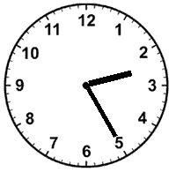
TIME PERMITTING
FOD DATA COLLECTION@ SAN ANTONIO

Slide 19
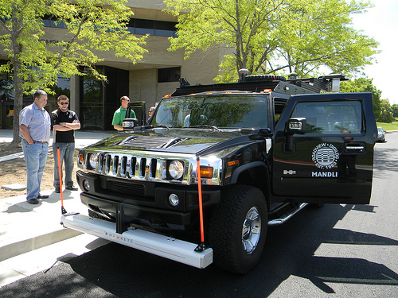
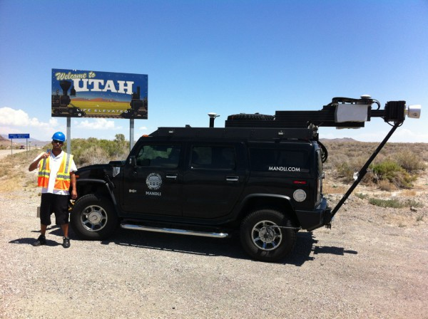
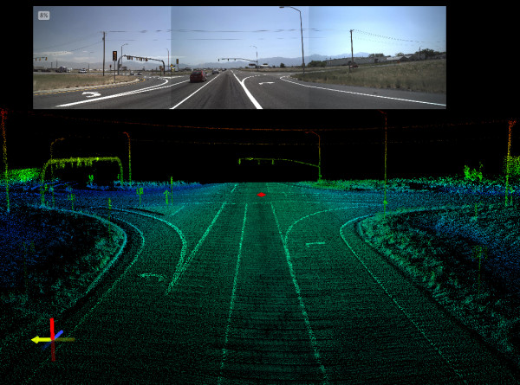
Mandli Testing
Mobile Foreign Object Detection System

Slide 20
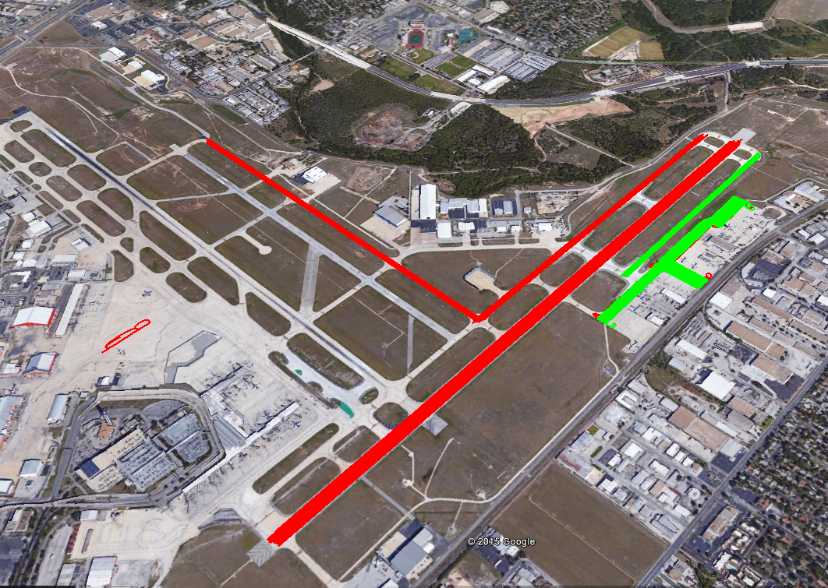
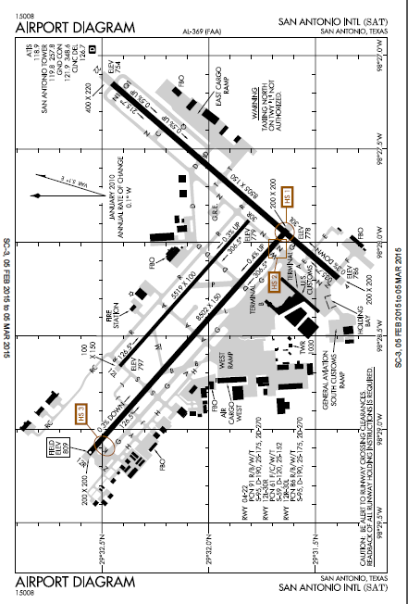
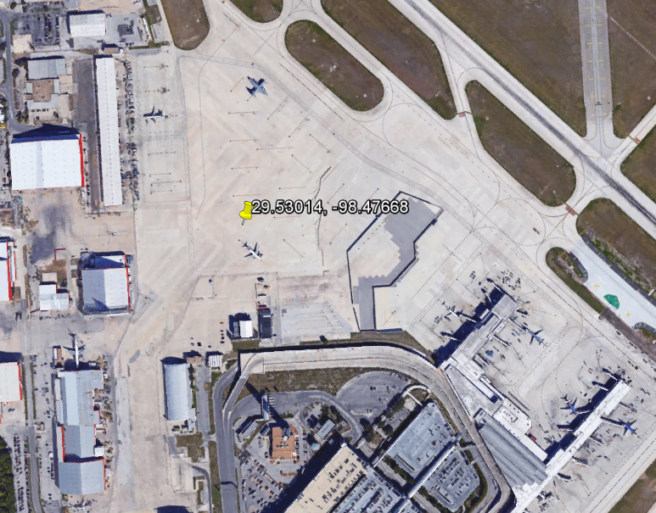
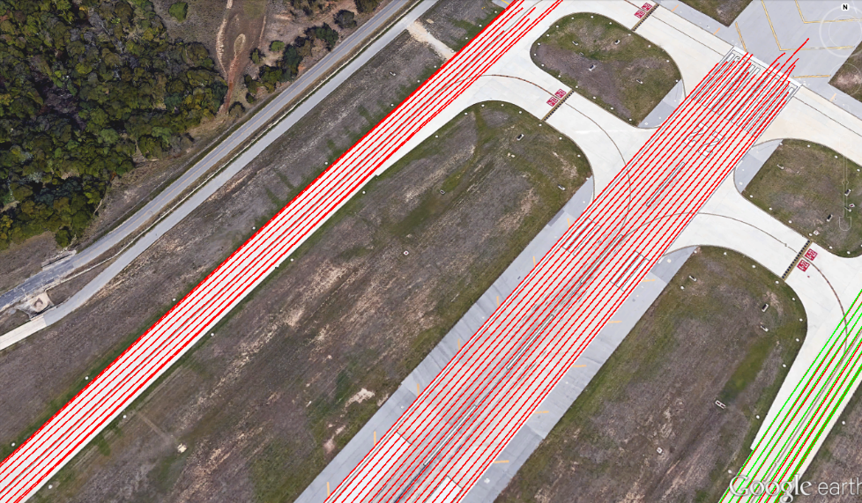
San Antonio Int’l Airport

Slide 21

CEAT Grid Schematic
117.3 in
Direction of Travel
18in to edge of vehicle
Test Run Speeds
15mph
25 mph
35 mph
Grid based on width of Hummer H2 at 81.3 in

Slide 22
Calibration Grid
117.3 in
Plastic Cylinders
Direction of Travel
Tethered Golf Balls
Test Run Speeds
15mph
25 mph
35 mph
Metal Cylinders
Tethered Golf Balls
Plastic Cylinders

Slide 23
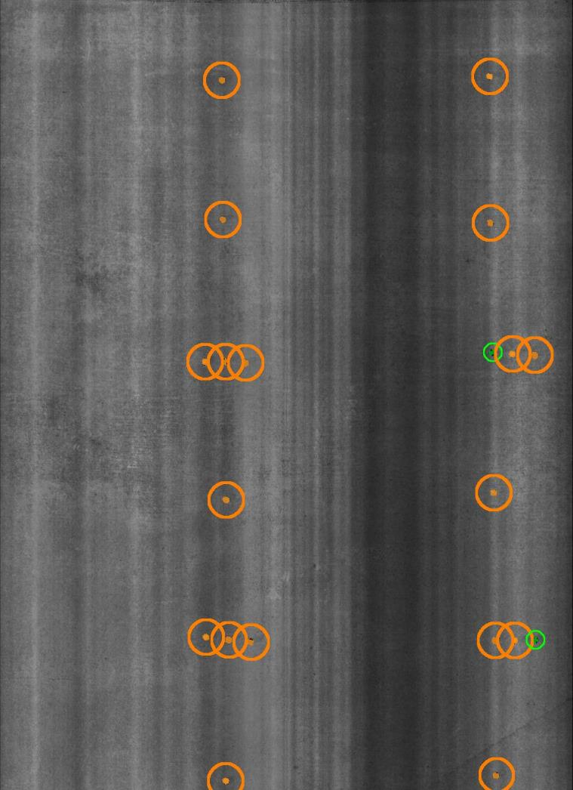
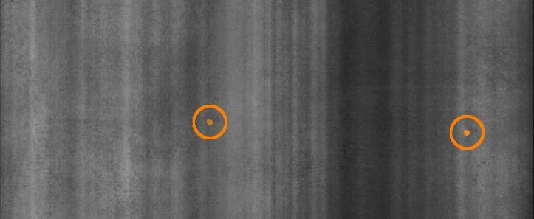
Run 1 – 15mph
Direction of Travel

Slide 24
Performance Tests Grid
Infrastructure Part
Roller Bearing
Small Fastener
Strapping Material
Water Bottle
Direction of Travel
Flat Metal Strip
Asphalt Chunk
AGL Light Piece
Concrete Chunk
Tall Lug Nut
Fiberglass Door Piece
Tire Chunk
Test Run Speeds
15 mph
25 mph
35 mph
Short Lug Nut
Rubber Chunk
Galvanized Screw
Wrench
Gas Cap
M10 Nut and Bolt
Hydraulic Line
Cotter Pin
Deep Socket
PVC Piece
Expansion Join Material
Bent Metal Strip

Slide 25
Performance Tests Results
Item | Number of Detections | Number of Placements | Detection Rate
AGL Light Piece | 6 | 6 | 100%
Asphalt Chunk | 6 | 6 | 100%
Bent Metal Strip | 6 | 6 | 100%
Concrete Chunk | 6 | 6 | 100%
Cotter Pin | 6 | 6 | 100%
Deep Socket | 5 | 6 | 83%
Expansion Joint Material | 6 | 6 | 100%
Fiberglass Door Piece | 6 | 6 | 100%
Flat Metal Strip | 2 | 6 | 33%
Galvanized Screw | 0 | 6 | 0%
Gas Cap | 6 | 6 | 100%
Hydraulic Line | 6 | 6 | 100%
Infrastructure Part | 6 | 6 | 100%
M10 Nut and Bolt | 6 | 6 | 100%
PVC Piece | 5 | 6 | 83%
Roller Bearing | 3 | 6 | 50%
Rubber Chunk | 6 | 6 | 100%
Short Lug Nut | 5 | 6 | 83%
Small Fastener | 0 | 6 | 0%
Strapping Material | 6 | 6 | 100%
Tall Lug Nut | 6 | 6 | 100%
Tire Chunk | 6 | 6 | 100%
Water Bottle | 6 | 6 | 100%
Wrench | 6 | 6 | 100%
Speed (mph) | Number of Detections | Number of Placements | Detection Rate
15 | 41 | 48 | 85%
25 | 41 | 48 | 85%
35 | 40 | 48 | 83%

Slide 26
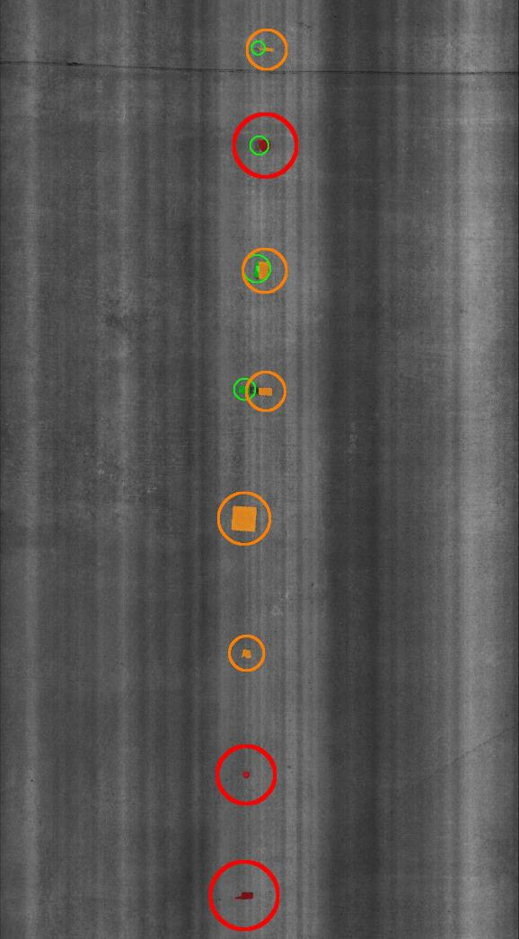
Blind Tests Grid
Screw Driver
Airplane Gas Cap
Bailer Belt
Direction of Travel
White Rubber Strip
Square Foam Board
Landing Light Clip
Runway Light Hex Bolt
Walkie Talkie

Slide 27
Blind Tests Results
Item | Number of Detections | Number of Placements | Detection Rate
Airplane Gas Cap | 6 | 6 | 100%
Bailer Belt | 6 | 6 | 100%
Landing Light Clip | 6 | 6 | 100%
Runway Light Hex Bolt | 6 | 6 | 100%
Screwdriver | 6 | 6 | 100%
Square Foam Board | 6 | 6 | 100%
Walkie-talkie | 6 | 6 | 100%
White Rubber Strip | 6 | 6 | 100%
Speed (mph) | Number of Detections | Number of Placements | Detection Rate
15 | 16 | 16 | 100%
25 | 16 | 16 | 100%
35 | 16 | 16 | 100%

Slide 28
System Function Notes
Mandli system Specifications
  Detect FOD as small as 2mm
  Vertical accuracy of 1mm
Speed of the vehicle needs to sync with the scan rate. If the vehicle is moving too fast it won’t detect the FOD.
The system uses laser crack measurement system and LIDAR.
System has 2 images one of which is the intensity (which is 2D)
Range measures distance from the ground to the sensor
Began testing at 8:20am
Prior to testing the area, cones were set out to signify the testing area. The image to the right shows the latitude and longitude of the corner of the CEAT grid. The testing area was on the seamless portion of the apron.
Mandli did several runs with the vehicle in order to automate the route for the auto drive feature of the vehicle.
Several runs with the Mandli system to align the grid correctly (Mandli may or may not include this with the data)
Mandli was not sure if the left column was within their detection area
Center of the grid for all testing was centered on the vehicle
All items were 18” from the edge of the vehicle
The Mandli system was utilized on the east ramp, indicated on the map
This scanning was to capture a “before” state prior to the quarterly FOD walk event scheduled for the following day.
The CEAT observer did not see any FOD and no FOD was apparent on the interior screen of the vehicle. However, the screen was small and the post-processing of data may show FOD.
Mandli system scanned Runway 4/22 beginning at midnight on Wed. and continuing into Thursday evening.
The runway was scanned with the vehicle moving at approximately 45mph, cruise control was not used
The auto-drive feature was utilized
The scanning of the entire runway was complete in less than 1.5 hours
An area without wet spots was found on the west ramp, indicated in the map. The dry pavement was necessary to perform the CEAT testing. The Mandli system does not function in rain.
CEAT testing (3hours)
  Calibration Testing (morning)
  Performance Testing (morning)
  Blind Testing
Quarterly FOD walk event (afternoon)
Mandli system scanned Runway 4/22 beginning at midnight on Wed. and continuing into Thursday evening.
The runway was scanned with the vehicle moving at approximately 45mph, cruise control was not used
The auto-drive feature was utilized
The scanning of the entire runway was complete in less than 1.5 hours

