Slide 1
RPD 155
Heated
Pavements
ANG-E REDAC Committee
Charles A. Ishee, P.E., Ph.D.
April 1, 2015

Slide 2
Presentation Outline
Current Projects
Future Projects
FY 2016 Plan
FY 2017 Plan
Questions

Slide 3
HEATED PAVEMENTS (RPD 155)
Outcomes
Greater Airport Operational Safety
Improved System Efficiency
Reduced Environmental Impact
Rationale
  The heated pavement project seeks to develop advanced materials, processes, and construction techniques to economically heat airport pavements for winter operations.
Projects
Contract Funds ($K)
 |  | FY15 | FY16 | FY17
Advanced Construction Techniques |  | $200
Advanced Materials for Heated Pavements |  | $300
Heated Pavement Construction at NAPTF |  |  | $650
Heated Pavement Construction at Airport |  |  |  | $1,000
 | TOTAL: | $500 | $650 | $1,000

Slide 4
Current Heated Pavement Projects
Greater Binghamton Airport
  Professor Bill Ziegler, University of Binghamton
Develop current economic analysis of heated pavements (Task 1A)
  Dr. Halil Ceylan, Iowa State University
Nano-Structured Superhydrophobic Pavement Surfaces (Task 1B)
  Dr. Halil Ceylan Iowa State University
Phase Change Materials for PCC Pavements (Task 1C)
  Dr. Jason Weiss, Purdue University
Advanced Construction Techniques for Heated Pavements (Task 1D)
  Dr. Halil Ceylan, Iowa State University
Phase Change Materials for HMA Pavements (Task 1E)
  Dr. Jason Weiss, Purdue University
Conductive Concrete for Airfield Heated Pavement
  Dr. Christopher Tuan, University of Nebraska - Lincoln

Slide 5
Greater Binghamton Airport
Construction to completed late May 2014
  Mechanical building has been built
  Geothermal wells (x20) have been drilled and heat piping field with water/glycol mixture
  All of the mechanical components and heat exchangers are tied together
After system was started, flow/pressure issue occurred
  Too much flow and instability when valves were restricted
  Variable frequency drives (VFD) had to be ordered and installed
  To be energized in the next couple of days
Grant requirements:
  In September, primary building chillers will be de-energized and system monitoring will begin
  System monitoring for operational cost and performance
  Data submitted on monthly basis
  Formal report of winter performance to be submitted in May 2015

Slide 6
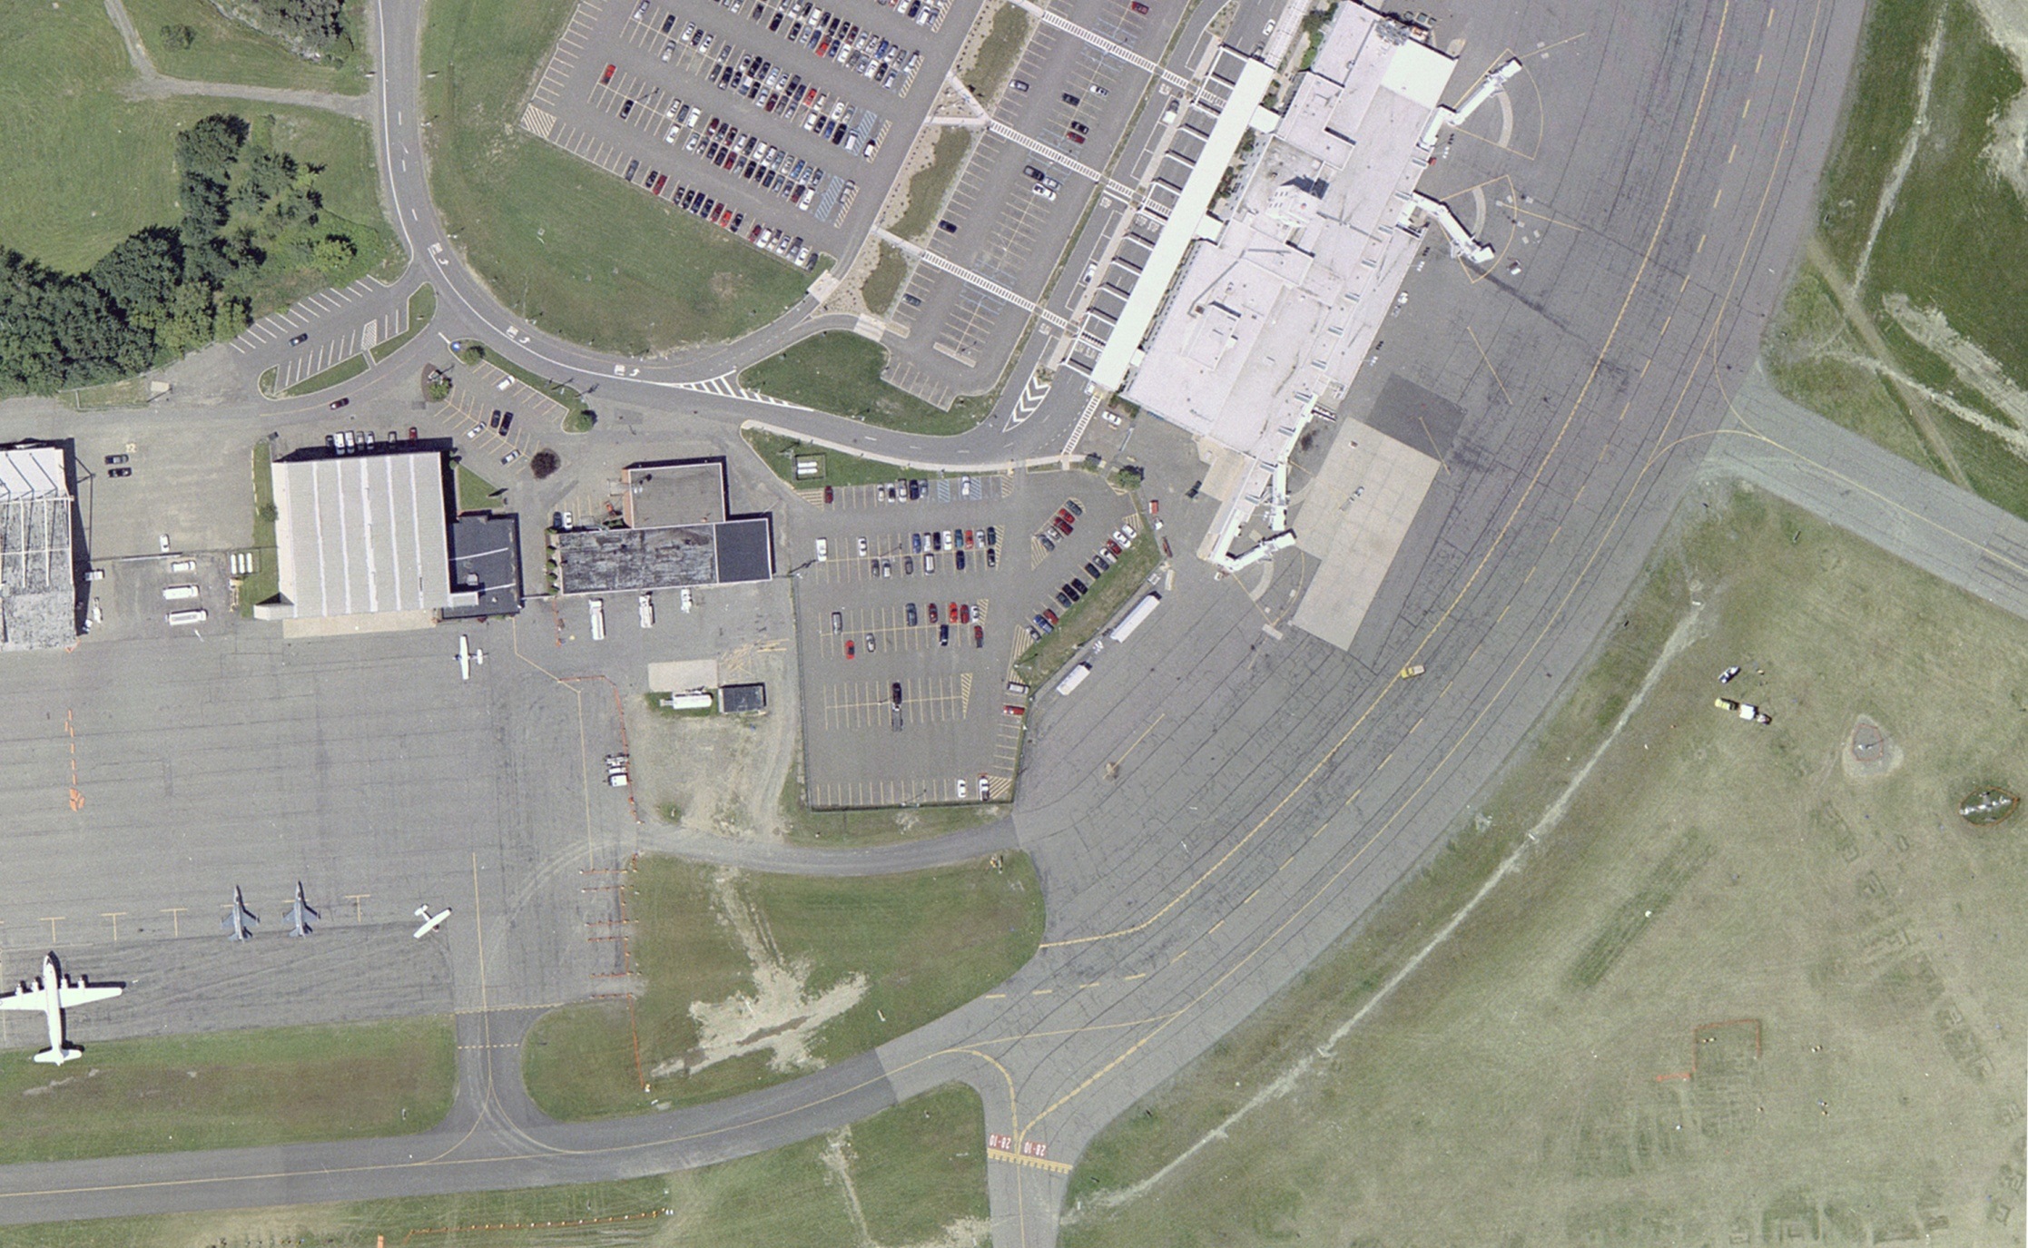
Greater Binghamton Airport
TERMINAL COOLING SYSTEM
GEOTHERMAL MECHANICAL BUILDING
IN-PAVEMENT HEATING SYSTEM
GEOTHERMAL WELL FIELD

Slide 7

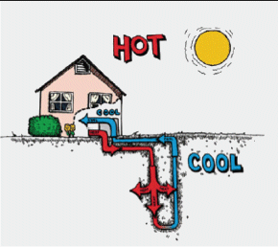
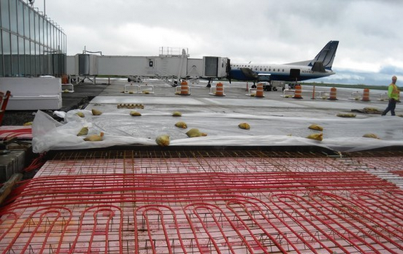
Greater Binghamton Airport
COOLING
First:
Glycol, better known as antifreeze, is pumped through tubing deep under the surface of the earth in the well fields where it arrives back at the earth’s surpface at a constant 55 degrees
HEATING
Then: In the spring and autumn, the glycol is circulated through heat pumps for further cooling and then sent pre-cooled into the terminal building to assist with air conditioning (cooling).
Then: In winter, the glycol is circulated through heat pumps for further heating, and then used to heat a separate set of glycol-filled tubing which is circulated under the concrete to prevent freezing at the surface.
WELL FIELDS

Slide 8
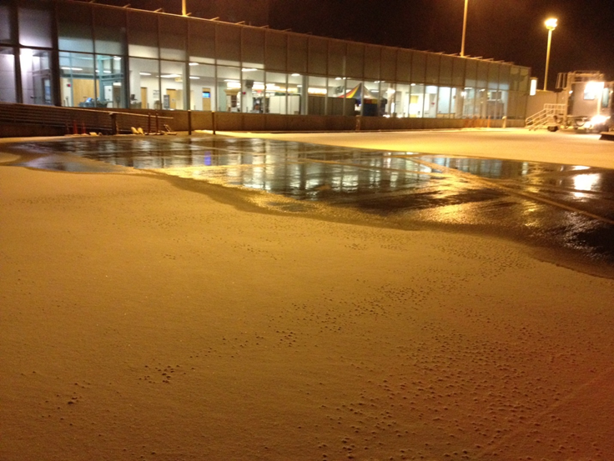
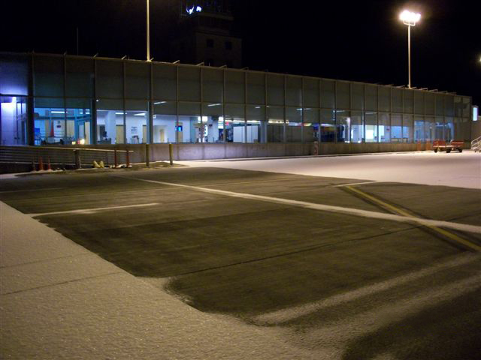
Greater Binghamton Airport
The system is currently up and running, and is successful in keeping snow and ice from forming on the pavement. This summer we will be testing the cooling capabilities of the system to assist with cooling the terminal building.

Slide 9
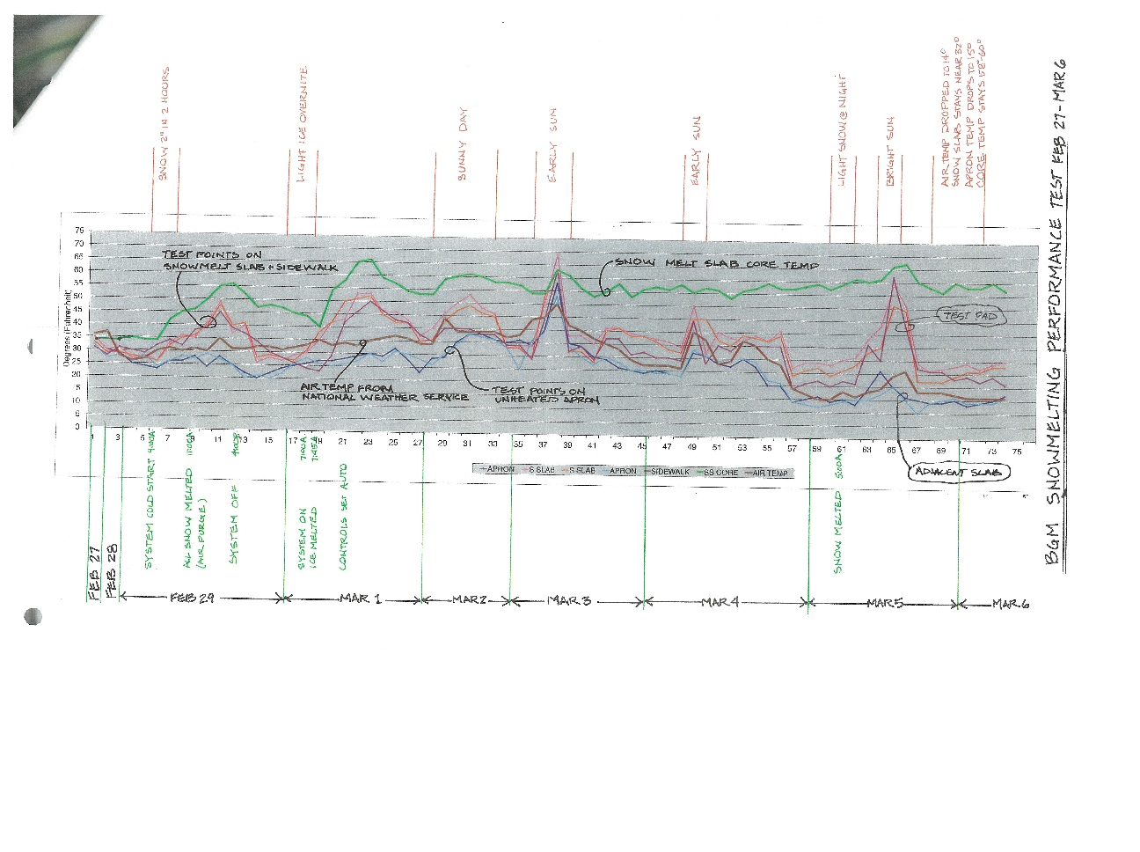
Greater Binghamton Airport
Currently conducting research on the system and will continue for at least two full years or more.
Collect data from 46 system sensors, every 15 minutes, 24 hours a day, 365 days per year. The diagram below is a small sample of the ongoing data analysis of what will amount to 1,611,840 data points analyzed per year.

Slide 10

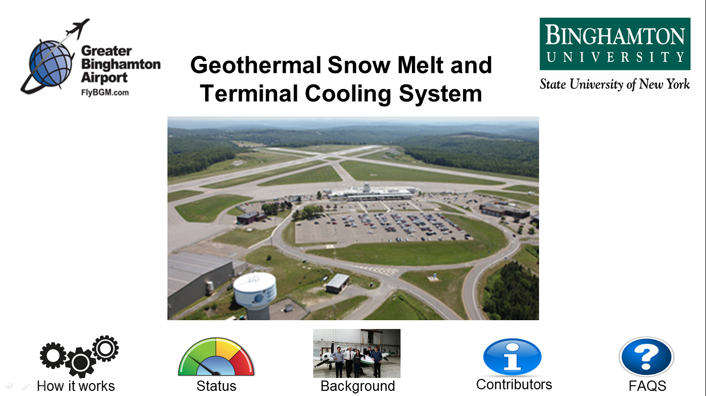
Greater Binghamton Airport
Interactive Kiosk in the Secure Waiting Lounge:
About to install an interactive kiosk with a 42” touch-screen display in the secure waiting lounge at BGM, which will explain the entire project from start to finish and provide passengers with live data as the system operates. The graphic below is the introductory screen:

Slide 11
Energy and Financial Viability
Identify six potential airports (GA & Commercial) for heated pavement installation
Determine best locations within the airports for work
Calculate heat demand for each location
Determine best current method of heating pavement
Determine costs associated with winter operations at selected locations
Provide cost/benefit analysis for each location
Develop a protocol to enable future systems to be readily evaluated

Slide 12
Energy and Financial Viability
Select Airport
    Commercial Airports
      St. Paul International Airport, MN
      Des Moines international Airport, IA
      Mason City Municipal Airport, IA
      Greater Rochester International Airport, NY
      Port Columbus International Airport, OH (newly added)
    General Aviation Airports
      Ankeny Regional Airport, IA
      Floyd Bennet Memorial Airport, NY
      Kent state University Airport, OH
      Faribault Municipal Airport, MN

Slide 13
Energy and Financial Viability
Utilize Benefit/Cost Analysis
  Loss to the airlines
  Fuel wastages during delays
  Value of time of passengers
  Initial cost
  Amount of snowfall
  Discount rate
  Analysis period
  Energy source
13

Slide 14
Energy and Financial Viability
Case example
Factor | Value
Snowfall | 1 in/hr
Duration of delays | 1 hour
Initial construction cost | $25/ft²
Discount rate | 7%
Analysis period | 20 years
Energy source | Natural gas
14

Slide 15
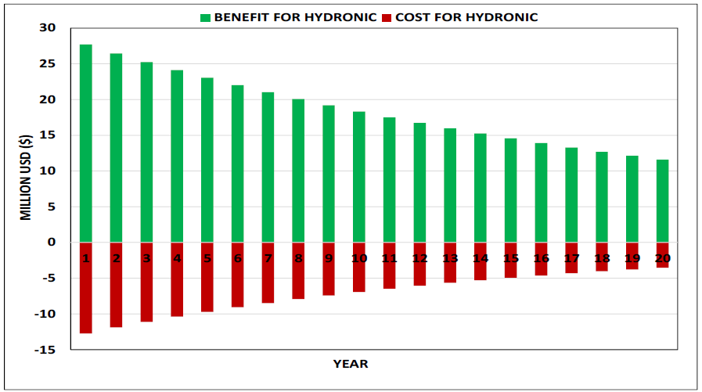
Energy and Financial Viability
Cash flow for the base case
15

Slide 16
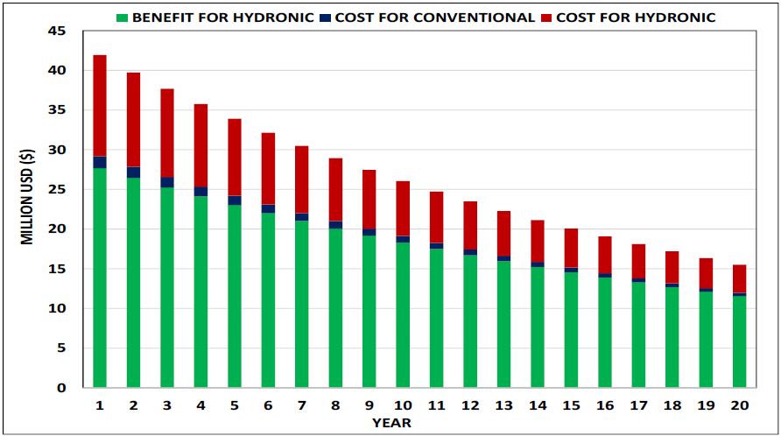
Energy and Financial Viability
Cost comparison for the base case
16

Slide 17
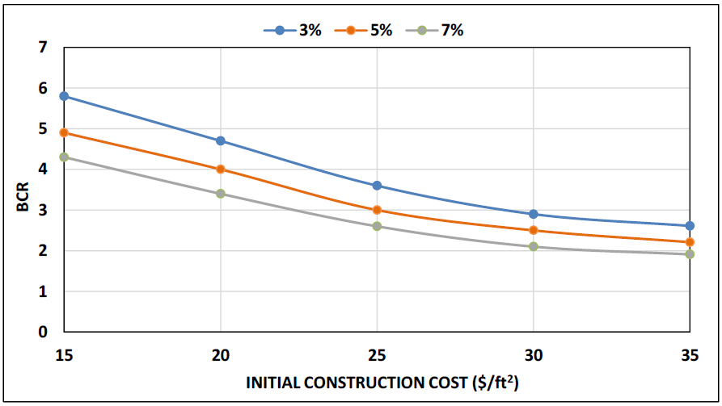
Energy and Financial Viability
BCR vs. initial construction cost at different discount rates
17

Slide 18
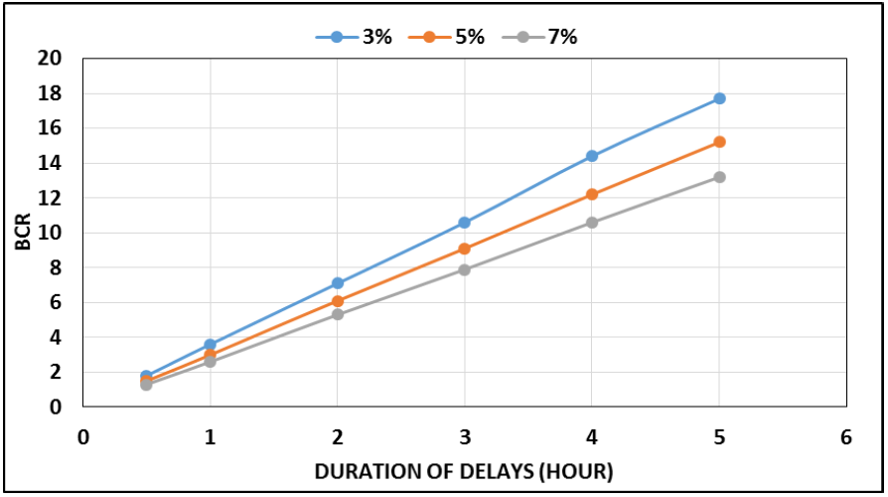
Energy and Financial Viability
BCR vs. duration of delays at different rates
18

Slide 19
Energy and Financial Viability
The BCR is very sensitive to the duration of delays and percentage of delays
Increase in the initial cost has a negative effect on the BCR, but as the time period of analysis increases, the BCR witnesses a steep rise, as expected.
BCR doesn’t show much variation with the changes in snowfall rates considered in the sensitivity analysis
Natural gas had the highest BCR
19

Slide 20
Nano Structured Superhydrophobic Coatings
Repel water to inhibit ice formation through a combination of roughness tailoring and material hydrophobicity
Investigate different materials (Silica, CeO2 & TiO2) and particle sizes for pavement coatings
Determine effectiveness as a stand alone treatment or in combination with conductive pavement
Determine physical properties of resulting concrete (compressive strength, friction coefficient, and roughness)

Slide 21
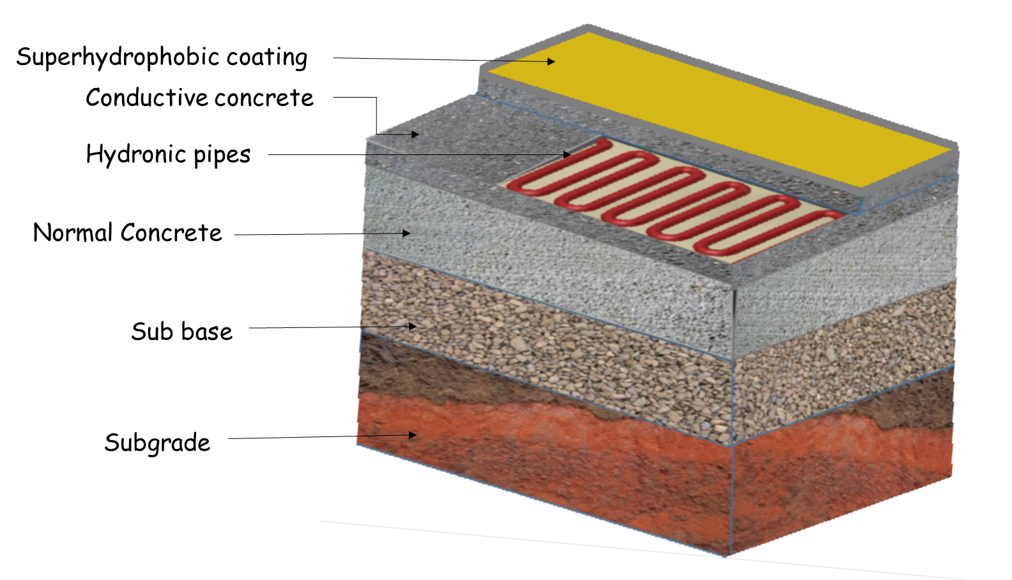
Nano Structured Superhydrophobic Coatings
Identify Overall System-Level Requirements

Slide 22
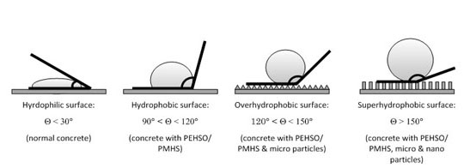
Nano Structured Superhydrophobic Coatings
Defining Superhydrophobicity and Hydrophobicity

Slide 23
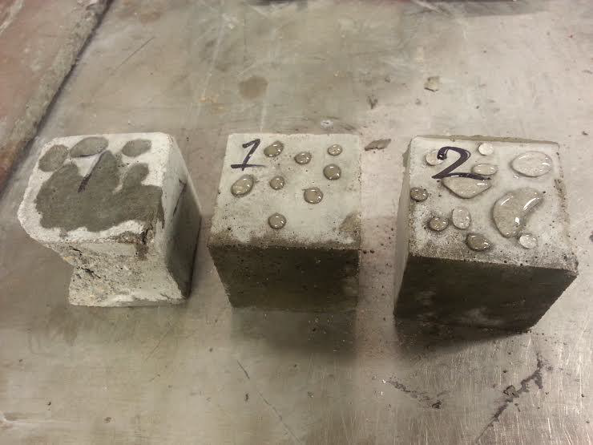
Nano Structured Superhydrophobic Coatings
Polytetrafluoroethylene (PTFE) coatings on concrete
From left to right: control, 2% PTFE, and 5% PTFE modified mortar specimens

Slide 24
Phase Change Materials for PCC Pavements
Main objective:
To examine the role that PCM may have in storing heat in pavements to melt snow and ice at airports
  PCMs can store thermal energy from the environment
  Stored energy can be released and melt ice and snow
  Improves anti-icing practices in airfield pavements
  Increases the safety of airport pavement
Energy released from PCM
Melted Snow and Ice
LWA with PCM
Concrete Pavement

Slide 25
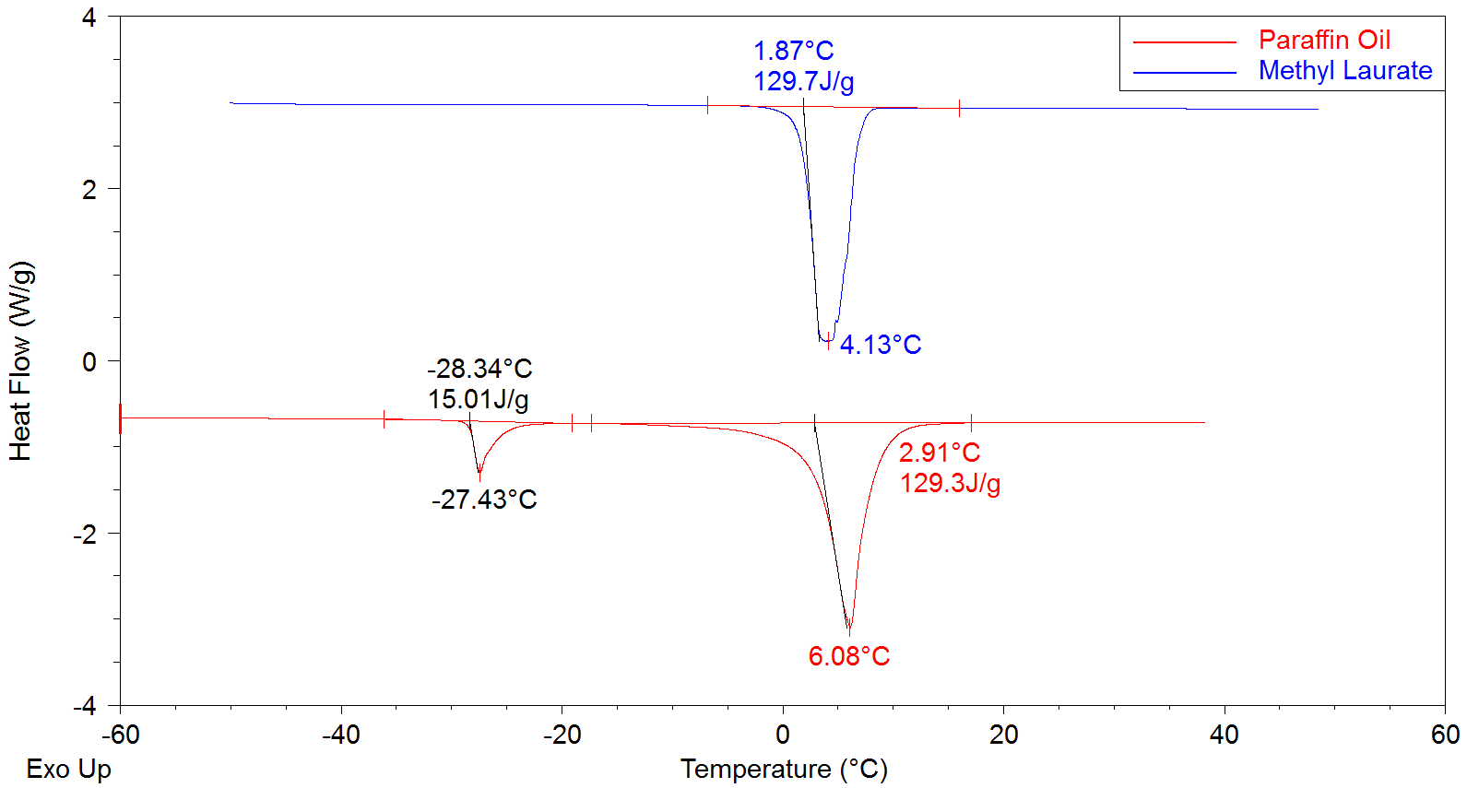
Phase Change Materials for PCC Pavements
Ideally the PCM phase transition temperature occurs at 3-6 ºC, has a high latent heat of fusion (ΔH), is chemically compatible with concrete, and is economic/commercially viable
Many PCM tested paraffin oil and methyl laurate have a desired thermal behavior for portland cement concrete pavement application
Developed quick tests to assess optimal PCMs
Able to change PCM freezing temperature for different climate conditions
Area under the curve shows the energy.

Slide 26
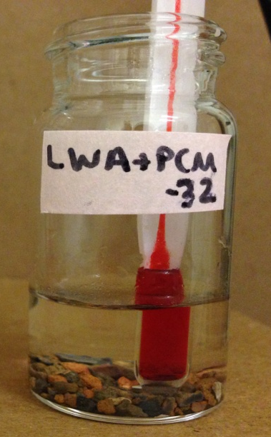
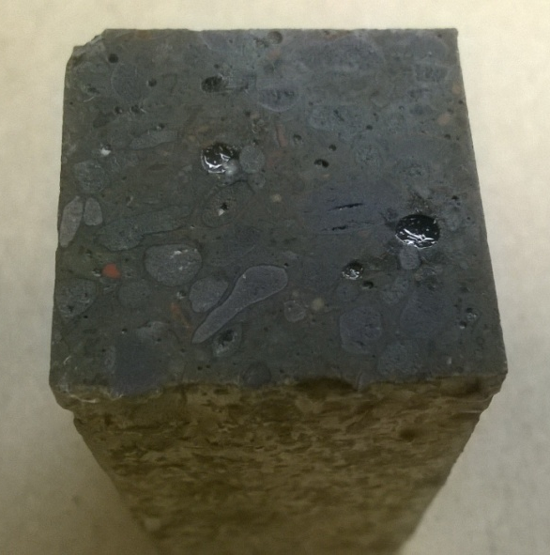
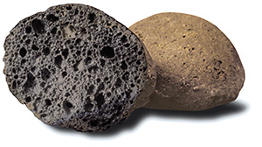
Phase Change Materials for PCC Pavements
Lightweight aggregates (LWA) were soaked in PCM and then were used to make concrete.
The same procedure can be used in the field to make concrete pavement using conventional paving operations
Using lessons learned and tools developed this will be extended to HMA during the coming year (Hard shell m&m)
Concrete with
LWA + Paraffin Oil
LWA

Slide 27
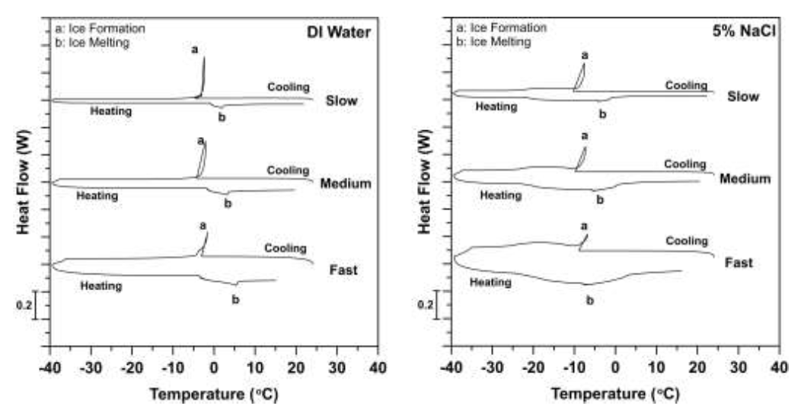
Phase Change Materials for PCC Pavements
Heat flow as a function of temperature predicted for samples saturated with deionized water (left) and a solution containing 5% NaCl (right) under different rates of thermal cycling

Slide 28
Advanced Construction Techniques for Heated Pavements
  Develop advanced techniques to best automate and accelerate the construction of large-scale heated pavements at airports
  Significant problems to be addressed include material selection, joint interfaces, new equipment necessary for installation of heating elements, time factors for installation, and location of ancillary equipment at the airport

Slide 29
Advanced Construction Techniques for Heated Pavements
Developing conceptual designs for heated pavement system
  Hydronic heated pavement system
  Electrically conductive concrete (ECC) based heated pavement system
Developed design for a prototype of ECC slab to be casted in ISU PCC lab
  Reviewed electrode types to improve bonding between conductive concrete and electrode
  Reviewed slab size design considerations for electrical heated pavement systems
  Compared between alternating current (AC) and direct current (DC)

Slide 30
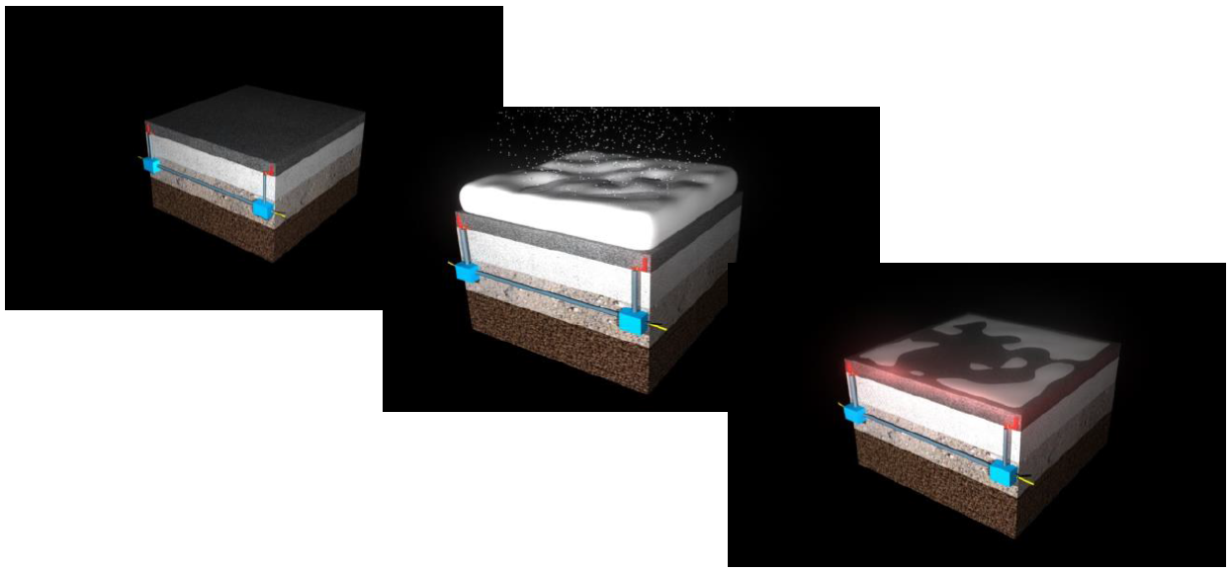
Advanced Construction Techniques for Heated Pavements
Conceptual design of heated pavement systems: 3D artist rendition and visualization of conductive concrete

Slide 31
Phase Change Materials for HMA Pavements
Develop approaches to consider the high processing temperatures used in asphalt pavement production
Extend the PCC model to asphalt mixtures and identify the ideal properties of the PCM given the impact of solar heating and layered systems
Review potential PCM based on their effectiveness and cost
Prepare samples demonstrating how PCM can be placed in asphalt mixtures
Evaluate the performance of the PCM in asphalt pavements

Slide 32
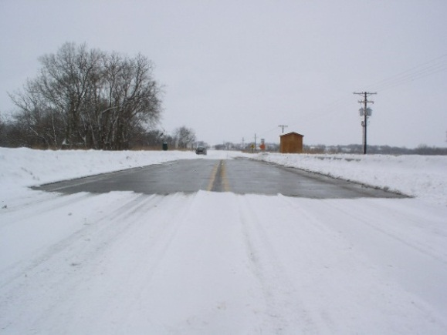
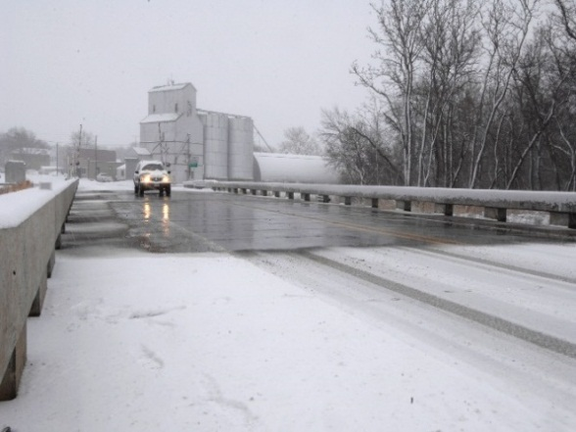
Conductive Concrete for Airfield Heated Pavement
Maximize the benefit/cost ratio of conductive concrete mix that yields the lowest cost while still providing adequate deicing performance and durability
Mix designs developed in our previous efforts were focused on using conductive materials with the best quality available rather than optimizing for cost
Selecting conductive materials, conducting mechanical and accelerated durability tests on conductive concrete specimens, and evaluating the deicing performance of small slabs made of various mix designs in a lab freezer
Feb 5, 2004
Feb 6, 2008

Slide 33
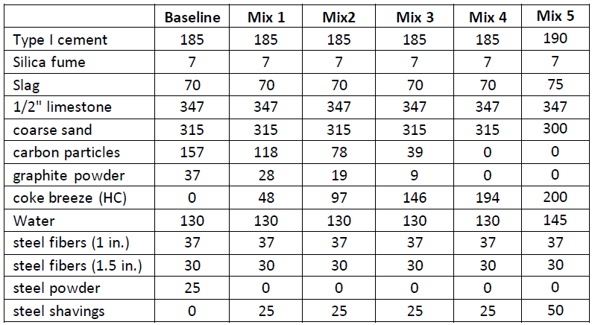
Conductive Concrete for Airfield Heated Pavement
Initial Trial Mixes

Slide 34
Conductive Concrete for Airfield Heated Pavement
Performing compressive, flexural, rapid freeze-thaw durability, shrinkage, and abrasion resistance
Performing testing up to 180 days after casting
Develop slab electrical conductivity and heating tests

Slide 35
FY 2015 Plan
Gather data and evaluate performance of geothermal heated pavement at Binghamton Airport – Report due May 2015
Go/no go decisions on further research projects from Energy and Financial Viability project – Report due June 2015
Selection of promising heated pavement technologies for construction of a test pavement section – August 2015

Slide 36
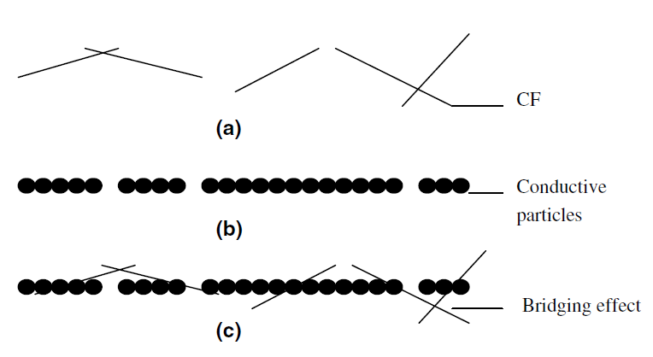
Future Heated Pavement Projects
Conductive Hot Mix Asphalt for Heated Airfield Pavements
  Snow and ice removal from electrical heating
  Research needed to determine the type of conductive additive materials (size, shape, composition and compatibility with asphalt)
  New construction requirements for mixing and placing
  Service monitoring (potential use for health monitoring sensor)

Slide 37
Future Heated Pavement Projects
Icephobic Materials for Nano-Modified Heated HMA Pavements
  Mitigate formation of ice crystals by being water-repellent
  Self cleaning of asphalt surface layer
  Mitigate HMA moisture damage (e.g. stripping)
  Similar to current research on PCC, but with different challenges
Without treatment
With treatment

Slide 38
Future Heated Pavement Projects
Construction of heated pavement test slab
  Construction based on most economic method for heating airfield pavement
  Testing for structural integrity under aircraft loads and tire pressures
  Fully economic analysis of construction, maintenance and operation cost would be performed

Slide 39
FY 2016 Plan
Construction and testing of promising heated pavement technologies at the NAPTF/NAPMRC
Research alternative energy solutions for heating pavements or facilities

Slide 40
FY 2017 Plan
Construction and testing of promising heated pavement technologies at a participating airport
Research alternative energy solutions for heating pavements or facilities

Slide 41

Questions?

