Slide 1
Surface Safety Initiatives Team (SSIT) Update
Presented to: REDAC Sub-Committee
By: Mike DiPilato – SRA
Date: March 31, 2015

Slide 2
What is the Safety Surface Initiatives Team (SSIT)?
The FAA Administrator formed the SSIT to identify surface safety and/or surveillance needs at airports that are no longer included in the Runway Status Light (RWSL) program and Low Cost Ground Surveillance (LCGS) pilot program.

Slide 3
SSIT Organization
Office of Airports:
Jim White/
John Dermody
NATCA
NextGen
Office of Airports
Runway Safety:
Jeff Stewart
Aviation Safety
Policy, International, Affairs, and Environmental
ATO Offices
Safety and Technical Training
Program Management Organization
System Operations Services
Mission Support
Notes:
Under SSIT Umbrella are CARA teams and AABC Teams

Slide 4
Comprehensive Airport Review and Assessment (CARA) Teams
The SSIT Charters CARA teams at in-scope airports.
Boston Logan International Airport (BOS)
Dallas/Fort-Worth International Airport (DFW)
San Diego International Airport (SAN)
Reno/Tahoe International Airport (RNO)
Different than a Runway Safety Action Team (RSAT)
Data Review
Document Review
Brainstorming
Identify Surface Safety Shortfalls
For example: Geometry, Procedures, and Technology
Deliverable is a Comprehensive Airport Review Plan (CARP)
Notes:
0 airports – 4 elected to participate
CARP is here – Description/justification/improvement concepts

Slide 5
CARA Team Organization
Safety Surface Initiatives Team (SSIT)
Comprehensive Airport Review and Assessment (CARA) Team Lead
Runway Safety Program Manager
Airport
Management
NATCA
FAA Airports
Flight Standards
Pilots
FAA Airport Safety R&D
Notes:
Sub-teams
In process of updating PP/team organization

Slide 6
Alternative Analysis and Benefits Case (AABC) Team
Three AABC Sub-Teams (for each airport):
Airport Design and Procedures – Office of Airports –Khalil Kodsi
Surface Technology – PMO – Bobby Nichols
Air Traffic Procedures and Policies – ATO – Pamela Dees
Identify Alternatives for each Shortfall
Rank and Recommend Alternatives based on:
Cost
Benefits
Impact
Present Alternatives to SSIT

Slide 7
Boston Logan International Airport
CARP Completed on June 18, 2014
Identified Shortfalls:
Planned Removal of RWSLs
Hot Spots
Cockpit Workload in Relationship to Time and Distance to Taxiways and Runways
1 RSAT Action Item – Aircraft Lined up to Land on a Taxiway
Alternative Analysis is Ongoing
Airport Design AABC Team
Analyzed ASDE-X Data
Conducted Focused Discussions
Developing Costs for Geometry Improvements
Notes:
**Some “improvement concepts” may not only help this airport, but others (e.g. Hot Spot Phraseology/visual hold line phraseology?)
**Alternatives = RIM second phase?
Use cost tool to generate costs
AABC – Implications with
Phase 1 and 2 RIM - upper hand / expedited list!

Slide 8
Dallas/Fort Worth International Airport
CARP was Recently Completed
Identified Shortfalls:
Planned Removal of RWSLs
Potential Non-Published Hot Spots
No criteria for defining/removing hot spots
Standard Taxi Routes
Wide Expanses of Pavement
Other Areas of Concern:
Limitations with Vehicle Squitters
Arrangement of Sign Panels on Dual Runway Exit signs (complex runway/taxiway intersections)
Not specific to DFW
The Next Step is the Alternative Analysis Process
Notes:
From reports, THLs have done their job
STD Taxi routes – some controllers use them, some don’t. Cause added stress / WL To pilots
Segway to moving maps. Also an improvement concept by BOS

Slide 9
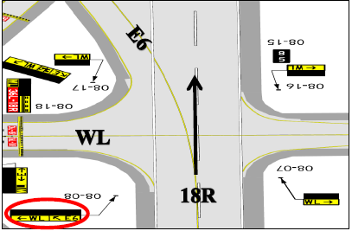
Arrangement of Sign Panels on Dual Runway Exit Signs
Notes:
Constantly learning and improving our standards. PROACTIVE.

Slide 10
San Diego International Airport
CARP Completed on January 9, 2015
Identified Shortfalls:
Runway Crossings at High Energy Intersections
Non-Standard Taxiway Geometry
Zero Distance Remaining Sign
Non-Standard EMAS
Area not Viewable from the ATCT (GA RAMP)
Alternative Analysis will begin within Q2 2015

Slide 11
Reno/Tahoe International Airport
CARP Completed on February 27, 2015
Identified Shortfalls:
Lack of a Runway Incursion Device in the ATCT
Reduced Visibility in the ATCT during Periods of Reduced Visibility and at Night.
Runway/Taxiway used as Supplemental Parking
Turning off Runway Lights (when active) to Conserve Energy
Non-Standard Taxiway Geometry
Reno’s Analysis Process will run Simultaneously with San Diego’s.
Notes:
Reduced visibility – note airport beacon blend in with RGLs

Slide 12
Questions?
Mike DiPilato
Airport Operations Research Analyst
SRA
Email: mike_dipilato@sra.com
Phone: 609-601-6800 x144

Slide 13
REFRENCE SLIDES

Slide 14
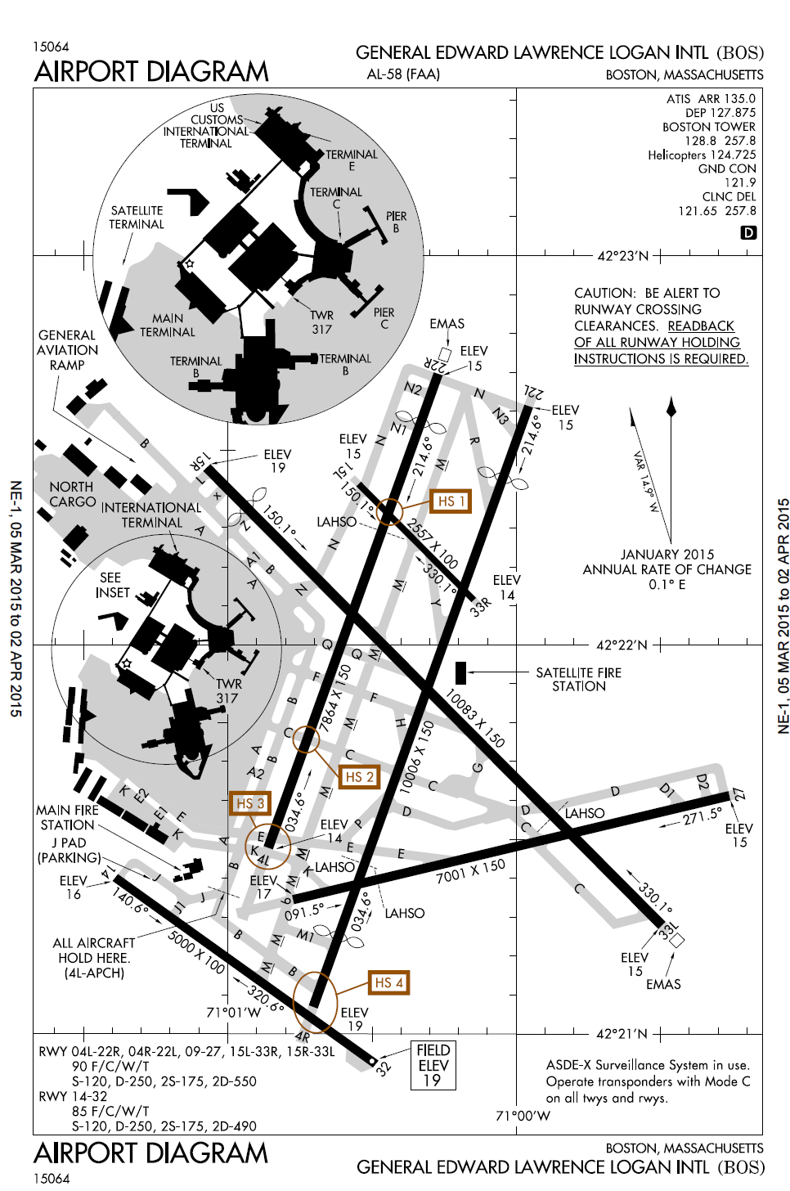

Slide 15
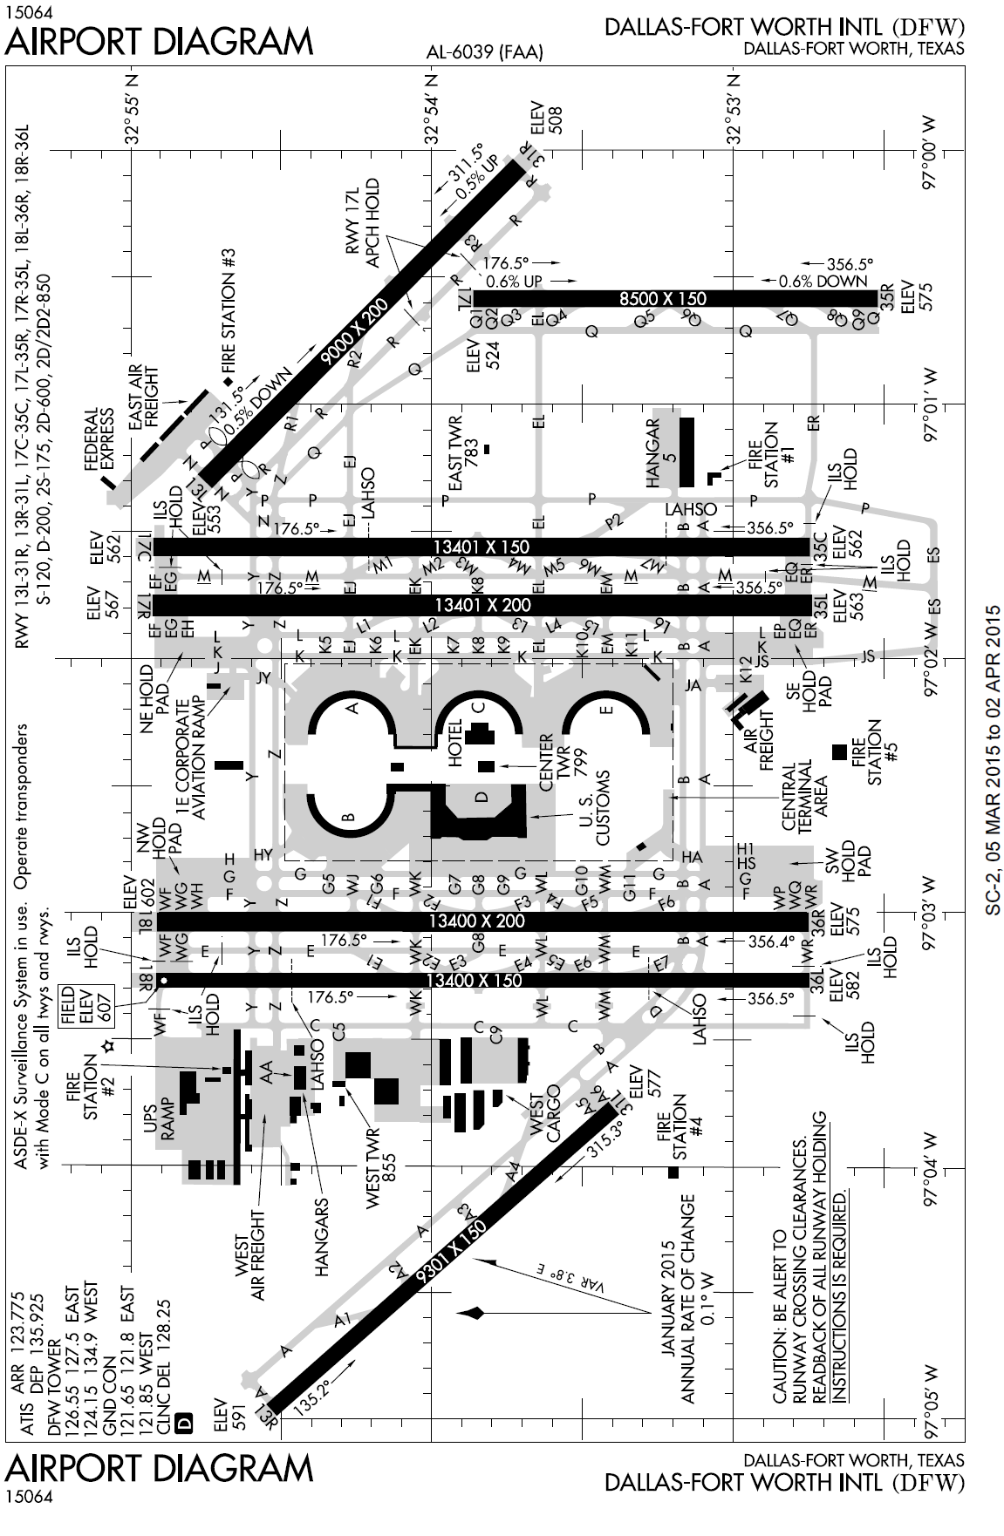

Slide 16
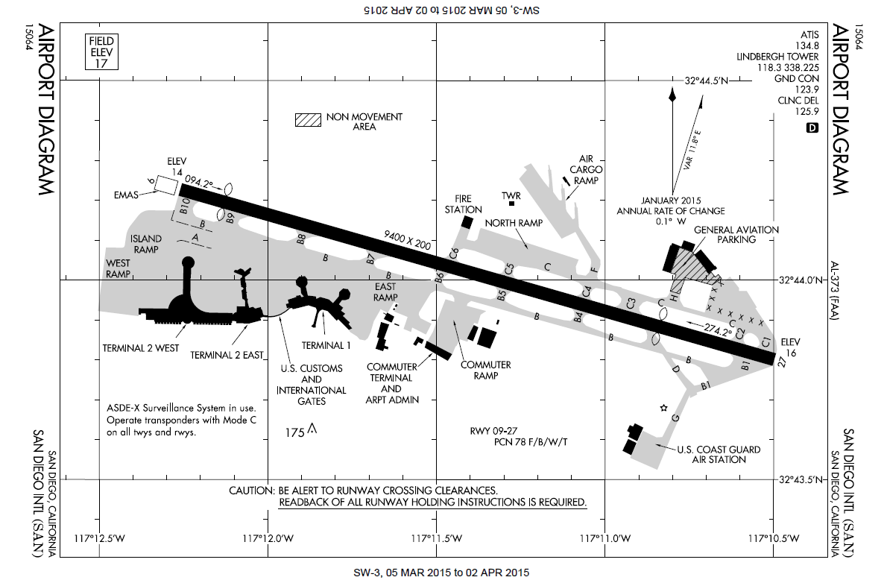

Slide 17
