Slide 1
New Facility and Construction Updates

Slide 2
New Facilities – 2017 and Beyond
Photometric Laboratory
NextGen Pavement Lab Expansion Office Space
Airport Safety Tech Storage / Warehouse
March 15, 2016

Slide 3
Technical Center Construction Approval Process
Technical Center Master Planning Approval
  Site Selection
    Infrastructure Requirements
  Environmental Assessment
    Review and Approvals by State and Federal Agencies
Design
  Plans and Specifications
Construction
March 15, 2016

Slide 4
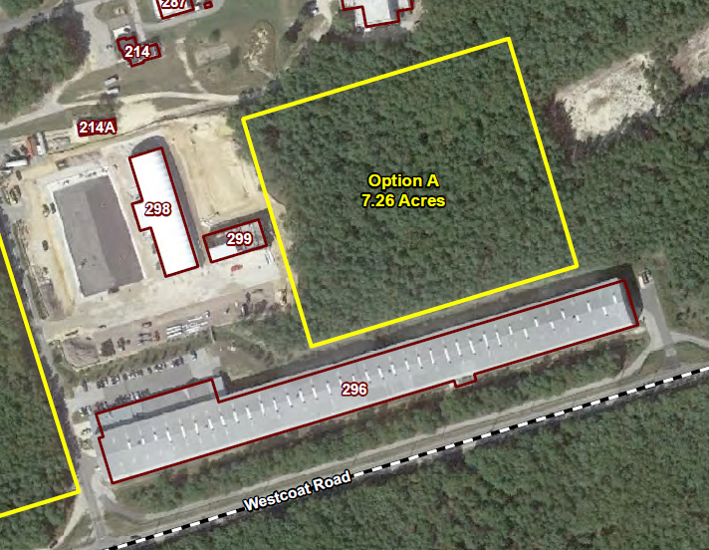
Site Selection
Water; Fire and Sewer Lines were Extended During
Current Construction
March 15, 2016

Slide 5
Site Selection
Can utilize Existing Environmental Assessment Study
  Reduced Time and Cost
Water, Fire and Sewer Lines have been Extended to the Site
Produces a More Centralized Campus
Does not Require Personnel to cross Pangborne Ave. to go to Bldgs. 296, 298 or 299
March 15, 2016

Slide 6
New Facility Planning

Slide 7
Technical Center Construction Approval Process
Technical Center Master Planning Approval
  Site Selection
    Infrastructure Requirements
  Environmental Assessment
    Review and Approvals by State and Federal Agencies
Design
  Plans and Specifications
Construction
March 15, 2016

Slide 8
Status of Environmental Assessment
Environmental Assessment began September 2015
Draft EA submitted February 4, 2016
  Included FoNSI, Finding of No Significant Impact
    Review comments by FAA have been provided
  Revised Draft EA submitted March 2, 2016 for FAA Review
  Submitted to State and Federal regulatory agencies for comment May 2016
  Comments addressed June 2016
March 15, 2016

Slide 9
Status of Environmental Assessment
Next Steps
  FAA submits final EA version to state and Federal regulatory agencies for comment (Est. early April)
  Public comment and review period
  Comments addressed
Final EA and FONSI Signed 7-13-16

Slide 10
Technical Center Construction Approval Process
Technical Center Master Planning Approval
  Site Selection
    Infrastructure Requirements
  Environmental Assessment
    Review and Approvals by State and Federal Agencies
Design
  Plans and Specifications
Construction
March 15, 2016

Slide 11
Design
Design Scope of Work
  Planned to use the Army Corps of Engineers Philadelphia District under the existing Interagency Agreement
  Funded with remaining funds from Cape May Research Taxiway
  Design Scope needs to be developed by ANG-E262 in coordination with Technical Center Facilities Engineers

Slide 12
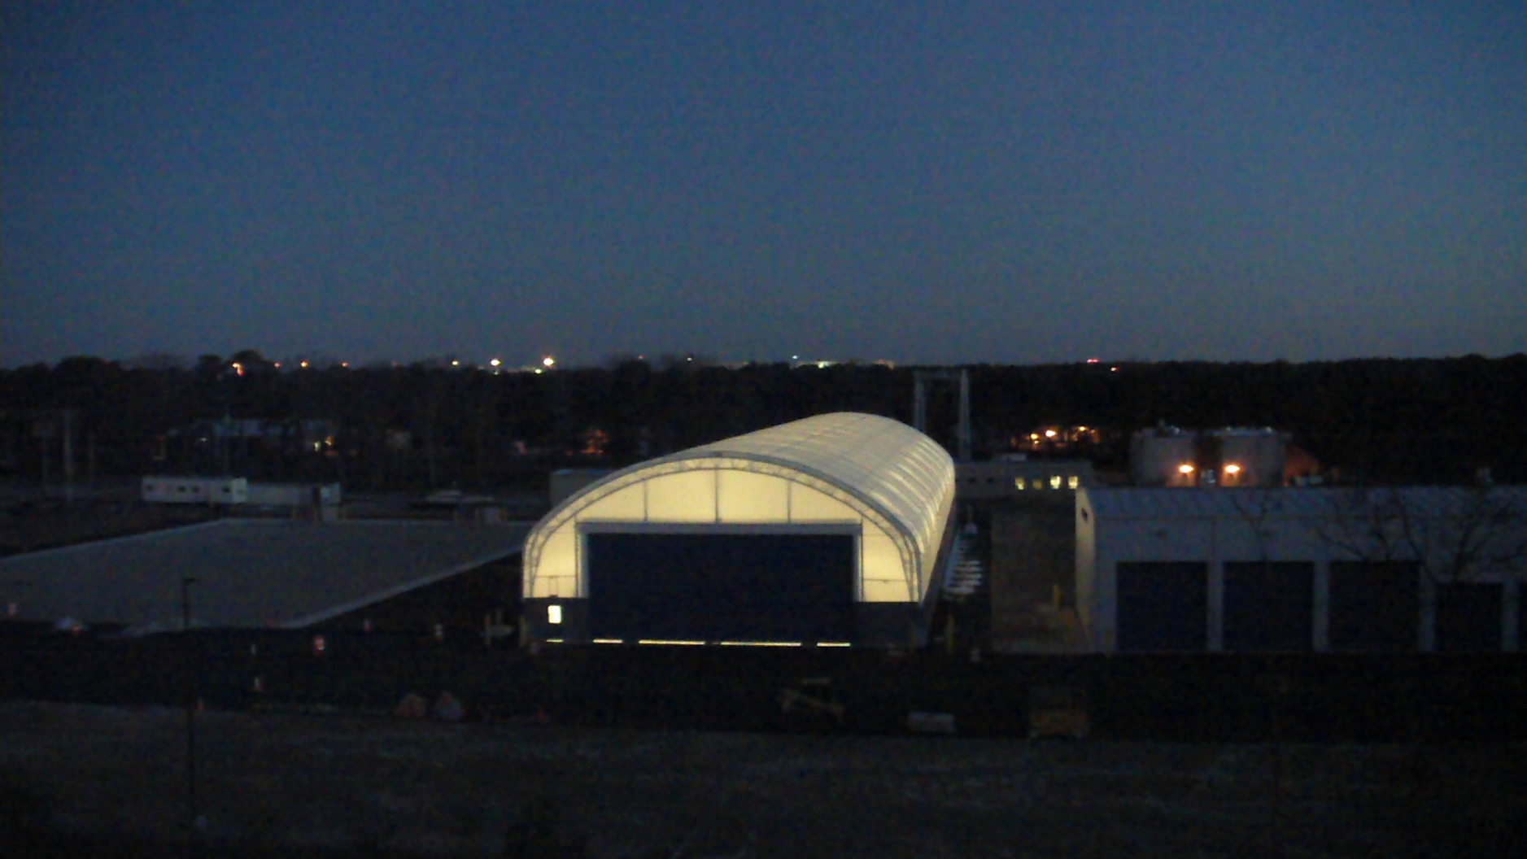
Thank You
March 15, 2016

Slide 13
QUESTIONS?
Comments?
www.airporttech.tc.faa.gov
Murphy.Flynn@faa.gov
March 15, 2016

