Slide 1
RPA S6.1
Aircraft Braking Friction
REDAC Subcommittee
Joseph Breen
August 16, 2016

Slide 2
Objectives
Determine the Aircraft Braking Friction Levels (Mu) that can be Achieved on the Winter Weather Contaminants.
Determine the Mu-Slip Characteristics at the Tire/Contaminant/Pavement Interface.
Determine the Behavior of Anti-Skid Braking Systems on these Low Friction Surfaces.
Identify Data that Commercial Transport Aircraft Can, or Should, Measure and Record to Identify the Braking Levels.

Slide 3
Recent Accomplishments
Draft Technical Report Completed for Aircraft Braking Friction Testing Conducted in 2016.
Technical Report to be Published after Completion of Editing Process.

Slide 4
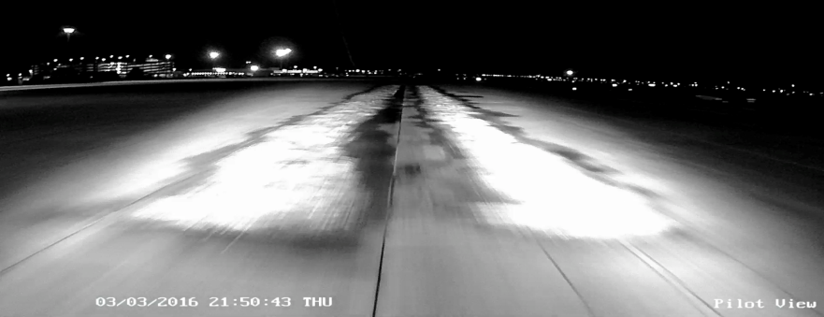
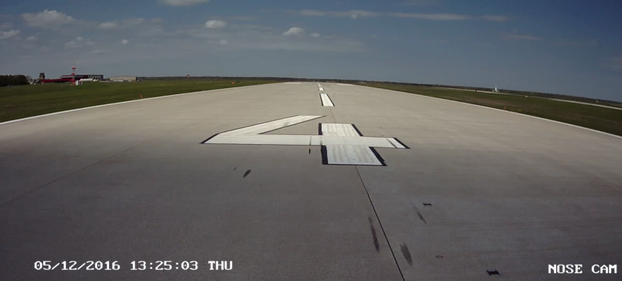
Aircraft Braking Friction Testing
Testing Conducted on FAA Ramp with Manufactured Snow, Wetted, and Dry Portland Cement Concrete (PCC) Surface Conditions.
Testing Conducted on ACY Runway 4-22 on Dry PCC Surface Condition.

Slide 5
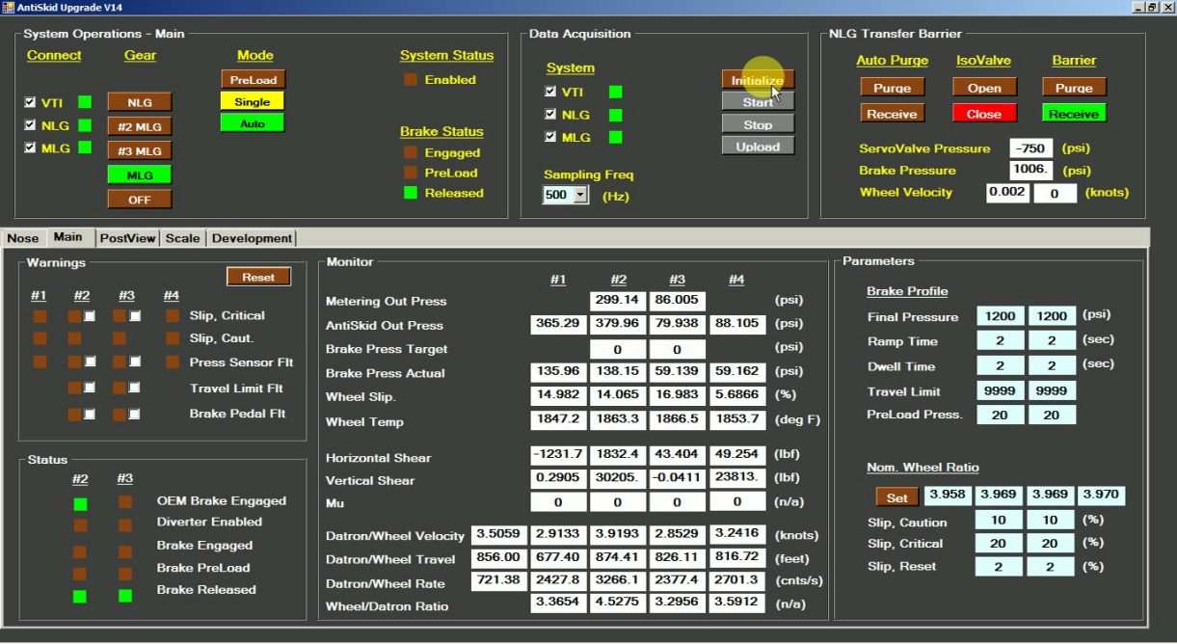
Testing Details
Testing Conducted Exclusively with Main Landing Gear (MLG) Braking.
Braking Applied with Either Anti-Skid Brake System to all Four MLG Wheels or Programmable Brake System to In-Board MLG Wheels.

Slide 6
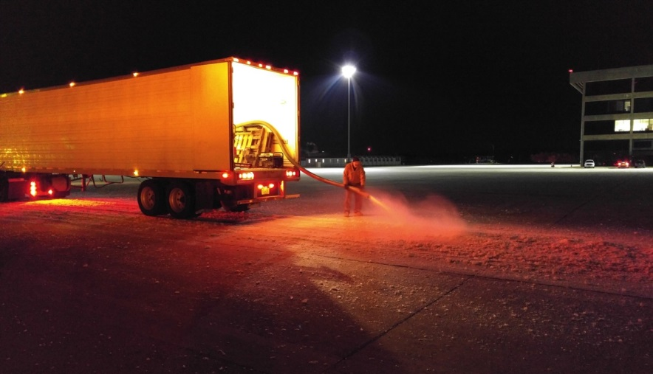
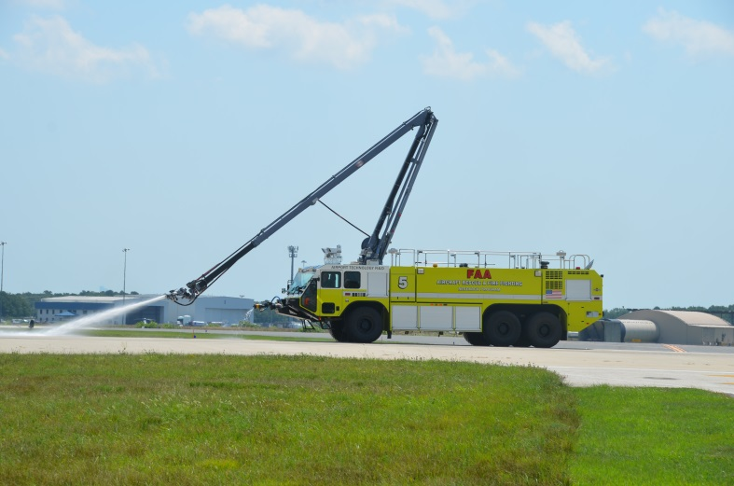
Testing Details (Continued)
Manufactured Snow Test Strips (Single and Dual) were 2 inches Deep, 8 ft. Wide, 400 ft. Long, and Spaced 18 ft.- 8 in. Center to Center.
Manufactured Snow Produced by Ice Blocks Fed into an Ice Crusher/Slinger Machine.
Wetted Surface Condition Created by an FAA Crash Fire Rescue (CFR) Vehicle.

Slide 7
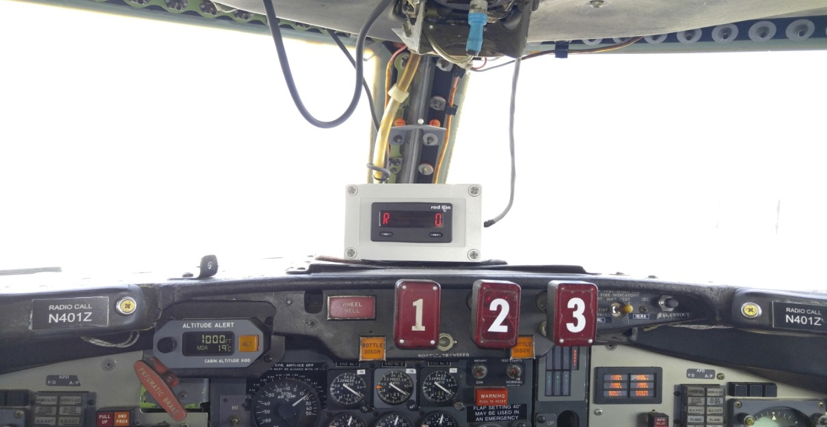
Testing Details (Continued)
Testing on FAA Ramp Conducted at 50 Knots with Both Anti-Skid Braking and Programmable Braking.
Testing on ACY Runway 4-22 Conducted at 100 Knots with Anti-Skid Braking and Contribution of Thrust Reversers (Landing Flight Phase Tests).

Slide 8
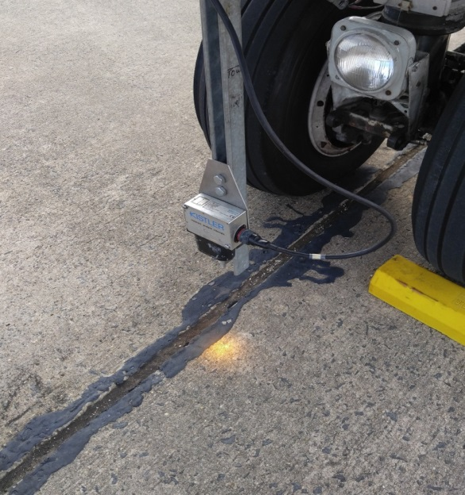
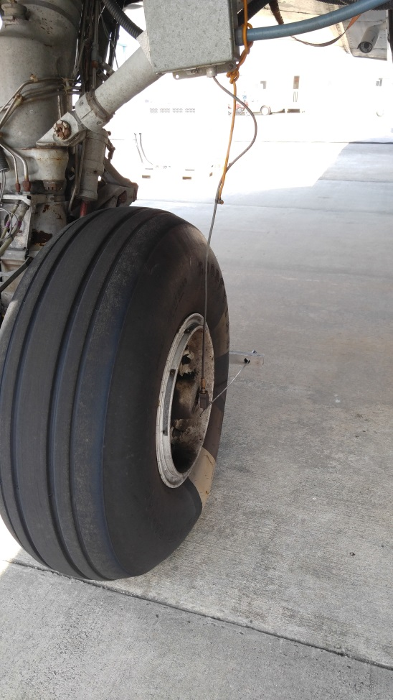
Aircraft Data
Longitudinal and Vertical Forces in Main Landing Gear
Deceleration of Aircraft
Aircraft Ground Speed
Wheel Rotational Speed
Brake Pressures
Electrical Current to Anti-Skid Valves

Slide 9
Programmed Braking on Manufactured Snow MLG Wheel #2, First Pass, 50 Knots

Slide 10
Programmed Braking on Manufactured Snow MLG Wheel #2, First Pass, 50 Knots

Slide 11
Anti-Skid Braking on Manufactured Snow MLG Wheel #2, First Pass, 50 Knots

Slide 12
Anti-Skid Braking on Manufactured Snow MLG Wheel #2, First Pass, 50 Knots

Slide 13
Testing Observations
Both Achievable Mus (Programmed Braking) and Anti-Skid Braking Mus on Manufactured Snow fell within the Range of 0.10 to 0.20.
- Mus Consistent with Values Obtained from Joint FAA/NASA Winter Weather Test Program on Natural Loose Snow.
A Mu of 0.30 was Reached during the Landing Flight Phase Tests on Dry PCC Runway.

Slide 14
Testing Observations (Continued)
Programmable Braking Performed as Designed.
- Brake Pressure Ramped to Target and Maintained Pressure for Dwell Period.
- Brake Pressure Released When Slip Cut-Off Limit was Reached.
- Brake Pressure Ramp Allowed for Determination of Achievable Mu and Dwell (Steady State Condition) Allowed for Determining Data Points for Mu-Slip Curves.
Anti-Skid Braking Exhibited Stable Behavior.
- Maximum Braking Remained Consistent While Wheels Were on the Snow.

Slide 15
Upcoming Work
Recalibration of Strain Gauges on Both Main Landing Gear and Nose Landing Gear.
Enhancements to Data Acquisition System.
Planned Testing for Upcoming Winter Season.

Slide 16
Future Project Test Strategy
Data Base
- FAA Ramp
- 50 Knots
- Dual Manufactured Snow Strips
- Main Gear Programmable Braking
- Main Gear Anti-Skid Braking

Slide 17
Future Project Test Strategy (Continued)
Data Base (Continued)
- Controlled Environmental Conditions
- Air Temperature 40 Degrees F
- (Snow, Slush, Water)
- Air Temperature 25 Degrees F
- (Snow, Icy Slush, Ice)

Slide 18
Future Project Test Strategy (Continued)
Validation
- ACY Runway 4-22
- 80 Knots and Below
- Natural Snow Events
- Main Gear Programmable Braking
- Main Gear Anti-Skid Braking
- Prevailing Environmental Conditions
(Snow, Slush, Ice, Water as Encountered)

Slide 19
Calculation of Braking Friction Based on Parameters Measured on Commercial Transport Aircraft
Algorithm to be Developed that Can Process the Measured Aircraft Parameters.
An Onboard Laptop Performance Computer (OPC) Can Use the Algorithm to Calculate Main Gear Wheel Braking Mu.
OPC of Follow-on Aircraft can Use the Mu in Its Aircraft Landing Performance Calculation.

Slide 20
RPA Overview
FY 2016 Accomplishments
- Programmable Braking
- Data Acquisition System
- Testing on Manufactured Snow
- Technical Report Completed
Funding Requirements
- FY 2016 - $300,000
- FY 2017 - $400,000
- FY 2018 - $450,000

Slide 21
Cooperative Research and Development Agreements (CRDA’s)
Team Eagle of Ontario, Canada, Braking Availability Test (BAT) Vehicle Operational.
ESCO Zodiac Aerospace of Logan Township, NJ, Developing and Testing Their Braking Action Safety System (BASS).

Slide 22
Questions?

