Slide 1
Reflective Cracking R&D Update
RPA P1
REDAC Subcommittee on Airports
David R. Brill, P.E., Ph.D.
August 17, 2016

Slide 2
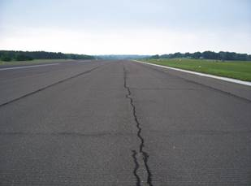
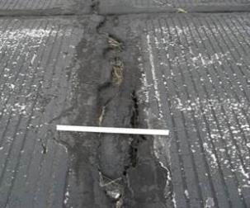
Background
At airfields, the potential for reflective cracking presents a major challenge for rigid pavement rehabilitation involving asphalt overlays.
The current FAA thickness design procedure (FAARFIELD) does not consider this important distress mode.

Slide 3
Research Objectives
Isolate, combine, and compare temperature and aircraft load effects on reflective cracking.
Generate full-scale data under controlled conditions:
Mechanically simulate temperature cycles occurring in nature.
Obtain repeatable crack propagation rate.
Develop a reliable performance model that relates the required thickness of HMA overlay to major input variables, including: aircraft loads, climate, and the condition of the existing pavement.

Slide 4
R&D Plan for Reflection Cracking

Slide 5
NAPTF Reflection Crack Rig

Slide 6
Test Overview
Test | Year | Cycles | Available Data
 |  |  | North | South
Phase I | 2012 | 2089 | X (38 cm)
Phase II | 2013 | 4869 | X | X
Phase III | 2014 | 6350 | X | X
Phase IV | 2015 | 3759 | X
Phase V | 2016 (planned)
Dynamic Data: 1 Hz acquisition Static Data: Hourly

Slide 7
Test Overview (2012 – 2016)
Test | HMA Overlay Structure
 | North | South
Phase I | 12 ft × 5 in (3.66 m × 127 mm)
Phase II | 5 ft × 5 in (1.52 m × 127 mm) | 5 ft × 5 in (1.52 m × 127 mm)
Phase III | 5 ft × 5 in (1.52 m × 127 mm) | *5 ft × 5 in (1.52 m × 127 mm)
Phase IV | 5 ft × 5 in (1.52 m × 127 mm) | 5 ft × 7 in (1.52 m × 178 mm)
Phase V | 5 ft × 3 in (1.52 m × 76 mm) | 5 ft × 6 in (1.52 m × 152 mm)
All Overlays P-401 HMA, PG 64-22, except *PG 76-22

Slide 8
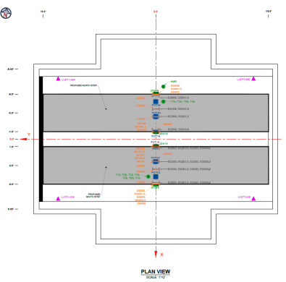
Phase V Test
Reconstruction and Instrumentation
Sensor Count:
Embedded Strain Gage: 24
Surface Strain Gage: 24
Thermocouple: 12
Potentiometer: 6
LVDT: 4
Joint Displacement Gage: 4

Slide 9
Phase V Schedule
Anticipate paving late Sept. – early October.
Bid package is complete. Project is expected to go out for bid within the next month.
Required gages are in stock or on order.
System upgrades:
No significant system upgrades for Phase V.
DAQ replacement is planned for Phase VI.

Slide 10
Crack Propagation Model I
Crack propagation rate = dL/dN.
Model form is the same as the classic Paris’ Law for crack propagation under repeated loading, except that failure strain ε_{f} takes the place of stress intensify factor range ΔK.

Slide 11
Measured vs. Predicted Crack Propagation Rate (Phase IV)

Slide 12
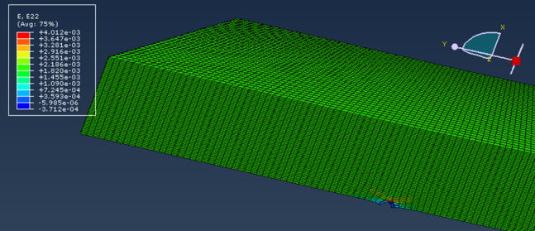
Related R&D Activities
Laboratory Testing
Finite Element Modeling
Phase V Laboratory Testing Plan
Compute energy release rates for advancing crack.
Apply to full-scale test to obtain Paris’ Law model.

Slide 13
Future Research
More full-scale test data
Different overlay thicknesses to confirm the performance of power and bilinear crack propagation models.
Varied loading cycles to examine extreme cooling cycles
Varied rest periods to examine fracture healing
Expected product
Crack Propagation Rate = f (Fracture Energy, Mixture Stiffness, Temperature)

Slide 14
Overlay Paving at NAPTF (2013)

