Slide 1
Full-Scale Testing – Perpetual Pavement Update

Slide 2
CONSTRUCTION CYCLE – 7 (CC-7)
PRIMARY OBJECTIVES
Develop Perpetual Pavements Design criterion for airport pavements.
Vertical strain threshold in the intermediate HMA layer to limit rutting.
Horizontal strain threshold in the HMA base layer to prevent bottom-up fatigue cracking.
Relationship between laboratory fatigue strain threshold and measured field HMA strains.
Study strain distribution in the HMA layer.

Slide 3
CONSTRUCTION CYCLE – 7 (CC-7)
PRIMARY OBJECTIVES
Verify/Refine/Modify fatigue model based on the ratio of dissipated energy change (RDEC)
Overload (South Side Pavements)
Determine allowable aircraft overload criteria for flexible pavement.

Slide 4
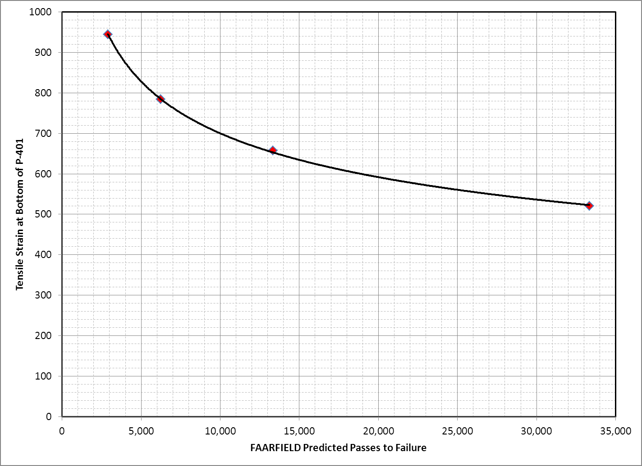
CC7 – PERPETUAL PAVEMENTS

Slide 5
Pavement Cross Sections

Slide 6
Traffic Tests:
Standard NAPTF wander pattern.
55 kips wheel load, 6-wheel gear.
Pavement Monitoring
Straight Edge Rut Depth Measurements
Surface profiles
Crack maps

Slide 7
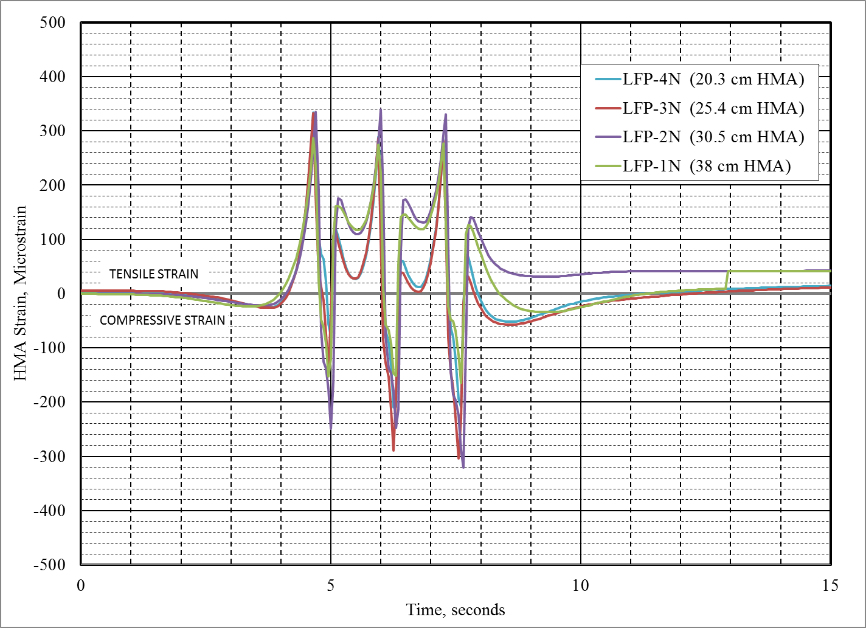
Vertical strains measured in HMA layer

Slide 8
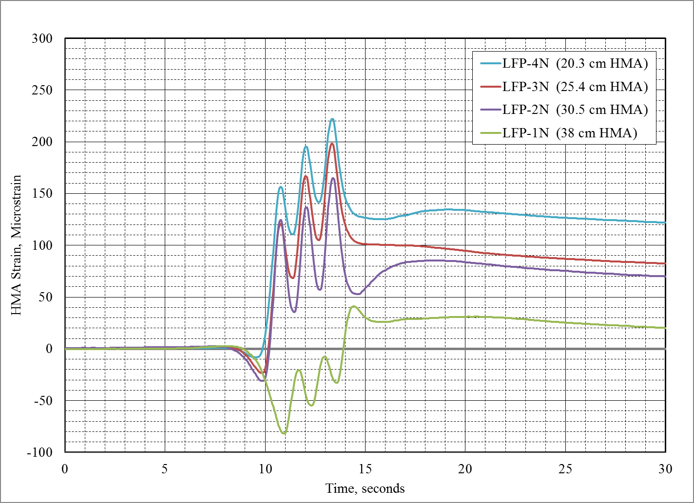
Transverse strains measured at HMA Surface

Slide 9
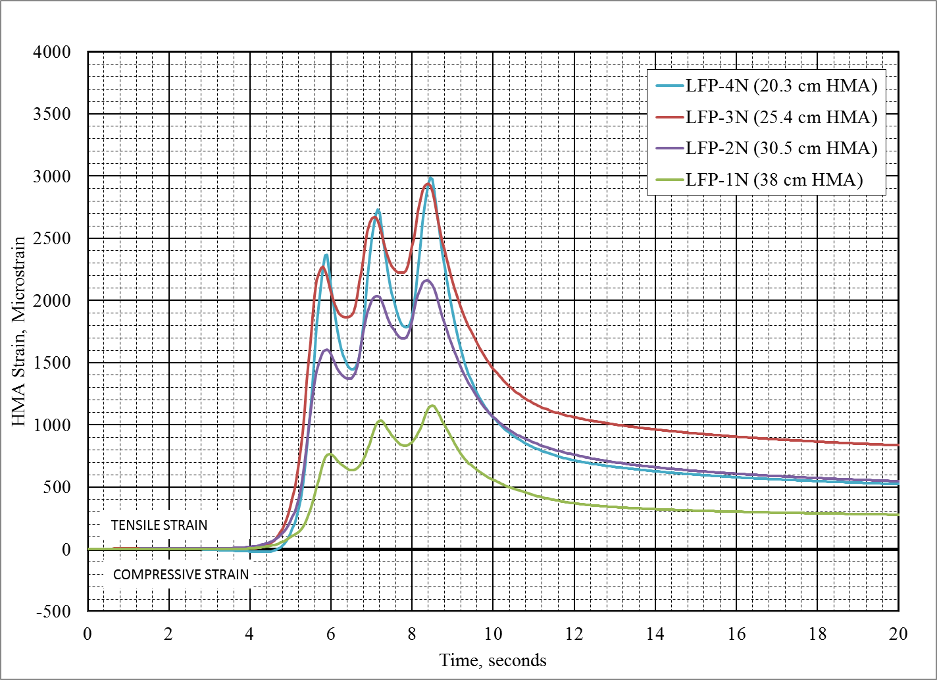
Transverse strains measured at Bottom of HMA

Slide 10
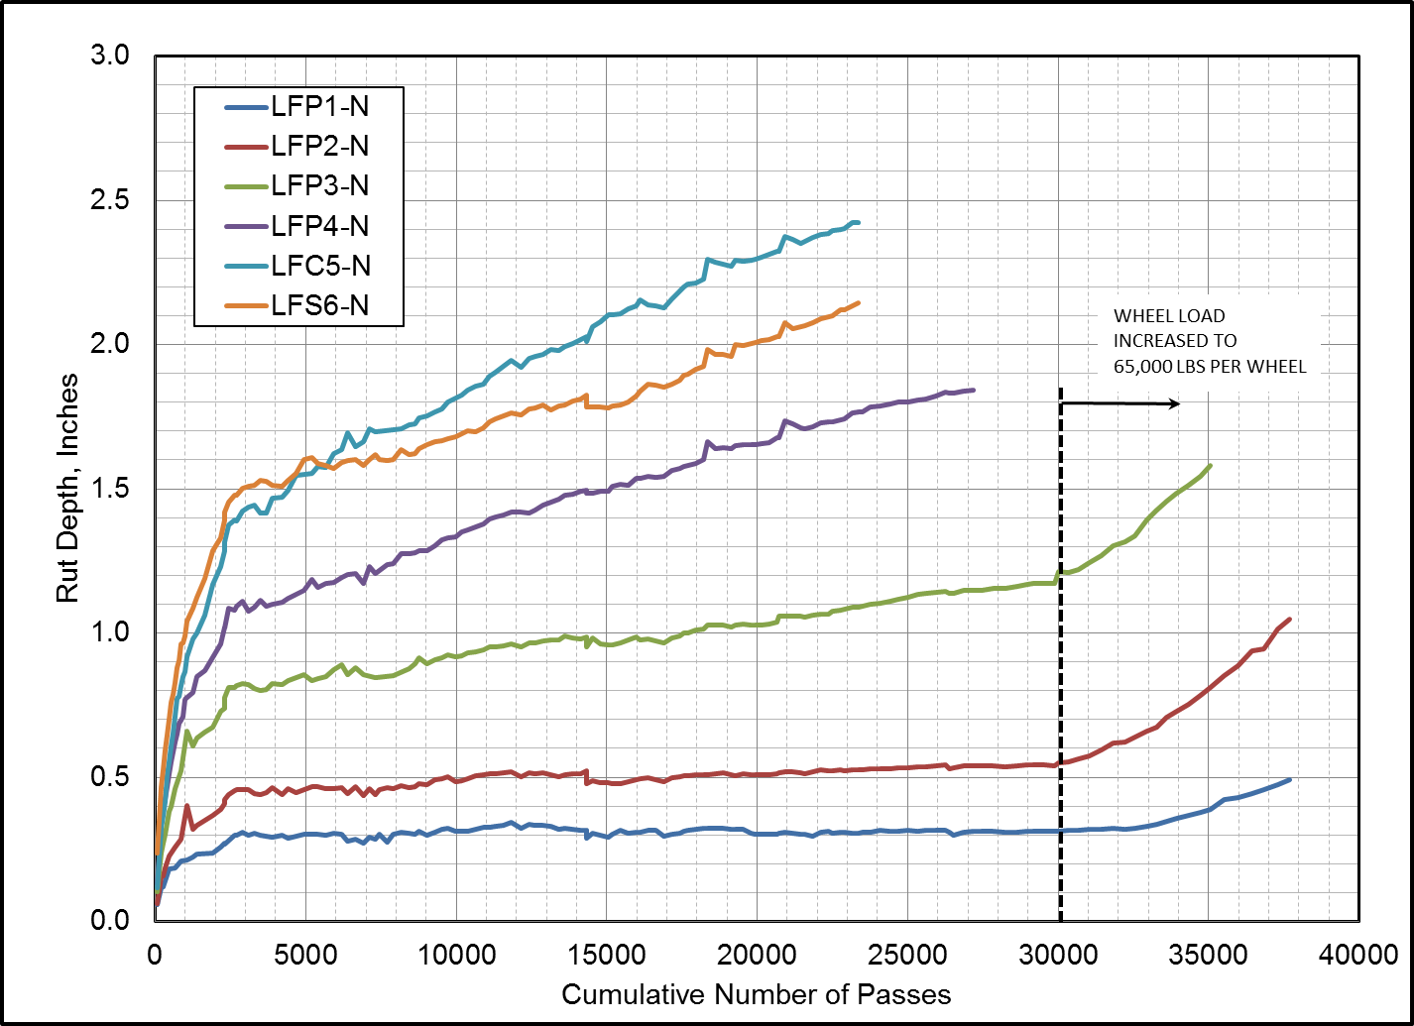

Slide 11
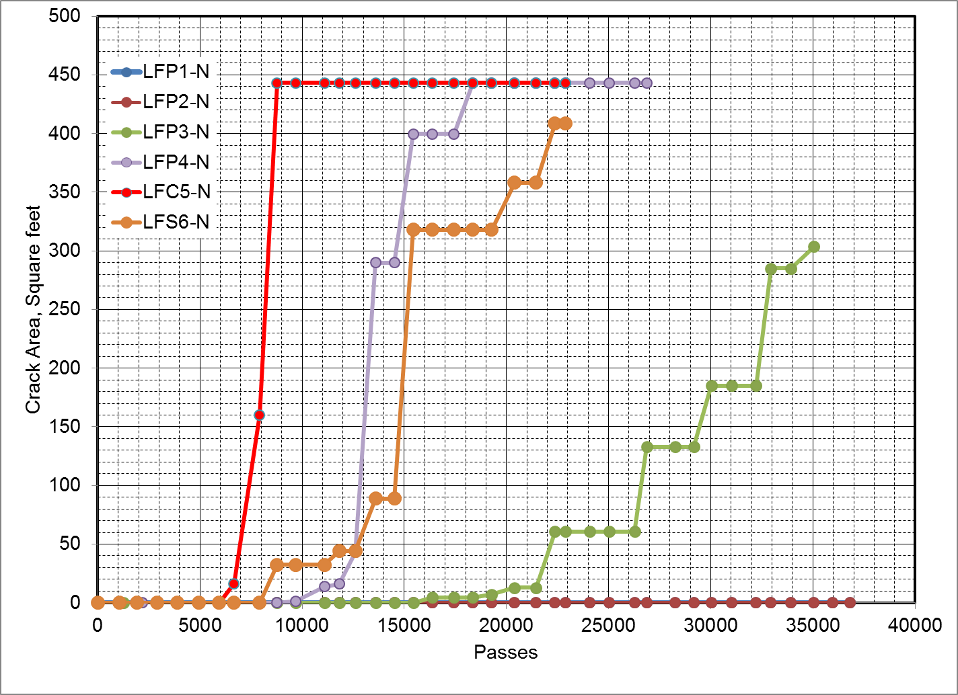

Slide 12
Summary:
Two of the thicker perpetual pavement test sections (LFP-1N and LFP-2N) did not show any evidence of fatigue cracks, whereas LFP-3N and LFP-4N showed severe fatigue cracking.
All the cracks were found to be top-down cracks. The conventional flexible pavement test section LFC-5N showed severe rutting and fatigue cracking.
The test section performance shows that under given aircraft gear loading used in the study, by increasing HMA thickness from 10 in. to 12 in. fatigue cracking was eliminated during the duration of testing (almost 38,000 passes).

Slide 13
Summary:
FOSP strain measurements were useful in understanding the HMA layer behavior.
Laboratory fatigue tests are under progress to determine input properties for the fatigue model incorporated in FAARFIELD and comparison will be made between predicted and observed fatigue life.
Posttraffic trenching – after completion of CC7 Overload study.

Slide 14
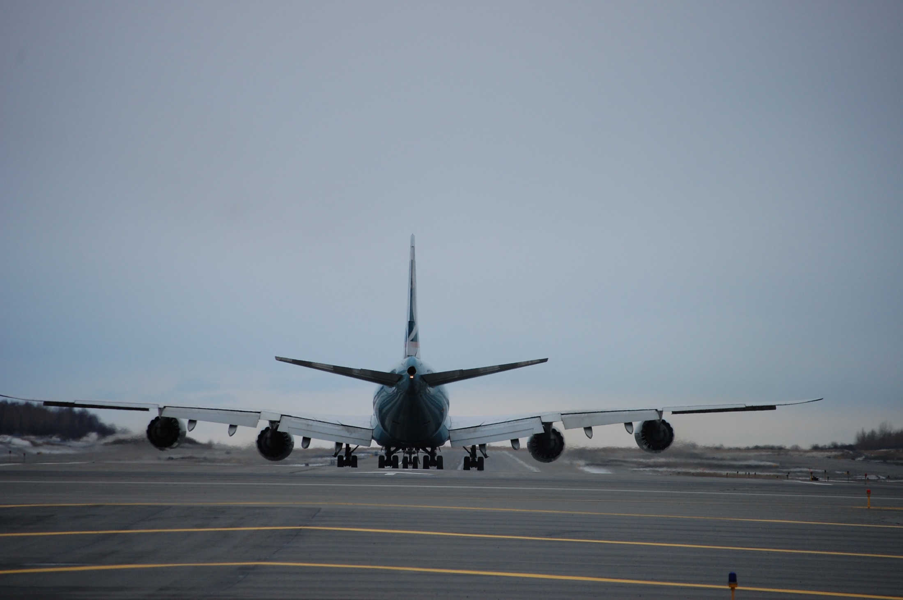
Thank you!

