Slide 1
RPA - P2
NAPMRC
(National Airport Pavement & Materials Research Center)

Slide 2
RPA P2 Overview - NAPMRC
Need
Research Goals
Research Goals
More durable, long-lived airport pavements, reduced lifecycle costs, better prediction of pavement service life, and accurate assessment of aircraft-pavement compatibility
Standards/specification for new asphalt technologies such as WMA, SMA, RAP, etc.
Deliverables
Technical Reports, technical papers.
NAPMRC provides the ability to test the surface layers, pavement materials, and alternative pavement materials. Improved paving materials characterization will conserve airport development funds and reduce the downtime of runways from construction and maintenance activities. Test results will help in developing standards/specification for new asphalt technologies such as WMA, SMA, RAP, etc.
FY 2016 Accomplishments
Funding Requirements
Complete traffic tests on Test Cycle – 1 (TC-1) by end of FY2016.
Lab study on SMA & RAP completed.
Milestones
- Complete tests on HMA at 214-psi tire pressure √
- Complete tests on WMA at 214-psi tire pressure √
- Complete tests on HMA at 254-psi tire pressure √
- Complete tests on WMA at 254-psi tire pressure √
- Indoor Lanes (2) remaining.
NAPMRC FY 2016 through FY 2018.
 | FY 2016 | FY 2017 | FY-18
Funding Target ($000) | $800 | $1700 | $1751
P2.1: Pavement Construction | - | $400 | $400
P2.2: Facility Operation | $800 | $1,100 | $1,100
P2.3: Facility Maintenance | - | $200 | $251

Slide 3
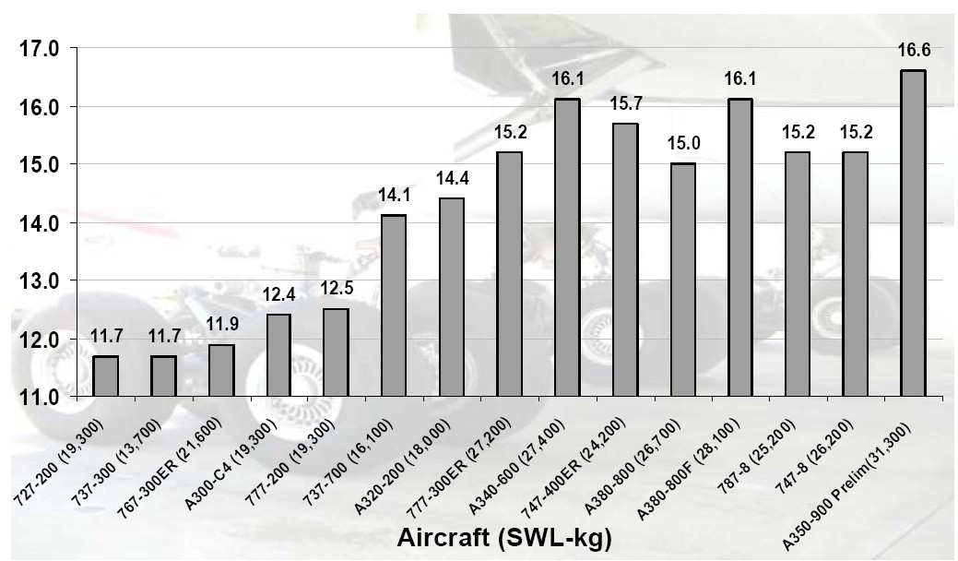
Aircraft Tire Pressure Trends
New X Category Limit
Old X Category Limit
Tire Pressure, bar

Slide 4
Aircraft Gross Weight Trends
73,300 lbs
100,000 lbs
A350-900
HVS-A
[Published by the International Industry Working Group (IIWG), 2010]

Slide 5
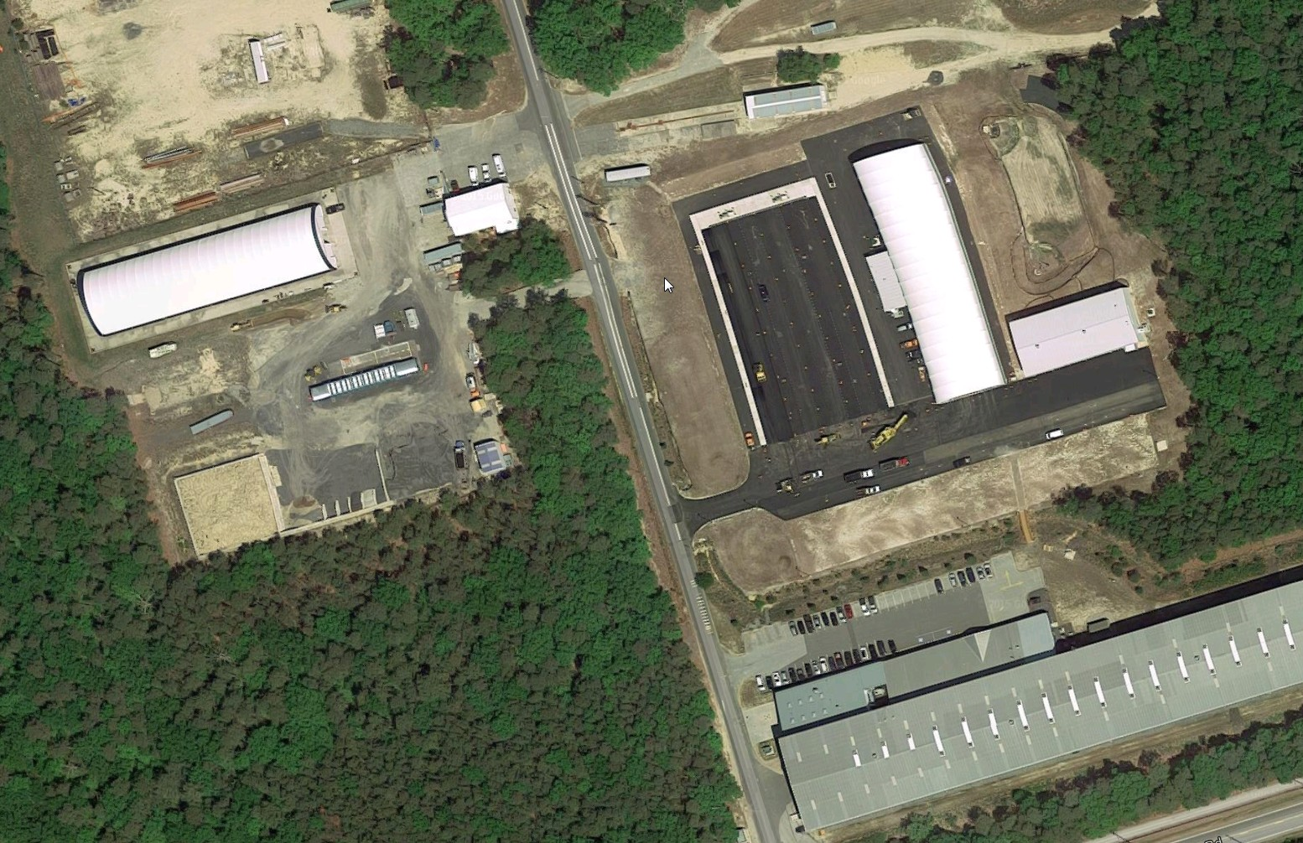
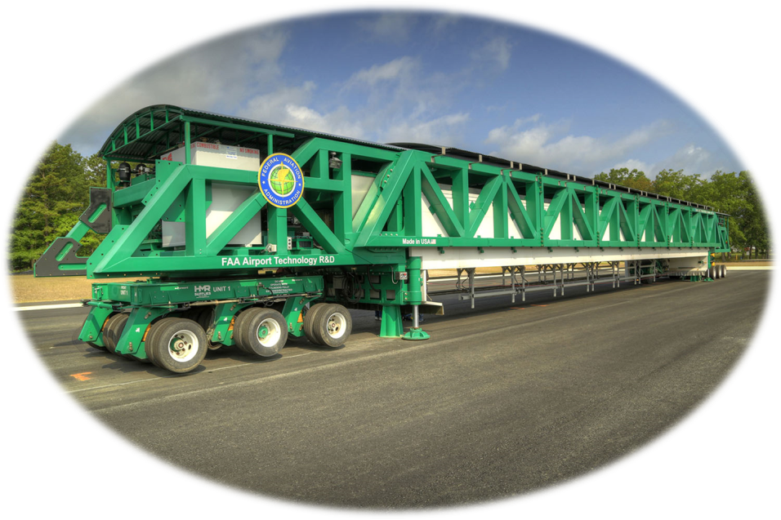

Slide 6
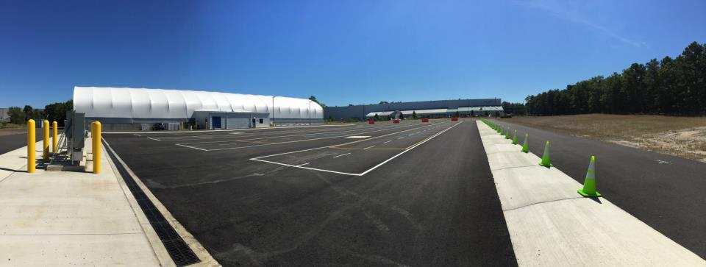

Slide 7
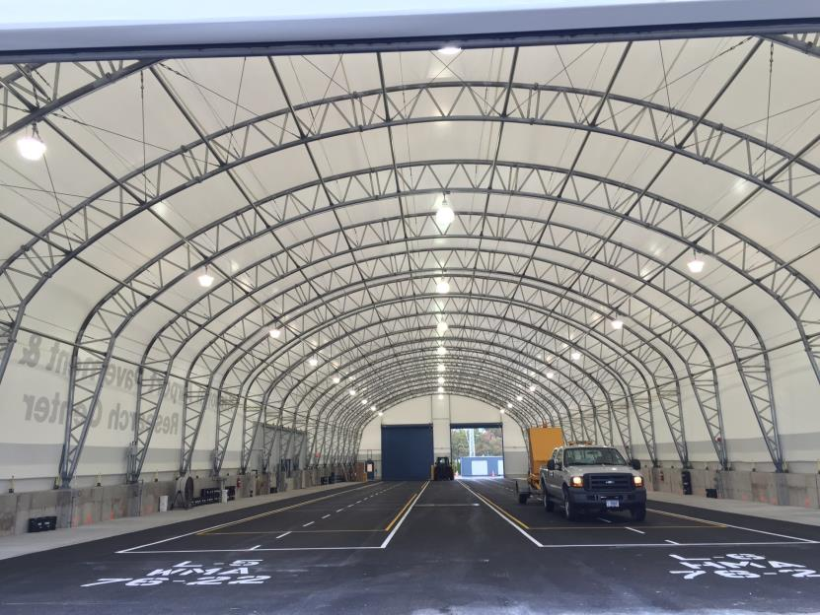

Slide 8
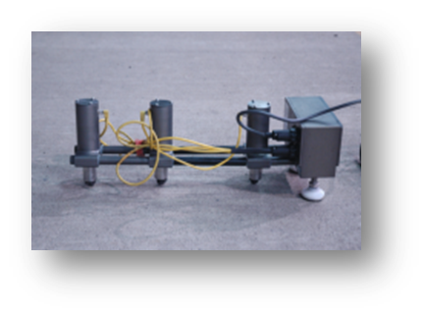
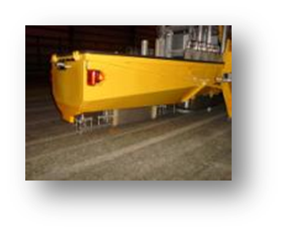
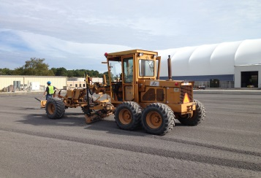
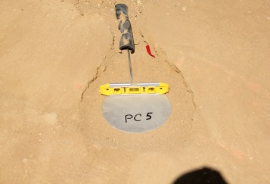
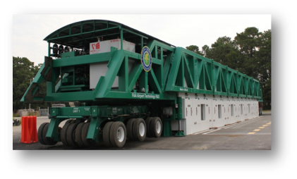
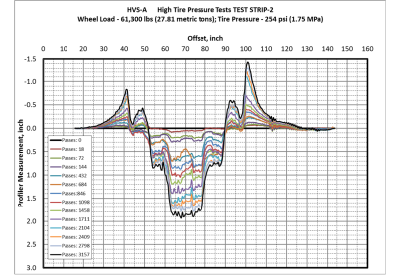
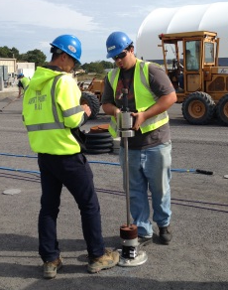

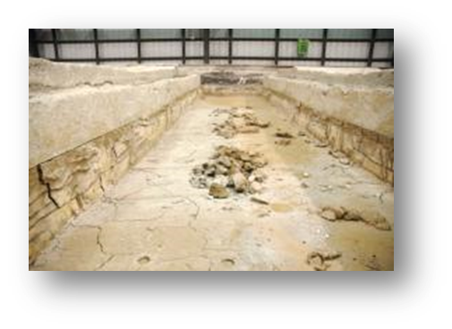
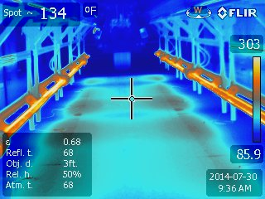
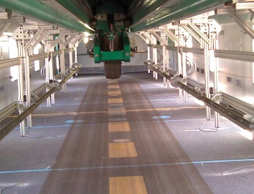
Objectives, Pavement
Construction, Sensors
NDT & Pavement
Characterization
TEST CYCLE (TC) AT NAPMRC
Posttraffic Testing
Full-Scale APT,
Pavement Evaluation

Slide 9
MATERIAL
WMA
WMA
P401
HMA
P401
HMA
WMA
P401
HMA
254
psi
254
psi
254
psi
254
psi
254
psi
254
psi
TIRE
PRESSURE
NAPMRC
Test Cycle-1
(TC-1)
210
psi
210
psi
210
psi
210
psi
210
psi
210
psi
BINDER
TYPE
PG
76-22
PG
64-22
PG
76-22
PG
64-22
PG
76-22
PG
76-22

Slide 10
Pavement Cross Sections

Slide 11
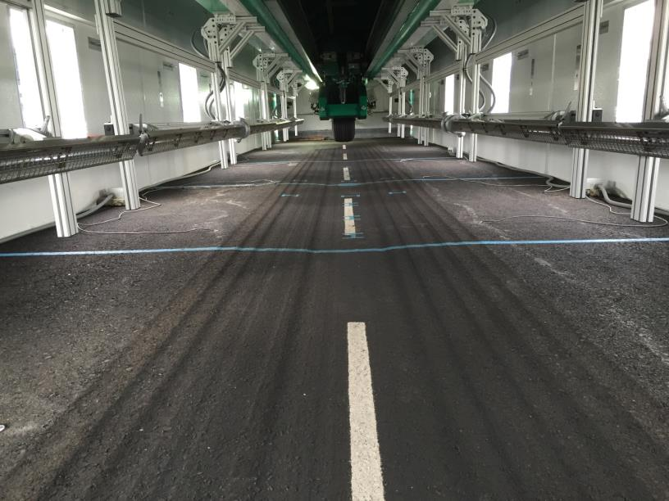

Slide 12
WMA
WMA
P401
HMA
P401
HMA
WMA
P401
HMA
254
psi
254
psi
254
psi
254
psi
254
psi
254
psi
CENTER
SECTIONS
254-psi 90°F
NAPMRC
Test Cycle-1
(TC-1)
210
psi
210
psi
210
psi
210
psi
210
psi
210
psi
PG
76-22
PG
64-22
PG
76-22
PG
64-22
PG
76-22
PG
76-22
Testing Completed
Currently Testing

Slide 13
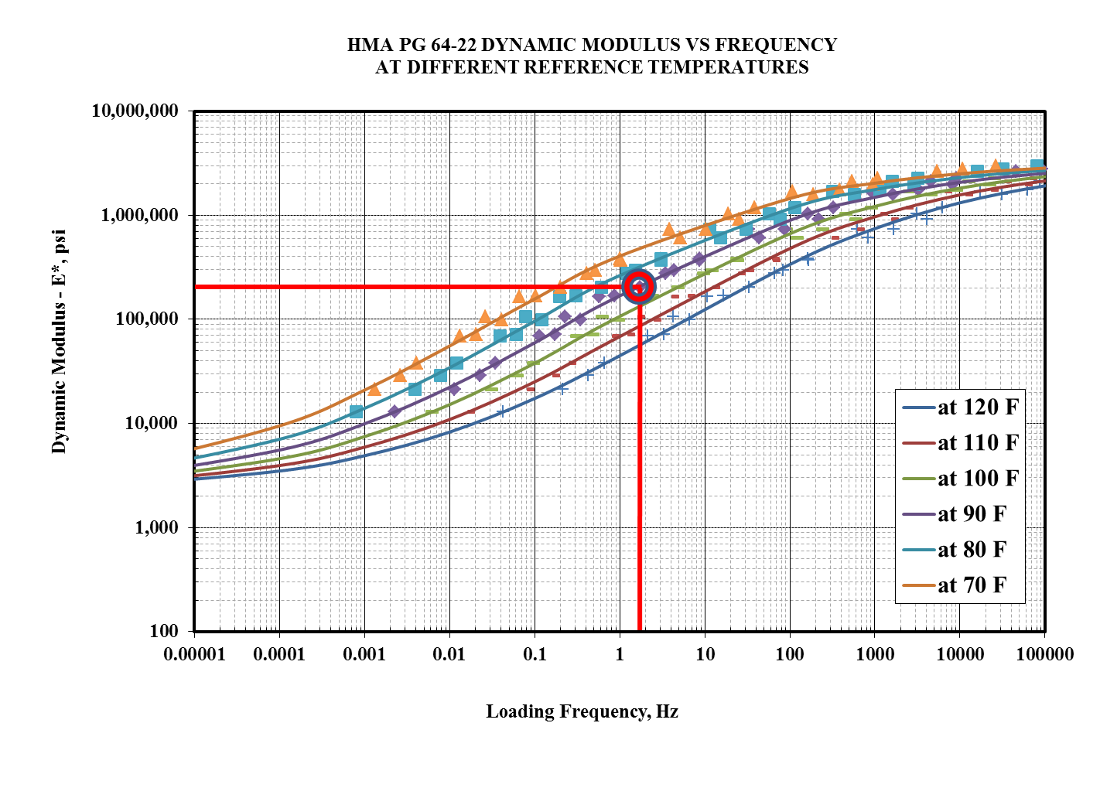

Slide 14
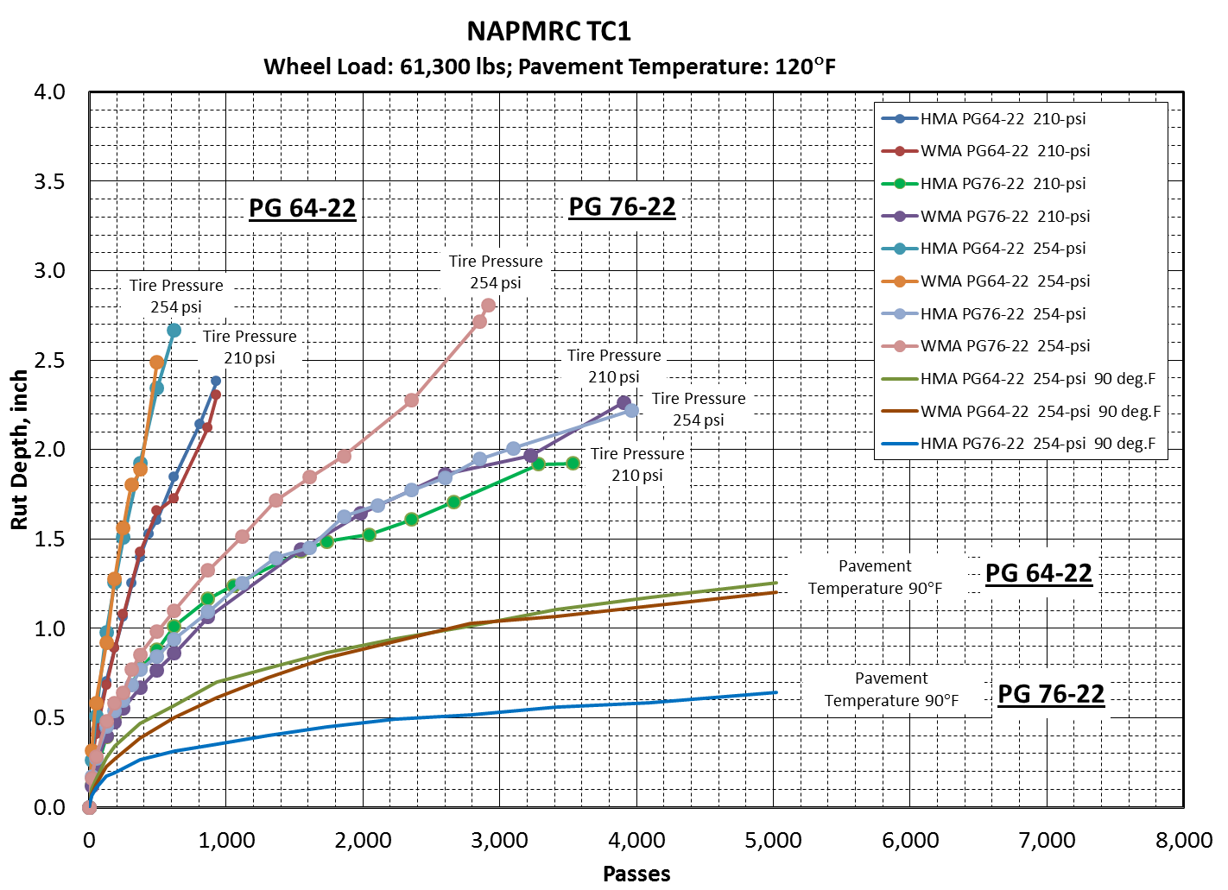

Slide 15
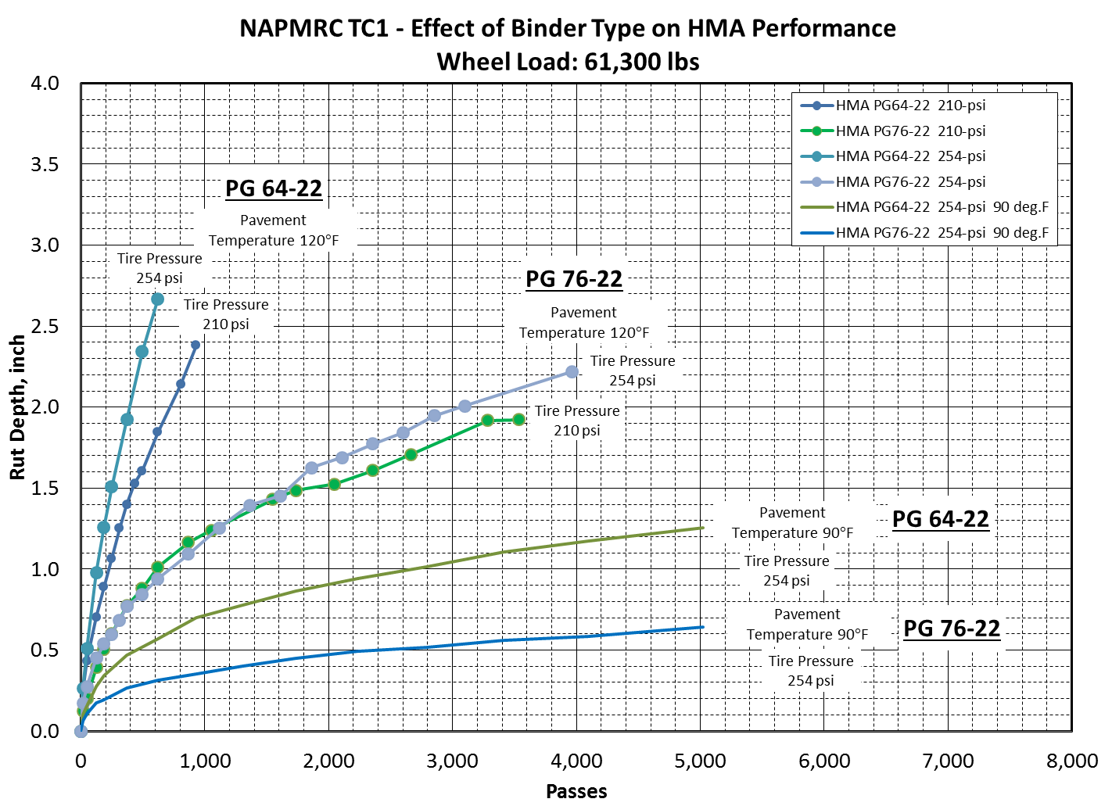

Slide 16
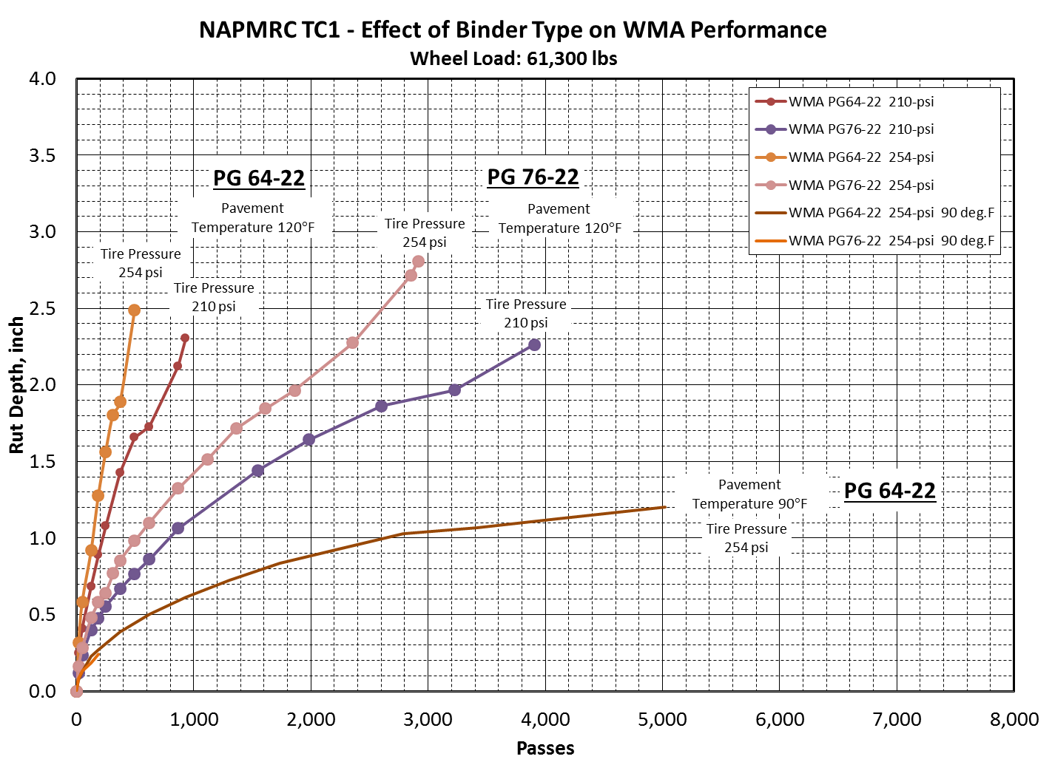

Slide 17
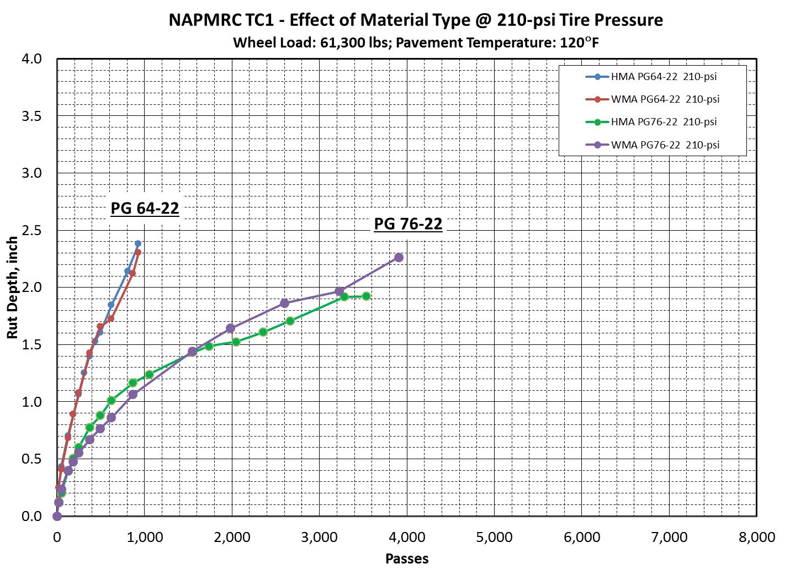

Slide 18
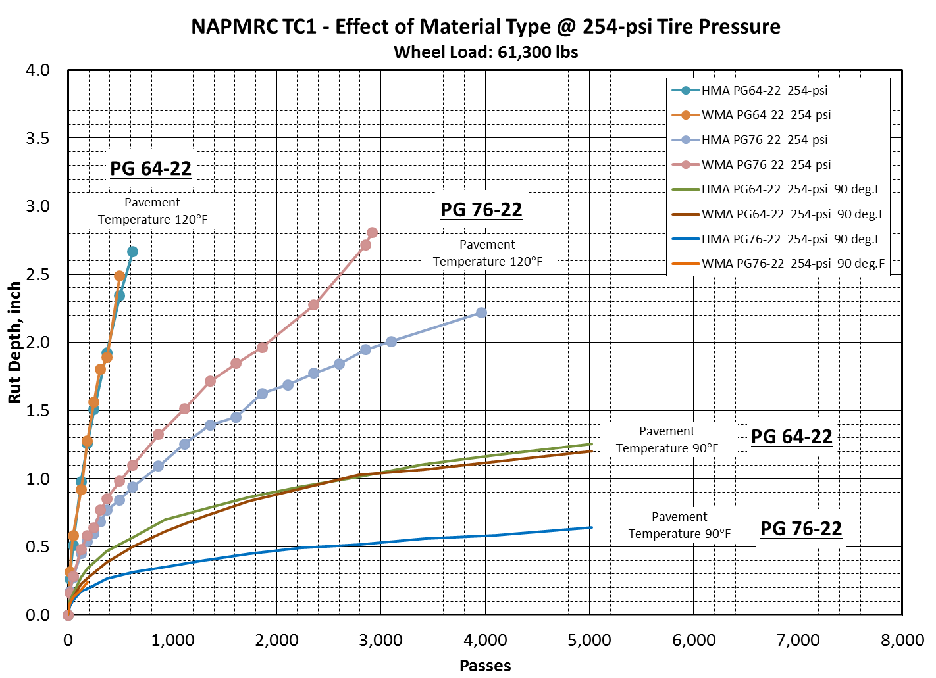

Slide 19
NAPMRC TC1 TEST PAVEMENT PERFORMANCE
 | Pavement Temperature = 120 deg.F |  |  |  | Pavement Temperature = 90 deg.F
Material | Binder | Tire Pressure, psi | Passes to Failure |  | Binder |  | Tire Pressure, psi | Passes to Failure
P401 HMA | PG64-22 | 210 | 220 |  | PG64-22 |  | 210
 |  | 254 | 130 |  |  |  | 254 | 2600
 | PG76-22 | 210 | 620 |  | PG76-22 |  | 210
 |  | 254 | 700 |  |  |  | 254 | 0.64 in Rut @ 5022
WMA | PG64-22 | 210 | 220 |  | PG64-22 |  | 210
 |  | 254 | 140 |  |  |  | 254 | 2600
 | PG76-22 | 210 | 800 |  | PG76-22 |  | 210
 |  | 254 | 520 |  |  |  | 254 | Testing in Progress
(Preliminary test results)

Slide 20
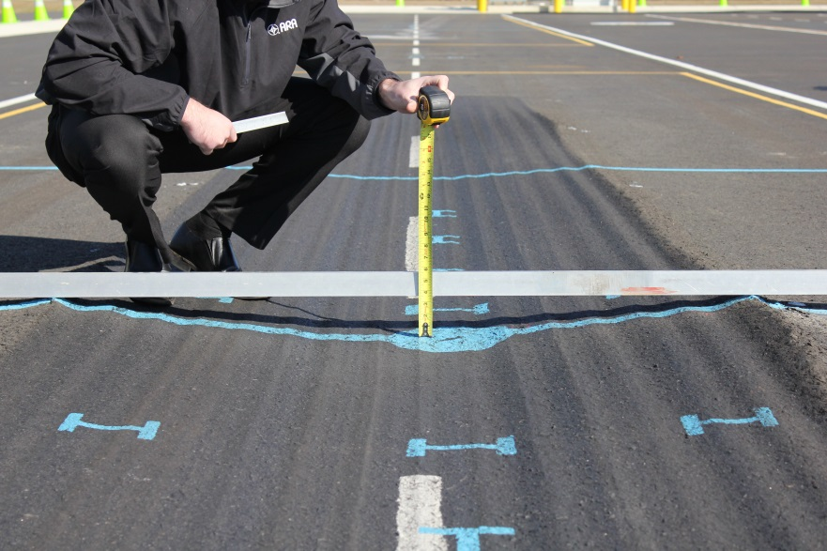
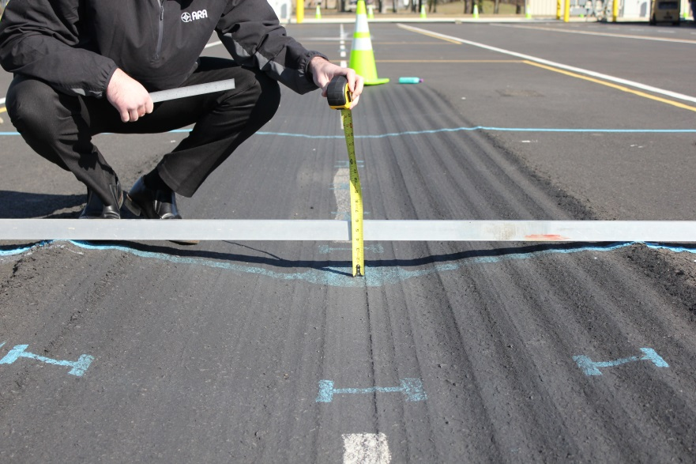


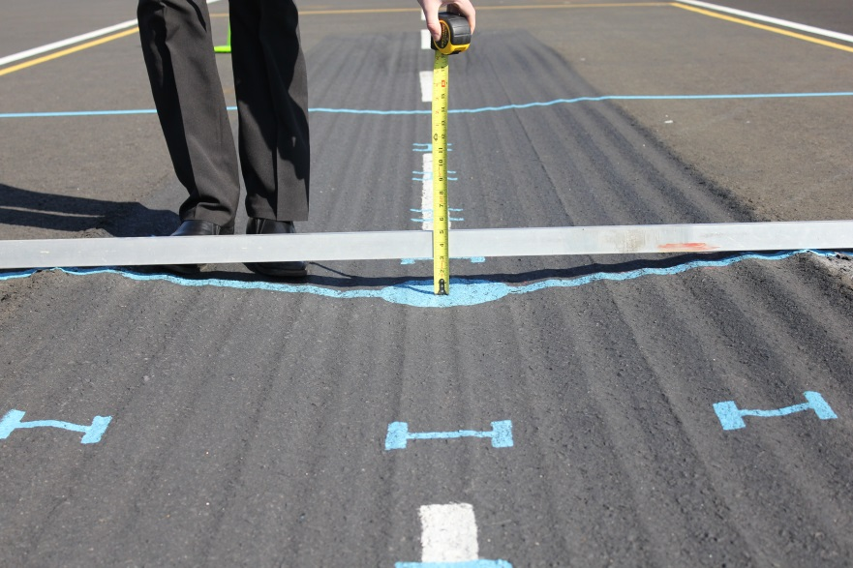
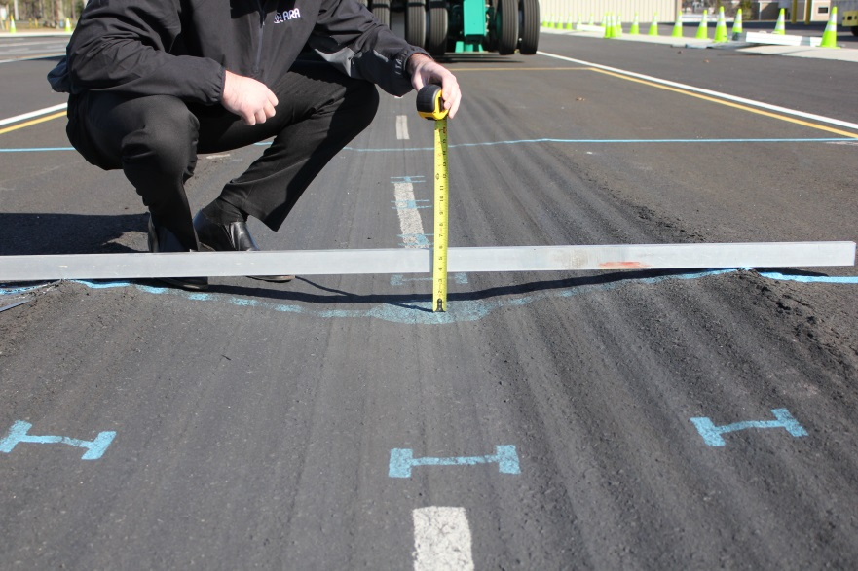


NAPMRC-TC1 SOUTH TEST AREA
No. of Passes to Failure: 800
Traffic Tests Terminated: 3906
No. of Passes to Failure: 220
Traffic Tests Terminated: 930
No. of Passes to Failure: 600
Traffic Tests Terminated: 3534
No. of Passes to Failure: 220
Traffic Tests Terminated: 992

Slide 21
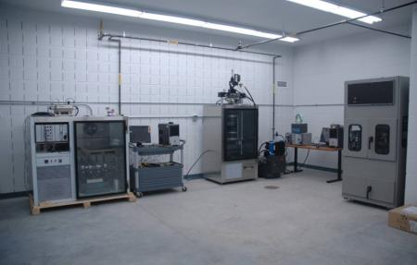
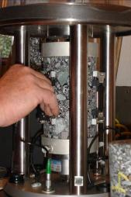
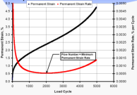
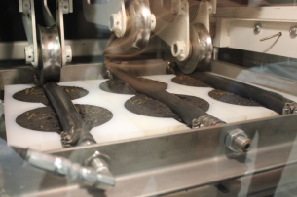
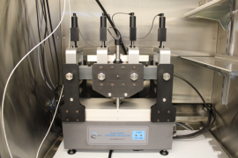

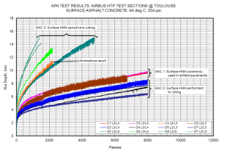
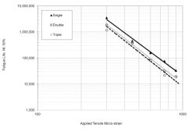
LABORATORY CHARACTERIZATION

Slide 22
Laboratory Characterization
Asphalt Mixtures:
  Dynamic Modulus Test
  Repeated Creep-Recovery Tests at Variable Stress Levels
  Repeated Creep-Recovery Tests at Variable Rest Periods
Asphalt Binders:
    Multiple Stress Creep-Recovery (MSCR)
Granular Materials:
  Resilient Modulus Test
  Repeated Creep-Recovery
  Triaxial Test to Calibrate CAP Model

Slide 23
Modelling – Texas A&M University
Development of Beta Version of Standalone PANDA-AP
Implementation of a robust constitutive relationship for granular layers
Conduct lab experiments on NAPMRC HVS-A materials
Conduct Performance Simulations

Slide 24
Modelling – Texas A&M University
Standalone PANDA-AP:
Considers failure mechanisms
Can be used as a supplement to FAARFIELD for refined analysis
Allows for the definition of different gear configurations, loading type, and pavement structure
User-friendly and customized for airfield pavements
Will be free to public and Independent of commercial FE software, such as Abaqus and Ansys

Slide 25
Modelling – Texas A&M University
PANDA Enhancement for Sub-layers:
Incorporates failure mechanisms for sub-layers
Accounts for permanent deformation of base, sub-base, and subgrade
Considers permanent deformation both due to shearing and densification
Can be applied for performance prediction of relatively thin AC pavements

Slide 26
Modelling – Texas A&M University
Performance Simulations:
Create 2D and 3D FE representation of airfield pavements subjected to different gear configurations
Analyze available lab experiments on FAA previous NAPTF materials
Conduct performance simulations of NAPTF sites to further validate and refine PANDA-AP
  Compare field rutting of NAPTF-CC3 sections with FE simulations

Slide 27
Other Research
Completed:
Laboratory Study on Stone Matrix Asphalt [Rutgers University]
HMA mixes with RAP [Univ. of California, Davis]

Slide 28
SMA Study
AAPTP 04-04 (Prowell et al., 2009) developed initial recommendations for SMA use on airfields
Study to utilize recommended specs to design two SMA mixtures
    9.5mm and 12.5mm NMAS
Compare to performance of two P401 mixtures using identical aggregate sources
    15% natural sand and 0% natural sand

Slide 29
SMA Study
Performance
Mixture stiffness
  P401 and SMA mixtures similar
  SMA showed slightly less stiffness at higher temperatures; most likely due to higher asphalt contents
Rutting Resistance
  P401 showed most rut resistance (lowest asphalt content)
  P401 with 15% natural sand most rut potential (rounded aggregate = poor shear strength)
  Both SMA mixtures met FAA APA specification

Slide 30
SMA Study
Performance
Fatigue cracking
  Both SMA mixtures showed better fatigue resistance than P401
  Crack initiation and crack propagation
  Higher effective asphalt contents

Slide 31
MATERIAL
P401
HMA
WMA
1
WMA
2
WMA
3
RAP
1
RAP
2
CRACKING
(test during
winter)
NAPMRC
Proposed
Test Cycle-2
(TC-2)
RUTTING
(test at high
temperature)
PG
76-22
PG
76-22
PG
76-22
PG
76-22
PG
64-22
PG
64-22
BINDER
TYPE

Slide 32
Future Research
EVALUATION OF NEW ASPHALT TECHNOLOGIES FOR AIRFIELD PAVEMENTS
Warm Mix Asphalt, Stone Matrix Asphalt, Polymer Modified Binders,
RAP Mixes, Full-Depth Rehabilitation
PROBLEM: Lack of Guidance/Standards/Specifications
Lack of Performance Data
Laboratory Performance Evaluation
Full-Scale APT
NAPMRC
Field Performance Evaluation
Evaluate:
Rutting
Fatigue
Moisture Susceptibility
Durability
Low Temperature Cracking
Full-Scale APT:
Rutting
Fatigue
Tire Pressure Effects
WMA
RAP/RAS
Full Depth Reclamation
Compare to P-401 HMA
Field Projects:
Lab Evaluation of Field Mixes
Construction Evaluation
Evaluate:
Mix Design Production, Construction
Support from AAS-100, ADO

Slide 33
