Slide 1
RPA – P3 Field Instrumentation & Testing

Slide 2
RPA P3 Overview – Field Instrumentation & Testing
Need
Research Goals
Provides better understanding of long term pavement behavior in the field under varied climatic and operating conditions, and improved paving materials characterization will conserve airport development funds and reduce the downtime of runways from construction and maintenance activities.
Research Goals
More durable, long-lived airport pavements, reduced lifecycle costs, better prediction of pavement service life, and accurate assessment of aircraft-pavement compatibility
Pavement performance data under different climatic conditions.
Deliverables
Technical Reports, technical papers.
FY 2016 Accomplishments
Funding Requirements
Completed data analysis on JFK & EWR Instrumentation Projects.
Finite Element Analysis - Underway.
Milestones
- Complete sensor installation at BOS.
- Complete lab tests on materials collected at BOS.
- Complete sensor installation at PHL.
- Complete lab tests on materials collected at PHL
- Complete in-situ tests at PHL.
Field Instrumentation & Testing FY 2016 through FY 2018.
 | FY 2016 | FY 2017 | FY-18
Funding Target ($000) | $600 | $900 | $927
P3.1: Sensor Installation | $200 | $300 | $310
P3.2: Material Testing | $250 | $400 | $415
P3.3: Data Analysis | $150 | $200 | $202

Slide 3
Objectives
• Evaluate the effects of environment on pavement performance;
• Determine thermal gradients within asphalt and concrete layers;
• Determine the effects of material properties and variability on pavement response and performance;
• Determine the effects of construction quality on pavement response and performance;
• Determine the effects of specific design features on pavement response and performance;
• Develop improved material characterization through in-situ and laboratory testing at new construction projects and, when available, subgrade testing for rehabilitation projects.

Slide 4
Type of Data Collected
• Climatic data (pavement & air temperatures).
• Pavement response data (strains, pressure, deflections).
• Material samples for laboratory testing.
• In-situ test data (non-destructive tests, vane shear, dynamic cone penetrometer, etc.).
• Heavy Weight Deflectometer tests.

Slide 5
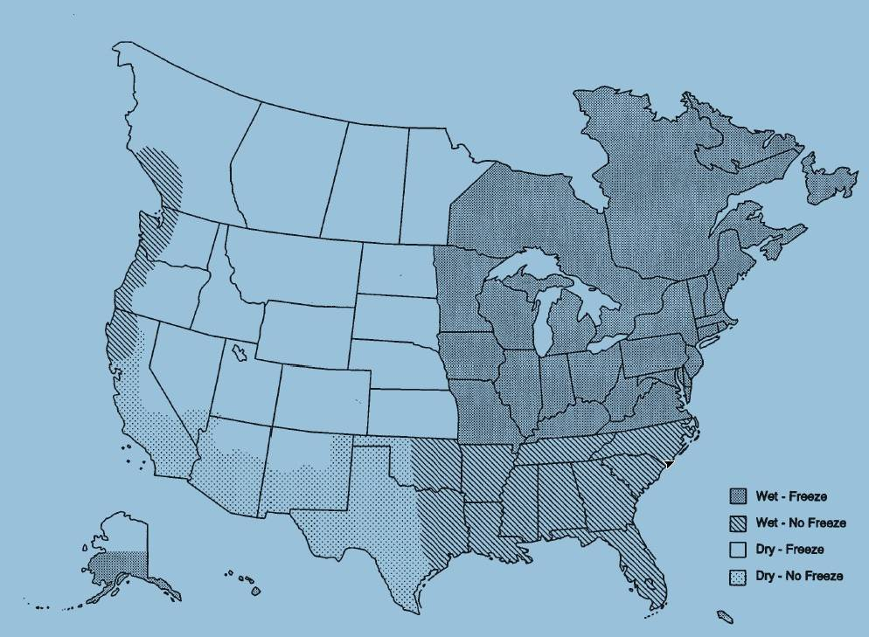
Current FAA Airport Instrumentation Projects
Newark Liberty International Airport, Newark – AC Overlay Pavement
JFK International Airport, NYC – PCC Pavement
LaGuardia Airport, NYC – AC Overlay Pavement

Slide 6
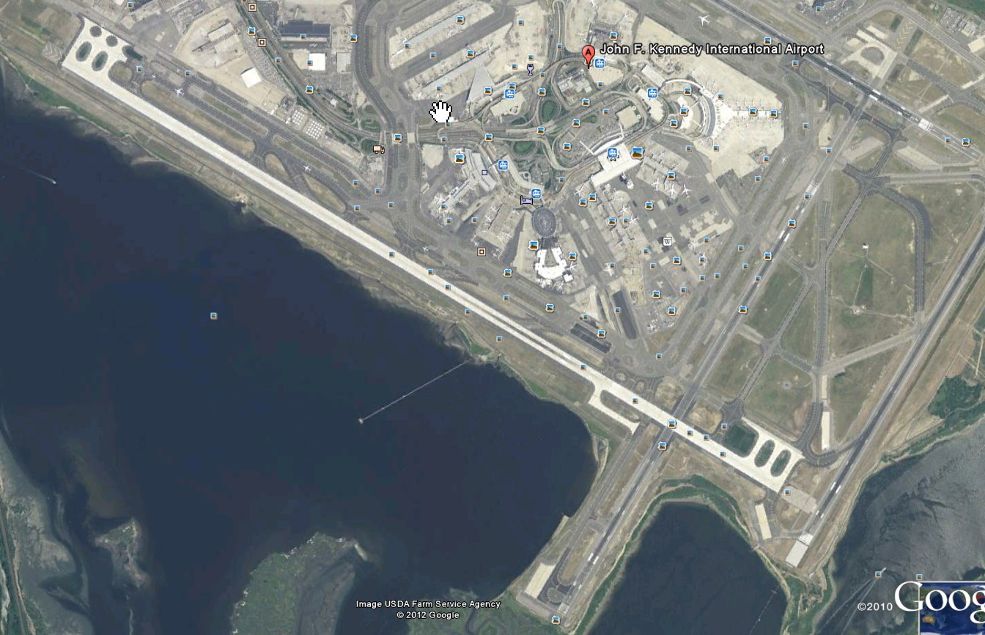
JFK Runway 13R-31L Reconstruction Project
4,443 m long, 61 m wide
Completed in 2 phases
Taxiway-Z

Slide 7
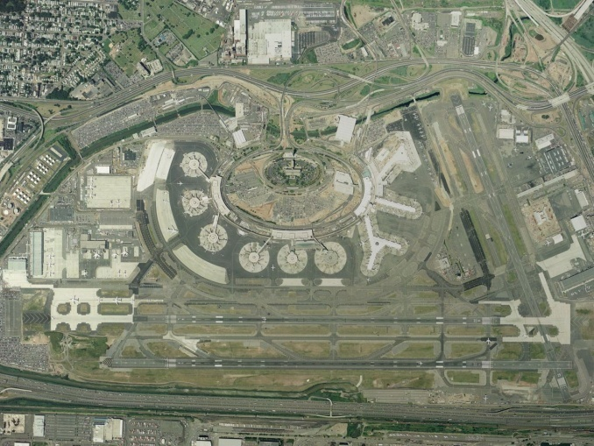
Study slippage failures on Runway 4R-22L at EWR.

Slide 8
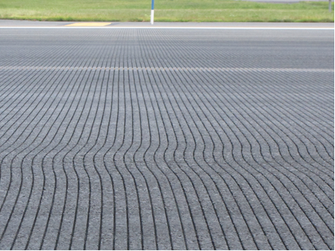
Courtesy of PANYNJ 2014

Slide 9
Current FAA Airport Instrumentation Projects
BOS International Airport, Boston – AC Overlay Pavement
PHLInternational Airport, Philadelphia – AC & PCC Pavement

Slide 10
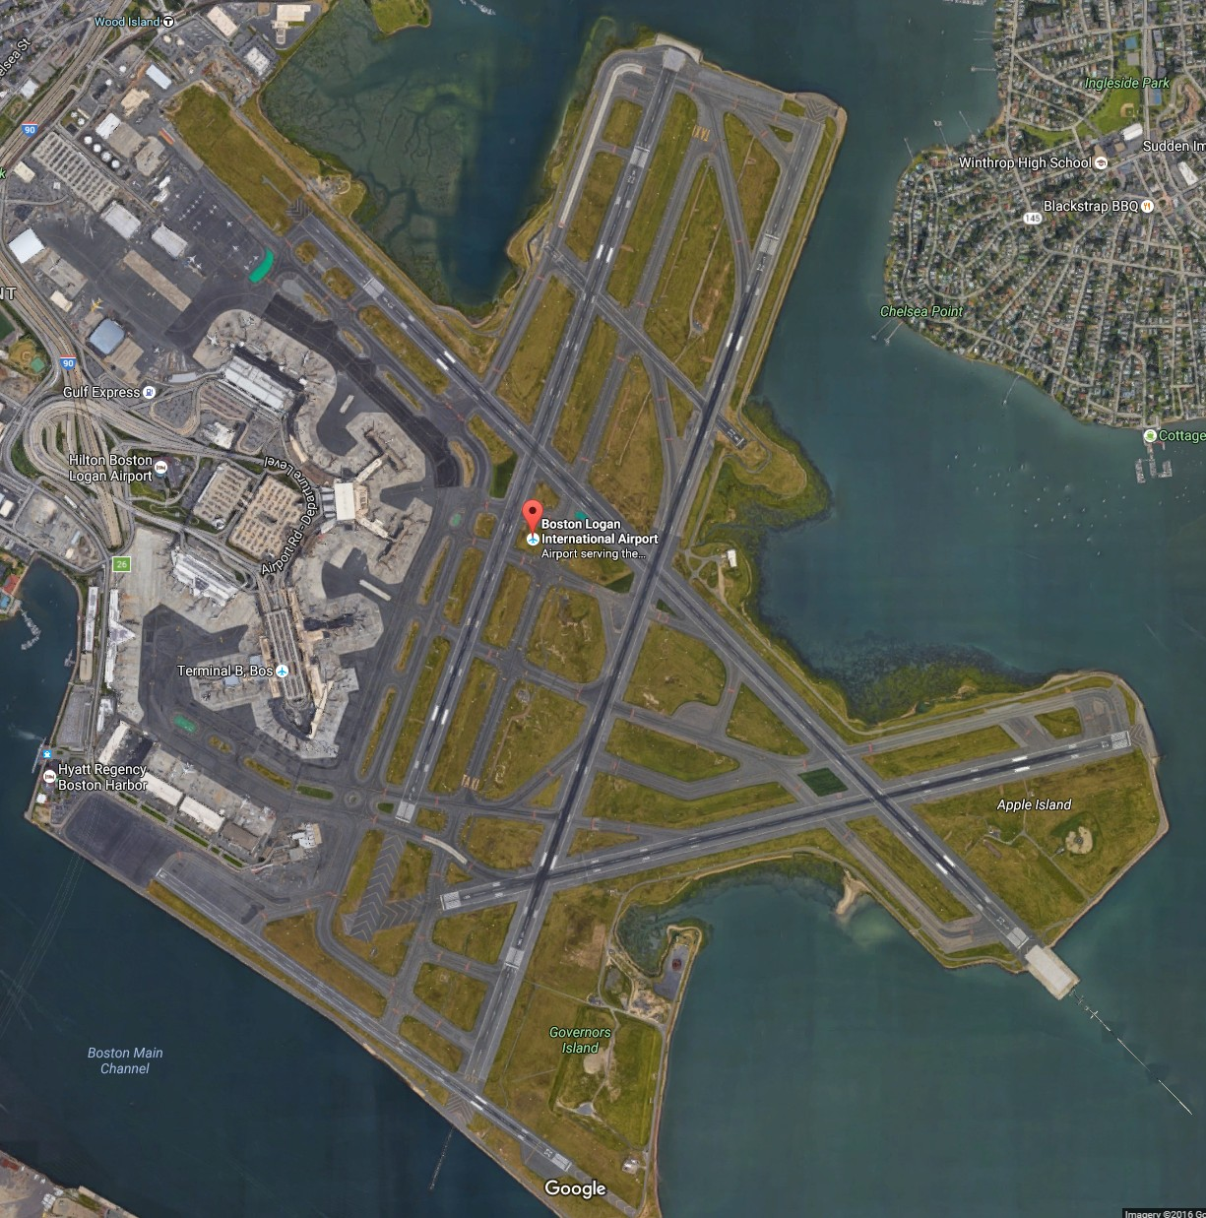

Slide 11
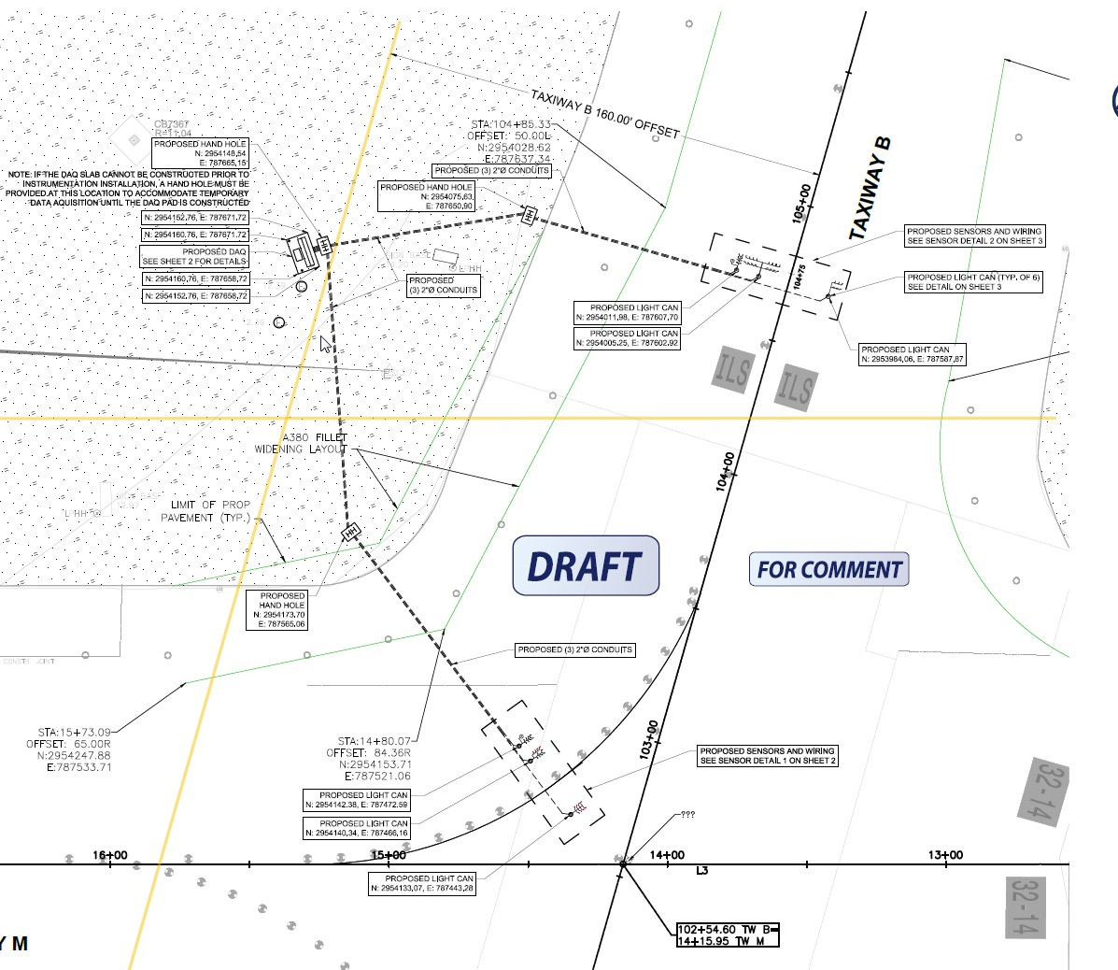
TAXIWAY M

Slide 12
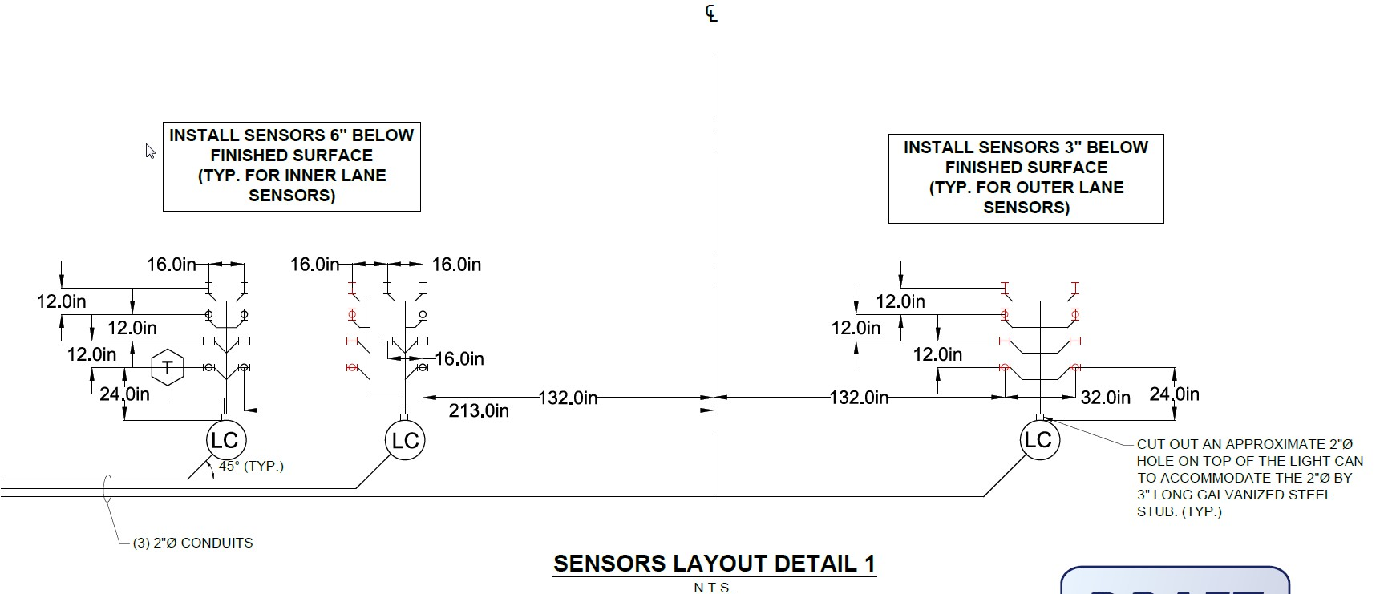
TAXIWAY M

Slide 13
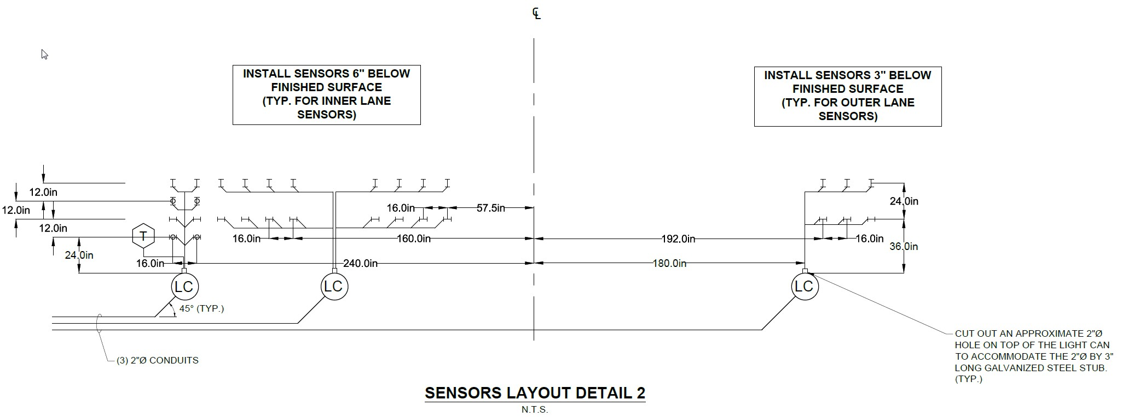
TAXIWAY B

Slide 14
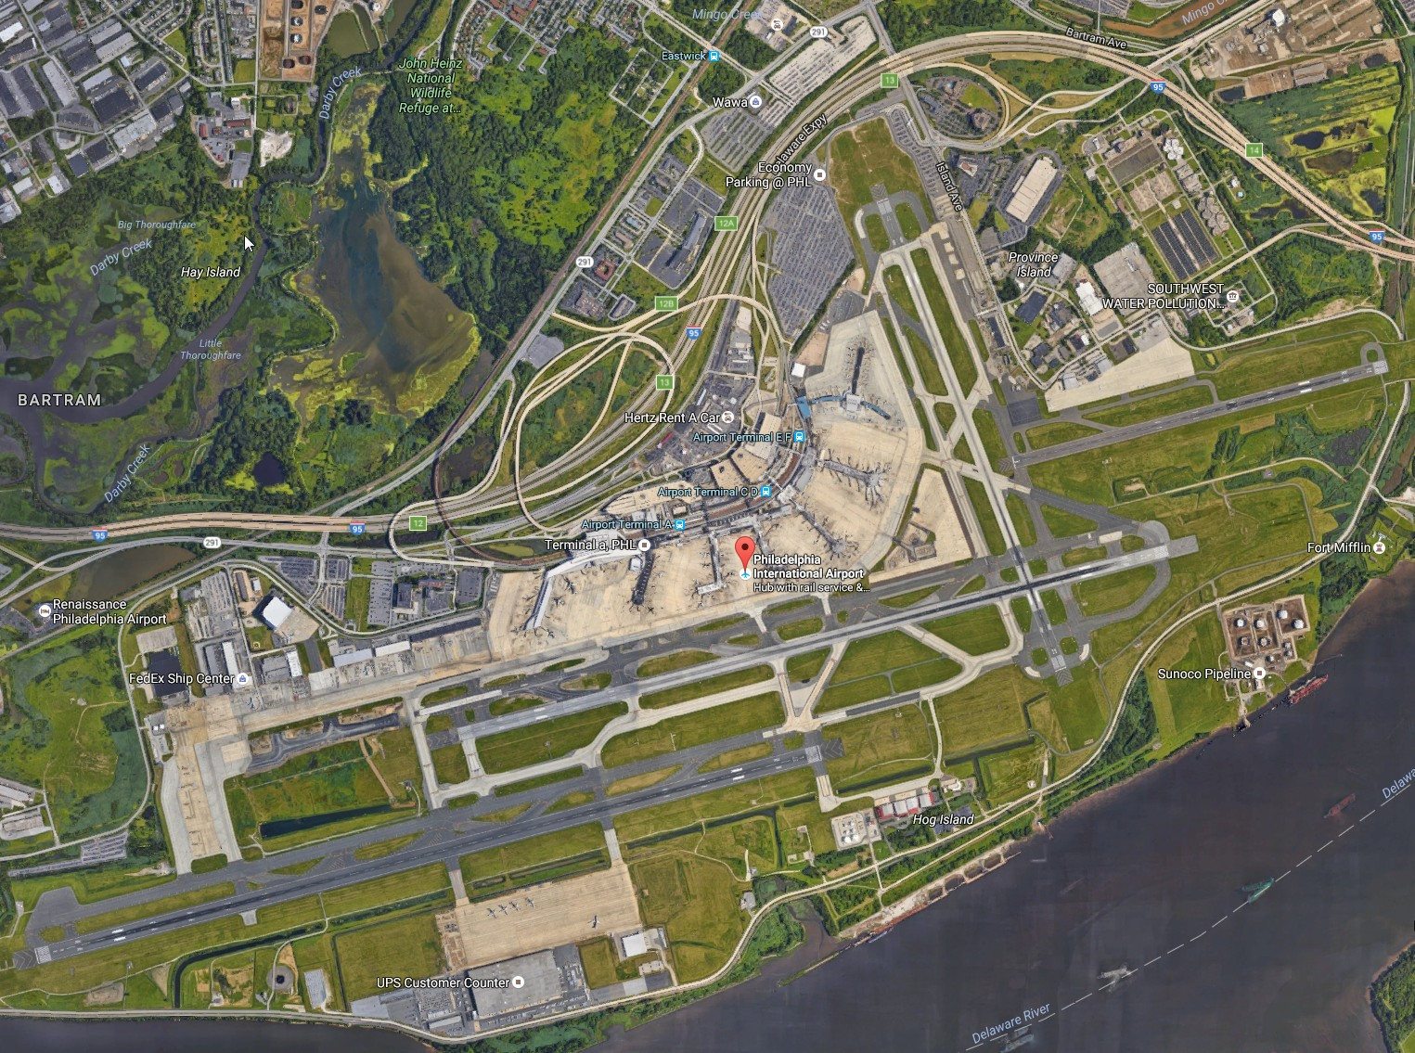

Slide 15
Objectives
Determine the response of concrete slabs and asphalt concrete under multi-gear aircraft such as A-350, B-777, etc.
Compare the performance of concrete slabs and asphalt concrete under aircraft load.
Evaluate the load transfer efficiency of the joint
Measure the temperature profile in cement pavement and asphalt pavement. Study the effect of temperature profile on pavement response.
Evaluate curling in concrete slabs.
Measure the pressure on top of subgrade and base layer under aircraft load for different pavement structure.
Characterize the subgrade, base, cement concrete and asphalt concrete materials.

Slide 16
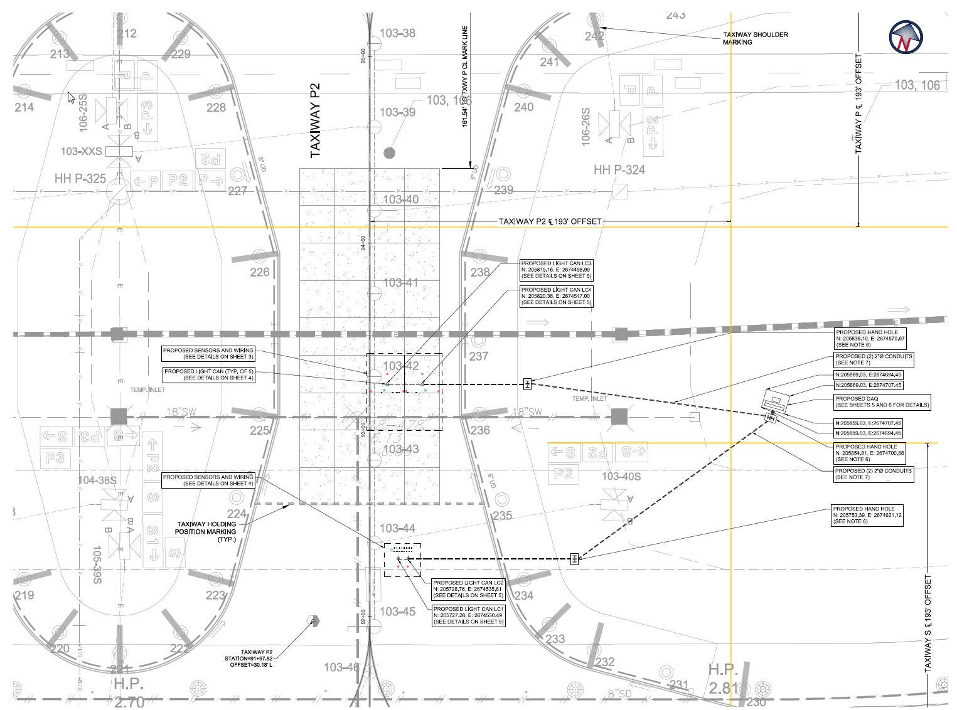

Slide 17
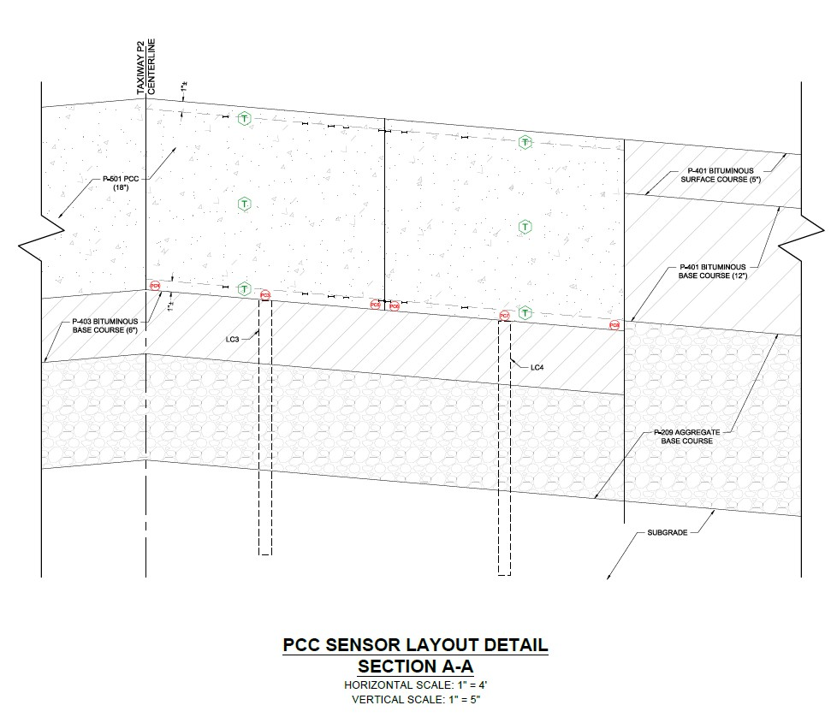
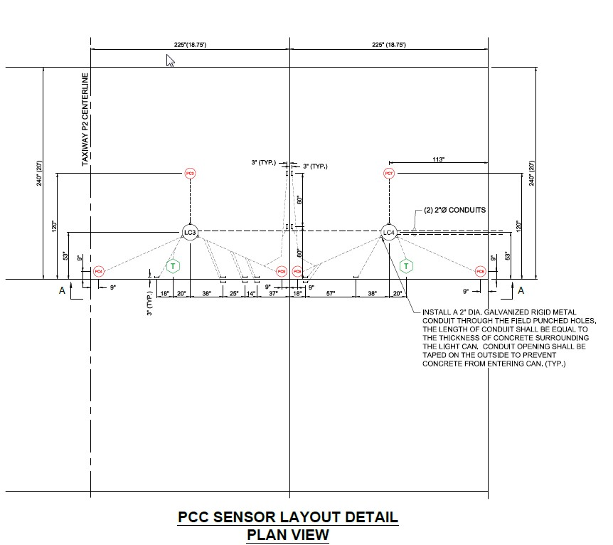

Slide 18
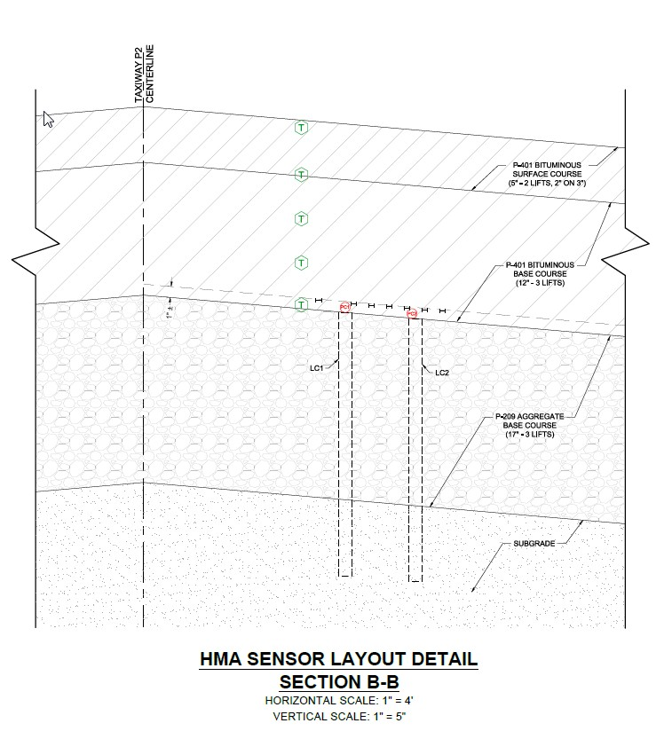
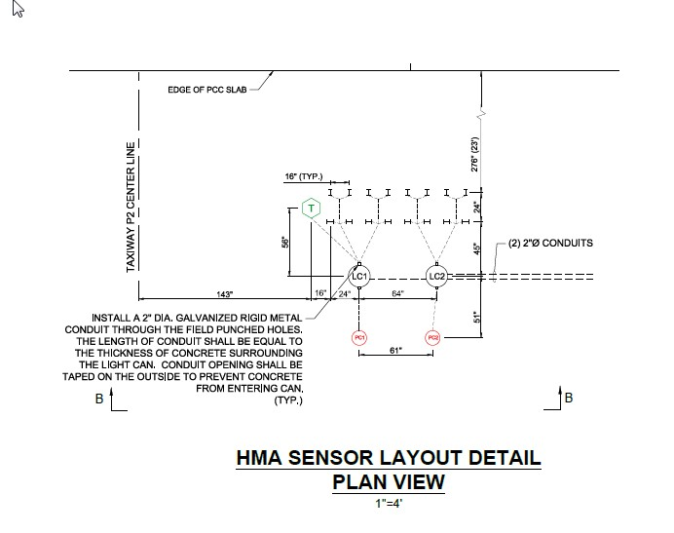

Slide 19
