Slide 1
Pavement Design and Evaluation
RPA P5
REDAC Subcommittee on Airports
David R. Brill, P.E., Ph.D.
August 17, 2016

Slide 2
RPA P5 – Pavement Design and Evaluation
Need
There is a need for advanced, computer-based pavement design & evaluation solutions to protect the FAA’s investment in airport pavement. The FAARFIELD program provides confidence that pavements will meet the required service life. Savings to the AIP will result from reduced construction costs and fewer runway closures.
Research Goals
Continue to update and modernize the FAARFIELD design software.
New ACN-PCN system of reporting airport pavement strength by FY17.
Incorporate top-down cracking mode in FAARFIELD rigid design by FY18.
Fully integrate FAARFIELD thickness design with LCCA procedures by FY22.
FY 2016 Accomplishments
Release FAARFIELD v. 1.4.
New FAARFIELD-based
ACN-PCN method for evaluation.
Tech Note on improved treatment of aircraft gears in tandem.
Funding Requirements
Project | Contract Funds ($K)
 | FY 2016 | FY 2017 | FY 2018
P5. Pavement Design and Evaluation | 2090 | 1200 | 1236
P5.1. Design Improvements | 875 | 750 | 771
P5.2. ACN-PCN Improvements | 250 | 250 | 250
P5.3. Analysis | 965 | 200 | 215

Slide 3
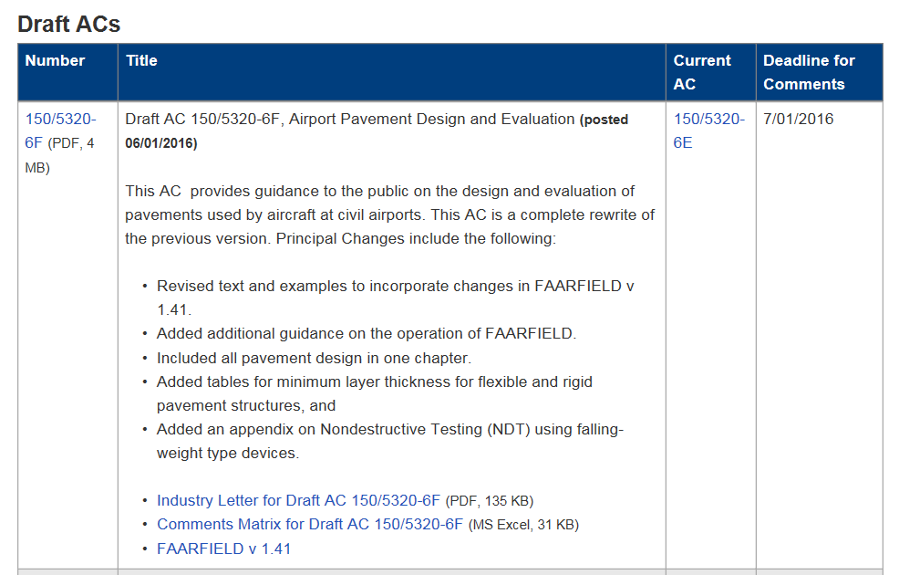
Draft AC 150/5320-6F
Posted 1 June 2016 for comment: http://www.faa.gov/airports/resources/draft_advisory_circulars/
Includes FAARFIELD 1.4

Slide 4
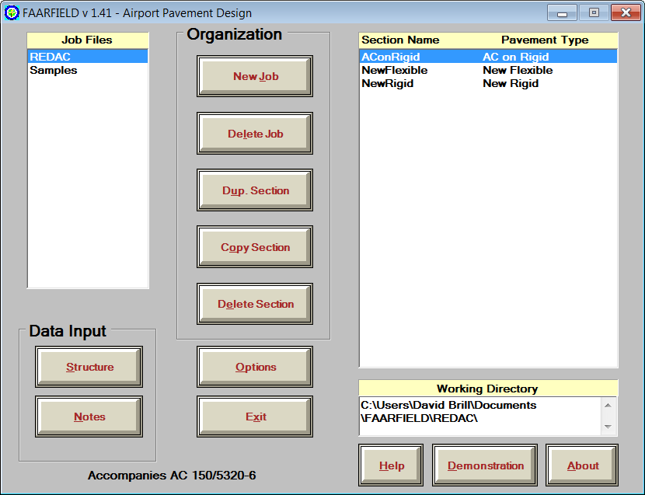
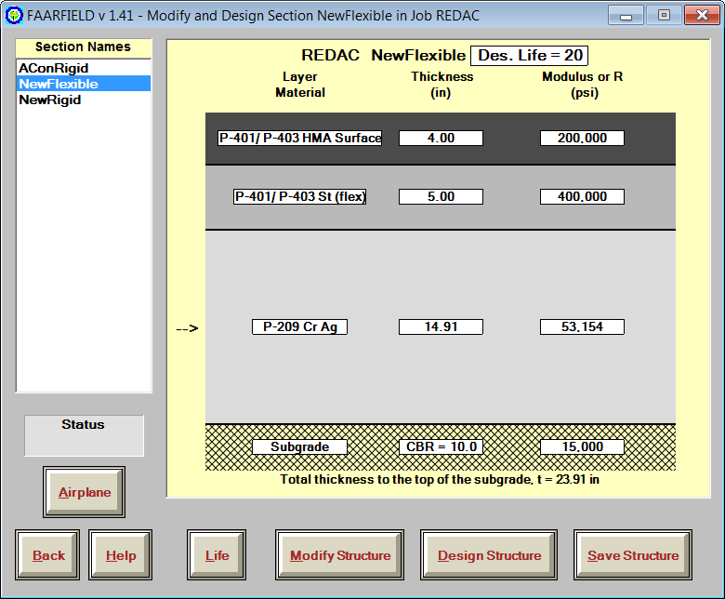
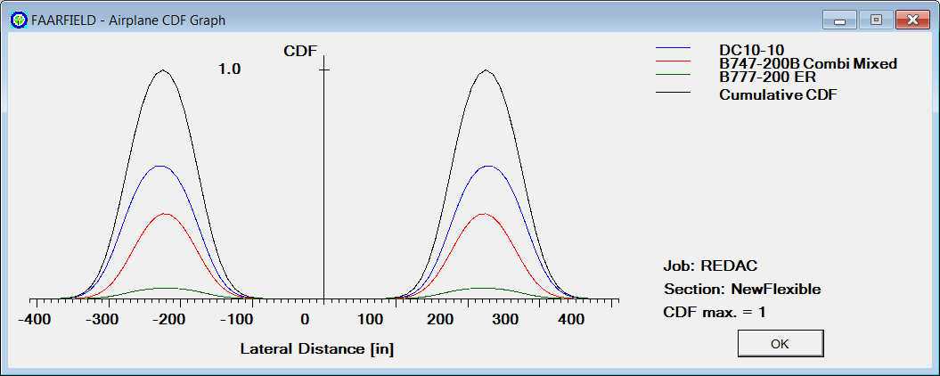
FAARFIELD 1.4 – Release Version

Slide 5
FAARFIELD 1.4 – What’s New?
Completely revised flexible and rigid failure models based on current NAPTF full-scale test data.
Reduced excess stabilized base thickness requirement.
Improved, more accurate 3D finite element model.
Completely rewritten concrete overlay design procedure.
Automatically generates PDF design report.
Automated, software-based compaction criteria.
Updated aircraft library aligned with COMFAA 3.0.
Include non-airplane vehicles in library (ARFF vehicles, etc.)
Support for user-defined gear configurations.
Advanced, energy-based asphalt fatigue models.
All data files now stored in document directories.

Slide 6
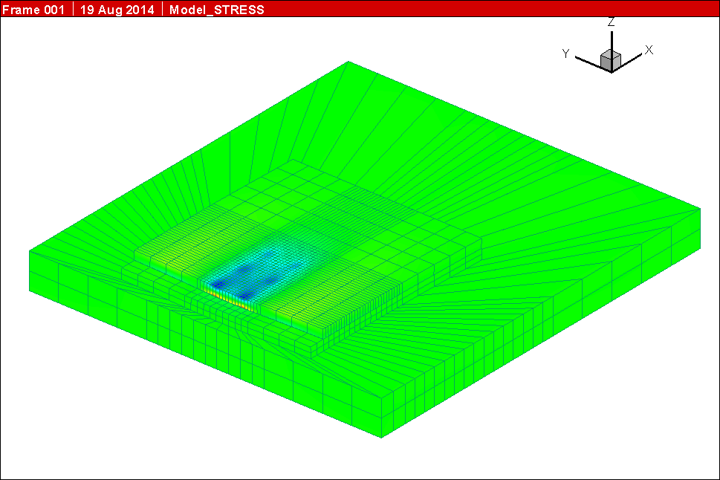
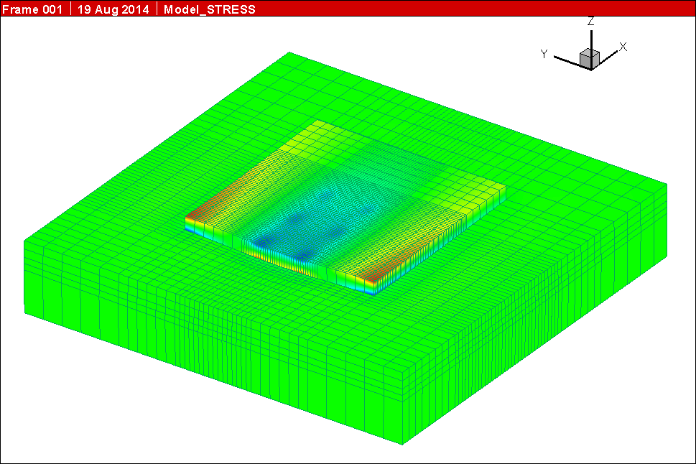
Improved 3D Finite Element Mesh
More accurate stress results.
Improved infinite foundation model.
Still one slab model with assumed 25% load transfer.
FAARFIELD 1.305
FAARFIELD 1.41

Slide 7
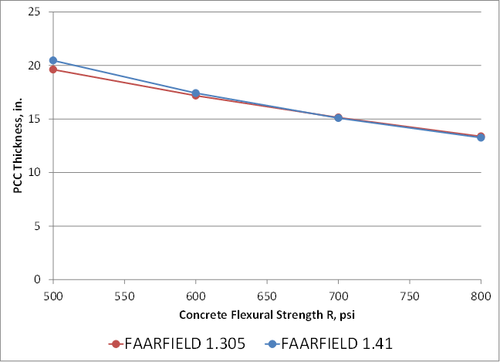
Rigid Pavements
New thickness designs are generally less conservative than FAARFIELD 1.3 designs for the same inputs.
Sensitivity to factors such as concrete strength, traffic level and subgrade support is similar to FAARFIELD 1.3.
Effect of Concrete Flex Strength
Effect of Traffic

Slide 8
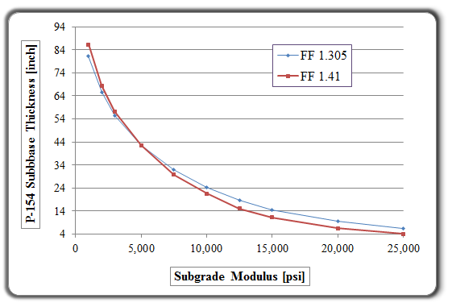
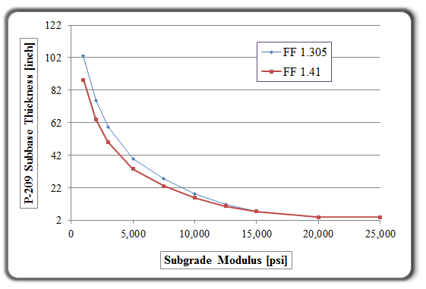
Flexible Pavements
New thickness designs are generally less conservative than FAARFIELD 1.305 designs for the same inputs.
Reduced stabilized base thickness requirements on P-209 subbase.
Conventional Flexible Pavement Comparison
Stabilized Flexible Pavement Comparison

Slide 9
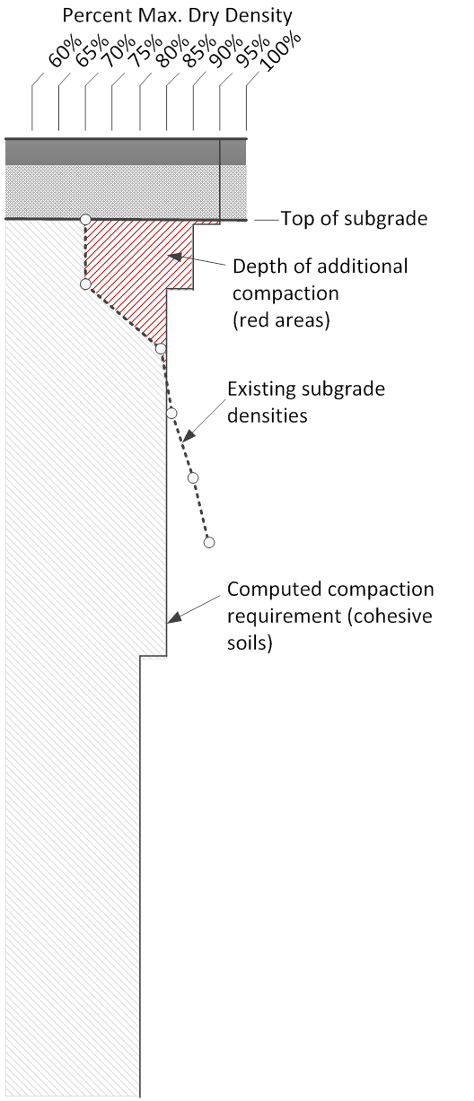
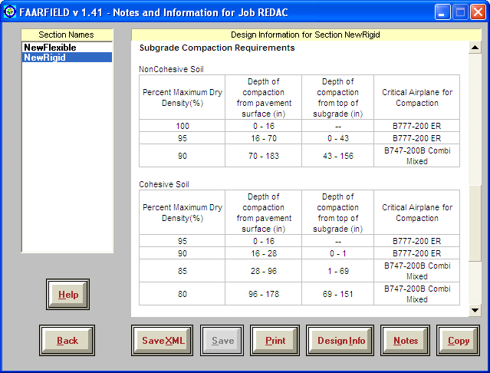
Automated Compaction Criteria
Computes compaction control points for rigid & flexible pavements.

Slide 10
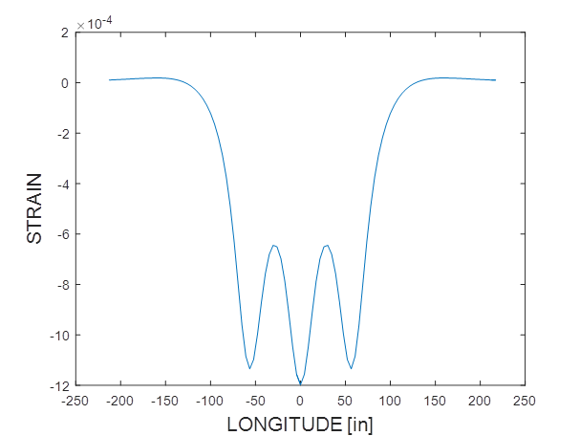
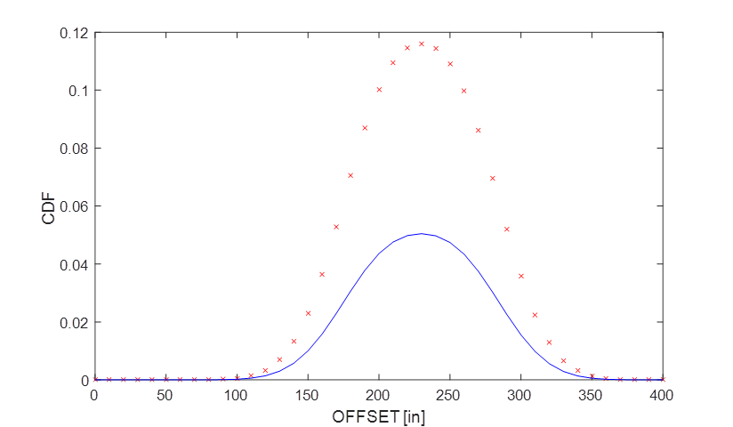
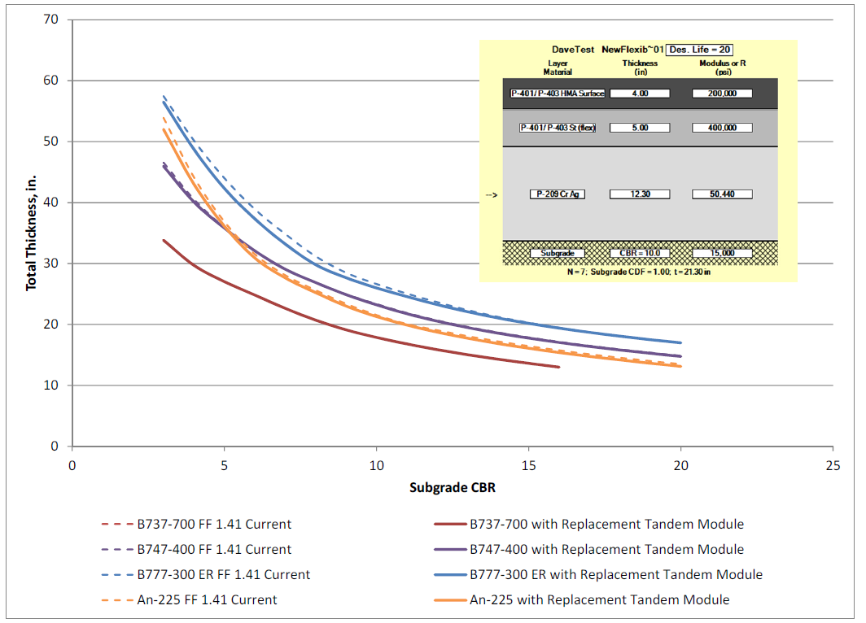
Direct Evaluation of Tandem Gear Damage
(Flexible)
Old Method
Old method was a two-part pass/coverage (P/C) ratio consisting of a wander-related factor multiplied by a tandem factor.
New method: Compute CDF for multiple wheels in tandem by numerical integration of the longitudinal strain profile.
Similar to method used by French DGAC (Alizé).
Displayed P/C ratio now relates only to wander.
New Method

Slide 11
Report in Publication
Technical Report “Replacement of FAARFIELD Tandem Factors with CDF Methodology”
Documents changes to evaluation of tandem gear damage.
In final editing.

Slide 12
Legacy Fortran Libraries
Existing Fortran libraries are modified from original 1995 programs.
Still distributed by FAA under a software sharing agreement with Lawrence Livermore National Laboratory, the original NIKE3D developer.
Very significant limitations for .NET programming.
  Unmanaged code.
  Not under the control of .NET memory management services.
  May lead to memory conflicts or crashes at runtime.
  Obsolete data storage and retrieval methods.
  Few young programmers have knowledge of Fortran.

Slide 13
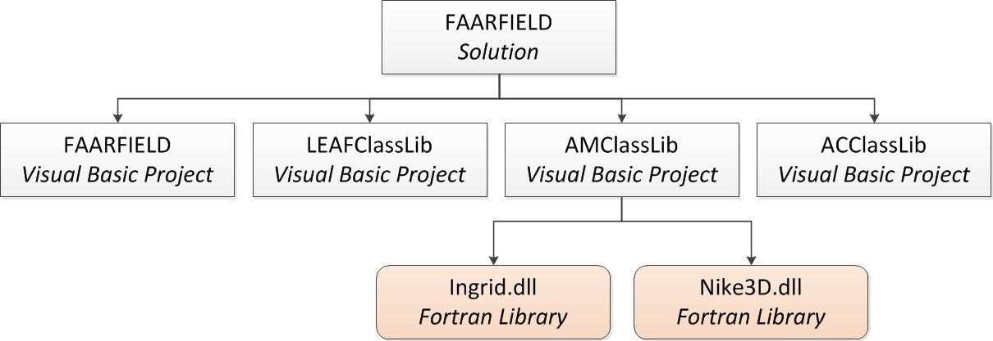
FAARFIELD Calling Structure

Slide 14
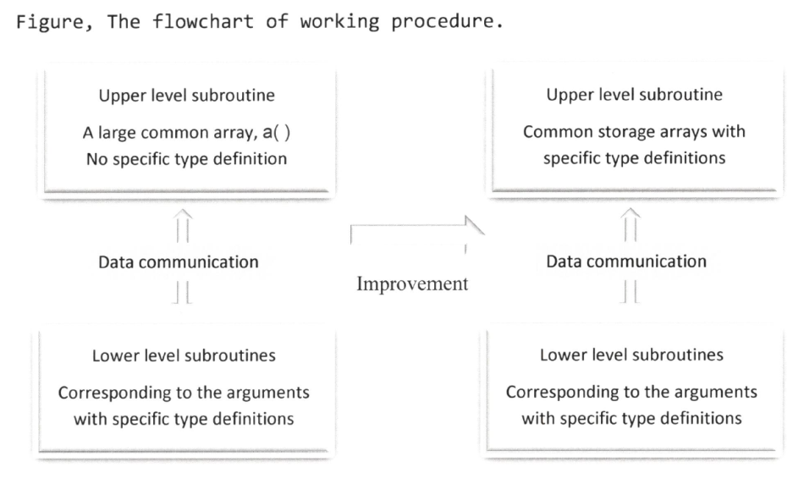
Short-Term Improvement
Enforce data type consistency.
  Legacy program uses a single common array to store dissimilar data types.
  Replace with multiple common arrays targeted to specific data types.
Better error handling.
Recompile existing Fortran libraries to fixed memory space.
Improvement to NIKE3D Common Storage Arrays (in progress)

Slide 15
Long-Term Solution
The FAA needs modern replacements for its legacy finite element libraries Ingrid.dll and Nike3d.dll.
Similar to LEAF, the new libraries should be:
  Open-source.
  Freely distributable – could be shared with third parties.
  Compatible with modern computing systems.
Keep the functionality of current NIKE3D.
Retain only element types, material libraries, etc., that are needed for design and analysis of pavements.
In progress: VB.NET replacement for Ingrid.dll.

Slide 16
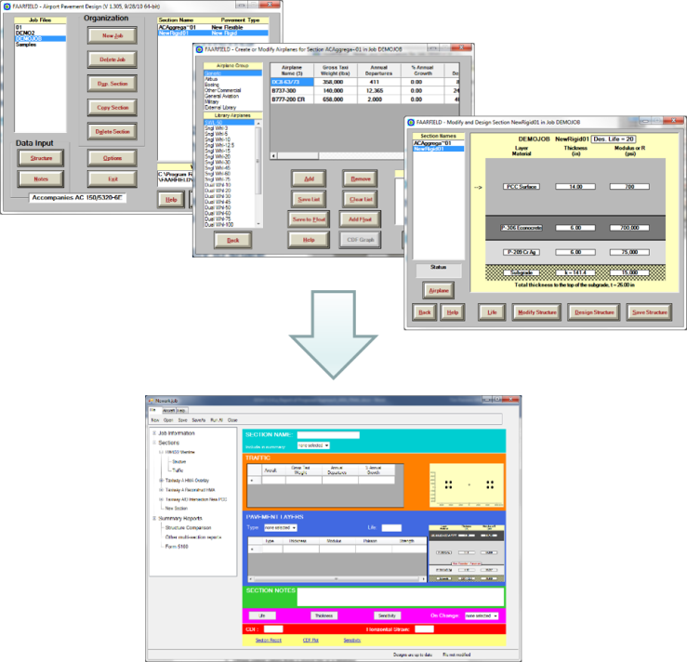
Further Improvements
Modernize the FAARFIELD graphical user interface (GUI).
  Job and section entry.
  Improved start-up screen.
  Improved screen re-sizing and appearance.
  Improved flow between screens.
Rationalize data file structure.

Slide 17
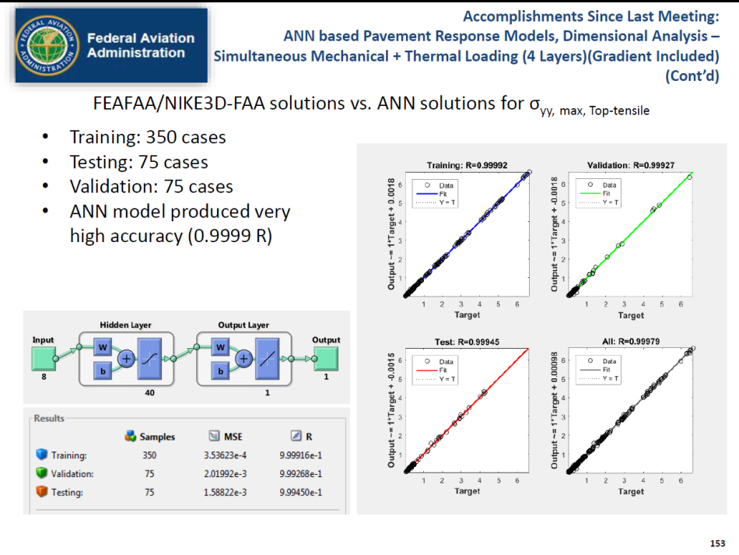
Top-Down Cracking Mode (Rigid)
ANN Development: Input Parameters
Current efforts are focused on artificial neural networks (ANN) for multi-slab model with curling.
Fast, accurate solutions within the defined problem space.
Grant to Iowa State U.
  P.I. Dr. Halil Ceylan
  1st year of 3-year project.

Slide 18
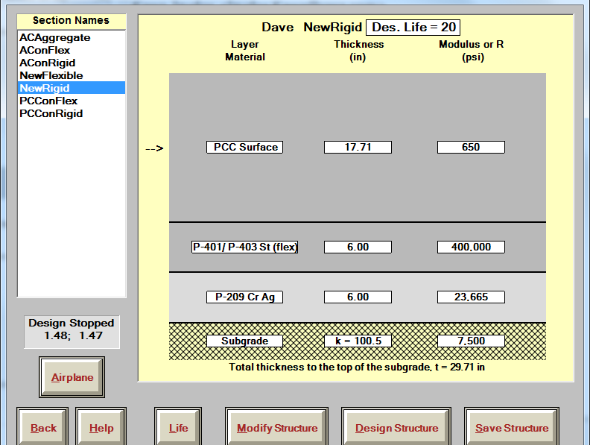
Questions?

