Slide 1
Extended Pavement Life
RPA P8
REDAC Subcommittee on Airports
David R. Brill, P.E., Ph.D.
August 17, 2016

Slide 2
RPA P8 – Extended Pavement Life
Need
Longer design periods for airport pavements, up to double the current standard of 20 years, will provide cost savings to the AIP by reducing lifecycle costs. Extended airport pavement life also provides many green benefits, and minimizes down time at the nation’s busiest airports.
Research Goals
Link PA40 database to historical traffic data sources in ASIAS by FY16.
Develop performance data models (Age-DL and Traffic-DL) by FY18.
Next-generation FAARFIELD program incorporating new 40-year life design procedures by FY22.
FY 2016 Accomplishments
Completed field data collection at TUS and MCI.
PA40 database 90% complete.
Funding Requirements
 | FY 2016 | FY 2017 | FY 2018
Funding Target ($000) | 1,210 | 1,000 | 1,030

Slide 3
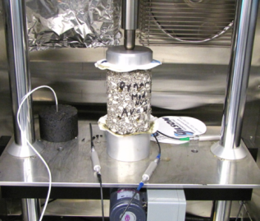
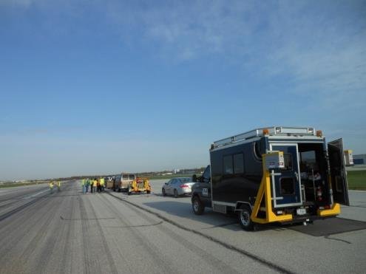
Pavement Life Extension
Runway data collection.
  4-year project – last year.
  Construction and performance data on medium- and large-hub runway pavements.
  Field data collection.
  Current efforts focus on filling known gaps in data.
FAA PAVEAIR database development (PA40).
Pavement life model development.

Slide 4
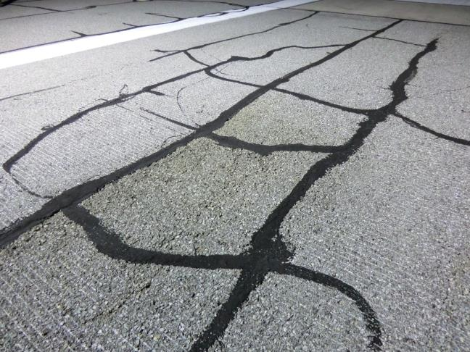
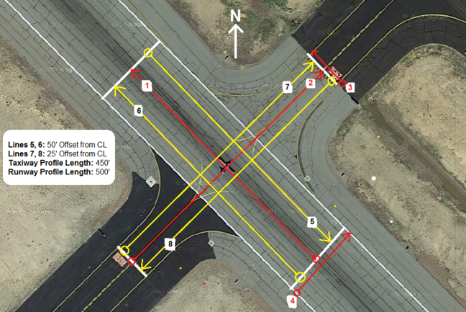
TUS Field Data Collection
December 2015
SurPro Guide @ Intersection
PCI Inspection, RWY 11L

Slide 5
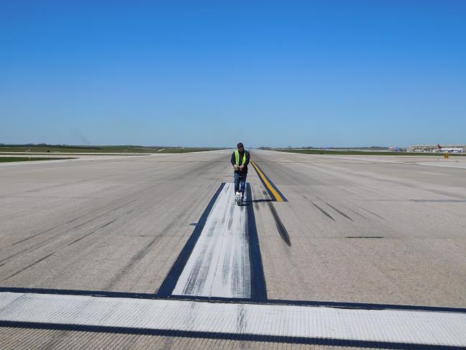
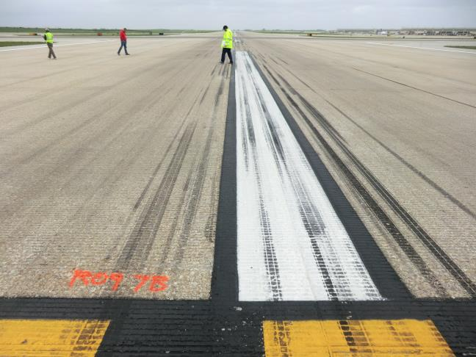
MCI Field Data Collection
April 2016
SurPro Profile, RWY 9-27
PCI Inspection, RWY 9-27

Slide 6
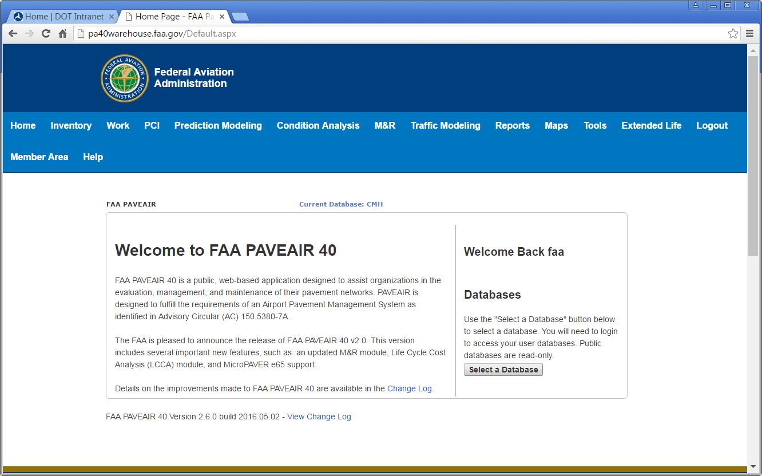
PA40 Database

Slide 7
PA40 Database Status

Slide 8
Updated Runway List

Slide 9
Traffic Data in PA40
Historical runway traffic data (as opposed to design traffic data) are generally not available from airport engineers.
Available data sources:
  ASDE-X (NAS data since 2012 stored at the WJHTC).
  PDARS (data for some airports back to 2010).
  Threaded Track Data (TTD) – produced by MITRE Corp.
  “Fusion” of data from National Offload Program (NOP), ASDE-X and Enhanced Traffic Management System (ETMS).
Access NAS data via NPN shared services.
Avoid unnecessary data duplication.

Slide 10
Accessing TTD via the NPN
Runway usage data searchable by:
Month/Year
Aircraft Type
Runway End
Arrival/Departure

Slide 11
Developing New Performance Models
New performance models will relate design inputs to a future distress index (DL) incorporating structural and non-structural elements.
Current Design Procedures:
Inputs
  Structural Layers
  CBR or k-value
  Aircraft Traffic
  Concrete Strength (rigid)
Output
  Passes to structural failure*
  *defined as 2.5 cm upheaval for flexible pavements or 50% of slabs cracked for rigid pavements
40-Year Design:
Inputs
  Everything to the left, plus …
  Age, Climatic Data
  Soil/Material Properties
  Maintenance Data
  Airport Feature (runway, apron, etc.)
Outputs
  Passes to structural failure, plus …
  Roughness index prediction
  Surface friction prediction
  Other functional indexes

Slide 12
Concept of Index DL
Define a new metric DL (“distress level”).
  Quantifies pavement serviceability.
  “Mega-Index” – Some combination of structural (SCI) and functional indexes (friction, roughness, etc.).
  Assume DL is on a numerical scale of 1 – 100.
Definition of failure:
  Quantitative: Pavement is failed when DL decreases below a lower threshold value (DL_{lower}) and cannot be restored to an upper threshold value (DL_{upper}) with probability p of remaining above the lower threshold for a period of 10 years or more.
  Qualitative: A fair LCCA would recommend full reconstruction as the best option.
Must determine the value of p, the upper and lower thresholds, and the specific component indexes.

Slide 13
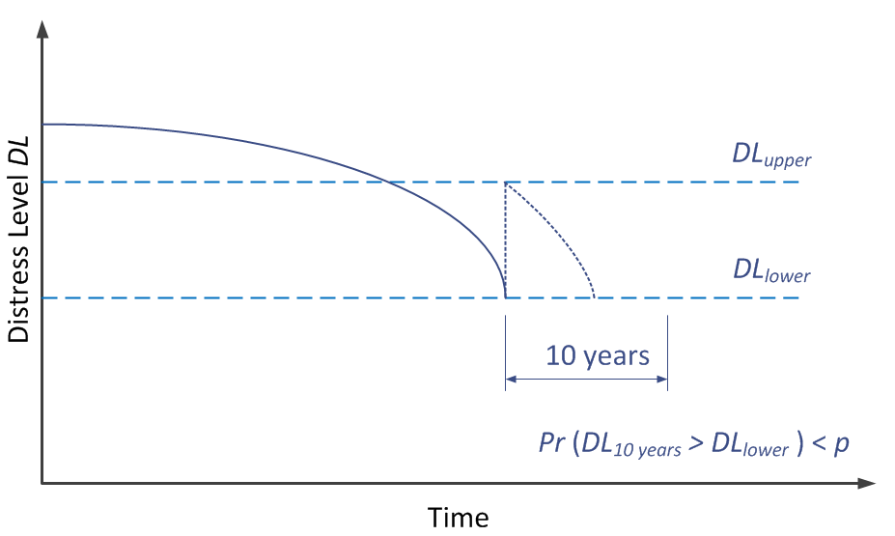
Graphical Representation
End of Life

Slide 14
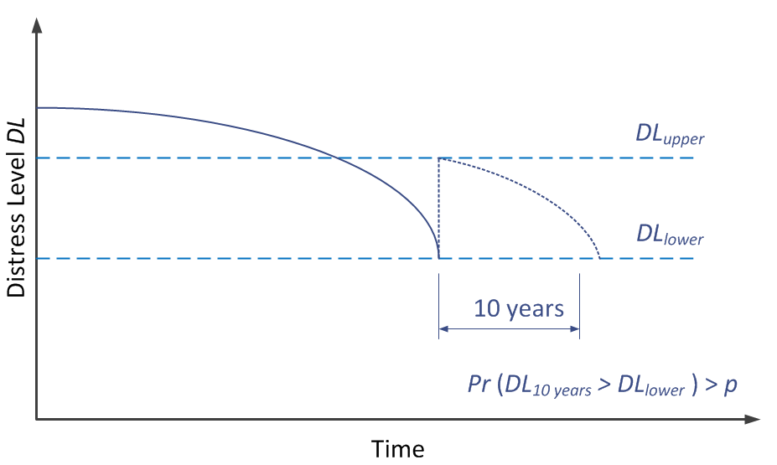
Graphical Representation
Not End Of Life

Slide 15
FY17 R&D Efforts
Complete population of PA40 (TUS, MCI).
Perform field data collection at one additional runway selected from those currently in the PA40 database (TBD).
Link to existing databases with historical runway traffic (TTD) and climatic data.
Develop new sets of family curves in PA40 (coordinate with RPA P7.1 – FAA PAVEAIR).
  “DL versus age”
  “DL versus applied traffic”
  Look at index components of DL to satisfy end of life definition.

