Slide 1
RPA S6.2
Airport Winter Safety and Operations
REDAC Subcommittee
Joseph Breen
August 16, 2016

Slide 2
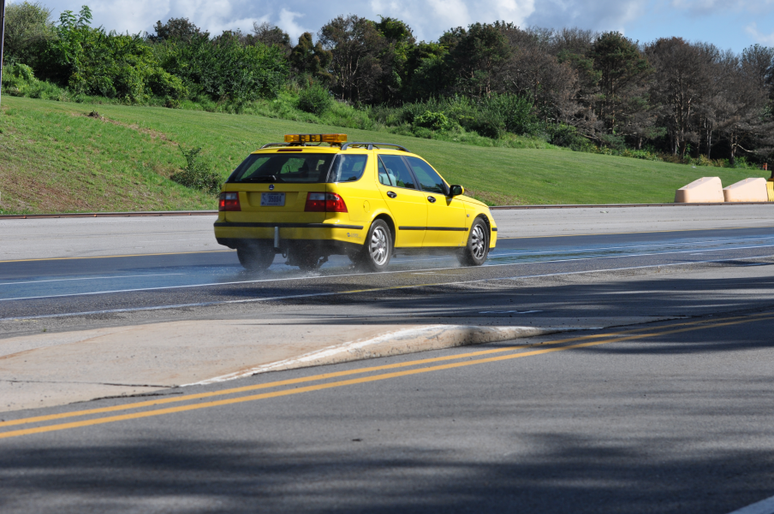
Objectives
Evaluate Airport Runway Surface Assessment and Maintenance Technologies.
Work with ASTM and ICAO in Developing Consistent CFME Equipment Calibration and Measurement Standards.

Slide 3
Recent Accomplishments
Completed Friction Survey and Runway Grooving Evaluation at Marine Corps Air Facility (MCAF) Quantico, Virginia.
Participated in the 2016 International Friction Workshop at the Penn State University Larson Institute.
Conducted Monthly Friction Surveys on ACY Runway 13-31.

Slide 4
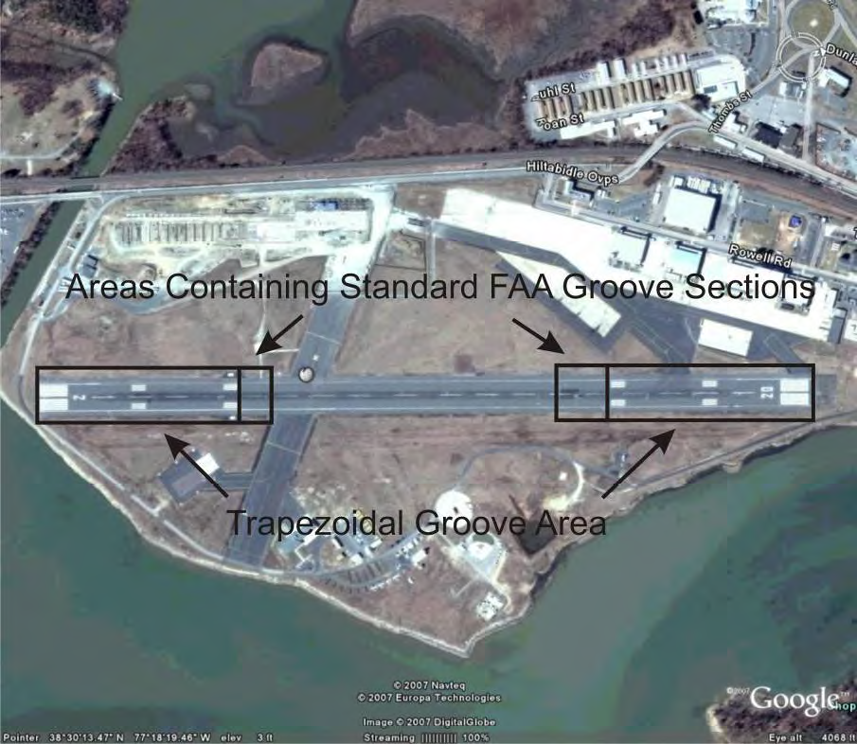
Recent Accomplishments
Friction Survey and Runway Grooving Evaluation at Marine Corps Air Facility (MCAF) Quantico, Virginia.
- Runway 02-20 at MCAF Quantico Has Large Sections FAA Standard and Trapezoidal Shaped Runway Grooving.
- Friction Survey of Entire Runway Conducted.
- Grooving was Evaluated for Deterioration and Rubber Build-Up.

Slide 5
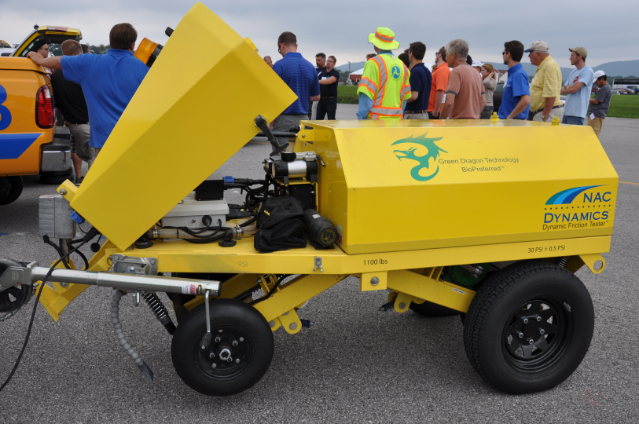
FAA Friction Measuring Equipment
Three FAA Approved Friction Measuring Equipment (CFMEs).
- Dynatest Runway Friction Tester (RFT)
- SARSYS Surface Friction Tester (SFT)
- NAC Dynamic Friction Tester (DFT)
Five FAA Approved Decelerometers.
- Decelerometers Representing Three Manufacturers.

Slide 6
Upcoming Work
Research Request from AAS-100 to be Submitted for Evaluating the Effect of Vehicle Anti-Lock Braking Systems (ABS) on Decelerometer Performance.
Participate in Braking Friction Testing with the FAA B727 Aircraft at ACY on Winter Weather Contaminants and on a Wetted Trapezoidal Grooving Test Bed.
Conduct Friction Surveys with FAA CFMEs on ACY Runways and at Other Airports as Requested.

Slide 7
RPA Overview
FY 2016 Accomplishments
- 2016 Friction Workshop
- Runway Friction Surveys
Funding Requirements
- FY 2016 - $225,000
- FY 2017 - $275,000
- FY 2018 - $250,000

Slide 8
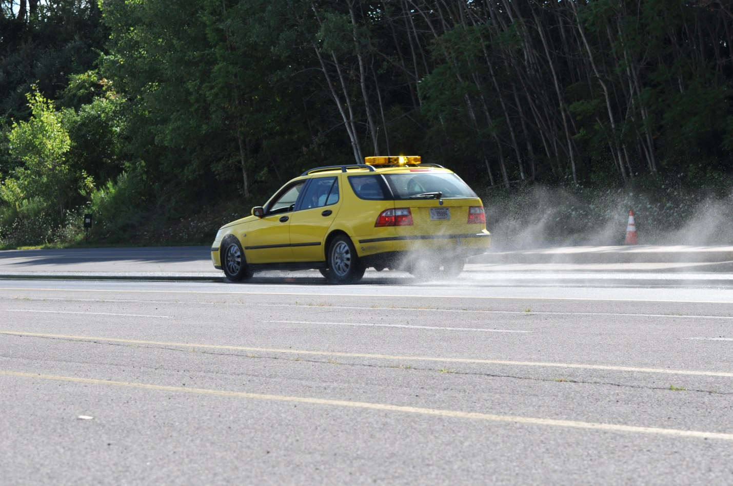
Questions?

