Slide 1
RPA S6.3
Aircraft
Arrestor Systems
EMAS
REDAC
Nick Subbotin, Program Manager
FAA Airport Safety R&D Section
August 2016

Slide 2
RPA 6.3 – Aircraft Arrestor Systems
Need
Research Goals
New EMAS Materials & Designs
EMAS Longevity
Airfield Field Issues & Investigation
Provide Technical Information to update EMAS Advisory Circular
Safety stop aircraft in the event of a runway excursion/overrun
FY 2016 Accomplishments
Funding Requirements
EMAS Inspection & Maintenance Program Assessment Report
New EMAS Material Fire Test Report
Aircraft Arresting Systems Research Funding
FY 2016 | FY 2017 | FY 2018
375K | 400K | 400K

Slide 3
New EMAS Possibilities
Zodiac Arresting Systems America (ZASA)
CRDA since 1994
Proposing a variety of new core materials in their EMAS block design
FAA R&D reviews of various testing methods & modeling
Future submittal to FAA Airport Engineering (AAS-100) for Advisory Circular compliance & approval
Runway Safe
CRDA in process
Proposing improvements to current EMAS design
Have shared testing methods & modeling with FAA R&D
Future submittal to FAA Airport Engineering (AAS-100) for Advisory Circular compliance & approval

Slide 4
New EMAS Possibilities
ATECH, Inc.
CRDA established in June 2016
Proposing new EMAS design
Have shared preliminary testing methods & modeling with FAA R&D
Future submittal to FAA Airport Engineering (AAS-100) for EMAS Design approval
4th EMAS Manufacturer
Renewed interest in EMAS design & development
Possible CRDA

Slide 5
Recent Activities
EMAS Inspection and Maintenance Program Assessment
Report Submitted to FAA Airports Engineering (AAS-100)
Information to make decisions on EMAS Longevity
Common issues & costs associated with maintaining EMAS
Information to provide airport education on EMAS
Provide information/criteria to FAA Cert Inspectors to know what to identify during annual inspections
Possible updates to FAA Advisory Circular on EMAS
Guidance information to provide airports on replacement

Slide 6
Recent Activities
ZASA NextGen EMAS Fire Tests
Report Submitted to FAA Airports Engineering (AAS-100)
Finding will be used for Advisory Circular compliance
Bid phase of new EMAS Test pad
Preliminary reviews and meeting with EMAS manufacturers on their proposed new EMAS designs

Slide 7
Upcoming R&D Activities
Technical Advisor & Review of EMAS design approvals for AAS-100
Complete a historical report on the Development of EMAS from 1994 – 2003
Evaluate EMAS manufacturers’ runway design reports and recommend critical factors & definitions required in Design Reports.
GOAL: Update guidance information for Design Report submissions to FAA Regions and Airport Operators for comparing EMAS designs.
Work with AAS-100 on developing EMAS Longevity R&D Plan.
Not easy based on numerous longevity factors that affect EMAS, several EMAS designs & manufacturers, and proprietary information
GOAL: Provide guidance information to Airport Operators on how and when to test EMAS and when to plan for replacement.

Slide 8
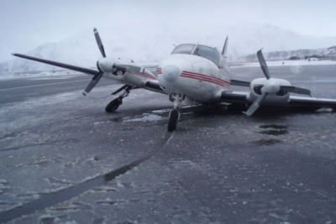
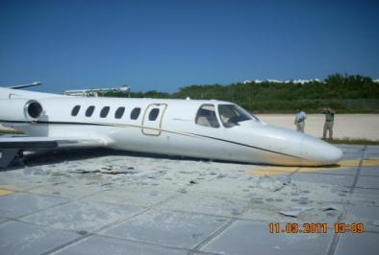
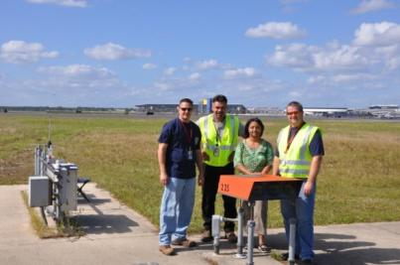
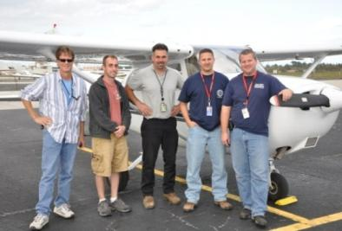
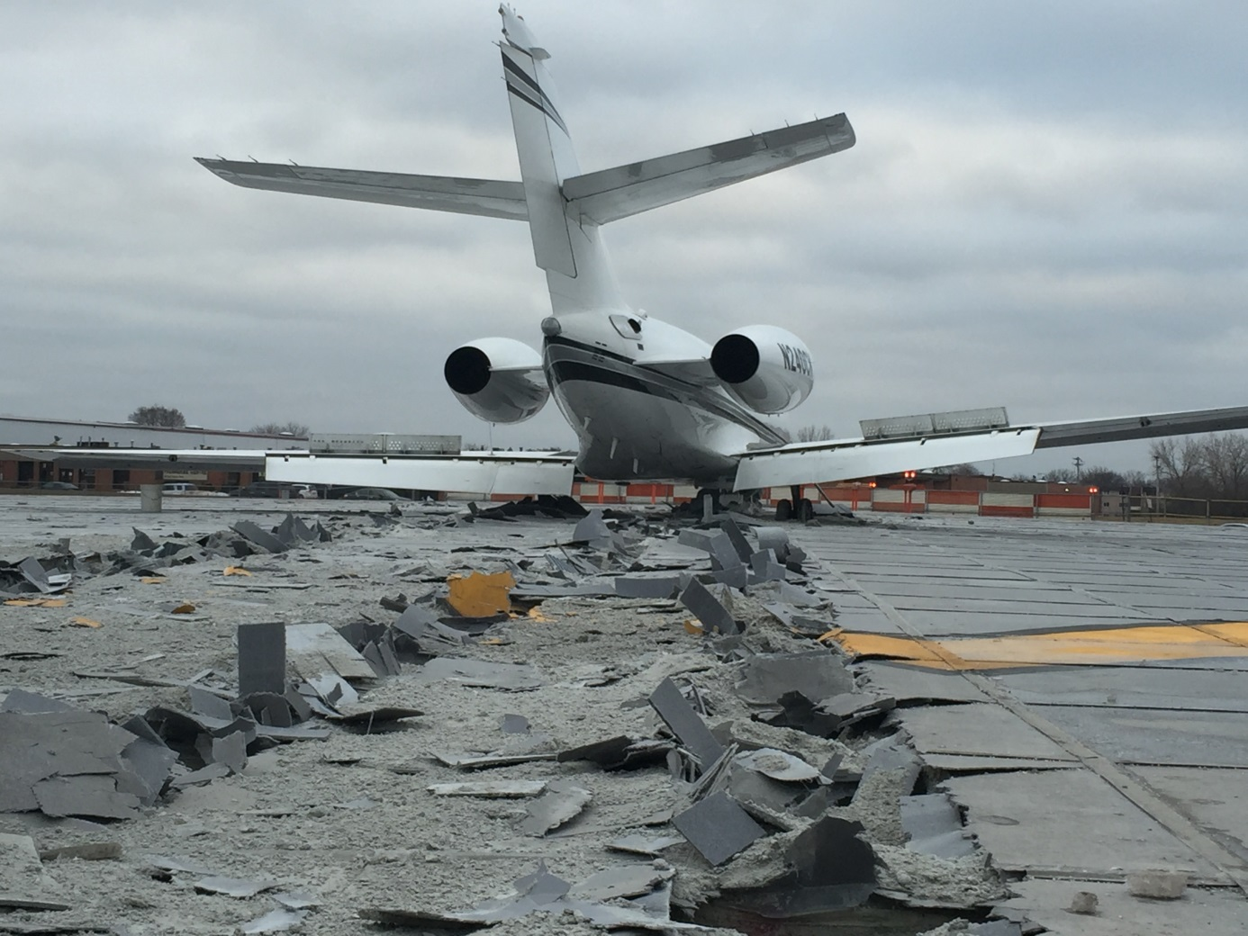
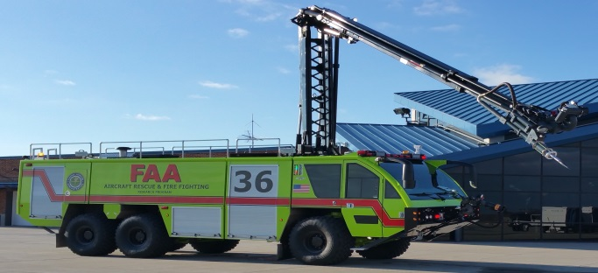
Questions or Comments?
FAA Technical Center
Airport Technology R&D Branch
ANG-E261, Building 296
Atlantic City International Airport, NJ 08405
Nick.Subbotin@faa.gov
609-485-8034
www.airporttech.tc.faa.gov

