Slide 1
New Facility and Construction Updates

Slide 2
New Facilities – 2017 and Beyond
Photometric Laboratory
NextGen Pavement Lab Expansion Office Space
Airport Safety Tech Storage / Warehouse

Slide 3
Technical Center Construction Approval Process
Technical Center Master Planning Approval
Site Selection
Infrastructure Requirements
Environmental Assessment
Review and Approvals by State and Federal Agencies
Design
Plans and Specifications
Construction

Slide 4
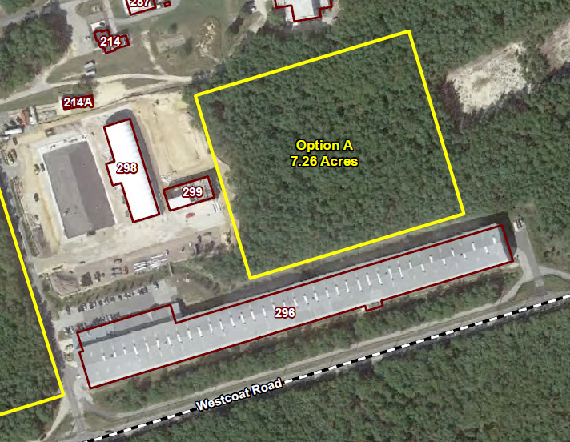
Site Selection
Water; Fire and Sewer Lines were Extended During
Current Construction

Slide 5
New Facility Planning

Slide 6
Technical Center Construction Approval Process
Technical Center Master Planning Approval
Site Selection
Infrastructure Requirements
Environmental Assessment
Review and Approvals by State and Federal Agencies
Design
Plans and Specifications
Construction

Slide 7
Status of Environmental Assessment
Environmental Assessment began September 2015
Draft EA submitted February 4, 2016
Included FoNSI, Finding of No Significant Impact
Review comments by FAA have been provided
Revised Draft EA submitted March 2, 2016 for FAA Review
Submitted to State and Federal regulatory agencies for comment May 2016
Public comment and review period – 45 days
Regulatory Agency Comments addressed June 2016

Slide 8
Technical Center Construction Approval Process
Technical Center Master Planning Approval
Site Selection
Infrastructure Requirements
Environmental Assessment
Review and Approvals by State and Federal Agencies
Design
Plans and Specifications
Construction

Slide 9
New Facility Design
Design Scope of Work
Plan to use the Army Corps of Engineers Philadelphia District under an existing Interagency Agreement
Draft Design Scope provided to USACE August 2016
Final design scope to be developed by ANG-E262 in coordination with Technical Center Facilities Engineers

Slide 10
Thank You

Slide 11
QUESTIONS?
Comments?
www.airporttech.tc.faa.gov
Murphy.Flynn@faa.gov

