Slide 1
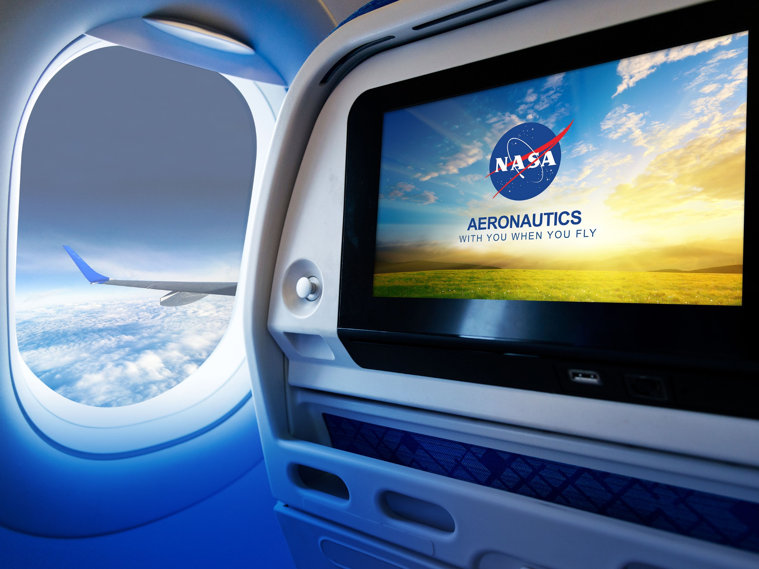
NASA Aeronautics FY 2017 Budget Request Investing in our Future
Briefing to REDAC Airports Subcommittee Meeting
John Cavolowsky, Director, Airspace Operations and Safety Program
March 16, 2016

Slide 2
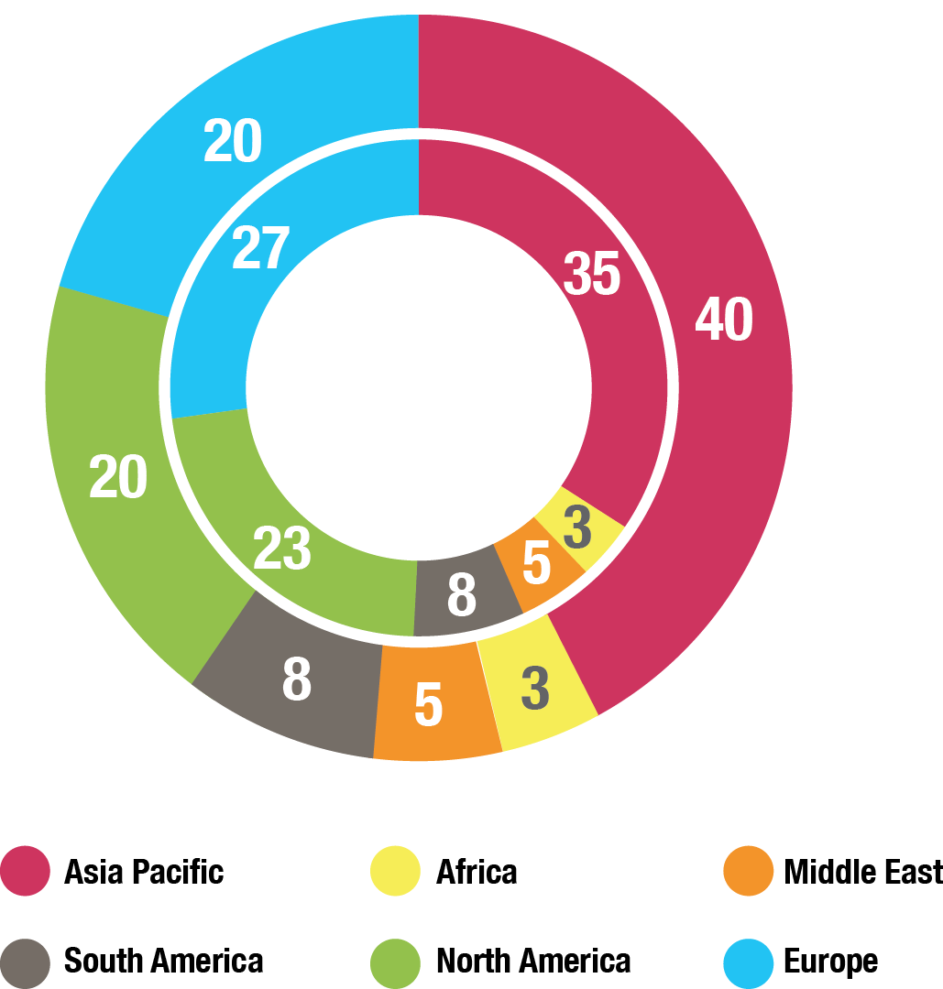
Global Growth in Aviation: Opportunities and Challenges
Global Air Passengers by Region (% of Total)
2014
Global Aviation Industry
3.3B Passenger Trips
North America and Europe combined is half of all Passenger Trips
58M Jobs
$2.4T GDP
2034
Global Aviation Industry, est.
7B Passenger Trips
Asia-Pacific Passenger Trips equal to North America and Europe combined
105M Jobs
$6T GDP
Over 36,000 New Aircraft required (replacement and growth) over the 20 year period ($4-$5T value)
Sources: International Air Transport Association, Air Transport Action Group, Boeing
Major Opportunities / Growing Challenges
Competitiveness—New state backed entrants, e.g., COMAC (China); Growing global R&D
Environment—Very ambitious industry sustainability goals; Large technology advances needed
Mobility—More speed to connect the worlds’ major cities; Opportunity for commercial supersonic flight
U.S. Technological Leadership Required!

Slide 3
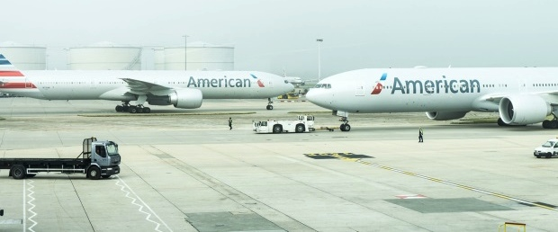
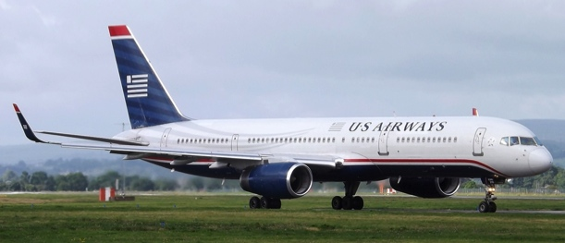
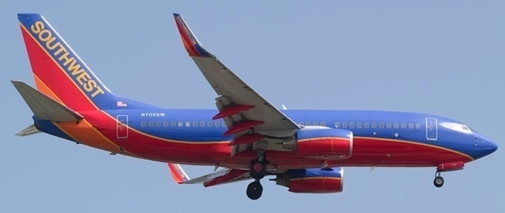
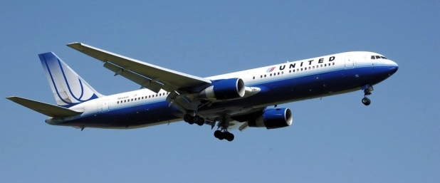
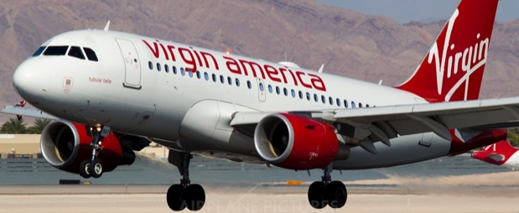
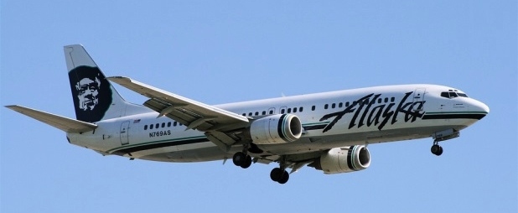
Major US Airlines Collaborating with NASA
American Airlines
US Airways
Southwest
(now part of American Airlines)
Photo credit: markyharky via VisualHunt / CC BY
Weather Rerouting
Changing the non-profitable flights into profitable flights
Terminal Sequencing and Spacing
Increasing throughput and fuel efficiency for arrivals
Surface Management
Reducing delays and fuel consumption
Data Mining
Improving efficiency and safety
United
Virgin America
Alaska Airlines
Efficient Descent Advisor
Saving time and reducing fuel burn for arrivals
Flight deck Interval Management
Increasing throughput with improved arrival spacing for landing
Traffic Aware Strategic Aircrew Requests
Optimizing time and fuel savings for pilot entered route changes
Flight Awareness Collaboration Tool
Reducing cancellations and delays due to winter storms
Traffic Aware Strategic Aircrew Requests
Optimizing time and fuel savings for pilot entered route changes

Slide 4
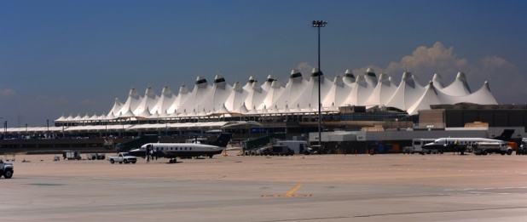
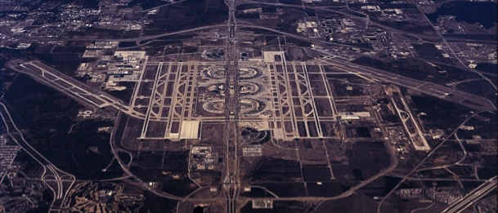
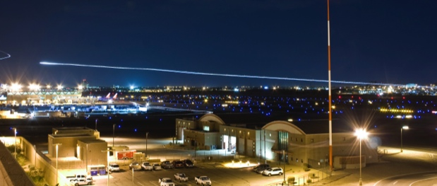
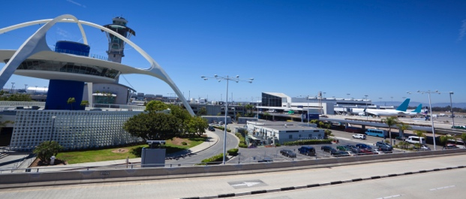
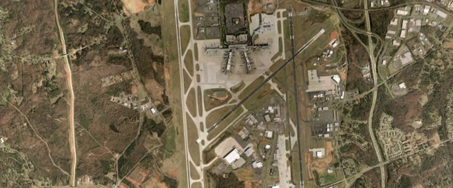
Major US Airports Collaborating with NASA
DEN
DFW
Denver International Airport
Dallas Fort Worth International Airport
Efficient Descent Advisor
Improving arrival efficiencies
Precision Departure Release Capability
Increasing departure time conformance
CLT
PHX
LAX
Charlotte Douglas International Airport
Phoenix Sky Harbor International Airport
Los Angeles International Airport
Integrated Arrival/Departure/Surface (IADS)
Reducing overall departure delay
Terminal Sequencing and Spacing (TSAS)
Increasing throughput and fuel efficiency for arrivals
Flight deck Interval Management (FIM)
Increasing runway throughput for arrivals
Terminal Sequencing and Spacing (TSAS)
Increasing throughput and fuel efficiency for arrivals

Slide 5
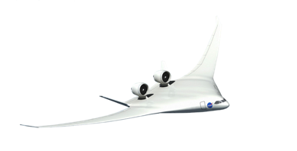
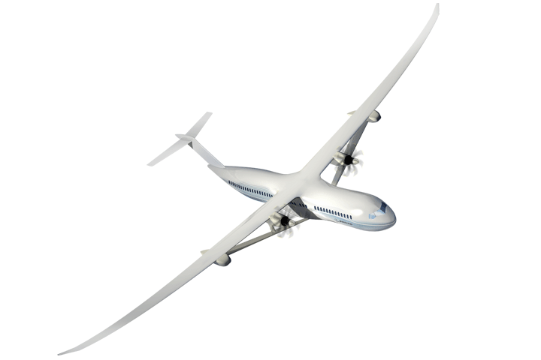
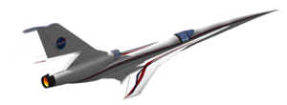
NASA Aeronautics Ready for Flight
Accomplishments and Planning
NASA Aero Vision and Strategy Established
Roadmaps Completed
2008-2013
2014/15
2016/17
2018-2026
N+3 Subsonic & Supersonic Concept/Technology Studies
Ground Testing of N+3 configurations and technologies
LBFD PDR
Completed
UEST PDR
Completed
N+2 Environmentally Responsible Aviation (ERA) Project Initiated
8 Integrated Tech Demos Completed, Tech transitioned to industry. HWB ready for Flight Dem/Val.
Ready for X-Plane Integration & Demonstration
NASA FAA NextGen Research Transition Teams (RTTs) Initiated
Technology Transitions to FAA: MSP, EDA, PDRC, TSAS
ATD-1 Completed and transferred to FAA
ATD-2, 3 Completed & Transferred to FAA
Ready for NextGen TBO Integration & Demonstration

Slide 6
FY 2017 Budget
$ Millions | FY 2015 | Enacted FY 2016 | FY 2017 | FY 2018 | FY 2019 | FY 2020 | FY 2021 | FY 2022 | FY 2023 | FY 2024 | FY 2025 | FY 2026
Aeronautics | $642.0 | $640.0 | $790.4 | $846.4 | $1,060.1 | $1,173.3 | $1,286.9 | $1,294.2 | $1,307.6 | $1,218.1 | $829.7 | $839.5
Airspace Operations and Safety | 154.0 |  | 159.4 | 159.2 | 176.2 | 189.1 | 221.5 | 198.7 | 200.9 | 193.2 | 175.5 | 167.8
Advanced Air Vehicles | 240.6 |  | 298.6 | 277.4 | 308.8 | 311.6 | 312.6 | 321.3 | 315.0 | 318.9 | 317.7 | 326.7
Integrated Aviation Systems | 150.0 |  | 210.0 | 255.4 | 381.4 | 493.0 | 556.7 | 591.5 | 612.2 | 525.0 | 203.8 | 210.6
Transformative Aeronautics Concepts | 97.4 |  | 122.3 | 154.4 | 193.8 | 179.7 | 196.2 | 182.8 | 179.4 | 181.0 | 132.7 | 134.4
Aeronautics budget includes paid-for 10-year mandatory funding from the Administration’s 21st Century Clean Transportation Plan. See appendix for additional detail.
Mandatory Budget Authority $ Millions | FY 2017 | FY 2018 | FY 2019 | FY 2020 | FY 2021 | Outyears
21st Century Clean Transportation Plan | 100 | 200 | 400 | 500 | 600 | 1900
Airspace Operations and Safety | 18 | 20 | 35 | 45 | 75 | 170
Advanced Air Vehicles | 30 | 41 | 79 | 80 | 65 | 305
Integrated Aviation Systems | 37 | 84 | 196 | 300 | 370 | 1170
Transformative Aeronautics Concepts | 15 | 55 | 90 | 75 | 90 | 255
Low Boom Flight Demonstrator | 56
Integrated Aviation Systems | 56

Slide 7
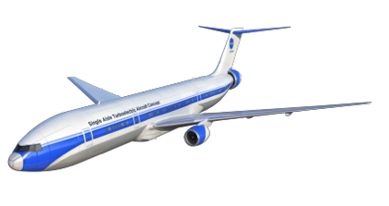
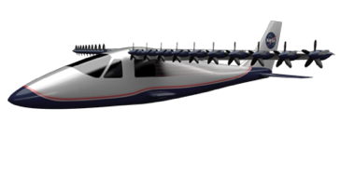
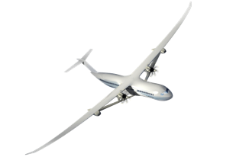
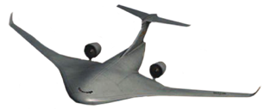
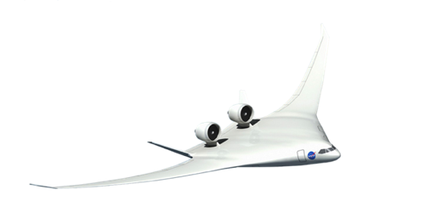
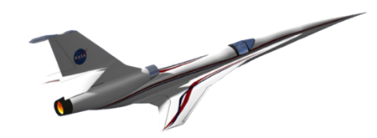
New Aviation Horizons Flight Demo Plan
Hybrid Electric Propulsion Demonstrators
DP
Transport Scale
Preliminary Design
Total Demonstration Cost ROM: $700M
Ground Test Risk Reduction
Small Scale “Build, Fly, Learn”
Design & Build
Flight Test
Validated HEP Concepts, Technologies
And Integration for U.S. Industry to Lead the Clean Propulsion Revolution
Design & Build
Flight Test
Design & Build
Flight Test
DP
Life Cycle Cost ROM: $400-500M
Ground Test Risk Reduction
Preliminary Design
Design & Build
Flight Test
Images Credit: Lockheed Martin
Potential Candidates
DP
Life Cycle Cost ROM: $400-500M
Ground Test Risk Reduction
Preliminary Design
Validated ability for U.S. Industry to Build Transformative Aircraft that use 50% less energy and produce over 40dB (cumulative) less noise
“Purpose-Built” UEST Demonstrators
Design & Build
Flight Test
DP
Life Cycle Early Cost Est: $850M
Preliminary Design
Design & Build
Flight Test
Fully integrated UEST Demonstrator
DP
Life Cycle Cost Est: $430M
Design & Build
Flight Test
Enables Low Boom Regulatory Standard and validated ability for industry to produce and operate commercial low noise supersonic aircraft
FY17
FY18
FY19
FY20
FY21
FY22
FY23
FY24
FY25
FY26

Slide 8
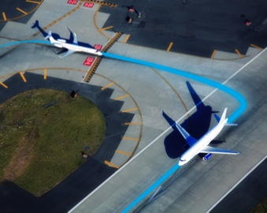
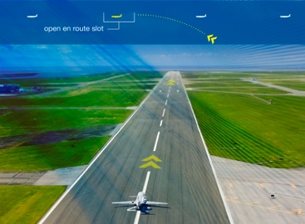
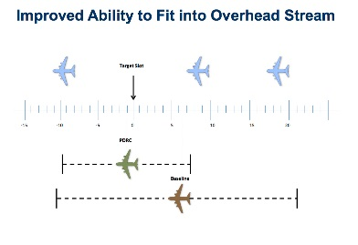
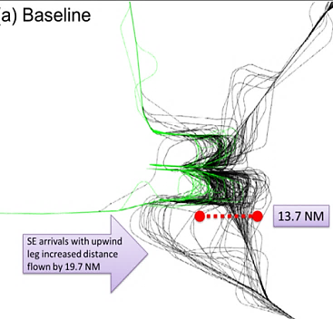
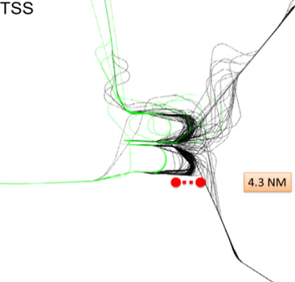
Trajectory Based Operations: Concept to Demo
Next Step in NASA Research and NextGen Development
Develop and Demonstrate NextGen Capabilities: Reducing fuel use and flight delays
Concept Validation
Technology Maturation
Demo
Gate-to-Gate Optimization
Gate-to-Gate 4DT TBO: Complete gate-to-gate flight optimization incorporating system constraints and user request.
Architectural Definition
Tech Gap Assessment
Gate-to-Gate Trajectory Based Operations
Enables airlines to operate increasingly efficient 4D “gate-to-gate” trajectories
Fast-time Simulation
Human In The Loop Simulation
Integrated Field Demo
RTT deliverable
Initial Integrated Demand Management
Concept Validation
Technology Maturation
IDM TBO: Integrates departure, en route, and descent flight operations for greater optimization
Initial Concept Demo
Fully Integrated Field Demo
ATD-2
RTT deliverable
ATD-2: Coordinated preflight, taxi, takeoff, and departure paths for all outbound flights at an airport
Complex Terminal Area Trajectory Management
Enables airlines to optimize efficient operations into and out of busy airports and terminal area airspace
Ground Side Demo
Flight Side Demo
ATD-1
RTT deliverable
ATD-1: Efficient descent, approach, and landing for all flights inbound to an airport
2015
2017
2020
2025

Slide 9
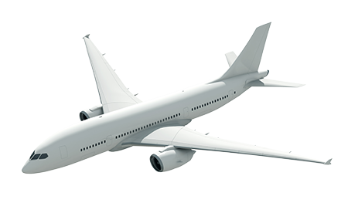
Back-Up

